Slide 1
Generation of Multiple Gravity Wave Couplets from Convection
Hongpei Yan , Yu Du and Junghong Wei
Date: 2024/6/4
Speaker: Ying-Jhang, Wu
Yang, H., Du, Y., & Wei, J. (2023). Generation of Multiple Gravity Wave Couplets from Convection. J. Atmos. Sci., 80, 2323–2343. https://doi.org/10.1175/jas-d-22-0212.1

Slide 2
Recall-Internal gravity waves
Low-frequency wave couplets can propagate for a long horizontal distance with little vertical energy escape
Higher-frequency waves triggered in the evolution of convection have been paid less attention in previous studies due to their large vertical component of group velocities.
The shorter time scales correspond to more vertical propagation of wave energy
Cold
Warm

Slide 3
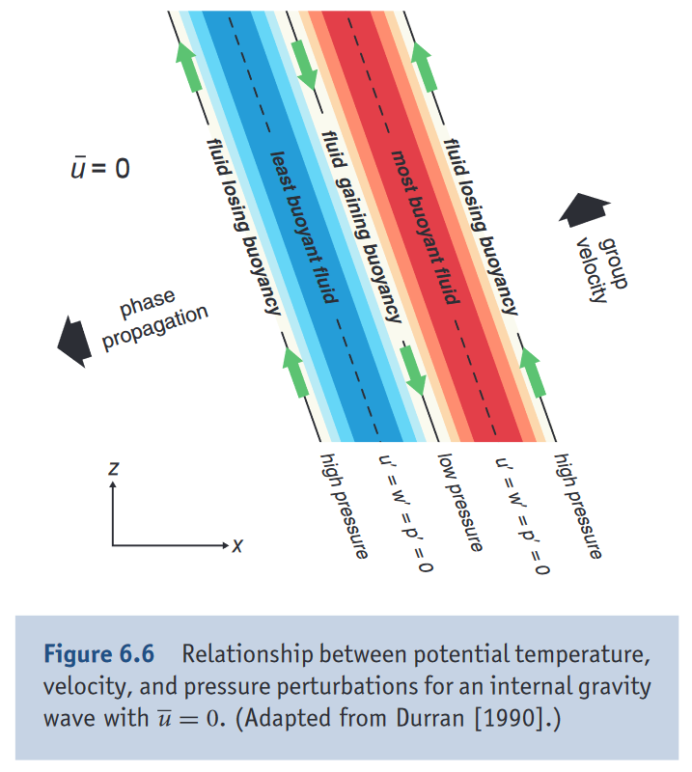
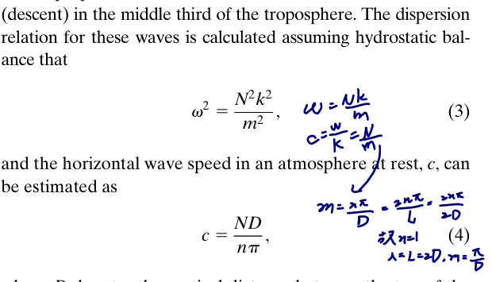
Low frequency internal gravity waves

Slide 4
Introduction
Nonlinear motions within clouds have also been proposed to play a role in generating gravity waves
The contribution of nonlinear advection to wave generation in the troposphere is not well understood.
The time scale of nonlinear advection is approximately half of the latent heating time scale, and the two can act to balance or counteract each other
Recent studies by Adams-Selin (2020, hereafter AS20) and Groff et al. (2021) argued that n=1 wave couplets are generated repeatedly due to variations in the latent heating profile during the periodic development of mesoscale convective system (MCS) updrafts.

Slide 5
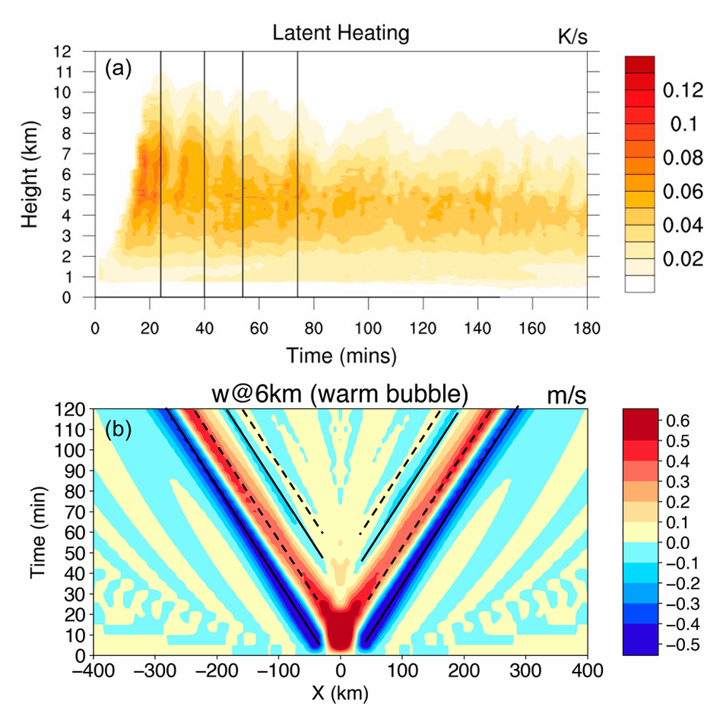
Introduction
The correlation between n=1 waves and latent heating is not always straightforward, as not all peaks in latent heating correspond to n=1 waves
the wave amplitude is not necessarily proportional to the intensity of latent heating.
Groff et al. (2021)
Does the generation of n =1 gravity waves exactly and directly correspond to the temporal variation in latent heating?
Nonlinear advection, may also play a role in the generation of n=1 gravity waves.

Slide 6
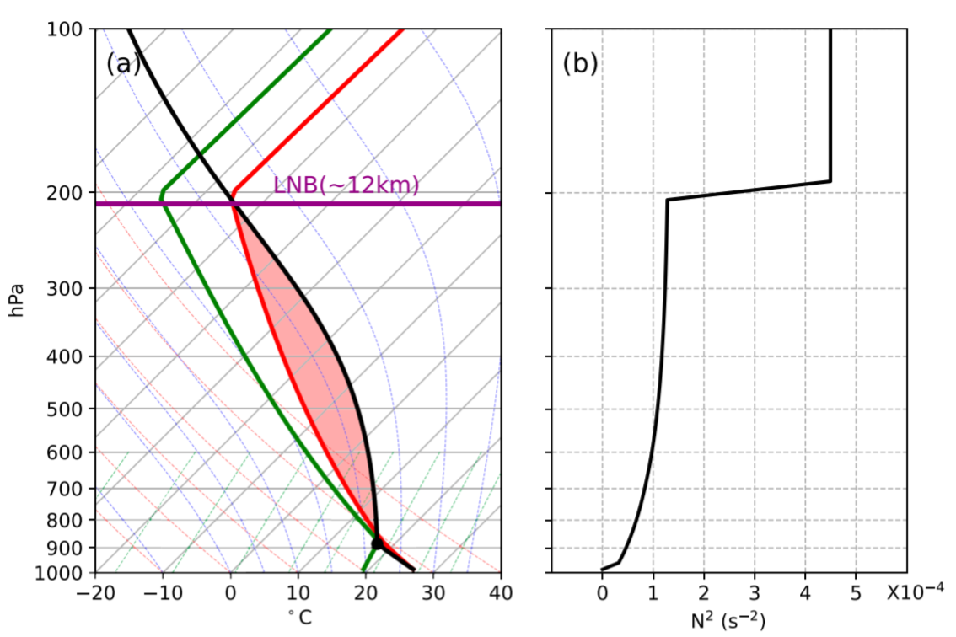
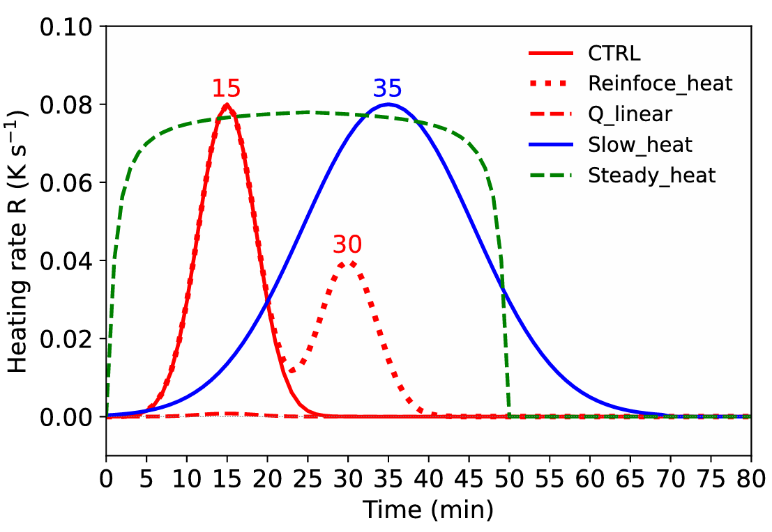
Methodology
Coriolis force, surface fluxes, and radiative processes were not included in 2D simulations.
No background wind or shear
Modified sounding from Weisman and Klemp (1982) for moist experiment
Artificial latent heating for dry simulations

Slide 7
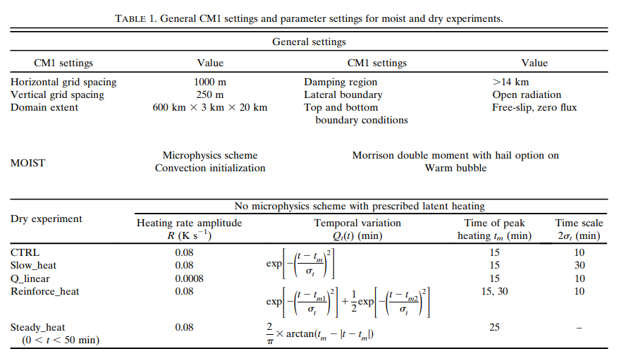
Methodology

Slide 8
Methodology
Nonlinear advection
Heat budget analysis
Vertical Fourier decomposition

Slide 9
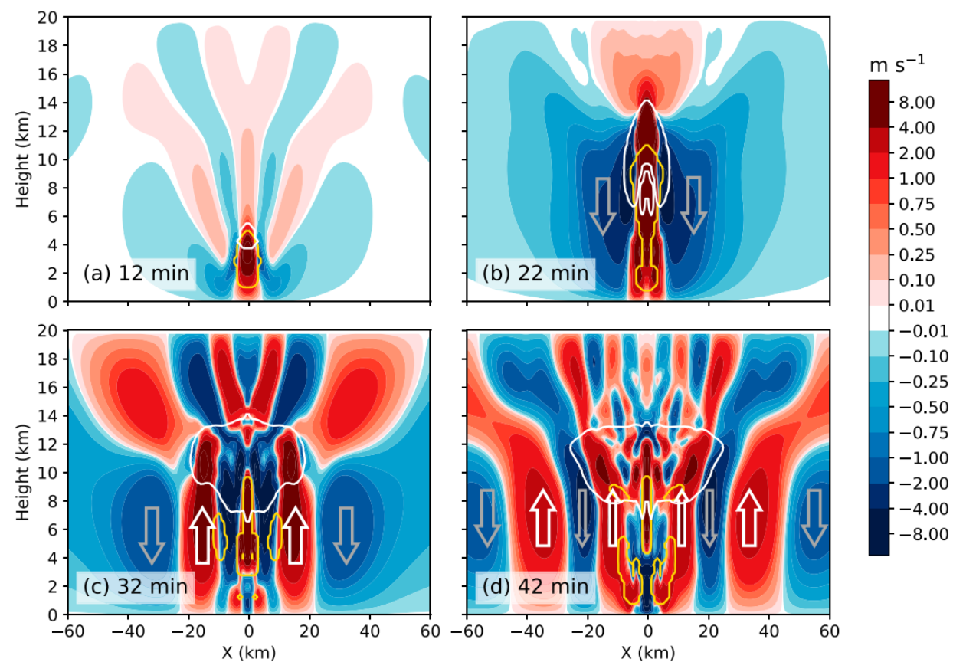
MOIST exp
Filled color
W>0 read
W<0 blue
Contour
Ice: white
Cloud: yellow
Cloud anvil dev

Slide 10
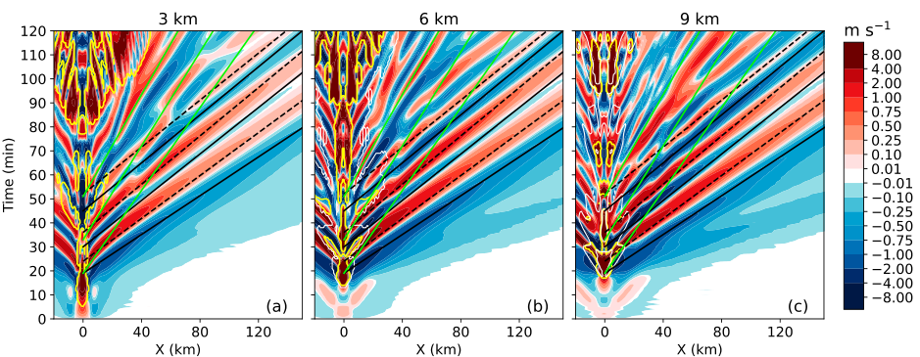
Wave propagation pattern
n=1 wave
n=2 wave
Cloud
ice
n=2 waves are generated at the same time with n=1 upward branches
New cloud formation is a response to the strong upward motion due to the combination of n=1 and n=2 waves

Slide 11
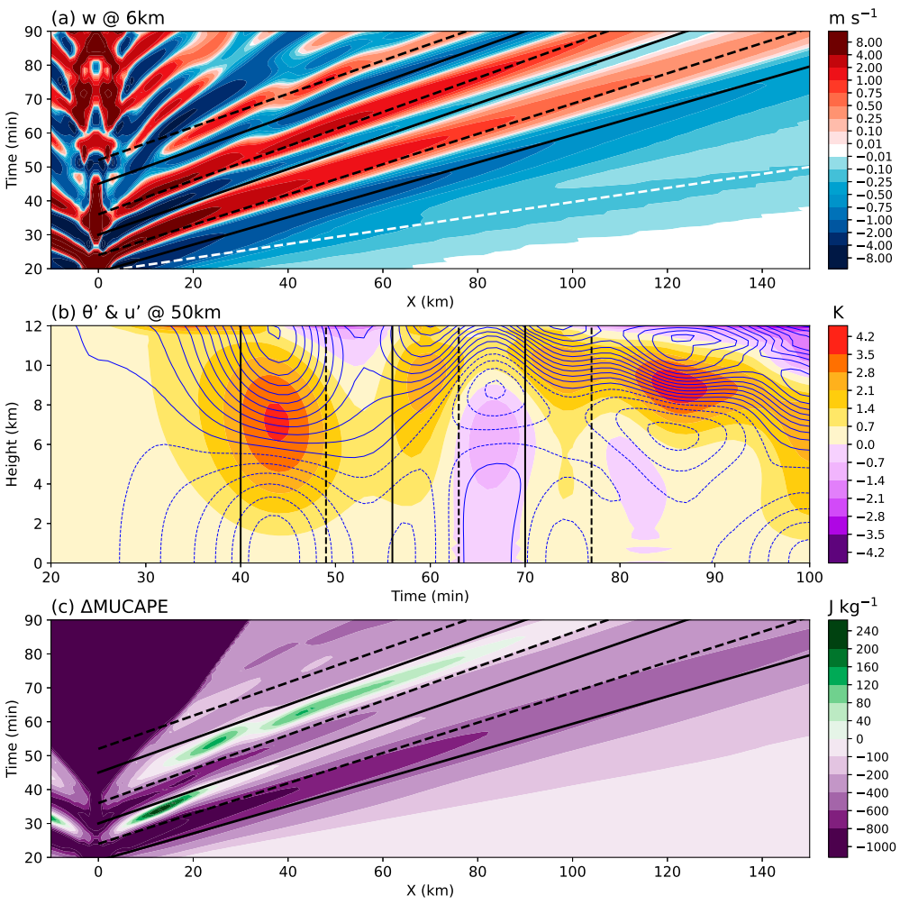
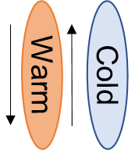
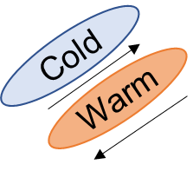
Vertical Structures
Slightly slower speed near the convective area
Fast mode: c=75m/s
maximum downward (upward) motions are quarter downstream of the maximum (minimum) potential temperature (horizontal velocity) perturbation
Parcel displacement
Cold
Warm
warming and drying (cooling and moistening) associated with the downward (upward) motion are responsible for the significant decrease (increase) in MUCAPE
Cold
Warm
subsequent larger upward branch offset the previous reduction in MUCAPE and even destabilize the environment→cloud anvils broadening
Notes:
vertical depth of the model
show that the wave signal is remarkably weakened, character-
ized by decreased amplitude and increased speed (figure not
shown), which suggests another possibility is that the response
of n 5 1 wave to the entire vertical simulation domain may not
be representative of what would occur in an actual atmosphere
without a top boundary

Slide 12
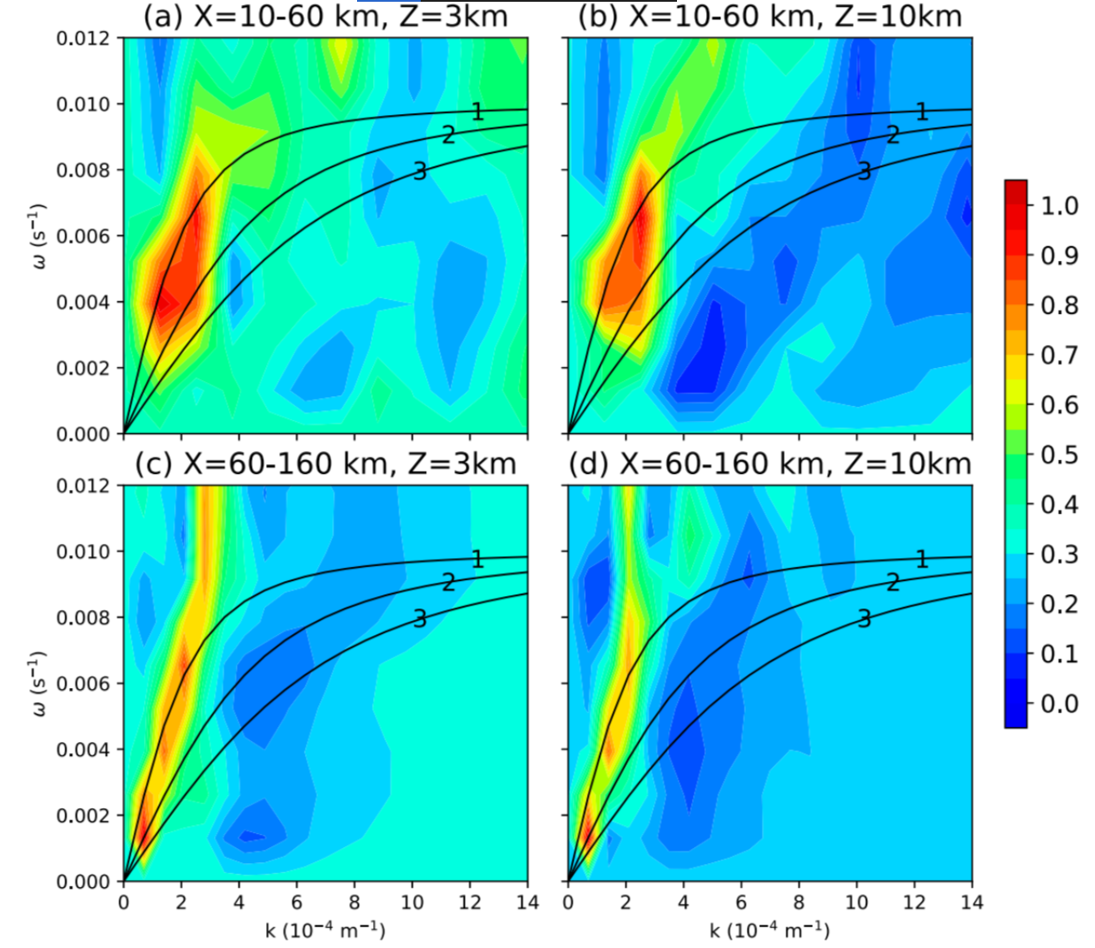
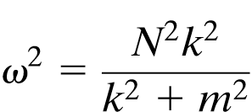
Nonlinear advect. mode
Dominance of n=1 waves
c=37.45 m/s
Latent heat mode
Waves with higher frequency lose energy more significantly due to more vertical propagation

Slide 13
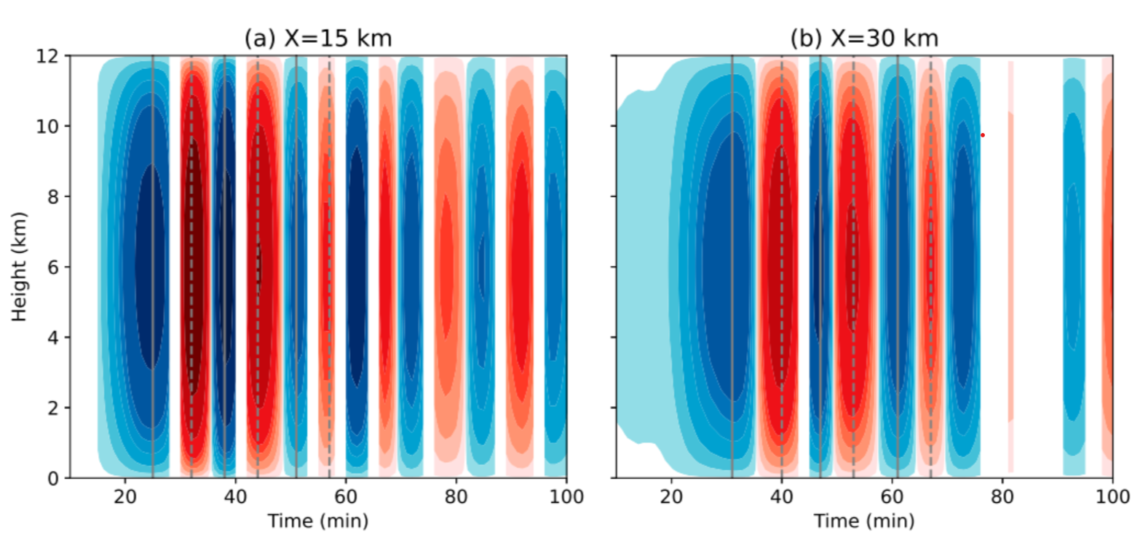
Generation of wave couplets
Vertical Fourier decomposition to extract the n=1 component
n =1 waves propagate at speeds of 35.7,31.2, 27.8, 27.8, 25, and 25 m/s
Track it backward linearly to determine the wave generation time at the source (X=0 km), where higher-frequency waves are more evident.

Slide 14
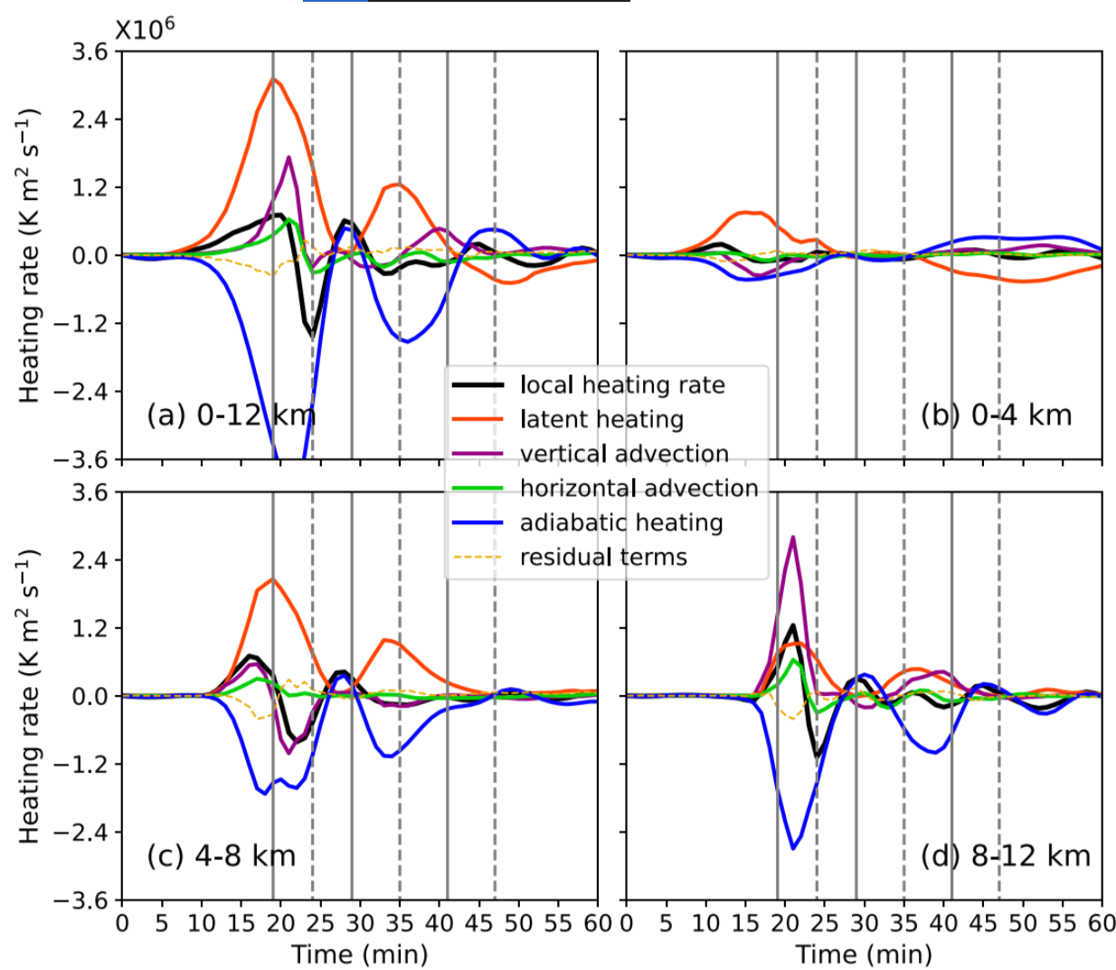
Timing of n=1wave generation is found to best correlate with the local heating rate$\frac{∂θ^{′}}{∂t}$
Local heating rate reaches its maximum (minimum) value, a downward (upward) branch of n=1 wave is generated
Second upward motion forced by adiabatic cooling, while latent heating acts to decrease wave amplitude.
Amplitude of the first upward branch is larger than that of the first downward branch, which can be explained through their corresponding amplitude of the local heating rate
Increased vertical motion inside convection enhances nonlinear advection of which the amplitude is comparable to that of latent The amplitude of nonlinear advection is roughly twice as intense as latent heating at high levels
n = 1 upward branch is attributed to the combination of latent heating, nonlinear advection, and adiabatic cooling.
Notes:
與前人研究periodic development of latent heating不同
n=1 的downward 主要是latent heat
N=1的upward 是三項(latenet, nolinear,adiabatic)不平衡之結果
N=1 的第二個downward 是補償上升的adiabatic cooling

Slide 15
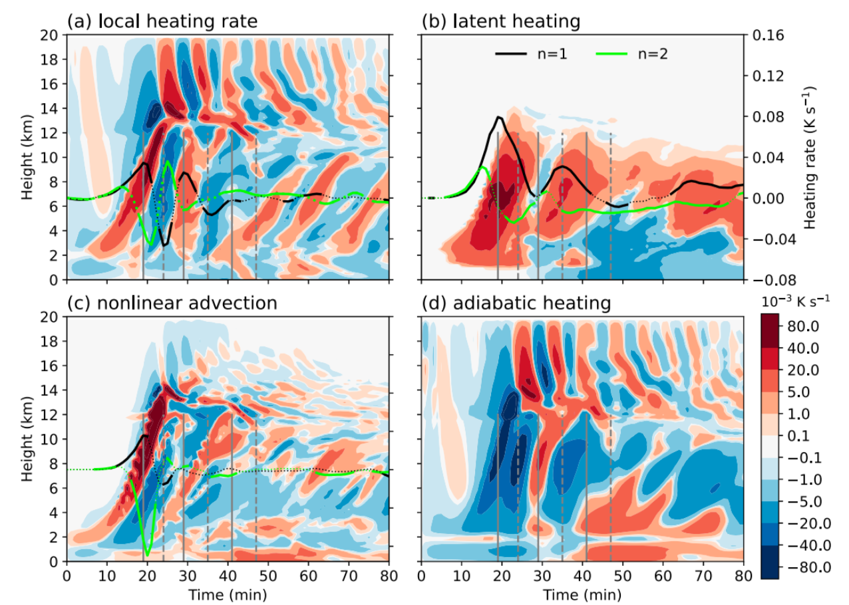
Latent heating is the primary contributor for initial n =1 wave generation
Nonlinear advection may play a role in generating both n=1 and n=2 waves
Nonlinear advection roughly follows latent heat release and time scale is about half that of latent heating
Imbalance initially induced by latent heating is found to be
further enhanced by nonlinear advection

Slide 16
Redevelopment of cloud

Slide 17
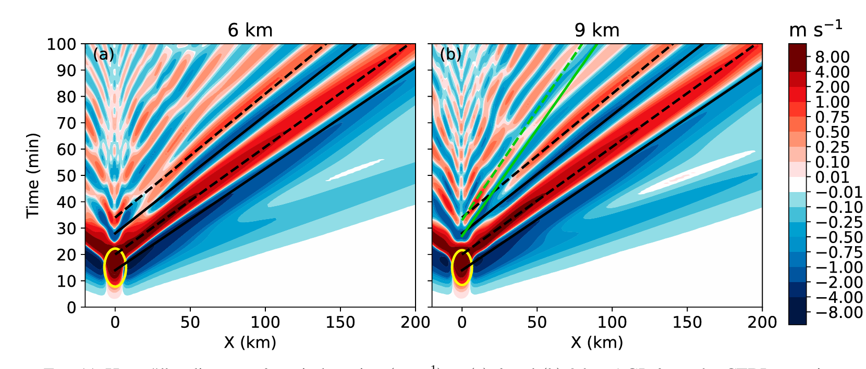
Dry exp
Subsequent n=1 waves are generated with smaller amplitudes
n= 2 waves are also produced and propagate outward with a slower wave speed

Slide 18
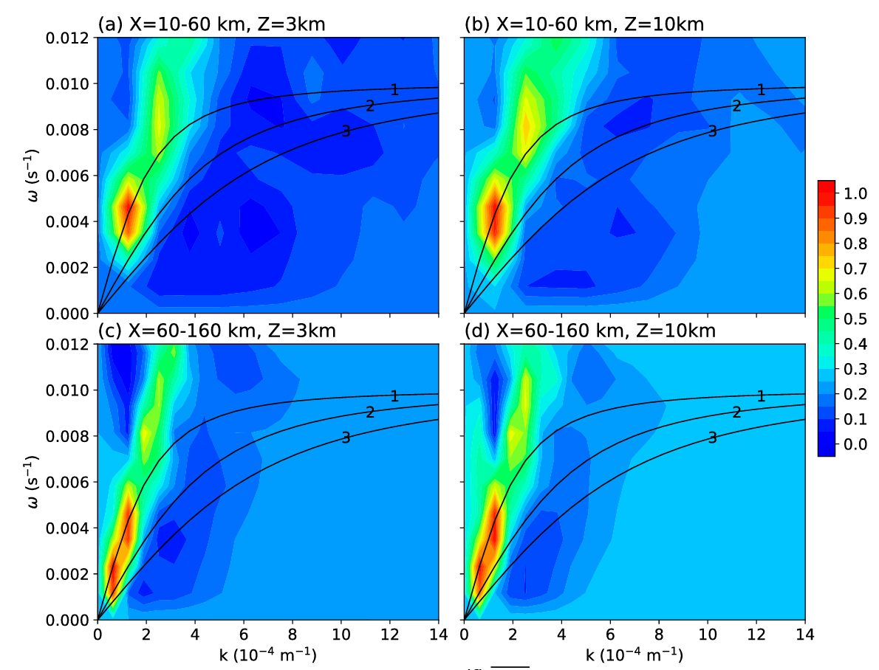
Higher-frequency waves does not match the n=1 curve neatly
→wave ducting,
inversion of the temperature gradient at the tropopause.
Notes:
圖(a)主要有兩個peak 其中 y=0.004 (T=25min)主要是人工加熱產生的;mode y=0.008 推論是nonlinear advection(T=15min)

Slide 19
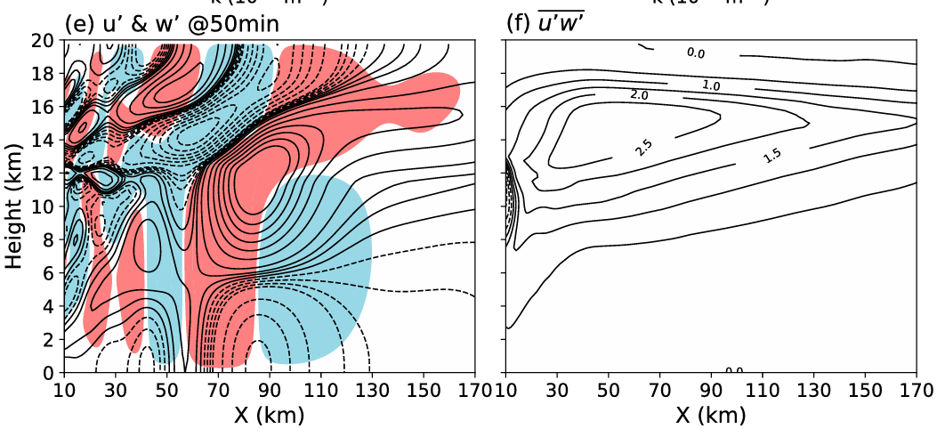
Higher-frequency waves with substantial concentration of net momentum flux
Nearly horizontally propagating waves carry little net vertical momentum flux

Slide 20
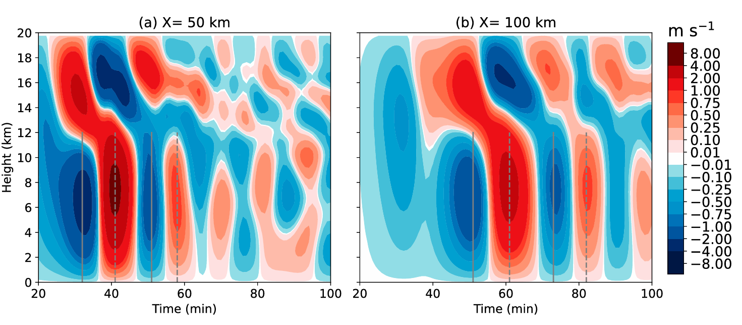
Generation of wave couplets

Slide 21
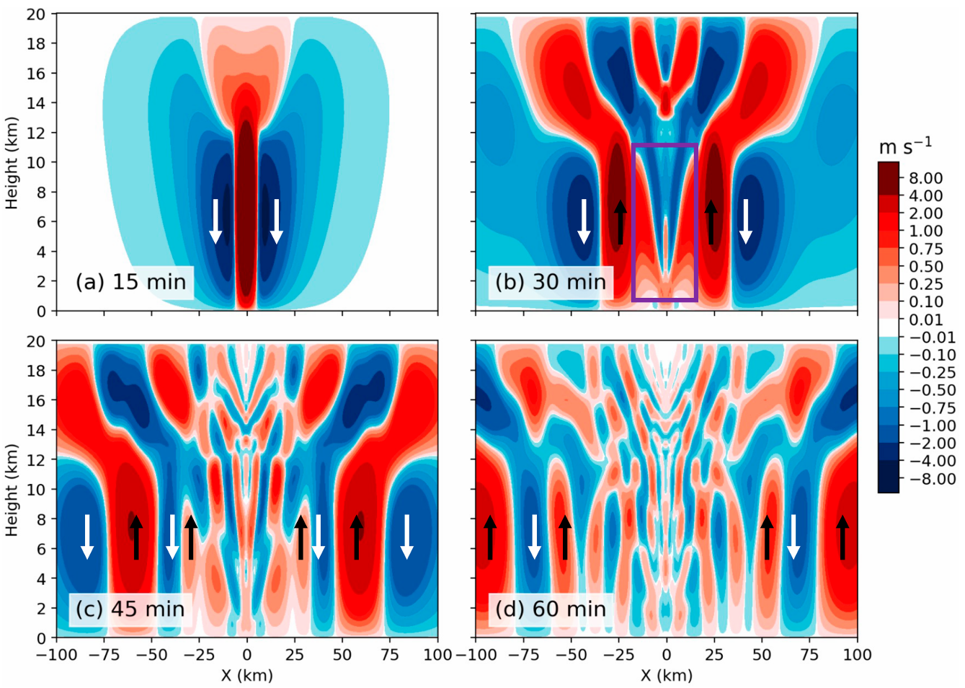
Notes:
Dry 實驗 當人工加熱強烈上升運動後，絕熱補償下沉氣流沒有淺熱釋放加熱效應，於原地產生高頻波動

Slide 22
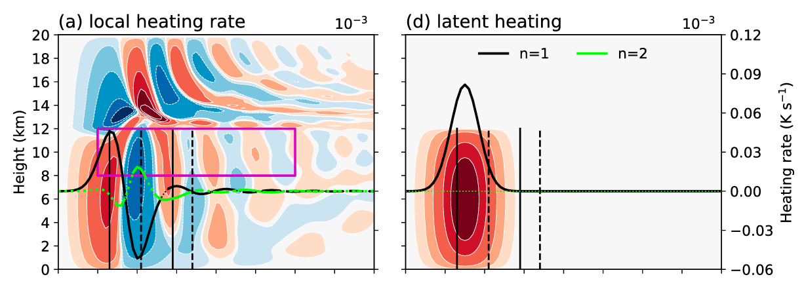
Why the local heating rate profile could still contain a large n=1 component when latent heating is weak?
Period~26min
Notes:
Downward branch ←→positive heating rate
N=1 model with large amplitude propagate further east as the field it goes, while the local heating rate magnitude is small. ← adiabatic heating
Local heating rate 有很強的負振幅n=1mode 是由於補償絕熱冷卻與非線性平流共同產生
而本身加熱也是n=1mode

Slide 23
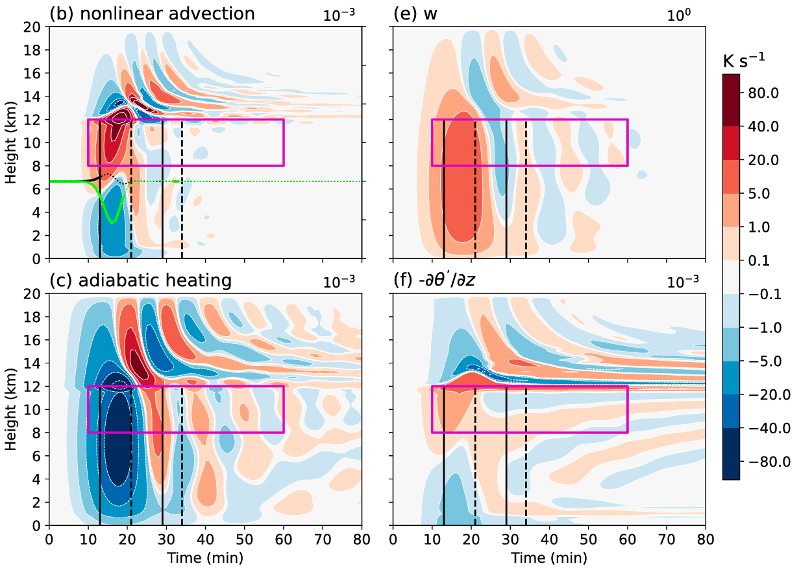
Period~15min
nonlinear advection also
plays a significant role
The balance effect of adiabatic heating/cooling is partially offset by nonlinear, resulting in a more persistent imbalance in the upper and a larger n =1 component in the local heating rate profile
Notes:
Nonlinear effect於10km高層相對抵銷絕熱冷卻效應，使得不平衡狀態持續，造成10km高度的後續n=1waves 產生 Adiabatic heating只是被動產生

Slide 24
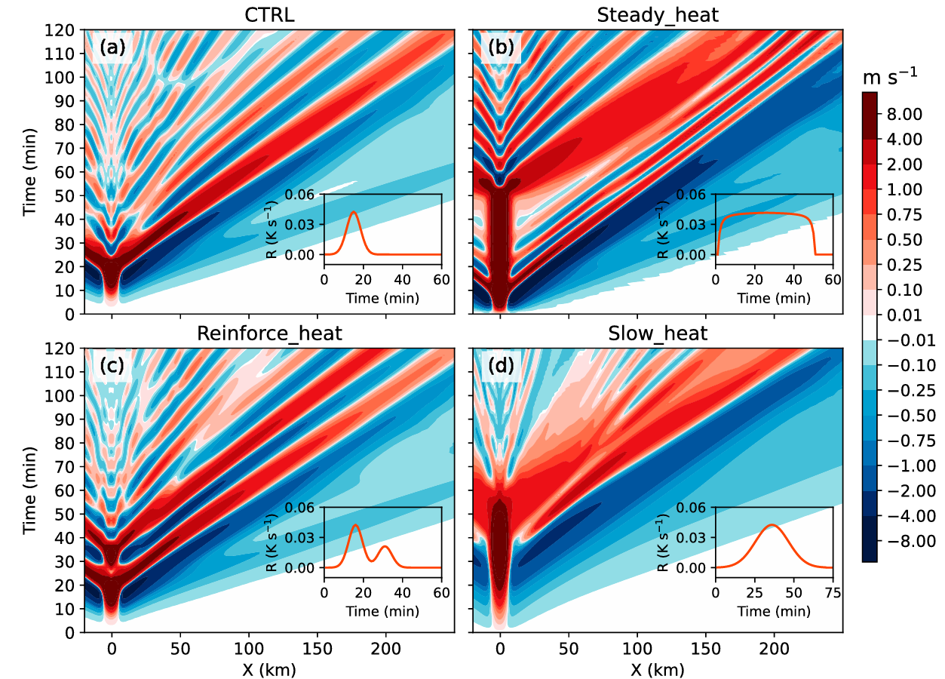
Sensitivity
experiments
n=1 wave signals cannot simply correspond to the variation in latent heating
Notes:
Gravity wave period around 10~10mins 圖b與圖a差最多 圖b在長期加熱時產生很多n=1 waves

Slide 25
Quasi balance between latent heating, nonlinear advection and adiabatic heating → less wavelets been generated
Nonlinear advection and latent heating are in phased
n=1 wave signals related to fluctuation of nonlinear advection
nonlinear advection
is stronger
(higher mode generated)
nonlinear advection
is weaker
(faster recovery)
Notes:
Steady heat 產生許多n=1 waves =>nolinear advection 造成的
左側:當 d g j 三項都平衡時不再產生明顯的wave 仔細看可以發現，絕熱冷卻效應中上層冷卻較強，直接抵銷人工加熱與垂直平流加熱之量值
Two peak exp: 由於first peak 非線性向項adiabatic 未平衡就出現第二個peak，越緩的heat 會有反應相對緩的nonlinear advect，造成local latent heat max 延後，波的產生也延後，並且這個人工peak 造成較強的second n=1model (comparing to CTL)
不太了解的敘述:
This is because the non-
linear advection induced by the first latent heat release is
not fully balanced when the latent heating is enhanced
again (Fig. 17h). And the more gradual onset of the sec-
ond latent heating, as well as the slower strengthening of
nonlinear advection, may also contribute to the local heat-
ing rate to peak earlier.

Slide 26
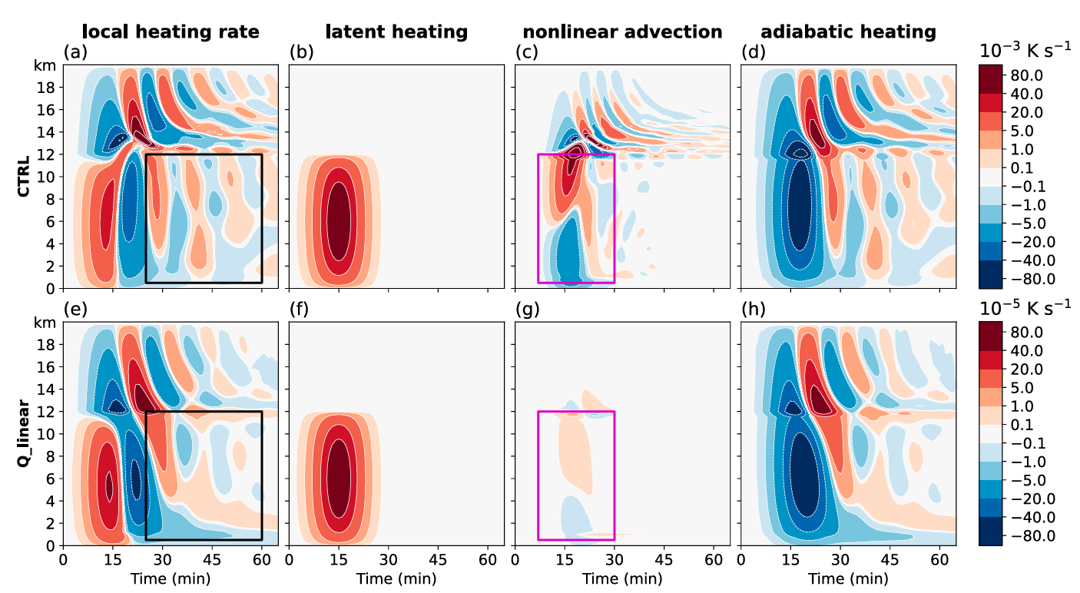
Faster recovery
Diabatic cooling can offset latent heating

Slide 27
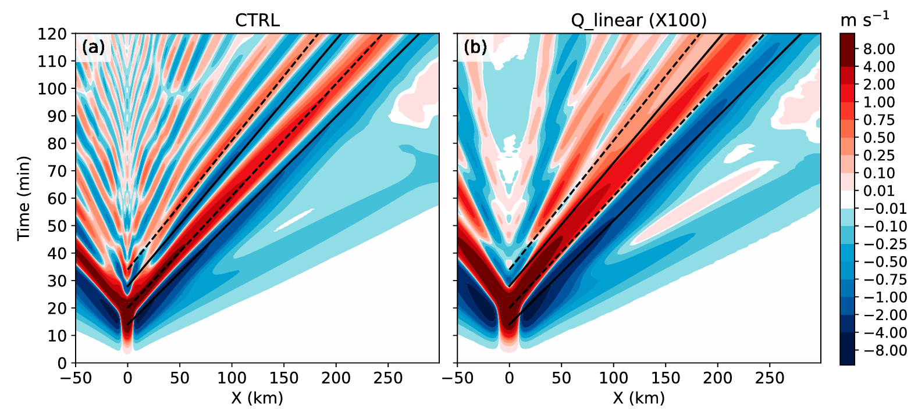
Additional n=2 and n=3 waves (only one branch of them) are generated
Notes:
Q_linear 上的黑線是CTRL的

Slide 28
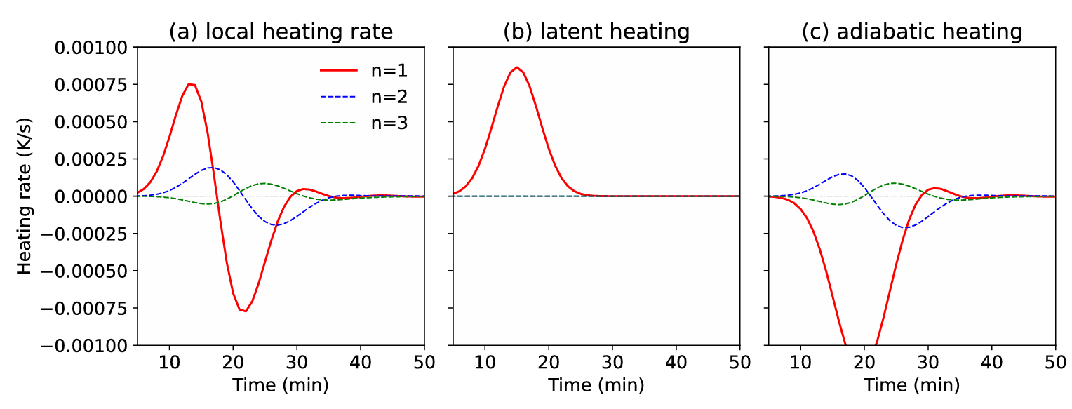
Adiabatic heating generates n=2 and n=3 waves
Might be attributed to the vertically heterogeneous distribution of buoyancy frequency
Vertical motion response to buoyancy frequency, especially when the strength of latent heating is relatively weak higher-order waves might be excited
Notes:
Q_linear 實驗有一些n=2 n=3高頻波，有可能是N^2不均勻分布造成

Slide 29
Conclusions and discussion
Multiple significant n=1 wave couplets with wave fronts that cover the entire depth of the troposphere are generated during the evolution of a convective cloud, as well as in dry experiments with prescribed latent heating.
The n=1 hydrostatic waves propagate away from the convective cloud at a high speed, greatly impacting the cloud environment by changing the MUCAPE field.
First wave couplet is mainly driven by strong latent heating, with adiabatic heating/cooling immediately balancing it. The upward heat transfer from the strong updraft in the source region, greatly enhances nonlinear advection.
Persistent buoyancy oscillation over the entire troposphere could persist for a longer time due to the opposite contribution of nonlinear advection and adiabatic heating/cooling at high levels, leading to the generation of successive n=1 wave couplets and higher-order waves.
Nonlinear advection, which has been shown to be closely related to latent heating, is found to interact with latent heating and create a more persistent state of imbalance.

