Slide 1
Observations of Boundary Layer Convergence Lines and Associated Updrafts in the U.S. Southern Great Plains SHANHE LIU, KAPIL D. SINDHU, AND DANIEL J. KIRSHBAUM (2023, Journal of the Atmospheric Sciences)

Slide 2
Introduction
Convergence lines (CLs):
Boundary layer convergence lines (or CLs) are narrow horizontal lines or arcs of intense horizontal convergence within the planetary boundary layer (PBL).
CLs are meteorologically important for their ventilation of PBL aerosols and pollutants (e.g., Lu and Turco 1995) as well as their initiation of deep convection (e.g., Wilson and Schreiber 1986; Kingsmill 1995; Koch and Ray 1997; Weckwerth and Parsons 2006; Rousseau-Rizzi et al. 2017).
Detection of CLs:
Fine line: enhanced reflectivity, usually in the 0–20-dBZ range
sharp shifts in Doppler radial velocity, on the order of 3 $m s^{−1} km^{−1}$
Notes:
回波常來自非氣象粒子

Slide 3
Introduction
Formation of CLs:
thermally direct circulations
synoptic fronts (e.g., Carbone 1982; Wakimoto and Bosart 2000)
sea-breeze fronts (e.g., Wilson and Megenhardt 1997; Bennett et al. 2006; Wang et al. 2019; Hock et al. 2022)
precipitation-induced cold out flows or gust fronts (e.g., Rotunno et al. 1988; Parsons 1992; Coniglio et al. 2012; Abulikemu et al. 2019)
diurnal mountain thermal circulations (Kirshbaum 2013)
dynamic
horizontal convective rolls (HCRs) (Weckwerth et al. 1999; Weckwerth and Parsons 2006)
orographically forced convergence (e.g., Wasula et al. 2002; Kovacs and Kirshbaum 2016)
differential drag over spatial variations in surface friction (e.g., Roeloffzen et al. 1986 and Bornstein and Lin 2000)

Slide 4
Introduction
CLs and deep-convection initiation (DCI):
The increased subcloud updraft width may promote DCI by initiating wider clouds that are less suppressed by entrainment-induced dilution. (e.g., Khairoutdinov and Randall 2006; Rousseau-Rizzi et al. 2017)
CLs also tend to increase cloud base vertical velocity, cloud mass flux, and cloud duration, all of which are favorable for DCI (Kirshbaum 2022).
Purpose:
The objective of this study is to improve the observational quantification of CL properties and their contrasts with turbulent updrafts in the undisturbed PBL.

Slide 5
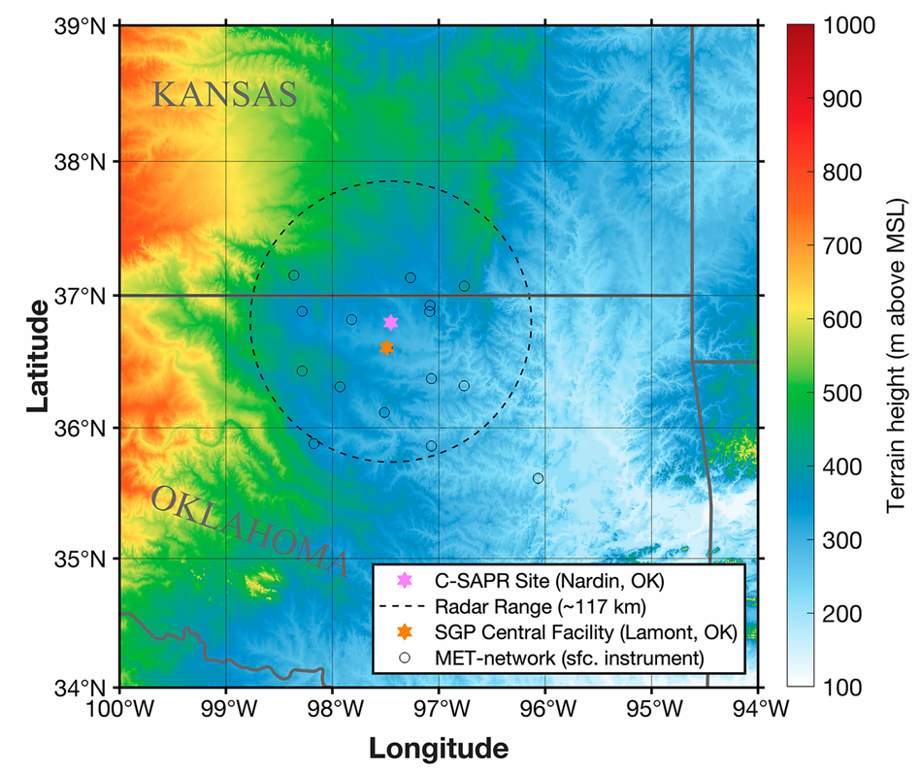
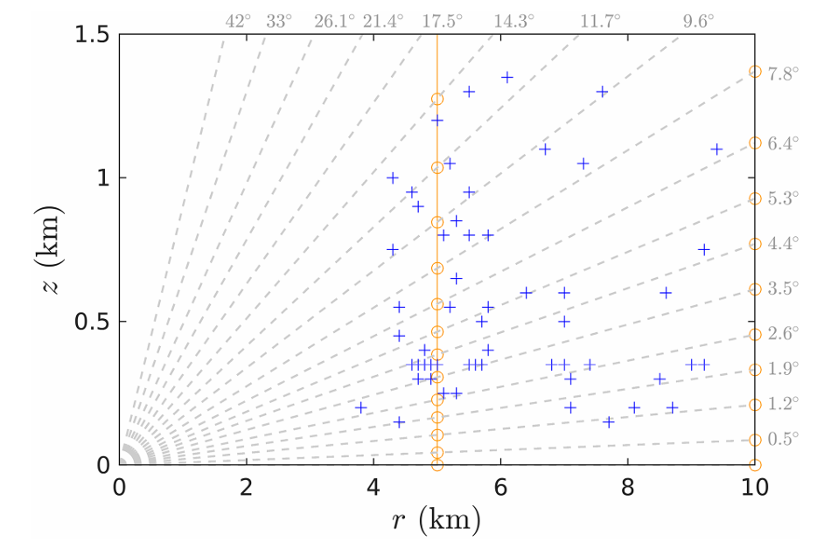
Data
C-SAPR
22 km
doppler lidar
ka-band ARM zenith radar (KAZR)
MET station
Notes:
儀器有
雷達
光達
Ka band 雷達
氣象測站

Slide 6
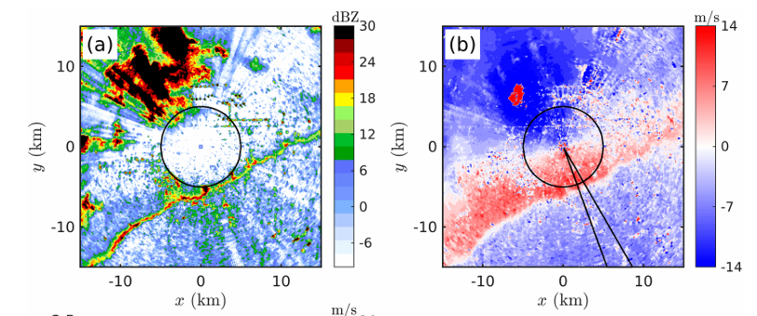
Radar Method
fine line & confluence
identify CLs
& CL range ($d_{CL}$)
3D cartesian
reflectivity
& radial wind
LROSE
C-SAPR PPI
$v_{r}$ smoothed
${\left(\frac{dv_{r}}{dr} \right)}_{b}<0$zones closest to $d_{CL}$
CL width
($W_{CL}$)
CL tracking: fine-line radar reflectivity maxima and coincident strong gradients in radial Doppler velocity.
(only > 10 km and > 1 hr)
mean ${\left(\frac{dv_{r}}{dr}\right)}_{b}$ in $W_{CL}$
CL convergence magnitude ($−δ_{CL}$)
mean $\frac{dv_{r}}{dr}<0$ depth in $W_{CL}$
CL depth ($D_{CL}$)
Notes:
照著流程圖講

Slide 7
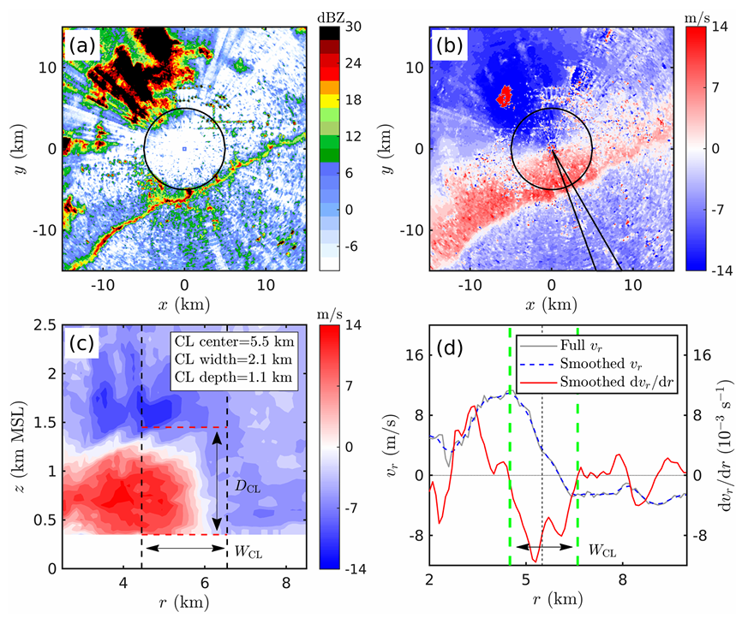
Radar Method
Notes:
先找fineline
B 10度寬的範圍平均 -> C
5 point average
寬度和強度是看最低層

Slide 8
Surface Method
Assume 2D circulation in n-z plane
CL-relative time derivative
$${\left(\frac{Dv_{n}}{Dt}\right)}_{CL}≈c_{n}\frac{∂v_{n}}{∂n}+\frac{∂v_{n}}{∂t}$$
Assume quasi-steady state
$$\frac{∂v_{n}}{∂n}≈−\frac{1}{c_{n}}\frac{∂v_{n}}{∂t}$$
2D circulation assumption ($\frac{∂v_{s}}{∂s}≈0$)
$$δ_{sfc}=∇_{h}⋅v=\frac{∂v_{s}}{∂s}+\frac{∂v_{n}}{∂n}≈−\frac{1}{c_{n}}\frac{∂v_{n}}{∂t}$$

Slide 9
Surface Method
KAZR
filter out precipitation CLs
Identify CLs
& COP
C-SAPR
3D cartesian
Propagation
Speed ($c_{n}$)
CL width
($c_{n}×Δt_{CL}$)
MET station
$δ_{sfc}<0$ period in COP
Duration of CL ($Δt_{CL}$)
$$δ_{sfc}≈−\frac{1}{c_{n}}\frac{∂v_{n}}{∂t}$$
C-SAPR
Doppler Lidar
KAZR
MET station
Notes:
critical observation period (COP)由雷達大致定出來

Slide 10
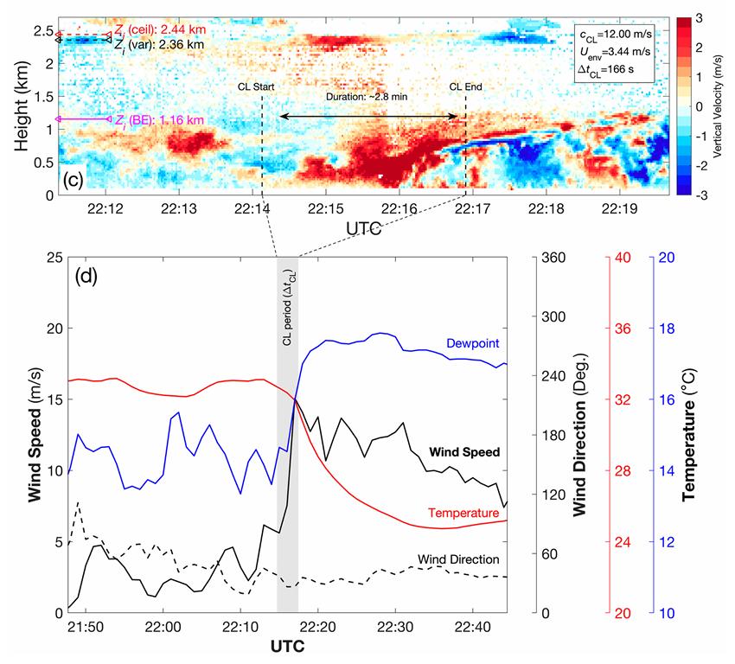
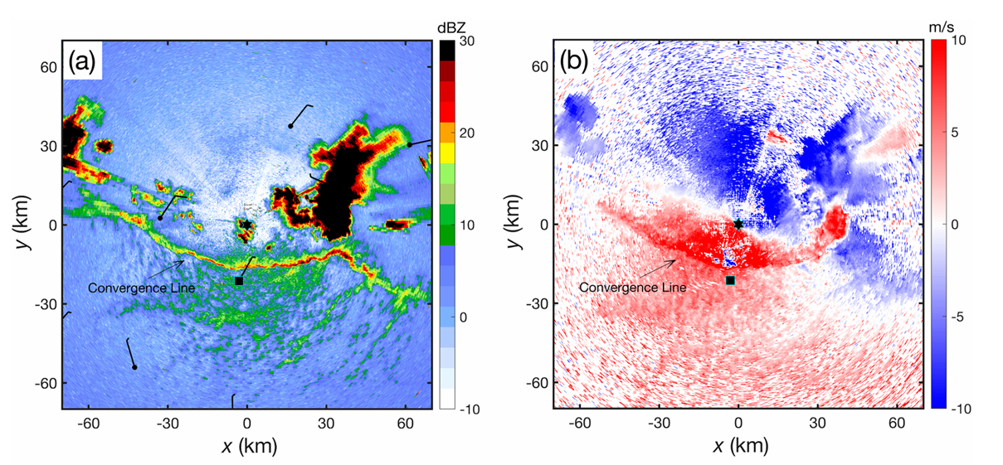
Surface Method

Slide 11
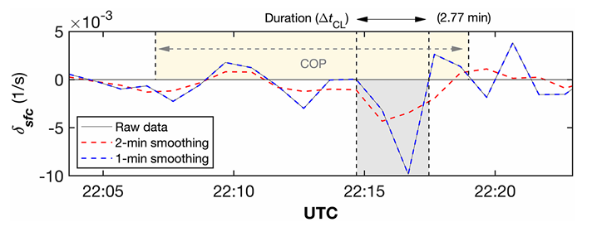
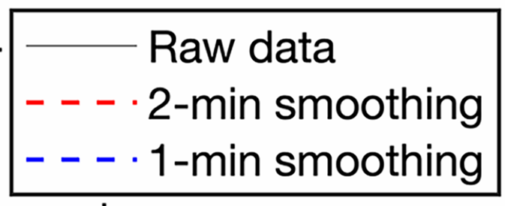
Surface Method

Slide 12
PBL Depth
ARM ceilometer
30-min prior to CL
PBL depth ($Z_{i}$)
subjective choose
Vertical velocity variance ($σ_{w}^{2}$)
$$Z_{i}\left(σ_{w}^{2}<0.08\frac{m^{2}}{s^{2}}\right)$$
Doppler Lidar
Time-height curtains of $w$
Notes:
兩個都好就用ceilometer
都不好的話取3km以下 $σ_{w}^{2}$的最大負梯度處

Slide 13
PBL Depth
Notes:
BE是best estimate

Slide 14
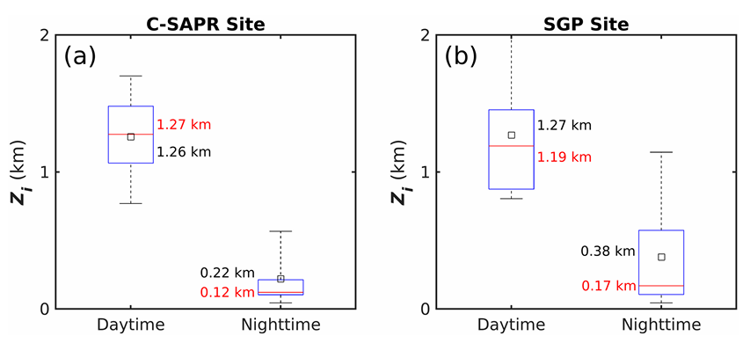
PBL Depth
Notes:
errorbar是10th和90th
紅色是中位數
黑色正方形是平均
白天大約都在1.2公里高左右
晚上很矮，多在200公尺以下

Slide 15
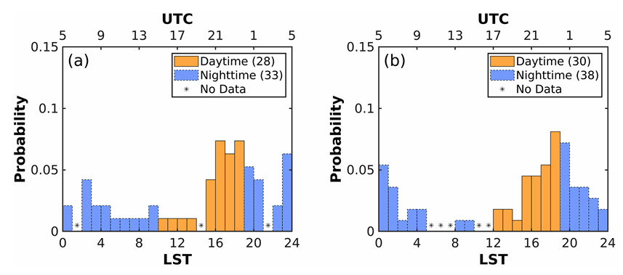
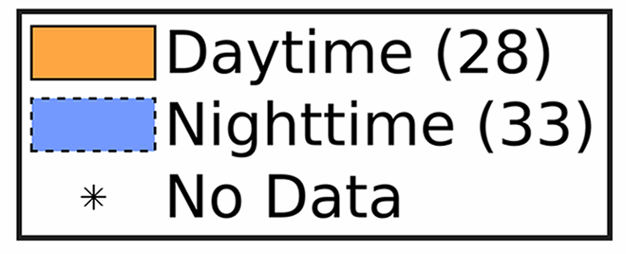
CL Occurrence
secondary peak
Primary peak
Notes:
CL的發生時間
在兩站相近

Slide 16
CL Types
Notes:
約有75~80%是前三者

Slide 17
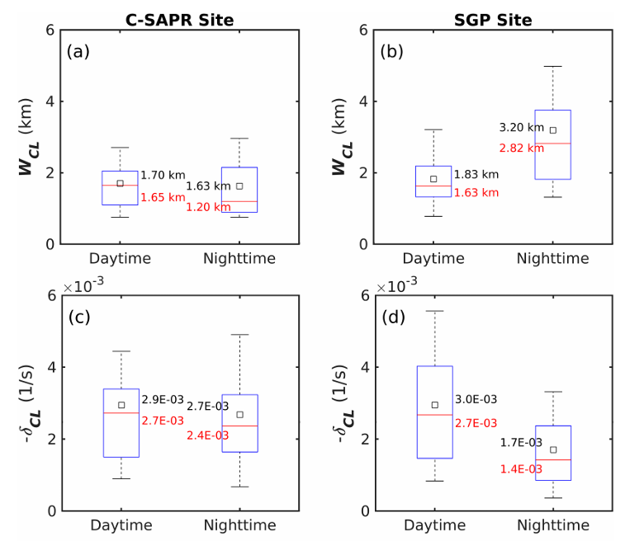
CL Properties
Notes:
CL寬度和強度的分布在白天很類似

Slide 18
CL Properties
Notes:
但在夜晚就差很多
可能跟夜晚PBL比較淺且穩定度較大有關
因為雷達包含地形和仰角，可能最低仰角也會掃描到高於PBL的高度，因此取樣到比較多PBL以上的穩定度較弱環境的CL
因此日夜變化對C-SAPR站的影響較小
SGP站(地面測站)算出來的夜間的CL相對是穩定度比較大、因此被壓扁的環流

Slide 19
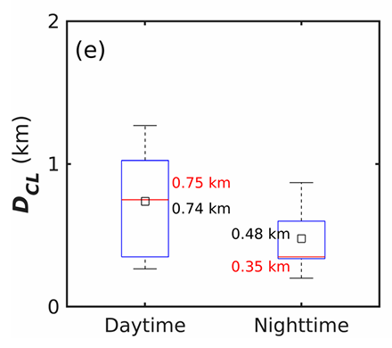
CL Properties
Notes:
只有雷達站有量CL高度
白天較高 晚上較低

Slide 20
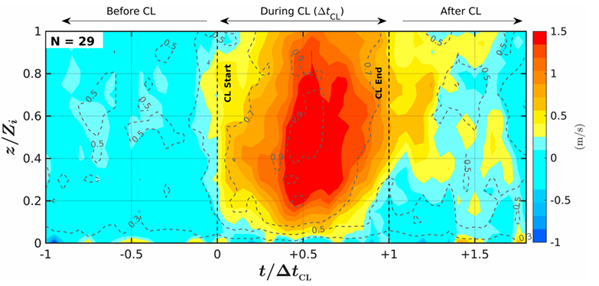
CL vertical motion
$t/Δt_{ct}=0$ : CL start time
$t/Δt_{ct}=1$ : CL end time
$z/Z_{i}=0$ : surface
$z/Z_{i}=1$ : PBL top
Notes:
用DL的資料 無因次化座標後平均白天的CL (因為白天CL被PBL限制，但晚上可以突破PBL)
中間時段上升最強 且向右傾斜
高度上大概在0.6最強，差不多是CL的高度
上升氣流越高越寬(可能跟shear instability或turbulence有關)

Slide 21
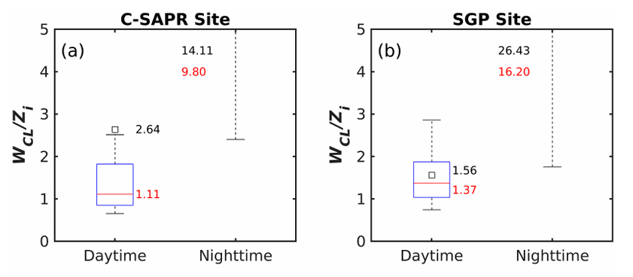
Comparison with PBL
Median 1.11
Median 1.37
Notes:
兩個站白天中位數都很接近1，代表CL寬度和PBL高度接近
但晚上都大一個數量級，其中SGP站又更高(之前提到過的，晚上PBL較矮穩定度較大，且雷達掃描到較高高度的問題)

Slide 22
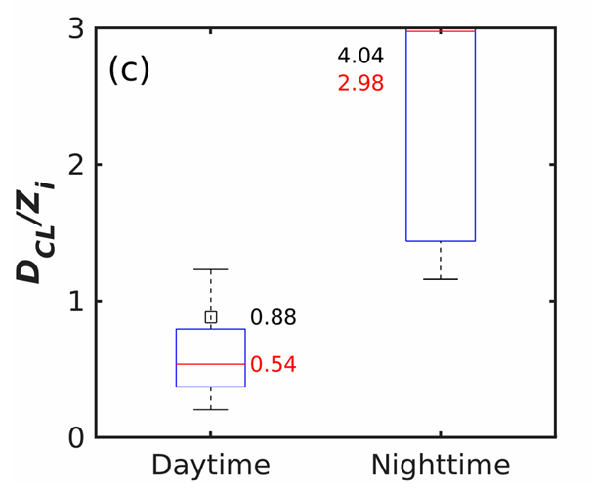
Comparison with PBL
Median 0.54
Notes:
呼應右圖上升流極值在中間
夜晚同樣是PBL太矮的關係
根據PBL高度與CL寬度高度的比較，他們發現一般邊界層亂流的尺度跟CL的尺度並沒有顯著的差距
因此這可能不是CL容易引發深對流的主因

Slide 23
Updraft analysis
$L_{e}$: updraft length
$D_{e}$: updraft depth
Notes:
定義上升流是t-h圖中相連的上升運動區 但Zi以上的值不考慮
至少一格在CL期間的算是CL-associated
Updraft length Le是水平格數乘以移速 移速可以是平均水平風或是CL移速 (frozen turbulence)
Updraft depth De是同一個上升運動區內最高高度減最低高度

Slide 24
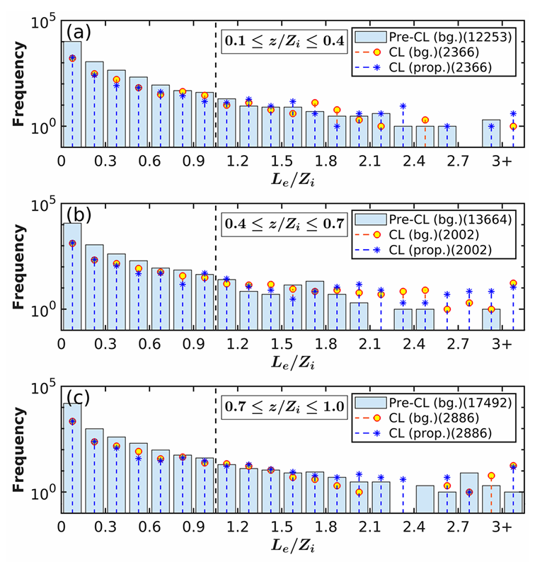
Updraft analysis
lower PBL
middle PBL
$L_{e}$: updraft length
$D_{e}$: updraft depth
$Z_{i}$: PBL depth
upper PBL
Notes:
CL期間和pre-CL其間差距些微

Slide 25
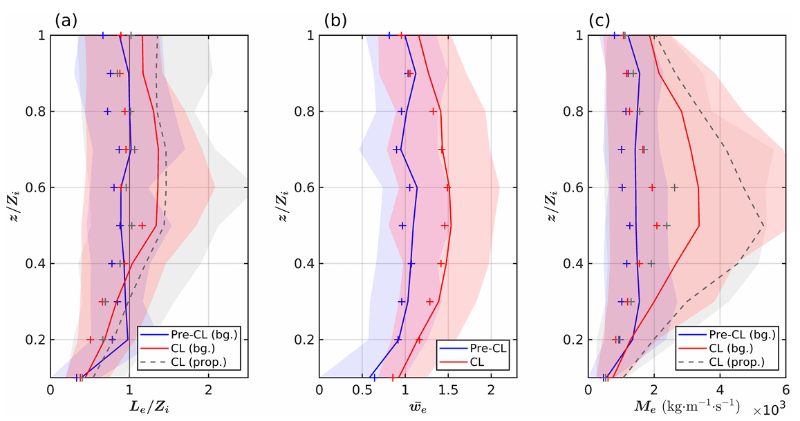
Updraft analysis
${\overline{W}}_{e}$: mean updraft speed
$M_{e}$: vertical mass flux
$$M_{e}\left(z\right)≡\int_{L_{e}}{ρ\left(z\right)w\left(x\right)dx}≈\sum_{n=1}^{N}{ρw_{e}Δx}=ρ\overline{w_{e}}L_{e}$$
Notes:
在邊界層中層
Le大了20% 而垂直速度大了約40%
導致垂直質量通量多了100%
這可能是CL容易導致DCI的原因之一
不過考慮到CL持續時間遠大於一般的亂流，在先前研究中提到的，長時間的上升氣流導致積雲可以較不受到逸入作用影響，可能也是一大因素

Slide 26
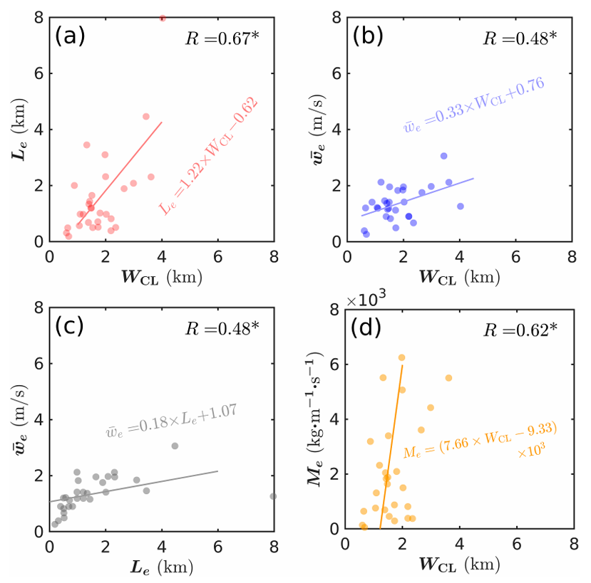
CL & updraft correlation
Lower PBL
Notes:
134都有不錯的相關性
2只在低層有好的相關
用不可輻散假設計算減化的上升速度與真實上升速度相關性很差，可能是因為地面輻合量不能代表整體輻合，也可能受到CL以上的輻散影響
計算做了很多假設，和儀器本身的誤差，可能都導致相關性降低

Slide 27
conclusions
The distributions of daytime CL width and intensity are statistically similar for both methods but different at night.
During the daytime, both CL width (at both sites) and CL depth (at the C-SAPR) only slightly exceeded PBL depth ($Z_{i}$).
The median CL updraft speeds were found to be 20%–60%larger throughout the PBL, leading to a substantial (50%–100%) enhancement in the vertical mass flux of the largest updrafts during the CL period.
The CL circulation and related updrafts are only slightly larger but considerably stronger than the largest PBL eddies.

