Slide 1
Bifurcation Points for Tropical Cyclone Genesis and Intensification in Sheared and Dry Environments
Paper review
mainly refer to
Chaehyeon C. Nam, Michael M. Bell, and Dandan Tao
Wei-Ting Fang
2024.03.05 @CPLab
Other references:
Lin, K. J., S. C. Yang, and S. S. Chen, 2018: Reducing TC position uncertainty in an ensemble data assimilation and rediction system: A case study of Typhoon Fanapi (2010). Wea. Forecasting, 33, 561–582.

Slide 2
Outline
1. Introduction
2. Experiment setup
3. Results
a. Overview of TC development
b. Bifurcation points for TC intensification for SH7.5_Moist50
c. Probabilistic approach to TC intensification
d. Time-lagged correlation analysis
4. Discussion and conclusions

Slide 3
Introduction
Both ensemble modeling studies and analyses of operational intensity forecast errors have shown that tropical cyclogenesis and intensification are the most unpredictable with moderate VWS (Zhang and Tao 2013; Finocchio and Majumdar 2017; Bhatia and Nolan 2013).
The dry midlevel air affects the overall upward vertical mass flux via entrainment of less buoyant air parcels (i.e., radial ventilation; James and Markowski 2010) and convective downdrafts into the subcloud layer (i.e., downward ventilation), which result in a longer recovery time for subsequent deep convection (Riemer et al. 2010; Alland et al. 2017).
Recent observational and modeling studies have revealed that TCs that successfully develop or intensify under moderate to large VWS undergo vortex restructuring processes such as “downshear reformation” (Nguyen and Molinari 2015; Rios-Berrios et al. 2018; Chen et al. 2018; Nam and Bell 2021).
Inside the convective area in the downshear region, the vertical component of vorticity is produced through tilting of horizontal vorticity, vortex stretching, and vertical advection of vorticity. The newly produced vorticity is accumulated inside the broader circulation through a vortex merger process.

Slide 4
Experiment setup
Model: ARW-WRF 3.1.1
Nested Domains: 18 km (240 × 240), 6 km (240 × 240), and 2 km (360 × 360)
The two inner domains were specifically designed to track the center of the vortex at the 850-hPa level.
Vertical Levels: 40 vertical levels (model top: 20 km)
Physics:
Yonsei University (YSU) boundary layer scheme
WRF single-moment 6-class microphysics scheme (WSM6)
Initial Conditions:
Maximum tangential wind: 15 m s⁻¹ at 850 hPa
Radius: 135 km
Tangential winds vanish at 800 km
Constant SST: 29°C

Slide 5
Experiment setup
Dunion and Marron (2008) non–Saharan air layer (SAL) mean hurricane season sounding was used for the initial thermodynamic profile
For all simulations, the moisture is the same in the inner-core regions (within a 200-km radius), and between 200- and 300-km radii, the moisture decreased linearly
Environmental zonal wind for SH5, SH7.5, and SH10 experiments
water vapor mixing ratio for the outer-core region (≥300-km radius) for Moist100, Moist50, and Moist 25

Slide 6
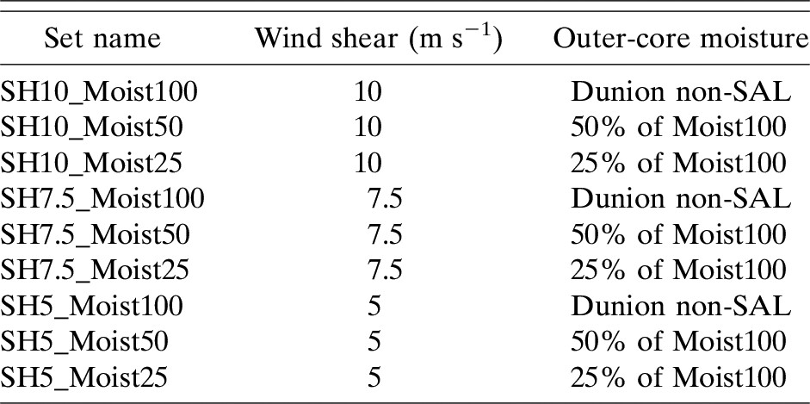
List of experiments
Each set of experiments consists of 20 ensemble members.

Slide 7
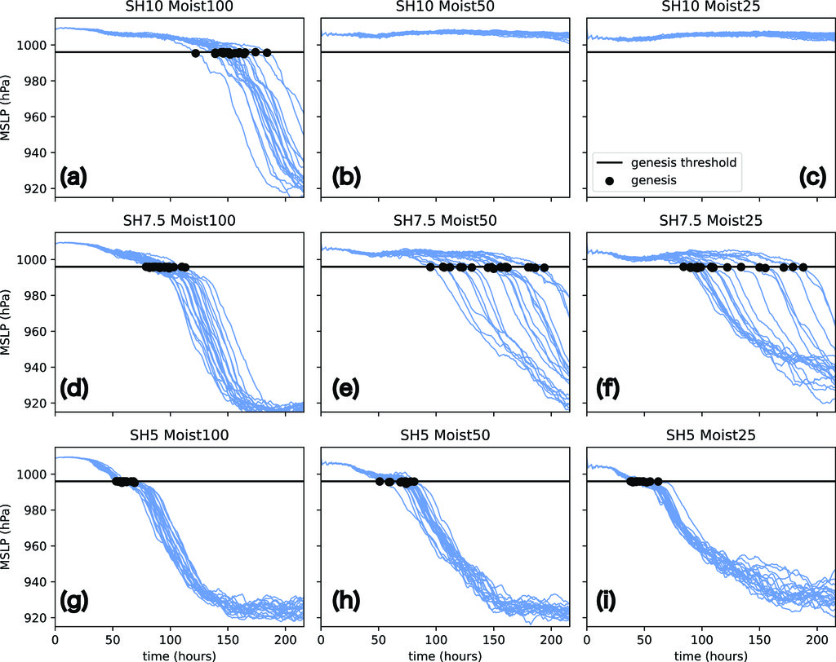
Overview of TC development
The timing of TC genesis is determined as the timing of the simulation obtaining minimum sea level pressure (MSLP) below a threshold of 996 hPa as the onset of sustained intensification.
The standard deviation of MSLP from 20 ensemble members of SH7.5_Moist50 was 18.8 hPa at median genesis time (153 h) and reached a maximum of 23.2 hPa at 191 h.
The second largest ensemble spread was found from SH7.5_Moist25 with a maximum of 21.7 hPa at 166 h.

Slide 8
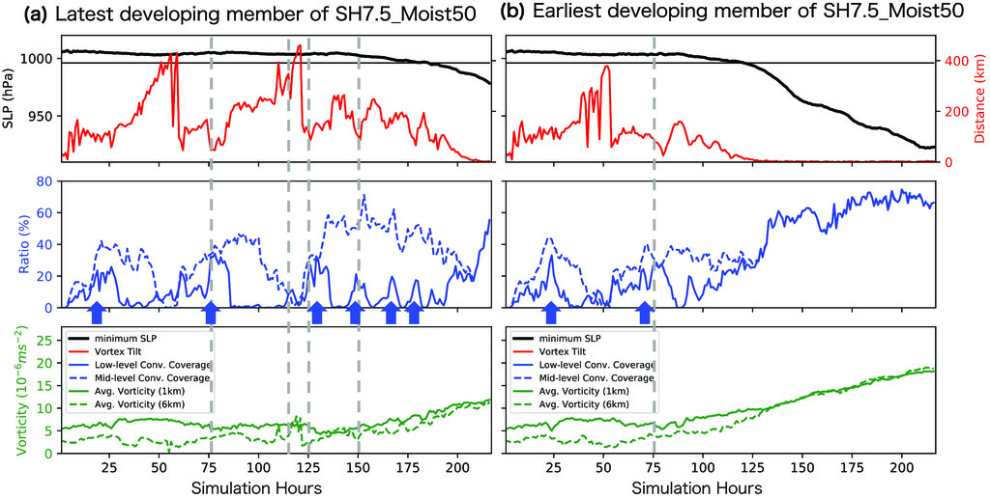
Bifurcation points for TC intensification for SH7.5_Moist50

Slide 9
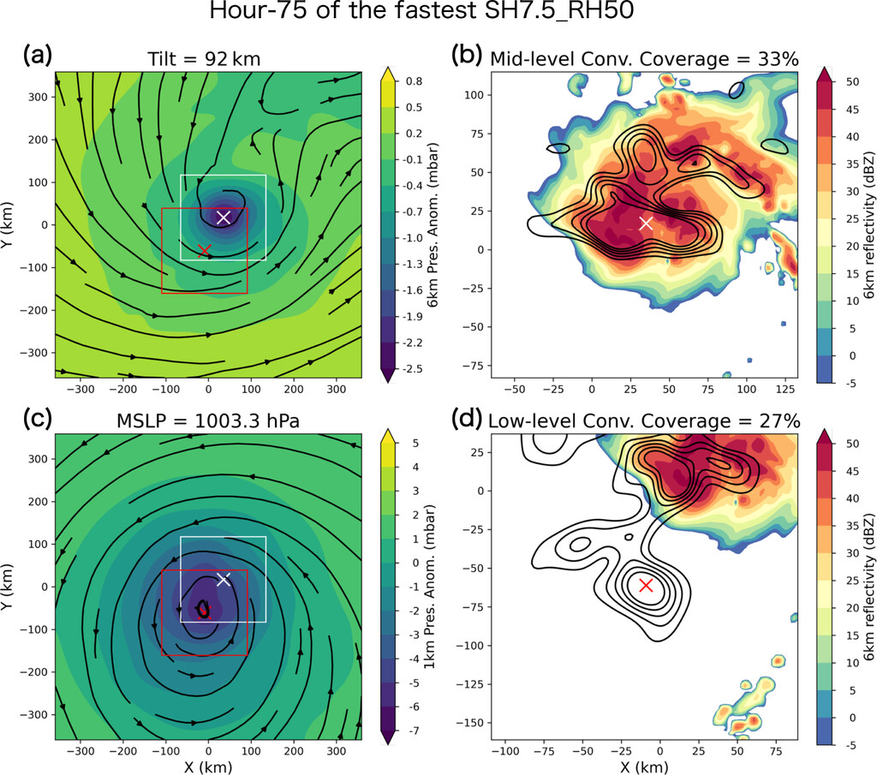
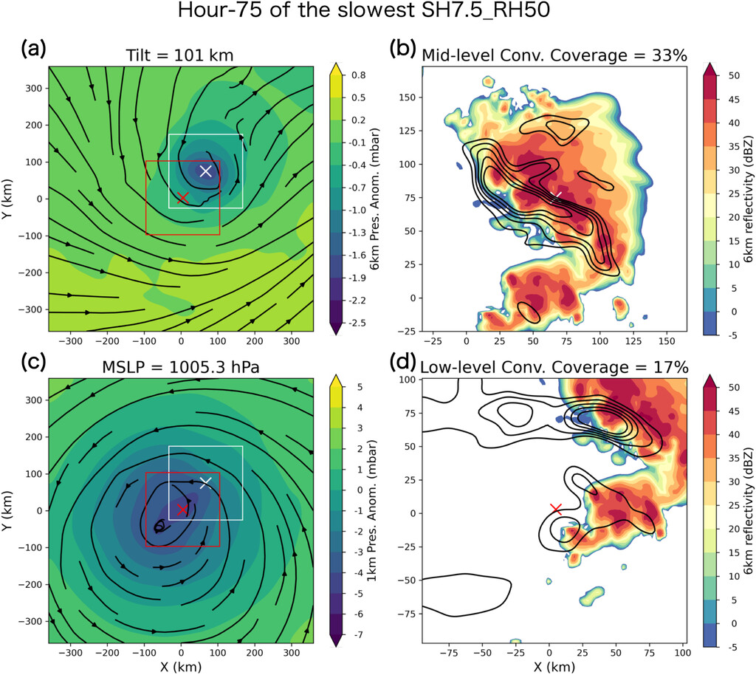
Earliest- and latest-developing member at hour 75
Earliest
Latest

Slide 10
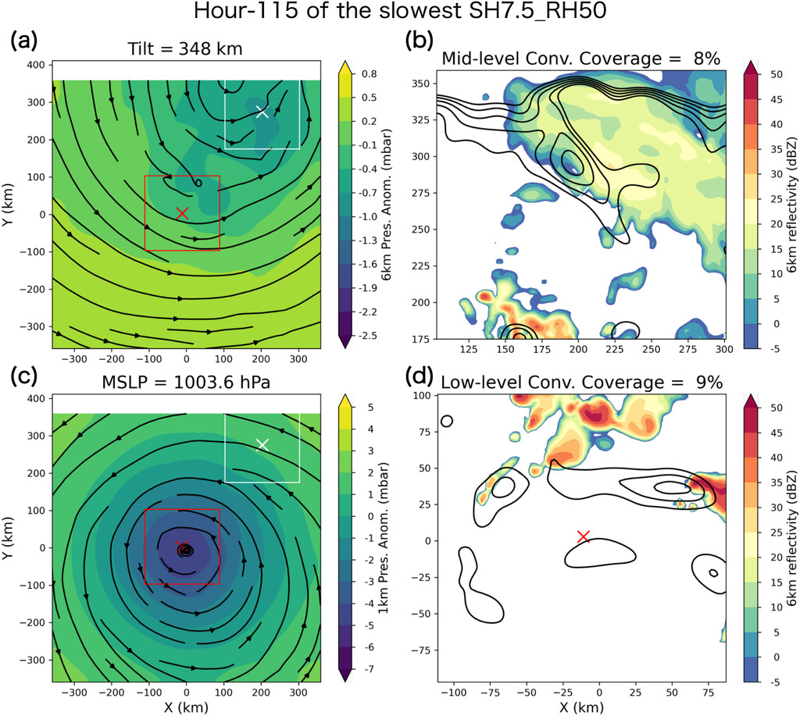
Latest-developing member at hour 115

Slide 11
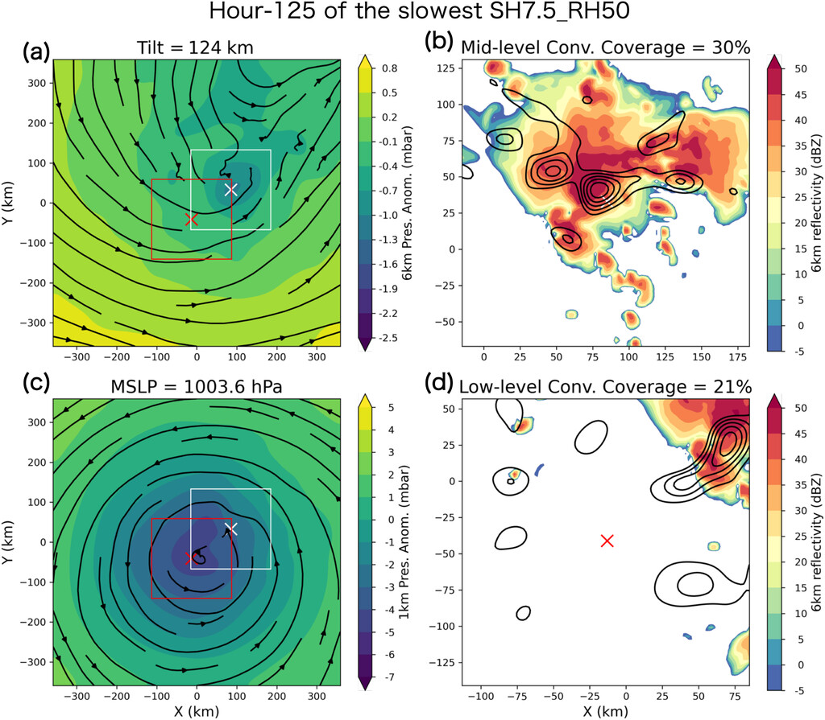
Latest-developing member at hour 125

Slide 12
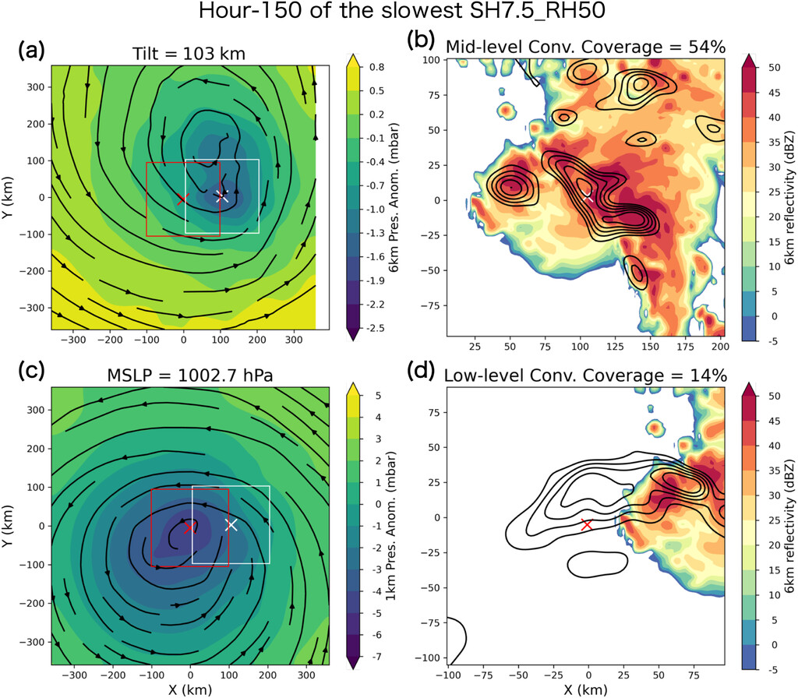
Latest-developing member at hour 150

Slide 13
Key findings
The earliest-developing member and the latest-developing member have similar behavior of precursor events until the 90-h mark.
The latest-developing member has multiple attempts at increasing convective coverage around the low and midlevel vortex centers that could possibly lead to TC intensification. Still, they all failed until the sixth attempt.
Only after vortex tilt decreases closer to zero, SLP starts to drop rapidly.
Low-level convective coverage is more episodic compared to midlevel convective coverage, and midlevel convective coverage persists for a longer time after tilt increases again.
Midlevel vorticity shows hints of increasing slightly sooner than low-level vorticity increasing and SLP decreasing.
Deep convection over a wider area inside the inner-core region generates a smaller-scale midlevel vortex, which results in an instantaneous vortex tilt decrease.
A key difference between the successful and failed precursor cycles in SH7.5_Moist50 ensembles is whether the newly generated midlevel vortex sustains the alignment with the low-level vortex or it is advected away by the VWS again.

Slide 14
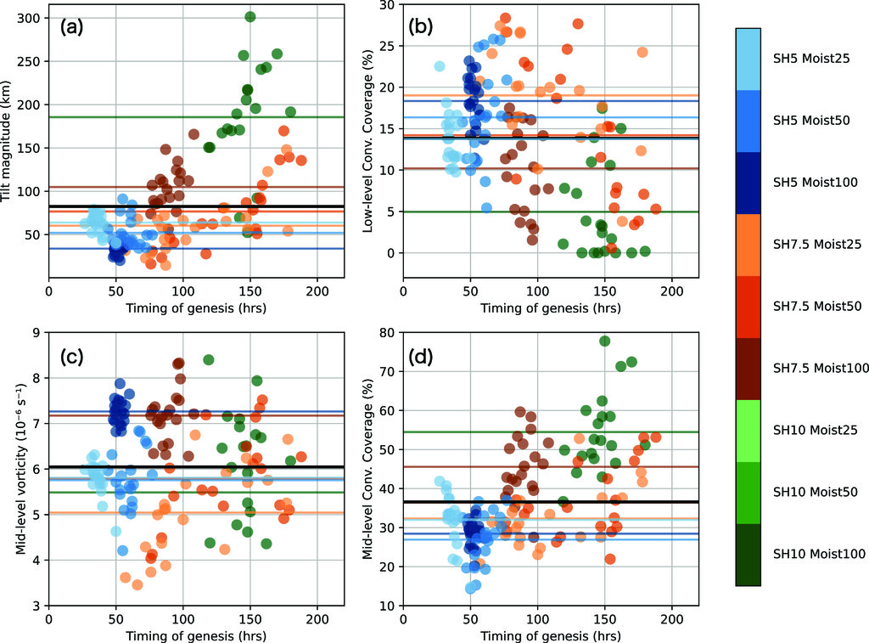
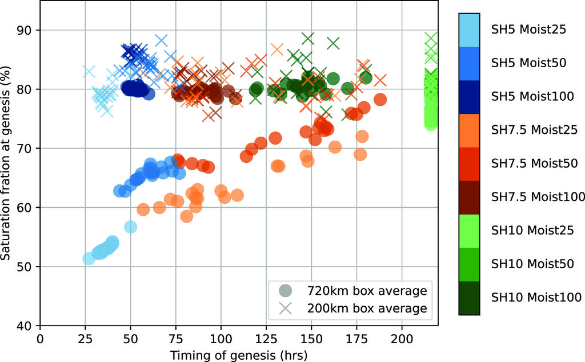
Probabilistic approach to TC intensification
The spread of data points of each precursor variable at genesis time indicates reaching a threshold does not guarantee TC intensification.
Thresholds for the four precursors (mean value at the genesis timing for 140 developing members ):
Vortex tilt magnitude: <82.0 km
Inner-core average midlevel vorticity: >6 × 10⁻⁶ s⁻¹
Inner-core low-level convective coverage: >14.0%
Inner-core midlevel coverage: >37.0%

Slide 15
Precursor events before TC genesis
Mosit100
SH7.5
Mosit100
SH7.5
Moist100 provides a very favorable thermodynamic setup of sea surface temperatures of 29C and moist tropical sounding; thus, it is likely that simulated TCs under Moist100 can afford a larger magnitude of vortex tilt.
Moist50 and Moist25, on the other hand, have a region of drier air in the outer-core region that can easily be brought into the inner-core region through radial ventilation if the vortex tower is tilted.

Slide 16
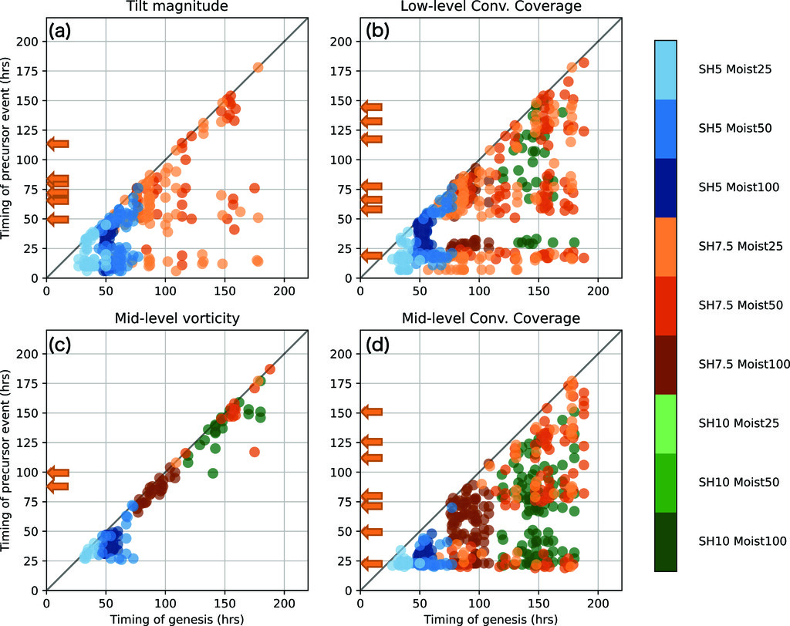
Precursor event vs. genesis timing
Convective burst
0~24 h
50~75 h
100~175 h
The median time of the first, second, …, and seventh (if any) precursor events for 60 members of the three SH7.5 sets.
SH7.5_Moist50 and SH7.5_Moist25:
The latest occurrence of
midlevel convective coverage: 31.4 and 34.4 h prior to genesis time
low-level convective coverage: 15.6 and 8.7 h prior to genesis time

Slide 17
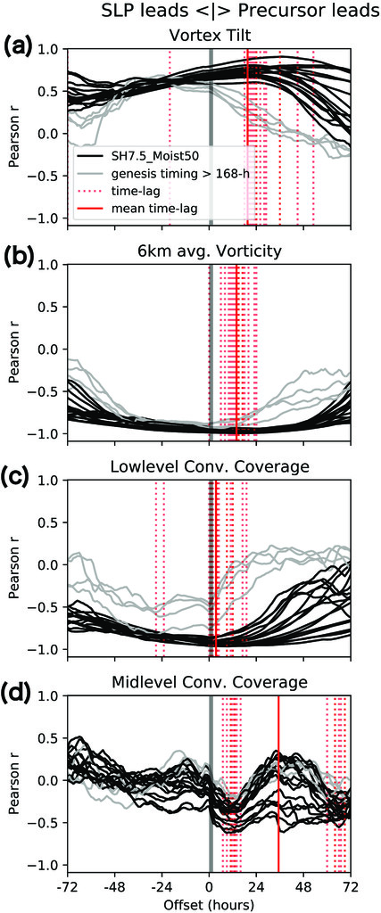
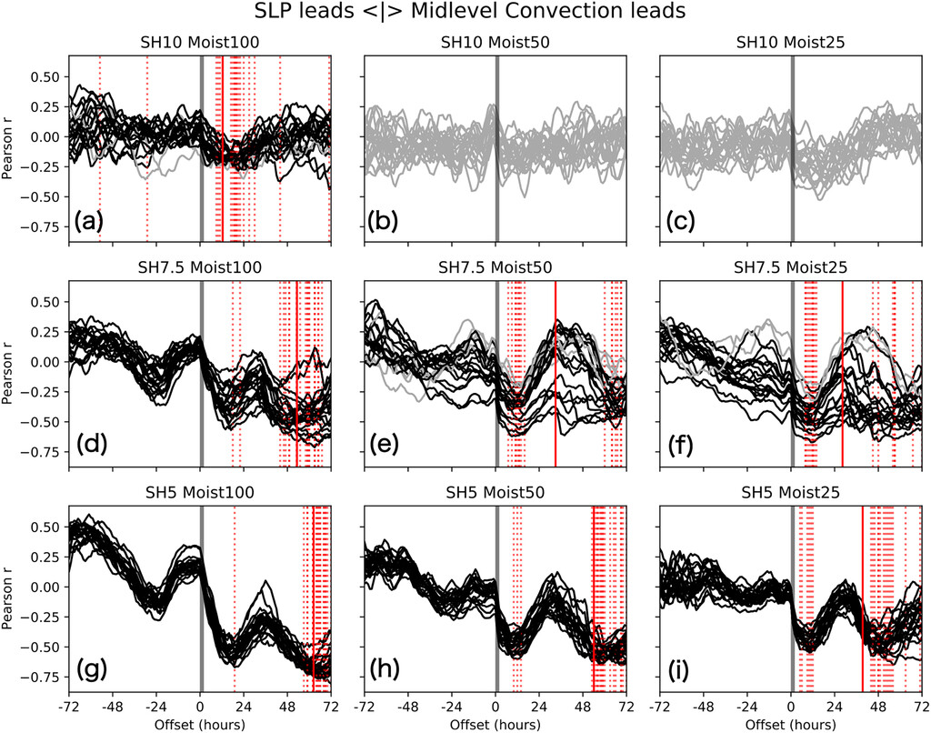
Time-lagged correlation analysis (1/2)

Slide 18
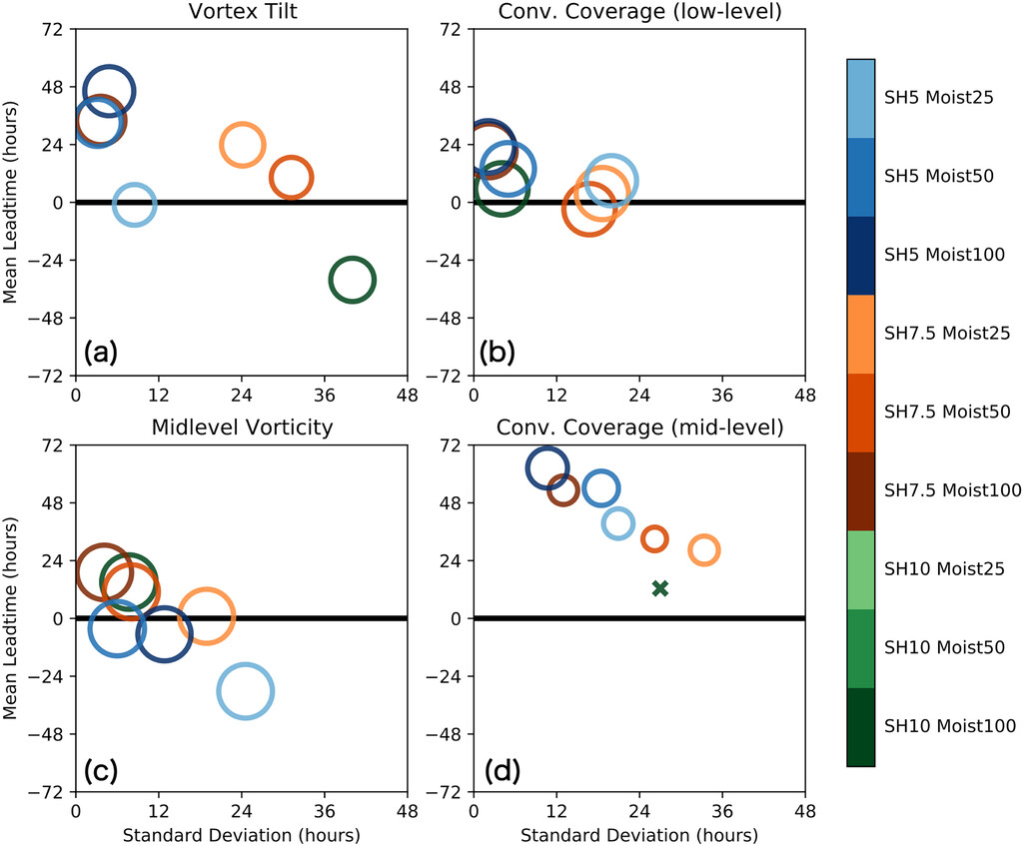
Time-lagged correlation analysis (2/2)
Leading time
2.
3.
4.
1.

Slide 19
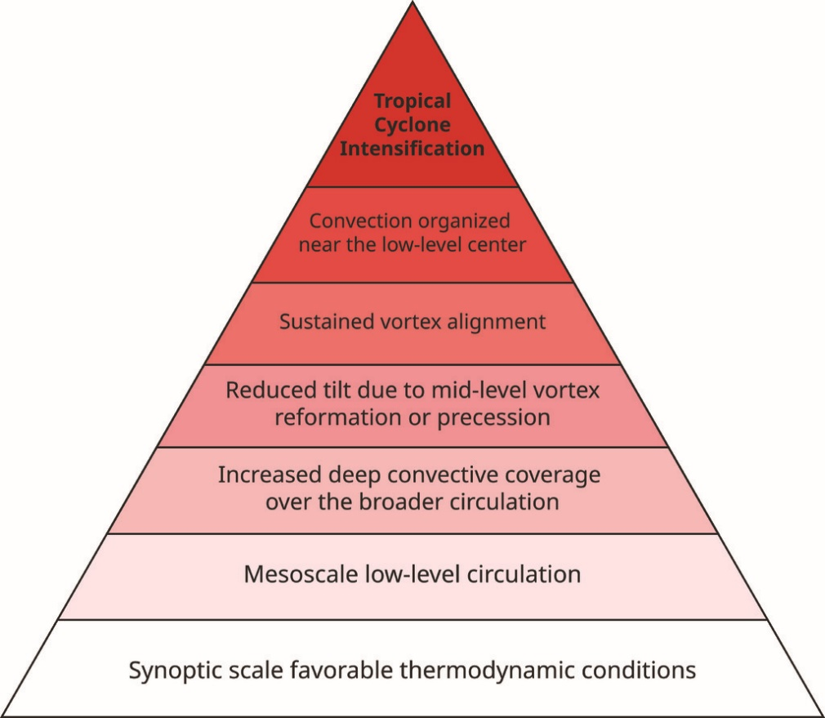
Pyramid diagram of TC intensification
Synoptic-Scale Thermodynamic Conditions
Necessary conditions for TC genesis, including a moist atmosphere and a well-mixed, warm oceanic layer.
Closed Mesoscale Low-Level Circulation
Signals the existence of intensification, observed in tropical disturbances within the "Invest" and TD range.
Emergence of Wider Deep Convection Area
Marks the transition to synoptic- to meso-alpha-scale environments.
Formation of Midlevel Vortex within Mesoscale Convective System
Rapid vortex tilt decrease, preparing for sustained alignment.
Sustained Vertical Alignment
Ensures resilience against Vertical Wind Shear.
Organized Deep Convection near Low-Level Center
Marks successful vortex alignment, preparing for intensification.
TC Intensification
Further intensification observed through increasing midlevel vorticity.

Slide 20
Discussion and conclusions
The study reveals key multiscale precursors influencing tropical cyclone intensification in sheared and dry environments.
The pyramid analogy identifies critical processes acting as bifurcation points between developing and nondeveloping vortices.
The sustained vortex alignment process on the fifth floor of the pyramid is a crucial bifurcation point for certain configurations.
Overlaps in lead times and large variances present challenges in disentangling precise timing and causal relationships between various precursor events.
The study could not pinpoint differences between midlevel vortices that maintain sustained alignment and those carried away.
The uncertainty can be largely attributed to the probabilistic characteristics of precursor events lining up together before TC genesis and intensification.
The environmental conditions change; thus, a system that requires multiple repetitions of precursor events could miss the window of opportunity and dissipate as the environment becomes more hostile.
On the other hand, some systems could develop into a TC climbing up the pyramid rapidly after entering a more favorable environment like the case of Hagupit (2008) (Nam and Bell 2021).

