Slide 1
An Observational Study on the Rapid Intensiﬁcation of Typhoon Chanthu (2021) near the Complex Terrain of Taiwan
Wei-Ting Fang
2024.02.20
@CPLab
Fang, W.-T., P.-L. Chang*, and M.-J. Yang, 2024: An observational study of rapid intensification of Typhoon Chanthu (2021) near the complex terrain of Taiwan. Mon. Wea. Rev., Early Online Release.

Slide 2
Outline
Introduction
Data and methodology
Results
Summary
Future work

Slide 3
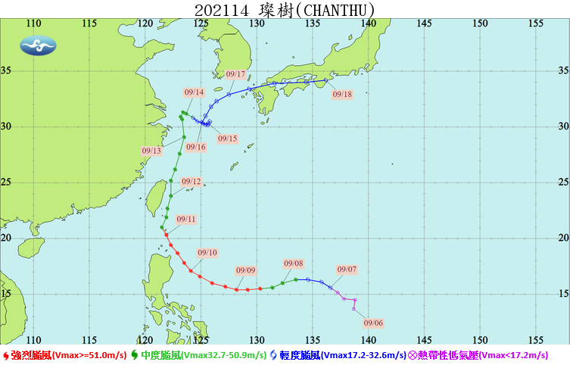
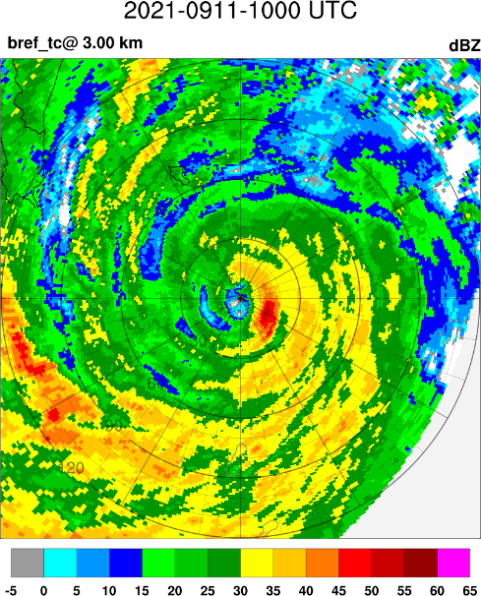
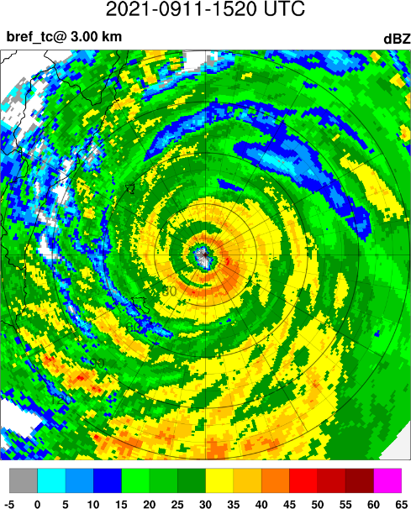
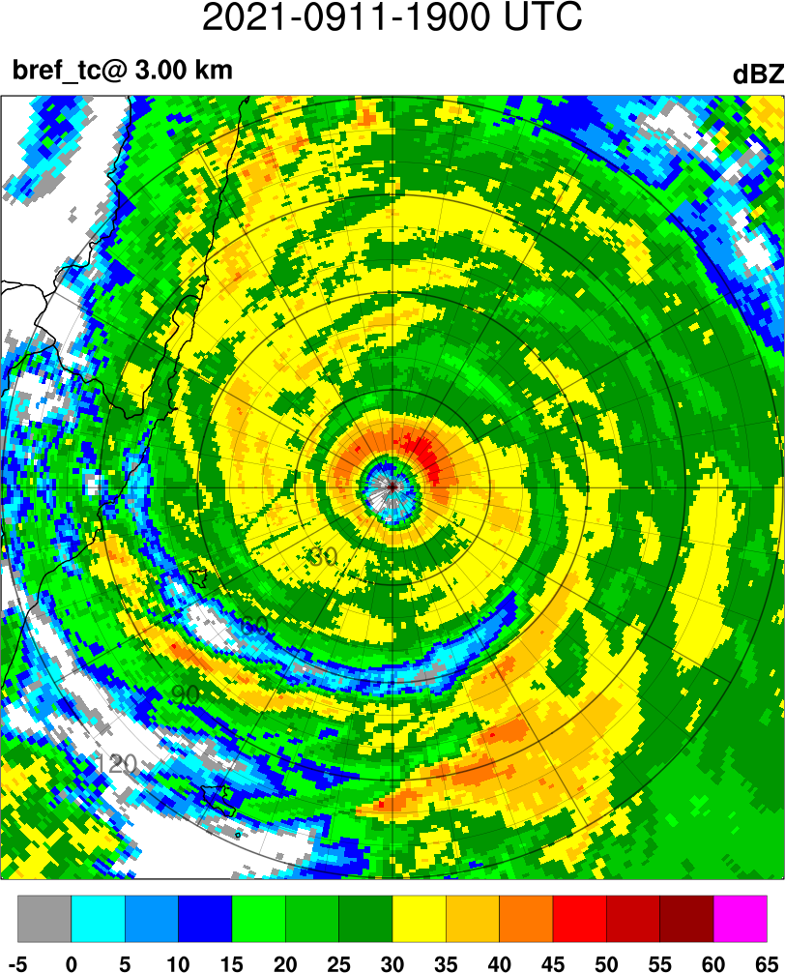
TY Chanthu (2021) – real-time intensity
UTC |  | CWB |  | JMA |  | ADT
2021/9/10 | 00:00 | 925 | 53 | 935 | 55 | 940.3 | 104.6
 | 03:00 | 925 | 53 | 935 | 55 | 918.6 | 124.6
 | 06:00 | 915 | 58 | 925 | 55 | 912.7 | 129.6
 | 09:00 | 915 | 58 | 920 | 55 | 884.6 | 152.0
 | 12:00 | 915 | 58 | 910 | 60 | 884.5 | 152.0
 | 15:00 | 915 | 58 | 905 | 60 | 880.5 | 155.0
 | 18:00 | 915 | 58 | 905 | 60 | 880.4 | 155.0
 | 21:00 | 920 | 55 | 905 | 60 | 880.3 | 155.0
2021/9/11 | 00:00 | 925 | 51 | 905 | 60 | 884 | 152.0
 | 03:00 | 930 | 48 | 910 | 55 | 905.5 | 134.8
 | 06:00 | 930 | 48 | 910 | 55 | 911.8 | 129.6
 | 09:00 | 940 | 45 | 910 | 55 | 917.5 | 124.6
 | 12:00 | 940 | 45 | 920 | 55 | 925.1 | 117.4
 | 15:00 | 940 | 45 | 920 | 55 | 933.2 | 109.8
 | 18:00 | 940 | 45 | 935 | 50 | 938.7 | 104.6
 | 21:00 | 940 | 45 | 935 | 50 | 938.5 | 104.6
2021/9/12 | 00:00 | 940 | 45 | 935 | 50 | 943.8 | 99.6
 | 03:00 | 940 | 45 | 940 | 50 | 943.5 | 99.6
 | 06:00 | 940 | 45 | 950 | 45 | 943.3 | 99.6
 | 09:00 | 940 | 45 | 955 | 45 | 960.8 | 82.2
 | 12:00 | 945 | 43 | 960 | 40 | 960.6 | 82.2
 | 15:00 | 950 | 40 | 960 | 40 | 960.4 | 82.2
 | 18:00 | 950 | 40 | 960 | 40 | 967.0 | 74.6
intensification
Rapid intensification
Weakening
1000
1520
1900
ADT: Advanced Dvorak technique

Slide 4
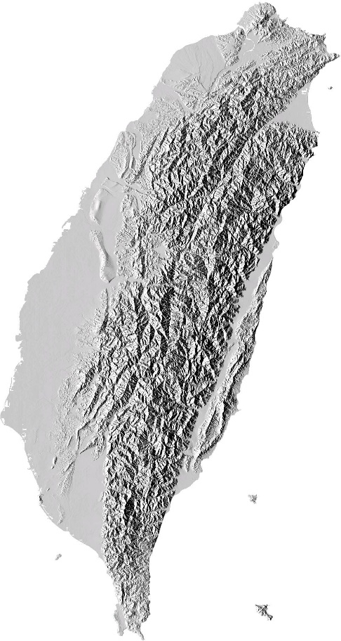
  Extreme rainfall: Nari (2001) , Morakot (2009) …
  (周等，2004，2008; Yang et al. 2008; Yang et al. 2011a;
  Yang et al. 2011b; Yu and Cheng 2013; Wu 2013; Huang et al. 2014)
  Track deflection: Haitang (2005), Krosa (2007)
  (Yeh and Elsberry 1993a,b; Jian and Wu 2008; Huang et al. 2011;
  Yeh et al. 2012; Hsu et al. 2018; Huang et al. 2020; Hsu et al. 2021)
  Confluence of TC and secondary low circulation: Mindulle(2004)
  (Lee et al. 2008)
  Eyewall Reintensification: Fanapi (2010)
  (李等，2015; Liou et al. 2016; Yang et al. 2018; Lin et al. 2020)
  Coastal barrier jet
  (Kao et al. 2019)
  Eyewall contraction
  (Jian and Wu 2008; Chang et al. 2009; Chang et al. 2019; Kao et al. 2019)
  Translation speed change
  (Hsu and Kuo 2013)
  Foehn Winds (Radar Anomalous Propagation)
  (Chang and Lin 2011)
Taiwan terrain

Slide 5
Upstream track deflection
Yeh and Elsberry (1993a)

Slide 6
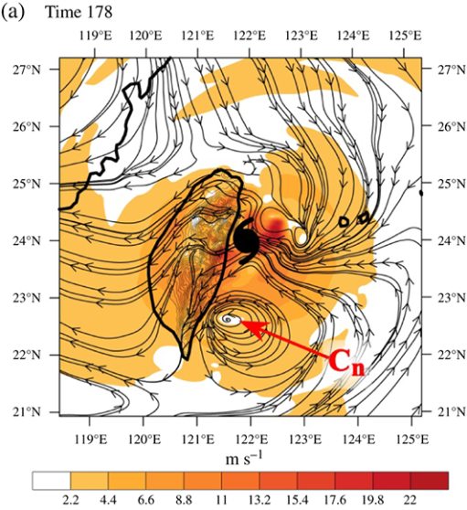
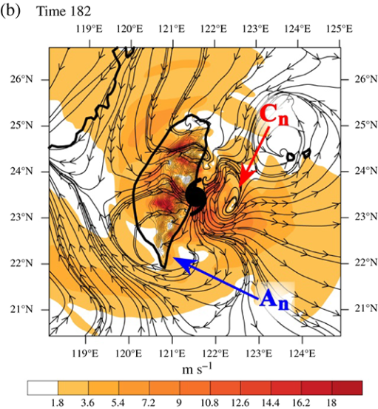
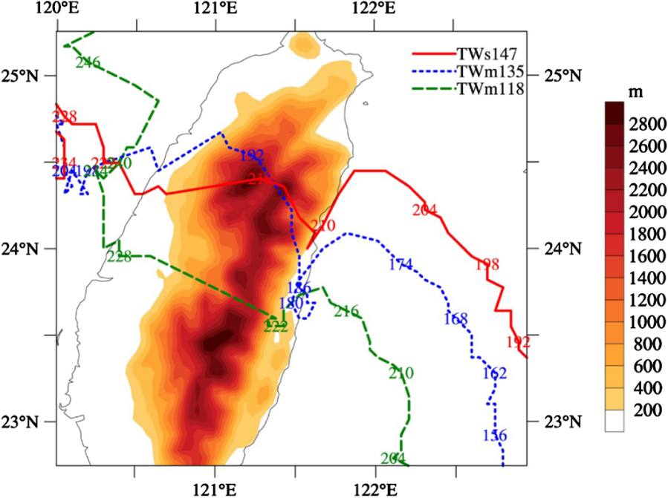
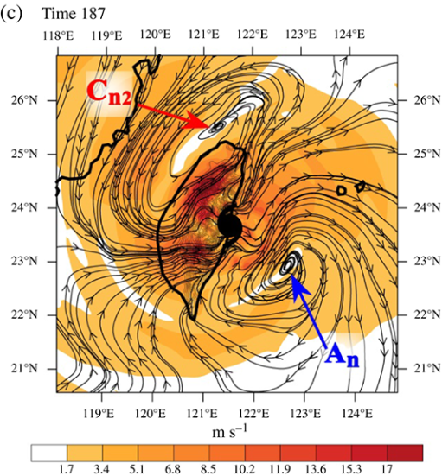
Flow associated with gyre pairs
  the presence of terrain can induce the formation of gyre pairs, leading to gyre-associated flow near the TC center that can influence the TC track prior to landfall.
A looping track occurs for a medium-size (R₁₅=350km) TC approaching central Taiwan and a V-shape track is found for a small-size (R₁₅=250km) TC approaching northern Taiwan.
Tang and Chan (2015)

Slide 7
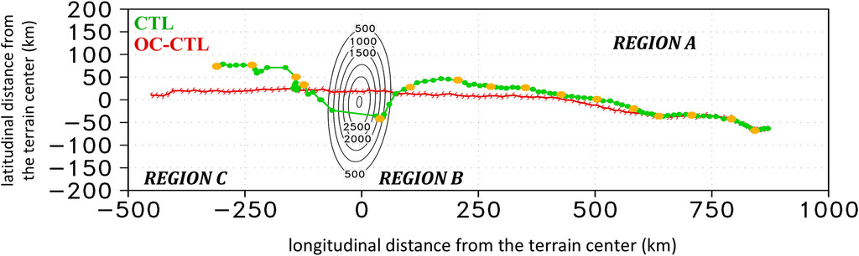
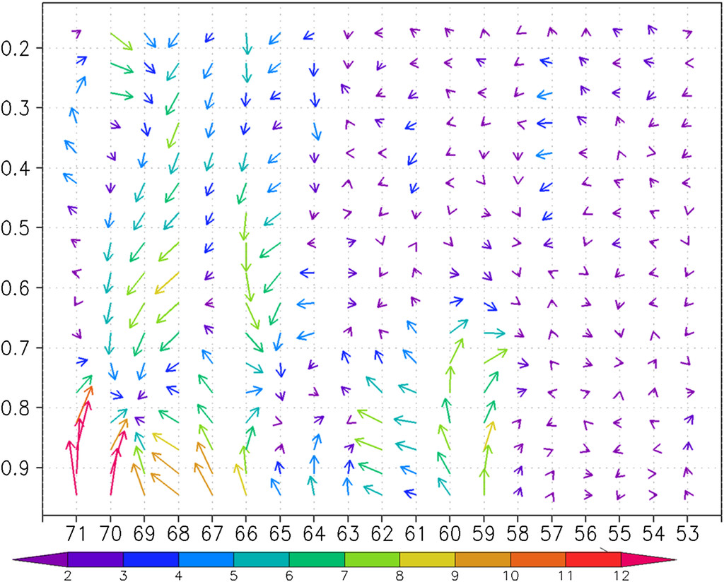
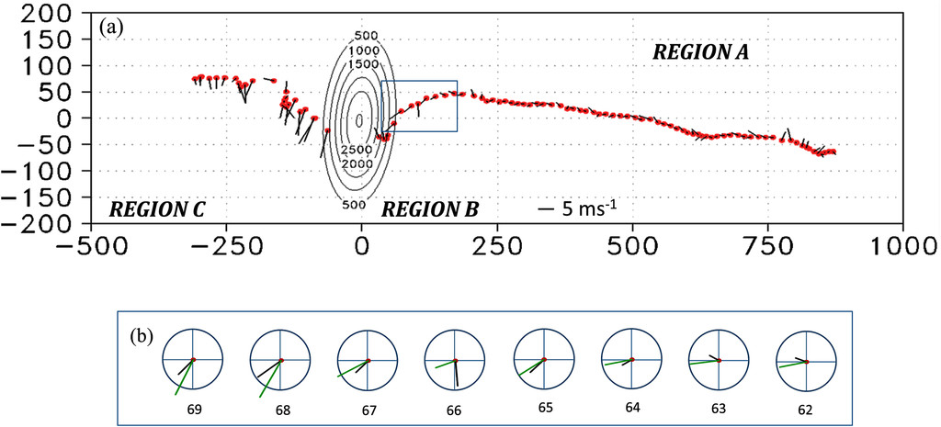
Vertical distribution of mean flows
66 h
60 h
54 h
Wu et al. (2015); Huang and Wu (2018)

Slide 8
Motivation
Previous studies have identified many key factors influencing the unique features caused by Taiwan's terrain.
However, the impact of terrain-induced flow on the inner-core evolution of a tropical cyclone (TC) with a semiparallel track to the eastern coast remains understudied.
The surrounding flow of the TC modulated by the terrain can influence its track, suggesting the possibility of its impact on the vertical wind shear (VWS).
The key directions for further exploration in this study are the roles of VWS and the interaction between the terrain-induced flow and the primary circulation of the TC. These aspects are crucial in understanding the inner-core evolution and intensification of TCs near Taiwan's terrain.
For a comprehensive investigation, it is crucial to accurately estimate the vertical distribution of mean flows near a TC with high temporal and spatial resolution.

Slide 9
Data and methodology
Data
  Reflectivity (APAR, RCKT, RCGI, RCHL and RCWF)
  Doppler velocity (RCKT, RCGI, RCHL and RCWF)
  Weather station
Doppler velocity dealiasing
  Vortex-Based Doppler Velocity Dealiasing Algorithm (VDVD) (Chang et al. 2019)
Wind retrieval
  Dual-Doppler synthetic wind
  GBVTD (ground-based velocity tracking display) (Lee et al. 1999)
Track
  Tropical Cyclone Eye Tracking (TCET) (Chang et al. 2009)

Slide 10
Results
Inner-core evolution
Eyewall asymmetry and VWS
Possible intensification mechanisms

Slide 11
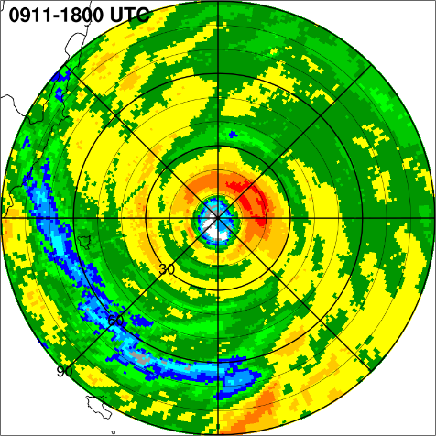
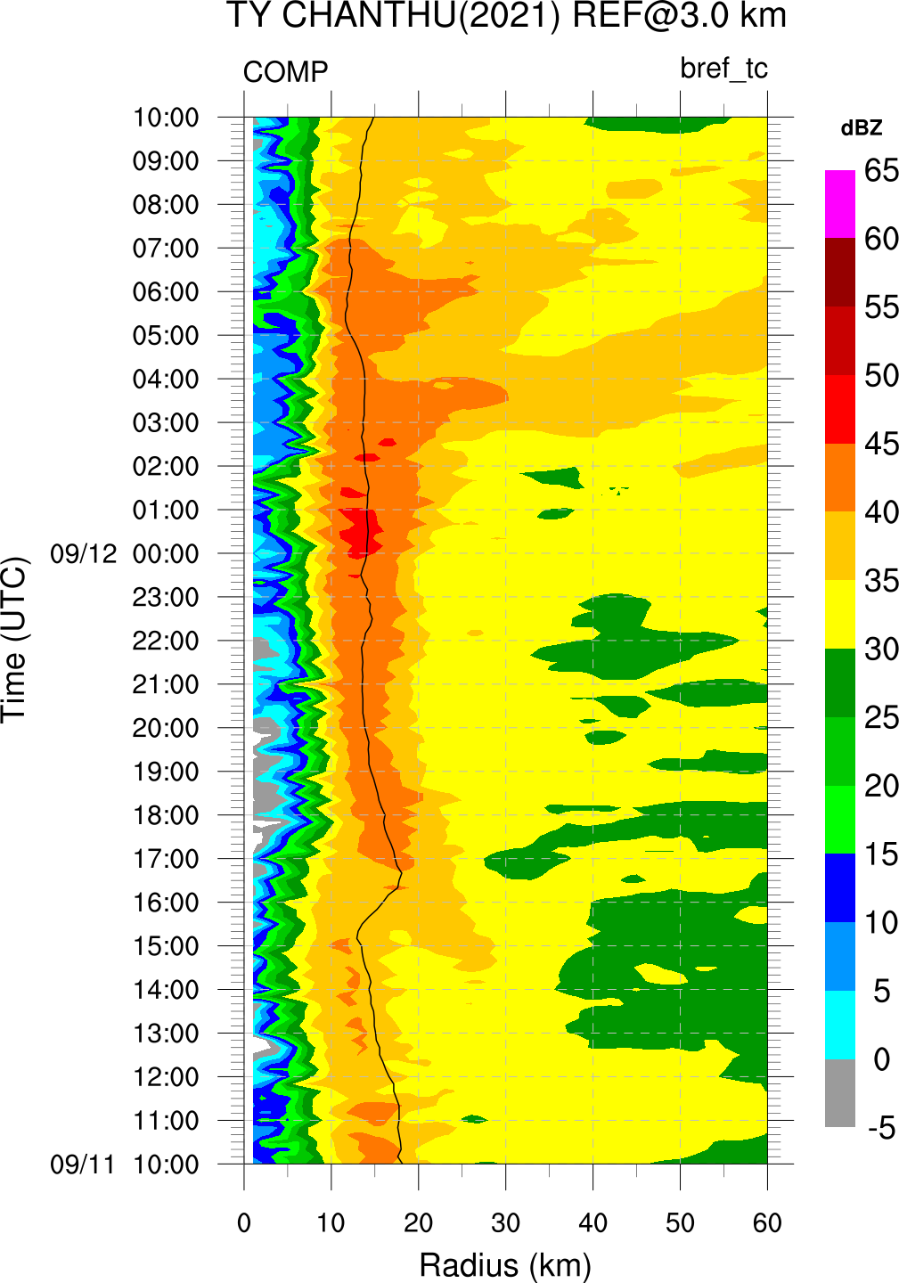
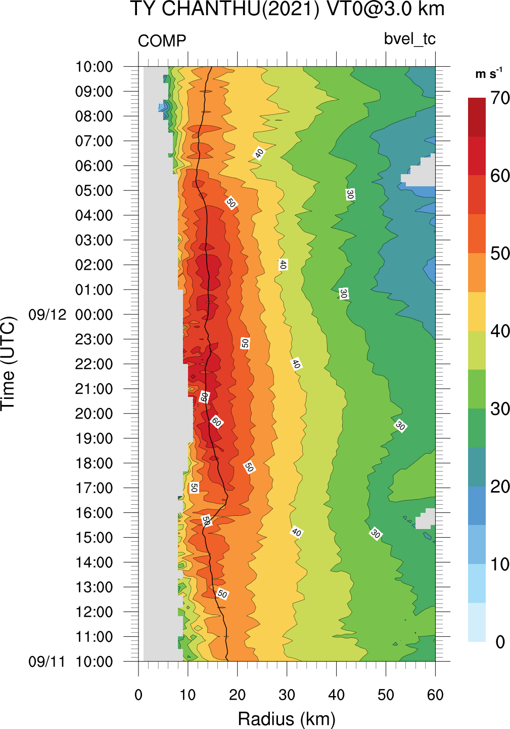
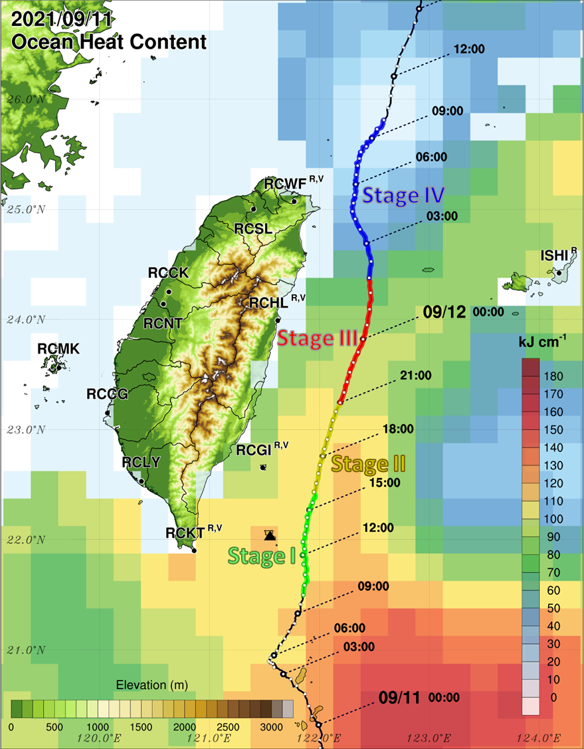
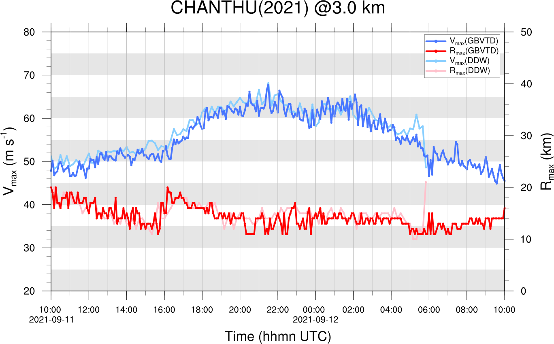
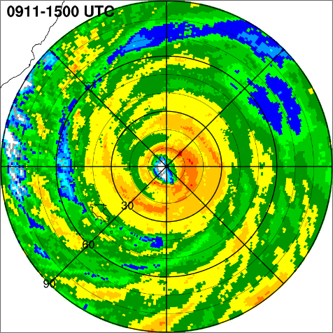
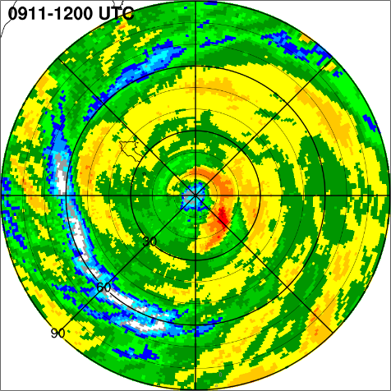
Overview of TY Chanthu(2021)
Rapid intensification: 30 kt day⁻¹ (Kaplan and DeMaria 2003)
or 20 kt (12 hr)⁻¹ (Kaplan et al. 2015)
GBVTD VT0@ 3km
- Rapid weakening: 20 kt day⁻¹ (DeMaria et al. 2012)
Azimuthal mean
reflectivity@ 3km
Stage IV
Stage I
Stage II
Stage III
Stage IV
Peak
Intensifying
Weakening
~19 m s⁻¹
~18 m s⁻¹
Stage III
Stage II
Stage I
Before and during the RI period, the energy supply from the ocean only changed slightly.
The eyewall convection with wavenumber-1 asymmetry and a sudden change in orientation may be attributed to vertical wind shear (VWS).
Track determined by the tropical cyclone eye tracking (TCET) algorithm

Slide 12
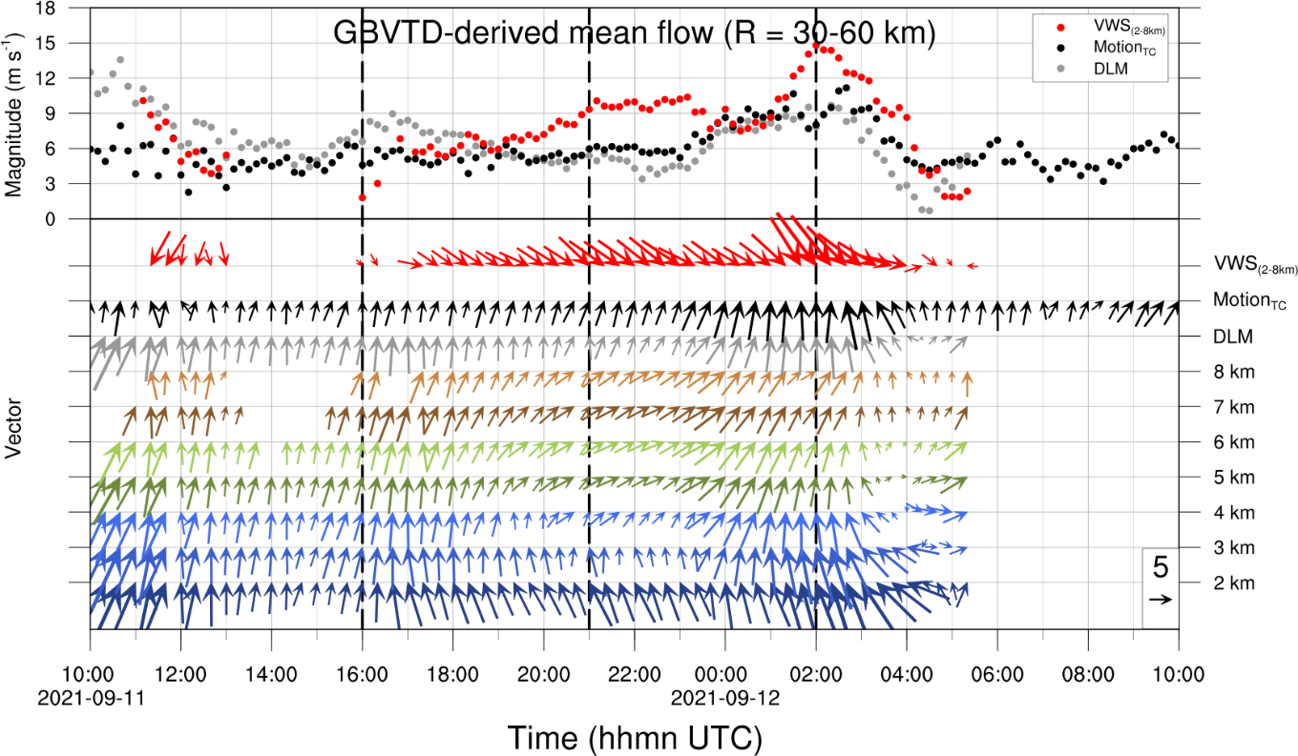
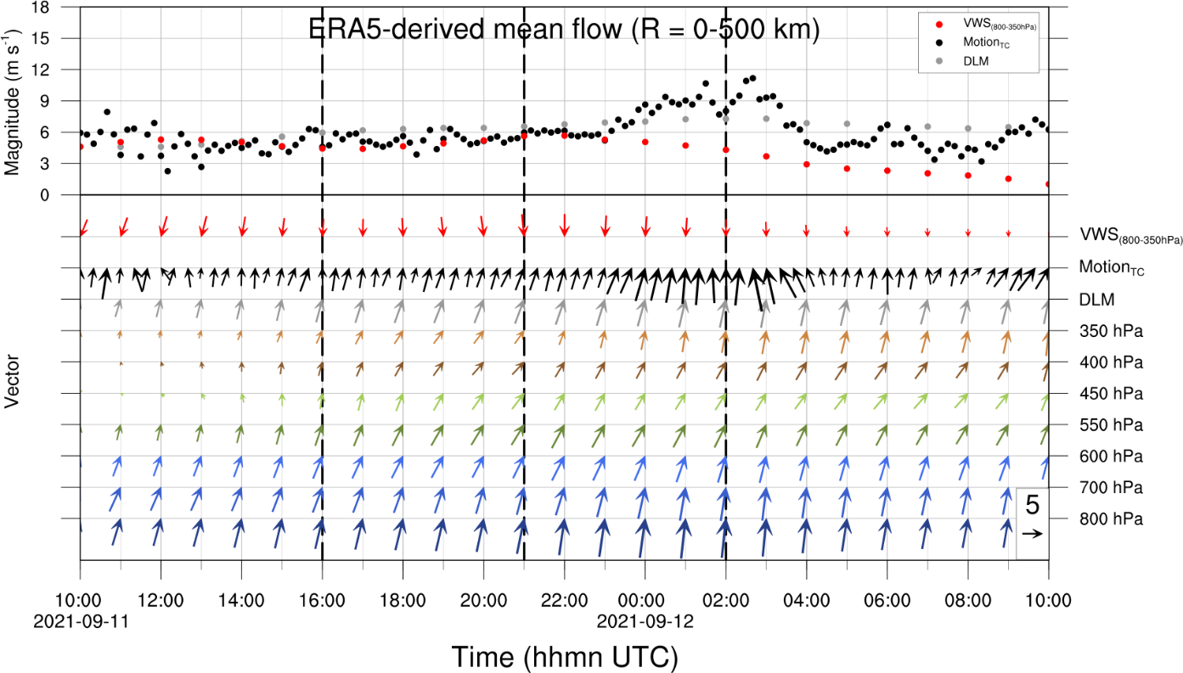

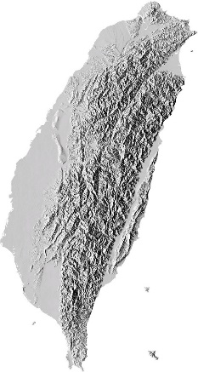


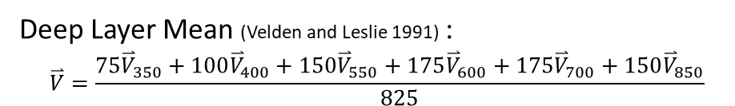
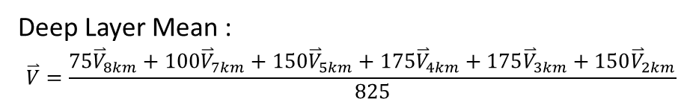
Deep-layer(2-8km) mean flow and VWS
Radar-derived
ERA5-derived
Deep Layer Mean :
$$\overset{⃑}{V}=\frac{75{\overset{⃑}{V}}_{8km}+100{\overset{⃑}{V}}_{7km}+150{\overset{⃑}{V}}_{5km}+175{\overset{⃑}{V}}_{4km}+175{\overset{⃑}{V}}_{3km}+150{\overset{⃑}{V}}_{2km}}{825}$$
Deep Layer Mean (Velden and Leslie 1991) :
$$\overset{⃑}{V}=\frac{75{\overset{⃑}{V}}_{350}+100{\overset{⃑}{V}}_{400}+150{\overset{⃑}{V}}_{550}+175{\overset{⃑}{V}}_{600}+175{\overset{⃑}{V}}_{700}+150{\overset{⃑}{V}}_{850}}{825}$$
Stage I
Stage II
Stage III
Stage IV
Stage I
Stage II
Stage III
Stage IV
Terrain-induced direction change of lower-level flow
(Wu et al. 2015; Huang and Wu 2018)
meso-β scale
meso-α scale
Mean state of
30 km~60 km
(2RMW~4RMW)
Mean state of
0 km~500 km

Slide 13
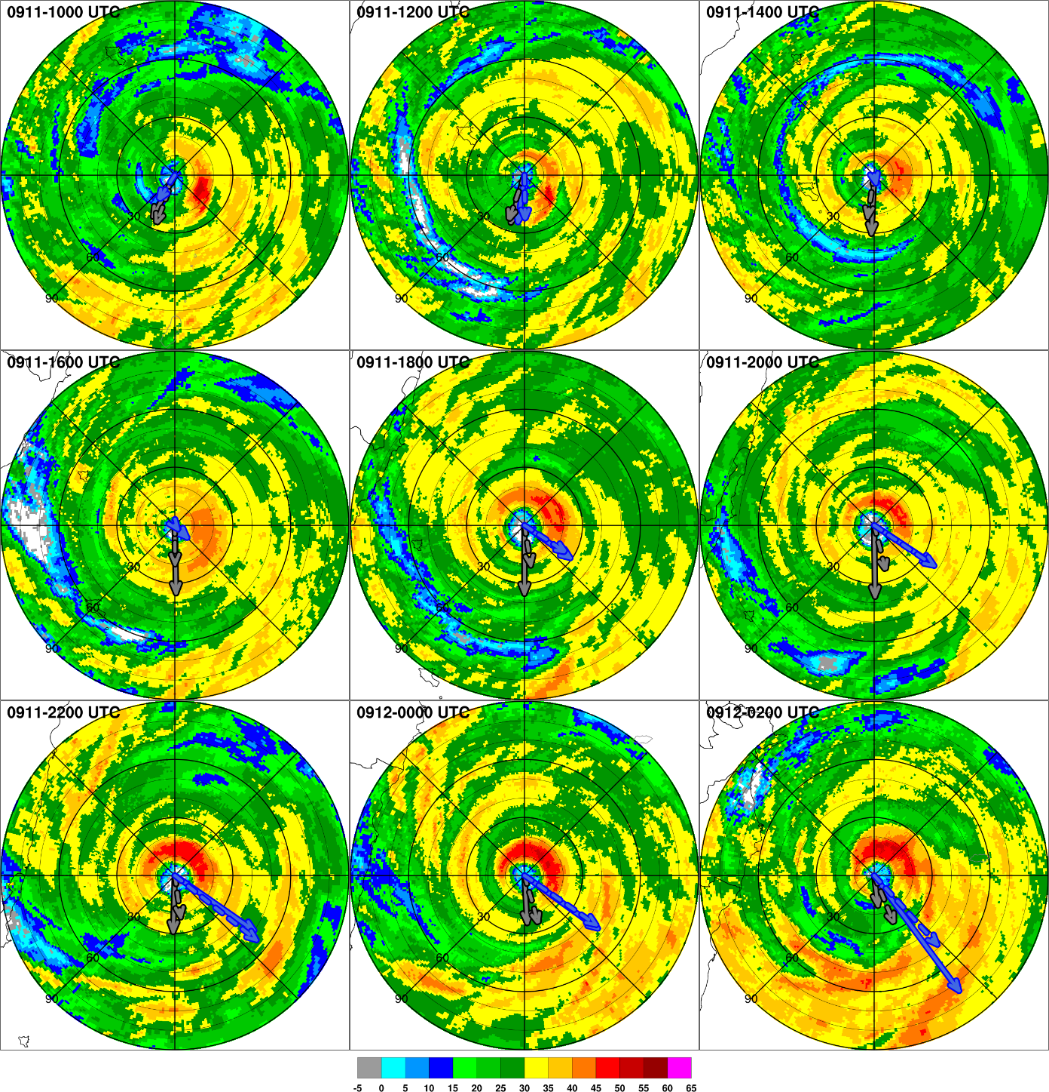
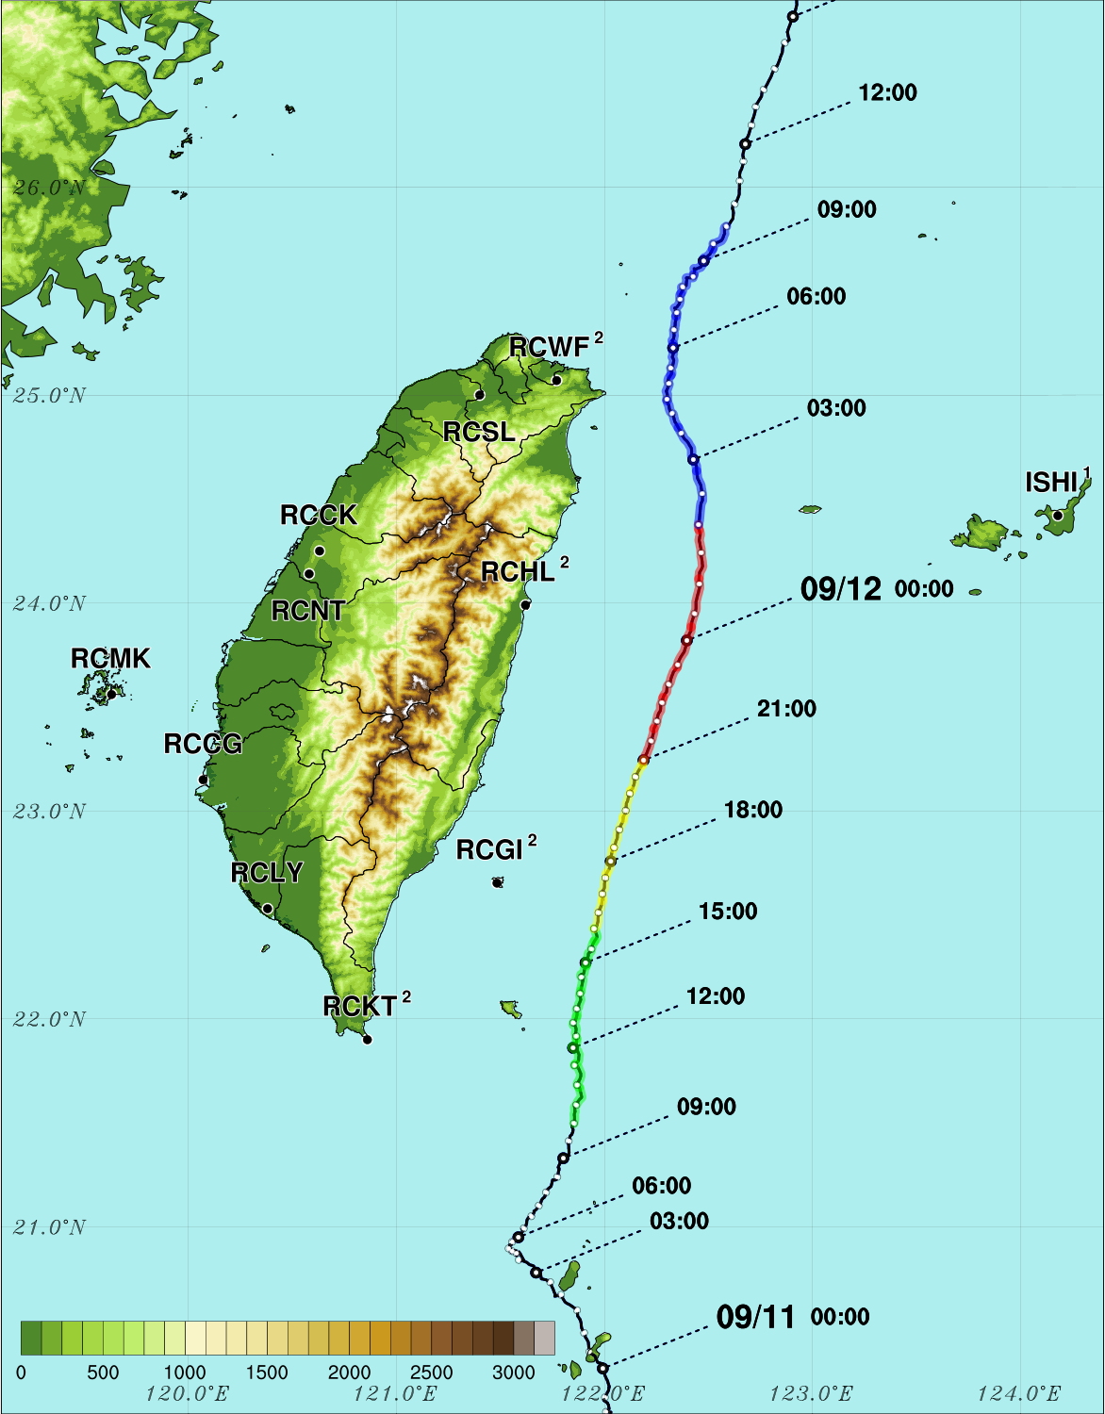
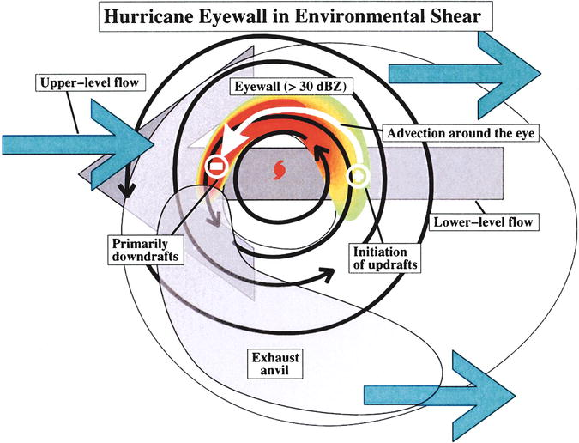
Eyewall asymmetry evolution
Vertical wind shear
ERA5 (2-8 km)
ERA5 (2-5 km)
Radar (2-8 km)
Radar (2-5 km)
Black et al. (2002)
Eastin et al. (2005)

Slide 14
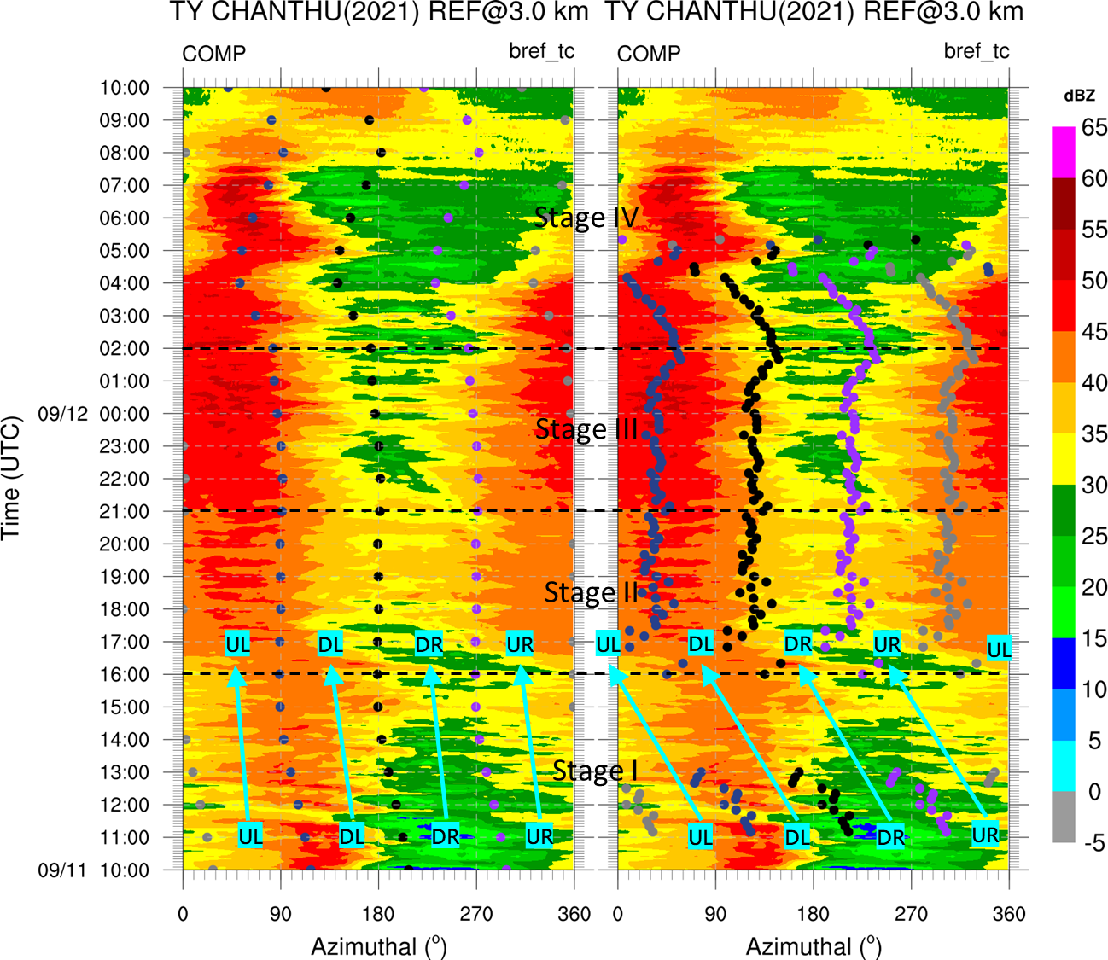
Eyewall asymmetry and deep-layer VWS
Mean reflectivity (RMW±2 km)
Downshear
Shear-left
Upshear
Shear-right
ERA5-derived VWS
Radar-derived VWS
The GBVTD-derived meso-β scale VWS can properly reflect the sudden change caused by the terrain and agrees better with the TC eyewall asymmetry.
When the TC was near the Taiwan terrain, the applicability of the ERA5-derived meso-α scale VWS may have been reduced.
(N)
(E)
(S)
(W)
(N)
(E)
(S)
(W)
Black et al. (2002)
Eastin et al. (2005)

Slide 15
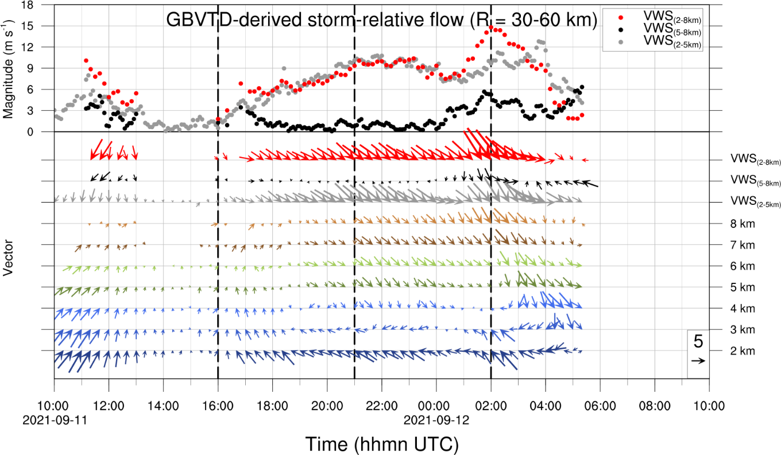
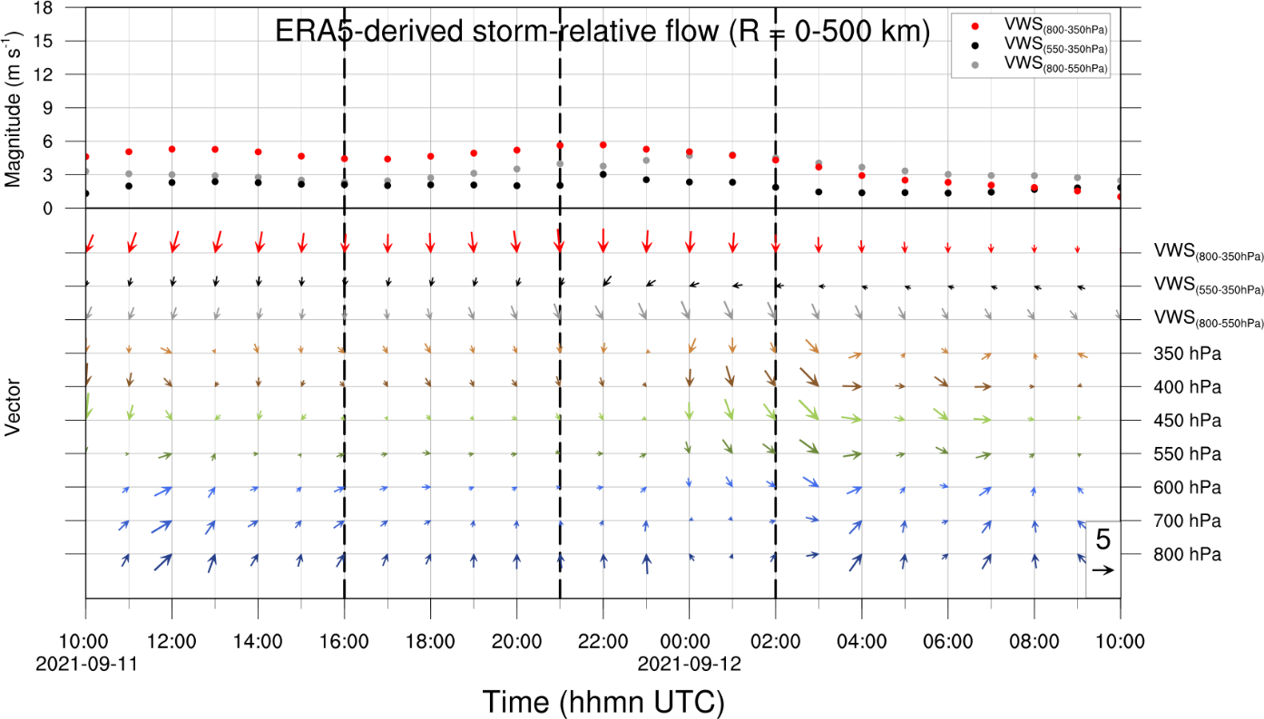
Storm-relative mean flow and lower(2-5km) and upper(5-8km) VWS
Radar-derived
ERA5-derived
Significant difference between lower- and upper-layer VWS magnitude
The magnitude of Lower- and upper-layer VWS are similar
Stage I
Stage II
Stage III
Stage IV
Stage I
Stage II
Stage III
Stage IV
meso-β scale
meso-α scale
Mean state of
30 km~60 km
(2RMW~4RMW)
Mean state of
0 km~500 km

Slide 16

Low-level flow direction
Intensifying
Peak
Weakening
Enhance surface heat fluxes in the downshear side
higher energy supply to the upshear-left convection
Stage I
Stage II
Stage III
Stage IV
GBVTD-derived
VWS
UL
UL
DL
UR
DL
UR
DR
DR
GBVTD-derived LLF
The UL-pointing low-level flow (LLF) favors fast intensification, while the DR-pointing LLF leads to slow intensification. (Rappin and Nolan 2012; Lee et al. 2021)

Slide 17
Lower-layer vs. upper-layer VWS
Intensifying
Peak
Weakening
Stage I
Stage II
Stage III
Stage IV
Lower-layer (2~5km) VWS
Upper-layer (5~8 km) VWS
The upper-layer shear is much more detrimental to the intensity of a mature tropical cyclone than the lower-layer shear. (Fu et al. 2019)

Slide 18
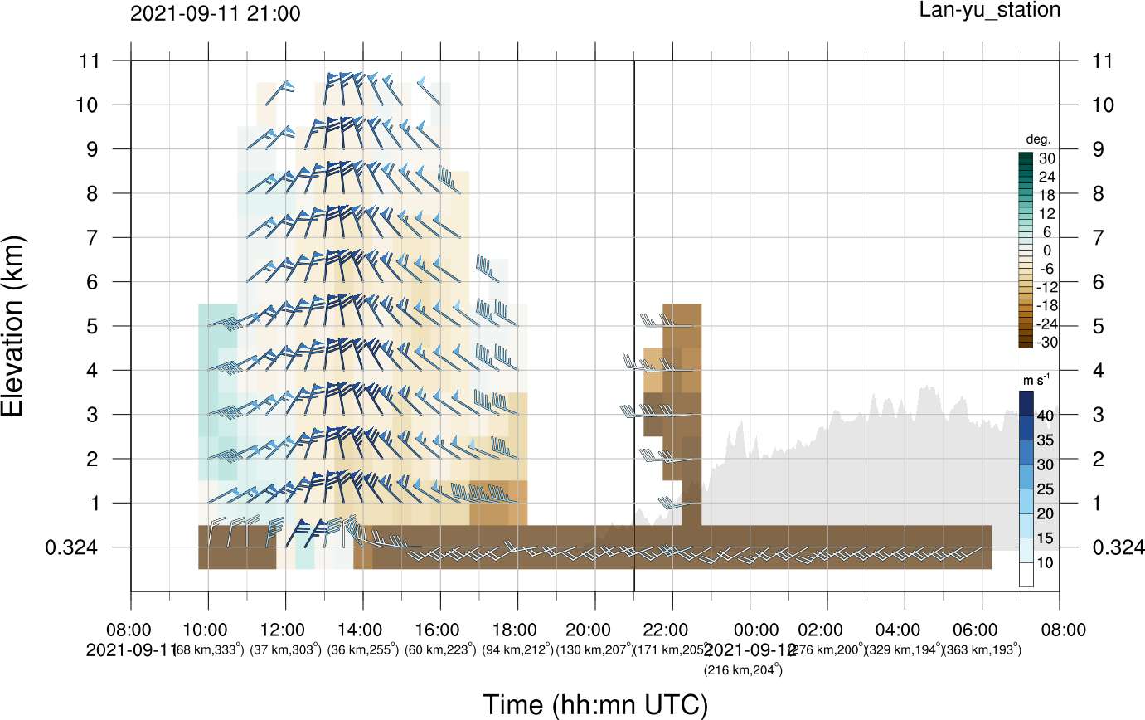
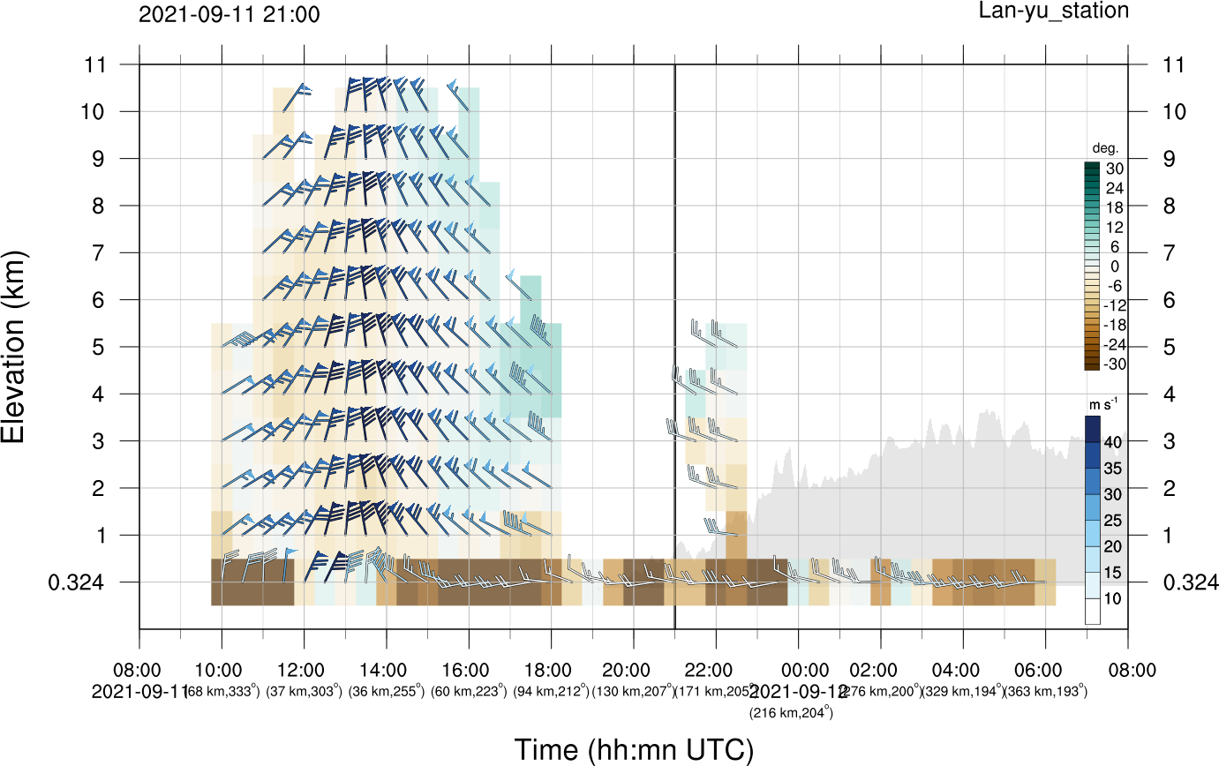
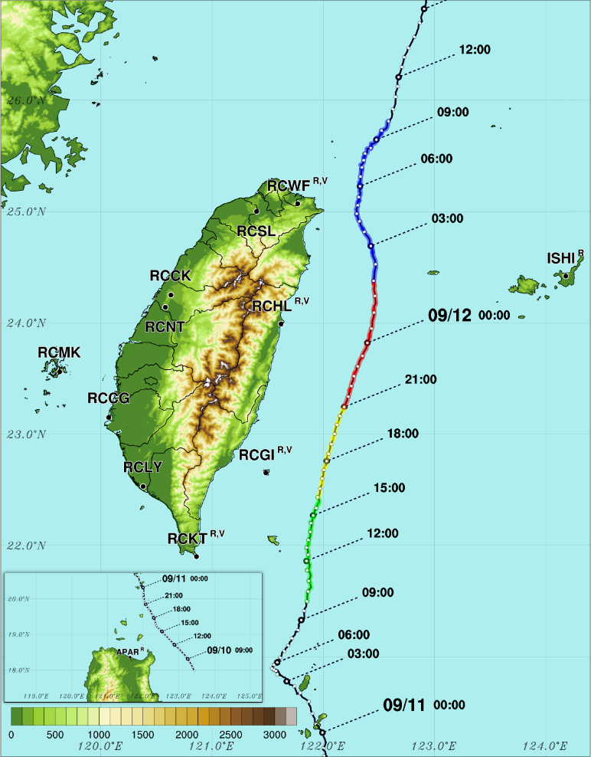
Terrain-induced low-level inflow
inflow
tangential
@Lan-yu station
Storm-relative
outflow
Stage I
Stage II
Enhance the convergence in the downshear-left quadrant
Stage III
Stage IV
UL
UR
DL
DR
Boundary layer LLF
Lan-yu station
Yeh and Elsberry (1993b)
Storm-relative
(surface wind)

Slide 19
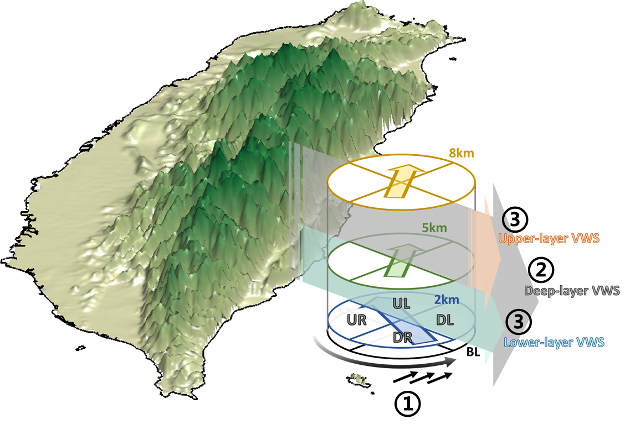
Schematic illustration
Terrain-induced boundary layer inflow
Upshear-left pointing low-level flow
Weak upper-layer vertical wind shear

Slide 20
Summary (1/2)
As Typhoon Chanthu (2021) passed through the east coast of Taiwan, a noticeable intensification was observed by the radar network around Taiwan.
During the intensification stage, the horizontal wind speed at an altitude of 3 km exhibited a rapid increase of approximately 18 m s⁻¹ within an 11-hour period, indicative of RI. At the peak of the intensification stage, the maximum wind speed exceeded 65 m s⁻¹, with a RMW of only 12 km.
During the intensifying stages, a significant rotation of the eyewall convection maximum in Typhoon Chanthu occurred, transitioning cyclonically from the eastern to the northern semicircle at 1600 UTC on Sep 11, coinciding with the completion of an apparent ERC.
Simultaneously, the terrain-induced west-southwestly boundary inflow from the south of the TC was initiated. Additionally, it was observed that the LMF rotated from southwesterly to southeasterly. Both modifications in the flows are suggested to be influenced by the terrain.
The analysis of mean flow reveals that the meso-β scale VWS derived from the GBVTD can effectively capture the abrupt changes induced by the terrain and is consistent with the observed eyewall convection asymmetry. In contrast, the meso-α scale VWS derived from the ERA5 shows only minor directional changes throughout the analyzed period, resulting in the maximum reflectivity being located on the upshear side.

Slide 21
Summary (2/2)
Based on the analyses conducted in this study, the factors that possibly contributed to the intensification of Typhoon Chanthu are:
  Terrain-induced boundary inflow south of the TC
    The terrain-induced boundary inflow and the primary circulation of the TC may potentially converge in the southeastern quadrant of the TC’s eyewall within the boundary layer, subsequently enhancing the convection on the downshear side of the TC.
  UL-pointing low-level flow
    The directions of VWS and low-level flow are counteraligned, surface heat fluxes can be enhanced on the downshear side, offsetting the ventilation effect in the UL quadrant.
  Weak upper-level VWS
    Stronger upper-level VWS hampers TC intensification by weakening the warm core through ventilation in the middle-upper troposphere.

