Slide 1
Radar Observations of Tropical Convection in GATE, TOGA-COARE, and DYNAMO
Robert Houze University of Washington
Presented at American Meteorological Society Annual Meeting, February 1, 2024

Slide 2
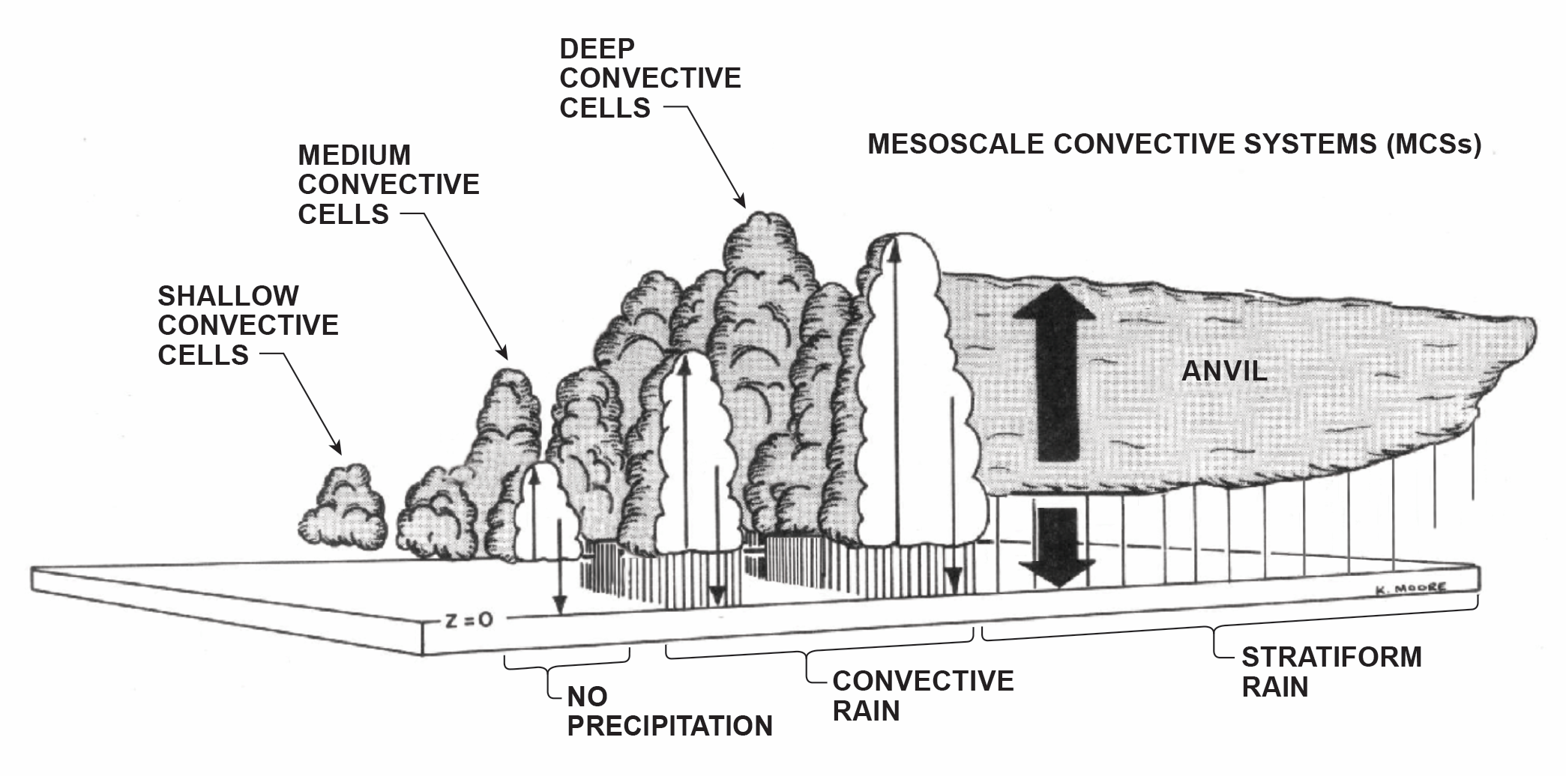
Tropical Oceanic Convective Cloud Population
Houze et al. (1980)

Slide 3
Zipser 1969

Slide 4
Oceanic Field Campaigns
20 N
10
EQ
20 S
150 W
120
90
60 W
30
0
30
60
90
120
150
GATE
1974
13 Aircraft
39 Ships
DYNAMO
2011-12
2 Aircraft
5 Ships
TOGA- COARE
1992-93
7 Aircraft
9 Ships
WMONEX
1978
1 Aircraft
3 Ships

Slide 5
GATE and WMONEX
Digital Radar Reflectivity Processing
Quantitative Precipitation and 3D structure

Slide 6
GATE 4 September 1974
NOAA Ship Researcher

Slide 7
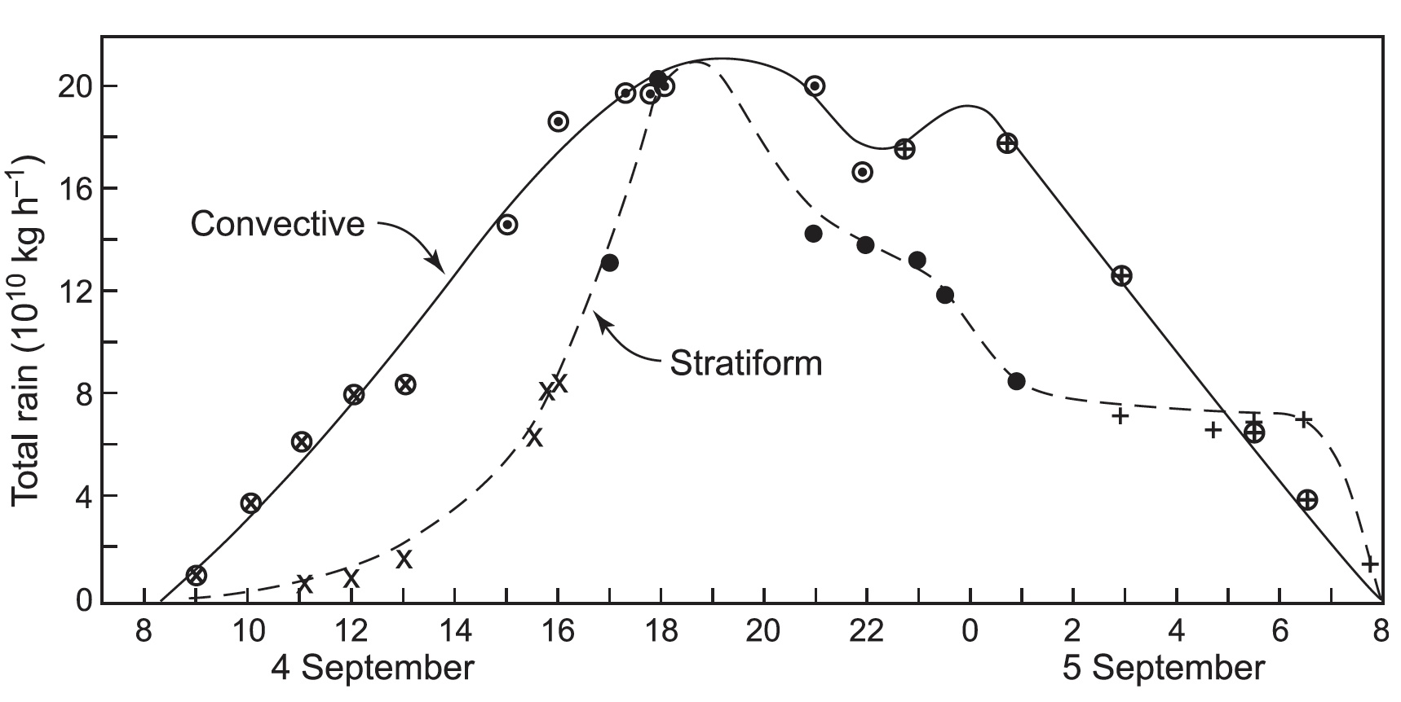
Precipitation Measured by GATE Radars
Houze 1977

Slide 8
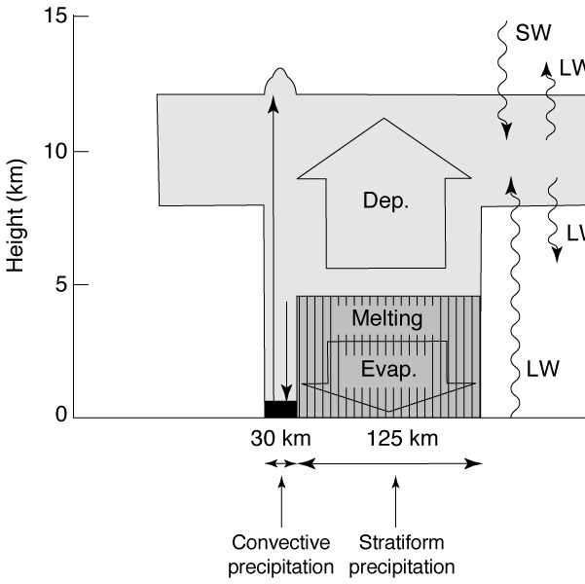
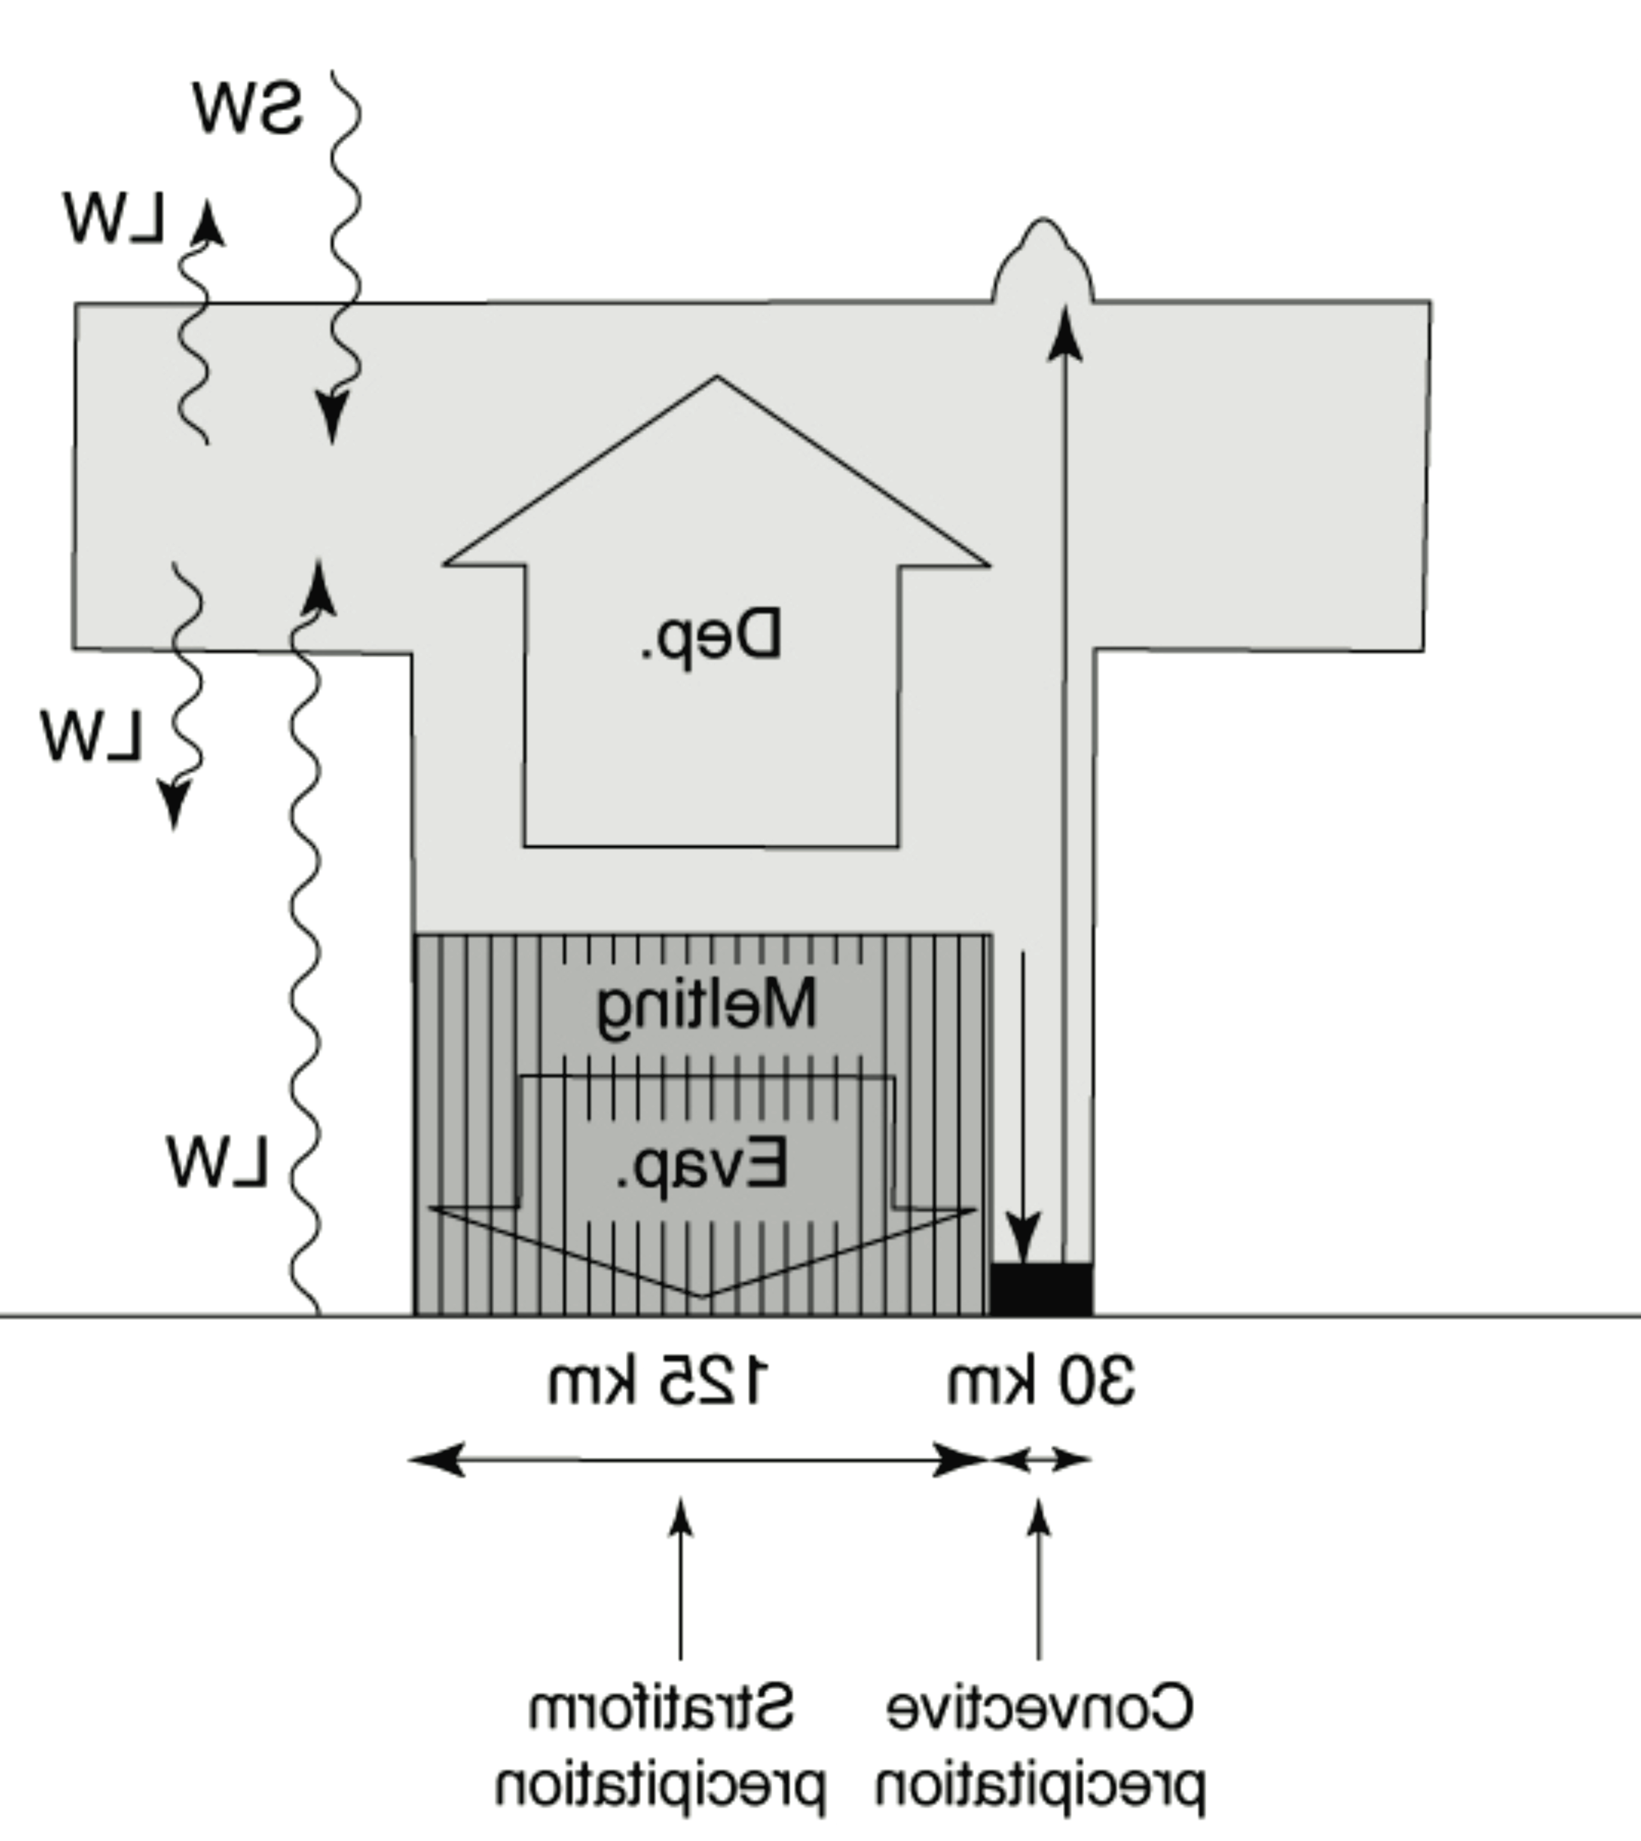
Deductions based on GATE and WMONEX radar observations
SW
MCS concentrates heating aloft
Cloud
warming
Deposition
LW
cooling
Melting
LW
Evaporation
125 km
30 km
~40%
Stratiform precipitation
Convective precipitation
Houze 1982

Slide 9
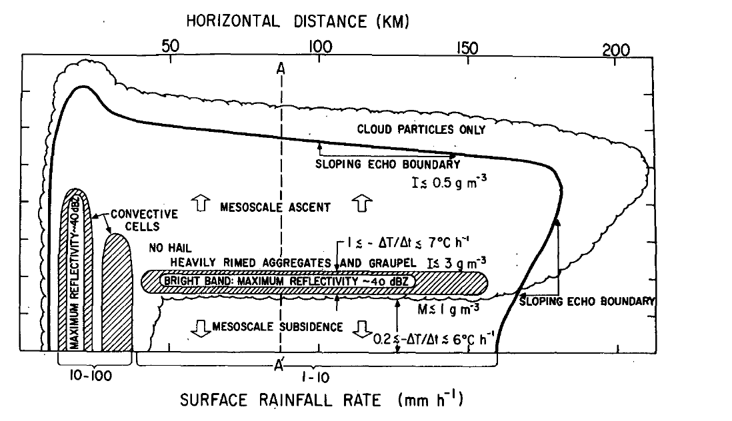
Microphysical Deductions Based on GATE Radar
Leary and Houze 1979

Slide 10
TOGA-COARE
Doppler Radar
Precipitation + Doppler Velocity

Slide 11
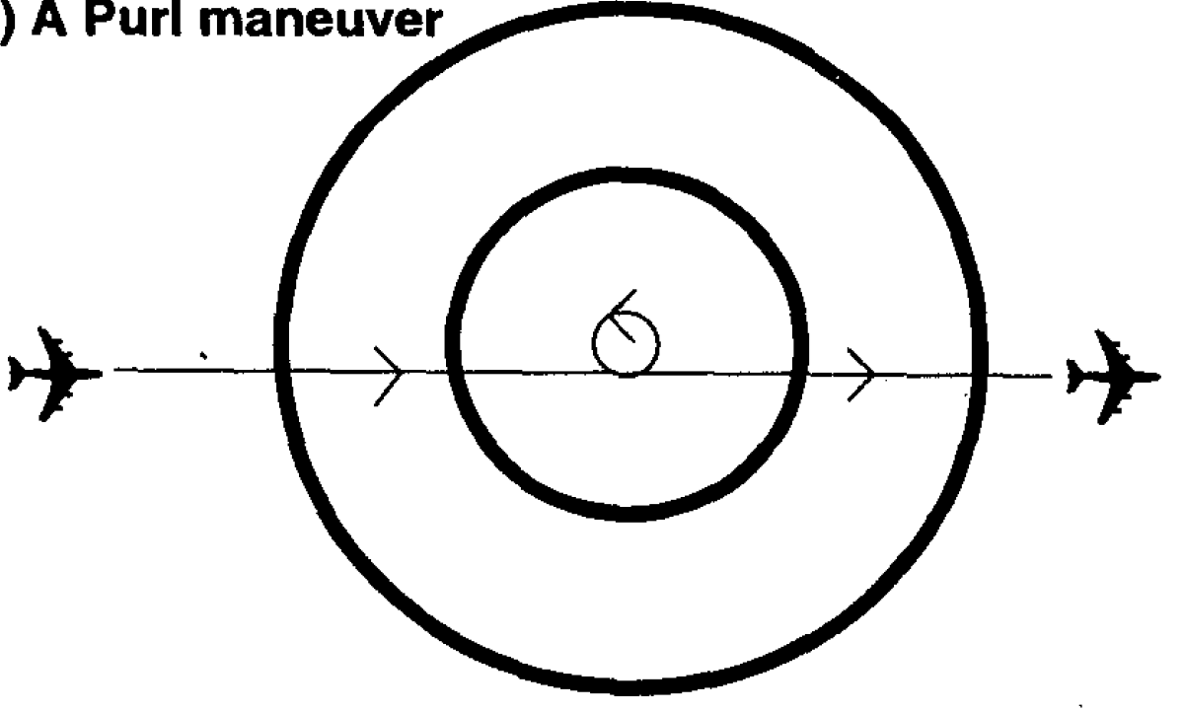
The Airborne Single Doppler Radar Purl Maneuver
Doppler Velocity
The purl maneuver yields an accurate direct measurement of radial velocity and hence divergence
Mapes and Houze 1995

Slide 12
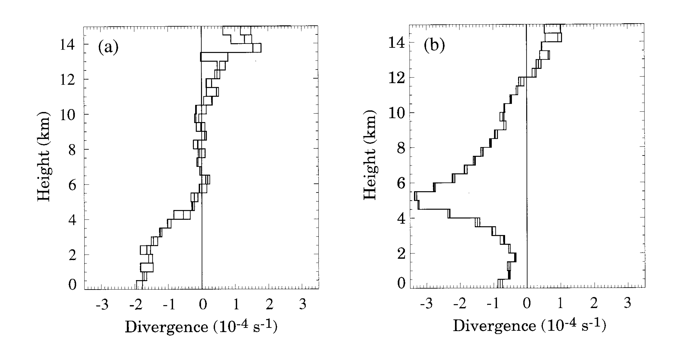
TOGA COARE aircraft purls showed top-heavy heating important in disturbed regions of MJO
Convective
Stratiform
Divergence profiles from airborne Doppler radar measurements
Graphs provided by Brian Mapes Dataset and Methodology in Mapes and Houze 1995

Slide 13
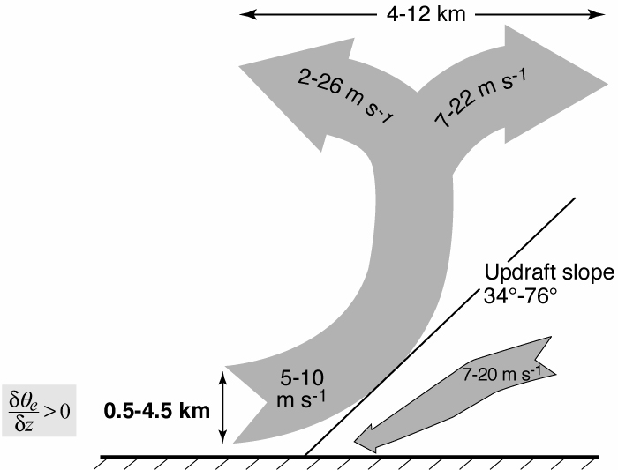
TOGA COARE
Airborne Dual-Doppler Analyses of MCSs
25 convective region flights
Deep layer
of inflow
<
Kingsmill & Houze (1999)

Slide 14
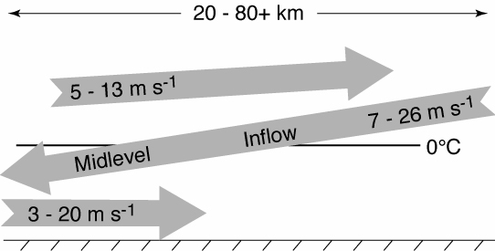
TOGA COARE
Airborne Dual-Doppler Analyses of MCSs
25 stratiform region flights
Direction of midlevel inflow determined by direction of large-scale flow—not orientation of a convective line
Kingsmill & Houze (1999)

Slide 15
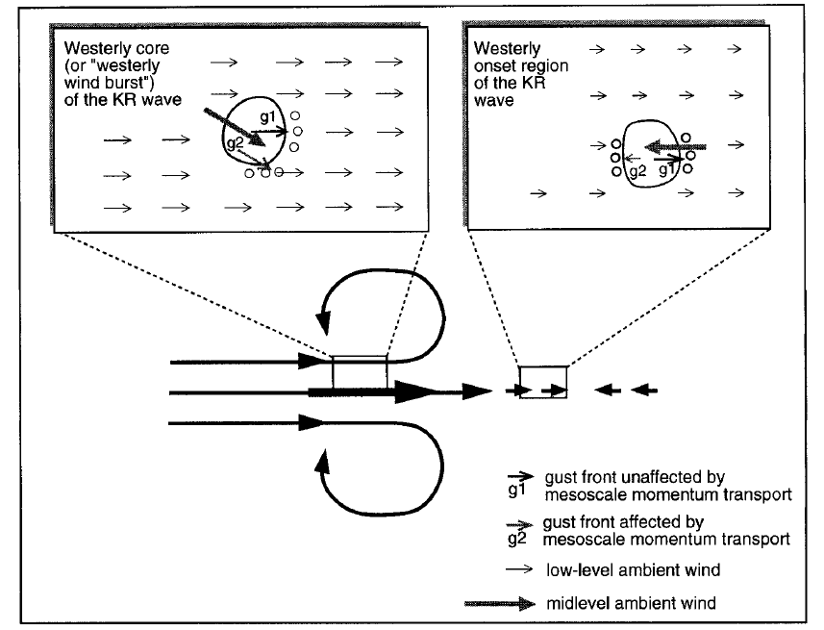
TOGA COARE
Shipborne Doppler Radars in Relation to MJO
Houze, Chen, Kingsmill, Serra, Yuter, 2000

Slide 16
DYNAMO
Dual-Polarization Radar
Precipitation + Doppler Velocity + Microphysics

Slide 17
Microphysics of hydrometeors in MCSs from dual-polarization radar disturbed period of DYNAMO October MJO over the Indian Ocean
Non-oriented ice
Dry aggregates
Wet aggregates
Graupel
Non-oriented ice
Dry aggregates
Wet aggregates
Graupel
Convective
Stratiform
Percent of Particle ID
Rowe and Houze (2014)
Notes:
the particle identification (PID) algorithm provides only the probable dominant type, but will provide a sense of the general microphysical characteristics of precipitating echo observed by S-PolKa

Slide 18
Summary
1970’s → GATE & WMONEX → 3D radar reflectivity
Quantified stratiform and convective precipitation
Implied heating maximized aloft
Indicated stratiform microphysics
1990’s → TOGA COARE → Doppler radar
Airborne & Ship Doppler radars
Measured divergence in convective and stratiform regions
Measured inflow and outflow layers of MCSs in MJO
2010’s → DYNAMO → Dual polarization radar
Vertical profiles of precipitation microphysical processes

Slide 19
End

