Slide 2
Outline
2
Data and Methods
3
4
Discussion and conclusions
1
Introduction
Results

Slide 3
Introduction

Slide 4
Introduction
A few studies have compared the environmental characteristics of RI and SI TCs, with varying outcomes.
Wang and Jiang (2021) conducted a longer climatological analysis of North Atlantic and eastern North Pacific TC environments using the Statistical Hurricane Intensity Prediction Scheme (SHIPS; DeMaria et al. 2005)
They found that RI events in the North Atlantic and eastern North Pacific had weaker vertical wind shear, larger 200-hPa divergence, larger low-level and midlevel relative humidity, and were farther away from their maximum potential intensities compared to SI events.
Notes:
過去比較少的研究針對RI跟SI個案來做比較
王跟江 針對北大西洋跟東太平洋進行長期的氣候分析
而他們發現RI的颱風具有 較小垂直風切 較大200輻散 在中低層有較高RH 且他們MPI>>SI個案

Slide 5
Introduction
Vertical wind shear tilts the TC vortex in the vertical and produces a wavenumber-1 asymmetry in convection, with convection enhanced downshear and suppressed upshear (Corbosiero and Molinari 2002, 2003; Chen et al. 2006; Hence and Houze 2012; Reasor et al. 2013)
Given the substantial influence of vertical wind shear on the TC structure and intensity, it is worth investigating how other factors could modulate the TC’s response to shear to hinder or promote RI.
Despite the overwhelmingly negative impacts of vertical wind shear on TC intensity, RI can proceed in moderate to high shear, as evidenced in observations (e.g., Zawislak et al. 2016; Ryglicki et al. 2018a) and simulations (e.g., Zhang and Tao 2013; Judt and Chen 2016; Rios-Berrios et al. 2018; Ryglicki et al. 2018b).
Notes:
垂直風切會使得颱風對流呈現wave number1特徵
下風切處對流被增強 而上風切處的被抑制
因為垂直風切對於颱風的結構以及強度有深遠的影響
因此相當值得探討其他因素在具風切環境下的颱風 如何阻礙或是促進颱風RI
雖然說垂直風切對於颱風強度具有負面效益
但是觀測及研究均指出 RI可以在中~高等風切環境下發生

Slide 6
Introduction
A greater azimuthal extent of convection allows for greater projection of latent heating onto the symmetric mode, which is more favorable for intensification when the convection occurs at and within the radius of maximum wind (Nolan and Grasso 2003; Nolan et al. 2007; Pendergrass and Willoughby 2009; Vigh and Schubert 2009; Rogers et al. 2013).
As such, factors that promote precipitation symmetrization are important to the intensification of sheared TCs (e.g., Rappin and Nolan 2012; Tao and Zhang 2014; Finocchio et al. 2016; Onderlinde and Nolan 2016; Zawislak et al. 2016; Munsell et al. 2017; Nguyen et al. 2017; Shimada et al. 2017; Rios-Berrios et al. 2018), and may be relevant for favoring RI versus SI.
Notes:
而在切方向上 對流分布的越廣 會使 潛熱加熱更加的軸對稱
當對流發生在RMW內時，使得颱風更適合增強發展
而使得降水分布更加軸對稱的因素則可能在具風切環境下的颱風顯得更加重要
且可能與颱風發生ＲＩ或ＳＩ有關

Slide 7
Introduction
Other factors such as midlevel relative humidity, low-level $θ_{e}$ and sea surface temperature (SST) can affect precipitation symmetry and intensification rates.
Multiple satellite-based studies have demonstrated that RI is most often associated with an increased azimuthal and areal coverage of precipitation and convection (e.g., Zagrodnik and Jiang 2014; Tao and Jiang 2015; Alvey et al. 2015; Tao et al. 2017; Fischer et al. 2018)
The convective characteristics of RI versus SI can be further clarified by comparing the evolution of convection of RI and SI TCs, while controlling for the effects of vertical wind shear and other parameters that influence RI.
Notes:
而像是 中層ＲＨ 低層相當位溫 ＳＳＴ 都可能影響到降水的對稱性及增強速率
許多衛星觀測研究指出 ＲＩ的發生伴隨切方向上降水和對流的分布面積增加
因此當我們控制垂直風切或是其他可能影響ＲＩ的因素時，ＲＩ跟ＳＩ的對流特徵可以更進一步藉由比較ＲＩ跟ＳＩ颱風對流的演變

Slide 8
Introduction
Although numerous studies have compared RI and non-RI TCs, few studies have compared RI and SI TCs.
Furthermore, prior studies compared RI and non-RI factors across a broad range of initial intensities, maximum potential intensities (MPIs), and vertical wind shear magnitudes. Given that these three factors exhibit significant controls on RI (e.g., Kaplan and DeMaria 2003; Kaplan et al. 2010)
Also, less is known about the temporal and spatial evolutions of these characteristics leading up to the start of RI.
The current study addresses the above considerations by employing an analog method that compares TCs that undergo RI with a set of analog TCs that have similar initial intensity, vertical wind shear, and MPI, but undergo SI. To the best of the authors’ knowledge, this is the first study that has sought to compare RI and SI TCs while directly considering similar shear and MPI environments along with initial intensities.
Notes:
雖然過去很多研究 比較ＲＩ跟非ＲＩ的個案
但很少研究比較ＲＩ跟ＳＩ
且過去的研究 ＲＩ跟非ＲＩ的個案初始強度，ＭＰＩ及垂直風切的量值差異很大
而這些因素都可能影響到颱風是否ＲＩ
同時也對於ＲＩ颱風開始前的空間及時間演變認識也很少
因此作者此研究會特別比較 ＲＩ跟ＳＩ颱風但是針對類似ＭＰＩ 初始強度 及垂直風切

Slide 9
Data and methods

Slide 10
Data and methods
Datasets
This study investigates TCs that developed in the North Atlantic basin during 1982–2019 and in the western North Pacific basin during 1990–2017. TC observations are obtained from the International Best Track Archive for Climate Stewardship (IBTrACS) dataset (Knapp et al. 2010).
The best track data are filtered so that all records of tropical waves, tropical depressions, subtropical and extratropical cyclones are removed. Additionally, any records within 100 km of land are removed to eliminate potential land interactions.
Notes:
熱帶波動 熱低 副熱帶低壓 溫帶氣旋移除
跟陸地距離＜１００公里移除

Slide 11
Data and methods
Datasets
Atmospheric fields are obtained from the fifth-generation European Centre for Medium-Range Weather Forecasts (ECMWF) Re-Analysis(ERA5; Hersbach et al. 2020).
ERA5 provides global data with a 0.28$°×$ 0.28$°$ horizontal grid spacing on 137 atmospheric levels up to a pressure of 0.01 hPa at 1-hourly temporal resolution.
To analyze TC convective characteristics, infrared (IR) brightness temperature data are retrieved from the GridSat-B1 dataset (Knapp et al. 2011)
GridSat-B1 IR brightness temperature data are available at a 3-hourly temporal resolution and 0.07$°×$ 0.07$°$ horizontal resolution.

Slide 12
Data and methods
b. Intensity change categories
Following Kaplan and DeMaria (2003), RI is defined as an increase in the maximum sustained wind speed of 30 kt or more in 24 h. For simplicity, this 30-kt threshold is applied across all basins. SI cases are defined as 24-h intensity changes between 10 and 15 kt.
The 15-kt upper bound, versus using 25 or 30 kt, allows for greater differentiation of factors that contribute to RI versus SI and accounts for the uncertainty in the best track intensity (Torn and Snyder 2012; Landsea and Franklin 2013).
This paper focuses on differences in the evolution of environmental and storm-scale characteristics associated with the first 24-h period of RI and SI that occurred in TCs. Doing so allows for a more straightforward comparison of TCs both leading up to and during the intensification period.
Notes:
ＳＩ定義為 １０～１５ｋｔ
不用２５或３０當上限 把ＲＩ跟ＳＩ區分更明顯
僅考慮第一次ＲＩ或ＳＩ

Slide 13
Data and methods
c. Analog selection and compositing method
The objective of the analog selection procedure is to find, for each RI case, a comparable SI case based on a small subset of environmental and TC characteristics that are important to TC intensity change: maximum potential intensity (MPI), vertical wind shear, and initial TC intensity.
For a particular RI case, this cost function is computed for every possible SI case pairing in the basin as follows:
where SHR is the magnitude of the vertical wind shear, MPI is the MPI, Vmax is the best track maximum wind speed, and $σ$ is the standard deviation of the variable for all eligible TCs.
Notes:
把ＲＩ跟ＳＩ個案 一一配對 定義一個COST function
先找一個RI個案 然後分別對每個SI個案都算一次

Slide 14
Data and methods
c. Analog selection and compositing method
The cost function quantifies the degree of similarity between an RI and SI case by summing the normalized differences in the intensity at t = 0h [first term on rhs of Eq. (1)], the normalized differences in vertical wind shear at t = 0, 6, 12, 18, and 24 h [second term on rhs of Eq. (1)], and the normalized differences in MPI at t = 0, 6, 12, 18, and 24 h [third term on rhs of Eq. (1)].
All SI cases are then ranked in order of suitability as an analog for an RI case based on the magnitude of their respective J values. The specific SI case that results in the minimum value of J is tentatively selected as the analog of the RI case. This procedure is repeated for each RI case.
In situations where one SI case is chosen as the best analog for multiple RI cases, the algorithm assigns the SI case to the RI case that has the largest minimized J (i.e., the “hardest” to match). Then, the algorithm determines the next best available SI analog for each of the remaining RI cases.
Notes:
第一項(紅線)是標準化 標度(在增強onset的時間點)
第二項(綠線)是標準化VWS 把t=0.6.12.18.24都加起來
第三項(藍線)是標準化MPI 把t=0.6.12.18.24都加起來
挑出一RI個案 SI每個都算一次 J最小的 兩者配對
但是當一個SI個案配對到很多颱風時 , 則比較每個配對時那個最小值 找出當中最大的 作為配對

Slide 15
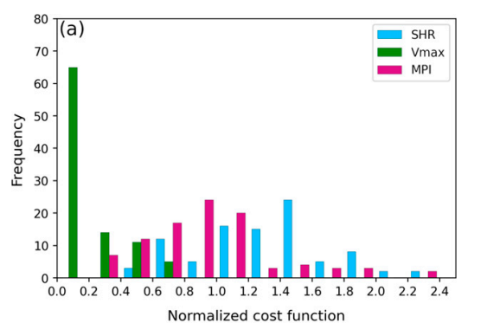
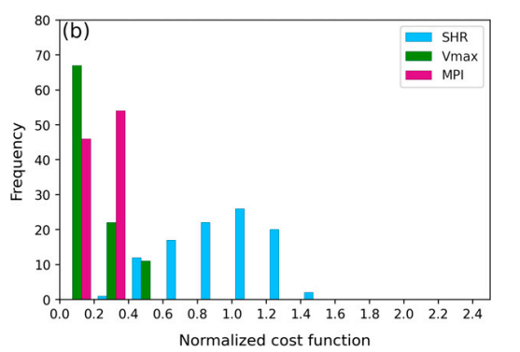
Data and methods
Figure 1 shows the distribution of the three components of J for the final set of analog TCs in each basin.
The distributions indicate that, on average, vertical wind shear differences make the largest contribution to the total cost function in both basins, particularly the western North Pacific.
This pattern suggests that it is more difficult to find RI and SI TCs that have similar 24-h vertical wind shear evolutions compared to the initial intensity and 24-h MPI evolutions, likely due to the more variable nature of vertical wind shear.
North Atlantic
western North Pacific
Notes:
分別秀出 cost fuction 3項 分別的frequency
垂直風切(藍色) 分布最廣, 也占了cost function量值中的最大部分 尤其是西太
而此圖亦顯示出 要找到跟RI個案具有相同VWS變化的SI個案最為困難

Slide 16
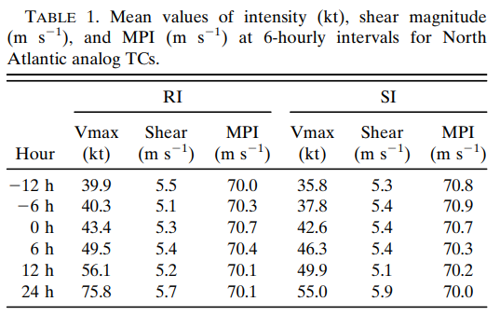
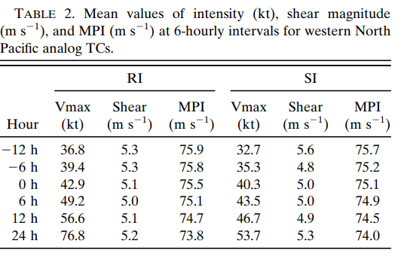
Data and methods
North Atlantic
West North Pacific
Notes:
由圖可見 不管事北大西洋或是西太
RI跟SI颱風 RI SI前後 的垂直風切 MPI其實都差不多
在增強前RI的強度略略高於SI
但增強後RI個案>MPI
同時發現甚至增強 onset之前 12小時 SI的增強速率略大一點

Slide 17
Results

Slide 18
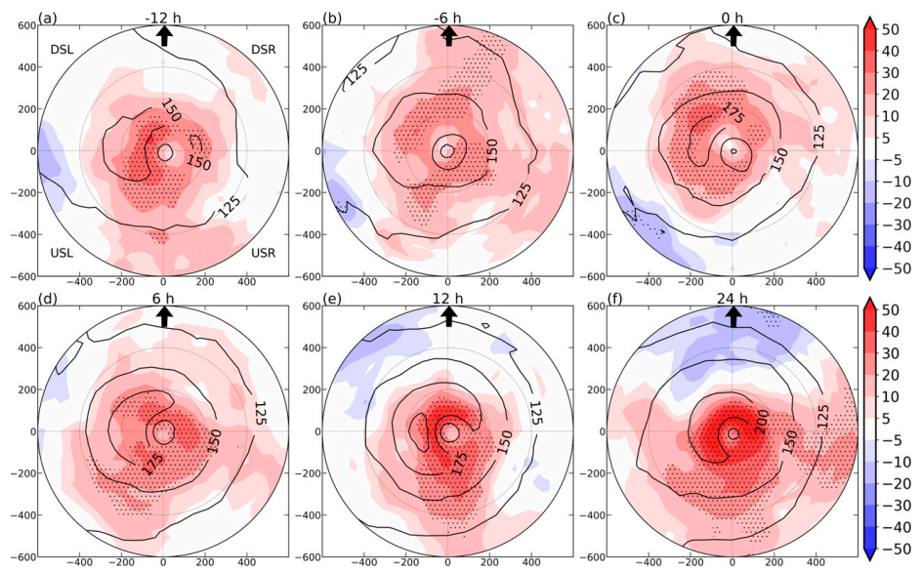
Results
This analysis focuses on the latent heat flux component of the total surface enthalpy flux, since latent heat fluxes dominated over sensible heat fluxes in the TC environments (e.g., Jaimes et al. 2015; Gao et al. 2016; Nguyen et al. 2019).
SURFACE FLUXES (North Atlantic)
The mean surface latent heat fluxes tend to be larger in the left-of-shear quadrants than right-of-shear quadrants.
RI TCs generally have larger surface latent heat fluxes at all azimuths. Statistically significant positive differences are mostly present within 400 km of the TC center and are most pronounced in the inner-core region, within 200 km of the TC center.
At and before 0 h, the largest positive differences are generally confined to the left-of-shear quadrants, particularly downshear left, within the innermost 200 km. After 0 h, positive differences amplify in all quadrants within the innermost 200 km.
Notes:
這邊探討近地面的一些通量
而由於 surface LF >> 可感熱通量 而占了大部分 enthalpy flux
這邊主要關注 LF
而在大多數時間 mean LHF 風切左側都較大
而RI的颱風在各象限都有較大(紅)的LHF 在400公里內大多數具有統計顯著性 尤其在200公里內更顯著
而在增強開始前 LHF差異較大的地方(較紅)落在左側 尤其200公里內
而在增強開始後則擴到所有現象 200公里內

Slide 19
Results
SURFACE FLUXES (North Atlantic)
RI TCs are associated with larger magnitudes of surface latent heat fluxes leading up to RI onset and increasing azimuthal symmetry of surface latent heat fluxes during the 24-h intensity change period.
Recent studies have shown that enhanced surface enthalpy fluxes in left-of-shear quadrants of RI TCs is a more favorable thermodynamic configuration for overcoming the effects of downdraft-induced low entropy air in left-of-shear and upshear quadrants (e.g., Wadler et al. 2018b, 2021).
Notes:
RI的颱風在增強前就有較大的LHF
且增強開始後 LHF的軸對稱性開始增加
過去研究指出下沖流帶入低相當位溫至左側或上風切處而,而風切左側 的通量增加 可克服前述對於颱風增強的負面作用

Slide 20
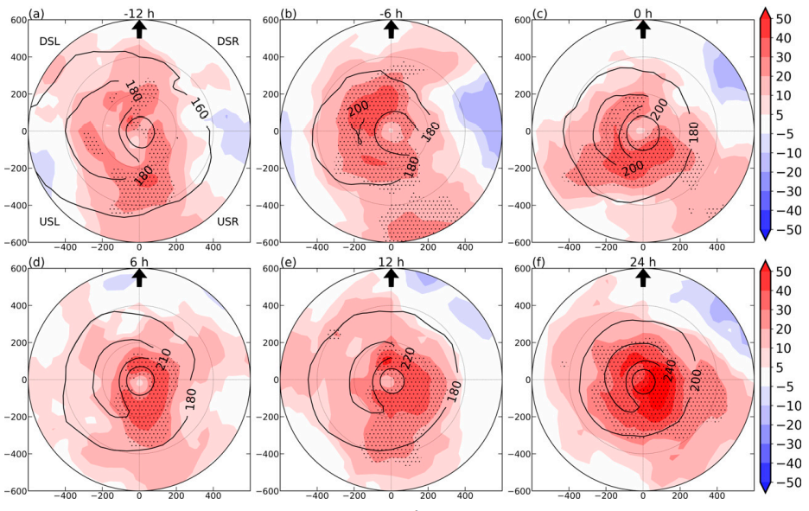
Results
SURFACE FLUXES (western North Pacific)
As in the North Atlantic, surface latent heat fluxes tend to be maximized to the left of shear. RI TCs generally have significantly larger surface fluxes than SI TCs within the innermost 400 km.
Prior to the onset of the intensity change period, significant positive differences of up to 40 ${W/m}^{2}$ are present left of shear and upshear, within 200 km. Thereafter, positive differences are maximized upshear and right of shear, indicating greater azimuthal symmetry of surface latent heat fluxes in RI TCs versus SI TCs.
Notes:
至於西北太平洋也是有類似的結果
通量大值在左側
同時RI的颱風在中心四百公里內有顯著較大的量值
增強前紅色較大的值在左側
然而增強後在上風切處及右側→表示RI颱風有更佳的對稱性(因為右側有明顯較大的量值,而整體平均大值在左側)

Slide 21
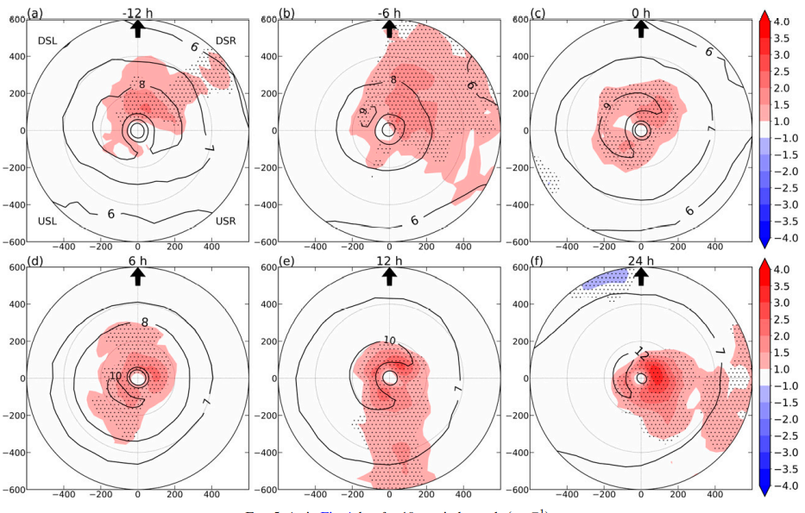
Results
The factors responsible for surface latent heat flux differences from -12 to 0 h are assessed by comparing moisture disequilibrium and near-surface wind speeds between RI and SI TCs.
At all lead times, the moisture disequilibrium differences between RI and SI TCs are noisy and generally lack statistical significance (not shown).
From -12 to 0 h, the 10-m wind speed differences, albeit small in magnitude, are statistically significant predominantly in the downshear-right quadrant.
The storm translation speed and direction are not significantly different between RI and SI TCs at -12 and -6 h (not shown), so these parameters are not the cause of the wind speed differences
10-m wind speed (North Atlantic)
Notes:
而LHF的差異可能是由由於海氣之間的水氣差或是地表風差異所導致
而水氣的差異缺乏統計顯著性 作者就沒秀
在-12小時到onset時 雖然差距小 但卻具有統計顯著性
一開始 -12~0 主要在DSR
而颱風移動速度跟方向並無顯著差異(RI跟SI之間) 在-12 跟-6HR
因此這並非是導致風速差距的主因

Slide 22
$L_{V}$ is the latent heat of vaporization ${\text{(2.5 }\text{x} {10}^{6}\text{J} \text{kg}\text{)}}^{−1}$ ,
$c_{k}$ is the exchange coefficients for latent heat (taken as $\text{1.2} \text{x} {10}^{−3}$; Nguyen et al. 2019),
$R_{d}$ is the dry air density (taken as 1.2 kg $m^{−3}$ ),
$U_{10}$ is the 10-m wind speed,
q* is the saturated specific humidity at SST,
$q_{2}$ is the 2-m specific humidity.
Note that the surface sensible heat flux is not examined here because the total surface enthalpy flux is generally dominated by the LHF (Nguyen et al. 2019).
Notes:
地表可感熱通量這裡沒有探討
因為整體地表enthalpy的通量是由潛熱通量主導

Slide 23
Results
Areas of positive differences in near-surface wind speed generally overlap with areas of positive differences in surface latent heat fluxes.
However, at -12 h, the greatest positive differences in 10-m wind speed are mostly confined downshear, while the greatest positive surface latent heat flux differences are found in the left of-shear quadrants. Similarly, at -6 h, the greatest positive differences in 10-m wind speed are mostly confined to the downshear-right quadrant ,while large positive differences in surface latent flux are present in the left of-shear and upshear quadrants.
Prior to 0 h, additional nonlinearly interacting factors could contribute to the significantly larger surface fluxes in left-of-shear and upshear quadrants of RI TCs. After 6 h, the positive wind speed differences and surface latent heat flux differences in the inner core increase concurrently.
10-m wind speed (North Atlantic)
Notes:
而LHF跟 10米 正差值(紅色區域) 大部分是重疊的
然而在-12H的時候 10米風正差值在下風切處
而LHF則是在風切左側
而-6H 10米風 主要在DSR
而LHF在左側跟上風切處
代表了 在增強開始前 可能有些非線性的交互作用
導致RI颱風LHF在左側還有上風切處 有較大量值
而在6H之後 LHF跟10米風 則大致重合

Slide 24
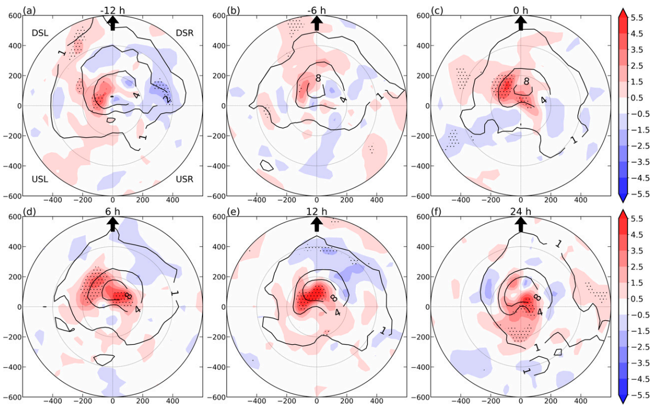
Results
As surface fluxes supply the TC boundary layer with moisture for convection, significant differences in surface latent heat flux patterns could also contribute to differences in the strength and areal coverage of moist convection between RI and SI TCs.
The mean MFC has an asymmetric distribution.
Initially, the largest positive MFC differences are displaced cyclonically downwind of the downshear maximum in the composite mean, and the largest negative differences are located cyclonically upwind of the maximum.
After 0 h, the MFC of RI TCs evolves toward increasing azimuthal symmetry. This increasing symmetry is evidenced by the shift of positive MFC differences from mostly the downshear-left quadrant to upshear.
MOISTURE FLUX CONVERGENCE(North Atlantic)
Notes:
而LHF提供了颱風邊界層內水氣 使得對流有利發展
而RI 與SI LHF的顯著差異 → 對流的強度與範圍亦會有顯著差異
由圖可見 平均(contour) MFC 有WN1的不對稱性
一開始正差值在contour的氣旋市下風處(DSL)
而負差值在DSR
而0H之後 正差值開始往上風切處移動
而平均的極值仍坐落在下風切處→RI颱風具有更佳的軸對稱性

Slide 25
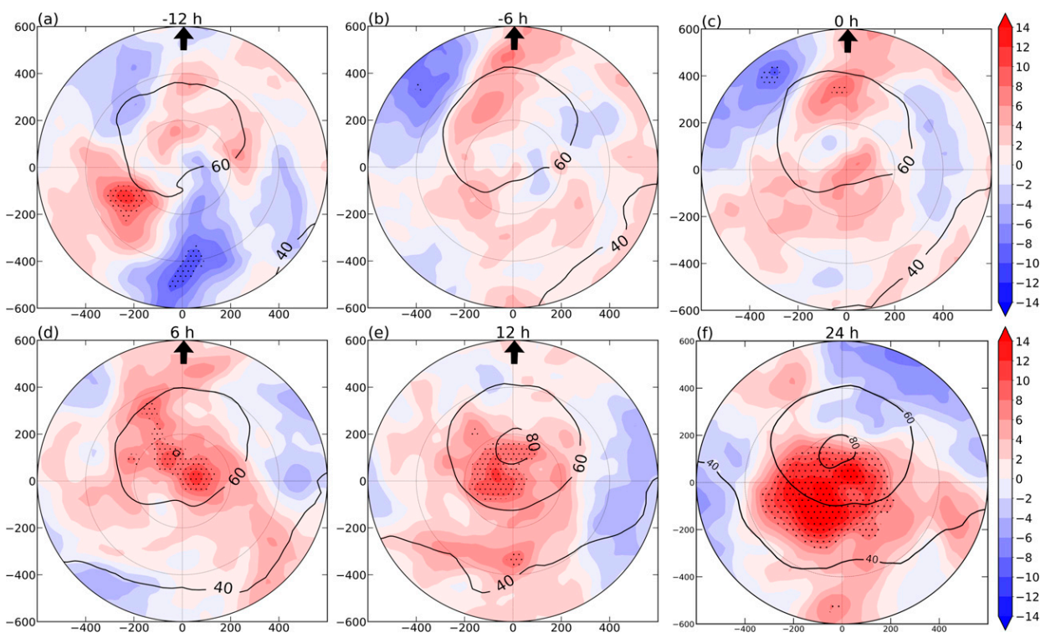
Results
The tropospheric moisture content is also important for TC RI (e.g., Kaplan and DeMaria 2003; Kaplan et al. 2015; Wang and Jiang 2021)
The total precipitable water composite differences and relative humidity composite differences below 500 hPa reveal no systematic differences between RI and SI TCs from -12 to 24 h (not shown). However, notable relative humidity differences are present around 400 hPa.
As early as -12 h, positive relative humidity differences are present in the upshear-left quadrant, consistent with observational and modeling studies that demonstrated moistening in upshear quadrants prior to RI.
From -6 to 0 h, a more symmetric relative humidity pattern emerges in RI TCs as positive differences of up to 5% expand in areal coverage within the innermost 400 km of upshear quadrant.
400hPa RH (North Atlantic)
Notes:
而對流層內的水氣量對於颱風的RI也是一個重要指標
而作者發現500hPA的RH 沒啥差異
但是400就有比較顯著的差異性
在-12的時候USL 就有顯智差異 (跟之前的觀測及模擬類似)
而-6 -0 上風切的差異開始變大(平均極值在下風切) 代表RI的上風切處開始增濕(且更軸對稱)

Slide 26
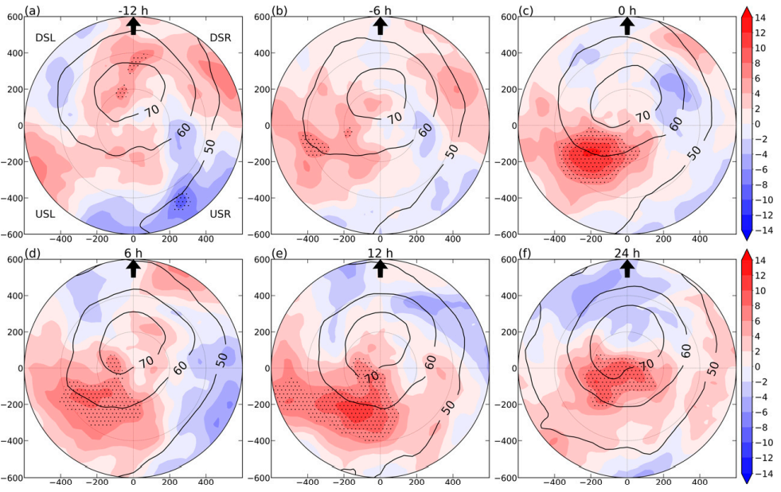
Results
400hPa RH (western North Pacific)
Although the 400-hPa relative humidity differences are not significant over a large region until 0 h, positive differences upshear-left, albeit small, are present at -12 and -6h.
At the onset of the intensity change period, RI TCs have as much as 8% greater 400-hPa relative humidity in the upshear-left quadrant (Fig. 13c).
Subsequently, areas of significant positive relative humidity differences progress cyclonically downstream into the upshear-right quadrant and spread inward.
Notes:
其實跟北大西洋類似
但是顯著性在0H才明顯(onset 在UL差8%)
但一樣大多數時間平均都在DS
而差值開始往US 傳遞( 跟之前一樣代表RI更加軸對稱了)

Slide 27
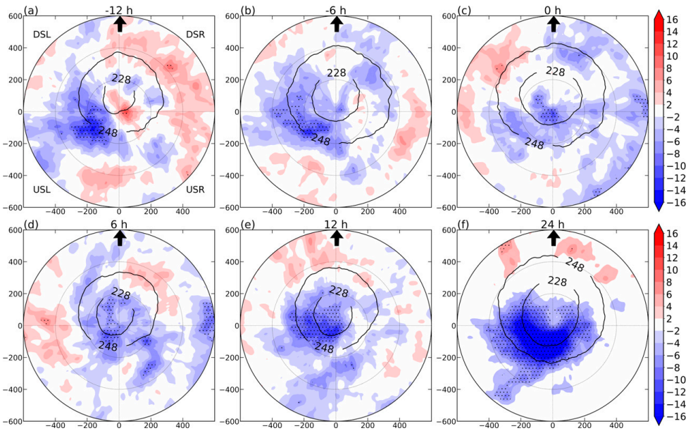
Results
INFRARED BRIGHTNESS TEMPERATURES(North Atlantic)
The analysis above is complemented with an analysis of differences in convective characteristics between RI and SI TCs using composites of IR brightness temperatures
At -12 h, the deepest convection (coldest IR brightness temperatures) occurs downshear of the TC center for both RI and SI TCs .This pronounced convective asymmetry in the composite mean is consistent with the effects of vertical wind shear on the TC convective structure.
At -12 and -6 h, an area of significant, negative IR brightness temperature differences, approximately 10-K colder cloud tops in RI TCs, is present in the upshear-left quadrant.
Notes:
這邊用IR亮溫 分析RI SI的對流差異性
平均而言極值都在DS(VWS影響)
而在-12 -6 開始有顯著負差值在USL
(其他時段也有只是不顯著)

Slide 28
Results
INFRARED BRIGHTNESS TEMPERATURES(North Atlantic)
After 0 h, the upshear expansion and subsequent amplification of negative IR brightness temperature differences are indicative of increasing azimuthal symmetry of deeper convection in RI TCs.
These IR brightness temperature differences are in agreement with previous studies that related an increase in azimuthal coverage of precipitation to greater rates of intensification, including RI (e.g., Zagrodnik and Jiang 2014; Alvey et al. 2015; Kaplan et al. 2015; Tao and Jiang 2015; Rios-Berrios and Torn 2017; Tao et al. 2017; Fischer et al. 2018; Alvey et al. 2020).
Notes:
0H 之後 上風切負差值拉大(RI颱風上風切的對流增強 亮溫開始掉)
代表其對流的軸對稱性開始增加
這跟之前的研究可相呼應 降雨的軸對稱性增加 對應到更高的增強速率

Slide 29
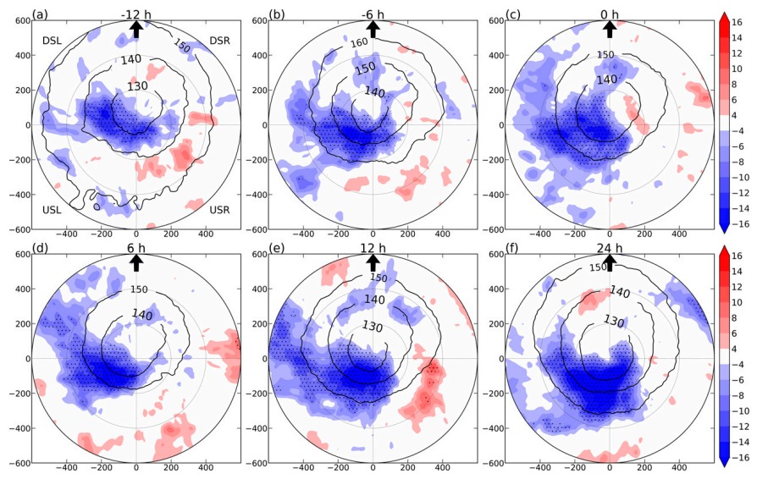
Results
INFRARED BRIGHTNESS TEMPERATURES(western North Pacific)
A comparison of IR brightness temperatures reveals significant differences in convective intensity between RI and SI TCs .
At -12 h, an area of >10 K lower IR brightness temperatures, indicative of colder tops in RI TCs, is generally present to the left of shear and upshear within 200 km.
From -12 to 0 h, this area of colder cloud tops is most prominent in the inner-core region of the upshear-left quadrant. Significantly lower brightness temperatures in RI TCs are collocated with the composite mean convective maximum at 0 h, reflecting higher initial intensities of RI TCs relative to SI TCs in this basin.
Notes:
作者這張圖有問題
140K 的亮溫= =
但是PATTERN是類似沒問題
-12-0h usl dsl顯著

Slide 30
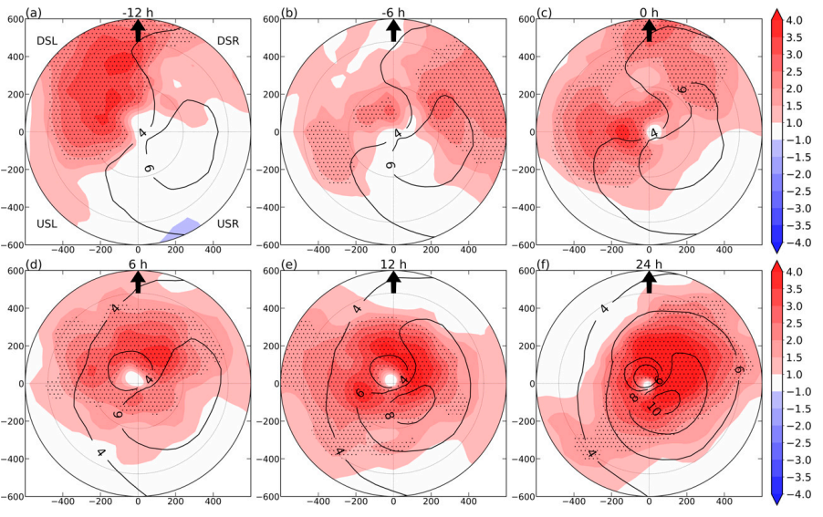
Results
400hPa tangential wind(North Atlantic)
Storm-relative tangential wind differences are positive through the troposphere (not shown) but are most pronounced near 400 hPa. At this level, significant positive differences appear over a broad region around the TC from -12 to 0 h .
The right-of-shear orientation of the maximum in the mean storm-relative tangential wind and left-of-shear orientation of the greatest positive differences indicate that RI TCs have a stronger, more symmetric circulation at mid- to upper levels prior to the intensity change period.
Notes:
切向風 在400的差異較大
所以時間都有大範圍差異
而平均而言風切右側有較大切向風
但正差值在平均極值的左側顯著
→暗示RI颱風有更強更軸對稱的切向風

Slide 31
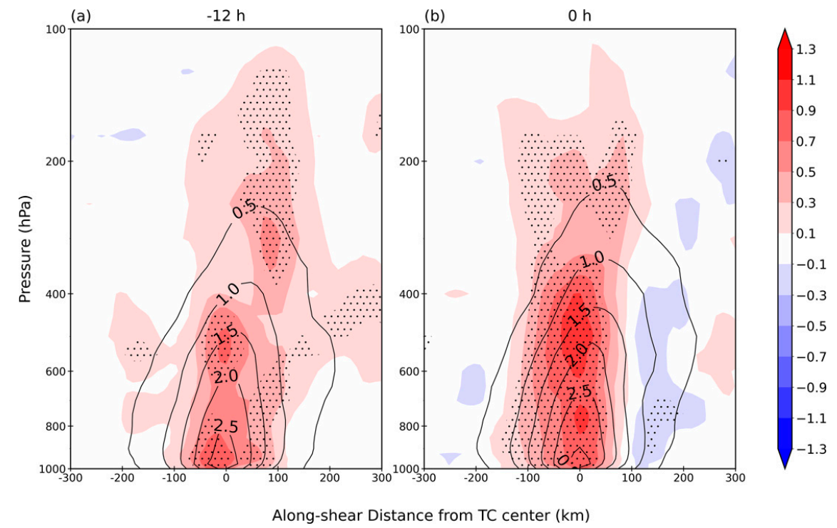
Results
TC-centered, along-shear vertical cross section of relative vorticity (North Atlantic)
The mean vorticity structure generally displays a slight downshear tilt with height above the 700-hPa level. Statistically significant, positive relative vorticity differences extend from the surface to above 200 hPa, and are maximized at the midlevels.
The stronger and deeper mid- to upper-level vortex structure in RI TCs leading up to RI onset suggests the importance of the three-dimensional vortex structure to RI versus SI. By 0 h, the statistically significant positive relative vorticity differences at midlevels are mostly present to the left of the mean vorticity maximum axis, suggesting that RI TCs achieve a more vertically aligned vortex at RI onset.
Notes:
Shading 是渦度
-12h時候
同時從地面延伸到高層
但是此時ri si強度差不多
但是ri卻有較強較深的vortex 結構
700以上有略為down shear tilt
同時從地面延伸到高層
-0
大部分具有顯著的地區落在 0-~100 (upshear)
但是contour (total)略有downshear tilt
代表ri的個案在上風切處有更強的渦度
→RI渦旋結構更加align

Slide 32
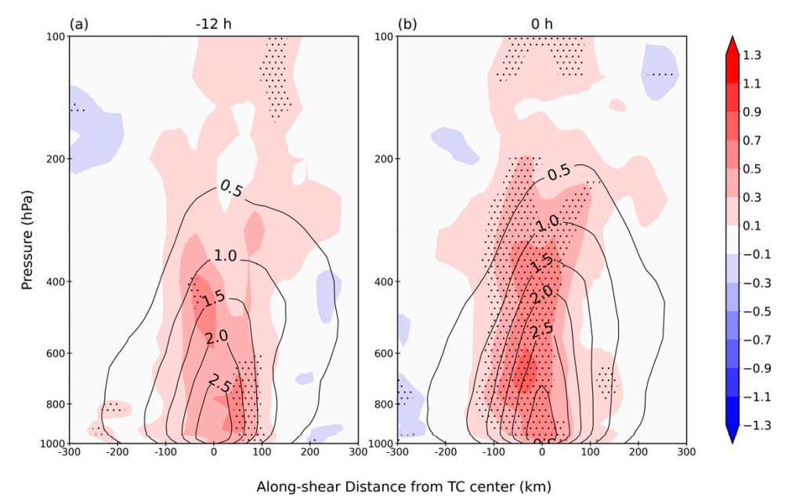
Results
TC-centered, along-shear vertical cross section of relative vorticity (western North Pacific)
Similar to the North Atlantic, the vortex structure as a whole appears to be important for RI versus SI.
In RI TCs, the stronger and broader near-surface wind fields are reflected in the relative vorticity composite differences, which show positive differences over much of the troposphere near the center. RI TCs exhibit a stronger vortex up to 200 hPa and are more vertically aligned at 0 h.

Slide 33
Discussion and conclusions

Slide 34
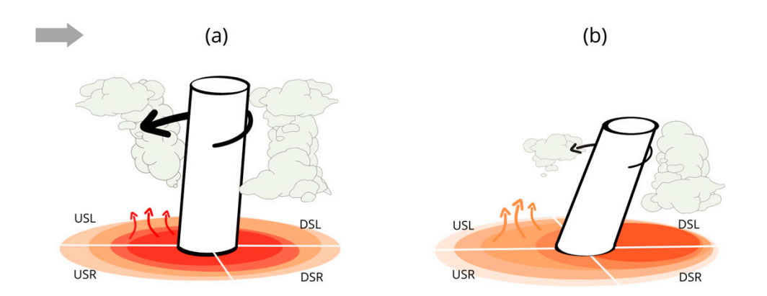
RI onset
SI onset

