Slide 1
Zou, Q., X. Cui, and S. Hao, 2022: The statistical relationship of lightning activity and short-duration rainfall events over Guangzhou, China, in 2017. Weather Forecast., 37, 601-615.

Slide 2
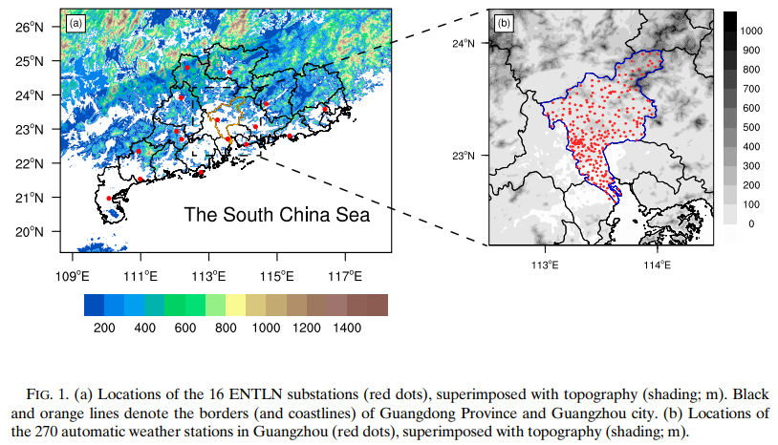

Slide 4
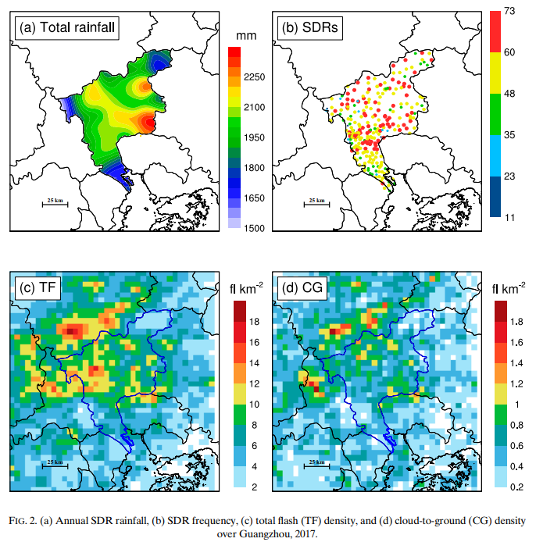

Slide 5
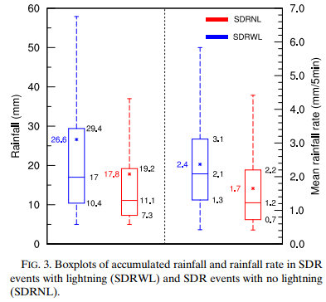

Slide 6
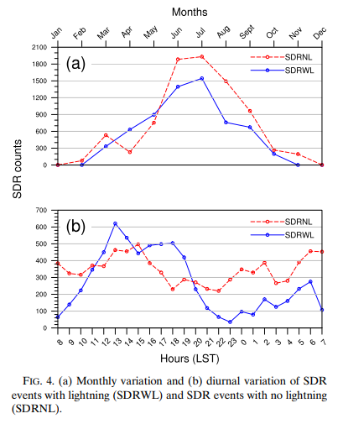

Slide 7
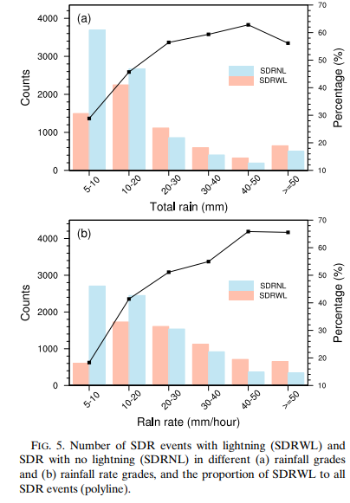

Slide 8
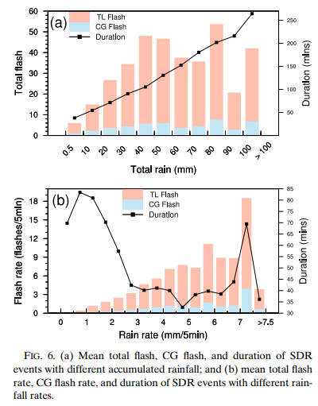

Slide 9
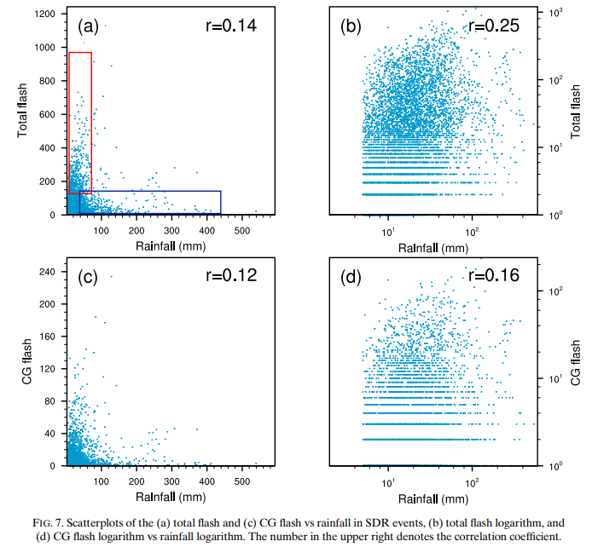

Slide 10
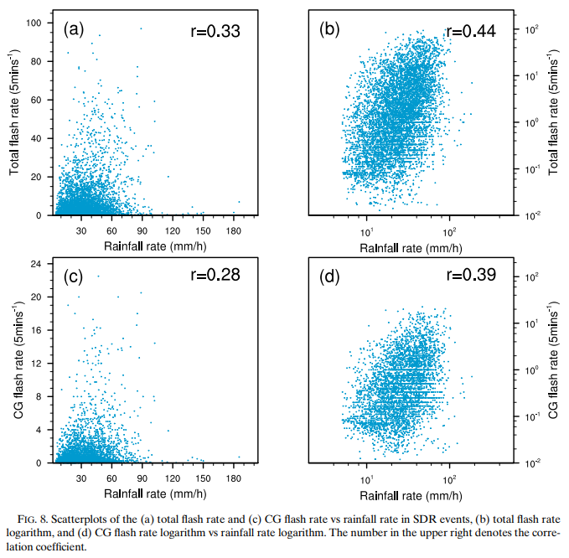

Slide 11
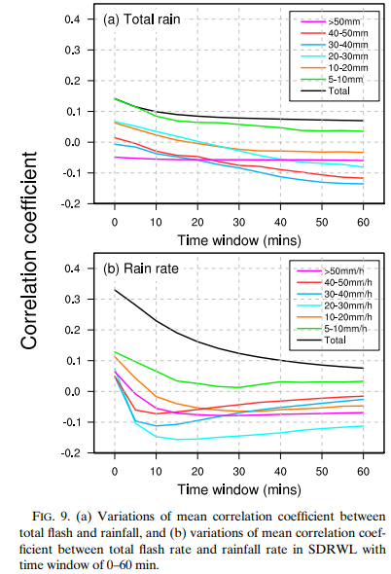

Slide 12
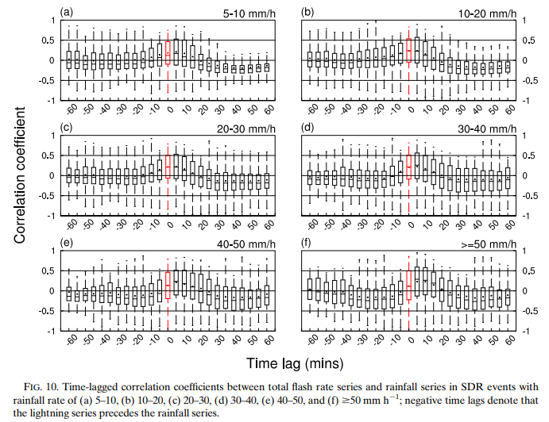

Slide 13
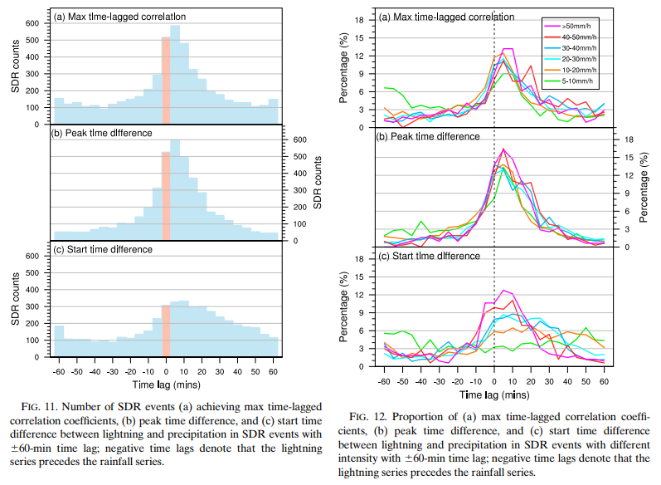

Slide 14
Summary
The average annual SDR rainfall of 2017 over Guangzhou is about 2000 mm, and a topography effect has been found in the spatial distribution of annual rainfall. The mean total flash density is about 10 flashes km22 yr21 . In 2017, there were 14758 SDR events reported on 270 AWSs, and the average is 54. The average duration of SDR events is found to increase with increasing accumulated rainfall but decreases with the increasing rainfall rate.
The results show that about 43% of the SDR events are accompanied by lightning activity, and the accumulated rainfall and rainfall rate of these SDR events are significantly higher than those with no lightning. More SDR events are reported in the warm seasons than the cold seasons, and the peak occurs in July. A high ratio of SDRWL to SDRNL is found in April and May, which is closely related to the different environmental conditions for convections before and after the breakout of the SCSSM in late May.

Slide 15
Summary
The flash rate is found to decrease in SDR events with extreme rainfall. The correlation coefficient between flash rate and rainfall rate in 6427 SDR events shows a moderate (0.33) positive correlation. This correlation coefficient is higher (0.44) between flash and rainfall rate logarithm, indicating a power-law relationship.
Generally, the lightning series in SDRWL lags precipitation for 5–10 min in SDRWL, and this lag is more obvious in heavy SDRWL. Lightning is found to precede precipitation in more than 35% of SDRWL and lag precipitation in about 55% of SDRWL. About half of SDRWL obtain max timelagged correlation coefficient and peak time difference when lightning is lagged from 210 to 20 min. This distribution varies slightly in SDR events with different rainfall rates. The start time difference is closely related to the intensity of SDRWL

Slide 16
Summary
The flash rate is found to decrease in SDR events with extreme rainfall. The correlation coefficient between flash rate and rainfall rate in 6427 SDR events shows a moderate (0.33) positive correlation. This correlation coefficient is higher (0.44) between flash and rainfall rate logarithm, indicating a power-law relationship.
Generally, the lightning series in SDRWL lags precipitation for 5–10 min in SDRWL, and this lag is more obvious in heavy SDRWL. Lightning is found to precede precipitation in more than 35% of SDRWL and lag precipitation in about 55% of SDRWL. About half of SDRWL obtain max timelagged correlation coefficient and peak time difference when lightning is lagged from 210 to 20 min. This distribution varies slightly in SDR events with different rainfall rates. The start time difference is closely related to the intensity of SDRWL

Slide 17
Summary
In weak SDRWL, lightning can start at any time in 60 min before or after precipitation. With the increase of intensity, lightning is more likely to occur after precipitation from 25 to 20 min.

