Slide 1
Analysis and Simulations of a Heavy Rainfall Event Associated with the Passage of a Shallow Front over Northern Taiwan on 2 June 2017 CHUAN-CHI TU, YI-LENG CHEN, PAY-LIAM LIN, AND MU-QUN HUANG (2022, Monthly Weather Review)

Slide 2
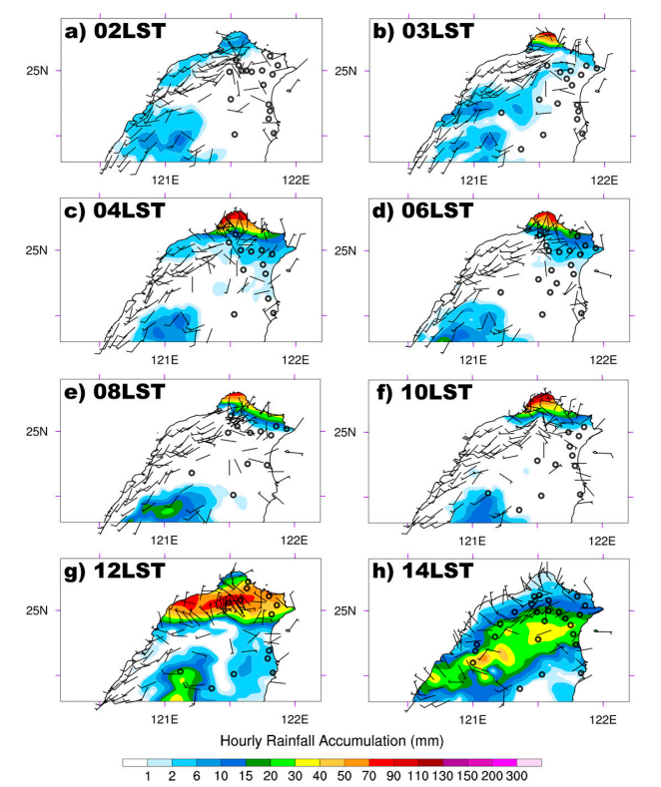
02~10 LST > 600 mm
> 500 mm/day
> 70 mm/hr

Slide 3
Introduction - recent studies on 2017/6/2
Factors important in the prediction of the frontal rainfall (Wang et al. 2021)
position and speed of the surface mei-yu front and the low-level wind-shift line
moisture amount in the environment
location and timing of the mesoscale low pressure disturbances along the front
frontal intensity
Southwesterly marine boundary layer jet (MBLJ) was present prior to the arrival of the mei-yu jet/front system. (Tu et al. 2020)
Notes:
該梅雨個案近期研究
鋒面和風切線的位置和移動速度
環境水氣量
鋒面擾動低壓
鋒面強度
海洋邊界層噴流在鋒面抵達台灣前已經存在

Slide 4
Introduction - main foci
timing, duration, and location of heavy rainfall affected by
moisture supply
lifting mechanisms (e.g., frontal lifting and orographic lifting)
depth of the postfrontal cold air
frontal movement
Notes:
本研究主題是強降雨的位置和時間如何受 水氣供應 舉升機制 冷空氣厚度 鋒面移動 影響

Slide 5
Literature review - baroclinic characteristics
Similar to other case frontal systems in recent studies:
appreciable temperature/moisture gradients in the lower troposphere
a marked vertical tilt
an upper-level jet/front with tropopause folding
a thermally direct circulation across the frontal zone
(Chen et al. 1989; Trier et al. 1990; Chen 1993; Chen et al. 1994, 1997; Tu et al. 2014; Chen et al. 2018;(Hsiao and Chen 2014; and others)
Notes:
溫度水氣梯度
傾斜結構
對流層頂褶皺
熱力直接環流

Slide 6
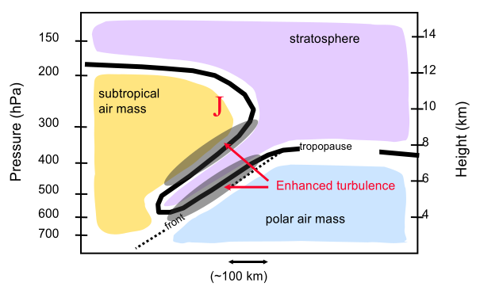
Literature review - baroclinic characteristics
Similar to other case frontal systems in recent studies:
appreciable temperature/moisture gradients in the lower troposphere
a marked vertical tilt
an upper-level jet/front with tropopause folding
a thermally direct circulation across the frontal zone
(Chen et al. 1989; Trier et al. 1990; Chen 1993; Chen et al. 1994, 1997; Tu et al. 2014; Chen et al. 2018;(Hsiao and Chen 2014; and others)
(Feltz and Wimmers, 2010)

Slide 7
Literature review – frontal slope
Mei-yu fronts have a northward vertical tilt, and the frontal slope is determined by the balance between Coriolis acceleration and the density difference across the front. (Chen et al. 1989; Chen and Hui 1990, 1992; Margules 1906)
As the mei-yu front penetrates into the subtropics, the depth of the postfrontal cold air decreases due to a decrease in the Coriolis parameter. (Chen et al. 1989)
Notes:
梅雨鋒向北傾斜，且傾斜程度是科氏力和冷暖空氣密度差的平衡結果
當梅雨鋒向南移動時，鋒後冷空氣的厚度會因為科氏加速度變小而變小

Slide 8
Literature review – low-level jets
The subsynoptic low-level jet (SLLJ):
SLLJ is associated with the secondary circulation of the moist baroclinic jet/front system. (Chen et al. 1994, 1997; Chen and Tseng 2000; Chen and Chen 2002; Hsiao and Chen 2014)
The marine boundary layer jet (MBLJ; <900-hPa level):
It develops when the mei-yu trough is deeper and/or the western Pacific subtropical high (WPSH) is stronger. (Tu et al. 2019, 2020)

Slide 9
Literature review – low-level jets
The barrier jet (BJ):
BJ is the result of orographic blocking of the SLLJ/MBLJ. (Chen and Li 1995a,b; Li et al. 1997; Tu et al. 2017)
Convergence between BJ and frontal wind shift line leads to the development of localized heavy rainfall. Moreover, the BJ transports abundant moisture to the convergence area. (Li et al. 1997; Yeh and Chen 2002; Chen et al. 2018; Ke et al. 2019; Kerns et al. 2010)
Notes:
BJ和鋒面的風切線輻合會導致區域性強降雨
而且BJ還會傳輸水氣到輻合區域

Slide 10
Data and methodology
Data:
FNL, ARMTS, station-observation, Banciao sounding
Model description (WRF)
CTRL
RmY (Yang-Ming Mountain >150m → 150m)
Notes:
Final Operational Global Analysis
Automatic Rainfall and Meteorological Telemetry System

Slide 11
Data and methodology
Integrated vapor transport (IVT):
flow regimes:
$M×Fr_{0}$
$Fr_{0}=\frac{U_{0}}{\sqrt{g^{∗}H_{0}}}, M=\frac{h_{m}}{H_{0}}$
Notes:
hm is the mountain height
H0 is the depth of the cold air

Slide 12
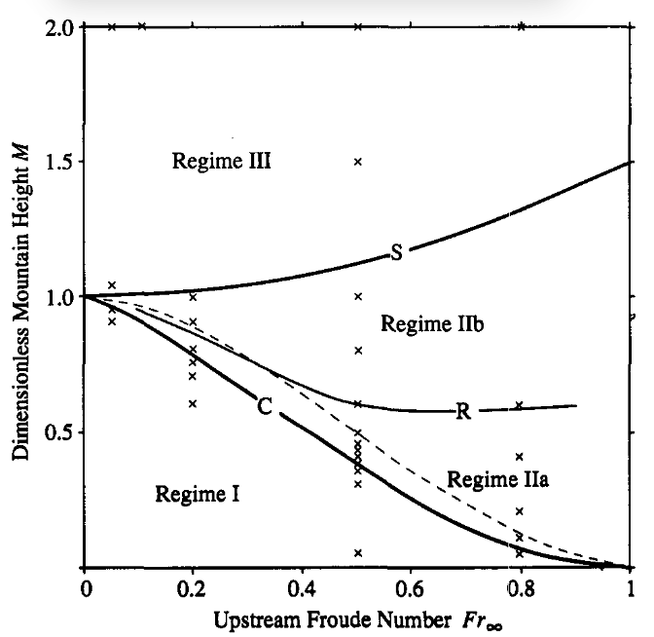
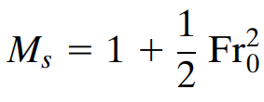
Cannot flow over the hill
$$Fr_{0}=\frac{U_{0}}{\sqrt{g^{∗}H_{0}}}, M=\frac{h_{m}}{H_{0}}$$
flow over the hill
with hydrolicjump
flow over the hill
without hydrolicjump
Schar and Smith (1993)
Notes:
hm is the mountain height
H0 is the depth of the cold air
可以透過一直增加冷空氣的厚度來達成過山的條件

Slide 13
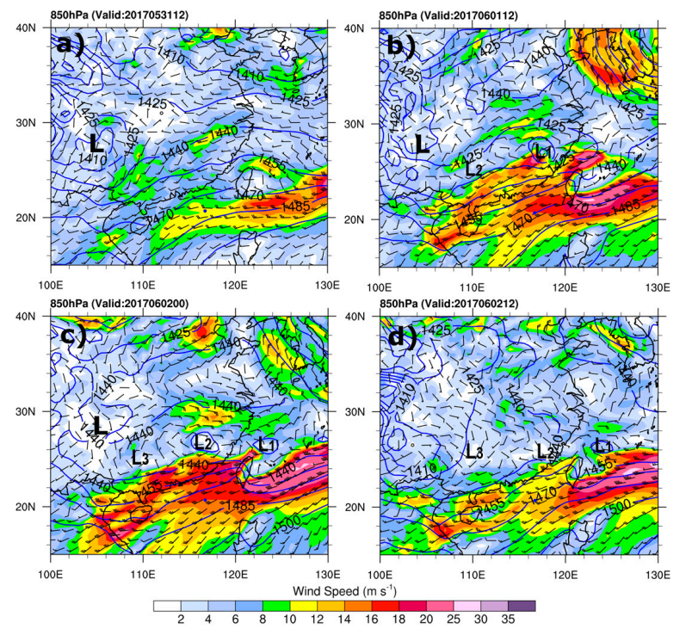
0531 12Z
0601 12Z
850 hPa (FNL)
Winds
Geopotential height
0602 00Z
0602 12Z
L
SLLJ
WPSH
Notes:
0531 雲貴高原的背風渦漩和西太平洋副高的延伸之間有SLLJ
0601有兩個梅雨鋒渦漩，SLLJ增強
0602L1L2向東移動 L3生成
0602 12Z 梅雨鋒渦漩減弱 SLLJ也減弱

Slide 14
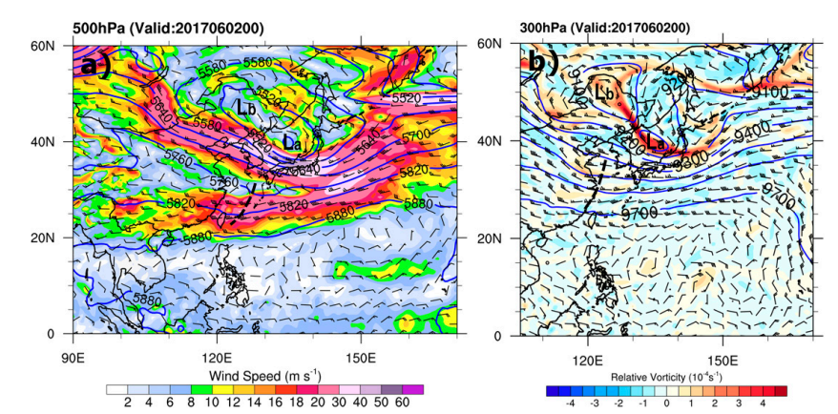
0602 00Z
0602 00Z
500 hPa (FNL)
Winds
Geopotential height
300 hPa (FNL)
Relative Vorticity
Geopotential height
Notes:
500有兩條噴流
槽向西傾斜

Slide 15
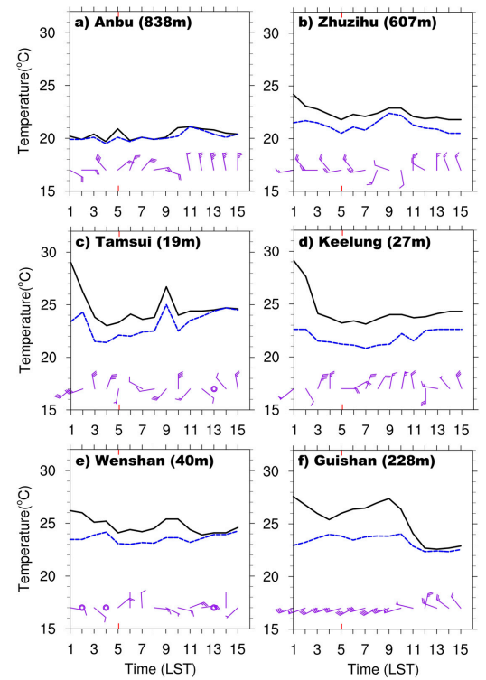
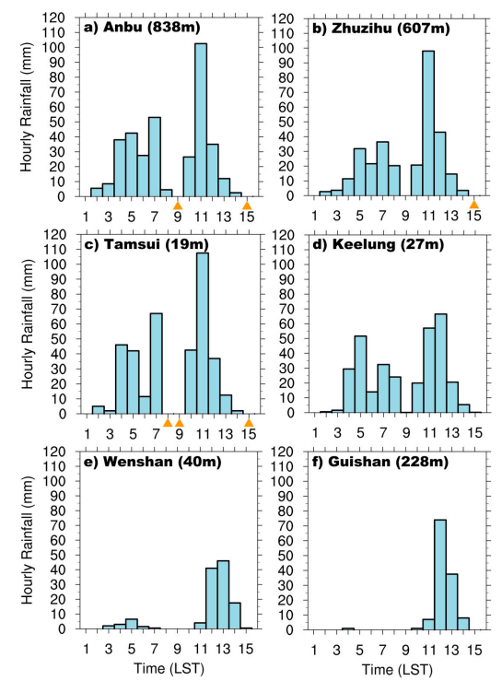
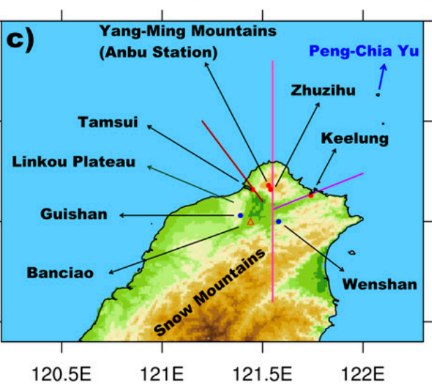
02LST
Front arrived
T
Td
Notes:
當鋒面剛抵達
被卡在陽明山北側
整個陽明山顯著降雨
而且北風被陽明山偏轉，冷空氣順著河谷入侵

Slide 16
02LST
Front arrived
T
Td
Cold air
Cold air
rain
Notes:
當鋒面剛抵達
被卡在陽明山北側
整個陽明山顯著降雨
而且北風被陽明山偏轉，冷空氣順著河谷入侵

Slide 17
11LST
Front move over the mountain
T
Td
Notes:
當鋒面終於越過陽明山
各測站降雨顯著增強
部分測站有顯著風向變化
部分測站顯著溫度下降

Slide 18
02~10 LST Yang-Ming
Mountains
windward side
Front move over the mountain

Slide 19
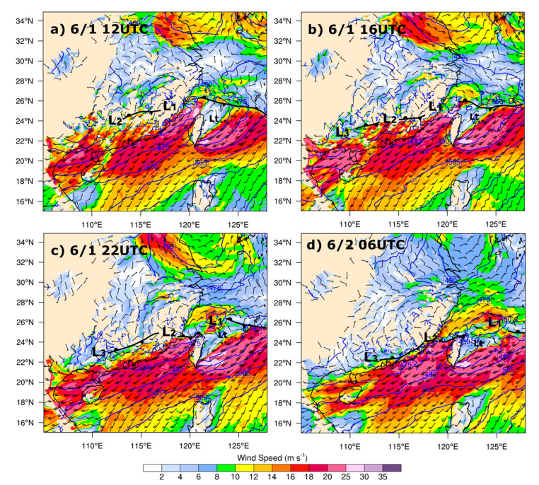
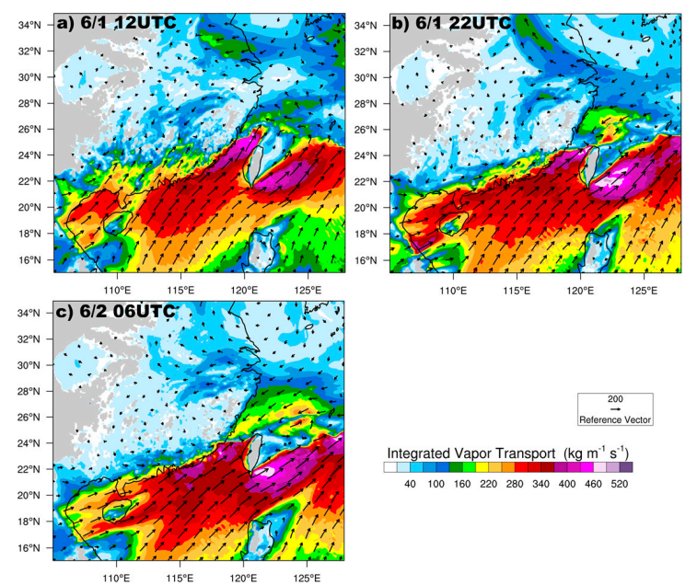
950 hPa (CTRL)
Winds
Geopotential height
(CTRL)
IVT (below 900 hPa)
L1 move eastward
Enhance the vapor convergence
Notes:
L1跟副高延伸之間有較大氣壓梯度，中間有MBLJ
最大風速軸從南海北部延伸到台灣海峽
台灣海峽西南MBLJ水平水氣輸送明顯
梅雨鋒面在北台灣，鋒前西南風被CMR阻擋，導致BJ沿台灣西北海岸發展，並在東南海岸發展背風渦漩
隨著MBLJ增強，加上CMR的作用使BJ同時也增強
台灣西北部的極值與BJ有關
隨時間發展：
L1向東移動到台灣東北部，在台灣海峽北部LI西南側的西北風和BJ的西南風會合，水氣輸送最大值(9b)比之前更大

Slide 20
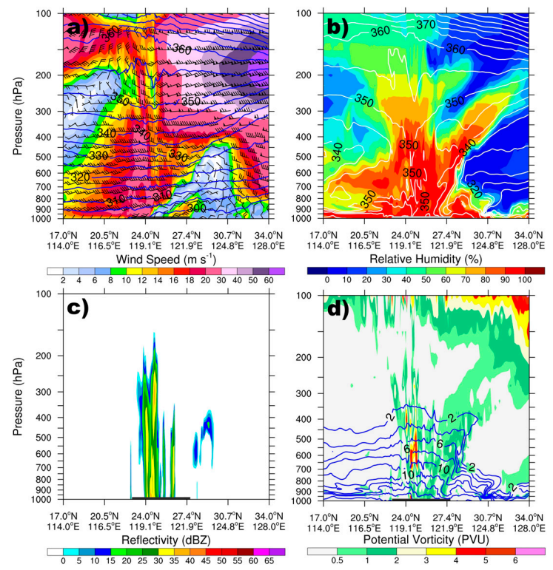
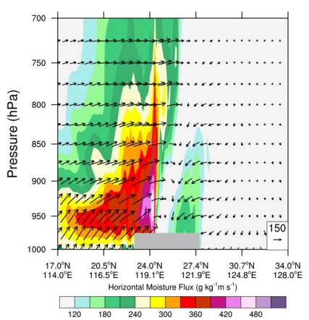
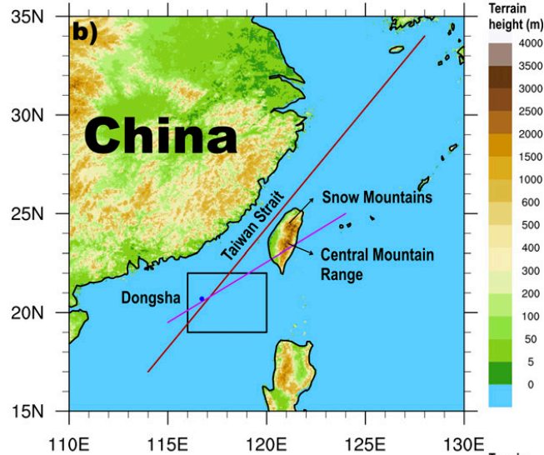
Wind
RH (%)
Q flux
6/2 06 LST (CTRL)
dBZ
PV
cross section along this line
in CTRL
Notes:
風速圖
SLLJ最大風速從900到600，主要在鋒前區
且伴隨著超過420的水氣傳輸
20.58N附近925處的MBLJ
水氣傳輸>360
因為BJ，台灣西北部水平水氣傳輸>950
圖10abc，鋒區濕舌(80RH)沿傾斜鋒面向上延伸至350hPa
10ad
34N，與高PV相關的對流層頂褶皺

Slide 21
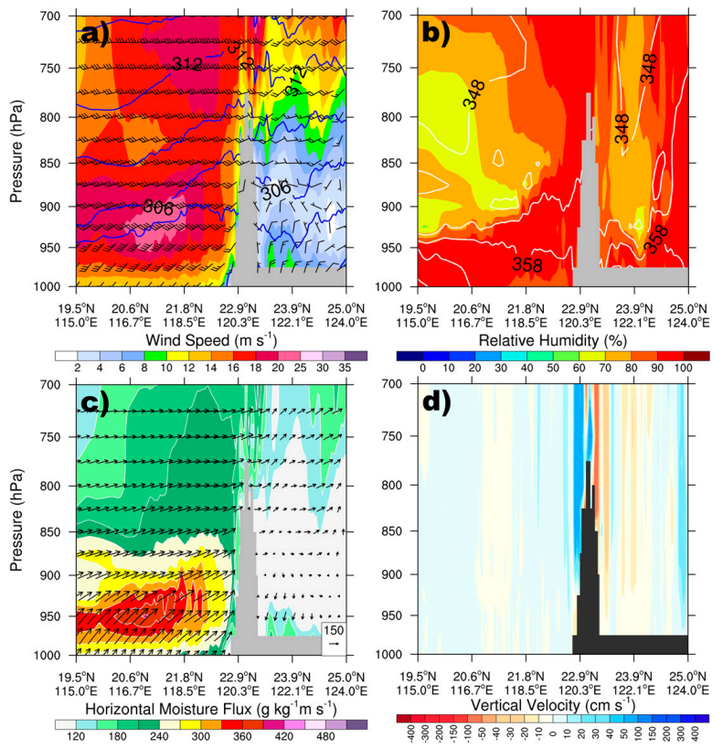
wind
RH (%)
6/2 06 LST (CTRL)
MBLJ, RH>90%, q flux maximum in PBL
Strong upstream
Q flux
w
cross section along this line
in CTRL
Notes:
12a
西南流撞CMR
最大風速950-900 (MBLJ)
12b
西南方RH90在900以下
12ac
水平水氣傳輸主要在MBL
低空西南流的地形抬升造成中央山脈和雪山山脈迎風面強降雨
西南風符合Tu 2020的MBLJ定義

Slide 22
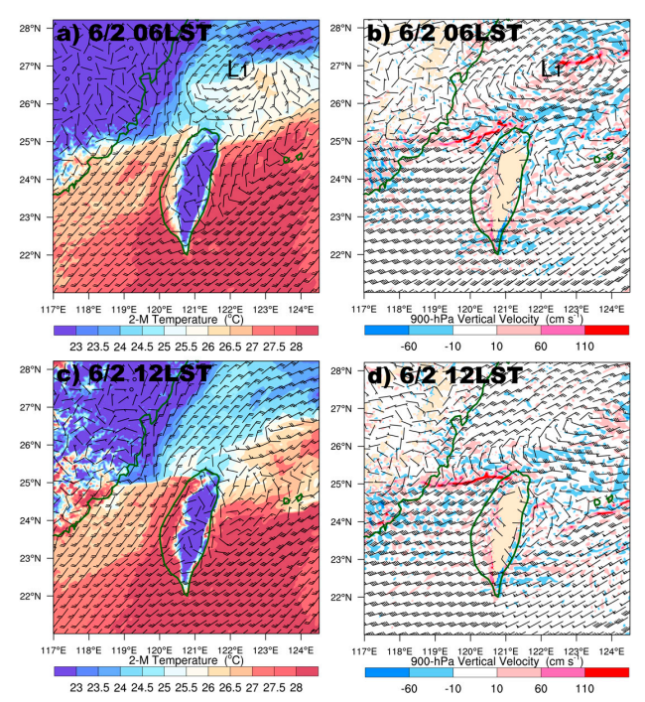
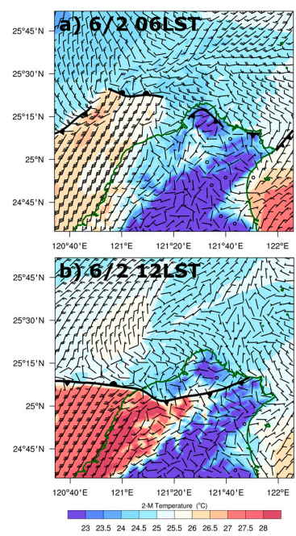
6/2 06 LST (CTRL)
cold air flow along rivers
BJ and northwesterly flow converge
6/2 12 LST (CTRL)
Front move southward
BJ and northwesterly flow converge
Notes:
圖13ab
6/2 06LST
L1西北側的冷北風被陽明山偏轉穿過淡水基隆河谷
觀測到的地表風更偏北(圖4)
13b
在900
BJ與L1西南側的西北風輻合增強鋒上對流
13c 14b
12LST地表鋒向南移動
鋒面雨帶到台北盆地
900高 梅雨槽西南側的西北風與BJ的輻合增強鋒面對流
鋒後北風向南推進像林口台地以南移動

Slide 23
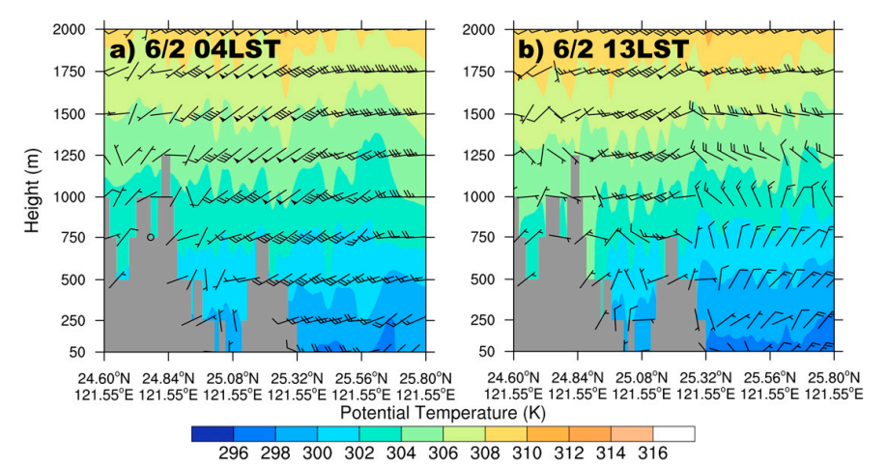
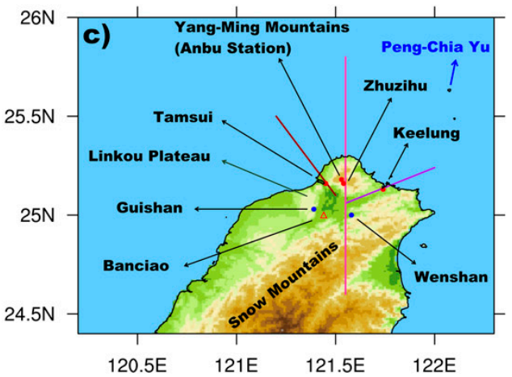
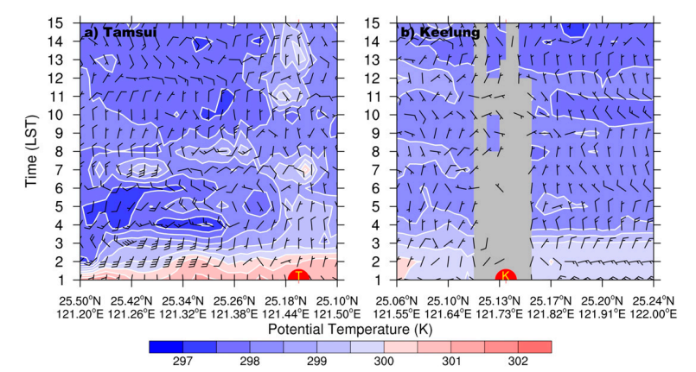
larger cold air depth
cross section along this line
in CTRL
Tamsui
Keelung
Hovmoller diagrams
along these two lines in CTRL
Large temperature gradient
Notes:
2點鋒面剛到的時候，冷空氣從兩個河谷入侵台北盆地
冷空氣厚度逐漸變厚
中午後北風終於南向進到台北盆地

Slide 24
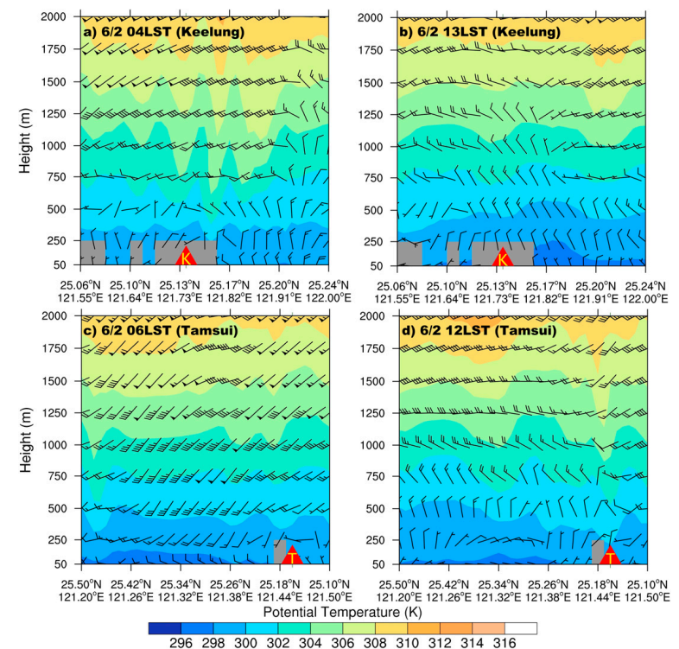
northly flow and higher cold air after 12 LST
Cross section
along these two lines in CTRL
Notes:
中午過後有明顯北風
和較厚的冷空氣

Slide 25
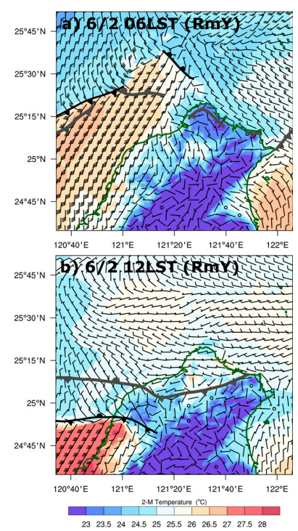
BJ is stronger in RmY run
After removing Yang Ming Mountains, front is located farther south than the CTRL run

Slide 26
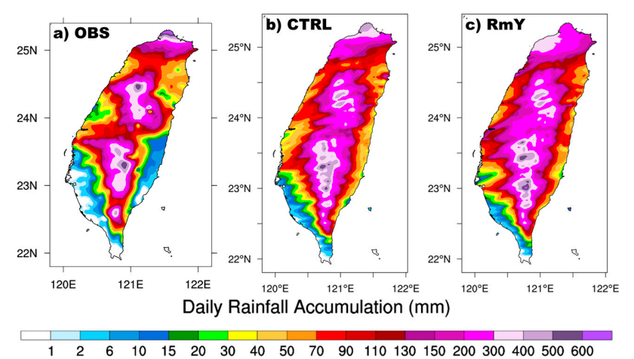
Different
similar

Slide 27
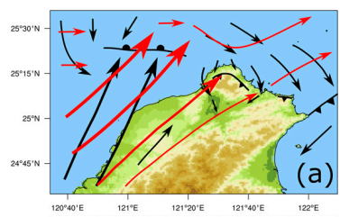
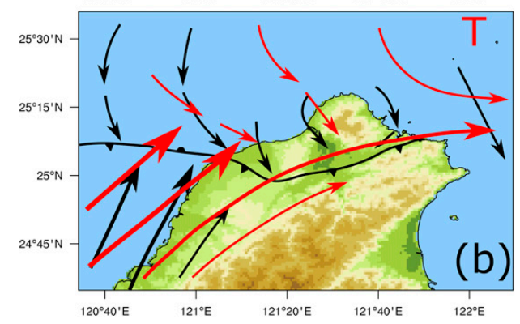
Conclusion
Mei-yu trough + WPSH -> MBLJ (+ CMR) -> BJ
Southwesterly flow contributes to heavy rainfall on windward of CMR and Snow Mountain.
BJ brings moisture to northern Taiwan.
The front stay anchored until depth of cold air is large enough.
Before that, cold air arrived Taipei basin through two river valleys.
Remove Yang Ming Mountain in WRF than the front quickly moves southward.

