Slide 1
Multiscale Interactions Contributing to Enhanced Orographic Precipitation in Landfalling Frontal Systems over the Olympic Peninsula
Dolan, Brenda, Steven A. Rutledge, and Kristen L. Rasmussen (2022)

Slide 2
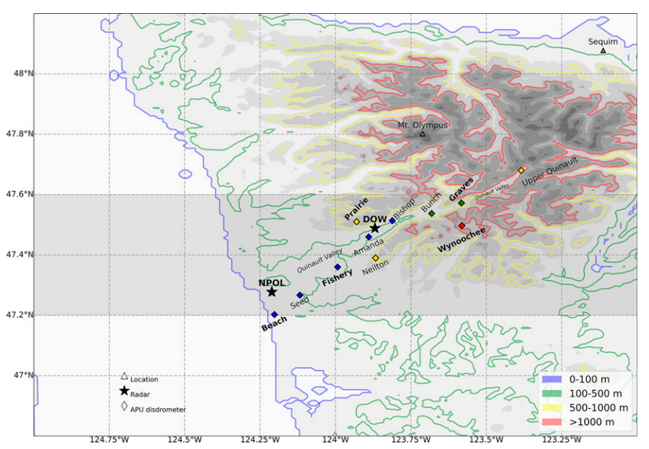
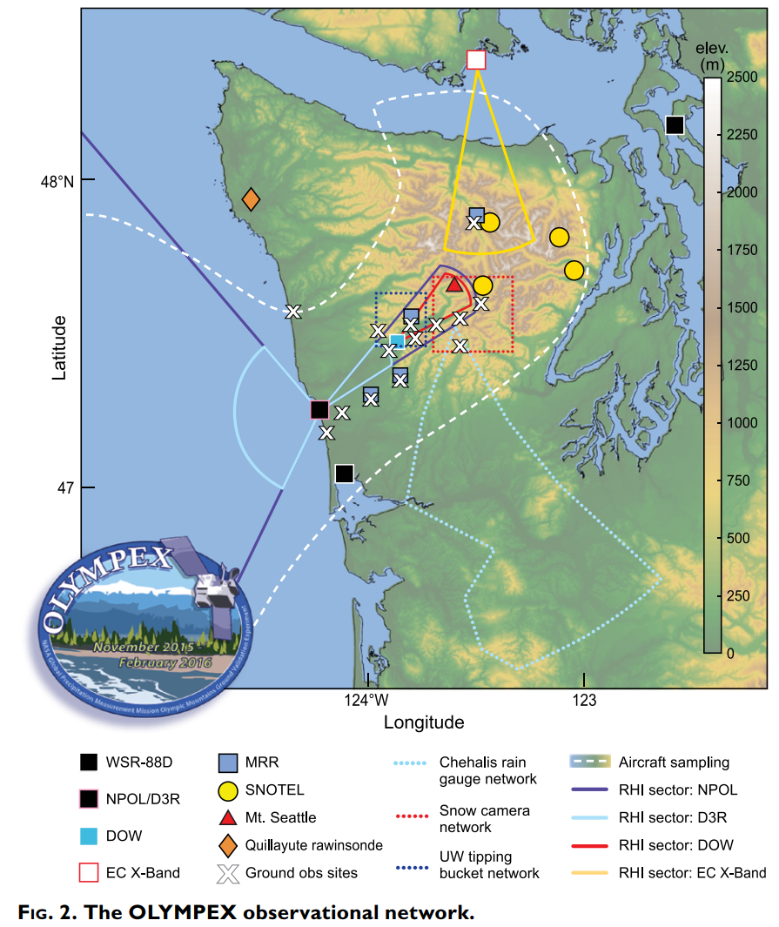
Data and methods
NPOL radar
NASA’s mobile radar
S-band
PPI+RHI: 20 min
RHI_ocean: 210º-326º
RHI_valley: 30º-60º
Radar estimated parameters:
D₀: median drop diameter
N_{w} (logN_{w}): normalized intercept parameter
SW: spectrum width
Houze et al, 2017; BAMS

Slide 3
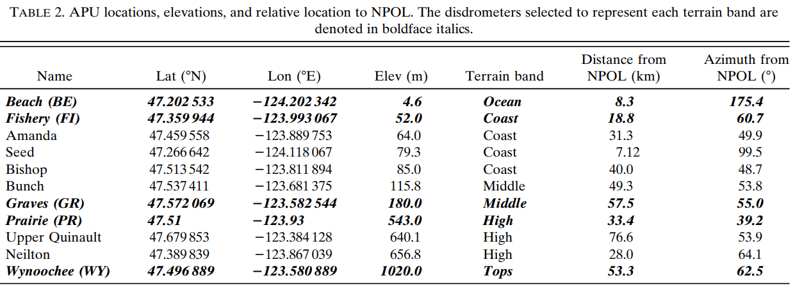
Data and methods
HCA (Hydrometeor classification algorithm)
Ice phase: dendrites (DN), plates (PL), aggregates (AG), and ice crystals (IC)
Uses polarimetric data to locate the melting layer
Dominant hydrometeor type
APU (Automated Parsival Disdrometers)
Along the Quinault Valley
Terrain bands
Ocean (z < 5 m)
Coast (5 < z < 100 m)
Middle (100 < z < 500 m)
High (500 < z < 1000 m)
Tops (z > 1000 m)

Slide 4
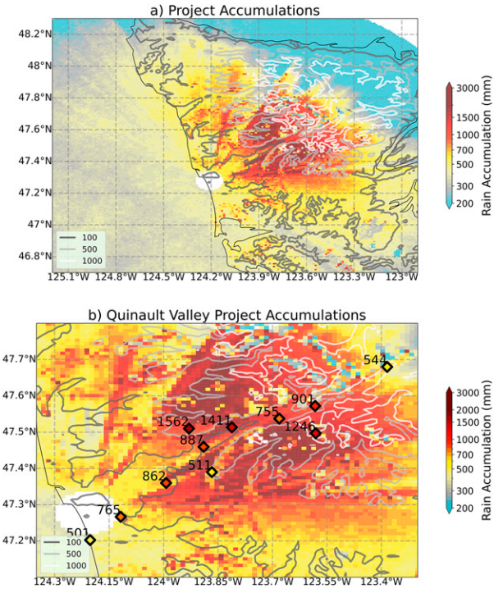
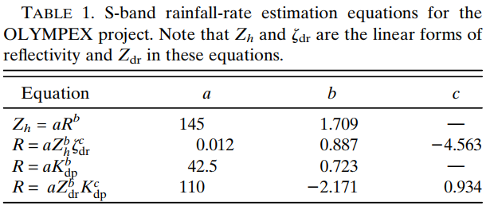
Precipitation variability
11/12-12/19 2015
OLYMPEX precipitation accumulations from November to December 2015 show significant enhancement in the terrain at the Middle to High elevations
Due to beam blockage and curvature effects at longer ranges from NPOL (>100 km) where the beam may actually be above the melting level, it is difficult to quantify the effect of the rain shadow in the lee of the Olympic Mountains
Terrain bands
Ocean (z < 5 m)
Coast (5 < z < 100 m)
Middle (100 < z < 500 m)
High (500 < z < 1000 m)
Tops (z > 1000 m)
R(K_{dp},Z_{dr}): K_{dp} > 0.3 km⁻¹, Z_{dr} > 0.25 dB, Z > 38 dB
R(Z,Z_{dr}): Z_{dr} > 0.25 dB
R(K_{dp}): K_{dp} > 0.3 km⁻¹, Z > 38 dB
R(Z): otherwise

Slide 5
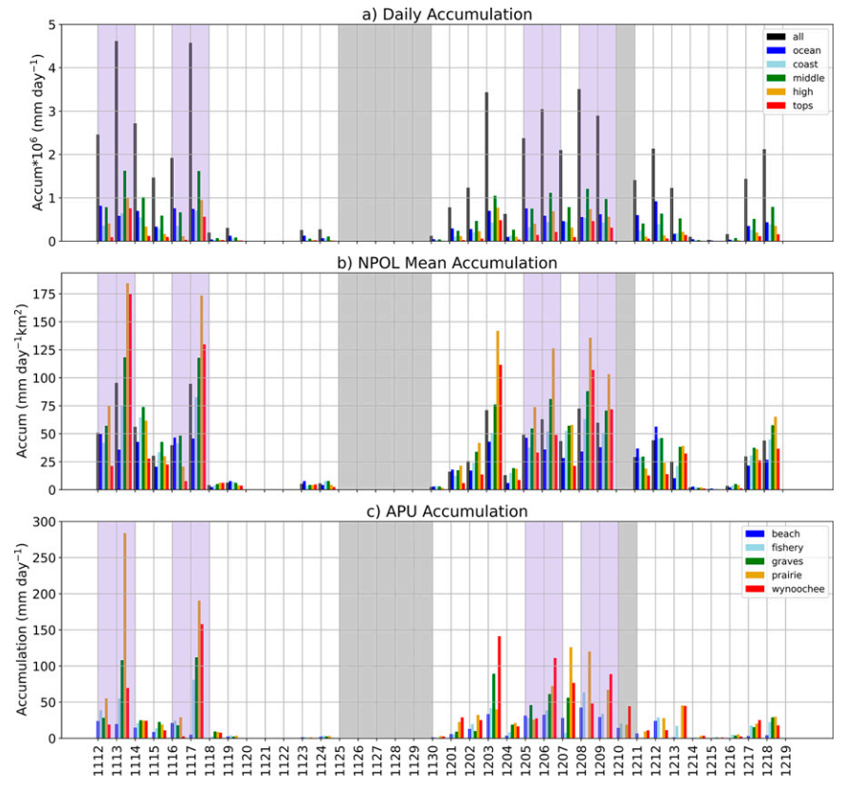
Precipitation variability
If we consider the mean accumulation per square kilometer in each band, the High terrain notably accumulates the largest mean rainfall on 11 days, indicating that it is likely raining harder and/or for longer periods of time compared to the other bands.
Terrain bands
Ocean (z < 5 m)
Coast (5 < z < 100 m)
Middle (100 < z < 500 m)
High (500 < z < 1000 m)
Tops (z > 1000 m)

Slide 6
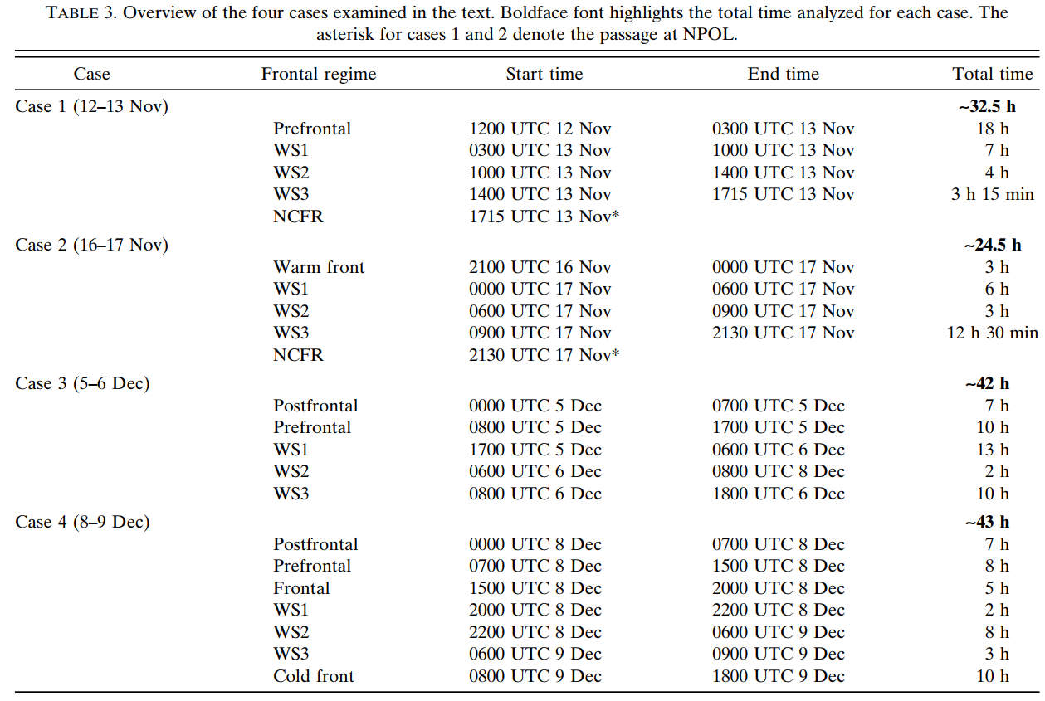
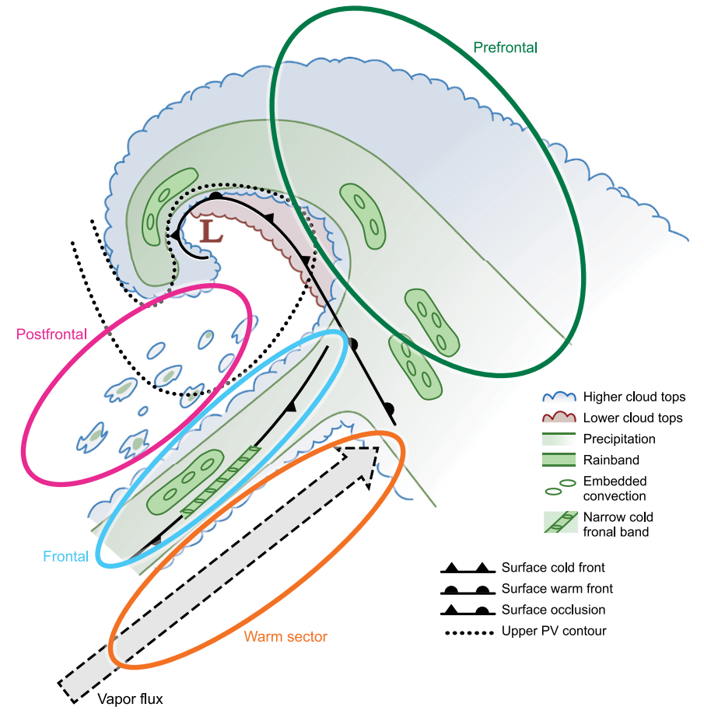
Precipitation variability
Houze et al, 2017; BAMS

Slide 7
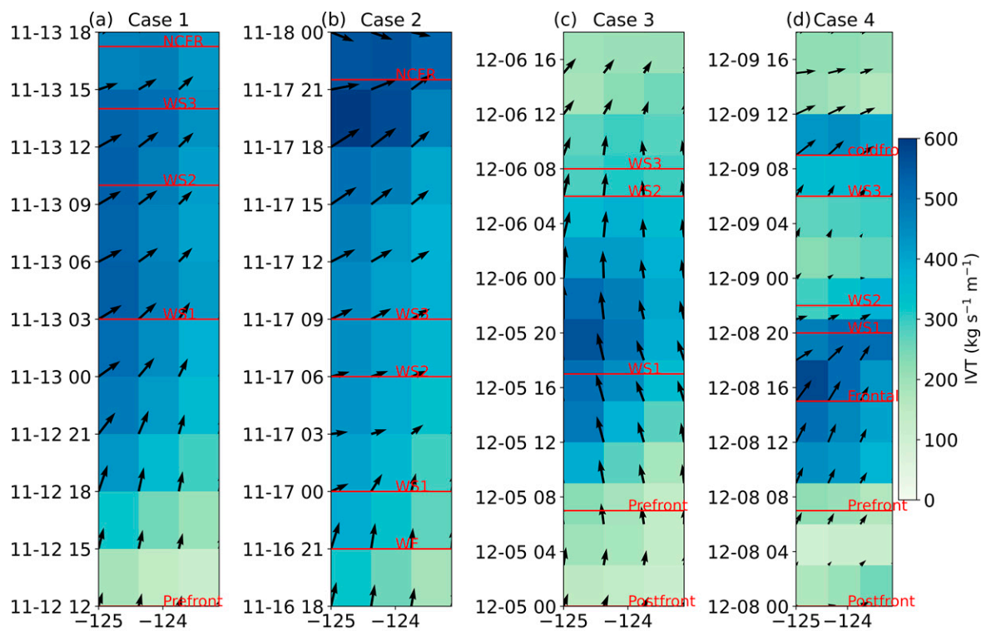
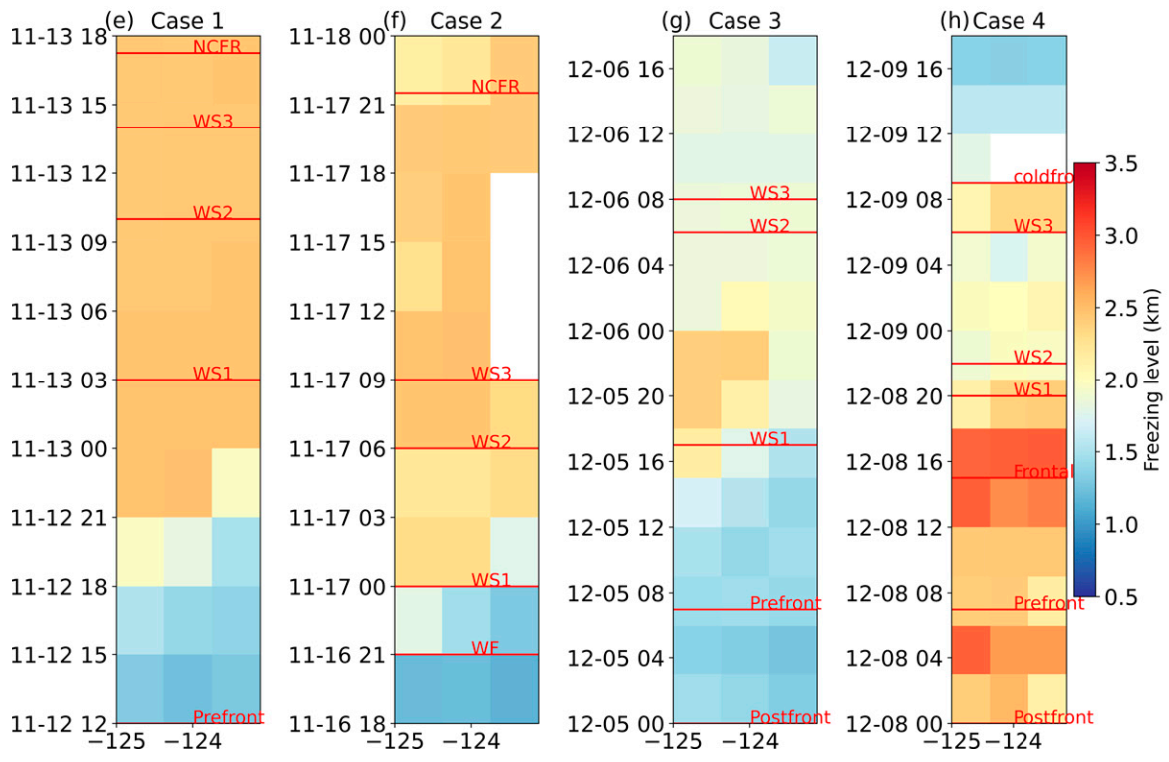
Precipitation variability
MERRA2: reanalysis
IVT & U/V wind at 850mb
Freezing level
Cases 1, 2, and 4 are all AR events with southwesterly flow, turning westerly with time. The flow brings substantial moisture directly into the Quinault Valley.
Case 3 stands out with slightly lower IVT values than the other cases, and southerly flow at 850 hPa throughout the period over the entire domain.
Cases 1, 2, and 3 are characterized with low freezing levels (<1.5 km) initially, which rise to over 2 km in the warm sector.
Case 4 has initially higher melting layers (>2.0 km) which lower after the passage of a cold front at the end of the period around 0900 UTC 9 December.

Slide 8
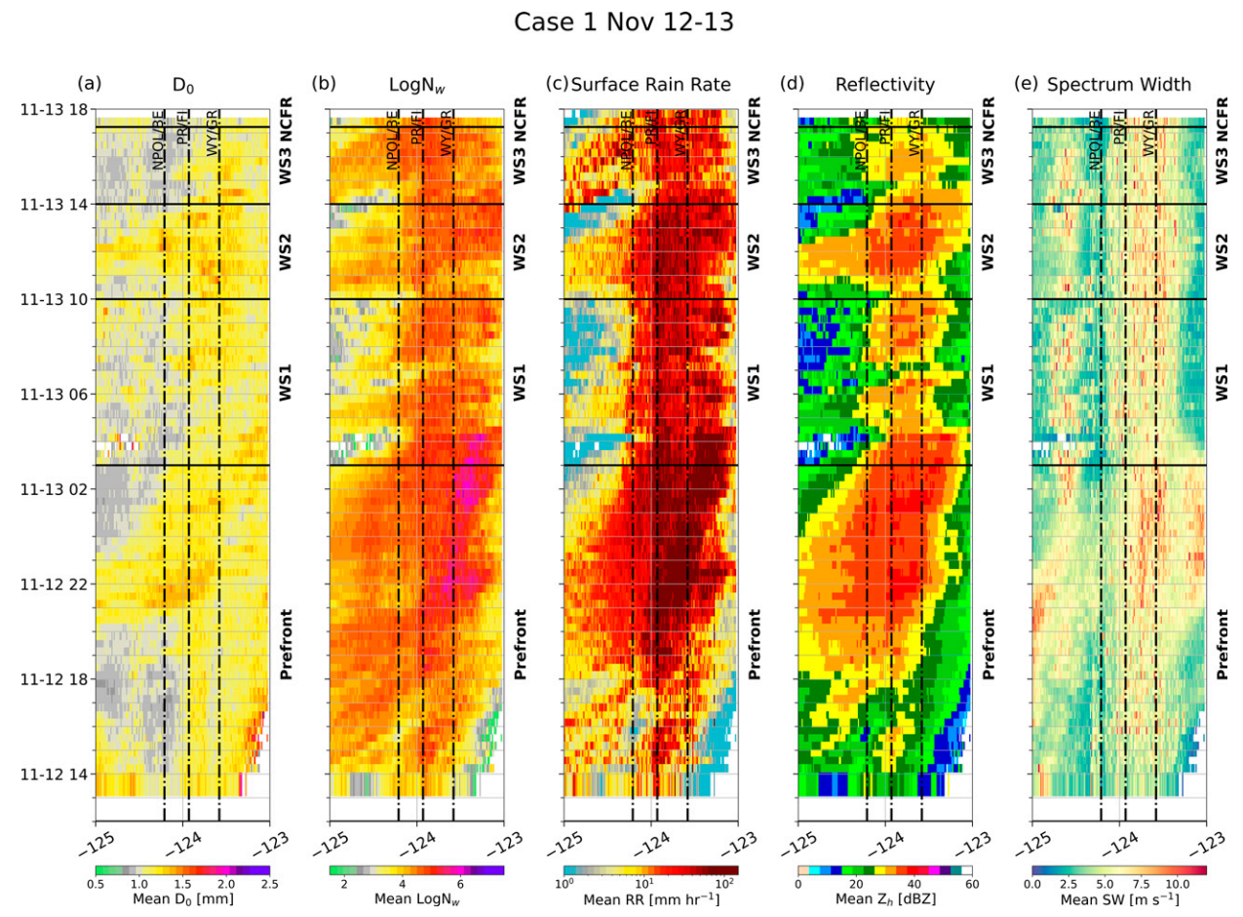
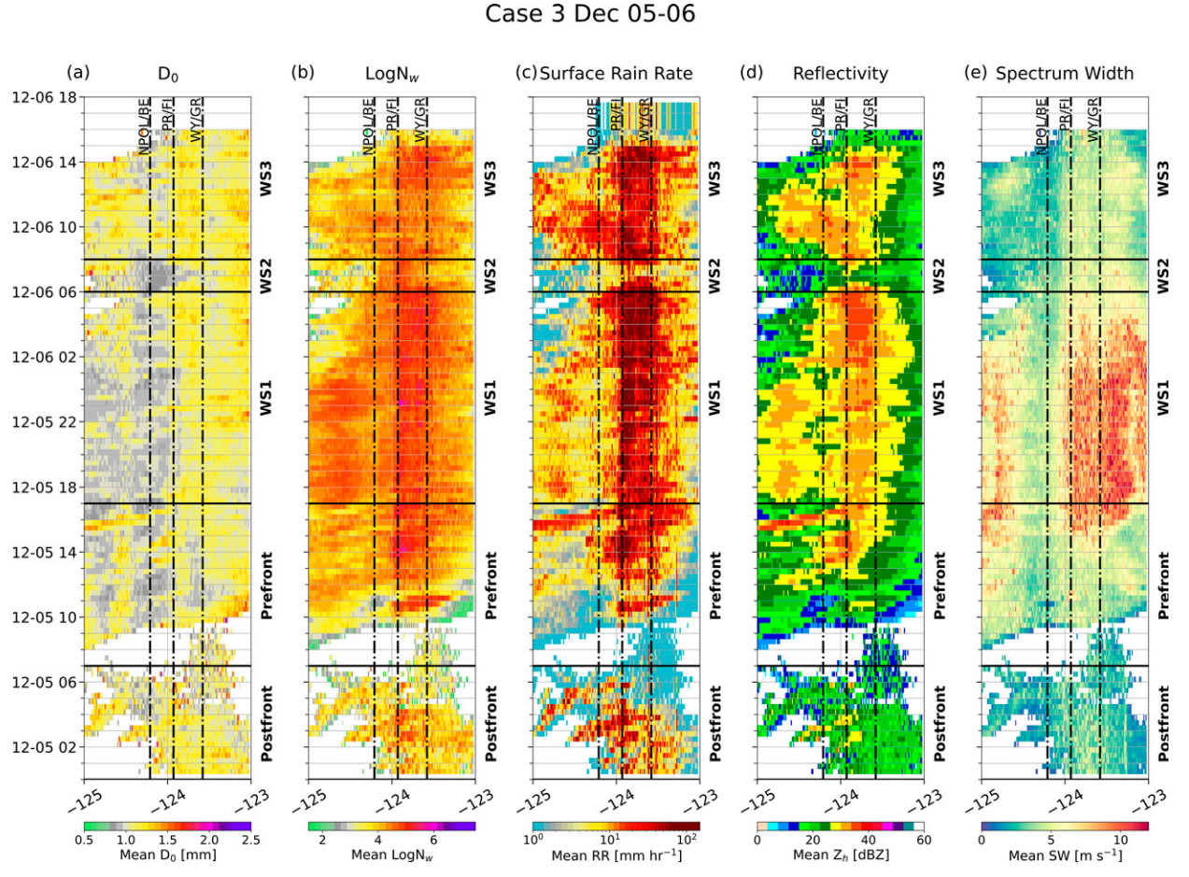
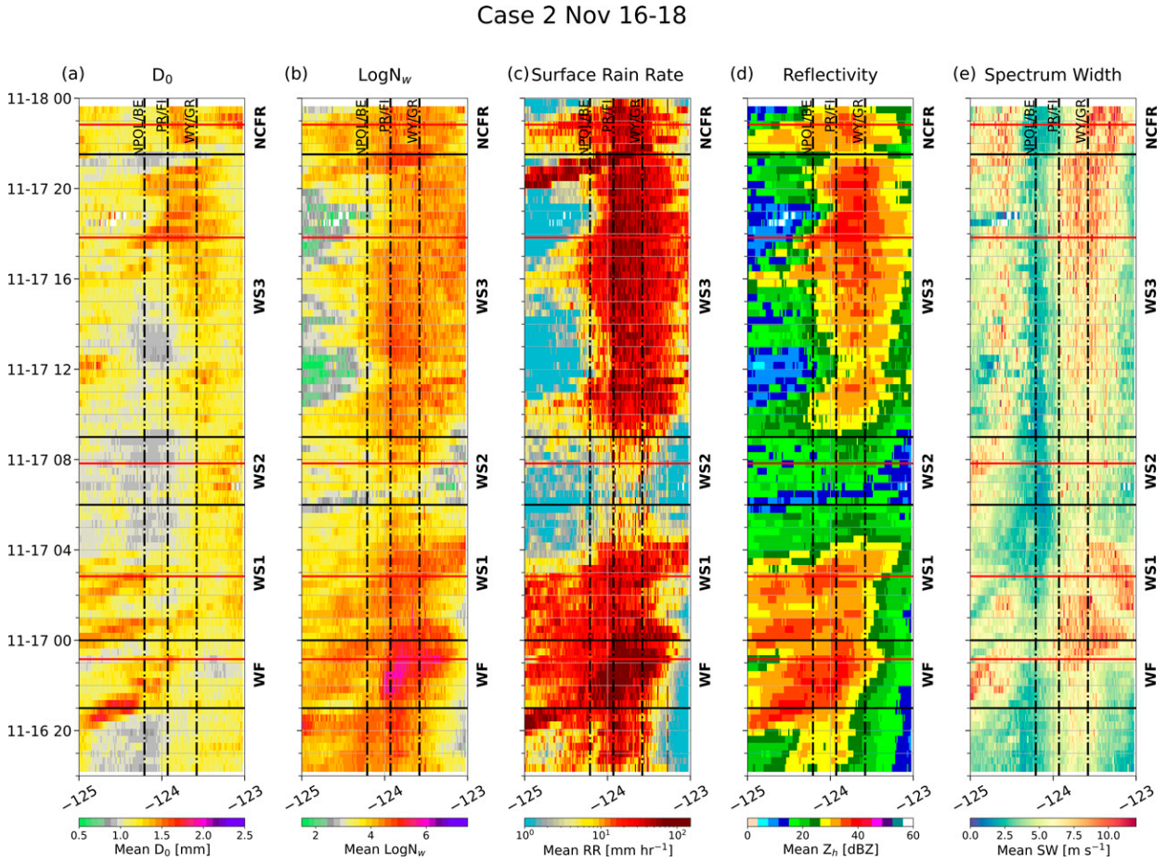
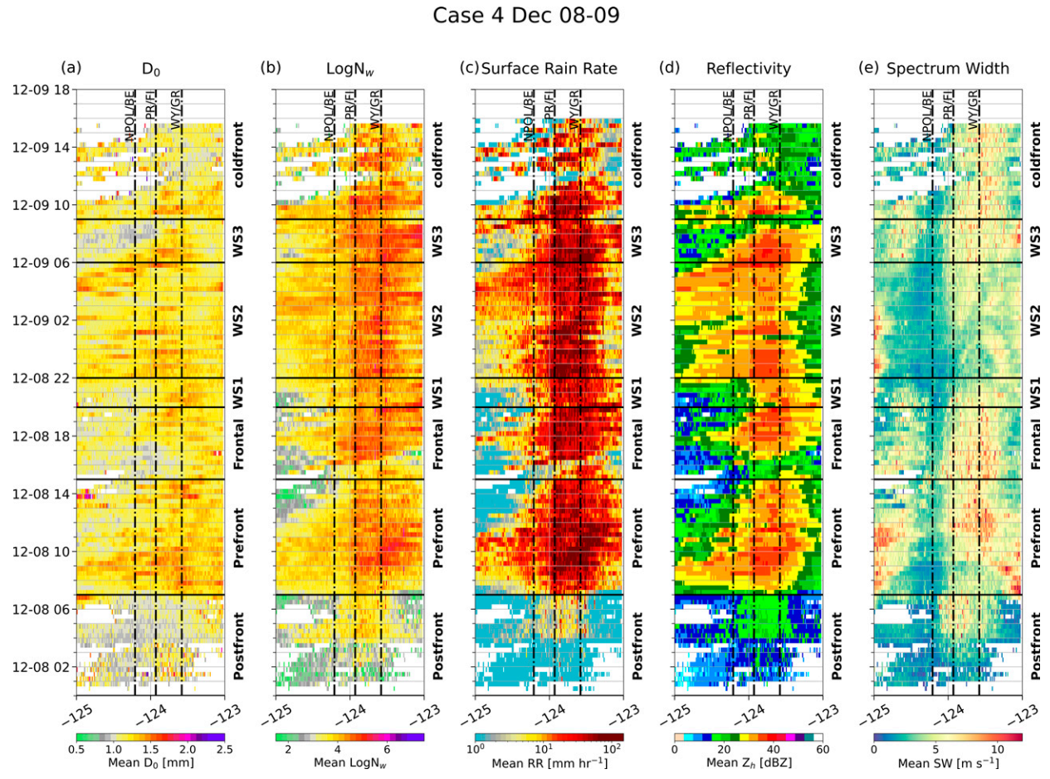
Precipitation variability
(Prefrontal) Widespread moderate rain rates (1–5 mm/h) over the ocean, and heavier rain rates (10–25 mm/h) impinging on the steep terrain
(Prefrontal) High logN_{w} (>5) and elevated mean D₀ (>1.2 mm) over the highest terrain.
Case 3 has relatively light mean rain rates (<3 mm/h) over the ocean and small D₀ (<1.0 mm) but higher mean rain rates (>5 mm/h) over the terrain with uniformly high logN_{w} (>5) and larger D₀ (1.0–1.4 mm)
Case 4 has continuous heavy rainfall (>10 mm/h) over the terrain with lighter periods over the ocean

Slide 9
Precipitation variability
The initial warm sector (WS1) is characterized by widespread mean rain rates >3 mm/h over both the ocean and land
A period of significantly decreased rain rates over both the terrain and ocean, denoted as Warm Sector 2 (WS2), case 2 and 3, which are characterized by smaller D₀ and lower logN_{w}
In the final phase of the warm sector (WS3), heavier rain returns, again focused on the terrain, most notably in cases 2 and 3
In all 4 cases, the heavier mean rain rates (>10 mm/h) are generally focused over the terrain through the duration of the warm sector

Slide 10
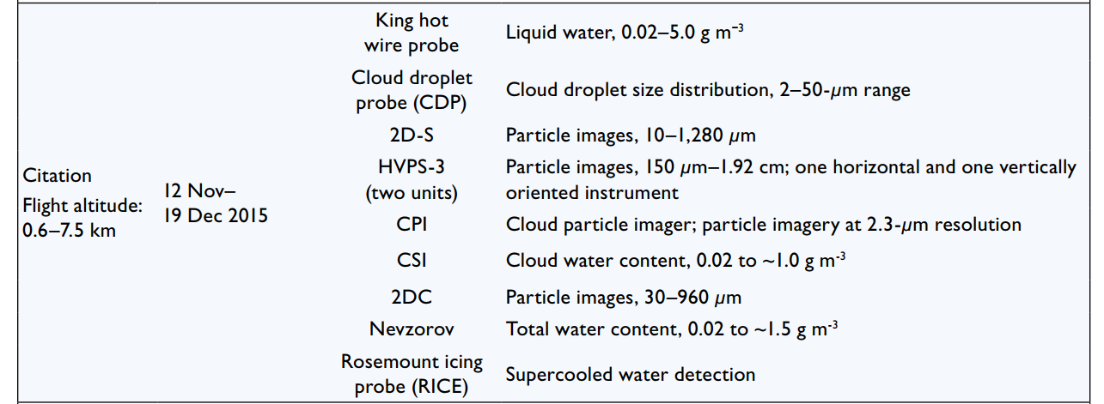
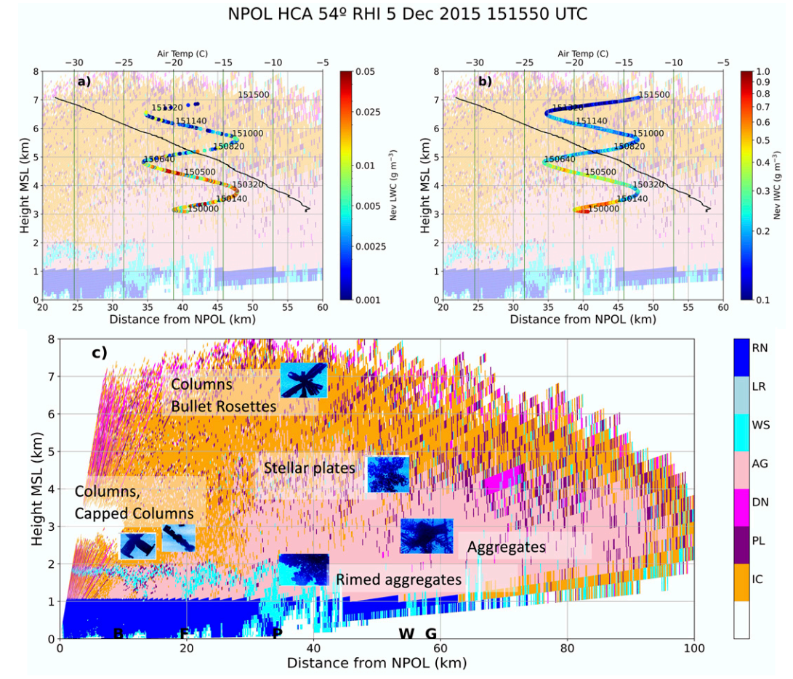
Microphysical variability
Citation performed flight legs or spirals over the Quinault Valley, data from the 2D particle imagers were compared to the HCA classifications and polarimetric radar data from vertical cross sections nearby in time and space
The LWC from the Nevzorov probe shows water contents reaching 0.05 g/m³ around 3 km and generally decreasing with height. The ice water content (IWC) reaches a maximum of 1.0 g/m³ with generally decreasing values with height. Both IWC and LWC have relative maxima in a layer near 4.5 km, corresponding to a temperature of -13ºC.

Slide 11
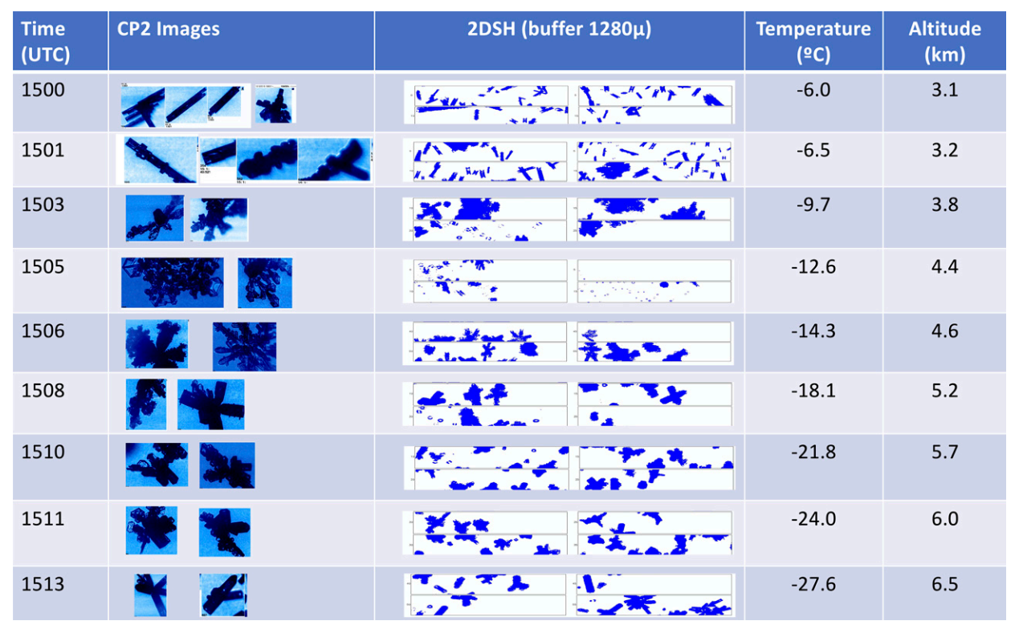
Microphysical variability
small columns with some riming and aggregation (AG)
the crystal growth mode changes to larger dendrites and plates with some bullet and columnar extensions (AG/PL)
stellar crystals and plates with dendritic extensions, fewer but larger crystals mixed in with some small water droplets (PL/DN)
numerous heavily rimed bullet rosettes and some plates (PL)
single columns, hollow columns, and clumps of columns are frequent (IC)

Slide 12
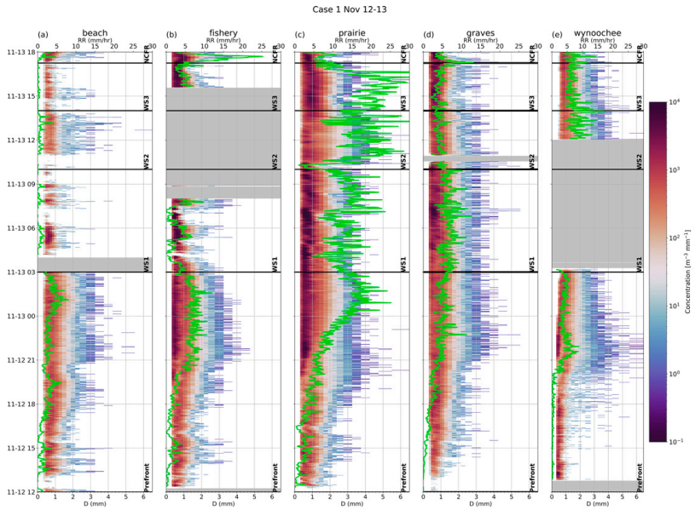
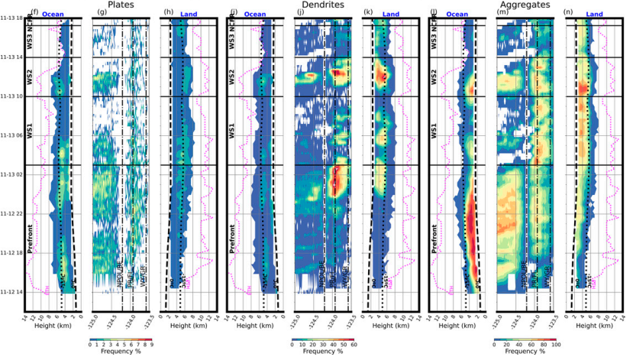
Microphysical variability
Notes:
prefrontal時期，海上高度6公里以下有高頻率的AG出現，跟這時期海上PL頻率增加有關
最靠近海岸線的BE測站雖然測到較低的雨量，但卻有較大的雨滴
Prefrontal後期，陸地上的DN出現頻率增加，但是AG頻率沒有增加，PR測站雨量增加，是由於小雨滴數量增加
WS1時期，陸地上的DN和AG有相對增加，而海上有較低的回波高度和較低的降雨率
NPOL雷達DSD分析，海上的logNw下降，陸上的logNw相對較大
此時，西南風從海岸吹進河谷，IVT增加，水氣通量增加。從APU站來看，BE和FI站降雨率小，小雨滴濃度高。PR站雨量大，DSD分佈變寬，但小雨滴濃度還是很高。
這說明此時的暖雨過程主導地面降雨，冰相粒子對地面降雨的DSD沒有太多的調整
WS2時期，陸地上的DN和AG增加，同時ETH變高。
PR站的降雨率比WS1高，大雨滴的濃度提高，小雨滴的濃度下降。
大雨滴來自於DN/AG融化形成大顆的雨滴，掉落到ML下收集由IVT帶來透過condense形成的小雨滴。
WS3時期，DN和AG減少，ETH下降。
NCFR通過前，降雨率明顯減少，大雨滴濃度也減少，通過後降雨率突然提升，平均粒徑也變大，此時海陸的PL都很小，DN層由海上進入陸地，讓陸上DN增加，

Slide 13
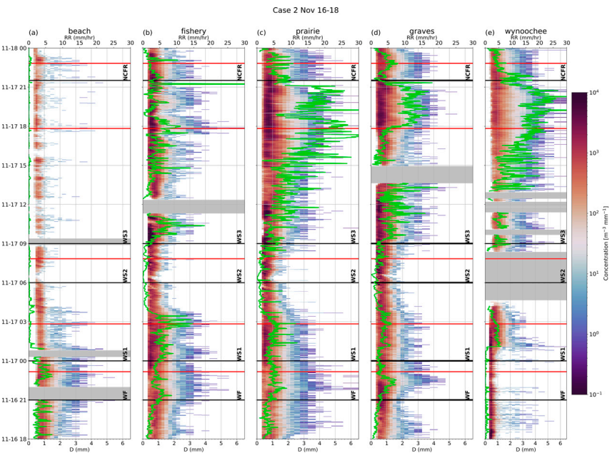
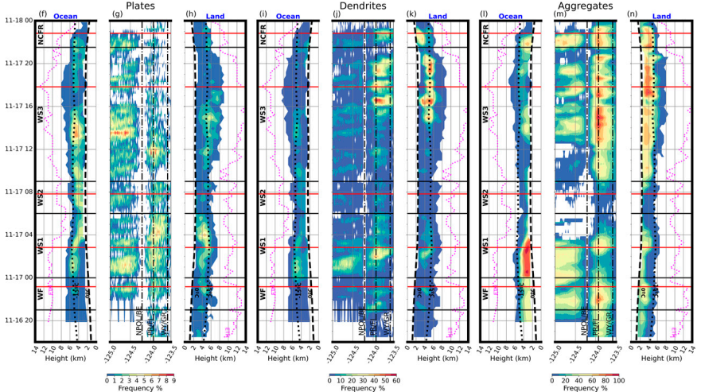
Microphysical variability
Notes:
WS1時期，DN和AG初期在海上有極大值，後期的極大值都在陸地上。
WS2時期，ETH較低，大的冰相粒子減少，這時期的測站降雨率低，並以小雨滴為主。
WS3時期，前期海上的PL增加，後來陸地上的DN和AG增加，伴隨較大的降雨率和大雨滴的濃度增加，同時小雨滴的濃度也增加，表示暖雨過程的貢獻也很重要。
NCFR時期，降雨率和大雨滴濃度在NCFR通過前降低而後增加。

Slide 14
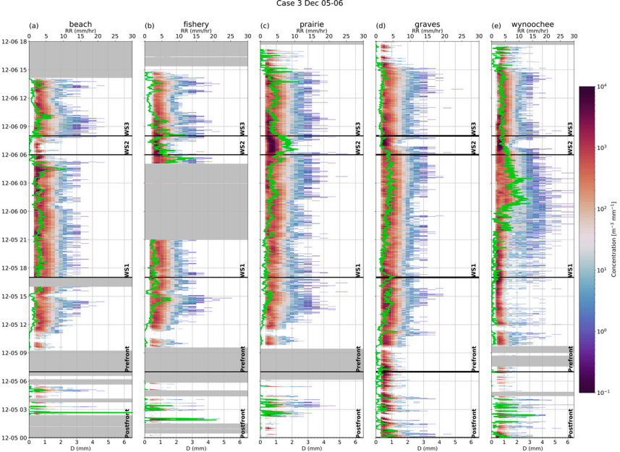
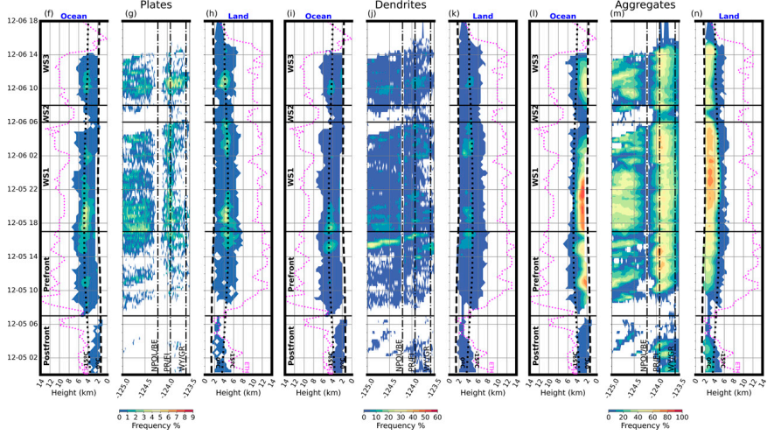
Microphysical variability
Notes:
Case3因為吹南風為主，因此DSD/降雨率/HCA的時空變化不大。
prefrontal後期，dendritic layer由海上移入陸地，但是對地面的DSD影響不大。
WS1時期，海上和陸上的AG都蠻多的，因此DSD的大雨滴濃度也高。
WS1時期的SW也較大，因為南風和地形造成的強風切發展成K-H wave，透過turbulent motion增加AG。WY站有高濃度大雨滴。
WS2時期的PR站，降雨率很大，而且有高濃度小雨滴，此時冰相物理過程不顯著，所以是由暖雨過程主導。

Slide 15
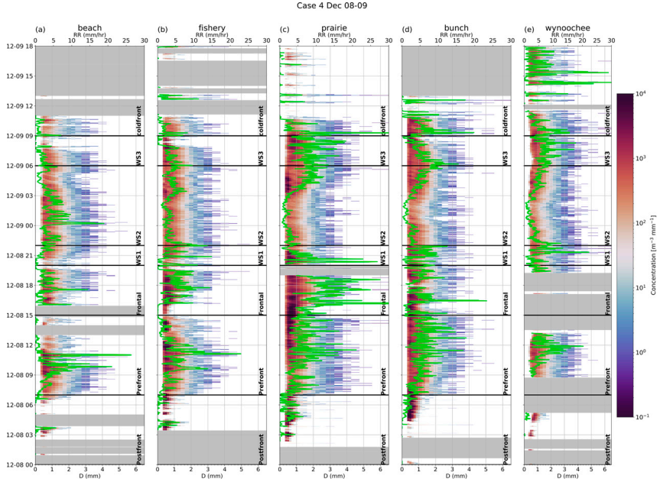
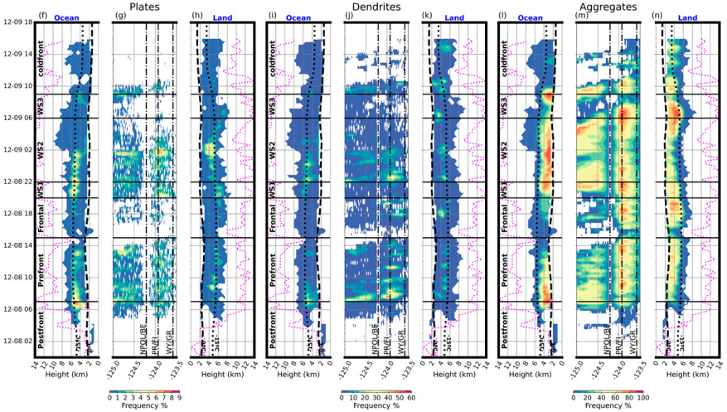
Microphysical variability
Notes:
DN有數個dendritic layer由海上往陸地移動，增加陸地上的DN。
Prefrontal/WS1/WS2時期海上出現高頻率的PL，伴隨海上AG增加，但PL沒那麼容易變成AG，可能要有較大的bulk density或rimed dendritic crystal才容易aggregate。
WS3時期，DN和AG增加，大雨滴濃度增加，但WY站的雨量增加與小雨滴的濃度增加更相關

Slide 16
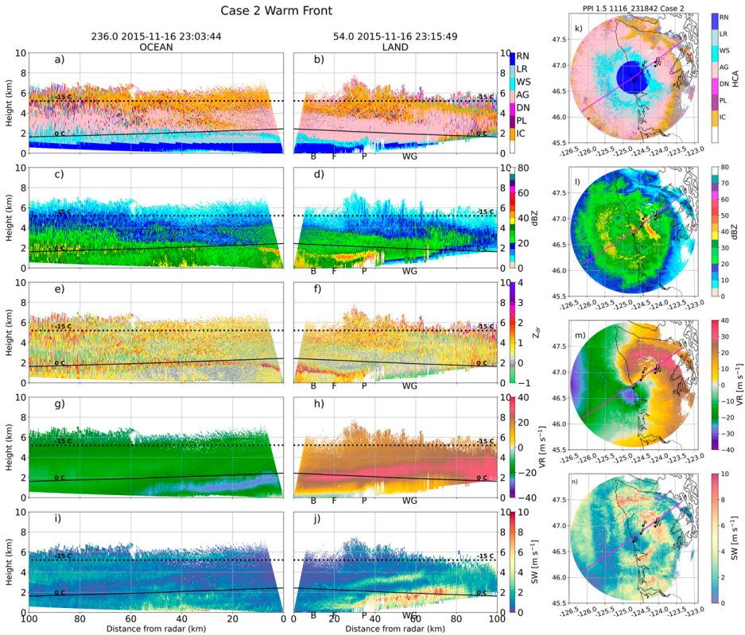
Case2 study
Notes:
WF登陸，可以看到傾斜的融化層(亮帶/Zdr極大值/WS分類)，海上的亮帶較弱，並維持在2公里高。海上40公里處是由碰撞合併為主的暖雨過程(近洋面Z大且Zdr大)
風場低層南風，高層轉西風，暖平流
傾斜的JET從海上50公里處往陸地延伸
亮帶往陸地傾斜，是由於濕雪(WS)融化產生diabatic cooling，冷空氣被地形trapped住。
SW可以看到兩氣團交界處的風切層在高度2公里附近

Slide 17
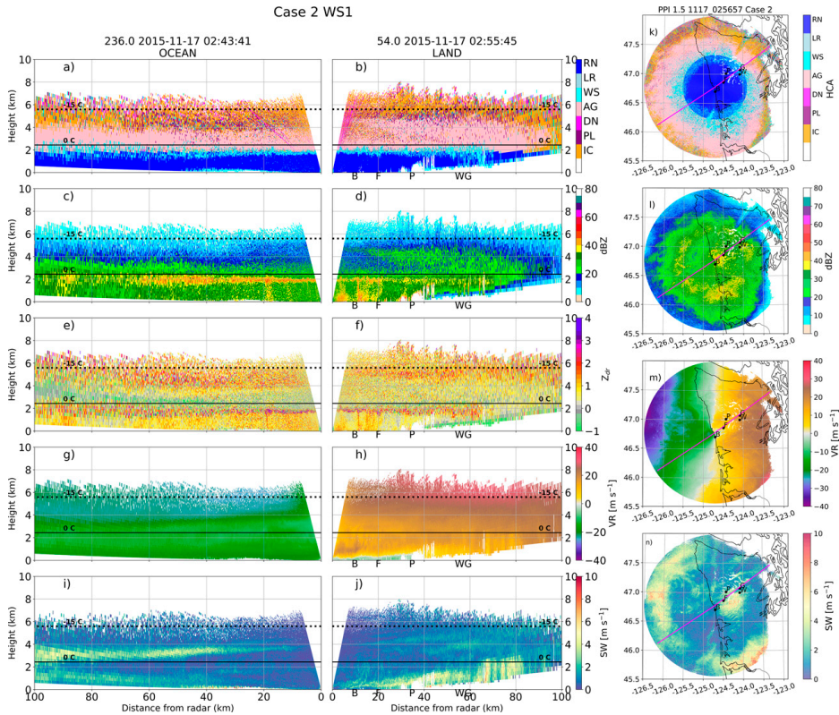
Case2 study
Notes:
WS1時期
深冷雲出現，在-15度線下方的位置有dendritic growth，下方是AG為主(Zdr~0 & Z增加)
亮帶回波強，但是厚度比較薄，因為大的AG融化
徑向速度RHI顯示均勻的西風，風速隨高度增加，海岸邊近地面有淺層的谷風吹向海洋。

Slide 18
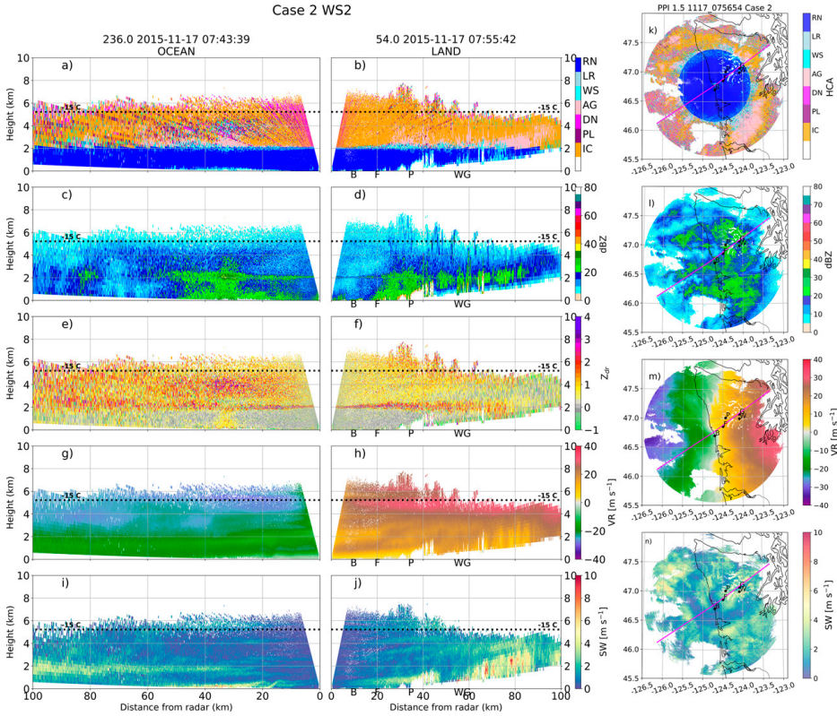
Case2 study
Notes:
WS2時期
此時DSD缺乏大雨滴，綜觀環境較弱，降雨率小，高空缺乏AG，ETH低，以IC為主。
上坡風較其他時期弱一些，減少高層的過飽和，不利於dendritic growth。
降雨以暖雨為主

Slide 19
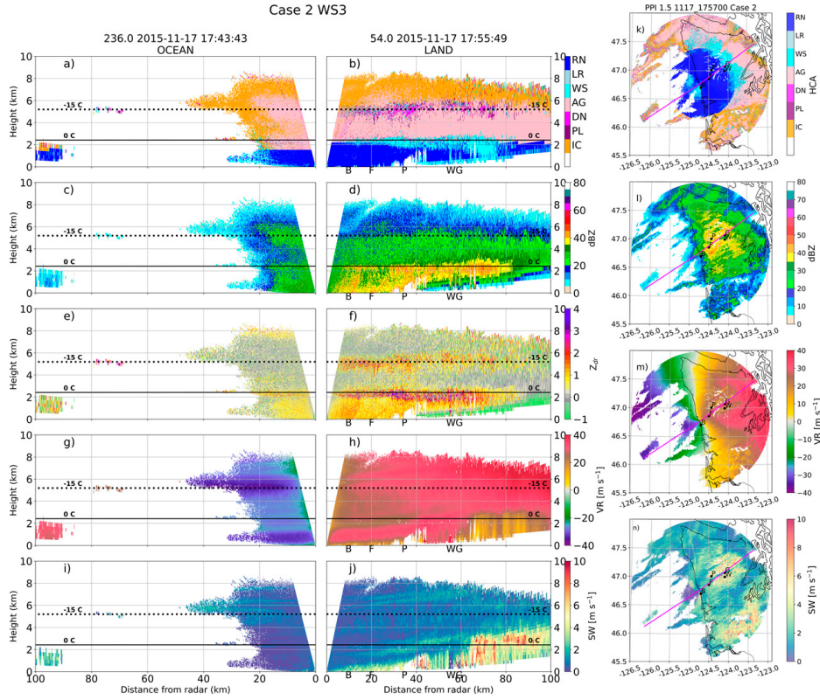
Case2 study
Notes:
WS3時期
深雲出現，ETH達到8公里，回波主要在陸地上。
6公里高(-15度線)附近有dendritic layer(Z中，Zdr大)，下方則是AG(Zdr降到0)。
亮帶很厚，亮帶下方Zdr仍維持很大，表示碰撞合併的特徵，PR站DSD有大雨滴濃度增加，小雨滴濃度也增加。
小雨滴增加可能因為LLJ在暖層帶來水氣，透過地形抬升凝結，形成很多小水滴。融化的AG也能收集成長。

Slide 20
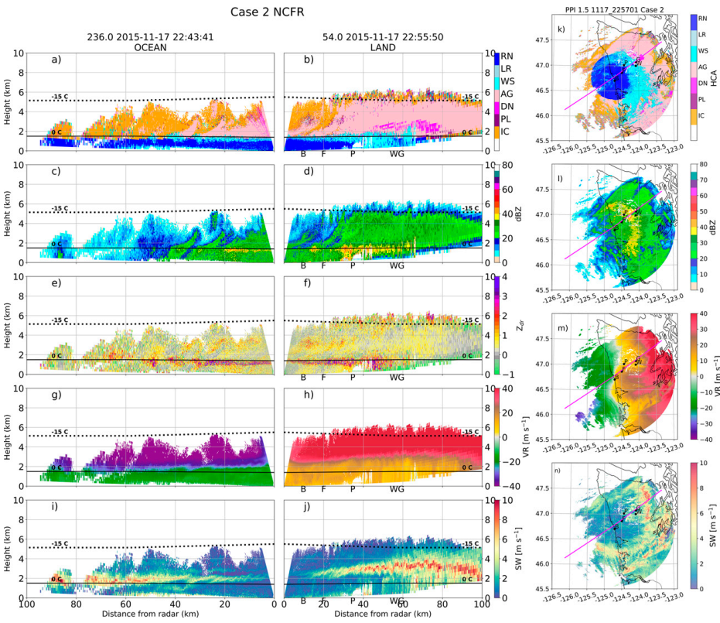
Case2 study
Notes:
NCFR時期
此時對流較淺，融化層較低(低於1.6公里)，陸地上ETH達6公里高
3公里高有風切層，對應到HCA有出現DN，這邊出現K-H wave的特徵，turbulence增加抬升和水氣飽和的機會

Slide 21
Conclusions
Analysis from the NPOL polarimetric S-band radar showed that up to 2000 mm of rain fell over the course of the radar operations, with the most precipitation occurring over moderate terrain heights (100–1000 m).
We analyzed 4 cases in detail that exhibited notable orographic enhancement. All of the cases were associated with ARs, although 3 had wind patterns favorable for moisture transport directly up the Quinault Valley.
There is a clear preference for prolific dendritic concentrations around the -10 to -15ºC height, and more frequent classifications of dendrites over the terrain compared to the ocean sector. The Hovmoller analysis shows that dendritic layers can propagate from the ocean to the terrain.
There is a clear preference for enhanced DN and AG classifications at the longitude of the Prairie disdrometer, which is approximately located at the entrance to the Quinault Valley and the beginning of terrain higher than 500 m. This could be an indicator of increased saturation levels as air is forced upward as it encounters the terrain, leading to further cooling.
Aggregation of ice particles increases sizes, which then can survive longer in the melting layer and/or serve as “seeder drops” at the top of the warm layer that efficiently collect populous small drops as they fall.

Slide 22
Conclusions
Higher frequencies of DN and AG were correlated with a broader DSD with larger maximum drop sizes at the disdrometer sites. However, this did not always result in higher rain rates.
During the early periods of the warm sectors, higher rain rates were correlated with significant increases in the concentration of small drops (<1 mm) and seemed to have little impact from the changes to the bulk ice microphysics.
Dynamics were important in creating small-scale waves such as Kelvin–Helmholtz waves and gravity waves along shear layers which locally enhanced lift and increased aggregation and/or collisions in the warm layer, increasing drop sizes.

