Slide 1
Observed Processes Underlying the Favorable Vortex Repositioning Early in the Development of Hurricane Dorian (2019)
George R. Alvey III, Michael Fischer, Paul Reasor, Jonathan Zawislak, And Robert Rogers

Slide 2
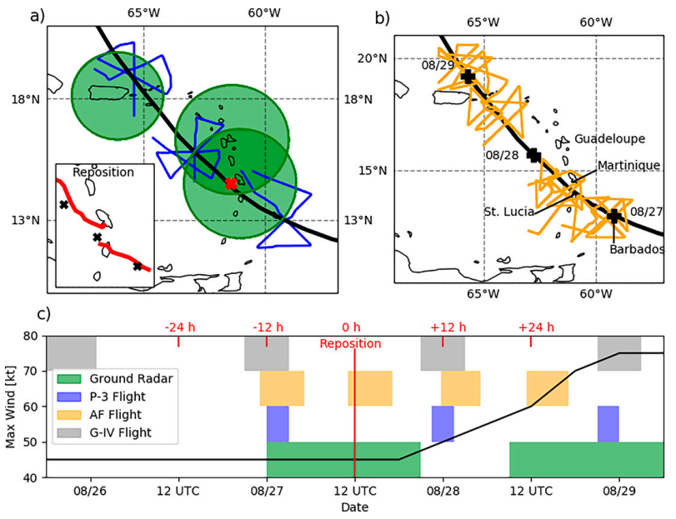
Synopsis/Motivation/Observing Platform Timeline

Slide 3
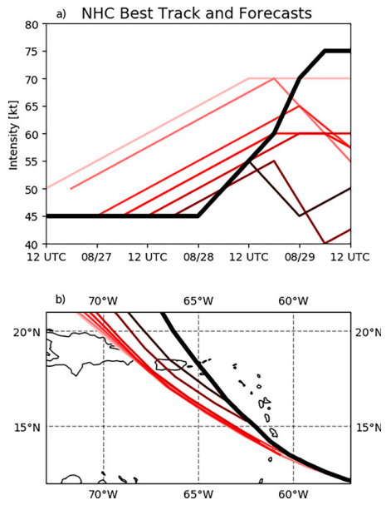
Synopsis/Motivation/Observing Platform Timeline
13-14km
1.5km
3km

Slide 4
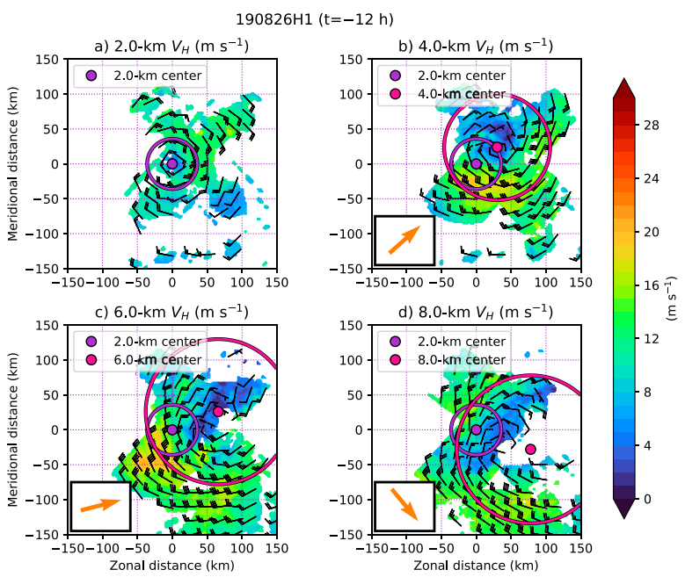
Stage-1 Shear-driven Vortex Misalignment And Dry Air Entrainment
Vortex Misalignment ⇿ Vertical Wind Shear

Slide 5
Stage-1 Shear-driven Vortex Misalignment And Dry Air Entrainment
west-southwesterly
vertical shear at -24h

Slide 6
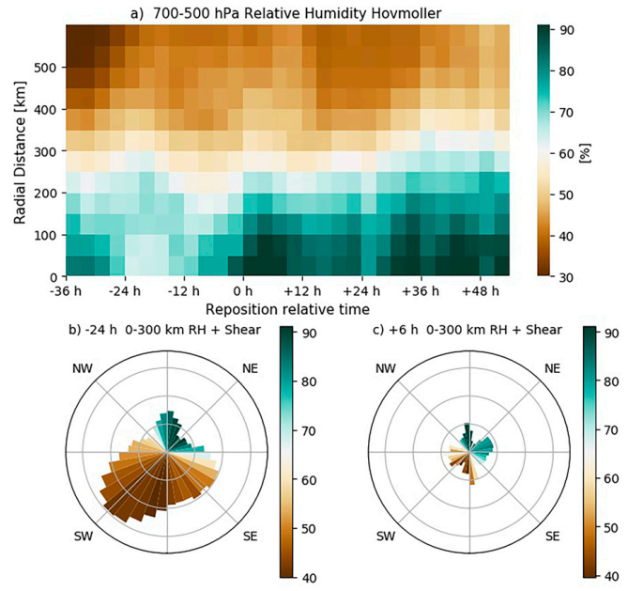
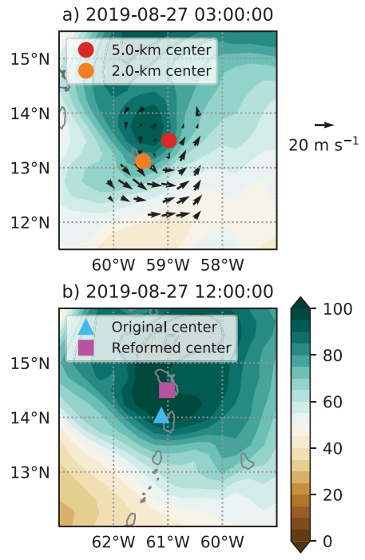
Stage-1 Shear-driven Vortex Misalignment And Dry Air Entrainment

Slide 7
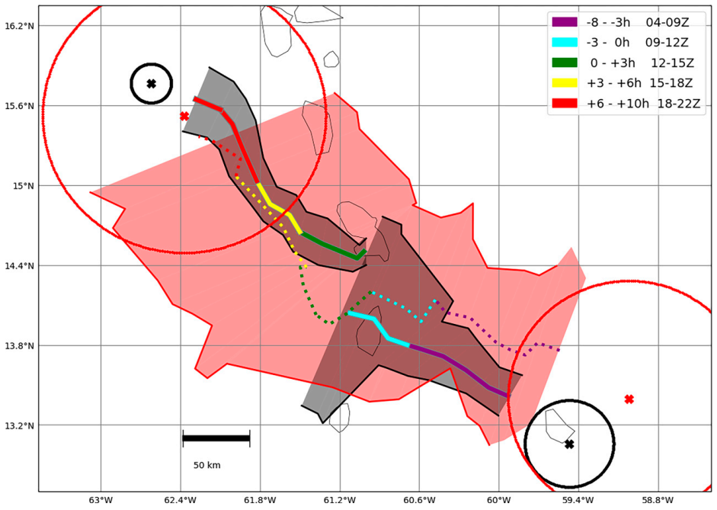
Stage-2 Tilt-driven precipitation and vortex structure in decreasing vertical wind shear

Slide 8
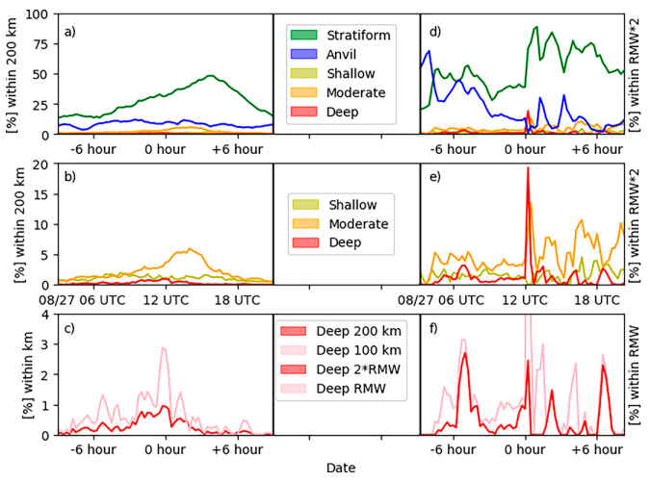
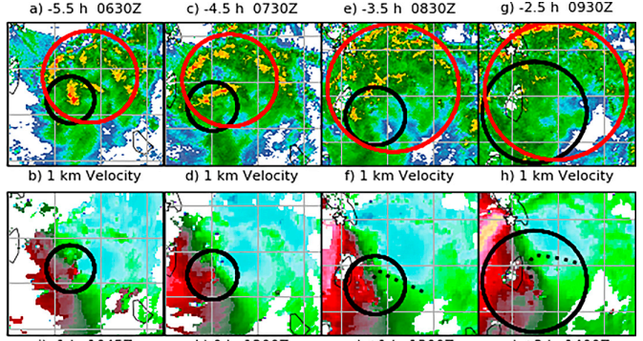
Stage-2 Tilt-driven precipitation and vortex structure in decreasing vertical wind shear

Slide 9
Stage-3 Vortex repositioning and interactions with Martinique and St. Lucia
1) Continued decrease in convection near the weakening LLC; 2) Subsequent increase in deep convection that persists for several hours near Martinique; 3) A distinct relocation of the LLC to the northeast of the MLC into a more humid environment near 8/27 1200 UTC.

Slide 10
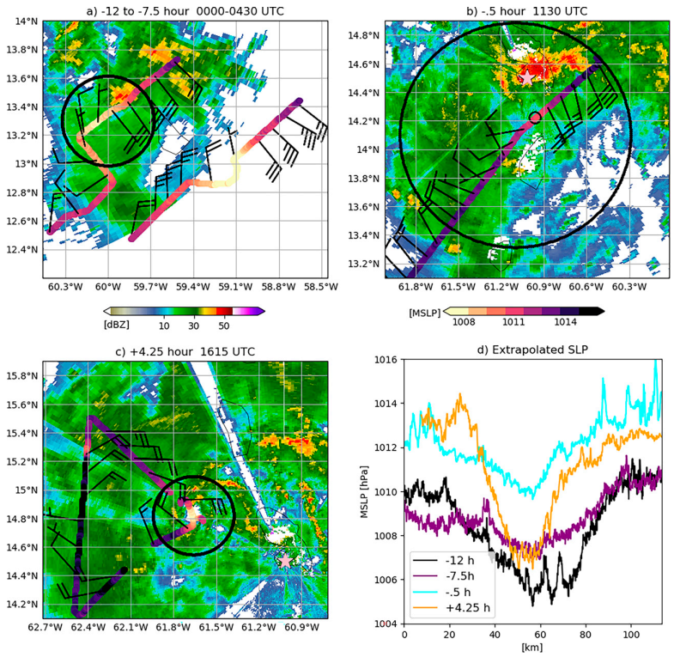
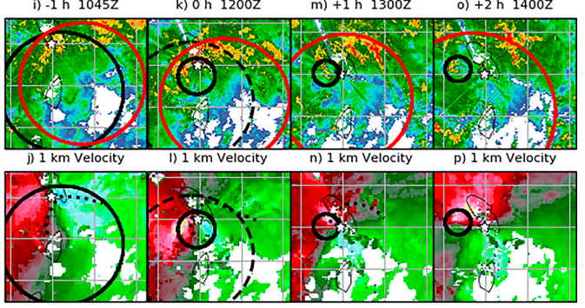
Stage-3 Vortex repositioning and interactions with Martinique and St. Lucia
1) Continued decrease in convection near the weakening LLC; 2) Subsequent increase in deep convection that persists for several hours near Martinique; 3) A distinct relocation of the LLC to the northeast of the MLC into a more humid environment near 8/27 1200 UTC.

Slide 11
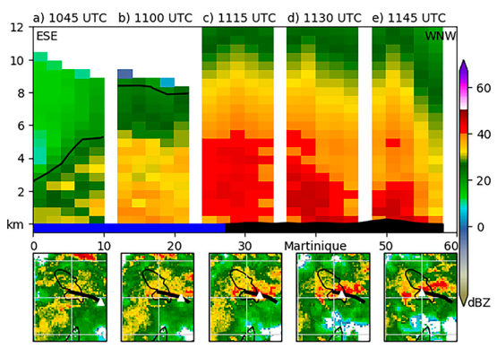
Stage-3 Vortex repositioning and interactions with Martinique and St. Lucia
1) Continued decrease in convection near the weakening LLC; 2) Subsequent increase in deep convection that persists for several hours near Martinique; 3) A distinct relocation of the LLC to the northeast of the MLC into a more humid environment near 8/27 1200 UTC.

Slide 12
Stage-3 Vortex repositioning and interactions with Martinique and St. Lucia
1) Continued decrease in convection near the weakening LLC; 2) Subsequent increase in deep convection that persists for several hours near Martinique; 3) A distinct relocation of the LLC to the northeast of the MLC into a more humid environment near 8/27 1200 UTC.

Slide 13
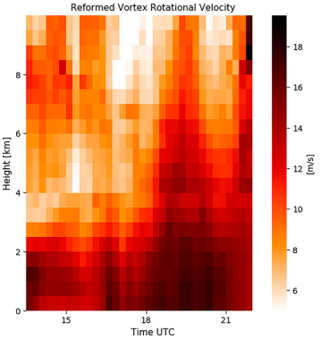
Stage-4 Post-repositioning circulation development
0h 3h 9h 15h

Slide 14
Stage-4 Post-repositioning circulation development

Slide 15
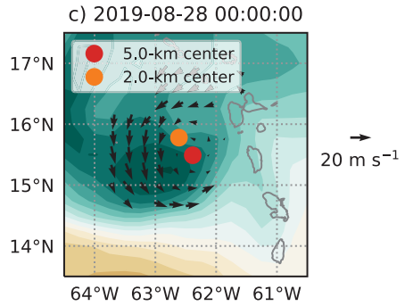
Stage-4 Post-repositioning circulation development

Slide 16
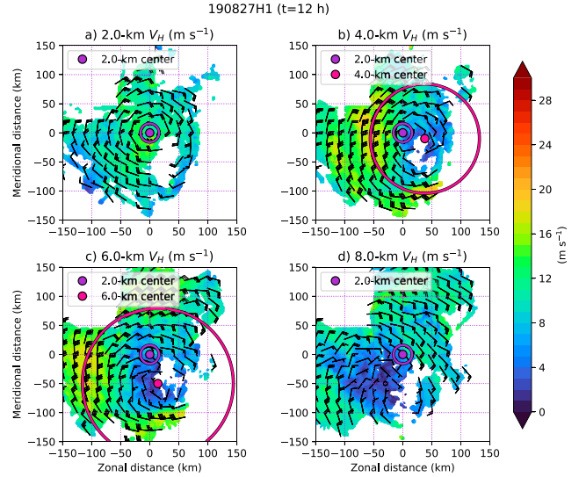
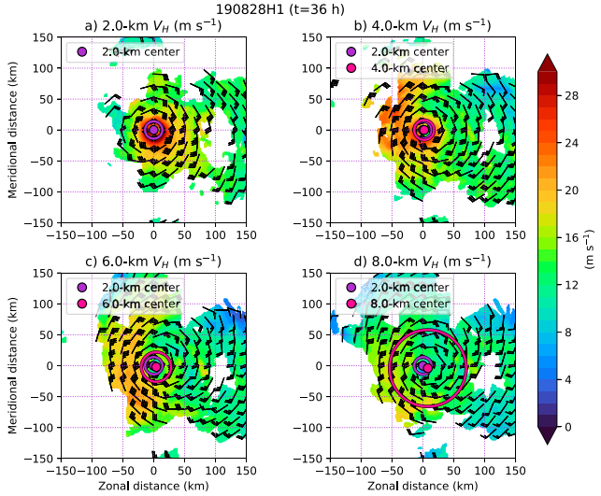
Stage-4 Post-repositioning circulation development

Slide 17
Conclusions
Dorian’s early stage evolution begins with a misaligned vortex and relative humidity asymmetries induced by vertical wind shear (from -12 to -24 h prior to repositioning).
As the primary LLC nears St. Lucia, it broadens and weakens, coincident with a decrease in near-center convection.
A convergence line subsequently interacts with Martinique causing an increase in deep convection that forms into one of the most concentrated CBs of Dorian’s early life cycle.
The development of a mesocyclone from this convective burst ultimately forms a new, compact LLC within the broad cyclonic envelope that eventually deepens and rapidly intensifies despite some continued misalignment.
Although misalignment likely limited potential intensification rates from greatly exceeding this low-end RI threshold, this also indicates that an aligned vortex is not required to initiate RI and the TC’s alignment can improve during intensification.
Aided primarily by episodic moderate and deep convection, the vortex developed vertically within the misaligned configuration following reformation, likely through contributions from vorticity stretching, tilting, and vertical advection.

