Slide 1
The Role of Low-Level Flow Direction on Tropical Cyclone Intensity Changes in a Moderate-Sheared Environment
Paper review
mainly refer to
Tsung-Yung Lee, Chun-Chieh Wu, and Rosimar Rios-Berrios
Wei-Ting Fang
2022.05.17 @CPLab
Other references:
Lin, K. J., S. C. Yang, and S. S. Chen, 2018: Reducing TC position uncertainty in an ensemble data assimilation and rediction system: A case study of Typhoon Fanapi (2010). Wea. Forecasting, 33, 561–582.

Slide 2
Outline
Introduction
Methodology
Model setting
The NBF(no background flow) and LLF(low-level flow) experiments
Results—NBF experiment
Results—LLF experiments
Intensity change and axisymmetric structure
Asymmetric structure
Backward trajectory analyses
Discussion and conclusions

Slide 3
Introduction(1/2)
Under moderate DLS (deep-layer shear; 10–20 kt; 1 kt ≈ 0.51 m s⁻¹), the operational intensity forecast error for intense TCs (maximum surface wind speed > 70 kt) is significantly greater than that in the regimes with weak (<10 kt) or strong (>20 kt) DLS (Bhatia and Nolan 2013). In addition, the predictability for the intensification of simulated TCs decreases under moderate-sheared environments (Zhang and Tao 2013; Finocchio and Majumdar 2017b).
Although DLS tilts and weakens TCs via the aforementioned mechanisms, TCs can withstand the negative impact of DLS to sustain its intensity or even intensify through a number of processes. Some of those processes include upshear precession (Jones 1995), vortex Rossby wave damping (Schecter et al. 2002; Reasor et al. 2004; Reasor and Montgomery 2015), downshear reformation (Molinari et al. 2004, 2006; Molinari and Vollaro 2010; Nguyen and Molinari 2012), and vortex restructuring (Rios-Berrios et al. 2018). All those processes facilitate tilt reduction, vortex realignment, and intensification.

Slide 4
Introduction(2/2)
In the simulations of Rappin and Nolan (2012) and Onderlinde and Nolan (2016), upshear-pointing LLF is more favorable for TC intensification than downshear-pointing LLF.
However, when the LLF points to the DL quadrant, the TC intensification rate is greater in the simulation of Chen et al. (2019).
Rappin and Nolan (2012) suggested that the upshear-pointing LLF favors intensification since the increased surface heat fluxes in the left-of-shear half can enhance the moist entropy in the boundary layer, after being ventilated by the midlevel dry air from the downstream (relative to the cyclonic circulation of TC) of the DL convection.
In contrast, Chen et al. (2019) pointed out that the DL-pointing LLF results in an enhancement of the downshear-right (DR) surface heat fluxes.

Slide 5
Methodology
Model setting
WRF-ARW Model (version 3.9.1)
Two-way vortex-following nested grid
250×250 (18 km): doubly periodic lateral boundary conditions 202×202 (6 km) 352×352 (2 km)
41 vertical levels
Model top: 25 km
f plane with the Coriolis parameter of 5.0 × 10⁻⁵ s⁻¹
Fixed sea surface temperature of 28°C
The physical parameterization schemes include the WRF single-moment 6-class microphysics scheme (Hong and Lim 2006), the rapid radiative transfer model scheme (Mlawer et al. 1997) for longwave radiation, the Dudhia radiation parameterization scheme (Dudhia 1989) for shortwave radiation, the Yonsei University planetary boundary layer scheme (Hong et al. 2006), and the revised MM5 Monin–Obukhov scheme (Jiménez et al. 2012) for surface-layer scheme.
No cumulus parameterization is employed owing to the convection-permitting resolution of the innermost domain.

Slide 6
Methodology
NBF: no background flow
LLF: low-level flow
The NBF and LLF experiments
A Rankine vortex (Rotunno and Emanuel 1987) with a maximum tangential wind of 15 m s⁻¹, a radius of maximum wind (RMW) of 82.5 km, a cutoff radius of 412.5 km, and a vortex depth of 20 km is placed at the center of the outermost domain. After the initialization, the NBF experiment is integrated for 168 h.
At the time when the maximum surface wind speed of NBF reaches 70 kt, the set of designed background flow is imposed onto the vortex. To simplify the interpretation of the experiments, the shortwave and longwave radiation schemes are turned off after the background flow imposition.
Each experiment is integrated for 72 h. During the simulation, the horizontal wind beyond 300-km radius from the center of the innermost domain is nudged to the desired background flow every 30 min in order to keep the background flow unchanged throughout the simulation, while not modifying the TC structure.

Slide 7
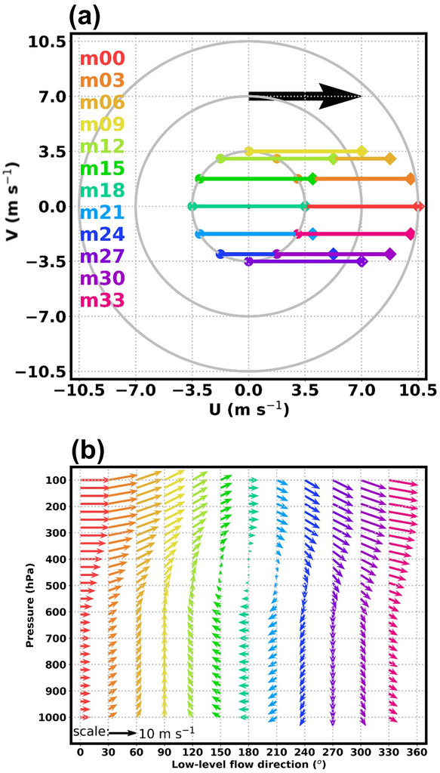
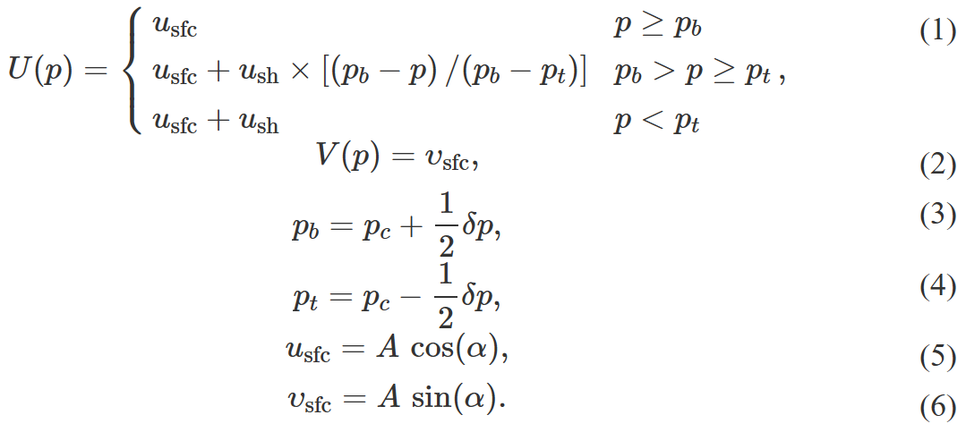
Methodology
Imposed background flow profile
p_{b} = 600 hPa and p_{t} = 250 hPa

Slide 8
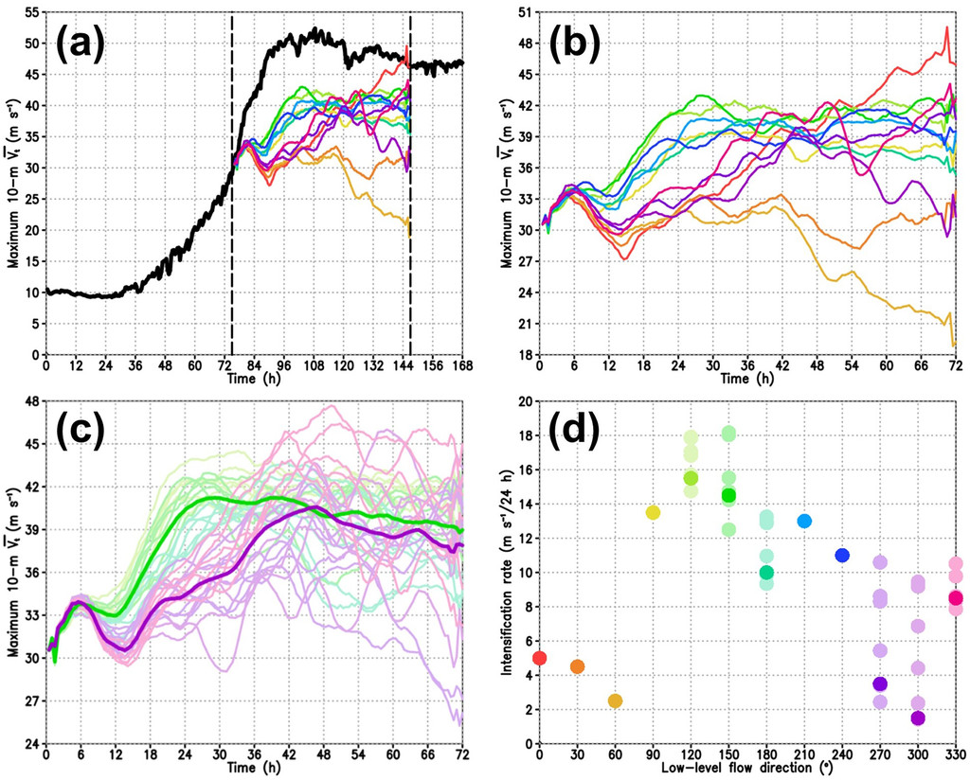
Results
FI: m09, m12, m15, m18, m21, and m24
SI: m27, m30, m33, m00
Other: m03 , m06
Intensity change
Fast-intensifying (FI) group
Adding random perturbation to the water vapor mixing ratio (within ±5 g kg⁻¹) below 950 hPa and only within the innermost domain at 0 h of the LLF experiment.
Slow-intensifying (SI) group

Slide 9
Axisymmetric structure
Perturbation of potential temperature
averaged between 300 and 500 hPa
500-hPa potential vorticity
NBF
FI
SI
NBF
FI
SI
850-hPa potential vorticity
Diabatic heating rate (shading; K h⁻¹) and vertical velocity (contours; every 0.5 m s⁻¹) averaged between 100 and 925 hPa
NBF
FI
SI
NBF
FI
SI

Slide 10
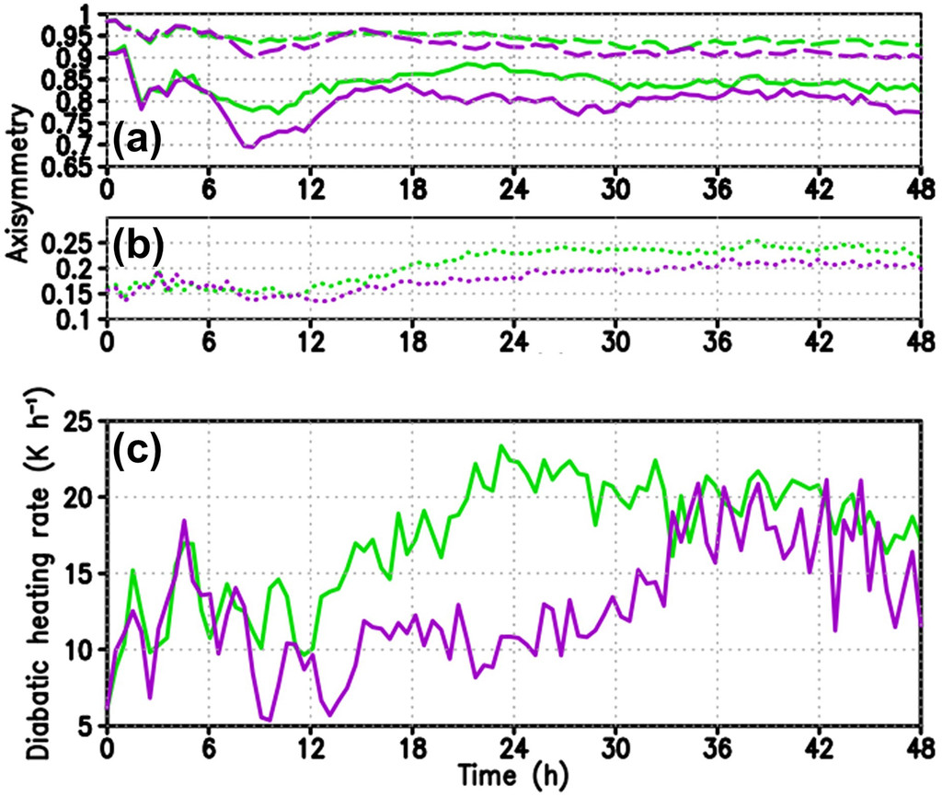
Axisymmetric structure
500-hPa potential vorticity
300–500-hPa perturbation potential temperature
Diabatic heating rate (dotted line) averaged between 100 and 925 hPa within 15–30-km radius
Averaged diabatic heating rate between 100 and 925 hPa within 15–30-km radius

Slide 11
Asymmetric structure
500–850-hPa tilt magnitude (km) of the potential vorticity centroid
500–850-hPa tilt angle (°) of the potential vorticity centroid

Slide 12
Eyewall development
FI
SI
FI
SI
FI
SI
Notes:
Figure 8 shows the ensemble-mean simulated reflectivity and 1 m s⁻¹ upward motion at 700 hPa and distribution of the 500-hPa PV. At the beginning (Figs. 8a,b), the eyewall convection develops in all shear-relative quadrants with numerous midlevel PV patches. As the simulation proceeds, the DLS starts to modulate the structure. At 6 h, the intense updrafts are confined in the downshear quadrants, with the maximum of simulated reflectivity at 700 hPa at the downwind side of the updrafts relative to the primary storm circulation (Figs. 8c,d). At this time, the midlevel PV forms a weak ring structure in both groups. In addition, a rainband outside the eyewall is located in the downshear quadrants. Substantial differences in convective activity occur after 12 h when the axisymmetric diabatic heating between the two groups starts to diverge (Fig. 4c). The intense updrafts of the FI group can extend from the DL quadrant to the UL quadrant (Fig. 8e), while the intense updrafts of the SI group is located in the downshear quadrants (Fig. 8f). At 12 h, the FI group shows a ring structure of midlevel PV, while the SI group has a weaker midlevel PV at the center. After 18 h, the eyewall and the midlevel PV of the FI group is well developed, showing more axisymmetric eyewall convection and intense PV ring (Figs. 8g,i). In contrast, the eyewall of the SI group is more asymmetric and sometimes open in the right-of-shear half (Figs. 8h,j) with weaker PV at the center.

Slide 13
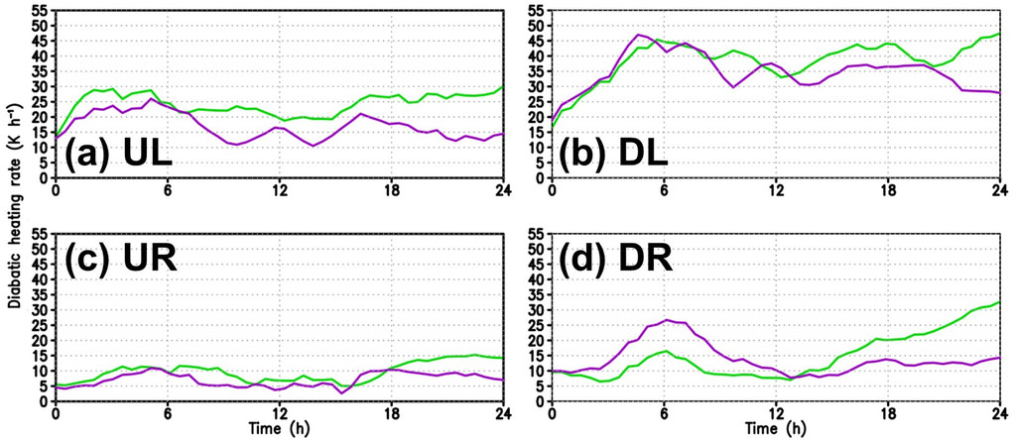
Deep-layer-mean diabatic heating
Notes:
DL (UR) heating is the largest (smallest) among all quadrants in both groups (Figs. 9b,c)
The FI group have a higher UL heating after 6 h (Fig. 9a). In contrast, the SI group experience a higher DR heating in the first 12 h (Fig. 9d).

Slide 14
UL-quadrant-averaged secondary circulation
FI
SI
FI
SI
Notes:
At 6–12 h, for the UL quadrant of the SI group, the 1.5 m s⁻¹ contour of downdraft extends from 450 to 650 hPa and the boundary layer inflow almost vanishes (Fig. 10d).
After 12 h, the UL eyewall of FI group is reestablished with a weaker midlevel inflow and robust secondary circulation (Figs. 10e,g).

Slide 15
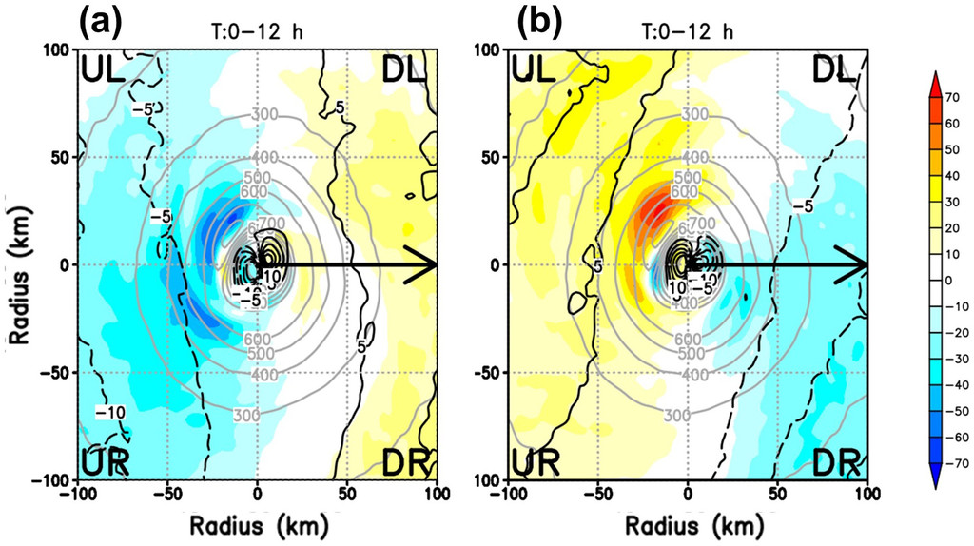
Moreover, a strong signature of surface heat fluxes enhancement occurs at 10–30 km in radius in the UL quadrant of the SI group (Fig. 12b), indicating a stronger ventilation effect in the SI group, since the surface heat fluxes also depend on the water vapor disequilibrium at the air–sea interface.
Surface heat flux
Notes:
The FI group experiences enhanced surface heat fluxes in the downshear half (Fig. 12a), while the SI group undergoes enhanced surface heat fluxes in the upshear half (Fig. 12b).

Slide 16
Thermodynamic properties of the boundary layer
θ_{e} averaged below 900 hPa at 12 hr
experiencing upward motion at 12 h at 700 hPa and
located below 700 hPa at each time step of the backward trajectory.
Notes:
The air parcels for this analysis are initially placed at 700 hPa in the UL quadrant at 16–30 km in radius (Fig. 13), representing the place of eyewall convection with large group difference of the boundary layer θ_{e} in the inner core (Fig. 13c). The radial and azimuthal resolution for these parcels are 2 km and 5°, respectively, which yields 152 air parcels for each LLF simulation (Fig. 13). These parcels are traced backward from 12 to 0 h with a time resolution of 10 min.

Slide 17
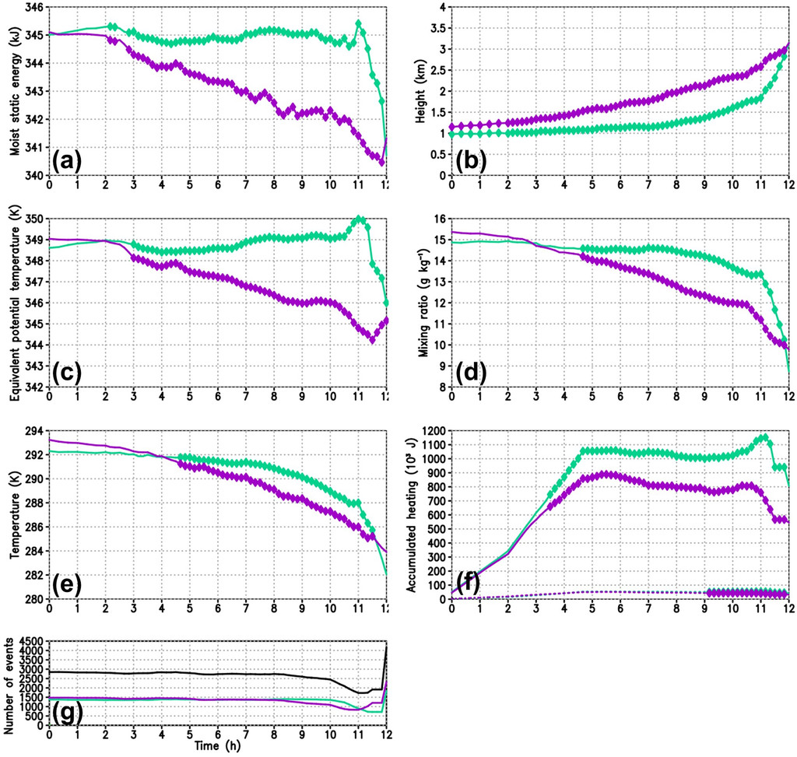
Backward trajectory analyses
moist static energy
height
equivalent potential
temperature
mixing ratio
accumulated heating from the latent heat flux (solid line) and sensible heat flux (dotted line)
temperature
Notes:
The SI group shows slightly but significantly larger height of these air parcels. Therefore, the moist static energy evolution difference is mainly associated with water vapor and temperature changes.
Both the water vapor mixing ratio (Fig. 14d) and temperature (Fig. 14e) show similar evolution as the moist static energy and θ_{e} (Figs. 14a,c).

Slide 18
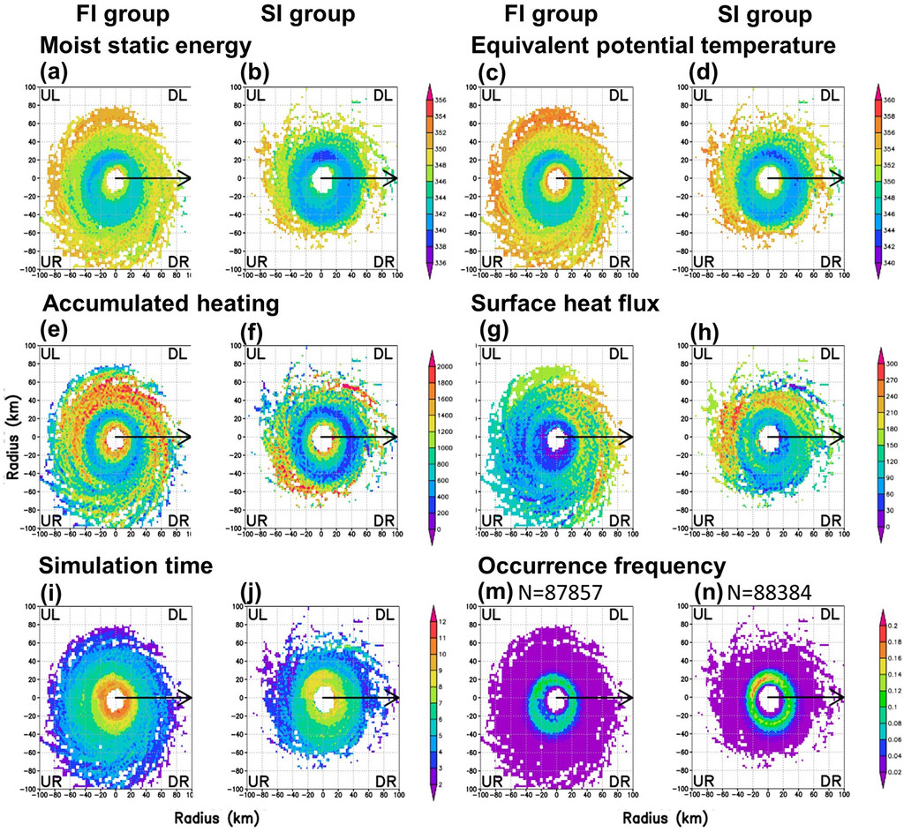
Grid-averaged properties
Notes:
The accumulated heating is calculated only when the air parcels are located below 950 hPa.

Slide 19
Discussion and conclusions (1/2)
The UL-pointing LLF favors fast intensification, while the DR-pointing LLF leads to slow intensification.
Both the value and axisymmetry of the inner-core PV and warm core of the FI group increase more rapidly than that of the SI group.
Corresponding to the earlier development of the PV and warm core, the eyewall convection of the FI group enhances and becomes relatively axisymmetric after 12 h. In contrast, the eyewall convection of SI group gradually develops after 24 h.
The evolution of tilt shows that the SI group experiences larger tilt reduction during 6–9 h while the tilt of FI group remain at a smaller value in the first 24 h.
However, the upshear precession process (Jones 1995) and downshear reformation (Molinari et al. 2004, 2006; Molinari and Vollaro 2010; Nguyen and Molinari 2012), shown as important mechanisms for TC intensification in previous works, are not found in this study.

Slide 20
Discussion and conclusions (2/2)
After imposing the background flow, the eyewall convection becomes asymmetric in both groups. While the eyewall of the SI group is mainly active in the downshear half, the convection of the FI group can develop through the UL quadrant.
The LLF direction is shown to be capable of modulating the surface wind speed and heat fluxes during the first 12 h when the enhanced surface heat fluxes occur mainly in the downshear and upshear half for the FI and SI groups, respectively.
By analyzing the plan view of the grid-averaged thermodynamic properties along the air-parcel trajectories, the selected air parcels of FI group experience larger latent and sensible heat fluxes in the downshear half corresponded to the area of with enhanced surface heat flux.
The maintenance of the UL convection then can enhance the axisymmetric heating and reduce the ventilation effect, both benefiting the following higher intensification rate.

