Slide 1
Thermodynamic Characteristics of Downdrafts in Tropical Cyclones as Seen in Idealized Simulations of Different Intensities
Wadler, J. B., D. S. Nolan, J. A. Zhang, and L. K. Shay, 2021: Thermodynamic characteristics of downdrafts in tropical cyclones as seen in idealized simulations of different intensities. J. Atmos.Sci., 78, 3503-3324.

Slide 2
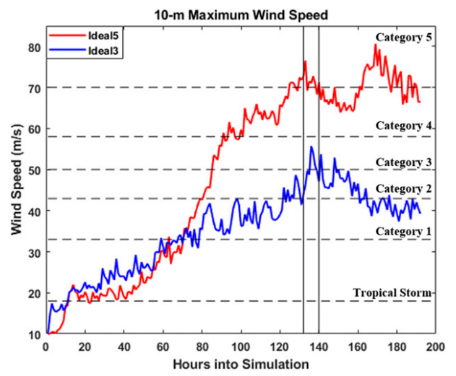
Data and Methodology
WRF v3.9.1.1
Ideal3 & Ideal5 (Klotz and Nolan, 2019)
Ideal5
90% qv mid-level
29ºC SST
Ideal3
100% qv
27ºC SST
132h < t < 140h
2min output
Two sets of trajectories 1. those initiated directly into downdrafts
w < -1 m/s 2. those initiated in an annulus around the storm
62 km < r < 122 km, 500 m < h < 6 km
dr = 1 km, dθ=2º

Slide 3
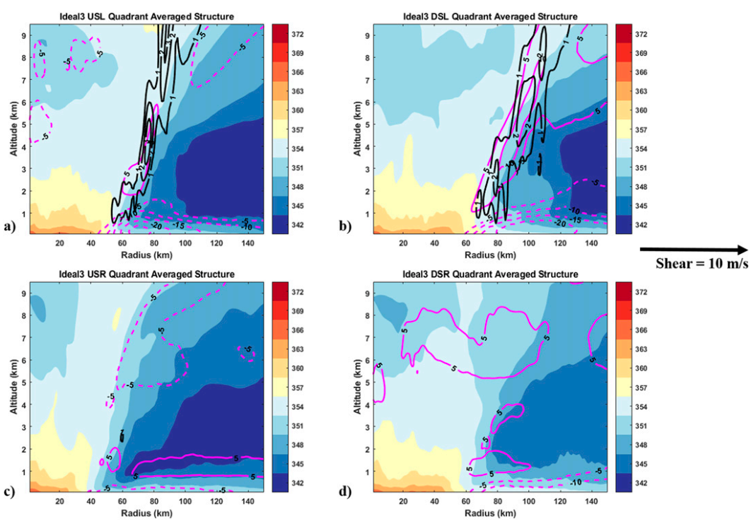
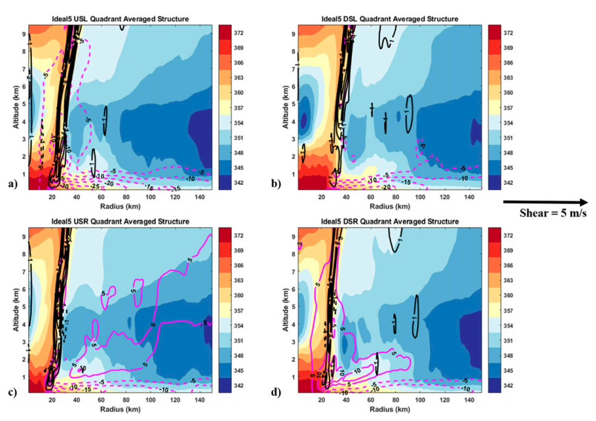
Generalized storm structure
Ideal3
Ideal5

Slide 4
Generalized storm structure

Slide 5
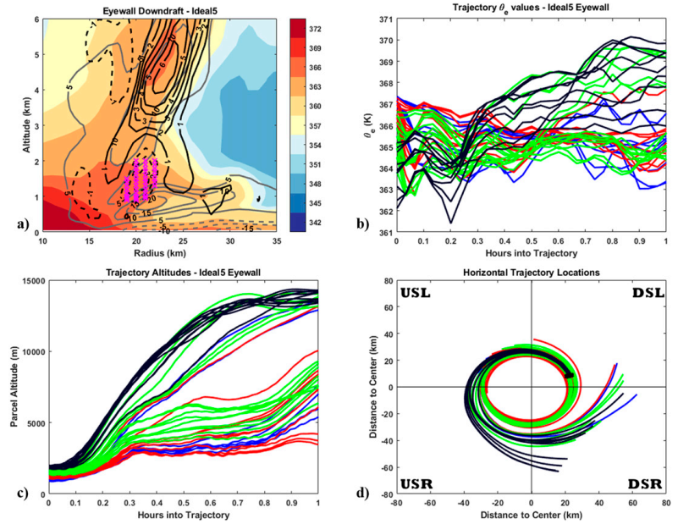
Downdrafts in the eyewall region (Ideal5)
DSL
h₀ <= 1000m
1000m < h₀ <= 1350m
1350m < h₀ <= 1700m
h₀ > 1700m
Do not pose negative
Thermodynamic influence

Slide 6
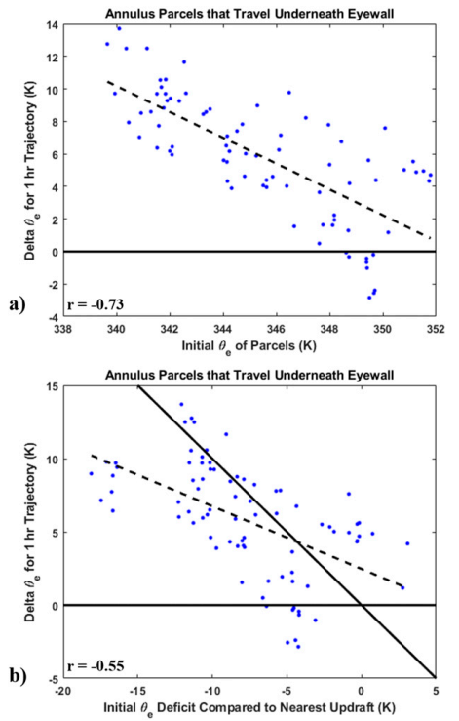
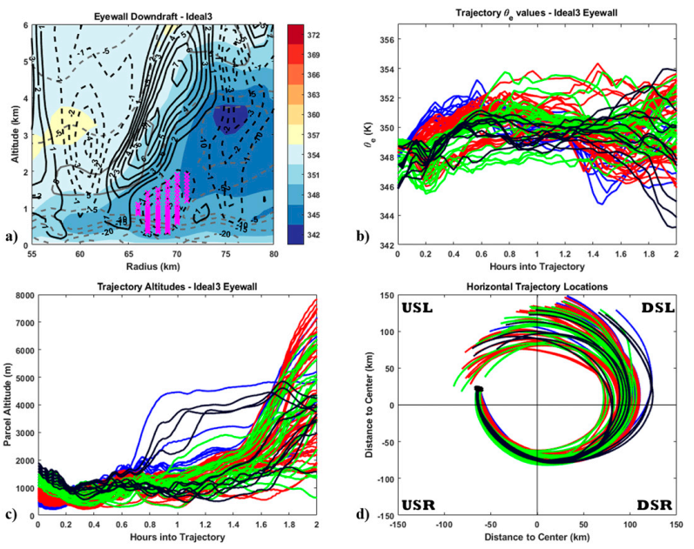
Downdrafts in the eyewall region (Ideal3)
USL
θe ↑
θe ↓
$$\overline{θ_{e_{eyewall}}}=353K$$
$$\overline{θ_{e_{parcels}}}=349K$$
h₀ <= 500m
500m < h₀ <= 1000m
1000m < h₀ <= 1500m
h₀ > 1500m
θe ↑
θe ↓
θe₀ - nearest updrafts max(θe)
Do pose negative
Thermodynamic influence

Slide 7
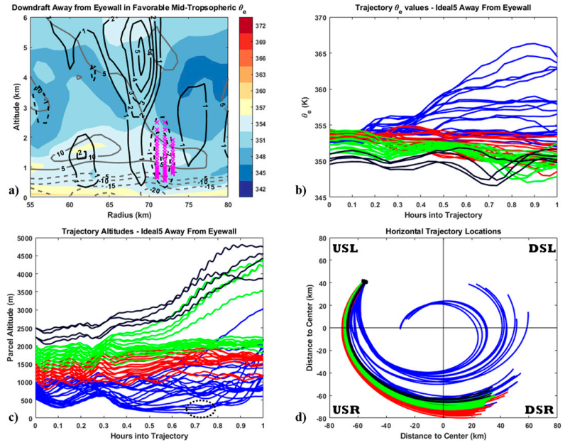
Favorable convective downdrafts away from eyewall (Ideal5)
h₀ <= 1000m
1000m < h₀ <= 1500m
1500m < h₀ <= 2000m
h₀ > 2000m
Do not pose negative
Thermodynamic influence
more convective stable

Slide 8
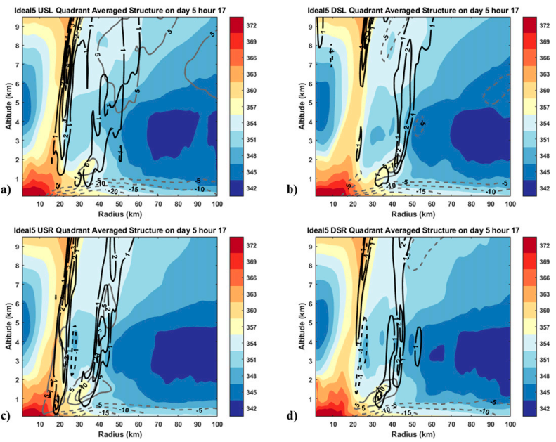
Favorable convective downdrafts away from eyewall (Ideal5)
113h - SEF
Thermodynamic shield

Slide 9
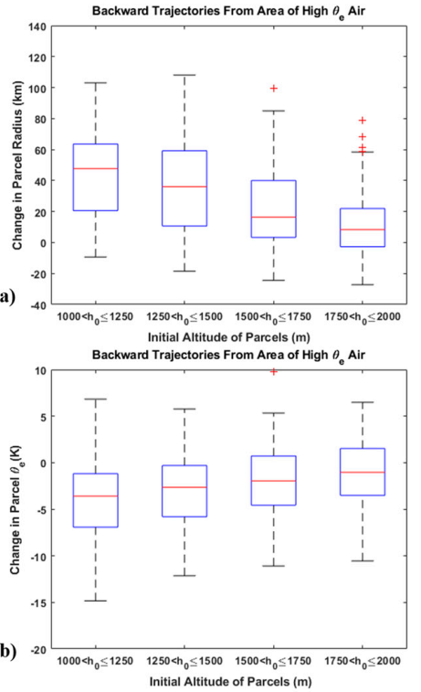
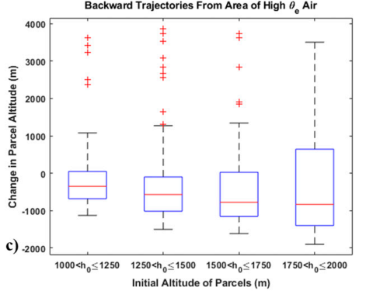
Favorable convective downdrafts away from eyewall (Ideal5)
t: 135h
r: 40-90km
h: 1-2km
backward 2hr
Δr
Δh
Δθe

Slide 10
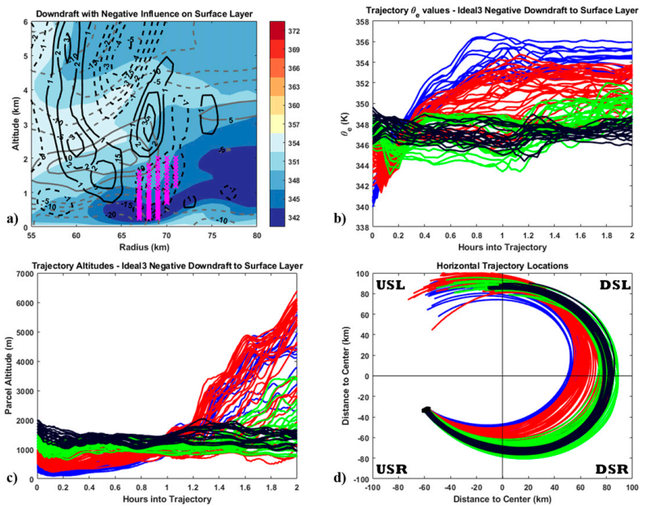
Unfavorable convective downdrafts away from eyewall (Ideal3 - surface layer)
Do not pose negative
Thermodynamic influence
h₀ <= 500m
500m < h₀ <= 1000m
1000m < h₀ <= 1500m
h₀ > 1500m

Slide 11
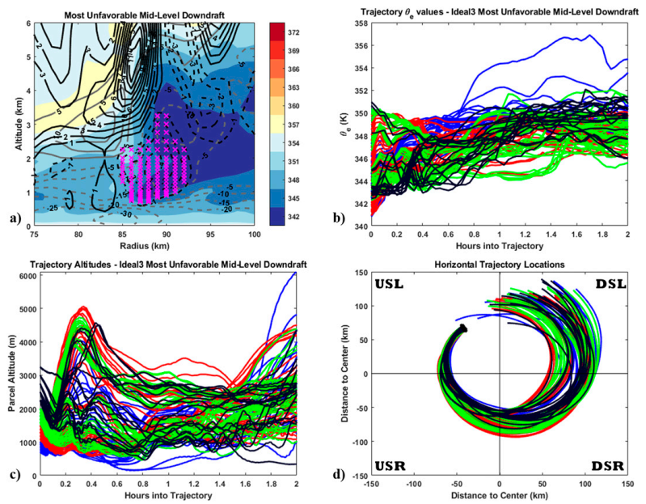
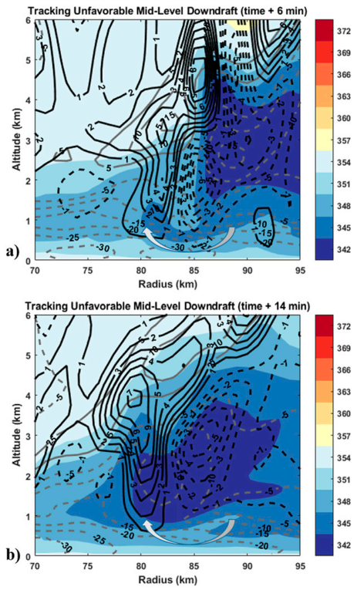
Unfavorable convective downdrafts away from eyewall (Ideal3 – mid-level)
Do pose negative
Thermodynamic influence
h₀ <= 1000m
1000m < h₀ <= 1500m
1500m < h₀ <= 2000m
h₀ > 2000m

Slide 12
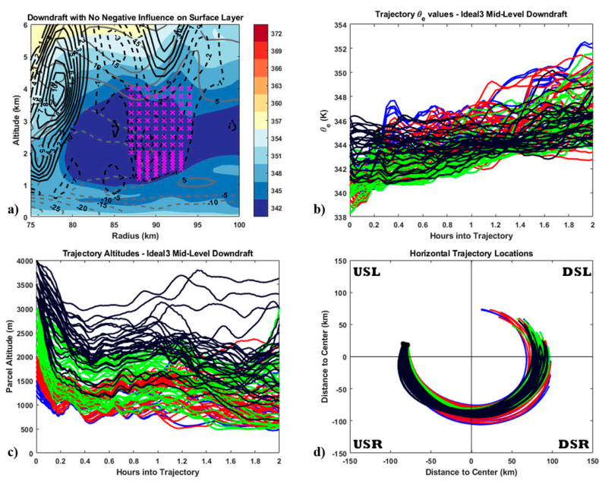
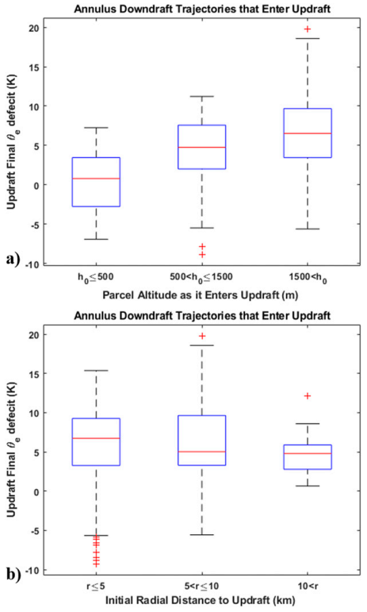
Unfavorable convective downdrafts away from eyewall (Ideal3 – mid-level)
h₀ <= 1500m
1500m < h₀ <= 2000m
2000m < h₀ <= 3000m
h₀ > 3000m
θe ↓
Do not pose negative
Thermodynamic influence
θe ↑
θe ↓
θe ↑

Slide 13
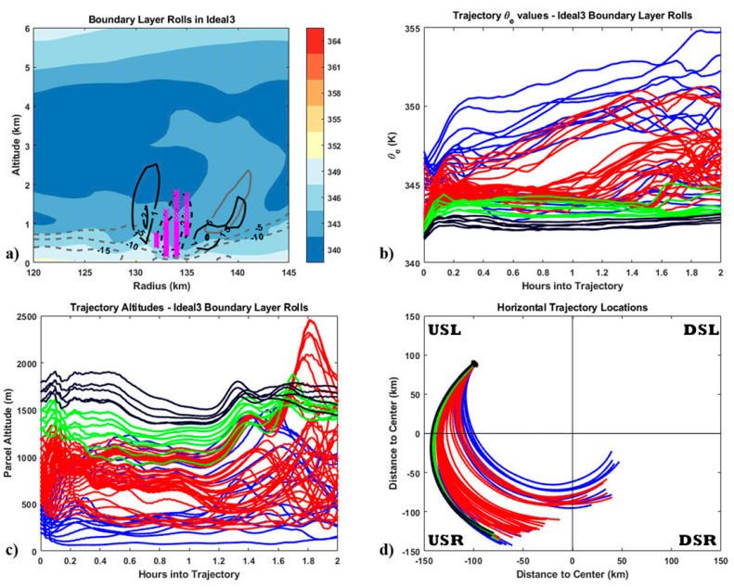
Nonconvective downdrafts (Ideal3)
Do not pose negative
Thermodynamic influence
h₀ <= 500m
500m < h₀ <= 1250m
1250m < h₀ <= 1500m
h₀ > 1500m

Slide 14
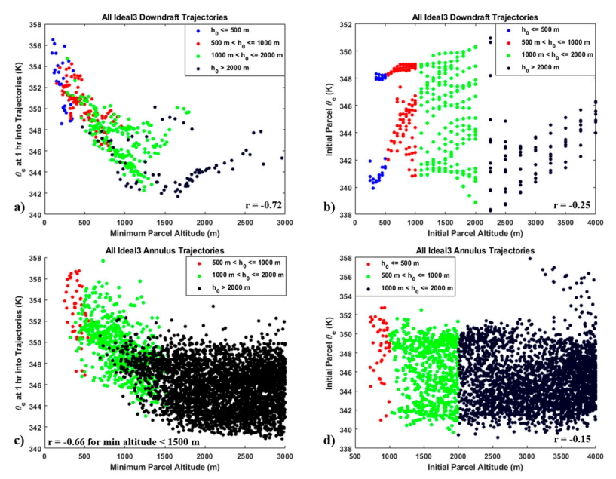

Slide 15
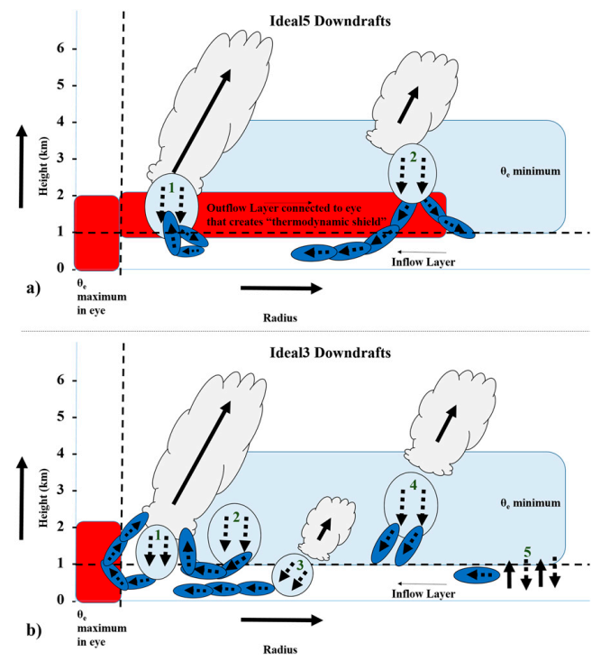
Conclusions
This study used idealized TC simulations of category-3 (Ideal3) and category-5 (Ideal5) intensity to study the thermodynamic variability of downdrafts in TCs in relation to intensity, storm structure, and storm-relative location.
The high-θe air was associated with low-level outflow from inside the eye and eye–eyewall mixing; downdrafts underneath the eyewall in this region (downdraft 1 in Fig. a) pose no negative thermodynamic influence to the boundary layer.
Forward trajectories from convective downdrafts in this region (downdraft 2 in Fig. a) show that the favorably high-θe values and associated convective stability in the outflow layer (increased stability reduces downward intrusions into the inflow layer) create a thermodynamic shield such that downdrafts have no negative thermodynamic impact to the boundary layer and eyewall updrafts.

Slide 16
Conclusions
For the convective downdrafts in Ideal3 (Fig. 17b), the radial location and altitude of a downdraft, relative to any nearby updrafts, is important for determining its effect on the boundary layer entropy and updraft thermal structure.
A downdraft underneath the eyewall transported low-θe air to 400-m altitude (downdraft 1 in Fig. b). Since the low-θe air was below 500 m the air moved radially inward below the eyewall and some recovery occurred near the eye.
The downdrafts that lead to the most negative thermodynamic impact to updrafts are those that transport low-θe air from the mid-levels to the top of the inflow layer (1–1.5-km altitude) and just radially outward (5 km) of the updraft core (downdraft 2 in Fig. 17b). The low-θe air at the top of the inflow layer can quickly travel to and enter the base of an updraft without undergoing much recovery.
A second midlevel downdraft was also analyzed transporting low θe from the midtroposphere downward (downdraft 4 in Fig. b). This convective downdraft was directly underneath the base of an updraft without significant radial tilt (and 15 km from the nearest radially inward updraft). Parcels from this downdraft entered the top of the inflow layer experienced small recovery, but did not enter an updraft within the 2-h trajectory integration (though the low- θe values could have prevented future updrafts from forming)

