Slide 1
The Implication of Outflow Structure for the Rapid Intensification of Tropical Cyclones under Vertical Wind Shear

Slide 2
Outline
2
Introduction
3
4
Composites results for RI events
5
Comparison among different intensity change cases
1
Abstract
Data and Methods
6
Summary

Slide 3
Abstract

Slide 4
Abstract
1. The implication of outflow structure for tropical cyclone (TC) rapid intensification (RI)
is investigated via a climatological study using the best track, reanalysis, and infrared
brightness temperature data during 1980–2019
2. Composite analyses are performed in a shear-relative framework for the RI events under different strengths of environmental shear.
Notes:
使用了best track 再分析資料 紅外亮溫 資料時間 1980~2019
同時針對不同風切下的RI 事件做合成分析

Slide 5
3. RI events
Increase of upper-level
outflow upshear of the storm
(owing to increasing active convection upshear)
moderate (4.5–11 m/s )
strong (>11 m/s)
environmental shear
RI onset
Decreases the local shear,
building an environment
favorable for RI
Outflow blocks the upper-level
environmental flow
RI under weak environmental shear (<4.5 m/s ) is found to be less attributed to this
outflow-blocking mechanism
Notes:
這篇主要是探討 氣旋的高層外流阻擋環境風場 進而建立一個適合颱風RI的環境
此機制適合 中等或強環境風切(切去下一頁講)
RI onset之後 氣旋高層上風切處的外流增強(肇因於上風切的對流增強)
外流阻擋高層環境的氣流侵入颱風
減少局地的風切,建立適合RI的環境
低風切的RI個案與此種機制較無關

Slide 6
Shear definition
Vertical Wind Shear(VWS) 200-850hPa
Previous study : within 200～500km radii
This study : within 400～800km radii
area averaged wind
Environment
VWS
This study : within 0～200km radii
area averaged wind
Local
VWS
Ryglicki et al. (2019)
Notes:
他說這樣可以比較好呈現大尺度風場

Slide 7
Abstract
4. Comparison between the RI and non-RI cases under moderate or strong environmental
shear reveals that the RI cases tend to have stronger outflow and convection in the
upshear flank than the non-RI cases, confirming the importance of outflow blocking on
the occurrence of RI.
5. Statistical analysis further indicates that the 24-h future intensity change under moderate or strong shear is more negatively correlated with the local shear than with the environmental shear.
Notes:
這篇PAPER 也同時比較 RI跟沒RI的個案在不同強度的環境風切下的情形
RI的個案與非RI的個案比較之下傾向在上風切處有較強的外流跟對流
統計分析也顯示,在中等或強環境風切下的颱風未來一天的強度變化
與環境及局地風切的相關性分析後, 與局地的負相關更明顯

Slide 8
Introduction

Slide 9
Introduction
Rapid intensification is defined as an increase of at least 30 kts in
maximum wind speed over a 24-h period (Kaplan and DeMaria 2003)
2. Previous studies (Kaplan and DeMaria 2003; Shu et al. 2012) showed
that the RI TCs usually experience higher SST, higher lower-level humidity
and weaker vertical wind shear (VWS) than the non-RI TCs

Slide 10
Introduction
3. Zhang and Tao (2013) found that the likelihood and timing of RI become
highly uncertain in the presence of moderate VWS(defined as 4.5–11 m/s;
Rios-Berrios and Torn 2017)
4. It is well known that moderate-to-strong VWS has a detrimental effect on the
TC intensification.
5. The vertically tilted TC usually has a poorly organized and shallow secondary
circulation, which is unfavorable for the inward transport of absolute angular
momentum and thus the spinup of the TC primary circulation (Rogers et al.
2015; Tao and Zhang 2019)
Notes:
.Zhang and Tao (2013) 發現環境風切為中等的情況下,RI發生的機會與時間點變得有很高的不確定性
而中等到強度的風切,對於颱風的增強是有害的
因為在此情況下,颱風的中心垂直方向上會傾斜 造成組織性較差且較淺的次環流
對於向內的AAM傳輸 並進一步spinup颱風主環流的過程是不適合的

Slide 11
Introduction
Precession
Overcome
VWS
Down-shear
reformation
Notes:
文中有提到一些之前的研究
這些研究室關於颱風如何克服垂直風切
並能夠進一步增強
而文中主要提到兩類
1.進動
2.下風切的再造

Slide 12
Precession
Midlevel vortex displaced downshear by VWS
Rotate cyclonically to the upshear flank, followed by a significant decrease of vortex tilt.
Establish a compact eyewall
with well-organized convection
and thus is more likely
to undergo RI
Axisymmetrization
of inner-core precipitation
Chen et al. 2018a; Tao and Zhang 2019; Shi et al. 2020
Notes:
precession 進動 主要分成四流程
1.一開始中層的渦旋受垂直風切影響而向下風切傾斜
2.而颱風的中心軸會向上風切處做氣旋式的旋轉,同時減小傾斜的程度
3.此時颱風內核的降雨逐漸軸對稱化
4.開始建立扎實眼牆並伴隨組織性良好的對流 如此一來就有可能產生RI

Slide 13
Down-shear reformation
Sheared TCs the active convection in the downshear flank can produce a meso-vortex in the lower-to-mid troposphere.
If this meso-vortex
is strong enough.
It will axisymmetrize and
replace the weak parent TC.
Vortex realignment and RI.
Molinari et al. 2006; Nguyen and Molinari 2015; Chen et al. 2018b
Notes:
1.受風切影響的TC 在下風切處有較較強的對流
這會在低至中層大氣產生一個中尺度渦旋
2.一旦這個渦度夠強
3.他會逐漸的軸對稱化,並取代較弱的母TC中心
4.此時渦旋再度對準(不再傾斜) 並發生RI

Slide 14
Bad trough good trough issue
All abovementioned mechanisms regarding RI under vertical wind shear mainly focus
on the interaction between convection and circulation at the lower to midlevels, while
relatively less attention has been paid to the upper troposphere.
When a TC approaches an upper-level trough, it may be subject to an increasing VWS and experience slower intensification or weakening (DeMaria et al. 1993; Peirano et al. 2016)
Bad trough
In some cases the TC–trough interaction may favor TC intensification by enhancing the eddy flux convergence of angular momentum and potential vorticity (Molinari and Vollaro 1989; Hanley et al. 2001; Leroux et al. 2016)
Good trough
Notes:
之前提到的有關RI發生在中度或強風切下的機制
主要是在探討中低對流層颱風的對流及環流之間的互動
但較少探討高對流層的角色
作者這邊提出之前的有針對高層槽線對於颱風的影響
主要有BAD GOOD 槽線
BAD就是對颱風有害 因為其會更進一步增強垂直風切使颱風減弱
而GOOD 槽線
就是在某些個案中 槽線可以增強渦流角動量通量及pv的conv 使颱風增強

Slide 15
As TC is sheared by upper-level anticyclone
6. TC sheared by an upper-level anticyclone is more likely to undergo RI than that
sheared by an upper-level trough, due to the fact that the strong upper-level wind
produced by the anticyclone is shallower in depth than that by the trough.
7. Ryglicki et al. (2019) showed that the divergent upper-level outflow emanated from down-tilt convection acts to block the background environmental flow around the TC, which leads to a decrease in the local VWS in the TC inner-core region and thus promotes the occurrence of RI.
Notes:
6.而另一種高對流層的角色就是
颱風在高層反氣旋出現時,垂直風切增大
但由高層反氣旋導致的垂直風切增加與高層槽線導致的垂直風切增加
颱風是比較容易發生增強的
因為高層的強風由反氣旋產生的話相較於槽線 是更淺的
7.由下風切處的對流產生的高層外流 扮演了阻擋背景環境氣流的角色
進一步使得局地風切下降並進一步提升RI的機會

Slide 16
Introduction
8. Dai et al. (2021) carried out a series of idealized simulations in which a strong VWS of 14 m/s is imposed on a TC of major-hurricane intensity and investigated the outflow– environment interaction
9.The modulation effect of the TC outflow on the environment is quantified by a TC-induced shear difference (TCSD), defined as the vector difference between the local shear around the TC and the environmental shear (by their definition, the 200–850-hPa shear averaged over the radii of 0–500 and 500–1000 km, respectively)
10. They found that the development of the outflow in the upshear quadrants produces a TCSD acting against the environmental shear and thus helps the resilience and re-intensification of the TC.

Slide 17
Introduction
8. Dai et al. (2021) indicate that the outflow-blocking phenomenon is not limited to the regime of moderate VWS and may serve as a precursor for the intensification of the real-world sheared TCs.
Authors intend to address the following questions:
How the outflow evolves relative to RI onset under environmental VWSs of different strengths.
How the outflow structures differ between sheared TCs with different intensification rates
Why some TCs can become resilient to VWS via the outflow blocking mechanism while the others cannot
Notes:
Dai 指出 高層外流阻擋環境氣流的機制不只侷限在中等風切的情形,且可以視為真實世界受風切影響TC的一個增強訊號
而針對此作者想進一步探討
1.在不同強度的環境風切下,RI前後外流如何演變
2.外流的結構在不同增強速率下的TC有何差別
3.為何有些TC可以藉由外流抵擋VWS 但有些TC不行?

Slide 18
Data and Method

Slide 19
Data and Method
a.Data
1.This study analyzes the TCs forming in the western North Pacific (WNP), eastern North Pacific (ENP), and North Atlantic (NA) basins during 1980–2019
2. The 6-hourly storm intensity and position estimates for the WNP TCs and the ENP/NA TCs are recorded from the best track datasets of the Joint Typhoon Warning Center (JTWC) and the National Hurricane Center (NHC), respectively
3. The atmospheric fields surrounding TCs are obtained from the ERA5 reanalysis of European Centre for Medium-Range Weather Forecasts with a horizontal resolution of 0.25° x 0.25 ° (Hersbach et al. 2018).
4. $T_{IR}$ data on a 0.07 ° X 0.07 ° grid from Gridded Satellite B1 (GridSat-B1; Knapp et al. 2011)
Notes:
1.分析 西北 東北太平洋 北大西洋的颱風
2.WNP 的BEST TRACK是用JTWC
ENP NA用NHC
3背景場用的是ERA5再分析資料 0.25度
4.衛星紅外用 Gridded satellite 0.07度

Slide 20
Data and Method
b. Cases classification and RI event
The 6-hourly records in the best track data are classified into four groups according to the changes in maximum-sustained 10-m wind in the subsequent 24 h ($∆V_{max}$)
Weakening
(WK)
Neutral
(NT)
Slow Intensification
(SI)
RI
$$∆V_{max}$$
-10kts
10kts
30kts
－In this study, we focus on the cases that are weaker than major hurricanes (i.e., TCs ≤95 kt)
－the cases to the north of 30 ° N are not considered in this study
Notes:
１．怕ＥＲＣ造成強度浮動
２．怕轉溫且ＳＳＴ太低，對於強度而言ＶＷＳ變得相對不重要

Slide 21
Data and Method
C. Shear definition
Vertical Wind Shear(VWS) 200-850hPa
Previous study : within 200～500km radii
This study : within 400～800km radii
area averaged wind
Environment
VWS
This study : within 0～200km radii
area averaged wind
Local
VWS
Ryglicki et al. (2019)

Slide 22
Data and Method
C. Shear definition
Vertical Wind Shear(VWS) 200-850hPa
Weak
Moderate
Strong
$$∆V_{}$$
4.5m/s
11m/s
Following Rios-Berrios and Torn (2017), the moderate VWS is defined as 4.5–11 m/s ,
which corresponds to the 25th and 75th percentiles of the VWS experienced by TCs globally.
Notes:
4.5 11 是全球的TC統計後 遇到的環境垂直風切 的 25 跟 75百分位

Slide 23
Data and Method
C. Shear definition
Vertical Wind Shear(VWS) 200-850hPa
Weak
Moderate
Strong
$$∆V_{}$$
4.5m/s
11m/s
According to the strength of environmental VWS at the initial time of cases, the cases in each intensity change category are further divided into three groups
However, the three types of RI events are classified according to the mean environmental VWS during 0–24 h before RI onset.
Notes:
WK NT SI是根據強度發生變化的當下,定義該TC在該時刻的 環境風切分組
但RI的三組是針對 RI 0~24小時前的平均去分類

Slide 24
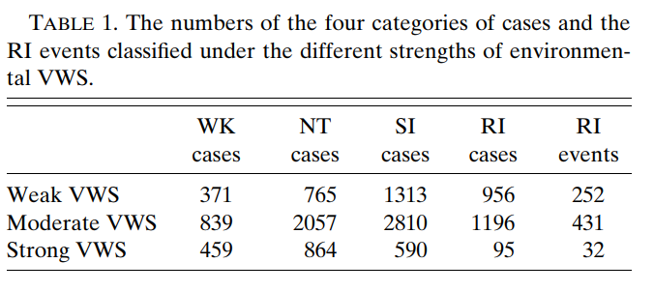
Data and Method
Notes:
不同類型分別對應的數目

Slide 25
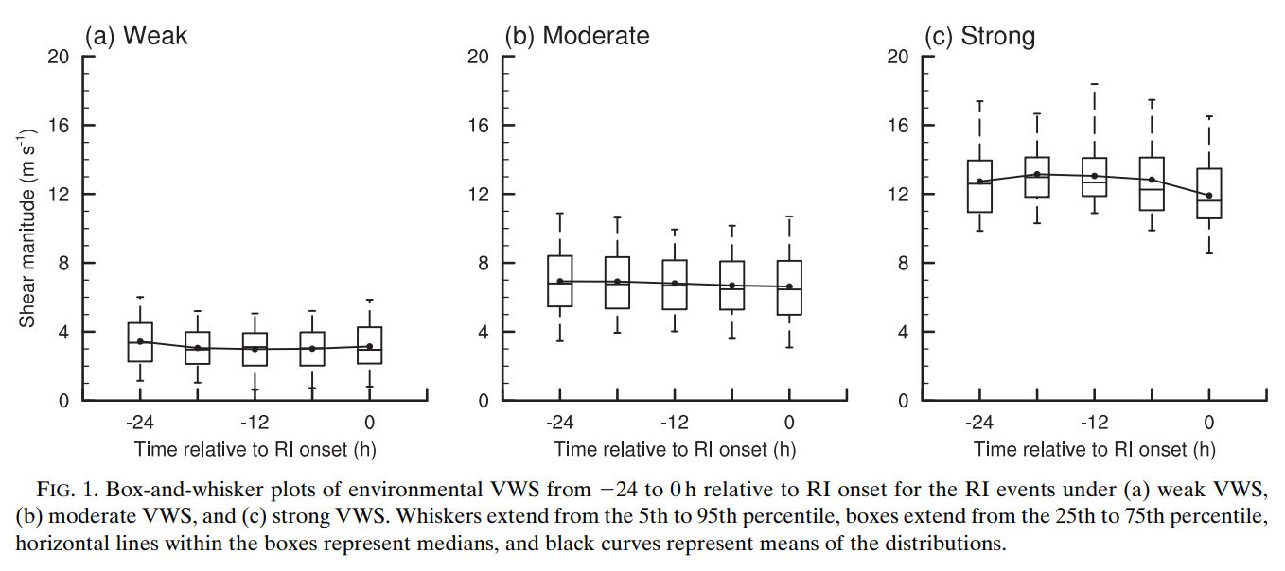
Data and Method
Mean(dot)
95th
75th
50th
25th
5th
Notes:
RI個案中 三種不同環境風切 隨時間變化的盒狀圖 (-24~0HR)
三者量值差異在不同綜觀時間皆有通過統計檢定
且隨時間變化不大
這是環境風切

Slide 26
Composites results for RI events

Slide 27
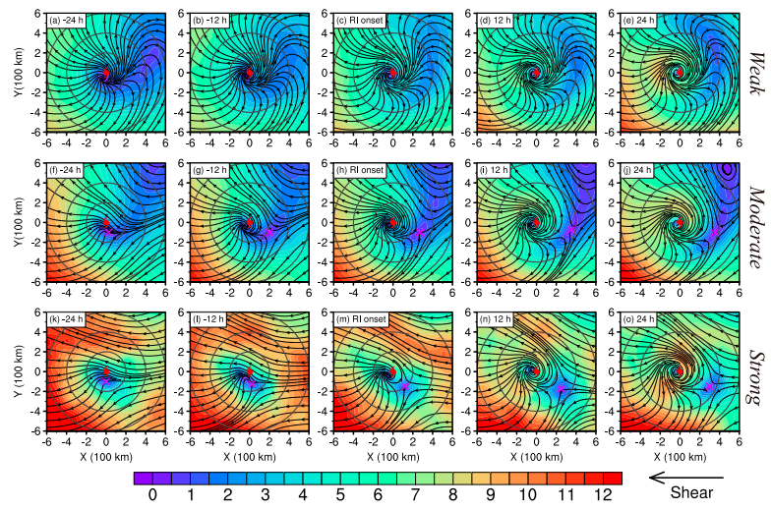
Streamline, Shading: 200hPa total wind X : stagnation point
Notes:
流線表再分析場 composite 200風場 shaing則是200 風速量值
圈圈由內而外 200 400 600km
X是stagnation point停滯點
等等一起解釋
對於weak VWS RI case而言
在ri -24時 就已經建立外流,且隨時間增強 更對稱
而中等及強的風切下
一開始並沒有外流的建立 且環境的風場可以直接侵入颱風的內核但接近中心時會分流
X代表的是颱風上風切處風速最低值的所在
此處也是環境氣流與颱風高層外流互相完全抵消的地方
而隨著時間過去,颱風高層外流逐漸建立,把這個x逐漸往外推

Slide 28
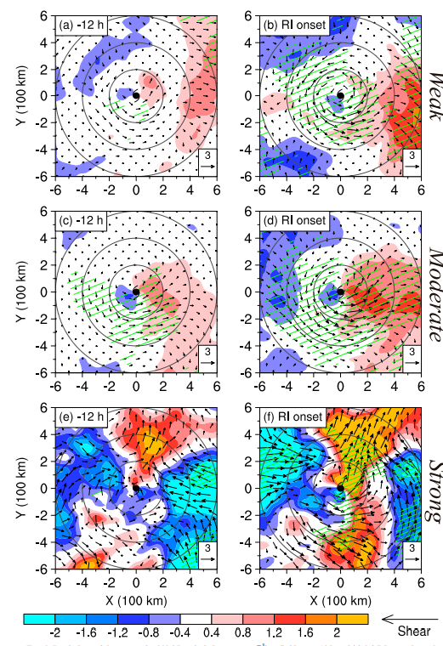
Fig on LHS: RI onset – RI-24h
Fig on RHS: RI-12h – RI-24h
Vectors:
Deviations of the composite 200-hPa winds(m/s)
Shadings:
Radial component of the wind deviation (m/s)
Green hatching denotes the wind difference
is significant at the 90% confidence level
Notes:
左圖為 ri -24 到 ri -12
右圖為 ri-24 到 ri onset差異
風標表示徑向風場 在兩時間的差異
綠線表示該處在90%信心水準下風速隨時間差異具有統計上差異

Slide 29
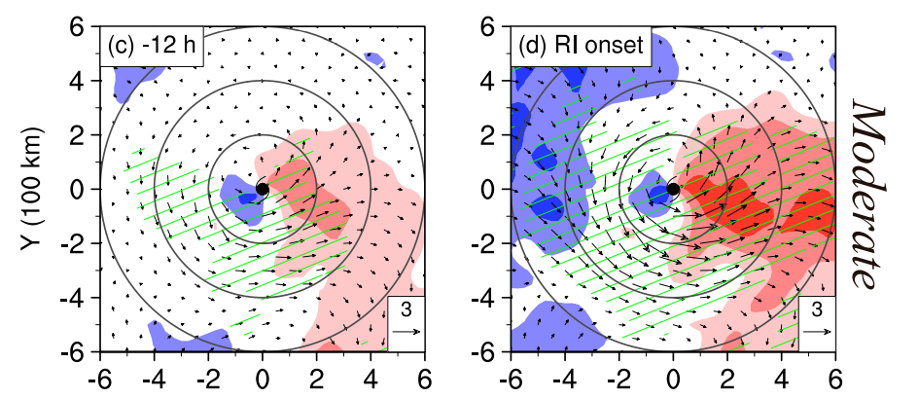
Moderate shear
Notes:
上風切的outflow不斷增加 且隨時間往更外圍擴增
使得剛剛那x點點往外跑
400km內的氣旋式風場也顯著增強

Slide 30
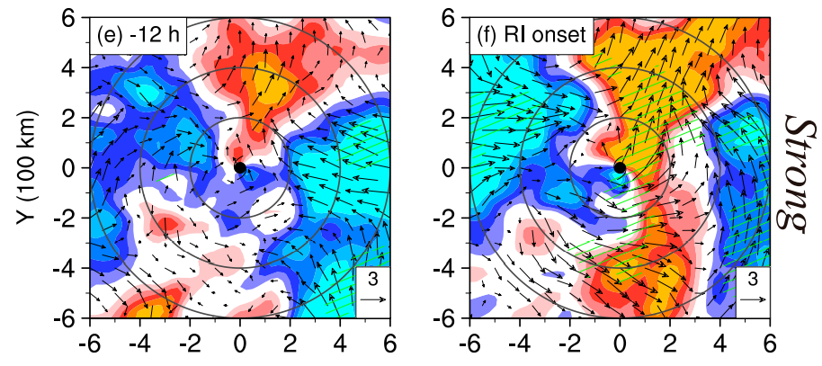
Strong shear
Notes:
至於強風切也是有類似情形
但是分布較不同,較侷限在USR

Slide 31
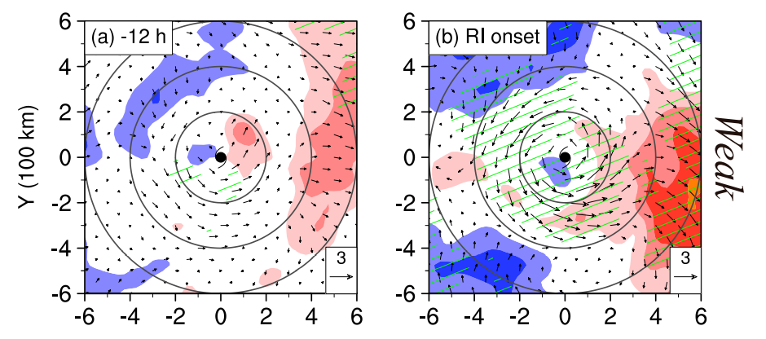
Weak shear
Notes:
相較中跟強風切
雖然一樣在上風切處有增強
但在較外圍處(>400KM)而非近颱風中心

Slide 32
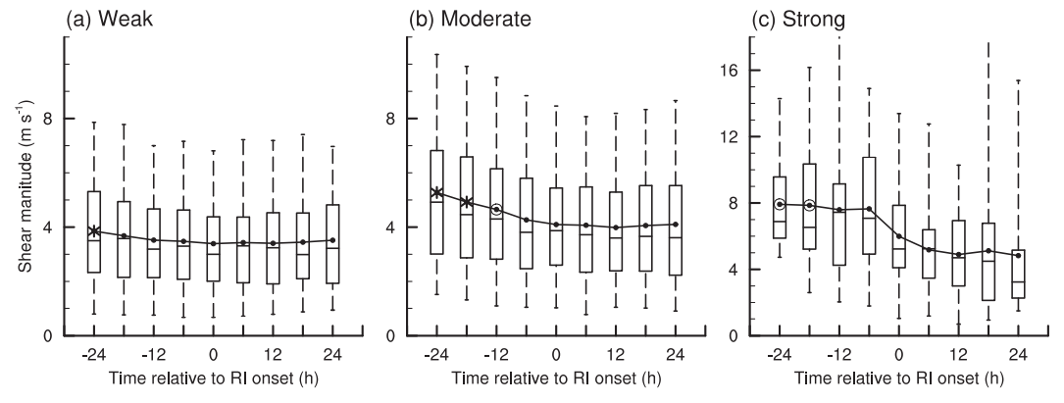
Previous studies have shown that the outflow development in the upshear flank can modulate the VWS in the inner-core region.
(Ryglicki et al. 2019; Dai et al. 2021; Ryglicki et al. 2021)
95th
Mean
75th
50th
25th
5th
Notes:
過去的研究指出 上風切處的高層外流的發展可以調整(這邊其實就是降低) 颱風內核的VWS
分類是針對於原始的環境風切下的風切程度
但是圖表顯示的是local 風切量值的盒狀圖
米狀表示 跟RI ONSET 時 在95%信心水準下 具有顯著差異 圓圈表示90%
中度風切
在RI前24~6 逐漸連續下降(ri前24到onset local風切減小1.2m/s)
強風切
則是在RI前6~+12H下降(下降的local 風切則有2 m/s比中等風切多)
同時值得注意的是,環境風切在中等及強風切下則略微上升(0.2,0.8m/s) 這裡沒秀出來
因為外流把環境氣流擋住了
所以local風切才下降,但並非改變大環境風場(所以local風切降 環境風切不降)
雖然弱風切的環境下
Local風切依然也有下降(雖然也有統計意義),但不明顯 對於後續ri貢獻也較小
跟上張圖對比 也是同樣,因為弱風切在颱風內部(200km內)的風場變化本來就不大

Slide 33
The above results indicate that the blocking effect due to the TC upper-level outflow on the environmental flow and the resultant decrease of local VWS can be viewed as a precursor for the RI events under moderate-to-strong shear, in good agreement with the mechanisms proposed by recent numerical studies (Ryglicki et al. 2019, 2020; Dai et al. 2021)
95th
Mean
75th
50th
25th
5th
Notes:
而這個再分析資料的合成分析結果與前人進行的模擬結果一致
在中強風切下的颱風
由颱風外流開始發展後開始阻擋環境氣流
進而減少局地風切 可視為RI(中強風切下)的前兆

Slide 34
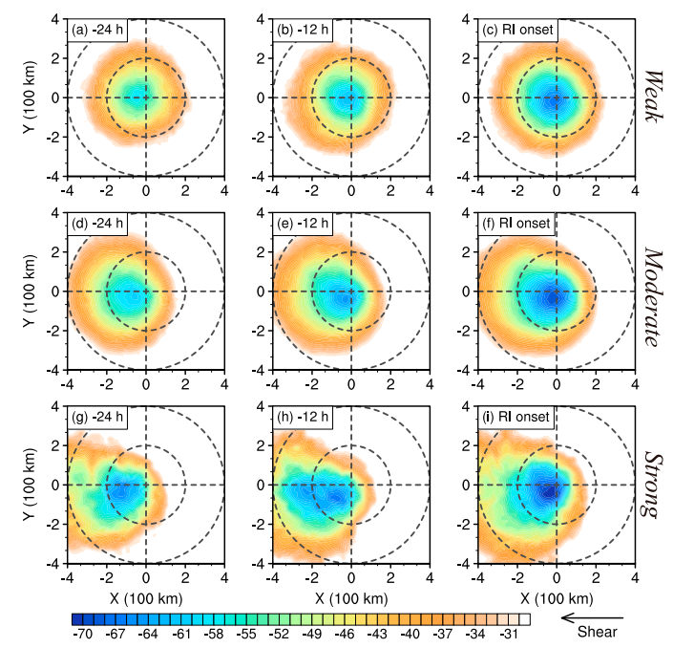
Shadings: Composite $T_{IR}\left(℃\right)$ ,< -30 $℃$
Inner circle : 200 km radii
Outer circle : 400 km radii
Notes:
由左至右 RI -24 -12 ONSET
由上至下 弱 中 強 環境風切

Slide 35
1.For all three categories of RI events, the
areal coverage of $T_{IR}<$-30$℃$ is larger in
the downshear flank than in the upshear
flank at t =-24 h.
2. During the 24 h prior to RI onset, all
three types of RI events experience an
intensification of the inner-core convection.
3. The moderate-shear and strong-shear
RI events undergo evident convective
axisymmetrization before RI onset, as
reflected by the increase in the coverage
of $T_{IR}$ $<$-30$℃$ within the 200-km radius.
Notes:
1. t=-24 所有風切下的颱風 在下風切處有較大範圍的 ir亮溫<-30度區域
2. 從-24 到onset 所有種類都增強 從內核的對流增強(亮溫降低)看出
3.中度跟強風切在 -24~onset 對流逐漸軸對稱化 自200公里半徑內 IR<-30度C範圍可看出

Slide 36
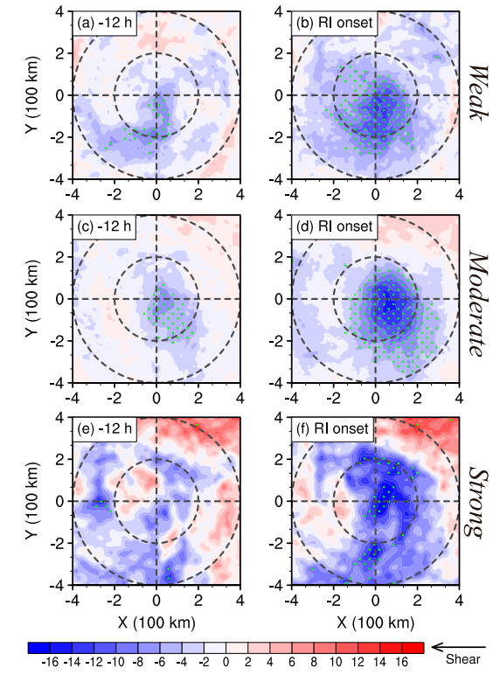
Fig on LHS: RI-12h – RI-24h
Fig on RHS: RI onset – RI-24h
Shadings:
Deviations of the composite $T_{IR}(℃)$
Green dots denote the deviation is significant
at 95% confidence level.

Slide 37
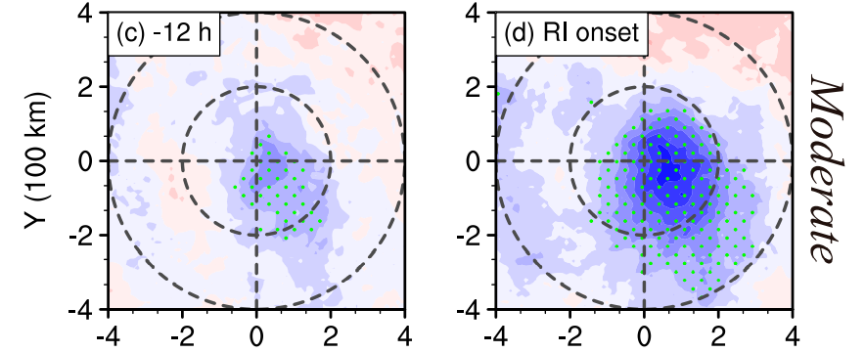
Moderate shear
1. For the moderate-shear RI events, a significant decrease of $T_{IR}$ is observed in the upshear-left quadrant at t =-12 h, hinting at a tendency
of convection symmetrization
2. At the RI onset, the significant decrease of $T_{IR}$ extends further into all shear-relative quadrants within the 200-km radius
Notes:
對於中等風切下的RI
1.在T=-12時候 上風切處開始有較顯著的亮溫下降
暗示著開始軸對稱(因為一開始下風切的亮溫更低,現在上風切處的亮溫下降更明顯,因而逐漸對稱化)
在onset後 200km里內都有顯著下降 意味的內核對流增強

Slide 38
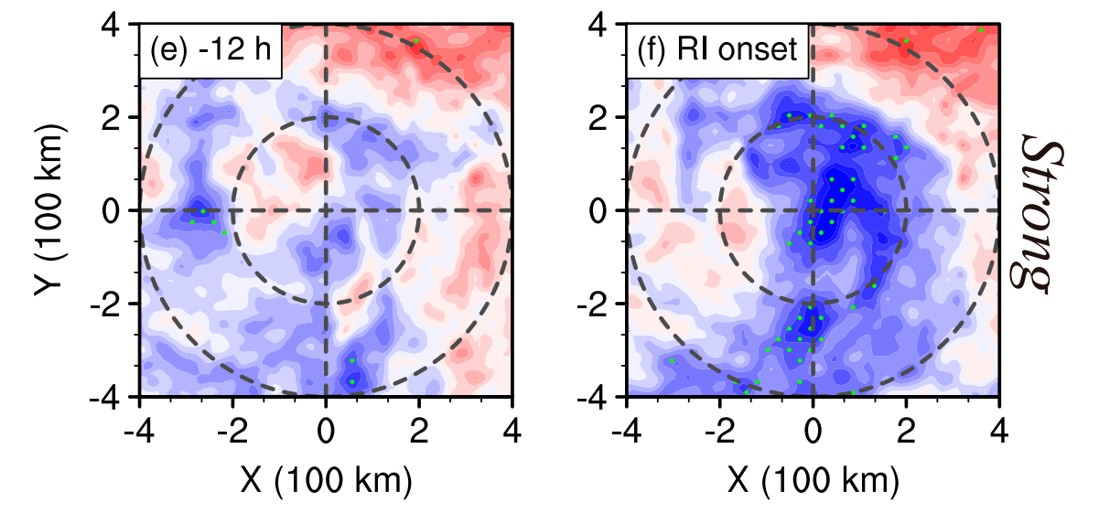
Strong shear
There is also significant decrease in $T_{IR}$ in the upshear quadrants for the strong-shear RI events
The magnitude of $T_{IR}$ decrease is larger than that for the moderate-shear RI events, consistent with the stronger changes in radial flow.
Notes:
對於強風切個案
上風切處一樣可看到顯著的量溫下降
下降的量值比中等風切得更多,與更強的徑向風變化一致

Slide 39
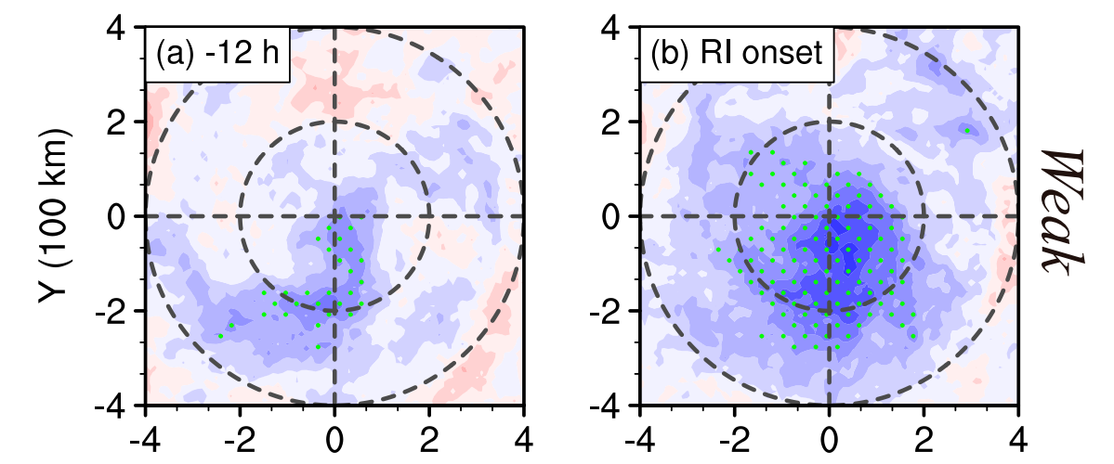
Weak shear
$T_{IR}$ decrease for the weak-shear RI events is weaker than those for the strong-shear and moderate-shear RI events
Since the convective structure of the weak-shear RI events is already relatively symmetric at t = -24 h ,the change in the convective structure prior to RI onset is less evident than those observed in the moderate-shear and strong-shear RI events.
Notes:
1.對於弱風切而言, 亮溫的下降比中等及強風切的個案少
2.因為弱風切下的颱風他的對流結構本身在 RI前24小時 的時候已經是相對對稱
因此他的變化比較不明顯

Slide 40
Comparison among different
intensity change cases

Slide 41
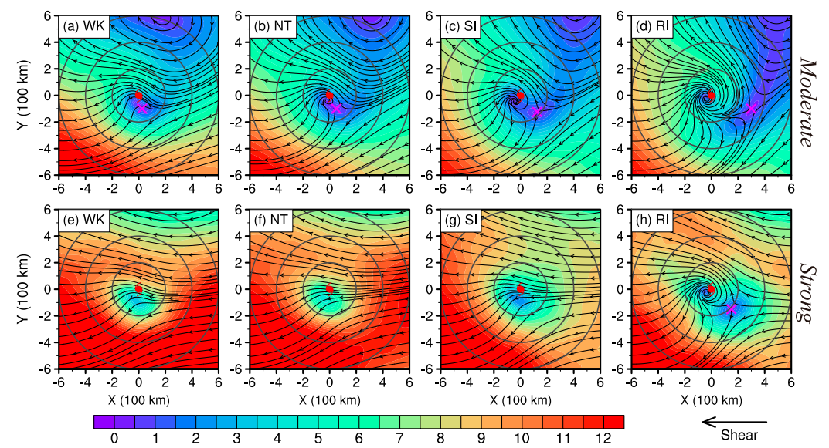
Streamline, Shading: 200hPa total wind X : stagnation point
Notes:
RI的是在RI onset時間點的圖
講完圖說直接跳下一頁

Slide 42
Moderate shear
Within 200km
Outside 200km
Hinting at a greater influence of
environmental flow on these TCs
Suggesting the environmental wind is well blocked from the storm inner-core region.
Implying that the faster intensifying storms are less susceptible to the influence of upper-level environmental flow.
Notes:
對於WK NT SI而言
它們的stagnation point 都在兩百公里內
意味著環境氣流對於他們的影響更明顯
而RI的則在 200KM外
意味著環境的氣流被阻擋在內核外
>>增強越快的颱風 受到環境的氣流影響越少

Slide 43
Strong shear
The upper-level environmental wind intrudes in to the TC center in all three categories of non-RI cases, with no clear interface between the TC and the environmental flow.
Notes:
至於強風切下的個案
WK NT SI的個案
環境的氣流直接侵入颱風的中心
外流和環境氣流沒有交界(沒stagnation point)

Slide 44
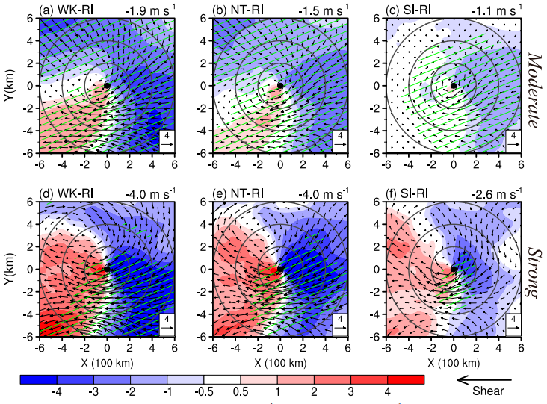
Vectors:
Deviations of the composite 200-hPa winds(m/s)
Shadings:
Deviation of radial flow at 200 hPa(m/s)
The gray circles mark the 200, 400, and
600 km radii, respectively.
Green hatching denotes the wind difference
is significant at the 95% confidence level.
The radial flow difference averaged within
the 200-km radius in the upshear quadrants
is shown in the top-right of each panel
Notes:
Shading 跟 風標 表示 200百帕的風場差異
相減後可明顯看見 上風切處的外流明顯較RI的弱
且差異 WK >NT > SI
上風切處半徑兩百公里內的徑向氣流差異 每個panel右上有秀

Slide 45
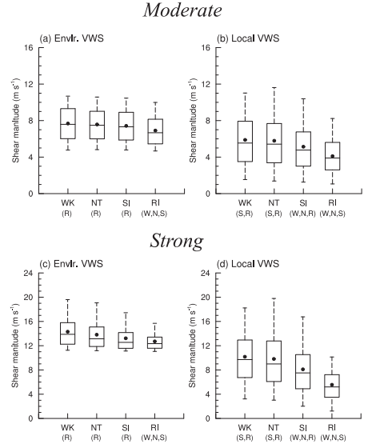
1. RI cases has the smallest local VWS among
the four groups, consistent with the most prominent
outflow blocking in the upper troposphere
2. The mean environmental VWS of the RI cases is
also significantly smaller than those of the non-RI cases
3. The differences in environmental VWS are much
smaller than the counterparts in local VWS, indicating
that the internal process of TC (i.e., stronger upshear
outflow) plays a major role in lessening the local VWS
of the RI cases.
4. The differences in local VWS between the SI and the
other non-RI groups are also statistically significant
at 95% confidence level, whereas the differences in
environmental VWS between any two non-RI groups
are insignificant
Notes:
W,N,S,R分別代表該增強類型與其他哪幾種增強類型
在95%信心水準下是否具有顯著統計差異
1.RI 個案有最小的局地VWS 跟外流阻擋高層環境氣流有關
2.RI 個案也有最小的環境垂直風切
3.環境風切的對於不同增強速率的差異比局地風切的差異小
作者認為這可能暗示著颱風內部動力(上風切高層外流) 扮演一個減小RI個案局地風切的腳色
4.而對於非RI的CASE而言
看SI, LOCAL 的VWS和其他非RI(NT,WK)的差異都具有統計上的差異
然而環境VWS卻沒有明顯差異
因此對於非RI的颱風且處在中或強風切的颱風而言
未來強度的變化可能與局地風切更有關而非環境風切

Slide 46
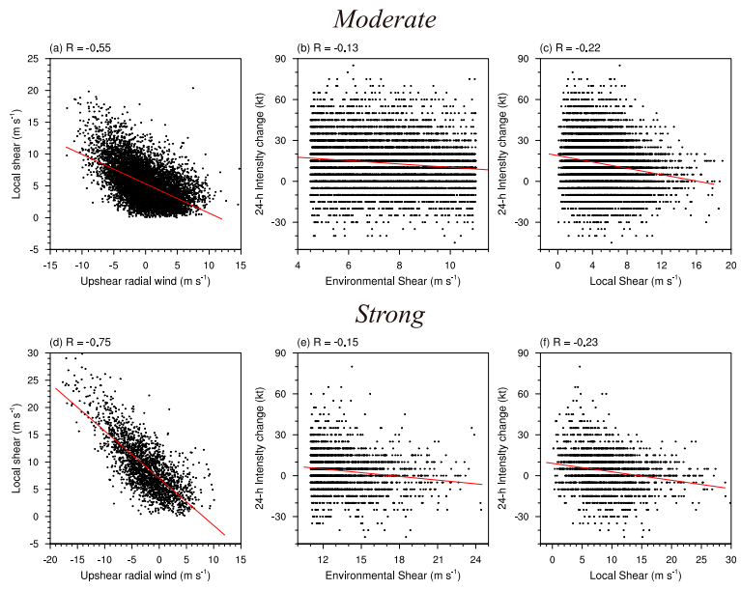
1. (a)and (d) are the scatterplots of the
radial wind averaged within a 200-km
radius in the upshear flank versus the
local VWS for the moderate-shear and
strong-shear cases, respectively.
2. Local VWS shows a decreasing trend
with increasing upshear outflow.
3. For both the moderate-shear and the
strong-shear cases, the environmental
shear shows a weak correlation with the
24-h future intensity change .In contrast,
the correlation coefficients between the
local shear and 24-h future intensity
change exhibit a moderate increase.
Notes:
Ad 是 上風切徑向風 跟 局地風切的散布圖
Be 是 環境風切跟未來24小時 強度變化的 散布圖
Cf 是 局地風切跟未來24小時 強度變化的 散布圖
1.a,d圖中 x軸的上風切徑向風是兩百公里半徑內的平均
局地風切與上風切徑向風的相關性高 尤其是強風切下相關性更高
上一頁投影的合狀圖有提到不同增強速率下,其環境風切差異不大
在此以scatter plot分析
雖然環境或局地風切跟未來強度的負相關都很弱
但local shear的相關性較大一點
作者說此趨勢分析有通過統計檢定(表示趨勢變化明顯)
但覺得 我後四張很不明顯= = 有點硬要

Slide 47
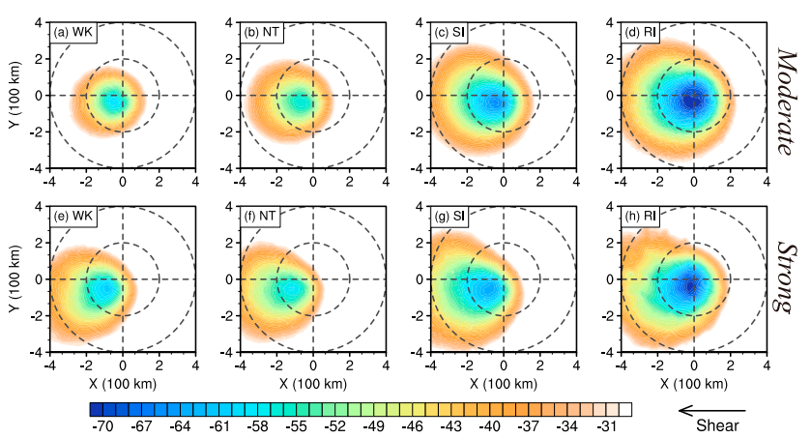
Shadings: Composite $T_{IR}\left(℃\right)$ ,< -30 $℃$
Inner circle : 200 km radii
Outer circle : 400 km radii
1. RI TCs have stronger convection and larger convection coverage in the inner-core region
than the non-RI TCs.
2. The distribution of $T_{IR}$ becomes more symmetric as the intensification rate increases,
Notes:
跟之前出現的一樣
但上次出現這圖是ri的隨時間變化圖
這次是不同case onset時的case
1.RI的颱風在內核對流更強 內核有更大範圍的強對流
2.而增強速度越大的颱風 也有更對稱的 亮溫分布

Slide 48
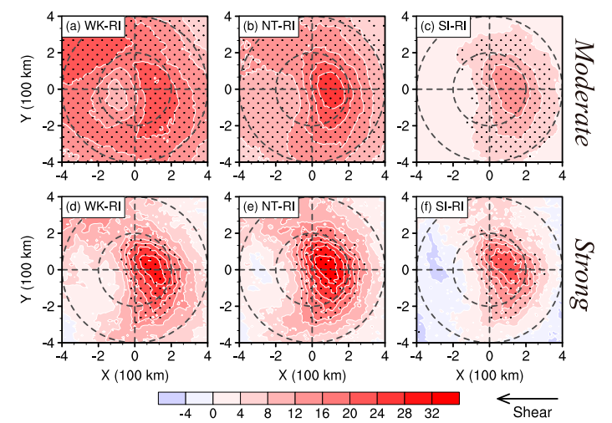
Shadings:
Deviations of the composite $T_{IR}(℃)$
The black dots denote the deviation is
significant at the 95% confidence level.
Inner circle : 200 km radii
Outer circle : 400 km radii
The most prominent differences in $T_{IR}$ between RI and three non-RI categories are all
situated in the upshear flank within the 200-km radius.
2. This further confirms the crucial role of the upshear convection in the occurrence of RI.
Notes:
RI與沒有RI的個案TIR的最大差別 落在上風切 半徑兩百公里內(ri的case上風切處亮溫更低)
上風切對流對於RI的重要性

Slide 49
What is the possible causes for the
different strengths of upshear convection?

Slide 50
Previous studies suggested that the environmental thermodynamic conditions have a great impact on the strength and spatial distribution of the inner-core convection in sheared TCs.
(Ge et al. 2013; Rios-Berrios and Torn 2017; Alvey et al. 2020)
All parameters being examined are averaged over the 24-h period prior to the initial time of the cases.
700hPa RH
SST
surface latent heat flux
(LHF)
Notes:
過去研究指出對於受風切影響的颱風 環境的熱力場對其內核的對流強度與分布有很大影響
在此作者檢視(1)700hPa RH (2) SST (3)地表潛熱通量
這些量值是各種強度變化發生的前24小時平均
因為平均熱力場在強度發生變化前就已經開始影響上風切的對流

Slide 51
$L_{V}$ is the latent heat of vaporization ${\text{(2.5 }\text{x} {10}^{6}\text{J} \text{kg}\text{)}}^{−1}$ ,
$c_{k}$ is the exchange coefficients for latent heat (taken as $\text{1.2} \text{x} {10}^{−3}$; Nguyen et al. 2019),
$R_{d}$ is the dry air density (taken as 1.2 kg $m^{−3}$ ),
$U_{10}$ is the 10-m wind speed,
q* is the saturated specific humidity at SST,
$q_{2}$ is the 2-m specific humidity.
Note that the surface sensible heat flux is not examined here because the total surface enthalpy flux is generally dominated by the LHF (Nguyen et al. 2019).
Notes:
地表可感熱通量這裡沒有探討
因為整體地表enthalpy的通量是由潛熱通量主導

Slide 52
Moderate shear
RH
(700hPa)
SST
LHF
Notes:
都是 t= -24~0的平均
點點代表95%信心水準下 差異具有顯著性
mean是所有case丟下去算
1.Downshear 有最大RH ,upshear 則較小 (wavenumber1)
2.RI比WK 跟NT 在200公里半徑外 有顯著較高的RH (尤其在風切左側)
作者表示這意味著RI的CASE有較少環境的乾空氣侵入
但SI RI的相差較小 可能有其他的變數值得探討
3.有較高SST的增強較快
4.至於LHF則是呈現左右風切側的 WN1不對稱
增強速率越快的颱風有更大的LHF
而RI跟其他組的落差最大在上風切處 半徑兩百公里內
5.之前的研究表明風切左側跟上風切的
高地面enthalpy 可以幫助回復因為受到風切所導致的downdraft帶入邊界層的低entropy
使得對流可以逐漸軸對稱化
因此高LHF有助於強化RI個案的上風切對流

Slide 53
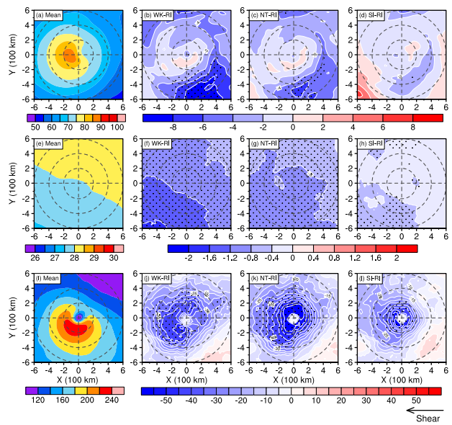
Strong shear
RH
(700hPa)
SST
LHF
Notes:
1.而在強環境風切下
RH分布也跟中度強度風切差不多
最大的差異大致落在上風切處(尤其USL)
差值比中等風切更大
2.RI的LHF和其他增強類型的差異不侷限在上風切處
反而是在下風切處有較大
作者表示這也可能代表不同增強類型颱風的LHF差異 可能也和環境風切有關
但是為啥這樣這篇目前不會提 他說等待之後的研究

Slide 54
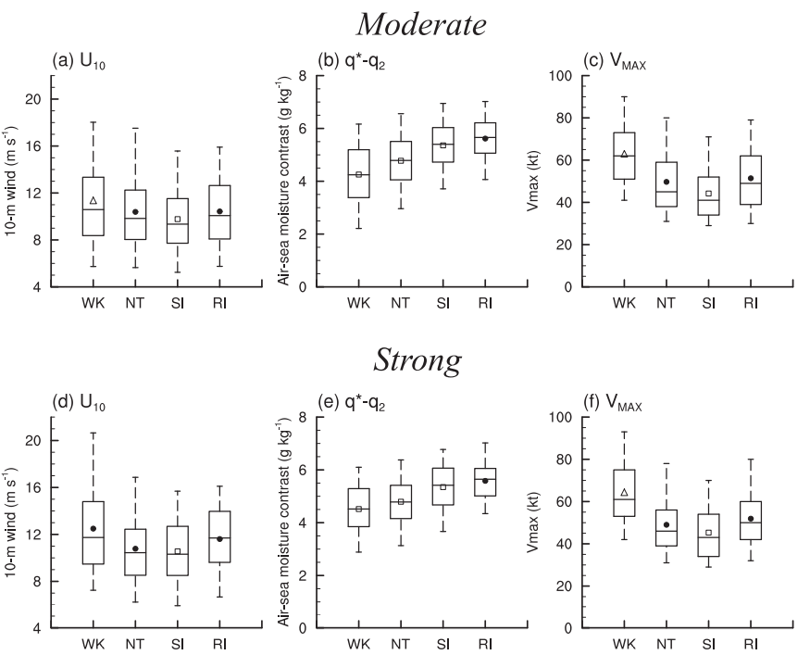
Difference
among
WK,NT
and RI
Difference
between
SI and RI
Notes:
圖案皆表示mean
但是三角形表示95%信心水準下顯著高於RI的值
正方形表示95%信心水準下顯著低於RI的值
U10的分布 受到Vmax的分布影響
Wk nt的Vmax比較高的原因 主要還是因為它們可能已經是較強的颱風要逐漸減弱了或是強度到頂
不會有颱風一開始就超強然後開始減弱
而ri的颱風通常一開始強度還沒很強
這張圖一樣是顯示t = -24~0 半徑兩百公里內的平均
而十米風速 wk nt 跟 ri的差異並不顯著
也因此WK NT LHF的差異並非來自10米風
而是來自 海氣的水氣差異
隨著增強速率的增加 q-q2的差異也就越大 (可能來自sst的差異)
而SI的個案 十米風 跟 q-q2都比ri小 因此他的LHF差異可能是兩者的綜合

Slide 55
Summary

Slide 56
Summary
1.For the moderate-shear and strong-shear RI events, the TC upper-level outflow in the
upshear flank tends to intensify significantly during the 24-h period preceding RI onsets.
2. The enhanced outflow acts to block the upper-level environmental flow from the inner-core
region of TC, which leads to a significant decrease in the local VWS and thus sets up a favorable
environment for RI, but the RI under weak environmental VWS is less attributed the outflow
blocking mechanism.
3. RI cases under moderate-to-strong environmental shear have stronger outflow in the
upshear flank than the WK, NT and SI cases, which can mitigate the detrimental effect of the
upper-level environmental flow on TC intensification.
Notes:
1.在中等或強風切環境下的RI案件, 颱風高層的外流在RI開始前24小時 在上風切處快速增強
2.增強的高層外流扮演了阻擋高層環境氣流進入颱風的內核 使得局地的VWS顯著的下降,並進一步建立一個適合RI的環境, 但發生在弱風切下的RI個案就與此機制關聯較小 3.RI的CASE相較其他增強速率的颱風 在上風切處有更強的外流 這可以減緩高層環境氣流對颱風增強帶來的負面效應

Slide 57
Summary
4. The RI cases have more favorable thermodynamic conditions characterized by higher
midlevel RH, warmer SST and higher surface LHF than the non-RI cases.
5. LHF differences between the WK, NT cases and the RI cases are attributed to the differences
in air–sea moisture contrast, whereas the lower LHF in the SI cases than in the RI cases is a
combined result of the weaker TC intensity and the weaker air–sea moisture contrast.
Notes:
RI 個案相較於其他增強速率下的颱風 有較高的中層RH 較暖SST 和較大的地表LHF
WK NT 跟RI的 LHF差距來源主要是海氣的水氣差異
但SI跟RI的CASE則是結合較弱的TC強度與海氣的水氣差異兩者皆有貢獻

