Slide 1
Wu. F., and K. Lombardo, 2021: Precipitation enhancement in squall lines moving over mountainous coastal regions. J. Atmos. Sci., 78, 3089-3103.

Slide 2
Introduction
Long-term (1931–2010) Global Precipitation Climatology Center (GPCC) V2018 reanalysis confirm these localized coastal maxima and reveal that their magnitudes have increased in recent decades, impacting coastal residents, offshore recreational and commercial activities, and coastal ecosystems (Curtis 2019).
As deep convective storms move from inland to offshore, precipitation is dictated by characteristics of a storm’s cold pool and the ambient stable marine atmospheric boundary layer (MABL) air driving a local sea breeze (Moncrieff and Liu 1999; Zuidema et al. 2017; LK18).
One of the leading theories on squall-line dynamics poses that squall-line strength and longevity are influenced by horizontal vorticity baroclinically generated by the cold pool and that of the ambient low-level wind shear, known as ‘‘RKW theory’’ (Rotunno et al. 1988).

Slide 3
Introduction
Sea surface temperature (SST) is not a good predictor for MCS longevity over the coastal waters (Lombardo and Colle 2012). Rather, the presence of strong environmental 0–3-km wind shear is critical, and can help sustain storms >100 km offshore (Lombardo and Colle 2012).
Contrasting case studies of northeastern U.S. quasi-linear convective systems (QLCSs) showed that bores can form following the collision between a QLCS’s cold pool and a MABL, which can successfully move storms over the stable layer (Lombardo and Colle 2013).
Pre-collision cold pool–MABL buoyancy differences determine bore development, with bores forming when the MABL is denser than the cold pool (LK18)
Terrain-crossing squall lines often propagate discretely, leading to heterogeneous precipitation patterns across the ridge (Teng et al. 2000; Frame and Markowski 2006). Storms initially intensify through orographic lift as they ascend a mountain, but weaken in the lee slope as their cold pools become partially blocked by the terrain.
Scientific Questions: Systematic quantification of coastal squall-line dynamics, specifically the impact of elevated topography and onshore sea-breeze flows.

Slide 4
Methods
Large-eddy simulations are performed with the Cloud Model 1 (CM1) version 19, a nonhydrostatic, cloud-resolving numerical model (Bryan and Fritsch 2002). The 800 km (horizontal) X 20 km (vertical) two-dimension domain is sufficiently large to limit the influence of the lateral boundaries on storm evolution. The horizontal domain has 200-m grid spacing, and the vertical resolution is stretched from 50 m below 3 km to 250 m above 10 km.
Morrison double-moment microphysical scheme (Morrison et al. 2009)
No radiation and surface fluxes are included to eliminate the influence of time-varying parameters (i.e., diurnal cycle) and isolate the influence of the MABL and orography on storms.
The horizontal boundaries are open-radiative, with free-slip conditions at the top and bottom boundaries.
A 1.5-km plateau is included from 0 to 300 km, with a slope extending from the plateau top to the base (300–360 km). A storm moving over this terrain in the absence of a MABL is used as a reference (‘‘CTRL’’). The bulk of the experiments quantify storm response as they descend the plateau and collide with a moving MABL, with depths of 500, 1000, and 1500 m and potential temperature perturbations (θ′) of −2, −3, −4, and −5 K relative to the base state.

Slide 5
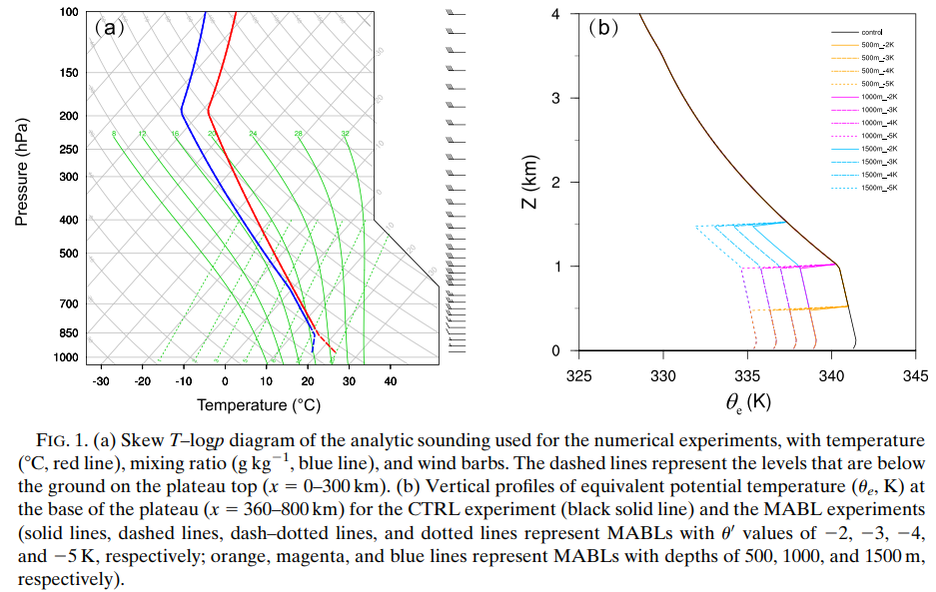

Slide 7
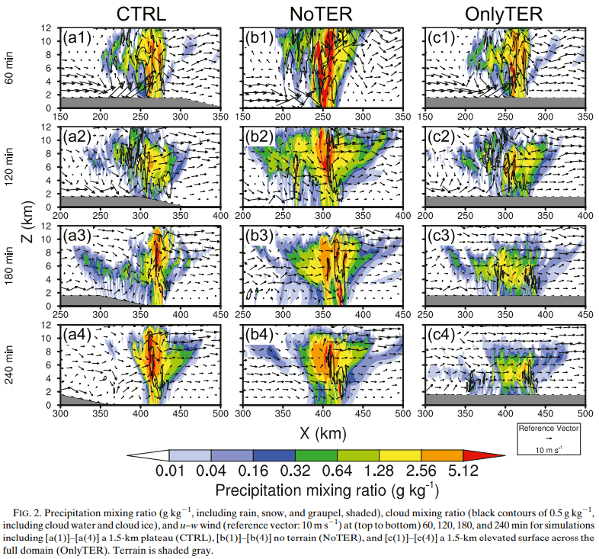

Slide 8
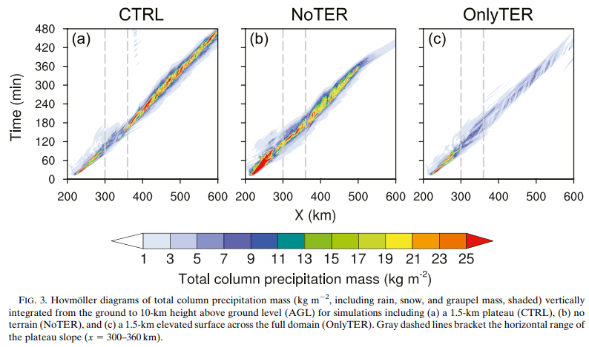

Slide 9
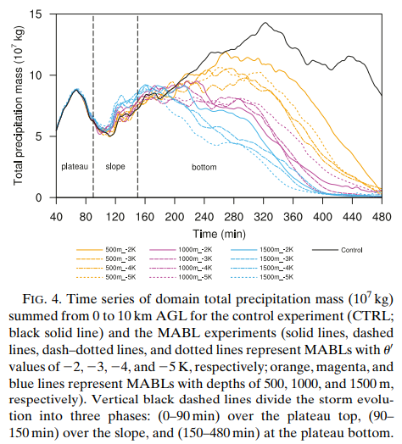

Slide 10
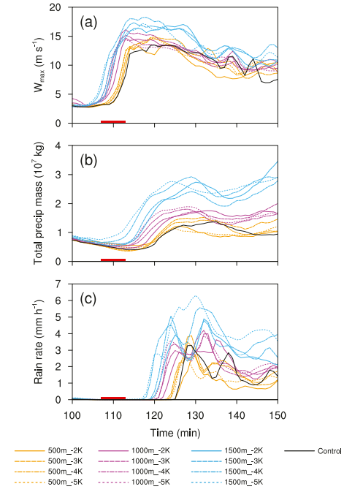
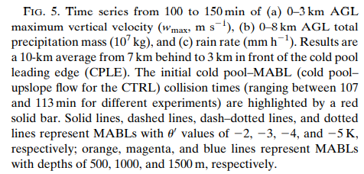

Slide 11
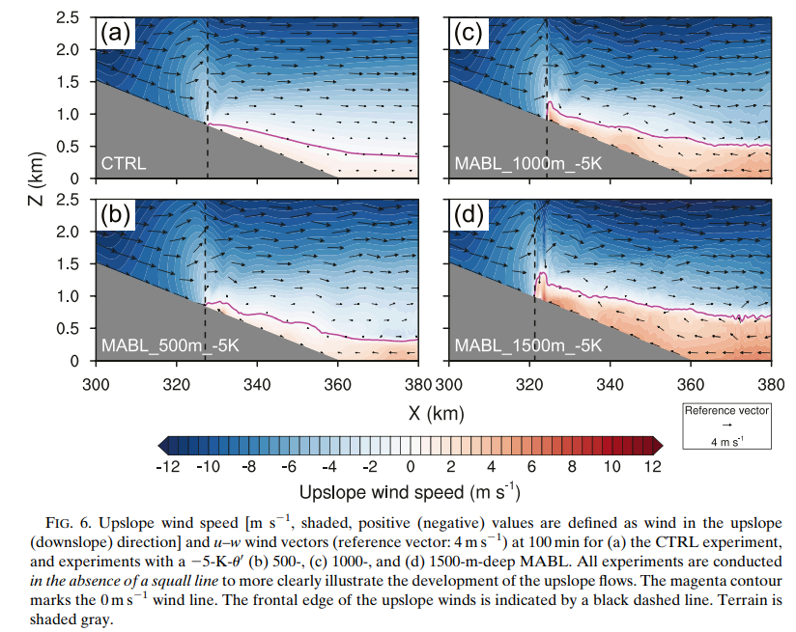

Slide 12
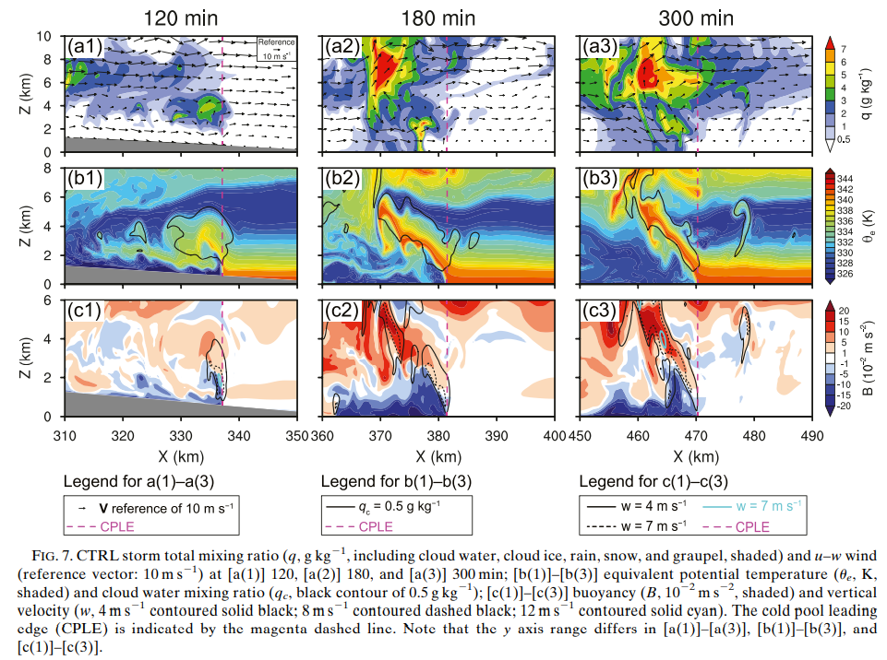

Slide 13
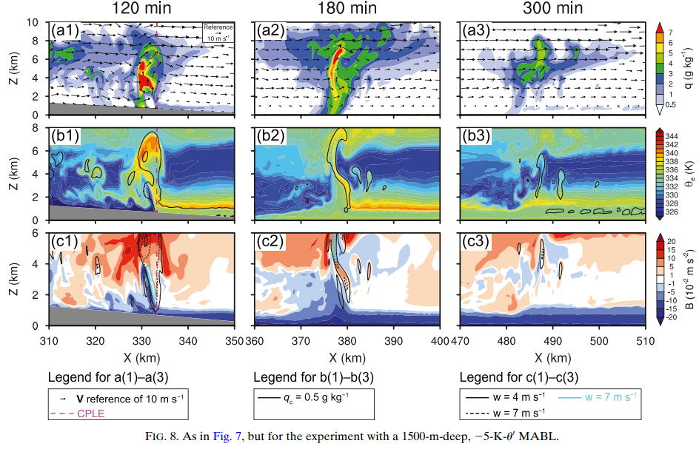

Slide 14
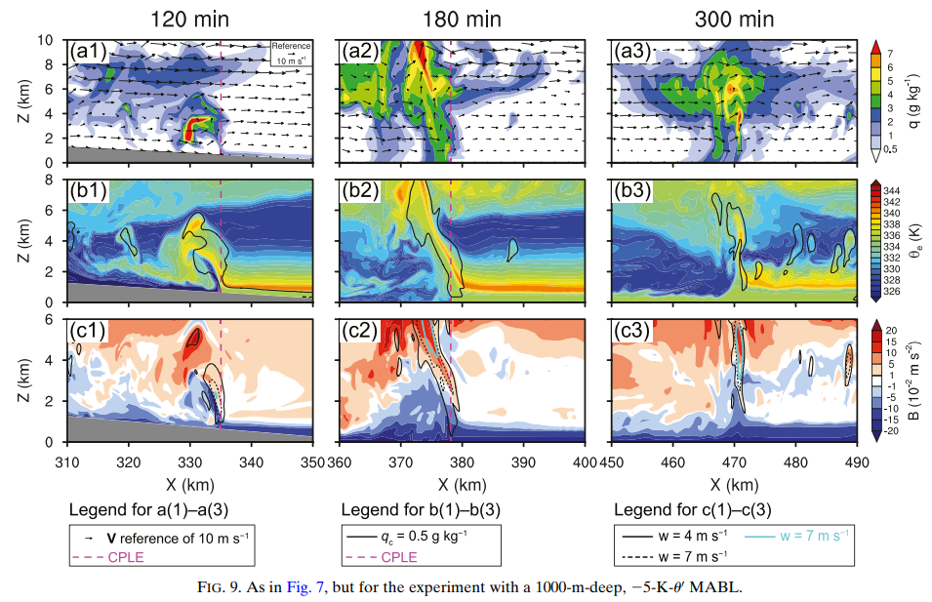

Slide 15
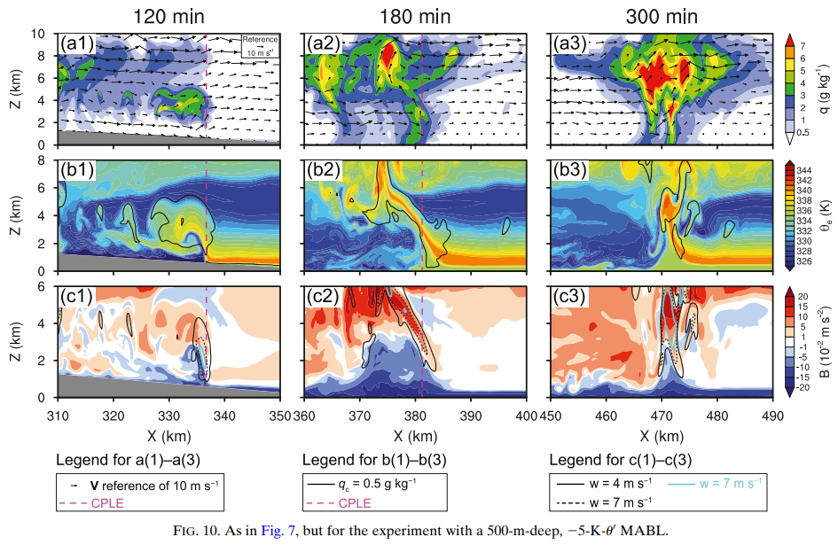

Slide 16
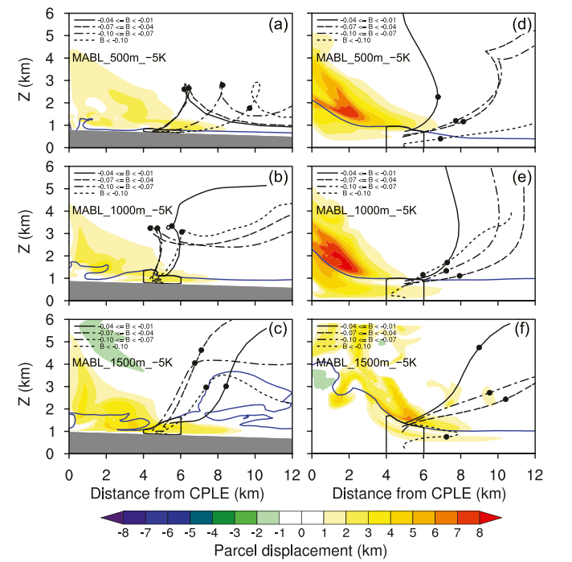

Slide 17
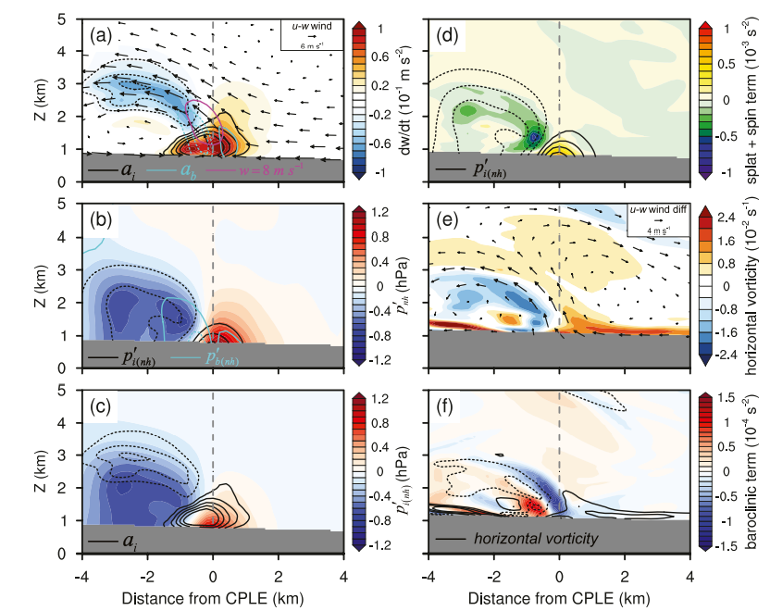

Slide 18
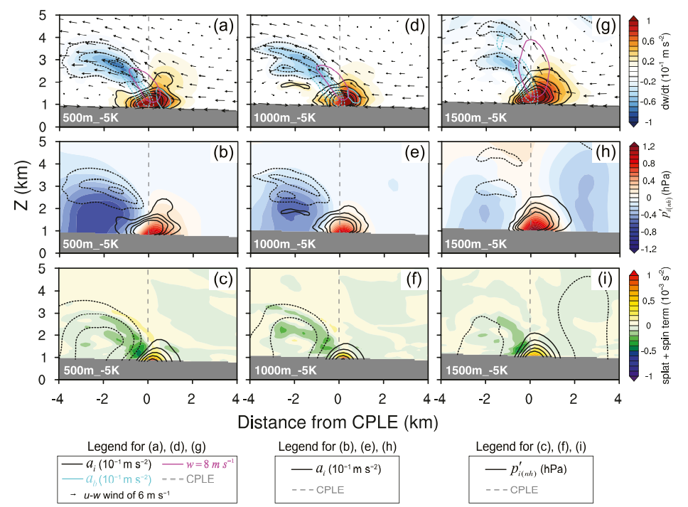

Slide 19
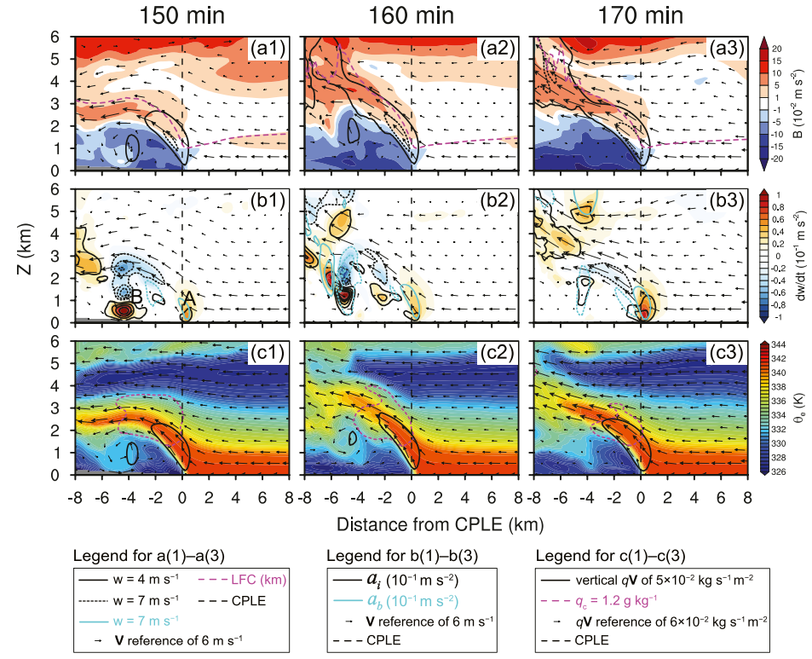

Slide 20
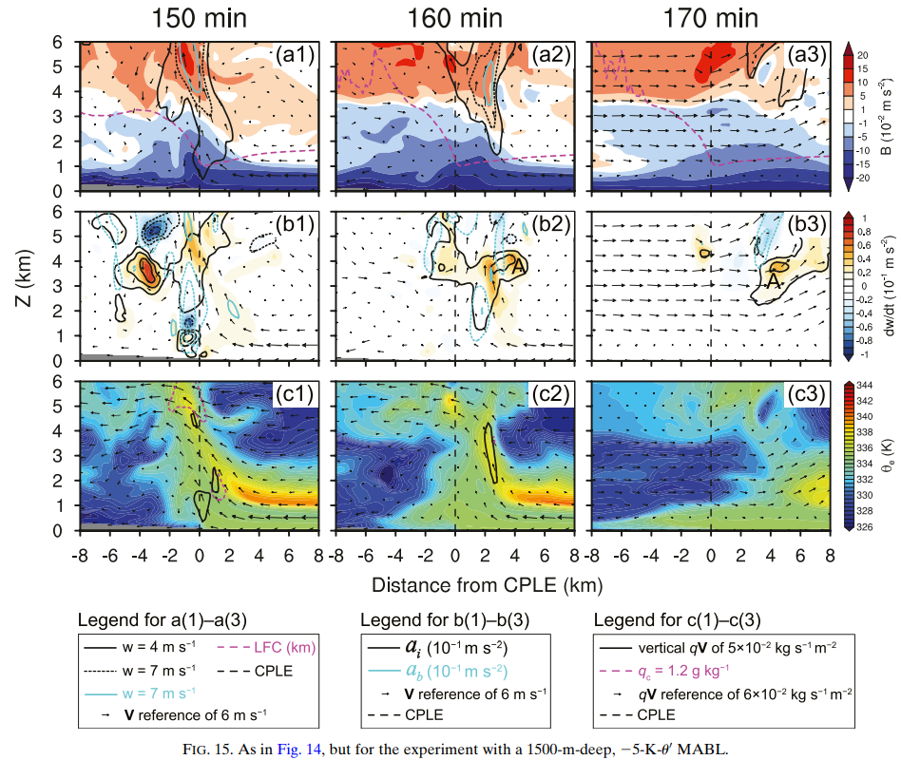

Slide 21
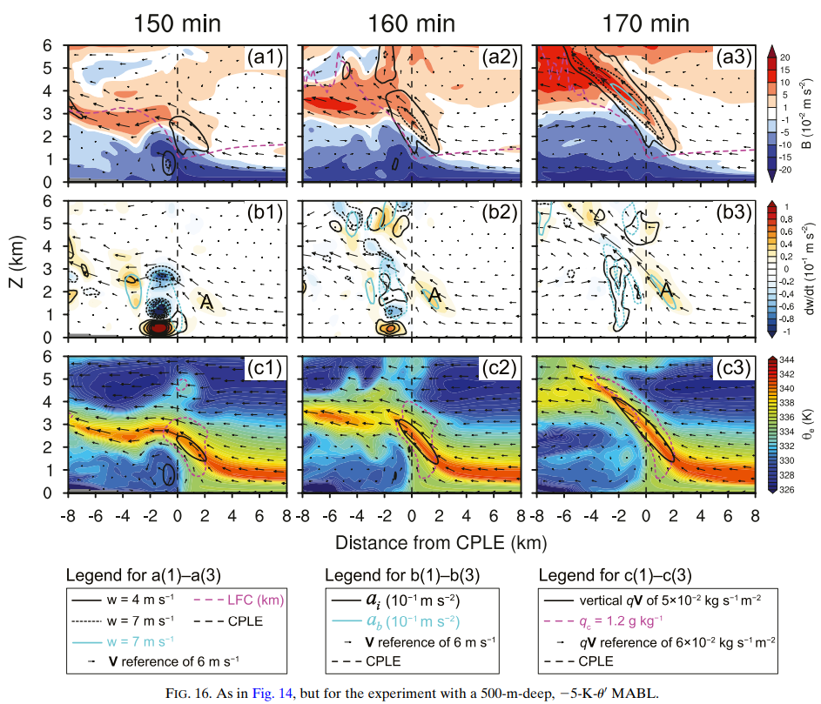

Slide 22
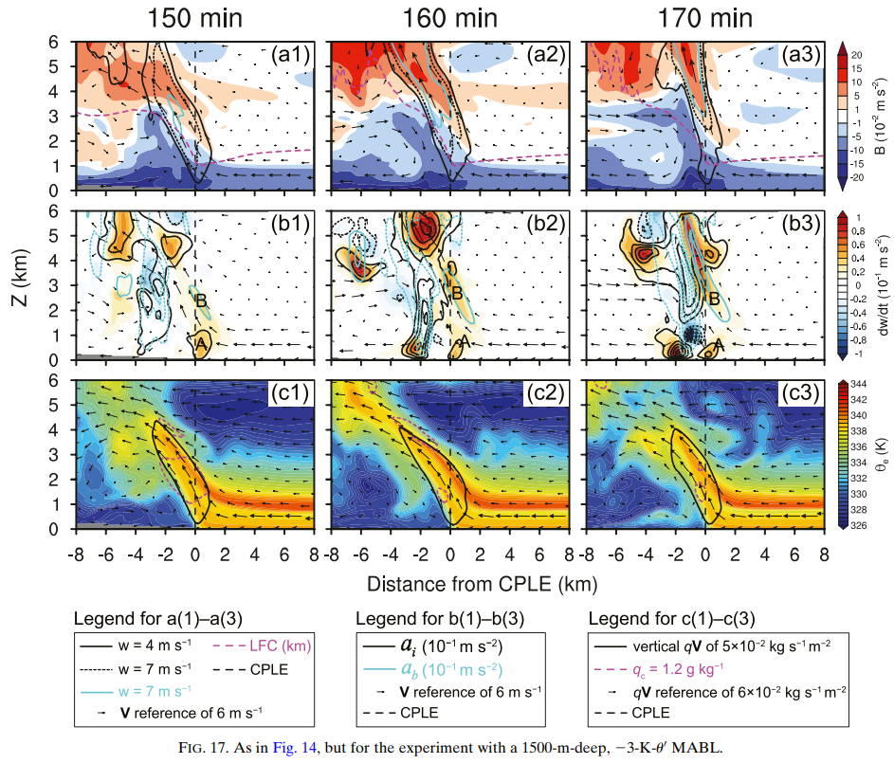

Slide 23
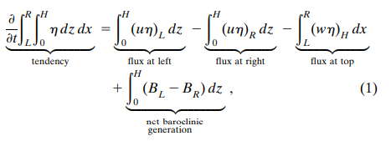
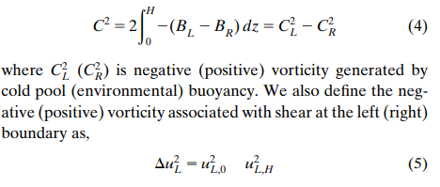
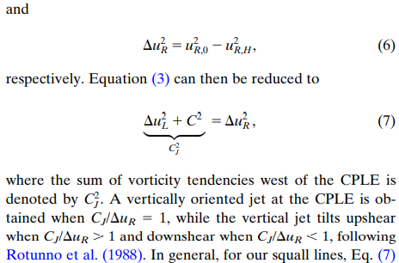

Slide 25
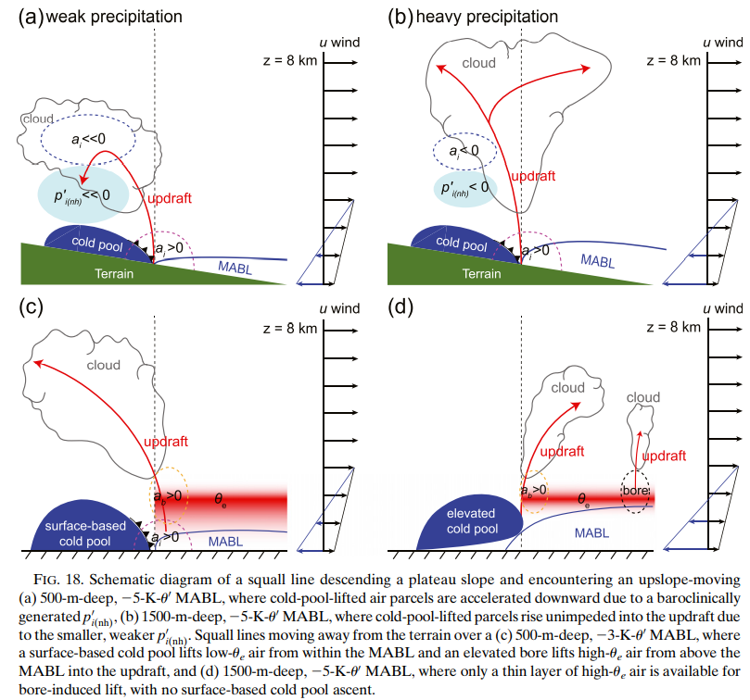

Slide 26
Summary
For large horizontal gradients in buoyancy across the gust front (e.g., 500-m-deep MABL), an elevated, but low-level, negative p'i(nh) induces a downward acceleration of air parcels following the initial cold pool lift, leading to shallow ascent and less precipitation.
Presence of a cold, deep MABL reduces the horizontal buoyancy gradient across the gust front, leading to smaller baroclinically generated horizontal vorticity behind the gust front, thus a smaller pressure perturbation and weaker downward vertical acceleration. Consequently, parcels ascend to higher altitudes along more upright trajectories leading to more overall precipitation and a greater rain rate.
The magnitude of this horizontal vorticity is sensitive to MABL depth, with less vorticity, a smaller negative p'i(nh), and a smaller negative vertical acceleration for deeper MABLs. Therefore, precipitation over the slope is more intense in the presence of deep MABLs, in spite of the smaller surface-based instability.

Slide 27
Summary
As the squall lines move away from the terrain, those over the deepest MABLs decay most rapidly, while those over the shallowest decay last, predominantly related to the availability of elevated instability. Low-level θ_{e} is reduced in the presence of the MABL, and more importantly, deeper MABLs diminish larger amounts of elevated instability available to the storm, promoting more rapid storm decay.
Further, MABL temperature determines whether a storm retains a surface-based component (e.g., −3-K θ′) or becomes completely elevated (e.g., −5-K θ′). For less cold MABLs, surface-based convergence persists, which allows MABL air to ascend into the storm, which overtime may be detrimental. For the coldest MABLs, cold pools become elevated due to the large stability of the lowest-layers (i.e., the moving MABLs), and storms are supported by bores with no surface-based forced ascent, which lifts the limited supply of warm, moist air from above the MABL into the storm

