Slide 1
Record-breaking summer rainfall in South Korea in 2020: Synoptic characteristics and the role of large-scale circulation
Chanil Park, Seol-Woo Son
Jera Kim, Yoo-Geun Ham
Joowa Kim, Dong-Hyun Cha
Eun-Chul Chang, Gyu Won Lee
Jong-Seong Kug, Woo-Seop Lee,
Yun-Young Lee, Hee Choon Lee, and Byunghwan Lim

Slide 2
Introduction
Several heavy rainfall events (HREs) induced destructive catastrophe in South Korea in 2020
These HRE were not local phenomena but a regional manifestation of an abnormal summer monsoon
These HREs resulted from the vertical couple of low-level and high-level systems and exhibited distinct synoptic characteristics depending on the occurrence period
The synoptic conditions of Eastern Asia Summer Monsoon (EASM) can be influenced by remote focings via atmospheric teleconnections

Slide 3
The most important atmospheric teleconnections in this study:
Indo–western Pacific Ocean capacitor (IPOC)
Pacific-Japan pattern (PJ pattern)
summer North Atlantic Oscillation (SNAO)
The main causes of HREs:
Extratropical cyclones (ETCs)
Monsoon Rainband (MRB)
Tropical Cyclones (TCs)

Slide 4
Data and Method
Hourly precipitation data were recorded by KMA stations
91 stations for case study
45 stations for climatology
Japanese 55-year Reanalysis (1979-2020) were used to analyze synoptic conditions
Grid size id 1.25º
Outgoing Longwave Radiation (OLR) provided by NOAA was utilized to define the location and strength of convection
The daily index of boreal summer intraseasonal oscillation (BSISO) was evaluated by the Asia Pacific Economic Cooperation Climate Center (APCC)

Slide 5
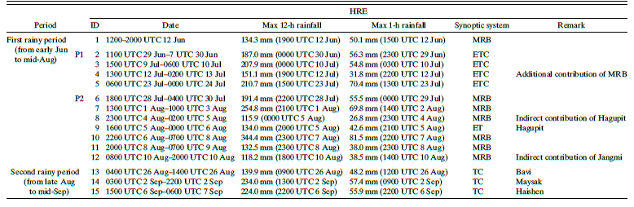

Slide 6
Overview of the 2020 summer rainfall

Slide 8
850-hPa vorticity

Slide 9
Satellite image

Slide 10
Subseasonal variation of the HREs and Background flow
P1(HRE2-5)
Dynamic-induced ascent

Slide 11
P2(HRE6-8
10-12)
Convective instability

Slide 12
Possible mechanisms of the monsoon circulation change from P1 to P2

Slide 13
P1
P2

Slide 14
P1
P2

Slide 15
The definition of SCS OLR index is the averaged OLR anomaly in SCS (10º - 22.5ºN, 100º -130ºE)
The definition of SNAO index is the averaged area-mean 500 hPa GPH in the North Atlantic Ocean (52º - 72º N, 10ºW - 25ºE)

Slide 16
The climatology of PJ-like pattern
Like P1
Like P2

Slide 17
Evolution of SCS convection/SNAO index

Slide 18
Discussion
The mechanism inducing suppressed convection in SCS in P1
In P2, BSISO enhanced SCS convection

Slide 19
Summary and conclusions
The quick transition of synoptic patterns led to the different types of HREs in P1 and P2.
In P1, WNPSH stayed at a lower latitude and extended eastward due to IPOC. The stationary trough dictates the development of ETCs.
In P2, WNPSH moved northward to produce stronger southwesterly flow and active MRB.
The SCS convection- and SNAO-related teleconnections induced the march of WNPSH
The IPOC and BSISO modulated the evoultion of SCS convection

