Slide 1
Observations of diurnal variability under the cirrus canopy of Typhoon Kong-rey (2018)
Trabing, B. C., and M. M. Bell, 2021: Observations of diurnal variability under the cirrus canopy of Typhoon Kong-rey (2018). Mon. Wea. Rev., 149, 2945-2964.

Slide 2
The convection in the inner core of TCs has consistently been shown to be stronger in the overnight hours preceding the peak in rainfall.
Leppert and Cecil (2016); Navarro and Hakim (2016)
Introduction
Shortwave Radiation
The solar heating at upper levels is important for stabilizing the moat region of Hurricane Edouard (2014) simulations, which causes convection outside of the eyewall to develop at larger radii.
Tang et al. (2017)
The shortwave heating in the upper levels of rainband convection is responsible for weakening the diabatic heating profiles of convective clouds during the day and can modify the timing of secondary eyewall formation.
Trabing and Bell (2021)
Cirrus Canopy
The cirrus canopy is formed when deep inner-core convection penetrates the stable outflow layer and spreads radially, meaning that the cirrus canopy formation and fluctuations in thickness/altitude should therefore lag the diurnal cycle of convection.
Merritt and Wexler (1967); Duran and Molinari (2016); Houze (2010)
The direct radiative heating in the cirrus canopy may be responsible for generating gravity waves that can propagate away from the tropical cyclone center and throughout the depth of the troposphere.
Evans and Nolan (2019)
The radiative heating/cooling anomalies in the cirrus canopy can also change the upper-level stability and induce anomalies on the secondary circulation of the TC which could feedback on the strength of convection.
Duran and Molinari (2016); Navarro and Hakim (2016); Navarro et al. (2017)
Notes:
高層太陽輻射加熱讓moat區域變穩定，造成眼牆外的對流在更外圍的地方發展
高層的短波輻射會減弱對流的非絕熱的heating profile，改變次眼牆的形成時機
當內核深對流穿過穩定的outflow layer並向外擴張形成卷雲層，表示卷雲層的形成和對流的diurnal cycle會延遲一段時間
卷雲層中直接的輻射加熱會產生重力波，從TC中心向外傳播到整個對流層內
卷雲層中的輻射加熱和冷卻會改變高層的穩定度，誘發TC的次環流，影響對流的強度

Slide 3
Diurnal Pulses
The diurnal cycle of tropical cyclone rainband convection, and any impacts from the cirrus canopy, may be complicated by the existence of outward propagating rings of cold infrared (IR) brightness temperatures. These propagating cold rings within the outflow layers of mature tropical cyclones, referred to hereafter as diurnal pulses or cooling pulses.
Dunion et al. (2014)
Mechanisms of Diurnal Pulses
The diurnal pulses may be initiated by inner rainbands that become reinvigorated after propagating radially outward into thermodynamically favorable environments. It is unclear whether all diurnal pulses are coupled with deep convection, or if the features are driven by processes solely in the outflow layer.
Ditchek et al. (2020)
The recent modeling study suggests that diurnal pulses can be characterized by outwardly moving squall lines with associated gust fronts.
Dunion et al. (2019)
The diurnal pulses are linked to gravity waves that may be initiated by an enhancement of convection in the inner core that becomes coupled with convection as it moves radially outward.
O’Neill et al. (2017)
Notes:
紅外線觀測中，環型的低亮溫訊號在outflow layer中向外傳遞，在本研究又稱作diurnal pulse或cooling pulse
diurnal pulses可能透過內核區雨帶initiate並向外傳到適合對流發展的熱力環境
3&4 另一種說法是接近於向外側移動的颮線或是跟重力波有關係

Slide 4
Scientific Questions
How does the diurnal cycle of convective and stratiform precipitation vary under the cirrus canopy of Typhoon Kong-rey?
What role does the thermodynamic environment play in the variability of the observed rainband convection?
Are the diurnal pulses in Typhoon Kong-rey convectively coupled and consistent with previous modeling studies?
Notes:
卷雲層下對流與層狀區的diurnal cycle怎麼變化
熱力環境對雨帶對流的變動扮演什麼角色
diurnal pulse有沒有跟對流耦合

Slide 5
Data and Methods
PISTON (Propagation of IntraSeasonal Tropical OscillatioNs) field project
Research vessel (R/V) Thomas G. Thompsom (mid-August to mid-October)
Soundings (dt: 3 hrs)
SEA-POL on R/V (C-band; R = 120-km; 240º field of view)
Radiometer (downward solar fluxes)
High spectral resolution lidar (HSRL; dt = 10 min; dz = 60 m; cloud base height)
Himawari-8 (10.4 μm IR brightness temperature)
TC PRIMED (passive microwave imagery from SSM/IS & AMSR2)
Convective-stratiform partition algorithm
(Yuter and Houze 1997)
Cat. 5
TS
[UTC+9] 9/29 18L – 10/3 06L

Slide 6
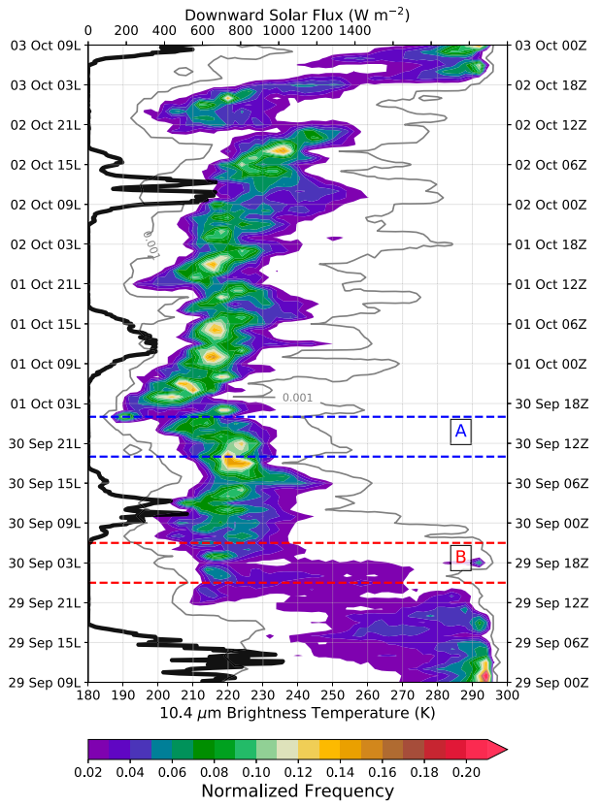
Rainband under the Cirrus Canopy
Notes:
亮溫由290K移到220K附近，210-230K的雲頂高約10-14 km，本研究關注的時間就是從9/29 18L到10/3 06L這段由高層卷雲層或雲砧覆蓋的時間
向下的太陽輻射沒有超過700W/m2，平時晴空可達1200W/m2
亮溫最低的發生時間主要是在深夜或是清晨的時候，白天的亮溫增高
雖然符合熱帶海洋的對流日變化，但是增加了颱風的因素，這些高雲的冰是從內核對流透過高層出流帶來的還是來自於外圍雨帶對流的日變化所產生的，目前還不清楚

Slide 7
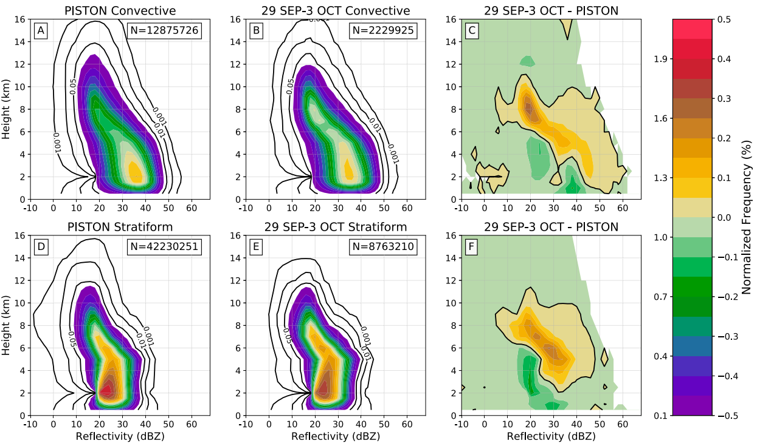
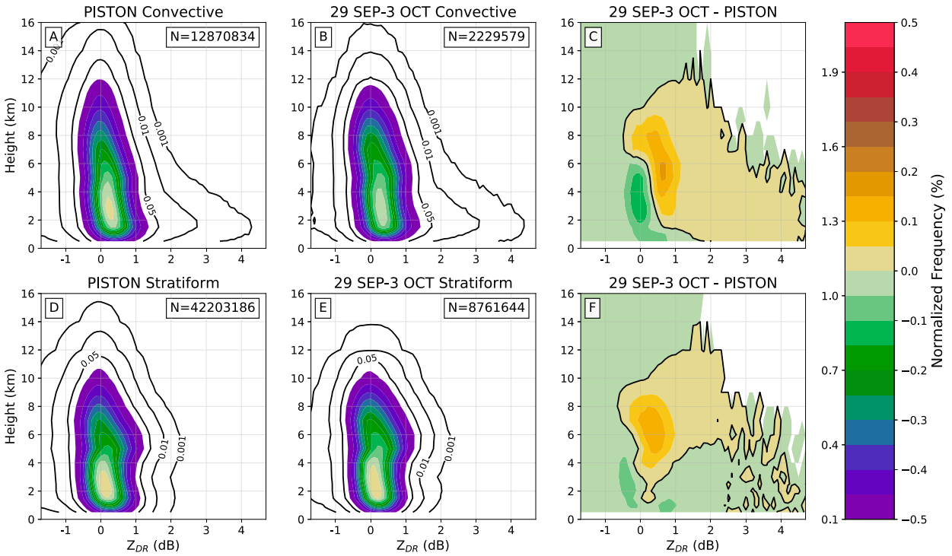
Rainband under the Cirrus Canopy (Convective/Stratiform)
reflectivity
ZDR
PISTON mean
TC
TC-PISTON
PISTON mean
TC
TC-PISTON
CV
ST
Notes:
超過14km以上的回波比較少，有兩個解釋，一是高層雲上方輻射冷卻而雲中幅射增溫，使高層變穩定；二是雲的垂直發展受到眼牆出流的限制
8-10km高度的20dBZ在對流和層狀都增加，對應到ZDR在0.5-1dB附近的增加，表示降水粒子的粒徑中位數變大
對流區和層狀區相比，卷雲層之下的對流區，5km高度融化層的附近和下方有強回波增加，對應到ZDR，表示對流區有更高濃度的水滴和冰相粒子
這個差異表示在卷雲層下是個適合對流發展的好環境

Slide 8
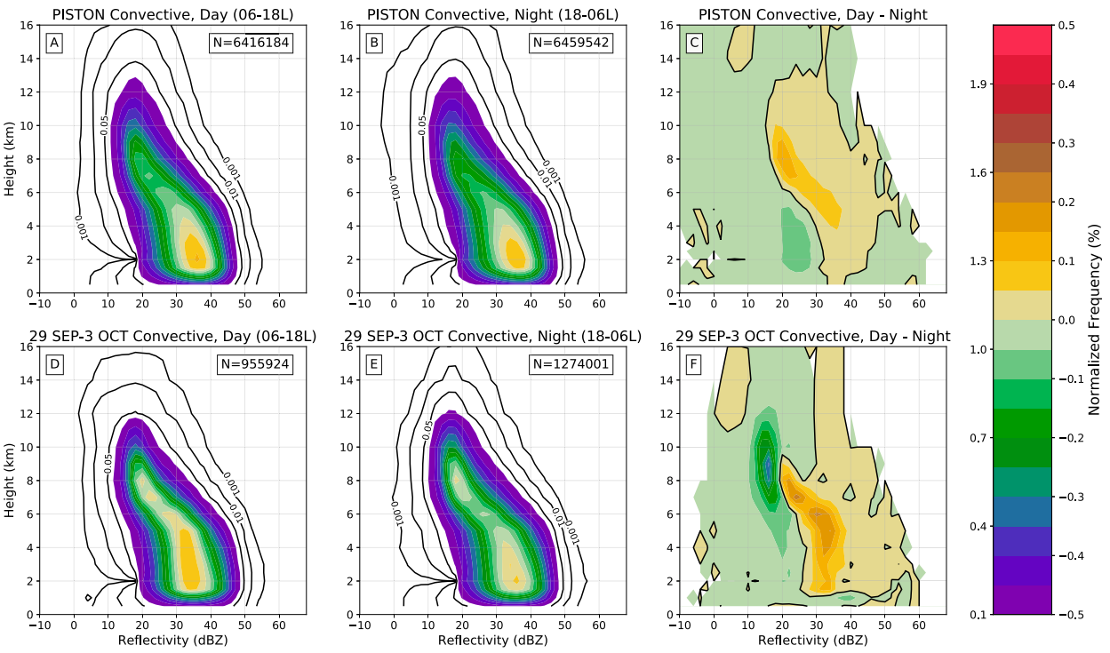
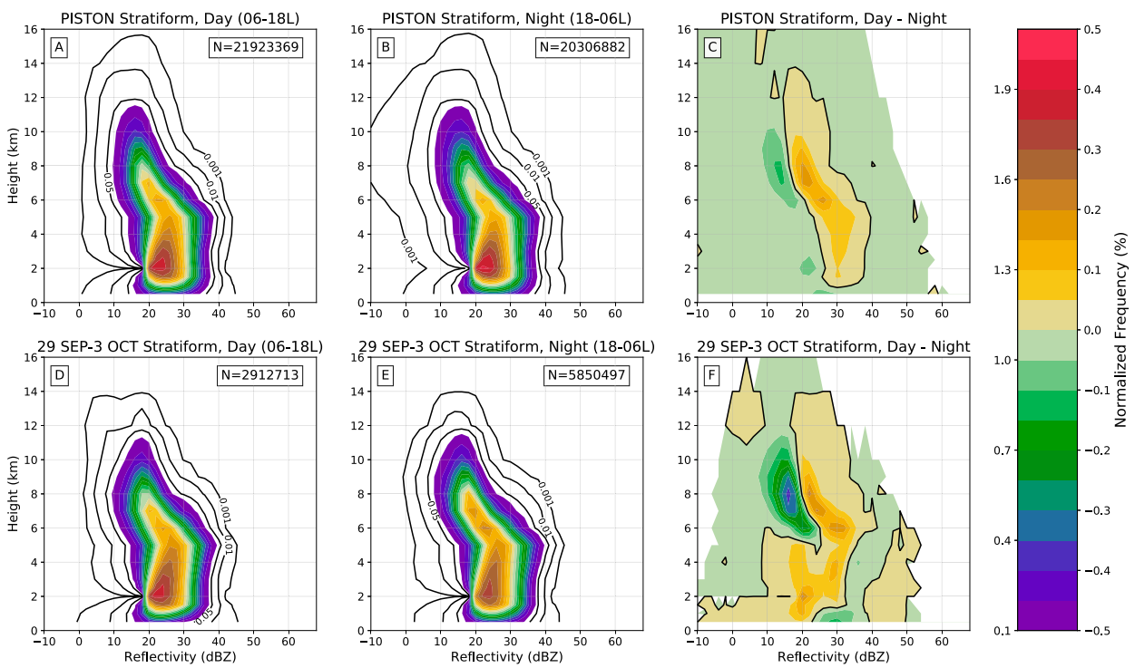
Rainband under the Cirrus Canopy (Day/Night)
Convective region
Stratiform region
Day
Night
Day-Night
Day
Night
Day-Night
PISTON
mean
TC
Notes:
PISTON實驗期間，白天對流的強回波可到較高的高度，特殊的是儘管夜間長波輻射冷卻高層RH增加，PISTON的夜間對流也沒有比較強
層狀區也是白天較強，有較大的回波
當卷雲層覆蓋的情況下，夜間對流通常達到8-12km，白天對流較淺(約2-6km)但回波較強。這個差異是由於白天短波輻射加熱使高層大氣穩定，降低對流高度
層狀區的日夜差異顯示夜間融化層之上有較多弱回波，白天融化層的上方有較多強回波，下方有較多弱回波

Slide 9
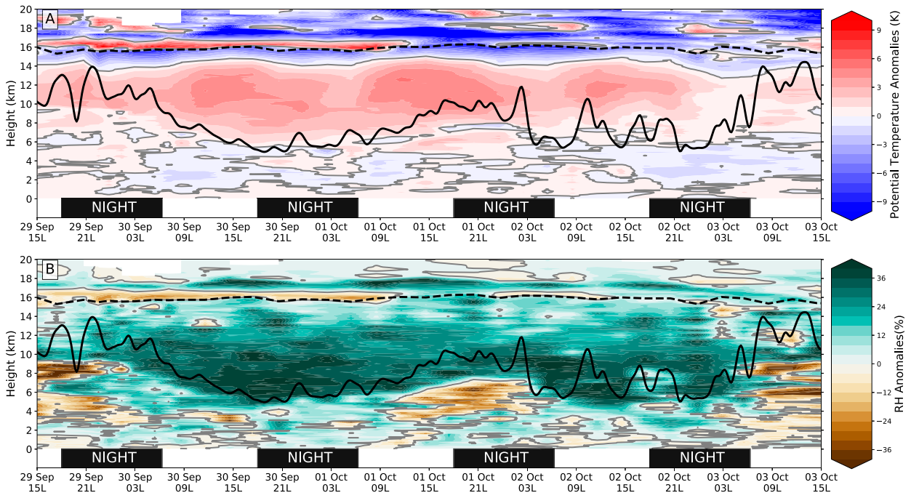
Rainband under the Cirrus Canopy (HSRL/soundings – θ/RH)
Anomalies from PISTON mean profile
Notes:
先講雲底位置，對流層頂，color
白天的時候上層增暖是由於雲層內水氣和降水粒子吸收短波太陽輻射
暖區上方且對流層頂下方的的冷區是因為雲頂的長波輻射冷卻
對流層頂附近有薄薄一層暖區，這是一層薄卷雲，是由長波輻射增溫造成
9/30-10/1的高層4-12km高有較大的RH，因為此時剛好是研究船距離TC中心最近的時候
水氣和水相粒子吸收短波輻射使得高層大氣增溫，對應到溫度圖中的增溫處
8-15km高層大氣吸收太陽輻射，增加高層的位溫梯度使得高層變穩定，也就解釋為什麼對流發展高度會降低，同時高層加熱也會影響到環境的CAPE

Slide 10
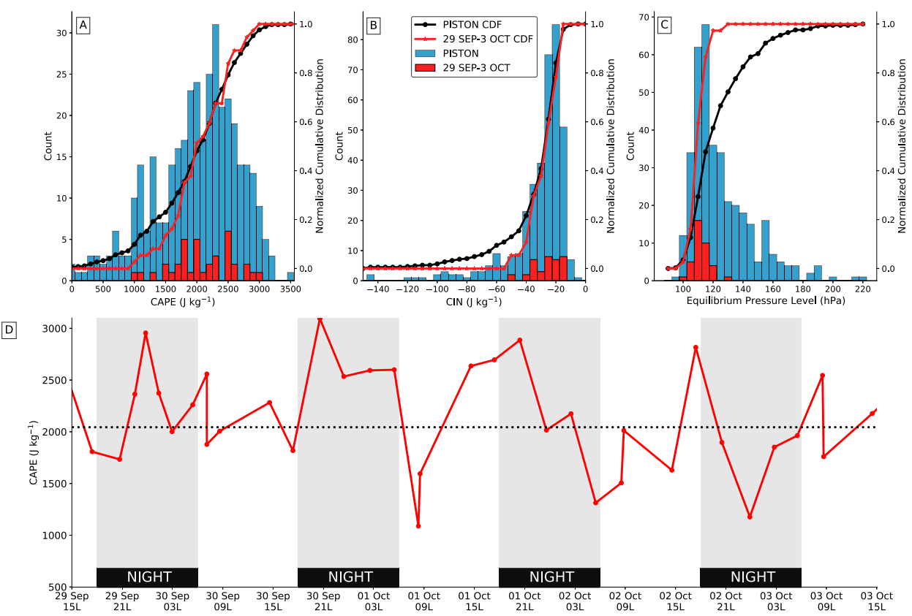
Rainband under the Cirrus Canopy (soundings - CAPE)
Notes:
康芮颱風的case相較於PISTON而言，CAPE較大，CIN較小，而氣塊都能到達到100hPa附近。
白天的CAPE平均約2070 J/kg，夜晚的CAPE平均約2210 J/kg，最大的CAPE出現在夜間，可以達到3000 J/kg
夜間到白天的CAPE下降，表示夜間的CAPE被對流消耗
綜合以上的觀測結果，即使高層有卷雲層，但環境會是適合對流發展的，但是白天太陽短波輻射再高層加熱會讓對流發展高度較低

Slide 11
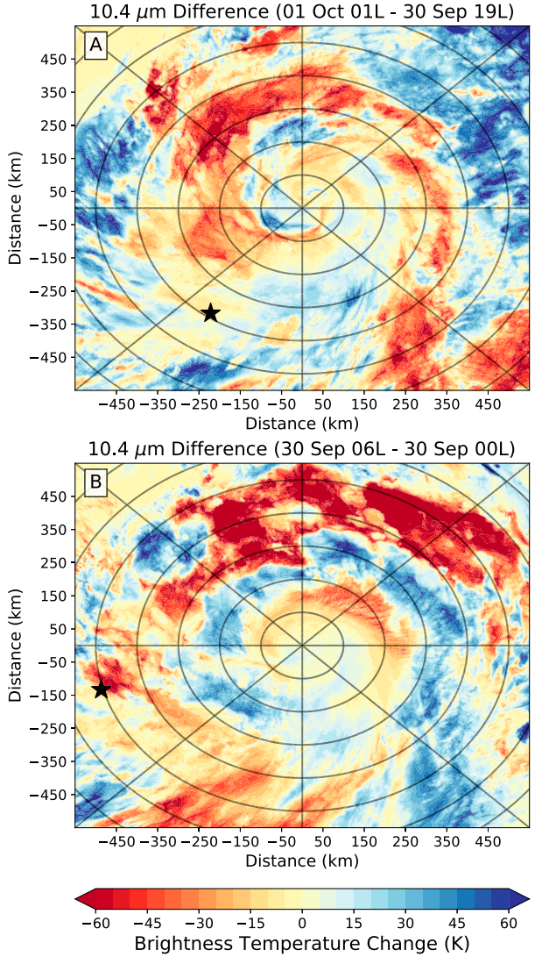
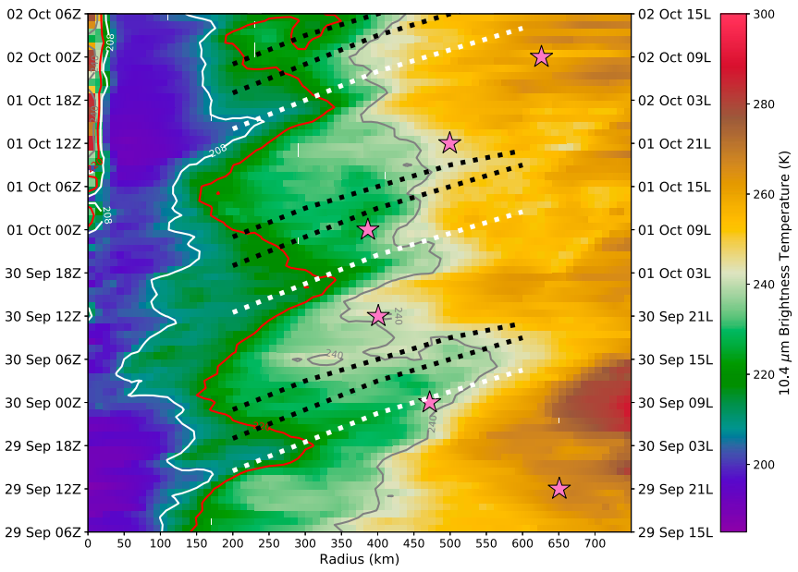
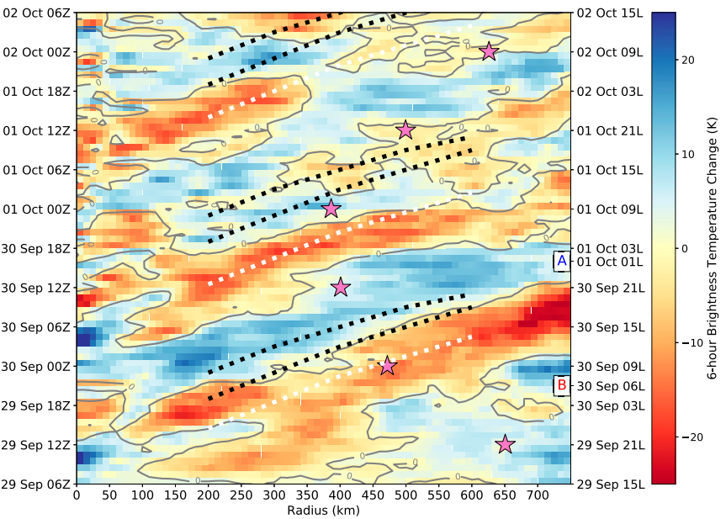
Diurnal Pulses in the cirrus canopy (Himawari-8)
220K
240K
Notes:
TC100km內的內核區亮溫低於210K，對流雲發展到很高。RI期間，冷雲向外移動。
220K等值線比傳統240K等值線更能看出日變化的訊號，表示短波輻射的影響很重要。
出現在outflow layer的diurnal pulse會受到TC次環流和雨帶對流的日變化的影響，所以為了去除次環流的影響，使用6hr的亮溫差來看diurnal pulse的訊號
黑虛線是利用Dunion(2014)中推算出預期的diurnal pulse發生的時間和位置，白虛線是觀測到的diurnal pulse，其中有兩次的cold ring propagation有被RV觀測到
有三次的低亮溫diurnal pulse向外傳，並隨後出現增溫的訊號，康芮颱風的diurnal pulse比預期的diurnal pulse提前6小時出現
接著計算cold ring或說diurnal pulse的傳遞速度，#1約5m/s，#2在200-300km約5m/s，400-500km約9m/s，這個速度差異是因為TC的強度
220K中午有極小值，剛好是太陽輻射最大值，向外擴張到凌晨，對應到SEA-POL雷達觀測到對流雲高度因為短波輻射減少。
由於環境中存在東北方向的中度垂直風切，康芮颱風的cold ring相較於過往紀錄的颱風還要不對稱

Slide 12
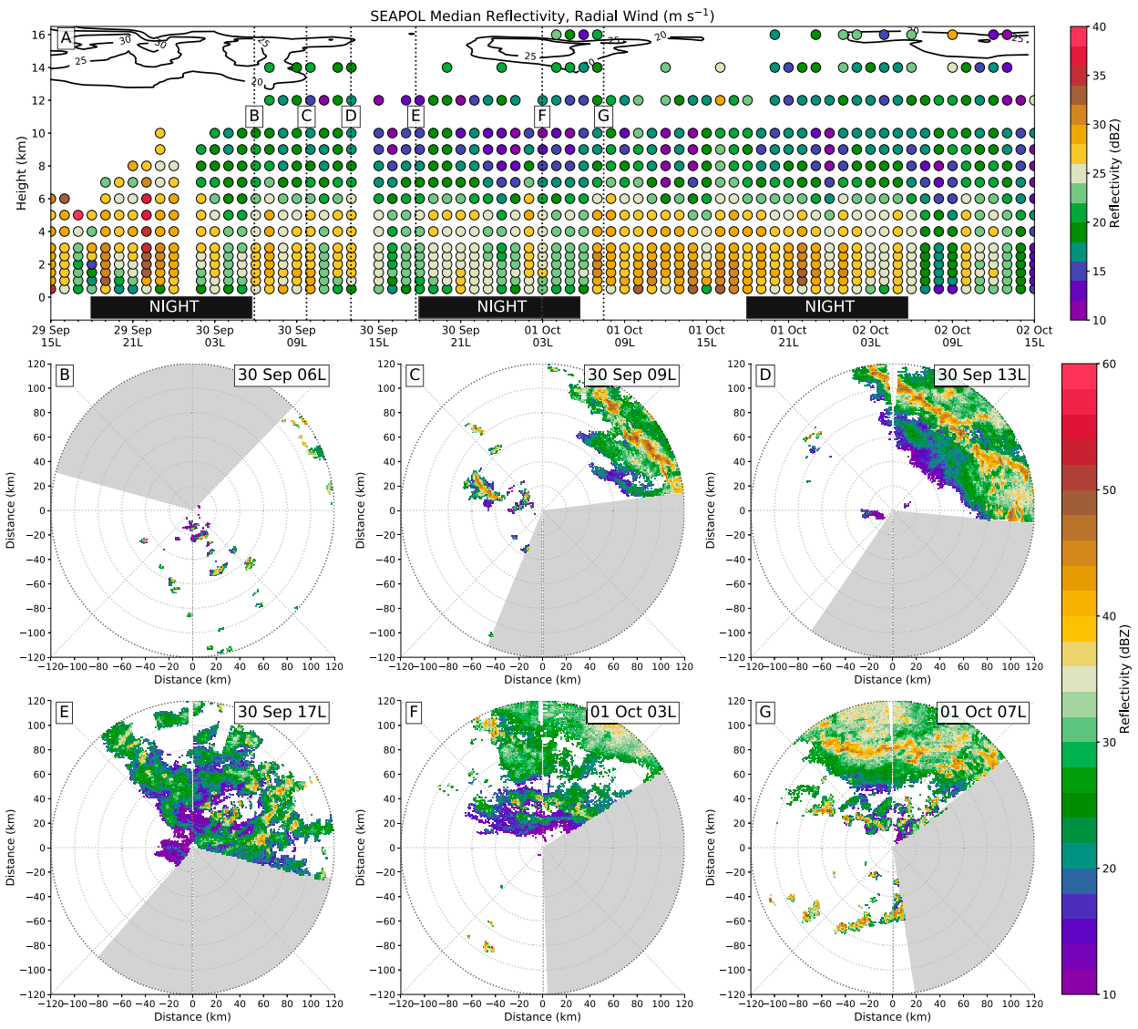
Diurnal Pulses in the cirrus canopy (SEA-POL/sounding)
Notes:
#1經過之前，高層有背景的東風，不是康芮的次環流
#1 diurnal pulse經過RV期間，15km高的outflow jet增強，回波高度增加，對應到有對流雨帶進入SEA-POL的觀測範圍(b-d)
#1 diurnal pulse通過之後，回波高度下降，層狀降水區增加(e)
#2 diurnal pulse通過時，探空有觀測到新的outflow jet，回波高度也增加。
回波達到outflow jet之上的高度，表示有深對流圖破穩定層，可能讓cold ring的訊號能持續更長一段時間
接著低層回波值增加，表示層狀區面積增加
#2 diurnal pulse通過之後跟#1一樣，回波高度下降，outflow jet減弱

Slide 13
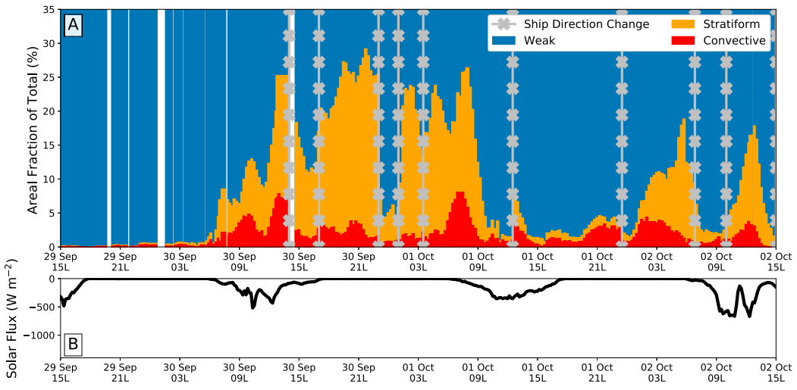
Diurnal Pulses
in the cirrus canopy
Notes:
#1 diurnal pulse通過時對應到對流區增加，幾個小時候達到最大值，隨後層狀區也開始增加，表示雨帶減弱
#2 diurnal pulse通過時，6小時後對流區域增加，而8小時後對流變得零散，是因為中層出現乾空氣

Slide 14
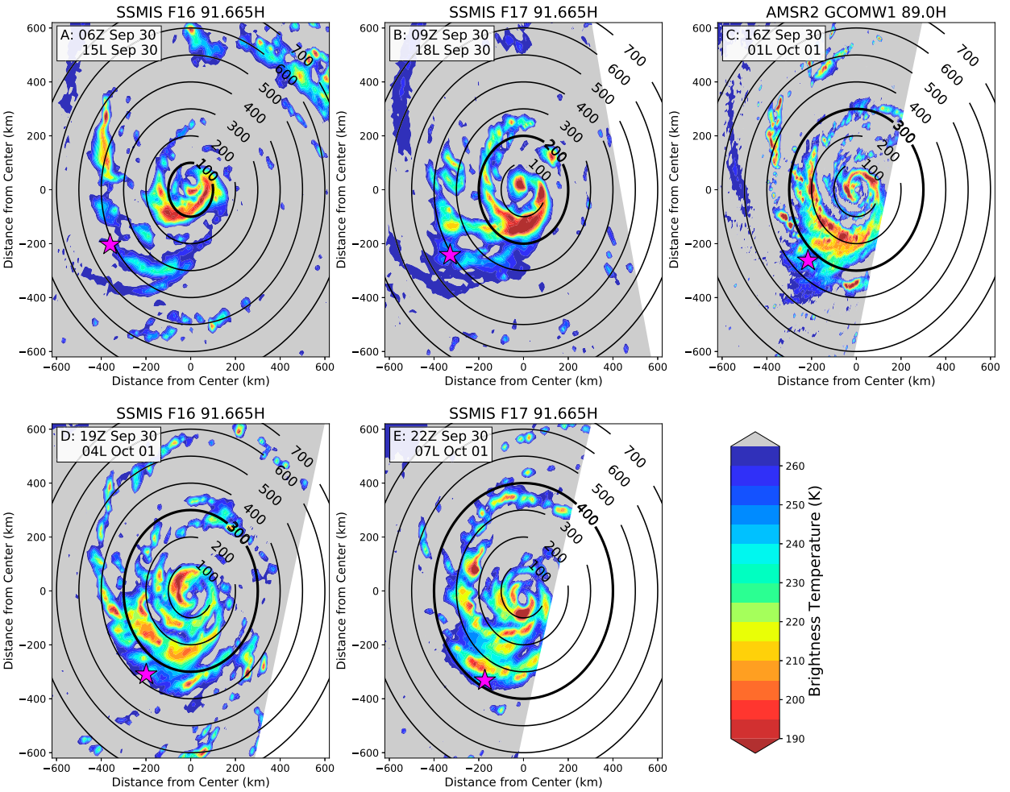
Diurnal Pulses in the cirrus canopy (microwave satellites)
Notes:
#2 diurnal pulse通過期間，有比較足夠的衛星微波觀測
A 主雨帶包覆颱風中心，位在半徑100km附近
B 主雨帶變寬，更軸對稱，向外側移動，位於半徑100-200km之間
C AMSR2有較高解析度，半徑100km內有眼牆的對流結構，主雨帶持續向外移到半徑大於200km處
D 雨帶變得較沒有組織，對流零星，雨帶變得較難分辨，位於半徑250km附近。在半徑150km附近有新的主雨帶形成
E 原來的主雨帶因為對流減弱，向外移動的特徵也變得不明顯
整體透過微波觀測估計出雨帶的移動速度約3-8m/s，因此作者認為cold ring或說diurnal pulse的移動是和主雨帶耦合的

Slide 15
Conclusions
Observations from PISTON provide evidence that the convective and stratiform clouds under the cirrus canopy of Typhoon Kong-rey were stronger compared to the overall distribution from PISTON. The peak altitude of convective and stratiform clouds, however, was reduced in the near TC environment and believed to be due to the increased stability from the outflow layer.
On diurnal time scales, a temperature response to shortwave heating was observed in the thermodynamic soundings and in rainband convection with reduced concentrations of ice aloft.
The cooling pulses in Typhoon Kong-rey were not on the ‘‘Dunion clock,’’ but three such oscillations occurred in the outflow of Typhoon Kong-rey suggesting that the feature is diurnally driven and recurrent. The cooling pulses were associated with maxima in the outflow (outflow jets), consistent with the model shown in Dunion et al. (2019) and the model analysis in Ditchek et al. (2020). The increasing convection after the cooling pulse in the outflow and in the IR imagery suggests a lagged coupling with rainband convection.
Observations from SEA-POL and the thermodynamic soundings showed convective reflectivity echoes penetrating the outflow layer suggesting that the cooling pulses at upper levels are coupled with, and likely maintained by, rainband convection and are not driven solely by inner-core convective processes of Typhoon Kong-rey.
Notes:
康芮颱風的卷雲層下的對流和層狀區比PISTON實驗的平均要強，但高度發展會受到outflow layer的穩定度增加而抑制
日變化的尺度下，短波輻射讓高層增溫，減少高空的冰
康芮颱風的cooling pulses沒有在預期的時間發生，但機制依然是受到diurnal cycle驅動。cooling pulses伴隨著高層的outflow jet，並落後雨帶的對流的發展
雷達和探空顯示對流的回波穿過穩定層進入outflow layer，並跟雨帶的對流耦合，而不是單靠颱風內核的對流過程驅動

