Slide 1
Remote Rainfall of Typhoon Khanun (2017): Monsoon Mode and Topographic Mode
Paper review
mainly refer to
Yi-Hsuan Lin and Chun-Chieh Wu
Wei-Ting Fang
2021.12.28 @CPLab
Other references:
Lin, K. J., S. C. Yang, and S. S. Chen, 2018: Reducing TC position uncertainty in an ensemble data assimilation and rediction system: A case study of Typhoon Fanapi (2010). Wea. Forecasting, 33, 561–582.

Slide 2
Outline
Introduction
An overview of Typhoon Khanun
Model configuration and experimental design
Simulation results
Monsoon mode
Topographic mode
Sensitivity to TC initial moisture and terrain of Taiwan
Summary

Slide 3
Introduction(1/2)
Quantitative precipitation forecasts (QPF) associated with TCs is affected by multiple factors, such as TC structure (Lonfat et al. 2004); track (Chang et al. 2013; Wu et al. 2013; Chien and Kuo 2011; Lin et al. 2020); translation speed (Yen et al. 2011); microphysics scheme (Tao et al. 2011) and model resolution (Wu et al. 2002, 2009, 2013).
Additionally, producing accurate QPFs is particularly difficult for operational forecast centers in Taiwan due to presence of the complex terrain and complicated interactions between TC circulation and the synoptic systems, such as Asia monsoon systems and upper-level troughs (Wu and Kuo 1999; Yu and Cheng 2008, 2013, 2014; Wu et al. 2009, 2013; Huang and Lin 2014; Chen and Wu 2016; Lin et al. 2020).
TC-related rainfall can be generally categorized into two types: direct and indirect (or remote; Wang et al. 2009).
The rainfall pattern associated with this remote effect is influenced not only by the TC track, but also by other factors such as the TC circulation/size, strength of the monsoon flow, and their interaction with terrain (Chen and Wu 2016).
Influence from environmental monsoonal flow and the terrain becomes prominent when TCs are 100 km away from Taiwan (i.e., remote effect; Wu et al. 2017)

Slide 4
Introduction(2/2)
If a TC passes over the South China Sea, warm and moist air advected northward by TC circulation would converge with dry and cold monsoonal northeasterlies. The confluence of two air masses of different characteristics is associated with frontogenesis, resulting in lifting and thus triggering heavy rainfall in the vicinity of northeastern Taiwan (Wu et al. 2009; Chen et al. 2013; Chen and Wu 2016).
Wu et al. (2009) categorized the remote rainfall events in Taiwan during the late TC season (e.g., October and November) into two modes: monsoon mode and topographic mode.
The results show that several components, such as TC size, monsoon strength, topographic effect, and model resolution, are responsible for the uncertainties in both the rainfall distribution and the accumulated precipitation amount of remote rainfall under the two modes.
Typhoon Khanun (2017) is an unusual case with rainfall in Taiwan under both monsoon and topographic modes. The objectives of this study are to investigate the mechanisms leading to different rainfall patterns associated with monsoon mode by ensemble simulations, as well as to examine the factors leading to the heavy rainfall under topographic mode, such as the impact of TC tracks, mountain geometry and confluent flow fields.

Slide 5
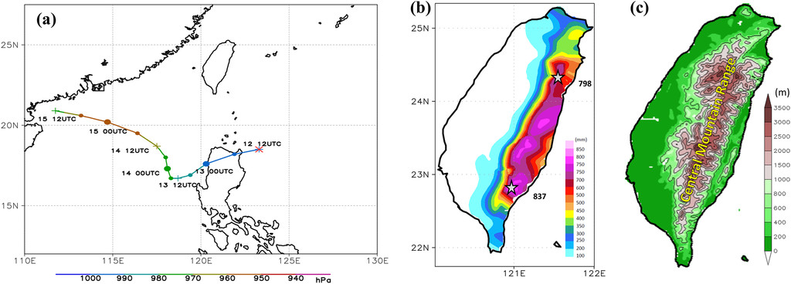
An overview of Typhoon Khanun (1/3)

Slide 6
An overview of Typhoon Khanun (2/3)

Slide 7
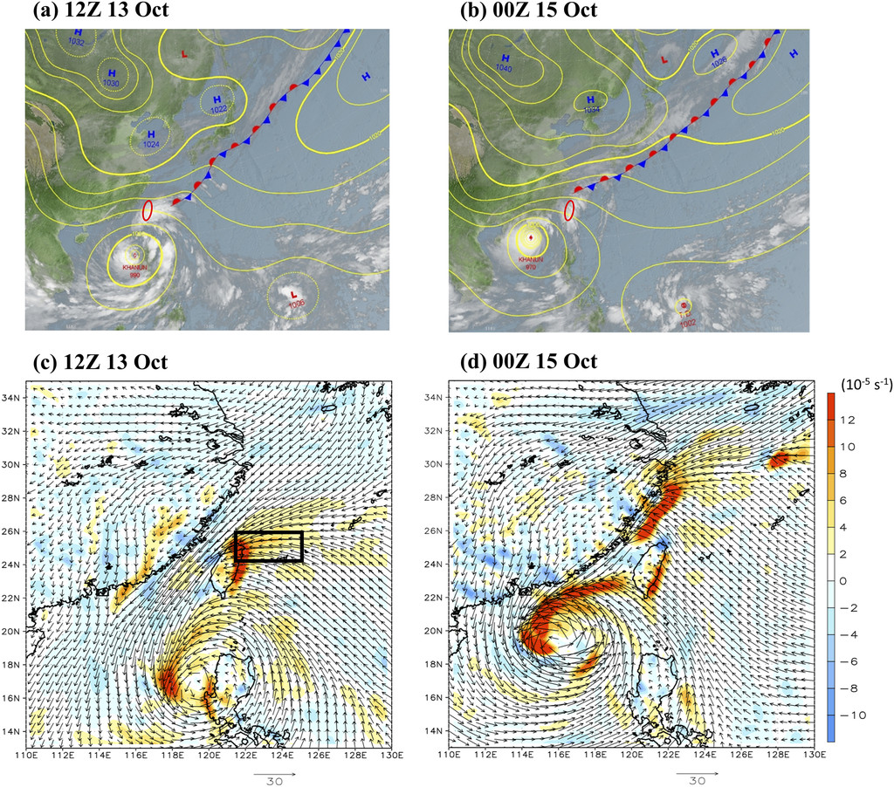
An overview of Typhoon Khanun (3/3)
(900–1000 hPa)
Monsoon mode is identified when both fluxes exist, with NE_flux being more dominant, which could correspond to moisture convergence. Meanwhile, a rainfall event is associated with the topographic mode if SE_flux is dominant.

Slide 8
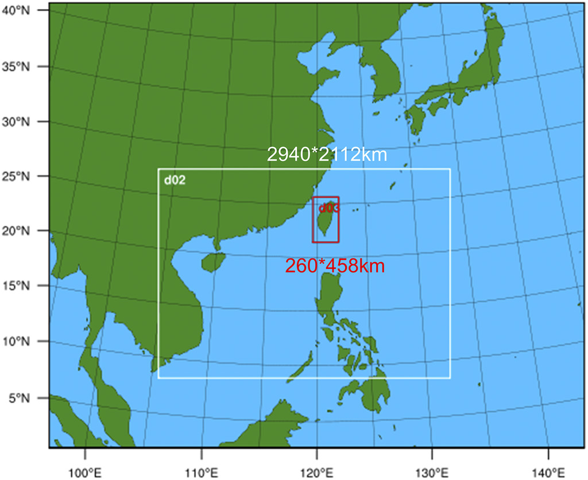
Model configuration and experimental design
Both the location and the translation speed derived based on the Japan Meteorological Agency (JMA) best track data are assimilated in this study, following the methodology outlined by Wu et al. (2010), which was developed based on the EnKF system of Meng and Zhang (2008a, b).
The sizes of the three one-way nested domains are 300 × 130, 490 × 352, and 130 × 229 grid points, with grid spacing of 18, 6, and 2 km, respectively.
The physical parameterization schemes in this study include the Goddard GCE scheme (Tao et al. 1989), the Rapid Radiative Transfer Model (RRTM) for long wave radiation (Mlawer et al. 1997), the Dudhia shortwave scheme for short wave radiation (Dudhia 1989), the Yonsei University (YSU) planetary boundary layer scheme (Hong et al. 2006), and the Kain–Fritsch scheme in the two coarse domains (Kain and Fritsch 1990).

Slide 9
Rainfall pattern
Monsoon mode
Monsoon mode

Slide 10
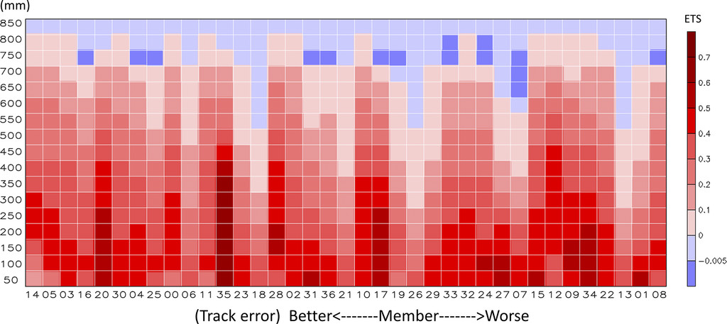
Simulation results
ALL_00
SE_35
NE_07
The occurrence ratio of rainfall maxima associated with the monsoon mode and topographic mode in zones A and B
ETS

Slide 11
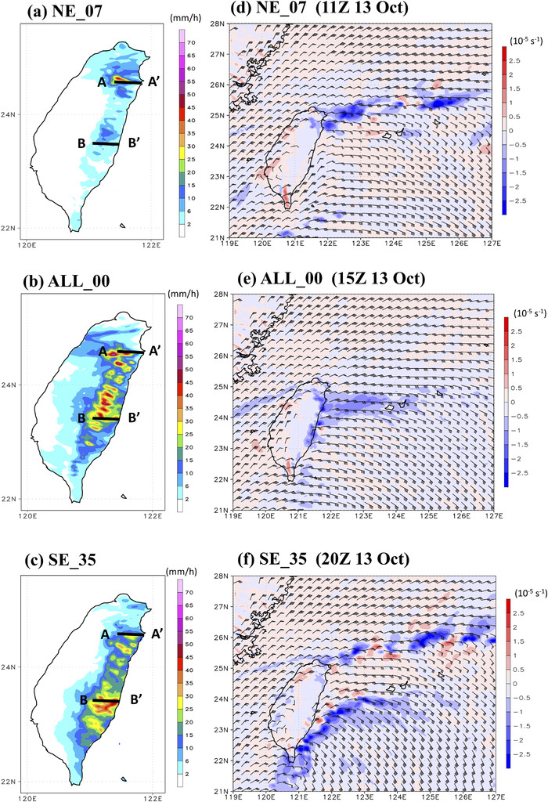
Monsoon mode
NE, which indicates the rainfall hotspots are mainly located near northeastern Taiwan
SE, which indicates the rainfall hotspots are mainly located near southeastern Taiwan
ALL, which indicates the heavy rainfall is distributed over the eastern region of Taiwan

Slide 12
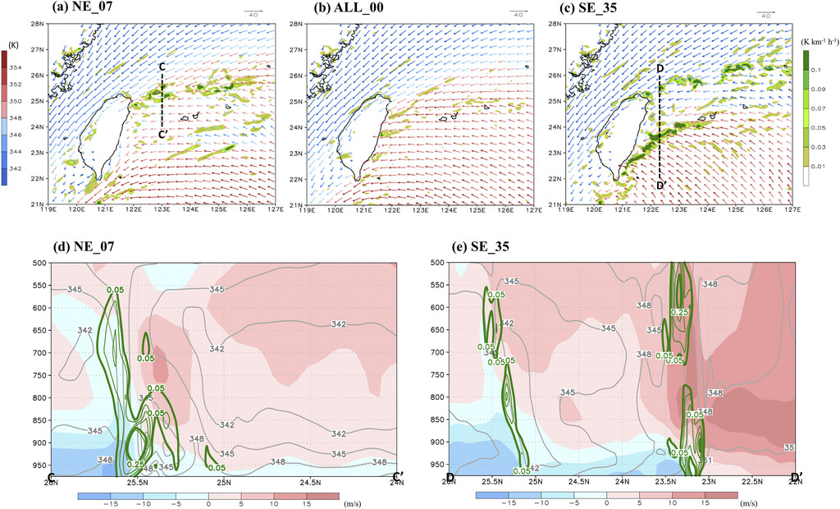
Frontogenesis

Slide 13
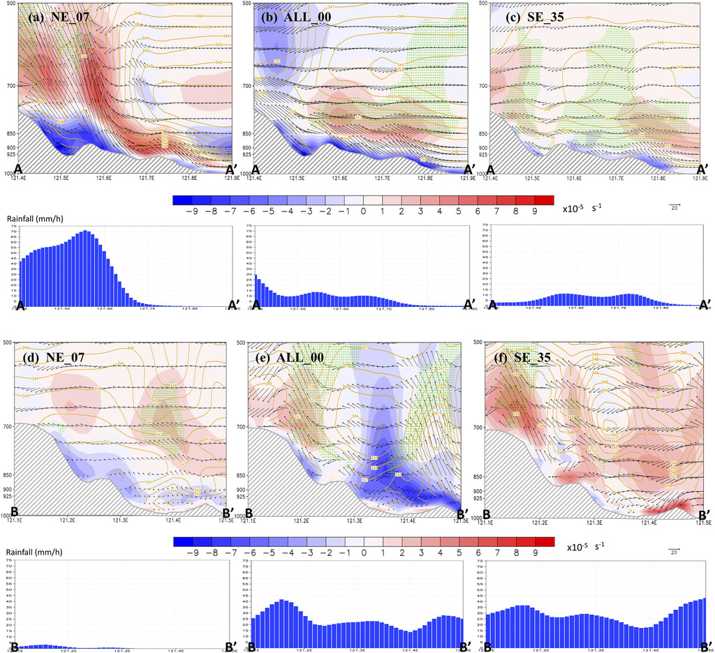
Vertical cross section

Slide 14
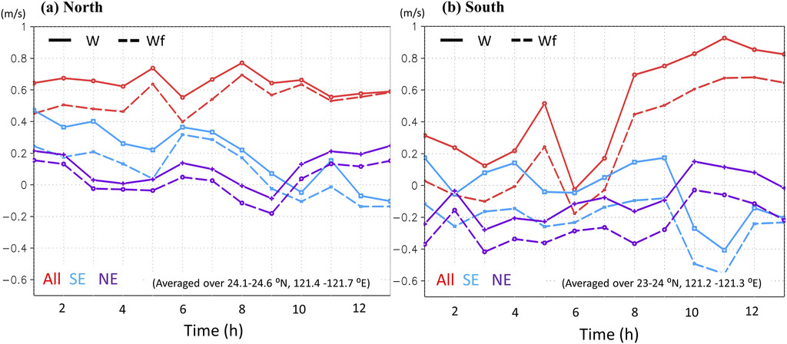
Topography-induced vertical motion
Wf=u⋅∇h

Slide 15
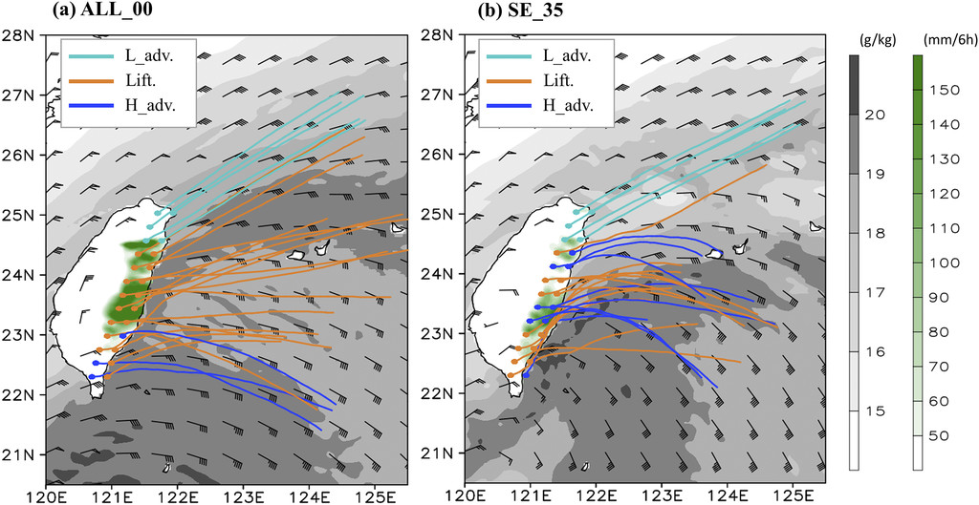
Backward air parcel trajectories
25 air parcels released at the model level (eta coordinate) of 0.969 in the rainfall region over eastern Taiwan
Those air parcels in the advection group are further divided into high-level and low-level subgroups according to the average parcel altitude of 500 m.

Slide 16
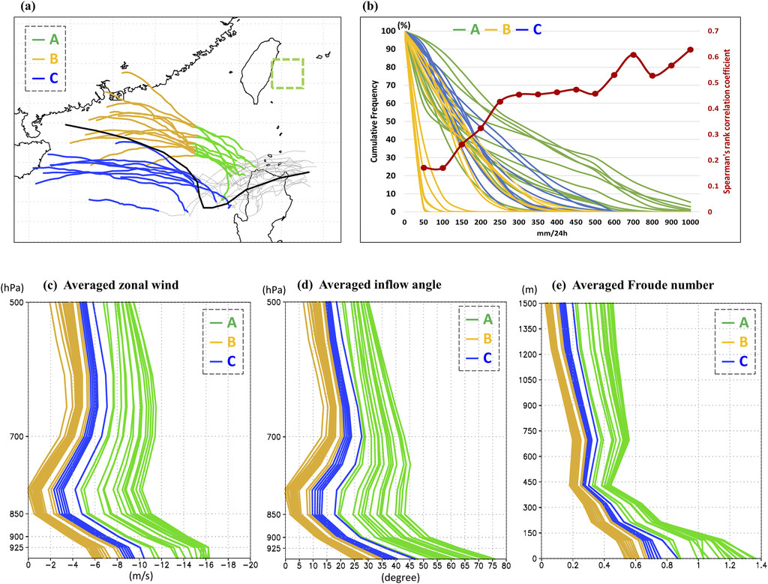
Topographic mode
Northern
earlier stage (A)
later stage (B)
Southern (C)

Slide 17
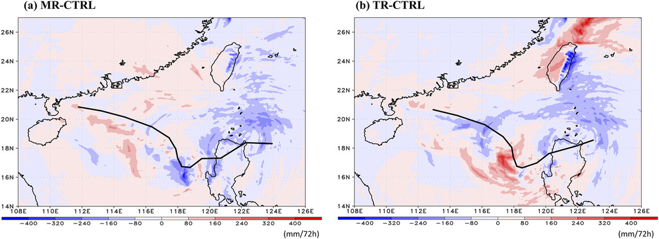
Sensitivity to TC initial moisture and terrain of Taiwan
leading to a 40% (roughly 200 mm) reduction of the 3-day accumulated rainfall
reduced by more than 90%
A latitude–longitude area of high precipitable water (>70 mm; which is the averaged value in the region within TC circulation) is defined, where the initial relative humidity over the two outer domains at all horizontal and vertical grid points is reduced to 55% (following Schumacher et al. 2011).
All of the land-associated parameters, such as the land mask, terrain height and background albedo over Taiwan are set to be same as the surrounding ocean (Chen and Wu 2016).

Slide 18
Summary (1/2)
To understand the key factors resulting in the uncertainty of TC-induced remote rainfall patterns associated with monsoon mode.
The confluence of the cold dry northeasterlies and the warm moist air transported by TC outer circulation creates a frontogenetical region offshore. With the onshore northeasterlies, the moist-laden flows are advected inland and ascend along the terrain. The topographically induced vertical motion accounts for more than 65% of the averaged vertical velocity among the three selective members, resulting in the heavy rainfall over northeastern Taiwan.
In eastern and southeastern Taiwan, the southeasterly moist flows transported by Khanun ascend over the topographically blocked northeasterly, and thus generating the precipitation offshore. With the convective bands embedded in rainfall systems being advected inland, the heavy rainfall occurs over southeastern Taiwan.

Slide 19
Summary (2/2)
To examine whether the precipitation associated with remote rainfall cases under topographic mode is also phase locked with the terrain as in the landfalling TCs.
The cumulative frequency of the rainfall with higher precipitation thresholds is highly correlated with the inflow angle of the TC circulation.
Members with higher impinging angles tend to have larger Froude numbers, and thus ascend and produce more rainfall associated with the topographic mode, which is similar to landfalling TCs.
To quantify the attribution of the TC-related moisture and the terrain of Taiwan to remote rainfall events.
Analyses from the sensitivity experiments show that the 3-day accumulated rainfall total in domain 2 (with grid resolution of 6 km) is reduced by roughly 200 (40%) and 450 mm (90%) in the moisture-reduced (MR) and the terrain-removed (TR) experiments, respectively.

