Slide 1
Importance of Midlevel Moisture for Tropical Cyclone Formation in Easterly and Monsoon Environments over the Western North Pacific
Hsu-Feng Teng, Ying-Hwa Kuo,
James M. Done

Slide 2
Introduction
Tropical cloud clusters (hereafter TCCs) usually developed into tropical cyclones (hereafter TC) in a suitable environment (Gray 1968,1998)
The relative importance of each parameter in different environments is not well understood
Emanuel and Nolan (2004) defined a TC genesis potential index (GPI), which consists: low-level vorticity midlevel relative humidity, vertical wind shear and maximum potential intensity (Bister and Emanuel 2002)
maximum potential intensity: $C_{P} T_{s}ln\frac{P_{0}}{P_{m}}=\frac{1}{2}V_{m}^{2}+CAPE$

Slide 3
Fu et al. (2012) and Kerns and Chen (2013) suggested that the TC formation is more sensitive to the environmental dynamics in the western North Pacific (WNP) but the thermodynamic conditions are more important in North Atlantic
Higher environmental moisture favors TCs with a larger size, larger rainfall radius, and higher intensification rate (Hill and Lackmann 2009; Wu et al. 2012; Lin et al. 2015)
Assimilation of GPS RO can improve the mid-level moisture in the initial conditions (Chen et al. 2020)
The importance of mid-level vapor may vary in different environment

Slide 4
Data and Methodology
The TC formation during July-October, 2006-10 were analyzed
TC best tracks are obtained from JTWC
TCs were defined when sustained surface wind speed equaled 25 knots and TCCs were the pre-TC disturbances
Gridded atmospheric data are derived from CFSR of NCEP (0.5º x 0.5º, 37-level, 6-hourly data)
To be the same as the operation, FNL data (1º x 1º, 26-level, 6-hourly data) were utilized as the model input
The data used in assimilation were from NCEP, including conventional observation, GPS RO

Slide 5
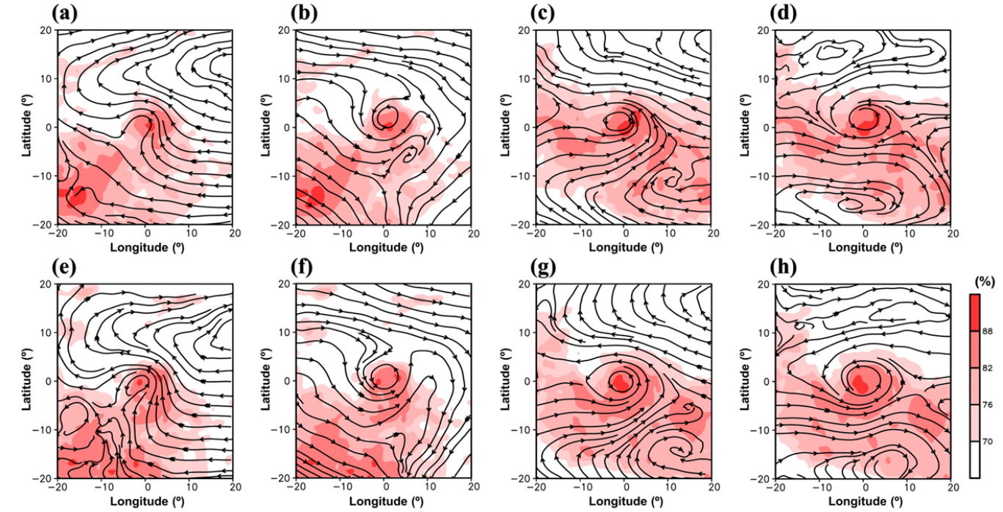
82 TCs were categorized as easterly-type TCs (ETCs) and 131 TCs were classified as monsoon-type TCs (MTCs) by the k-mean cluster analysis
13 ETCs and 22 MTCs which formed during peak period of GPS RO are analyzed and simulated in this study
TCC
TC
ETC
MTC

Slide 6
Model setting
Version | 4.0.3
Grid size | 15 km
Vertical layer | 41 layers
Microphysics | WDM6
Radiation | RRTM
Boundary layer | YSU
Cumulus scheme | Multiscale Kain-Fritsch
DA method | 3DVAR
GTS: conventional
observation
EPH: GPS RO

Slide 7
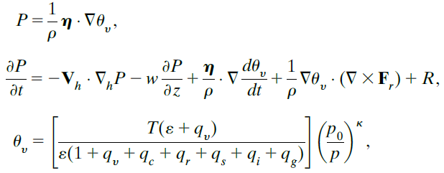
Analysis of diabatic potential vorticity term

Slide 8
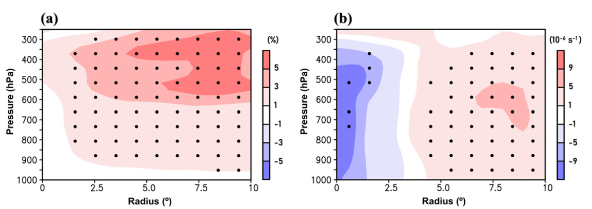
Environmental characteristics and simulation skill of TC formation
MTC-ETC at TCC formation
Relative Humidity
Vorticity

Slide 9
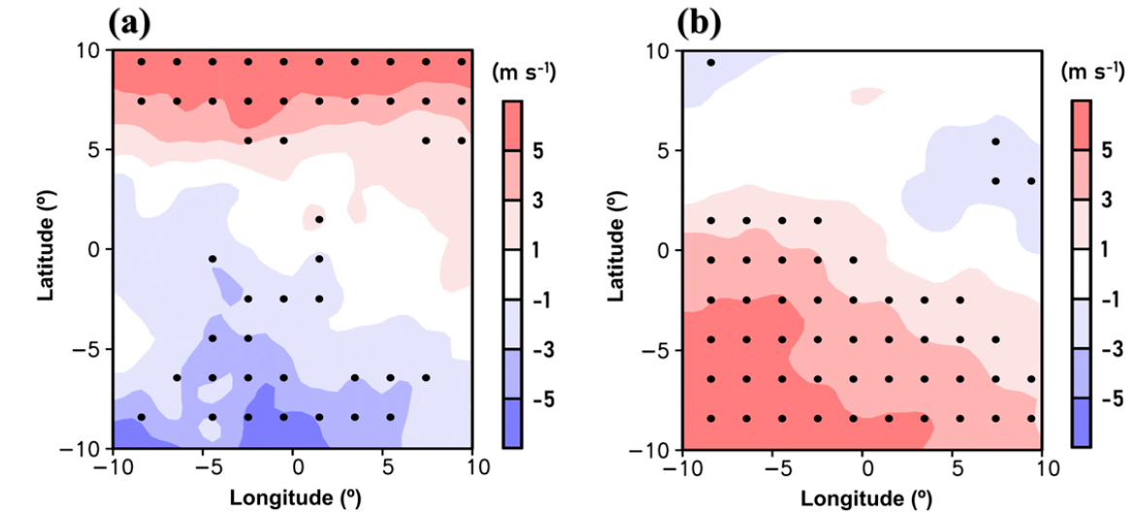
MTC-ETC at TCC formation
Maximum potential intensity
850-200 hPa wind shear

Slide 10
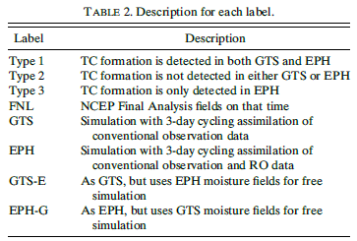
TC formation which is detected within -24 to 24 h and within a 1200-km radius of the observed location is defined as a detected TC

Slide 11
Importance of midlevel moisture for TC formation
Relative humidity
GTS-FNL
EPH-FNL
EPH-GTS

Slide 12
Vorticity
GTS-FNL
EPH-FNL
EPH-GTS

Slide 13
Relative humidity (EPH-GTS)
Type 1
Type 2
Type 3

Slide 14
Relative humidity
GTS-FNL
EPH-FNL
EPH-GTS

Slide 15
Relative humidity (EPH-GTS)
Type 1
Type 2
Type 3

Slide 16
Sensitivity Experiments
Relative humidity (EPH-GTS)

Slide 17
GTS-E and EPH-G are the experiments with exchanged moisture fields

Slide 18
Diabatic PV (within 2º )
GTS-E - GTS
EPH - EPH-G

Slide 19
Diabatic PV (within 2º )
GTS-E - GTS
EPH - EPH-G

Slide 20
Discussion
The dry bias may be induced by the relatively low resolution of simulations
The past studies with similar grid size (12~35km) suggested similar detection rates (20~40%)
MTCs is less sensitive to moisture since MTCs formed in a moist environment
Only developing TCCs were analyzed in this study
Slightly different from the previous studies, this study investigated the process that TCCs developed into TCs

Slide 21
Conclusions
GPS RO mainly improved the performance of vapor in model
Monsoon systems provided a large area of higher moisture while the easterly systems supplied higher vorticity around TC centers
MTCs have higher detection rates than ETCs
ETCs are more sensitive to mid-level moisture
The sensitivity experiments suggested the role of vapor on the type-3 TC formations

