Slide 1
How does vertical wind shear influence entrainment in squall lines?
Mulholland, J. P., J. M. Peters, and H. Morrison, 2021
J. Atmos. Sci, 78, 1931–1946.
R10229003 凌文海

Slide 2
Outlines
Introduction
Experimental design
Results
Summary, discussion and conclusions

Slide 3
Introduction
The strength and direction of LL shear that occurs over the depth of the cold pool regulates updraft tilt and speed.(Hane 1973, Thorpe et al. 1982, etc.)
RKW theory : the ratio of the LL shear magnitude to the cold pool intensity
Squall lines in environments with stronger LL shear have stronger updrafts
Substantial UL shear is also found within squall-line environments.(Davis et al. 2004)
Strong mid- to upper-level winds also influence the cold pool speed via downward momentum transport. Strong UL shear may also influence squall line motion via changes in steering flows aloft. (Mahoney et al. 2009)

Slide 4
Introduction
The importance of variations in both LL and UL shear collectively on squall-line updraft properties is largely unknown.
Seldom been discussed in the context of squall lines is entrainment.
Entrainment typically results in dilution of updraft buoyancy, leading to a reduction in vertical accelerations and vertical velocities (w).
Entrainment modulates the updraft, and the updrafts vertically redistribute heat, moisture, momentum, and chemical constituents.
A key role in the generation of large hail, damaging winds, tornadoes, lightning, and heavy rainfall.

Slide 5
Introduction – Squall lines system
Typically depicted a structure with deep convective updrafts along an OFB.
A ‘‘tongue’’ of high equivalent potential temperature and conditionally unstable air that slopes up and over the cold pool—colloquially known as front-to-rear flow ‘‘slab-like’’ ascent. (Zipser 1977; Houze 1989, .etc)
Often breaks down into discrete, quasi spherical updraft pulses ”thermals” in the middle to upper troposphere, with order of 1–2 km. (Redelsperger and Lafore 1988; Weisman et al. 1988, .etc)
The thermal-like structure of middle- to upper-tropospheric squall-line updrafts suggest that they are susceptible to the deleterious effects of entrainment. (Morton et al. 1956; Scorer 1957, .etc)

Slide 6
Scientific Questions
1) Do environments with stronger shear also foster wider squall-line updrafts than environments with weaker shear, and are squall-line updrafts in stronger-shear environments therefore less susceptible to entrainment-driven dilution?
2) What are the relative influences of LL and UL shear on this relationship?

Slide 7
Hypothesis
Stronger LL shear in squall-line environments equate to stronger LL OFB-relative flow, greater LL horizontal mass flux into the edge of the cold pool, and thus wider squall-line updrafts with less entrainment-driven dilution.
The wider squall-line updrafts in environments with stronger LL shear equate to larger updraft B, and consequently w.
Expect a similar relationship between UL shear.
LL shear should have a greater influence than UL shear : The connection between LL shear and both LL OFB relative flow and LL horizontal mass flux.

Slide 8
Experimental Design Numerical modeling setup
Idealized numerical model simulations in Cloud Model 1 (CM1; Bryan and Fritsch 2002) release 19.7.
Resolution : $∆x=∆y=∆z=250m$
$L_{x}=420km,L_{y}=99km,L_{z}=25km AGL$
Rayleigh dampening coefficient $3.33{×10}^{−3}s^{−1}$ layer applied z > 20km
Periodic lateral boundary conditions on Y-axis
Open radiative lateral boundary conditions on X-axis
The lower and upper boundaries were free slip with a rigid domain top
Results in coarser ($∆x=∆y$ = 1km) simulations were qualitatively similar

Slide 9
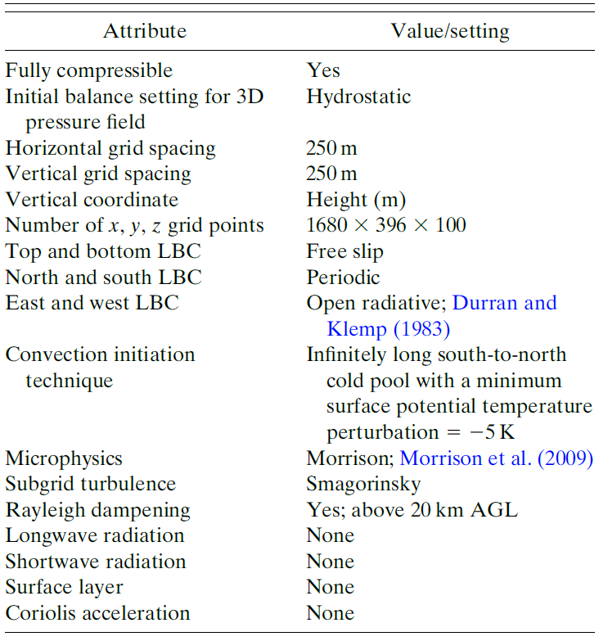
Experimental Design Numerical modeling setup
Neglected radiation, surface fluxes, friction, terrain, and Coriolis force
Microphysics : Morrison two-moment scheme(Morrison et al. 2009) with hail set as the prognostic rimed ice hydrometeor species
Time step = 3.5 s, 1output/5min
Total Time = 8 h

Slide 10
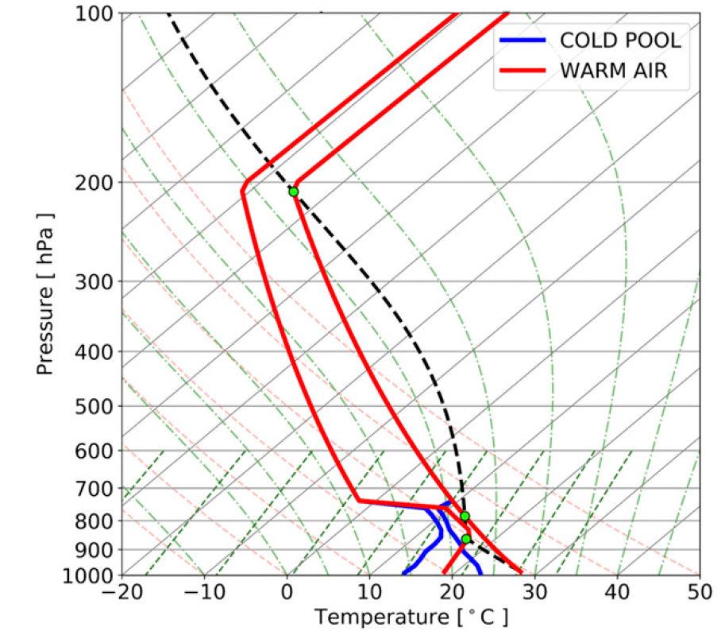
Experimental Design Base-state environments
Based on Weisman and Klemp (WK82)
Modifications:
Increasing the surface $θ$ : 300 to 302K
Reduce the amount of errant convection that occurred ahead of the squall-line OFB
Reduce the RH >2.5km AGL to 45%
More like the observed squall-line environments
The modified PBL mixing ratio = 14 g/kg

Slide 11
Experimental Design Base-state environments
All fall within the range of observed values for squall-line environments
The approximate effective inflow layer depth (EIL) ~2.5 km
Thompson et al. (2007)
Largest contiguous vertical layer with CAPE > 100 J/kg & CIN < -250J/kg
[J/kg] | Surface | 0-1km Mean Layer | Most Unstable
CAPE | 2043 | 2191 | 2615
CIN | -69 | -44 | -3

Slide 12
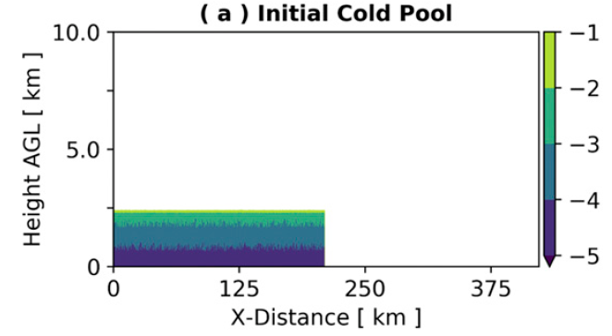
Experimental Design Base-state environments
A cold pool covering the domain from S-N and extending from the center to W.
The minimum surface$θ$ perturbation of the cold pool was set to -5K and decreased in magnitude toward 0 K with height. Depth = 2.5 km
$±$0.25 K random $θ$ perturbations in the I.C.

Slide 13
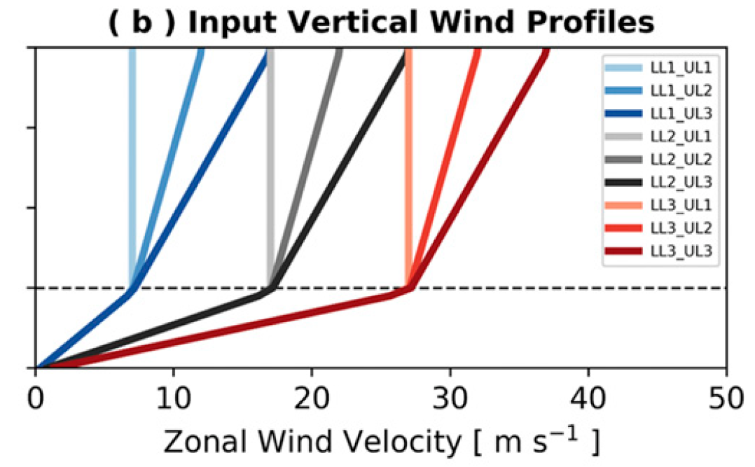
Experimental Design Base-state environments
Three different LL (0–2.5 km AGL) and UL (2.5–10km AGL) vertical wind shear magnitudes constituted our simulation matrix
Within the range of magnitudes used in prior squall-line simulation studies and also in observations
LL3 represents the far high end of the LL shear spectrum for observed squall lines in environments with substantial CAPE
UL3 is likely at the low to moderate end of the UL shear spectrum

Slide 14
Experimental Design Quantifying entrainment-driven dilution
A passive tracer (PT) was initialized in the base state to the E. of the cold pool 0~1.5 km AGL (light red shading)
The lower half of the EIL(~2.5km), where ${CAPE}_{max.}$ located
PT concentration in updrafts falls below 100% is used to quantify the degree of entrainment-driven updraft dilution

Slide 15
Experimental Design In-line forward parcel trajectories
In-line forward trajectories in the LL1_UL1, LL1_UL3, LL3_UL1 & LL3_UL3
At T = 4hr, 1000 trajectories were initialized ahead of the squall-line OFBs.
Trajectories were placed in a 10 km S-N line at 100 km east of the domain center and spanned between 25 and 835m AGL, covering the lower EIL.
Trajectories were calculated with a time step consistent with the model simulations (3.5 s) with output written every time step.
Compare the contribution of B versus the vertical perturbation pressure gradient accelerations (VPG) to $W_{max}$ along the trajectories among the four different simulations.

Slide 16
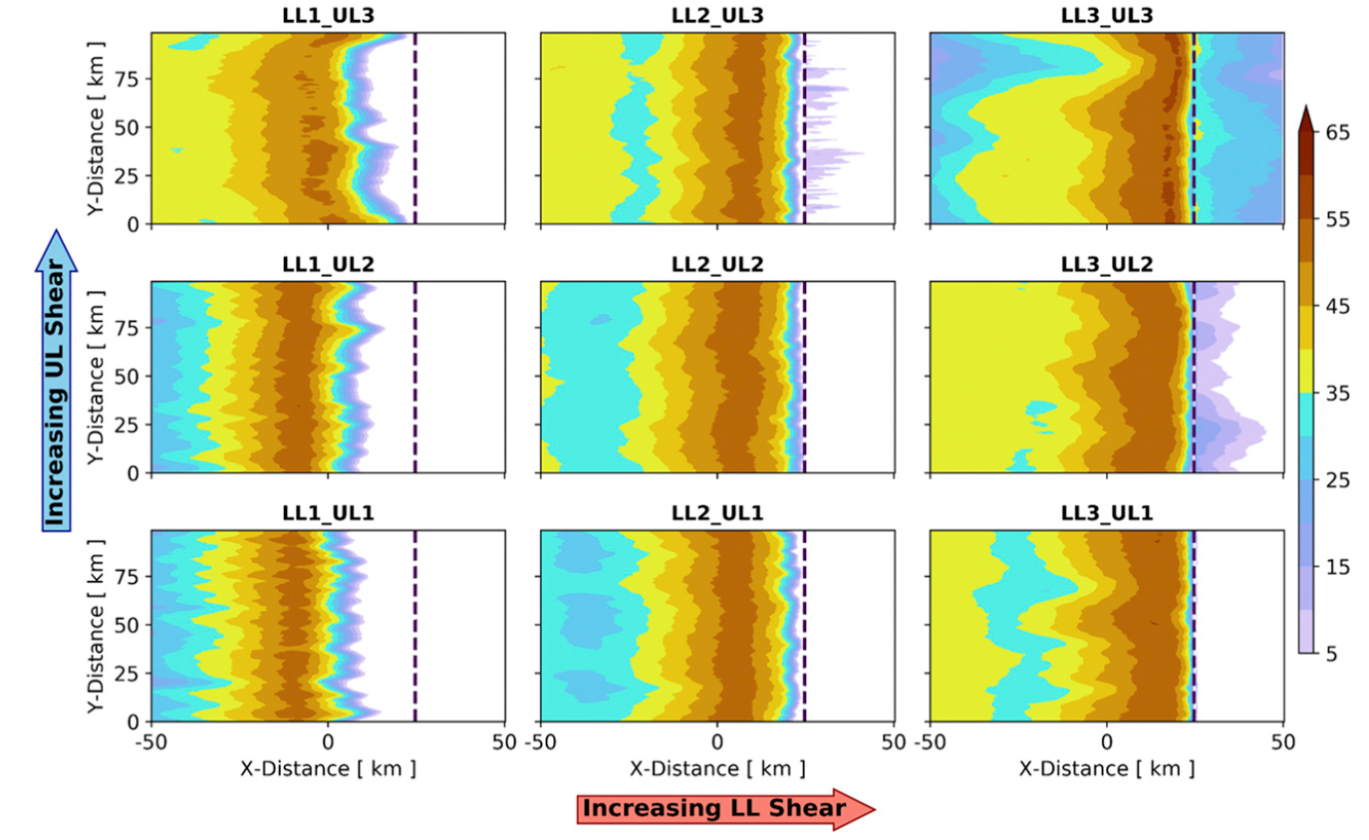
Results General attributes of simulations
The 4–7-h averaged lowest level (125m) [dBZ]
All simulations produced squall lines with many features of observed squall lines
A stratiform region that trailed the leading deep convective line
Notes:
Simulations with the weakest LL shear displayed notably broken and cellular reflectivity features displaced rearward of their OFBs
Increasing LL shear led to more widespread and coherent reflectivity structures with a nearly continuous S-N deep convective region that was located closer to the OFB (black dashed line), in agreement with Hane (1973) and numerous other studies.
Conversely, alterations in UL shear had relatively muted impacts on the squall lines’ organizational structures, especially in LL2 simulations.
Interestingly, increasing UL shear in the LL1 simulations actually resulted in slightly weaker reflectivity magnitudes closer in proximity to the OFBs
Alternatively, increasing UL shear in the LL3 simulations resulted in slightly stronger reflectivity magnitudes and more three-dimensional structures (e.g., bowing segments in LL3_UL3)—in agreement with the squall-line simulations of Coniglio et al. (2006).

Slide 17
Results General attributes of simulations
The 4–7-h averaged lowest level (125m) [dBZ]
LL1: broken into cellular features
Increase in LL led to more widespread structures
UL shear had relatively muted impacts
UL in LL1 & LL3 resulted differently
Bowing segments in LL3_UL3
Notes:
Simulations with the weakest LL shear displayed notably broken and cellular reflectivity features displaced rearward of their OFBs
Increasing LL shear led to more widespread and coherent reflectivity structures with a nearly continuous S-N deep convective region that was located closer to the OFB (black dashed line), in agreement with Hane (1973) and numerous other studies.
Conversely, alterations in UL shear had relatively muted impacts on the squall lines’ organizational structures, especially in LL2 simulations.
Interestingly, increasing UL shear in the LL1 simulations actually resulted in slightly weaker reflectivity magnitudes closer in proximity to the OFBs
Alternatively, increasing UL shear in the LL3 simulations resulted in slightly stronger reflectivity magnitudes and more three-dimensional structures (e.g., bowing segments in LL3_UL3)—in agreement with the squall-line simulations of Coniglio et al. (2006).

Slide 18
Results General attributes of simulations
We assessed the relative ‘‘balance’’ between the cold pool-induced circulation and LL shear-induced circulation for the simulated squall lines.
This was accomplished by calculating the $C/∆u$ ratio
$C=\sqrt{2\int_{0}^{H}{\left(−B\right)dz}}$,
H = cold pool depth, the height of the -1K $θ^{′}$ contour
$∆u$ = the zonal shear over the depth of the cold pool
$B=g\left[\frac{θ^{′}}{θ_{0}}+\left(\frac{R_{v}}{R_{d}}−1\right)q_{v}^{′}−q_{c}\right],$ $θ^{′}$ is perturbation from the horizontally invariant $θ_{0}$
Notes:
Simulations with weaker LL shear had correspondingly weaker and shallower updrafts
stronger LL shear had stronger and deeper updrafts.
The low-level OFBs were closer in proximity to the leading deep convective line in the stronger LL shear simulations
The OFBs were effectively detached from the middle- to upper-tropospheric updrafts in LL1 simulations.
Last, weaker LL shear simulations displayed greater dilution of the EIL PT aloft compared to
the stronger LL shear simulations.

Slide 19
Results General attributes of simulations
According to RKW theory:
$C/∆u$ >> 1 : moist updrafts tilt rearward over the cold pool
$C/∆u≈$ 1 : moist updrafts are approximately vertically oriented
Near center of the domain : LL1 : $C/∆u$ >4, LL3 : $C/∆u$ $≈$1.5
All simulations updrafts should slant rearward over the cold pool
Notes:
Simulations with weaker LL shear had correspondingly weaker and shallower updrafts
stronger LL shear had stronger and deeper updrafts.
The low-level OFBs were closer in proximity to the leading deep convective line in the stronger LL shear simulations
The OFBs were effectively detached from the middle- to upper-tropospheric updrafts in LL1 simulations.
Last, weaker LL shear simulations displayed greater dilution of the EIL PT aloft compared to
the stronger LL shear simulations.

Slide 20
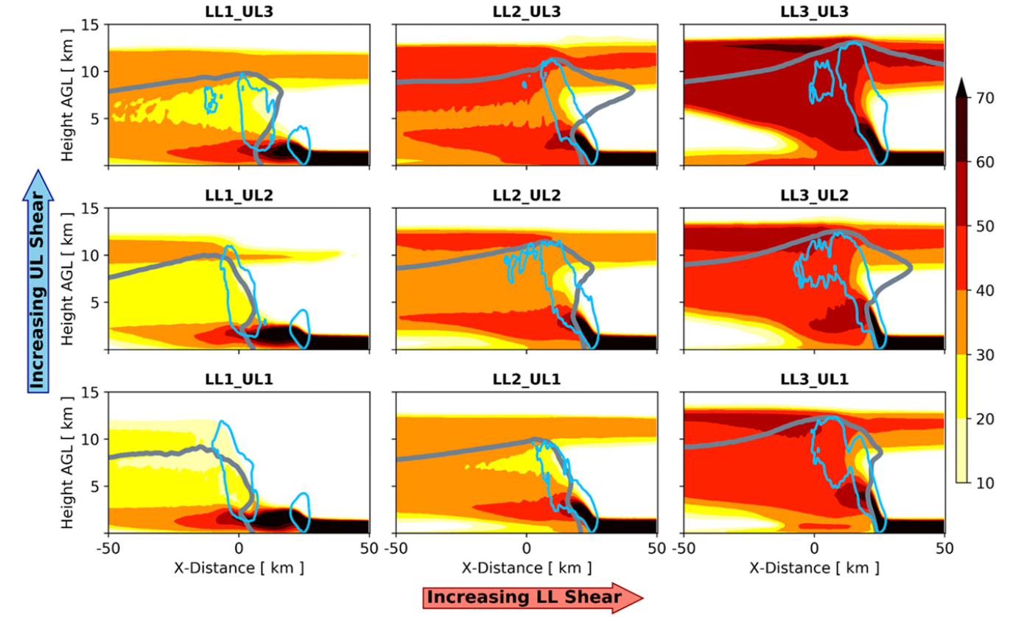
Results General attributes of simulations
vertical cross sections of PT concentration (shaded %)
vertical velocity (1m/s contour in light blue)
reflectivity (20 dBZ contour in dark gray)
4–7-h period
-5~+5km around the domain center
PT concentration, w, and reflectivity
Weaker LL has weaker & shallower updrafts
Stronger LL has stronger & deeper updrafts
Notes:
Simulations with weaker LL shear had correspondingly weaker and shallower updrafts
stronger LL shear had stronger and deeper updrafts.
The low-level OFBs were closer in proximity to the leading deep convective line in the stronger LL shear simulations
The OFBs were effectively detached from the middle- to upper-tropospheric updrafts in LL1 simulations. Last, weaker LL shear simulations

Slide 21
Results General attributes of simulations
vertical cross sections of PT concentration (shaded %)
vertical velocity (1m/s contour in light blue)
reflectivity (20 dBZ contour in dark gray)
OFB closer to deep convective line in stronger LL
The OFBs were effectively detached from the middle- to upper-tropospheric updrafts in LL1
Weaker LL displayed greater dilution of the EIL PT aloft.
Notes:
Simulations with weaker LL shear had correspondingly weaker and shallower updrafts
stronger LL shear had stronger and deeper updrafts.
The low-level OFBs were closer in proximity to the leading deep convective line in the stronger LL shear simulations
The OFBs were effectively detached from the middle- to upper-tropospheric updrafts in LL1 simulations.
Last, weaker LL shear simulations displayed greater dilution of the EIL PT aloft compared to
the stronger LL shear simulations.

Slide 22
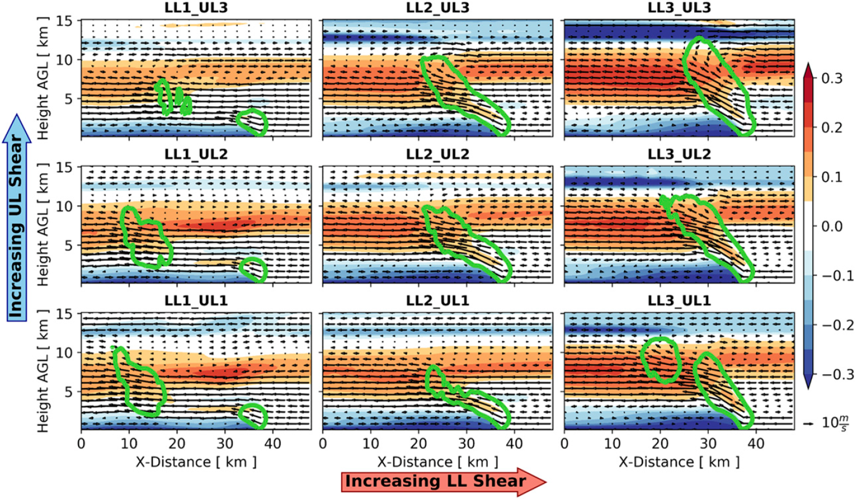
Results General attributes of simulations
vertical cross sections of B (shaded $m/s^{2}$)
vertical velocity (2m/s contour in green)
In-plane wind vectors (m/s)
4–7-h composites of B and w in -5~+5 km
Large horizontal expanses of positive B in all squall lines above ~4–5 km AGL regardless of shear magnitude
LL1 updrafts more slant than in LL3, consist with RKW theory
Notes:
Simulations with weaker LL shear had correspondingly weaker and shallower updrafts
stronger LL shear had stronger and deeper updrafts.
The low-level OFBs were closer in proximity to the leading deep convective line in the stronger LL shear simulations
The OFBs were effectively detached from the middle- to upper-tropospheric updrafts in LL1 simulations.
Last, weaker LL shear simulations displayed greater dilution of the EIL PT aloft compared to
the stronger LL shear simulations.

Slide 23
Results Influence of shear on updraft width and entrainment-driven dilution
Updraft area :
Contiguous horizontal regions that met a certain w threshold at each model vertical level. Excluding areas of small-scale vertical motion (areas < 1 ${km}^{2}$).
‘‘broad’’ (w > 5 m/s) and ‘‘core’’ (w > 20 m/s) updrafts.
Notes:
Simulations with weaker LL shear had correspondingly weaker and shallower updrafts
stronger LL shear had stronger and deeper updrafts.
The low-level OFBs were closer in proximity to the leading deep convective line in the stronger LL shear simulations
The OFBs were effectively detached from the middle- to upper-tropospheric updrafts in LL1 simulations.
Last, weaker LL shear simulations displayed greater dilution of the EIL PT aloft compared to
the stronger LL shear simulations.

Slide 24
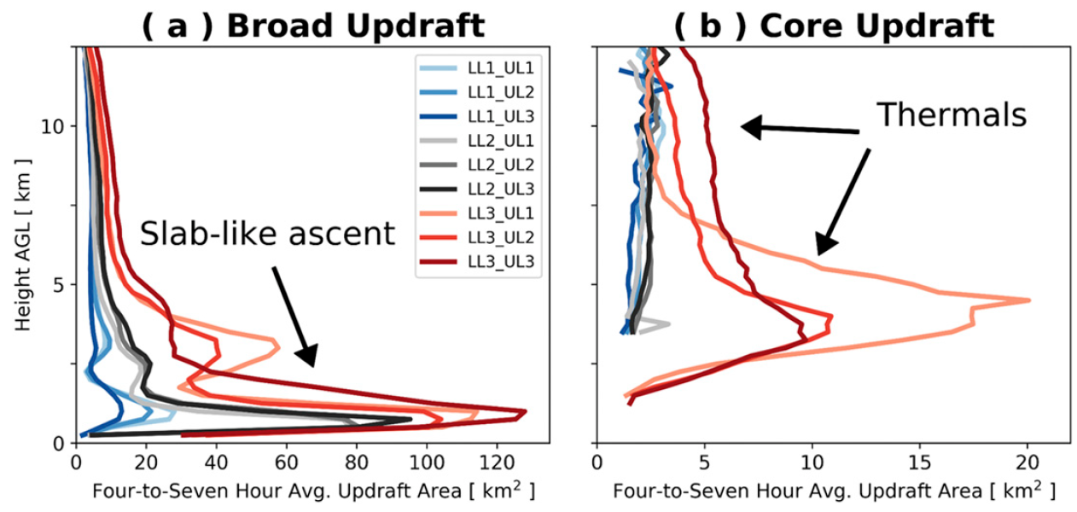
Results Influence of shear on updraft width and entrainment-driven dilution
Broad & core updraft area increased with increasing LL shear
UL shear have less pronounced effect than LL shear
The large broad updraft area below ~2.5 km were related to the front-to-rear slab-like ascending airstreams
Notes:
The larger regions of slablike ascent in the stronger LL shear simulations—which likely owe to stronger LL shear and stronger, deeper cold pools (see
Fig. 5; e.g., James et al. 2005)—appear to ‘‘set the stage’’ for wider thermals aloft

Slide 25
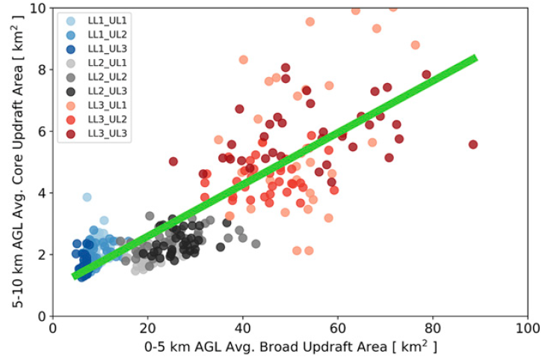
Results Influence of shear on updraft width and entrainment-driven dilution
The larger regions of slab-like ascent appears to ‘‘set the stage’’ for wider thermals aloft
Correlation coefficient =0.81; p value < 0.05 between average 0–5 km AGL broad updraft area and average 5–10 km AGL core updraft area over the 4–7-h
Notes:
The larger regions of slablike ascent in the stronger LL shear simulations—which likely owe to stronger LL shear and stronger, deeper cold pools (see
Fig. 5; e.g., James et al. 2005)—appear to ‘‘set the stage’’ for wider thermals aloft

Slide 26
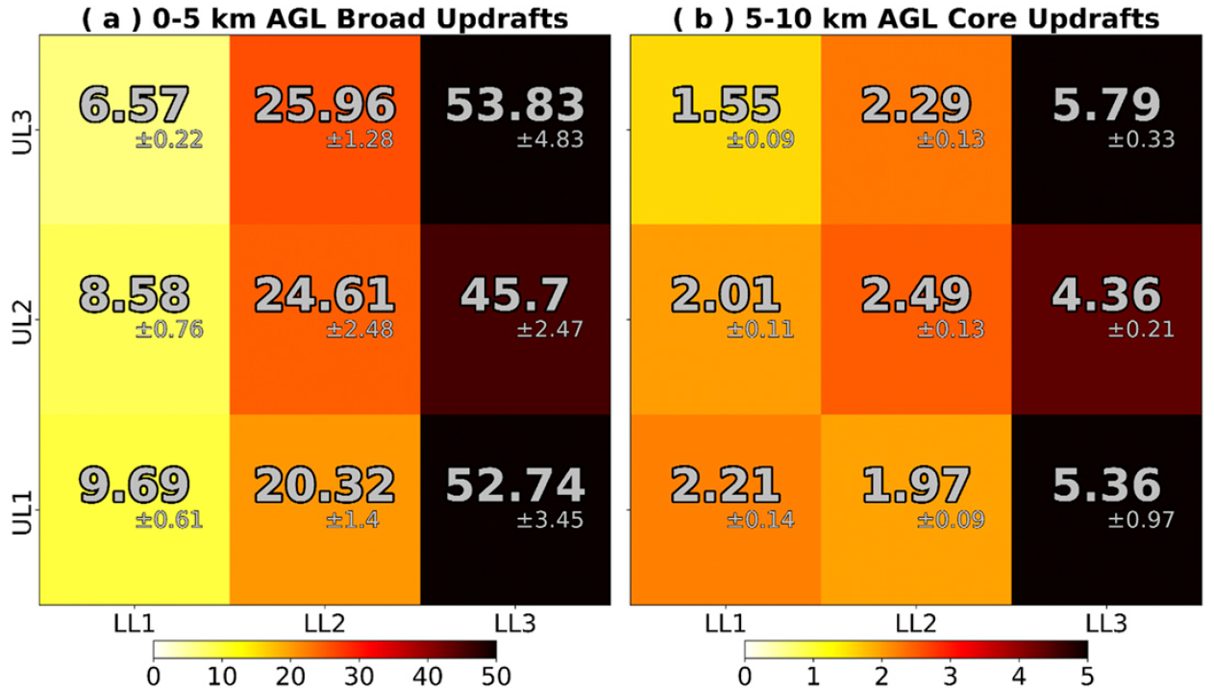
Results Influence of shear on updraft width and entrainment-driven dilution
Shading unit $[{km}^{2}]$
Lower right : $±$95% confidence interval around the median values
LL shear increased 0-5 km AGL broad updraft area increased
Similar to 5–10 km AGL core updraft area
updraft width appears to be more strongly influenced by LL shear than by UL shear
Notes:
The larger regions of slablike ascent in the stronger LL shear simulations—which likely owe to stronger LL shear and stronger, deeper cold pools (see
Fig. 5; e.g., James et al. 2005)—appear to ‘‘set the stage’’ for wider thermals aloft

Slide 27
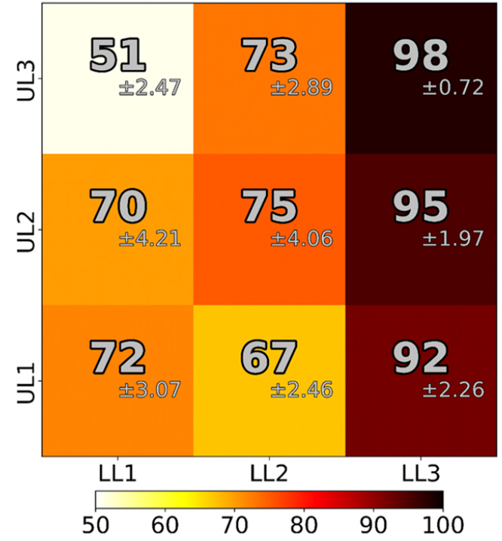
Results Influence of shear on updraft width and entrainment-driven dilution
The median 5–10 km AGL layer max. PT concentrations show that stronger LL shear equated to larger PT concentrations aloft
There was no statistically significant connection between UL shear and PT concentration
Median 4–7-h 5–10 km AGL layer maximum PT concentration
Lower right : $±$95% confidence interval around the median values
Notes:
The larger regions of slablike ascent in the stronger LL shear simulations—which likely owe to stronger LL shear and stronger, deeper cold pools (see
Fig. 5; e.g., James et al. 2005)—appear to ‘‘set the stage’’ for wider thermals aloft

Slide 28
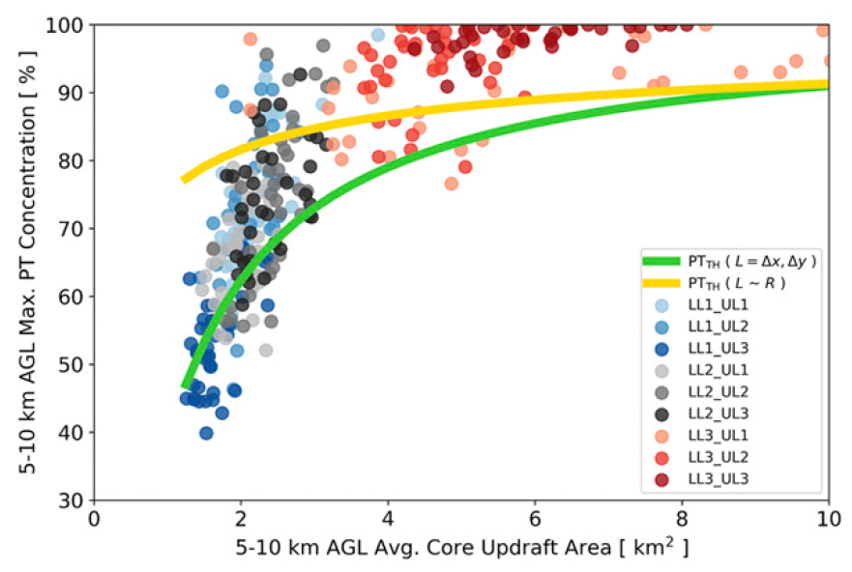
Results Influence of shear on updraft width and entrainment-driven dilution
Maximum PT concentrations and average 5–10 km AGL core updraft area were statistically significant (p value ,0.05), with a log-scaled CC = 0.83
Squall-line updrafts with stronger LL shear displayed less entrainment-driven dilution
Notes:
The larger regions of slablike ascent in the stronger LL shear simulations—which likely owe to stronger LL shear and stronger, deeper cold pools (see
Fig. 5; e.g., James et al. 2005)—appear to ‘‘set the stage’’ for wider thermals aloft

Slide 29
Results Updraft width and entrainment-driven dilution
Morrison (2017). Simple eddy diffusivity approximation for lateral mixing of environmental and updraft air
${PT}_{TH}=$ ${PT}_{TH,LFC}e^{−εz}, {PT}_{TH,LFC}$ is assumed 100%, $ε=2k^{2}L/(P_{r}R^{2})$
k is a nondimensional scaling constant (set here to 0.18)
L is a turbulent mixing length : set to grid spacing (250 m)
$P_{r}$ is a turbulent Prandtl number which is set here to 1/3
R is assumed to be constant with height [Morrison (2017)]
Axisymmetric updrafts were assumed $R=cR_{eff},R_{eff}={(A/π)}^{1/2}$
Max. PT concentration ~ z = 5km

Slide 30
Results Updraft width and entrainment-driven dilution
The closeness of the ${PT}_{TH}$concentration curve (green line) supports a $1/R^{2}$ scaling
1/R scaling [dry plumes & thermals, Morton et al. 1956; Scorer 1957] gives a poorer comparison with ${PT}_{TH}$ (gold line)

Slide 31
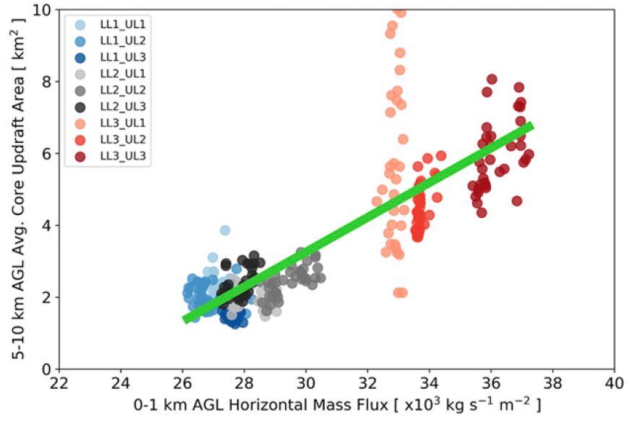
Results Influence of shear on updraft width and entrainment-driven dilution
The connection between LL shear and updraft width is evident in the statistically significant correlations (CC=0.79; p value <0.05)
The LL shear is directly connected to the LL horizontal mass flux and connected to the vertical mass flux via mass continuity.
Notes:
The larger regions of slablike ascent in the stronger LL shear simulations—which likely owe to stronger LL shear and stronger, deeper cold pools (see
Fig. 5; e.g., James et al. 2005)—appear to ‘‘set the stage’’ for wider thermals aloft

Slide 32
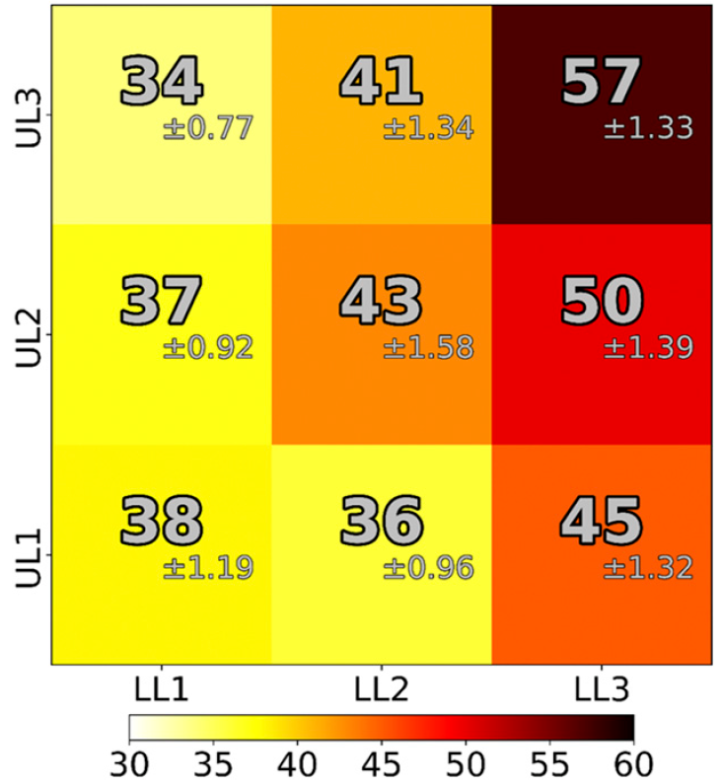
Results Updraft width & entrainment-driven dilution on $W_{max}$
LL shear increased, $W_{max}$ increased.
UL shear effect is not evident
Thermodynamic speed limit $\sqrt{2MUCAPE}$ ~ 72.3 m/s
95% of the speed limit in LL3_UL3 at T = 1 h
60~70% of the speed limit in LL1_UL1
Similar to the squall-line simulations analyzed in Lebo and Morrison (2015)
Median 4–7-h $W_{max}$ [m/s]
Lower right : $±$95% confidence interval around the median values

Slide 33
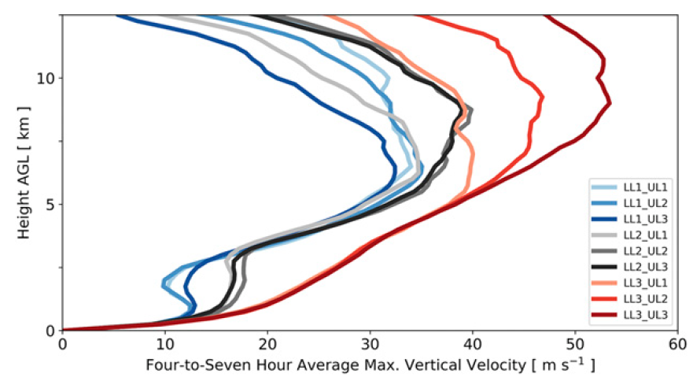
Results Updraft width & entrainment-driven dilution on $W_{max}$
Stronger LL shear equates stronger $W_{max}$ along the LL OFBs (~ <2.5 km AGL)
Height of $W_{max}$ corresponded with thermals aloft (>5km AGL) rather than LL OFBs
Variations in UL shear had the largest impact in LL3 simulations

Slide 34
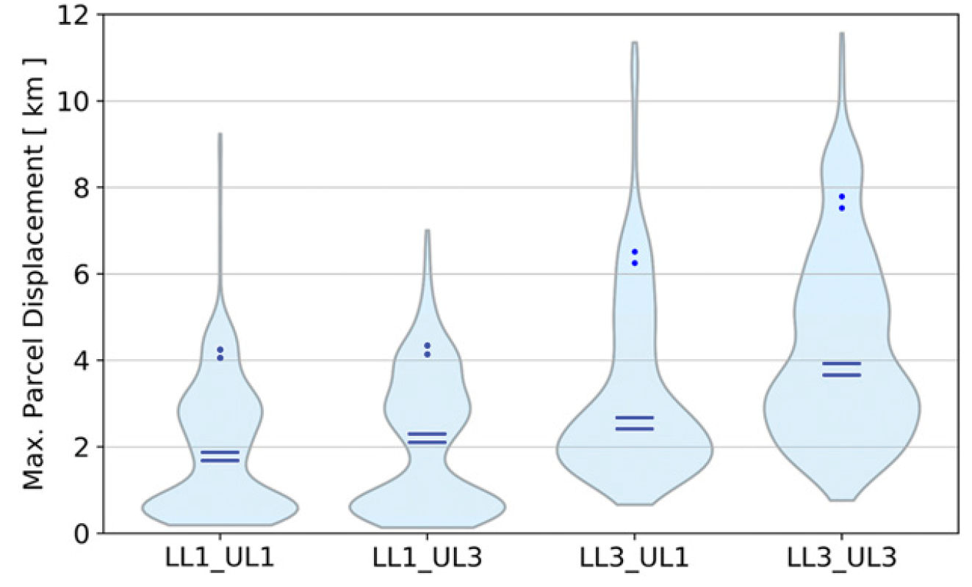
Results Updraft width & entrainment-driven dilution on $W_{max}$
Maximum parcel displacements were substantially larger in the stronger LL shear simulations
Updrafts experiencing stronger LL shear were faster and deeper
UL shear had lesser impact on maximum parcel displacements
Maximum parcel displacements (km) across all usable trajectories
Horizontal lines in each violin plot represent the 5th (lower) and 95th (upper) confidence intervals around the median values
Dots in each violin plot represent the 5th (lower) and 95th (upper) confidence intervals around the 90th-percentile values.

Slide 35
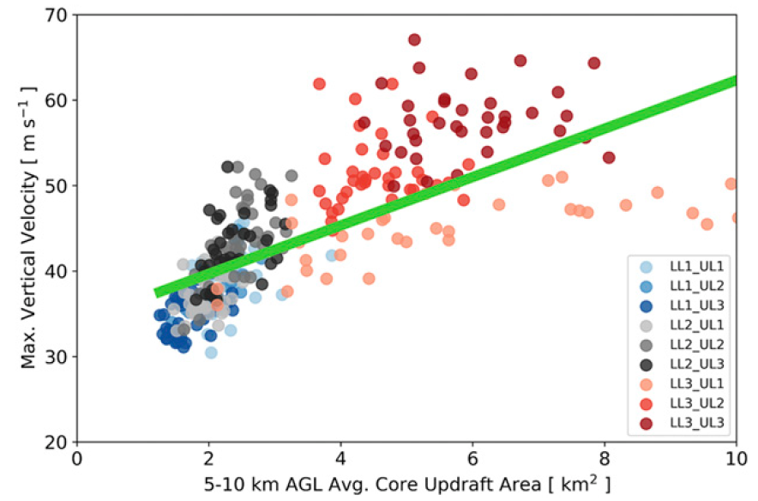
Results Updraft width & entrainment-driven dilution on $W_{max}$
The 4–7-h $W_{max}$ were statistically significantly correlated (CC =0.71 p value <0.05) with average 5–10 km AGL core updraft areas
Less entrainment-driven dilution associated with wider updrafts in the stronger LL shear simulations
Wider updrafts in the simulations with stronger LL shear were more buoyant because of their decreased dilution

Slide 36
Results Updraft width & entrainment-driven dilution on $W_{max}$
Inviscid vertical momentum equation
$\frac{dw}{dt}=B−\frac{1}{ρ}\frac{∂p′}{∂z}$
Peters et al. (2019b)
${(w^{2})}_{z}−{\left(w^{2}\right)}_{z_{0}}=2\int_{z∗=z_{0}}^{z∗=z}{Bdz}+2\int_{z∗=z_{0}}^{z∗=z}{−\frac{1}{ρ}\frac{∂p′}{∂z}dz}$
The buoyant contribution to w is given as ${w_{B}}^{2}=2\int_{z∗=z_{0}}^{z∗=z}{Bdz}$ (Assume ${w_{B}}^{2}\left(z_{0}\right)=0 m/s)$
The height of $W_{B,max}$was often slightly higher than the height of $W_{max}$
Downward-oriented dynamic PGA near cloud top
Not appreciably impact the magnitude of $W_{max}$

Slide 37
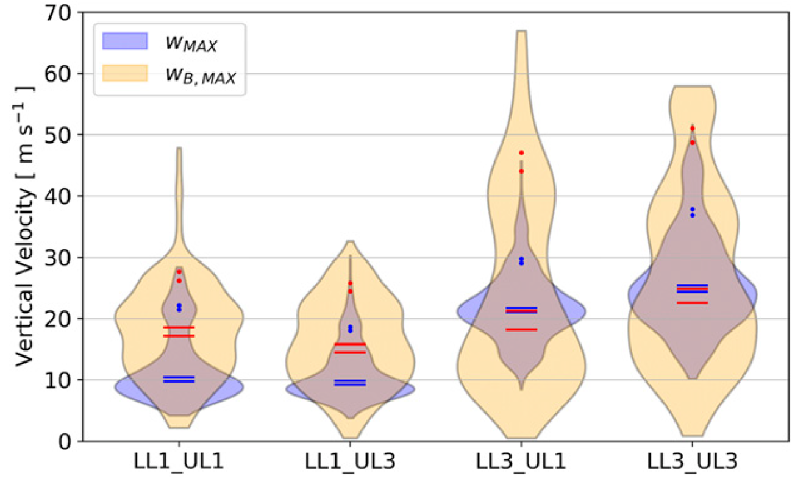
Results Updraft width & entrainment-driven dilution on $W_{max}$
Violin plots of $W_{max}$ & $W_{B,max}$ across all trajectories showed a positive correspondence between LL shear, $W_{max}$ & $W_{B,max}$
Larger B in the simulations with stronger LL shear contributed to larger vertical accelerations and larger $W_{max}$
UL shear had much less impact
Horizontal lines in each violin plot represent the 5th (lower) and 95th (upper) confidence intervals around the median values
Dots in each violin plot represent the 5th (lower) and 95th (upper) confidence intervals around the 90th-percentile values.

Slide 38
Results Updraft width & entrainment-driven dilution on $W_{max}$
Percentage of acceleration from B and VPG :
=$\left[\frac{\int_{t_{1}}^{t_{2}}{Bdt}}{\int_{t_{1}}^{t_{2}}{Bdt}+\int_{t_{1}}^{t_{2}}{−\frac{1}{ρ}\frac{∂p′}{∂z}dt}}\right]∗100$ and $\left[\frac{\int_{t_{1}}^{t_{2}}{−\frac{1}{ρ}\frac{∂p′}{∂z}dt}}{\int_{t_{1}}^{t_{2}}{Bdt}+\int_{t_{1}}^{t_{2}}{−\frac{1}{ρ}\frac{∂p′}{∂z}dt}}\right]∗100$
Integration was computed along contiguous sections of trajectory paths where w > 0.5 m/s that contained the point of $W_{max}$

Slide 39
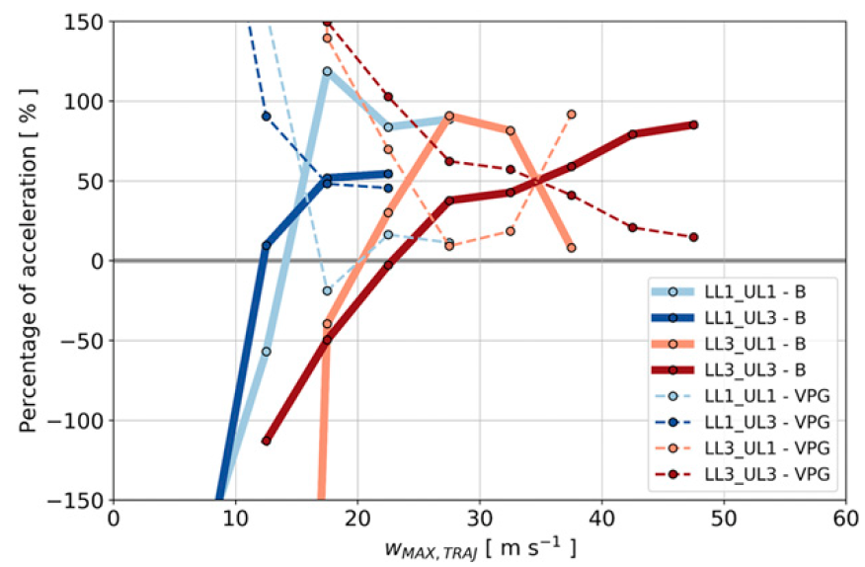
Results Updraft width & entrainment-driven dilution on $W_{max}$
The VPG accounts for a larger fraction of positive acceleration than B at weaker magnitudes of $W_{max}$
At stronger magnitudes of $W_{max}$ the percentage of acceleration from B was considerably larger than from VPG
Largest $W_{max}$ magnitudes were primary modulated by changes in B, and therefore by changes in entrainment-driven dilution owing to changes in updraft width
B (solid lines %) and VPG (dashed lines %)

Slide 40
Summary, discussion and conclusions
For a singular thermodynamic environment (i.e., fixed CAPE and CIN):
LL shear increased, LL horizontal mass flux increased, leading to wider squall-line updrafts that were stronger and deeper.
Wider updrafts in stronger LL shear environments → least amount of entrainment driven dilution of B, consistent with larger concentrations aloft of PT .
Statistically significant correlations were found between LL horizontal mass flux, updraft width, PT transport aloft, and $W_{max}$.
Changes owing to variations in UL shear were relatively minor.
Forward trajectory analyses : Larger B in wider, less dilute updrafts resulted in larger vertical accelerations and $W_{max}.$

Slide 41
Thanks for your listening!

