Slide 1
Marquis, J. N., A. C. Varble, P. Robinson, T. C. Nelson, and K. Friedrich, 2021: Low-level mesoscale and cloud-scale interactions promoting deep convection initiation. Mon. Wea. Rev., 149, 2473-2495.

Slide 2
Introduction
Processes leading to the initiation of deep convection often entail a reduction or removal of CIN and vertical perturbation of air parcels to LFC to release CAPE. Elimination of CIN does not necessarily guarantee deep convection initiation because a reduction of in-cloud vertical momentum and positive buoyancy can occur from opposing vertical pressure gradient forces and entrainment of the surrounding air into the updraft (e.g., Rhea 1966; Ziegler and Rasmussen 1998; de Rooy et al. 2013; Morrison 2017; Peters et al. 2019).
Common mesoscale convergence features that trigger deep convection initiation (hereafter CI) arise from surface air mass or wind shift boundaries such as fronts, drylines, and cold pool gust fronts (e.g., Wilson and Schreiber 1986; Kingsmill 1995; Wilson and Megenhardt 1997; Ziegler and Rasmussen 1998; Lee et al. 2000; Arnott et al. 2006; Hirt et al. 2020); orographic circulations (e.g., Kottmeier et al. 2008; Demko et al. 2009; Demko and Geerts 2010; Kirshbaum 2011; Kirshbaum et al. 2018; Mulholland et al. 2020); interactions with convective boundary layer (hereafter CBL) circulations (e.g., Wilson et al. 1992; Atkins et al. 1995; Peckham et al. 2004; Xue and Martin 2006); and horizontal heterogeneities of surface properties (e.g., Kang and Bryan 2011; Garcia-Carreras et al. 2011; Huang and Margulis 2013; Rieck et al. 2014).

Slide 3
Introduction
Superimposed surface mesoscale convergence, complex orography, and CBL circulations can yield significant sub-10-km-scale variation among environmental CAPE, CIN, moisture, and wind shear fields in the area immediately surrounding forecasted CI locations (e.g., Weckwerth et al. 1996; Markowski and Richardson 2007; Ziegler et al. 2007; Kalthoff et al. 2009; Behrendt et al. 2011; Khodayar et al. 2010, 2013; Nelson et al. 2021).
Recent field campaigns: the Remote Sensing of Electrification, Lightning, and Mesoscale/Microscale Processes with Adaptive Ground Observations (RELAMPAGO; Nesbitt et al. 2021) project, the Cloud, Aerosol, and Complex Terrain Interactions (CACTI; Varble et al. 2021) project, and the Plains Elevated Convection At Night (PECAN; Geerts et al. 2017) experiment.
These field campaigns deployed balloon radiosondes, scanning precipitation radars, and vertically profiling lidars and radiometers to detail the environments supporting CI. Three-dimensional dual-Doppler wind retrievals are conducted for all three cases, documenting flow structure in the boundary layer for several hours leading up to and during CI. These data allow estimation of the size, structure, and evolution of early convective updrafts in the context of the surrounding environmental thermodynamic conditions and mesoscale flow.

Slide 4
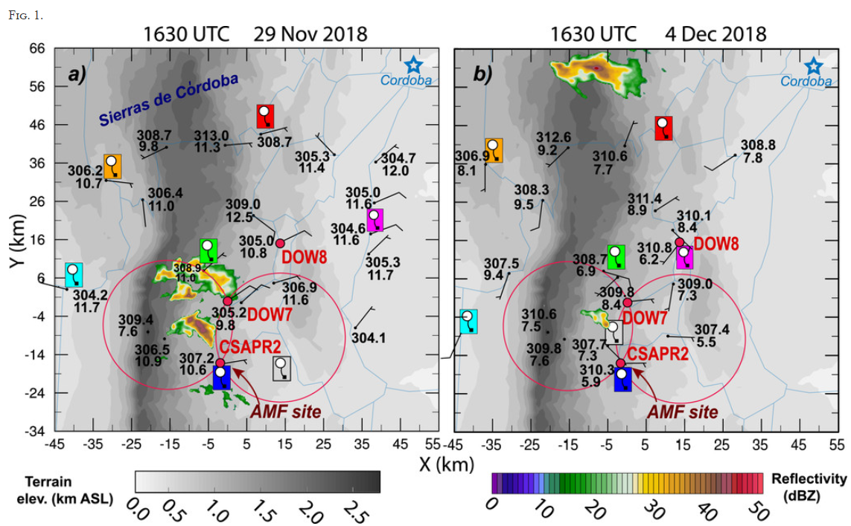
Notes:
A mesoscale radiosonde network consisted of hourly launches between 1300 and 1900 UTC from six mobile facilities (Schumacher 2019; Wurman and Kosiba 2021a) and every three hours from the U.S. Department of Energy Atmospheric Radiation Measurement (ARM) Mobile Facility (AMF) instrument site (Holdridge et al. 2018), collecting full tropospheric thermodynamic and wind profiles prior to and after CI. Two Doppler on Wheels (DOWs; Wurman and Kosiba 2021b) X-band radars and a C-band Scanning ARM Precipitation Radar (CSAPR2; Bharadwaj et al. 2018) collected data east of the SDC near the AMF site.

Slide 5
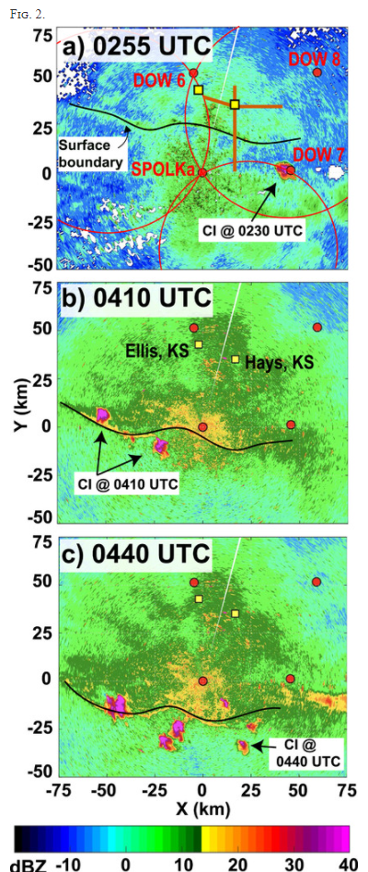
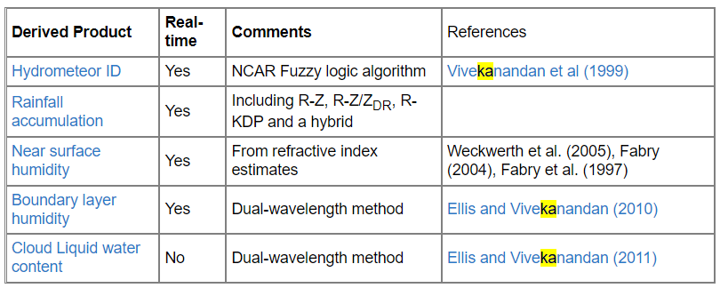
(a)–(c) Instrument deployment map for 3 Jul 2015. Positions of the SPOLKa, DOWs 6–8 radars, and radiosondes and profilers at Ellis, KS, are shown in each panel. Mobile mesonet transects are shown as brown lines in (a). SPOLKa radar reflectivity is shaded, and the position of the surface boundary is traced at three times between 0255 and 0440 UTC, when CI episodes occur.
S-PolKa: 10 cm and 0.86 cm wavelength
Notes:
Three DOWs (Wurman and Kosiba 2018a) were deployed from approximately 0200–0500 UTC (2100–0000 local time), performing synchronized PPI volume scans with the National Center for Atmospheric Research’s S-/Ka-band dual-polarimetric radar (SPOLKa; UCAR/NCAR 2016) located near McCracken, Kansas. Radar baselines are approximately 45 km, chosen to cast a large net over an area with large forecast uncertainty. Dual-Doppler volumes are available every 10 min. During this deployment, isolated convective cells develop along a southward-moving east–west-oriented line of enhanced radar reflectivity collocated with a surface wind shift between 0230 and 0430 UTC. Cells initiating at 0230 UTC persist for approximately 45 min, while those initiating at later times persist for 2–3 h. Only two balloon radiosondes were launched during the observing period, at 0300 and 0600 UTC at Ellis, Kansas (Clark 2016). The surface wind shift boundary passes over Ellis at approximately 0200 UTC; therefore, all radiosondes were launched north of it. However, vertically pointing lidar (Clark 2015a), atmospheric emitted radiance interferometer (AERI) instruments (Turner 2016), and surface observations (Clark 2015b) provide high-frequency retrievals of thermodynamic and moisture profiles prior to and after the passage of the wind shift boundary. Finally, two mobile mesonets (e.g., Waugh and Fredrickson 2010; Wurman and Kosiba 2018b) performed transects through the center of the radar domain, collecting 3-m surface meteorological observations across the surface boundary.

Slide 6
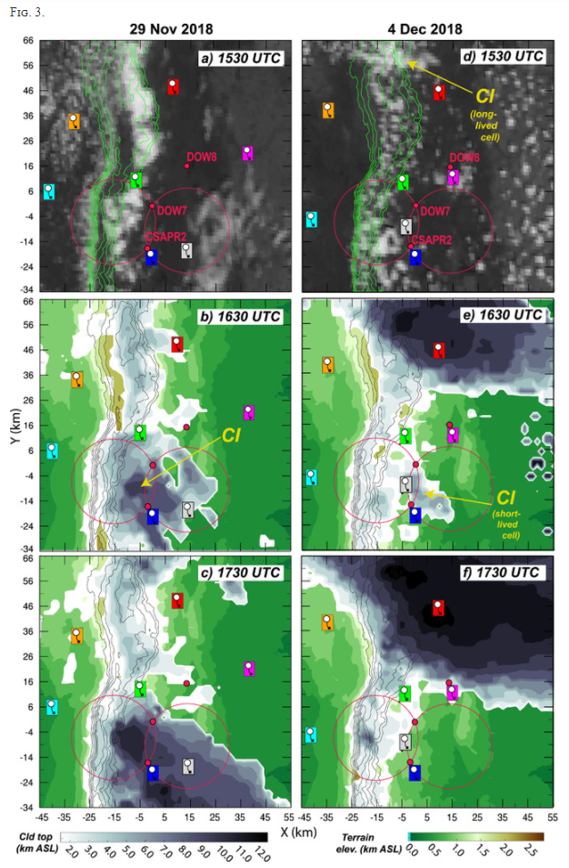
(a),(d) GOES-16 visible radiance at 1530 UTC (UCAR/NCAR 2019) and (b),(c),(e),(f) cloud top height derived from GOES infrared brightness temperature at 1630–1730 UTC (ARM 2018) on (left) 29 Nov and (right) 4 Dec 2018. Surface elevation above sea level is shown in green–brown shading in (b), (c), (e) and (f) and with contours (outermost contour is 1.5 km above sea level, incremented by 0.2 km) in green in (a) and (d), and in black in (b), (c), (e), and (f). Radiosonde launch sites and radar positions are shown in all panels. Locations of CI events discussed in the text are annotated in (b), (d), and (e).

Slide 7
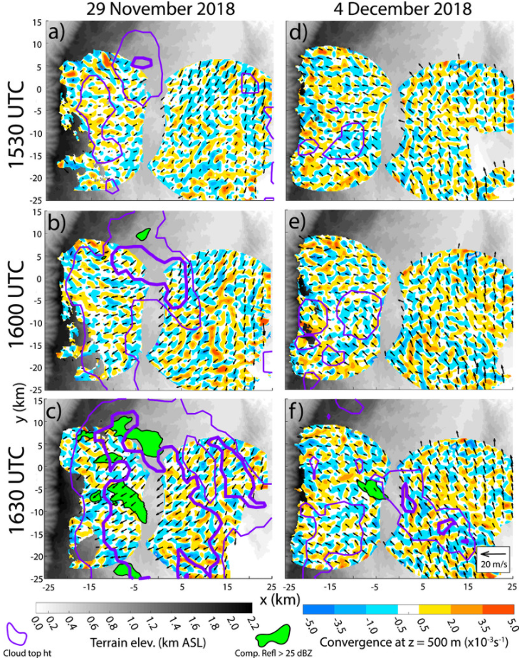
Dual-Doppler horizontal flow convergence at 500 m AGL (shaded), column maximum DOW X-band radar reflectivity > 25 dBZ at 500 m AGL (magenta), and GOES-estimated cloud top height (purple contours) at 3 (thin) and 6 (thick) km ASL. Plots are valid between 1530 and 1630 UTC (left) 29 Nov and (right) 4 Dec. Surface elevation above sea level is shaded in gray.
O(1)-km-wide convergence and divergence perturbations suggesting shallow dry CBL cellular or roll circulations

Slide 8
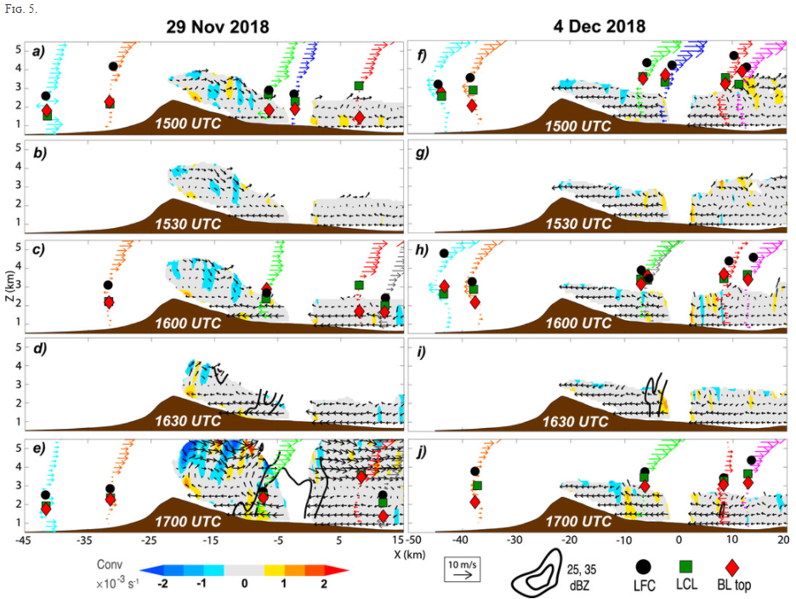
Cross sections of dual-Doppler meridional-mean zonal and vertical wind (vectors), horizontal convergence (shaded), and DOW radar reflectivity (25 and 35 dBZ; thick black contours) between 1500 and 1700 UTC (a)–(e) 29 Nov 2018 and (f)–(j) 4 Dec 2018. Radiosonde-measured horizontal winds (vector profiles colored to match launch sites shown in Fig. 1), boundary layer depth (red diamonds; measured as in Liu and Liang 2010; Nelson et al. 2021), ML LCL (green boxes) and ML LFC (black circles) measured from hourly radiosondes are projected into the cross section. The meridional-mean terrain profile of the SDC is shown in brown.
along-peak averages (over the range −25 < y < 5 km in Fig. 4)
Upslope wind
conv
LFC
Notes:
The meridional mean of the flow perpendicular to the SDC on 29 November illustrates that the northeasterly upslope winds are confined to a shallow layer (z < 0.75 km above ground level; hereafter AGL) on the eastern slope of the SDC (Figs. 5a,b). Prior to CI, shallow meridional-mean low-level convergence (~750 m deep) is occasionally detected near the ridgeline, located within weak winds in the lowest 3–3.5 km ASL (below 1–1.5 km AGL near the ridge top) rather than at the leading edge of the shallow upslope flow (Figs. 5a–c). This early shallow convergence signal may result from thermally induced orographic flow in response to solar heating of the terrain (e.g., Kirshbaum 2013). If significant convergence is associated with the upslope flow, it may be too shallow and close to the ground to detect at this time. However, meridional-mean convergence deepens to ~1.25–1.5 km AGL after 1630 UTC, as the previously shallow upslope flow strengthens and deepens (by ~2.5 m s⁻¹ and ~600 m, respectively), and reaches the ridgeline (Figs. 5d,e). The first near-surface precipitation radar echoes greater than 35 dBZ occur approximately 10 km east of the ridgeline between 1615 and 1630 UTC, as the shallow layer of upsloping winds begins to deepen and strengthen there. Though meridional mean low-level convergence and updraft is found along many potions of the eastern slopes throughout the observing period, new deep cumulus and CI episodes occur closer to the ridgeline after 1630 UTC (Fig. 3c) as the leading edge of the upslope flow approaches it. Flow from one such precipitating updraft is present within the meridionally averaged flow at 1700 UTC as it travels eastward (e.g., centered at x ~ −10 km in Fig. 5e), and should not be confused for a longer-wavelength terrain-induced mesoscale circulation. Radiosonde observations directly west of the dual-Doppler region (cyan profile in Figs. 5a,e) indicate low-level westerlies of similar magnitude to the easterly upslope flow. This limited wind data may suggest shallow anabatic flow that is partly symmetric about the ridgeline, consistent with the existence of an orographic solenoidal circulation. If both thermally and mechanically forced flows are generating convergence near the ridgeline, they may combine to support the evolution of cloud development and CI.

Slide 9
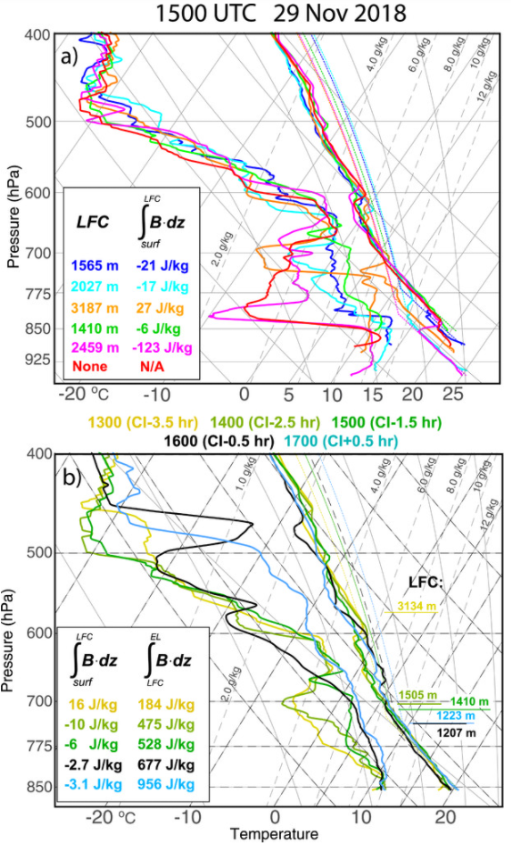
Skew T–logp diagrams from six synchronized radiosonde launches at 1500 UTC 29 Nov 2018. Sounding profiles are colorized to match launch sites mapped in Fig. 1a. ML CIN and LFC (AGL) are shown in the bottom-left legend. (b) As in (a), but for sequential hourly radiosonde launches nearest to the CI location (green radiosonde launch site in Figs. 1a and 3a–c) between 1300 and 1700 UTC. Time evolution of the ML CIN and CAPE are shown in the legend, and ML LFC is labeled at each time on the right side of the image.
elevated statically neutral layer (between ~830 and 700 hPa)
considerable moisture heterogeneity
Significant ML CIN is present over the lowest terrain. CI occurs near where ML LFC and CIN are minimized.
Notes:
Examination of synchronized radiosonde launches illustrates spatial heterogeneity of static instability and moisture surrounding the forecasted CI location (Fig. 6). The boundary layer¹ is topped by an elevated statically neutral layer (between ~830 and 700 hPa, depending on the radiosonde launch site), with considerable moisture heterogeneity present across the sounding array (e.g., water vapor mixing ratio q_{υ} spans 1.8–6.8 g kg⁻¹ at 775 hPa). Significant low-level mean layer (ML²) CIN is present over the lowest terrain, where the boundary layer and overlying elevated neutral layer are the most decoupled. CI occurs within 10–15-km horizontal distance of the highest portion of the ridgeline (located at y = −6 km in Figs. 1, 3, and 4), near where relative humidity is highest, and ML LFC and CIN are minimized (green and blue profiles in Fig. 6a). Relative humidity steadily increases in the upper boundary layer and lower free troposphere leading up to CI as a result of increasing specific humidity (Fig. 6b). This moistening corresponds to deepening upslope flow and possibly with moist updrafts and clouds detraining into the lower free troposphere (the soundings shown in Fig. 6b are launched near the cloud line that is continuous with the convergence line retrieved within the dual-Doppler lobes; Figs. 3a–c). A shallow elevated temperature inversion located at 600 hPa erodes between 1300 and 1500 UTC, reducing the ML LFC (from 3165 to 1592 km AGL) in the 1–3 h preceding CI. At most times leading up to CI, the ML CAPE was steadily increasing by ~150 J kg⁻¹ h⁻¹ and ML CIN was <20 J kg⁻¹. Initiation of the most sustained convection occurs between 1630 and 1715 UTC when the meridional-mean convergence along the terrain is most consistently deep and reaches heights that are most similar to the nearest radiosonde-measured environmental ML LFC height (Figs. 5a–e). This observation leads us to hypothesize that an environment where the LFC is similar to the depth of mesoscale ascent supports CI, possibly because it minimizes the depth over which parcels must rise before the production of buoyancy within an updraft, offsetting loss by free tropospheric entrainment (e.g., Houston and Niyogi 2007).

Slide 10
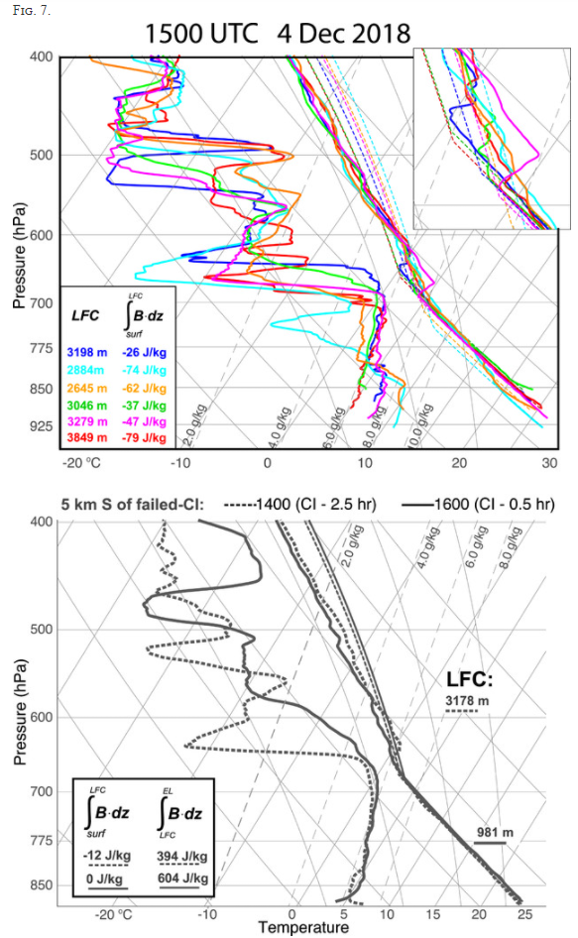
As in Fig. 6, but for the 4 Dec 2018 case. Soundings are colored to match launch sites shown in Fig. 1b. The area of the soundings between the LCL and LFC is enlarged in an offset in the top right of the panel. (b) Radiosonde launches at 1400 (dashed) and 1600 UTC (solid) from the location closest to the short-lived convective cell (gray launch location in Fig. 1b).
In both RELAMPAGO-CACTI cases, surface-based boundary layers and elevated neutral layers are more readily coupled over higher terrain than at lower elevation.
capping inversion erodes, eliminating ML CIN, and the free troposphere moistens (between 700 and 500 hPa). Despite these favorable conditions, CI processes do not yield sustained convection.

Slide 11
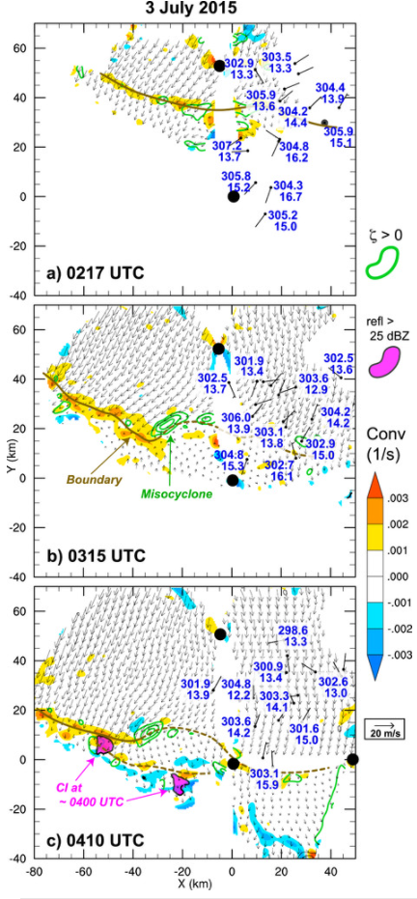
Horizontal flow convergence (shaded), ground-relative horizontal winds (vectors), and positive vertical vorticity (green contours; every 0.001 s−1) calculated from quasi-2D dual-Doppler retrievals (using only the lowest level radar scans) between 0217 and 0410 UTC 3 Jul 2015. These quasi-2D analyses isolate the structure of the boundary at the lowest radar-observed levels. 3-m θυ (K), qυ (g kg−1), and horizontal wind (m s−1; barbs) observations from mobile mesonets with positions adjusted with a time-to-space conversion within 60-min windows using the estimated mean boundary motion of (u, υ) = (−3.5 m s−1, −3.5 m s−1). Positions of the radars shown in Fig. 2 are highlighted with black dots. SPOLKa radar reflectivity > 25 dBZ is shown in magenta.

Slide 12
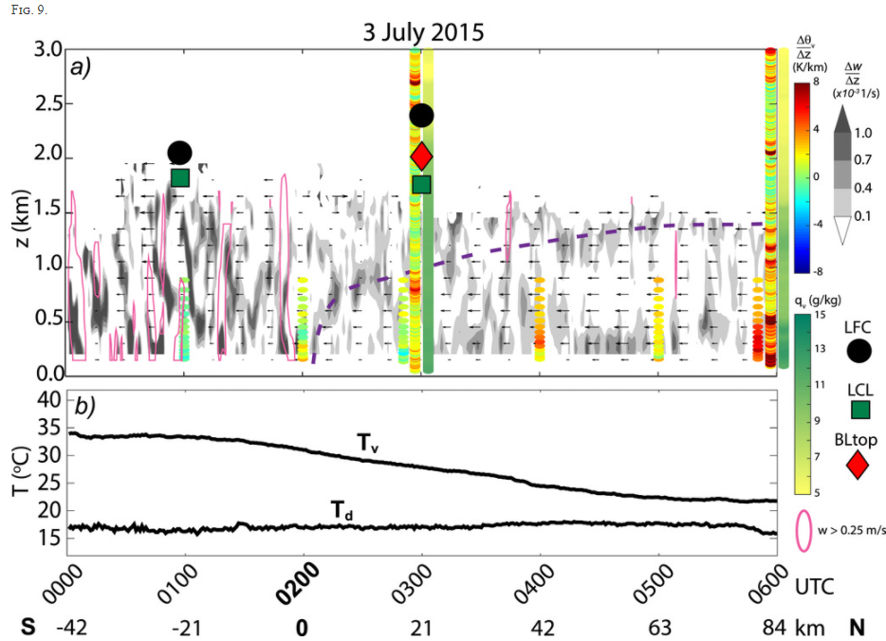
Lidar-retrieved boundary-relative meridional wind profiles (vectors), the vertical gradient of lidar-measured vertical velocity approximating horizontal wind convergence (shaded), lidar-measured updraft (>0.25 m s−1; magenta contour), AERI static stability profiles below z = 850 m (shown hourly), and radiosonde static stability and qυ profiles from the 0300 and 0600 UTC radiosondes located at Ellis, KS. Radiosonde-estimated (and combined radiosonde-AERI-estimated at 0100 UTC) ML LCL (green boxes), ML LFCs (black circles), and the 0300 UTC boundary layer top [red diamond; calculated with the Liu and Liang (2010) method] are overlaid. (b) Surface virtual temperature and dewpoint temperature observations. Boundary-relative winds are calculated and meridional distance (horizontal axis) is time–space converted using the mean meridional motion of the boundary, υ = −3.5 m s−1. Depth and slope of the wind shift boundary (purple dashed line) is subjectively estimated using wind, convergence, and radiosonde stability profiles.
Notes:
Assuming steady flow structure in time, the wind shift boundary is approximately 1 km deep 1 h after its passage, and approximately 1.5 km deep 3–4 h after passage (Fig. 9a). Horizontal flow convergence along the boundary extends up to ~1 km AGL. Steady surface cooling occurs at Ellis, Kansas, starting about an hour ahead of the wind shift and continues well after its passage (Fig. 9b). This cooling is likely a result of nocturnal radiative cooling (a shallow near-surface inversion develops between 0300 and 0600 UTC; green and red profiles in Fig. 10) rather than a significantly cooler northern air mass

Slide 13
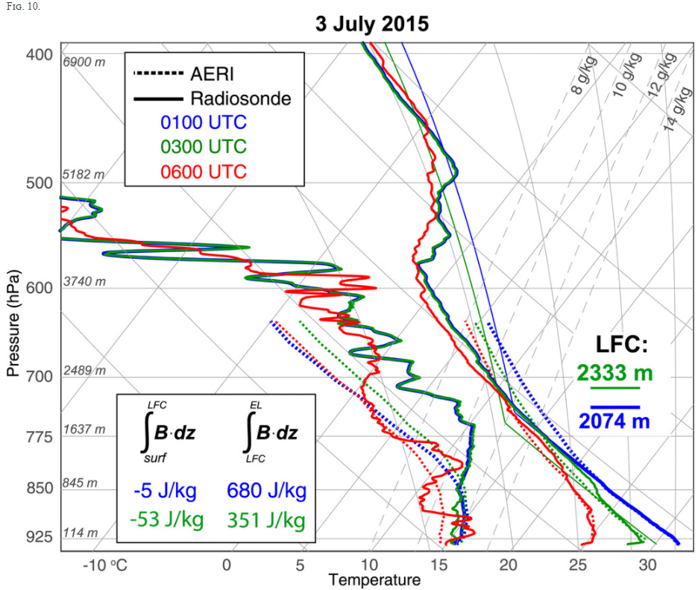
Skew T–logp diagrams from radiosonde and AERI measurements between 0100 and 0600 UTC 3 Jul 2015. Radiosonde profiles are shown with solid lines and AERI profiles are shown with dashed lines. The solid blue profile is a combination of low-level AERI data valid at 0100 UTC and the 0300 UTC radiosonde aloft (described in the text). ML CIN and CAPE from 0100 to 0300 UTC are shown in the bottom-left offset. ML LFC (AGL) is labeled on the right. For reference, the altitude AGL (mean of each sounding) is shown along each potted pressure level.
nearly statically neutral lapse rates and high qυ between the top of the wind shift boundary and z = 2 km AGL that extends almost all the way to the ML LFC.

Slide 14
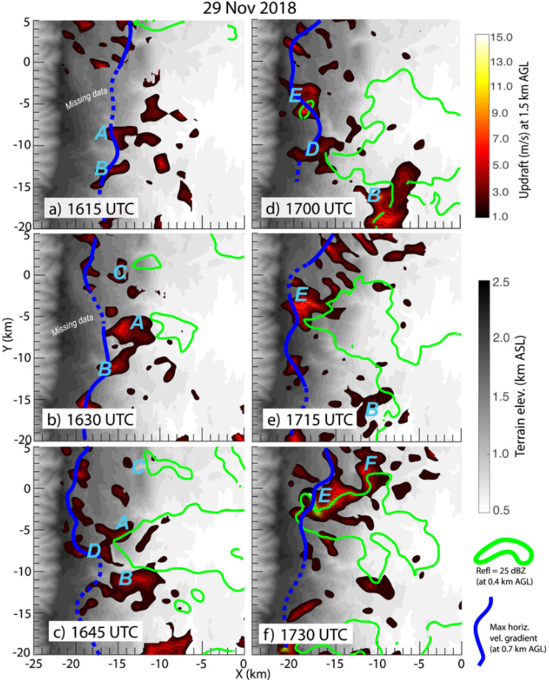
Dual-Doppler-retrieved vertical velocity at z = 1.5 km AGL (red–yellow shaded) and DOW radar reflectivity at z = 400 m AGL (25 dBZ; green contour) between 1615 and 1730 UTC 29 Nov 2018. Terrain elevation is gray shaded. Subjectively tracked precipitating updrafts described in section 4 are labeled “A”–“F.” Subjective trace of the maximum horizontal velocity gradient tensor at z = 700 m AGL, approximating the leading edge of enhanced upslope flow, is shown with a blue line (dashed where there is missing data or uncertainty).

Slide 15
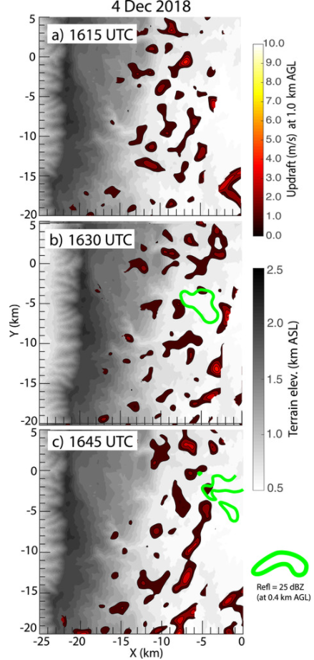
As in Fig. 11, but valid between 1615 and 1645 UTC 4 Dec 2018. Updrafts are shown at z = 1.0 km AGL because of the vertical coverage of available dual-Doppler data.

Slide 16
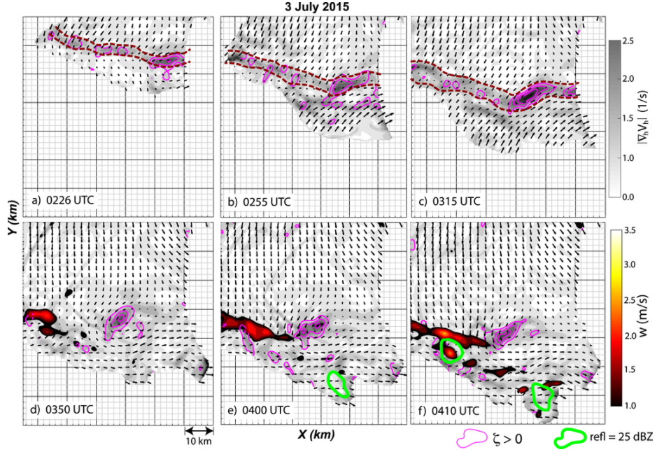
(a)–(f) Radar reflectivity at z = 1 km AGL (25 dBZ; green contour), positive vertical vorticity (purple contours; outermost is 0.001 s−1, incremented by 0.001 s−1), and updraft [red–yellow shading in (d)–(f)] at z = 1.25 km AGL, using dual-Doppler wind retrievals between 0226 and 0410 UTC 3 Jul 2015. Horizontal velocity gradient tensor (gray shading) produced using quasi-2D dual-Doppler wind syntheses (as in Fig. 8). Subjective width of the boundary is highlighted with dashed purple contours in (a)–(c).

Slide 17
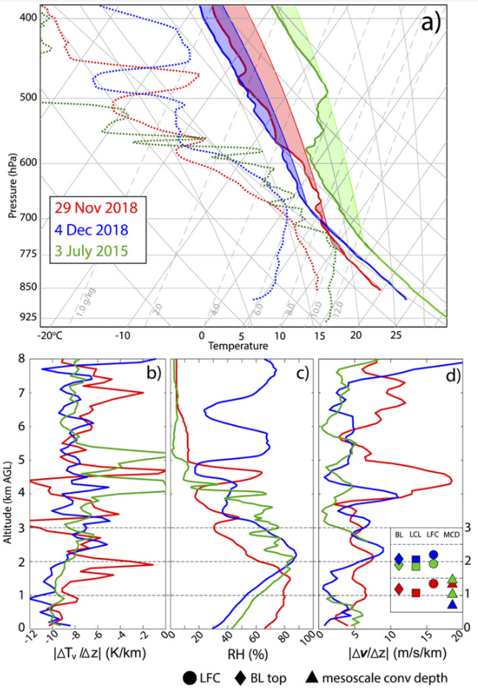
(a) Skew T–logp diagrams of radiosonde profiles collected closest in time and space to CI events on 29 Nov (red), 4 Dec (blue), and 3 Jul (green). The 3 Jul profile comprises the combined 0100 UTC AERI and 0300 UTC radiosonde. Layers of positive and negative buoyancy of a ML parcel are shaded for each profile. Vertical profiles of (b) lapse rate of virtual temperature, (c) relative humidity, and (d) vertical wind shear. Estimates of the height of the ML LFC (circles), ML LCL (squares), boundary layer top (diamonds; measured as in Liu and Liang 2010), and dual-Doppler or Lidar estimates of the depth of mesoscale horizontal convergence (triangles) are shown in an offset in (d). Two green triangles indicate the ranges of convergence detected ahead of and along the 3 Jul wind shift, discussed in section 5.

Slide 18
Summary
This study examined rare coordinated radiosonde observations and dual-Doppler radar wind retrievals capturing the initiation of deep convection during the RELAMPAGO, CACTI and PECAN field campaigns, permitting a detailed analysis of the environmental controls on the development of early convective updrafts.
(i) the interplay of mesoscale circulations and boundary layer flow convergence with the surrounding thermodynamic conditions that trigger deep convection initiation (CI), and (ii) the evolution of the size and intensity of the earliest detectable low-level precipitating updrafts.
CIN was effectively eliminated in all three cases. Low-to-middle tropospheric lapse rates generally were more unstable in the near-cloud environments of sustained CI events. This resulted in a vertical distribution of CAPE that favored larger updraft buoyancy near the LFC rather than higher in the troposphere, potentially aiding CI processes by offsetting buoyancy dilution from entrainment of environmental air. The most sustained CI processes occurring with the deepest and most prominently observable low-level mesoscale flow convergence.

Slide 19
Summary
The earliest detectable low-level updrafts associated with sustained, precipitating deep convective cells were 3–5 km in diameter, larger than the typical 1–3-km-wide shallow updraft thermals associated with the surrounding convective boundary layer turbulence. The size of typical individual convective boundary layer thermals outside of mesoscale convergence zones may limit the potential for CI in overlying clouds because they are too narrow to survive entrainment from the free troposphere.
This conclusion is perhaps partly supported by unsustained CI occurring on a day with little or no CIN, a small difference between the LFC height and boundary layer top, but relatively frail mesoscale convergence.
This finding emphasizes the need to properly resolve or parameterize both mesobeta-scale and mesogamma-scale features of triggering mechanisms in numerical regional and climate models.

