Slide 1
GOES-16 Observations of Rapidly Intensifying Tropical Cyclones: Hurricanes Harvey (2017), Maria (2017), and Michael (2018)
Paper review
mainly refer to
Erin B. Munsell, Scott A. Braun, and Fuqing Zhang
Wei-Ting Fang
2021.11.09 @CPLab
Other references:
Lin, K. J., S. C. Yang, and S. S. Chen, 2018: Reducing TC position uncertainty in an ensemble data assimilation and rediction system: A case study of Typhoon Fanapi (2010). Wea. Forecasting, 33, 561–582.

Slide 2
Outline
Introduction
Methodology and data
GOES-16 specifications and instrumentation
Satellite data acquisition
Satellite data analysis methods
Results and discussion
Evolution of environmental parameters, storm intensity, and storm cloud structure
Examination of convective structure: Brightness temperature thresholds
Examination of convective structure: Hovmöller diagrams
Conclusions

Slide 3
Introduction(1/3)
Although satellite data was initially explored primarily to determine the current intensity, convective characteristics, rainfall rates, and temperature structures within TCs (e.g., Dvorak 1975; Adler and Rodgers 1977; Griffith et al. 1978; Velden and Smith 1983), some studies also began analyzing microwave and infrared (IR) data to examine potential relationships to the future intensity of TCs (Gentry et al. 1980). Other early applications of geosynchronous data for tropical cyclone research included a study by Steranka et al. (1986), which utilized IR brightness temperature (T_{b}) data of cloud canopies within the innermost ~200 km of TCs that occurred between 1974 and 1979 and their relationship with future intensity changes.
The increase in available observations over the past few generations of geostationary satellites has also allowed for the development of a fully automated approach to estimating current TC intensity (advanced Dvorak technique, ADT; Olander and Velden 2007).
Data assimilation
Atmospheric motion vectors (AMVs; Velden et al. 1997)
All-sky IR radiances (Zhang et al. 2016)

Slide 4
Introduction(2/3)
Many studies have used TRMM (Kelley et al. 2004; Molinari and Vollaro 2010; Tao and Jiang 2015; Zagrodnik and Jiang 2014), other space-based microwave (Alvey et al. 2015; Fischer et al. 2018) and infrared (Monette et al. 2012; Fischer et al. 2018) products to observe the location and intensity of convection in TCs, either during RI, while steadily intensifying, in steady state, or when weakening.
All of these studies found evidence of shallow to moderate convection in the upshear quadrants of the TC prior to a period of intensification.
Areas of deep convection in the upshear quadrants were not typically found prior to RI (Zagrodnik and Jiang 2014; Alvey et al. 2015; Fischer et al. 2018) and only occurred once the system had already begun to intensify.
However, the study by Fischer et al. (2018) does discuss the fact that due to the lack of temporal availability, microwave retrievals can periodically miss deep convective bursts and that, while unlikely, it is still possible to have upshear deep convective bursts as a precursor to RI.
Symmetry of convection in conjunction with and throughout RI was also found across the studies, with some suggesting that shallow to moderate convection could be used as an RI predictor in statistical models (Alvey et al. 2015; Tao and Jiang 2015).

Slide 5
Introduction(3/3)
Based on the results of these previous studies, it is hypothesized that as a result of the extremely high temporal frequency of the GOES-16 observations, the potential for an improved dynamical understanding of the evolving convective structures in the times leading up to and throughout RI exists.
Therefore, this study uses the T_{b} data as captured by the Advanced Baseline Imager (ABI) on GOES-16 to conduct an observationally based examination of three TCs that all underwent at least one period of RI: Hurricanes Harvey, Maria, and Michael from the 2017 and 2018 Atlantic hurricane seasons.

Slide 6
Methodology and data
GOES-16 specifications and instrumentation
There are two Earth-facing instruments on GOES-16, the Advanced Baseline Imager (ABI) for imaging of Earth’s atmosphere and oceans and the Geostationary Lightning Mapper (GLM) for total lightning detection.
The ABI is an imaging radiometer with 16 spectral bands including 2 visible channels, 4 near-IR channels, and 10 IR channels.
The spatial resolutions of the channels range from 0.5 to 2 km, or at least twice as fine in each pixel direction as the channels from the GOES-13 imager (~1 to ~4 km).
In terms of temporal resolution, six full disk scans are now completed every hour (compared to one every 3 h from GOES-13), and CONUS scans are now available every 5 min (as opposed to 15 min from GOES-13).
Imagery from “mesoscale-scan mode” is available every 60 s, or if both mesoscale-scan domains are in the same area, the frequency of the imagery is 30 s.

Slide 7
Methodology and data
Satellite data analysis methods
According to the National Hurricane Center’s (NHC) glossary, RI is defined as an increase in the 10-m maximum winds of at least 30 kt (15.4 m s⁻¹; 1 kt ≈ 0.51 m s⁻¹) over a 24-h period.
NHC’s best track data: 0300 UTC 24 August for Harvey, 1800 UTC 17 September for Maria, and 1800 UTC 7 October for Michael.
The best track centers interpolated from a frequency of 6 h to 60 s. Radius of maximum wind (RMW) data that is displayed on the azimuthal mean Hovmöller diagrams is obtained from the NHC a-deck database.
Shear-relative Hovmöller diagrams are created using the Statistical Hurricane Intensity Prediction Scheme (SHIPS; DeMaria et al. 2005) deep-layer (850–200 hPa) vertical wind shear analyses, whose magnitudes and accompanying directions are calculated from the winds at the respective layers averaged over a 200–800 km annulus around the TC. These analyses are available at 6-h increments.

Slide 8
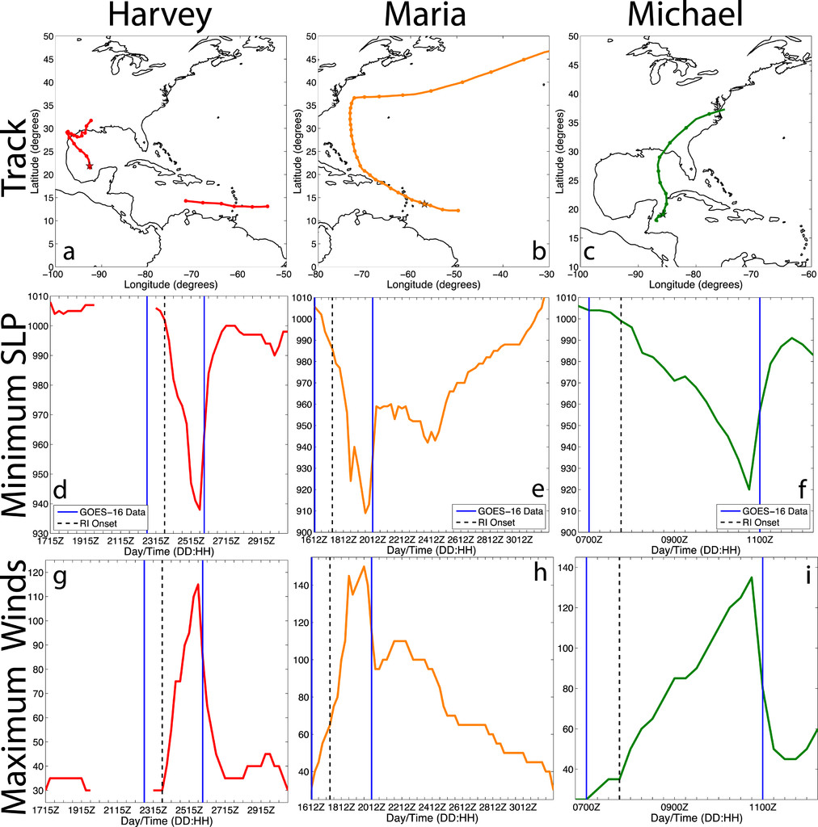
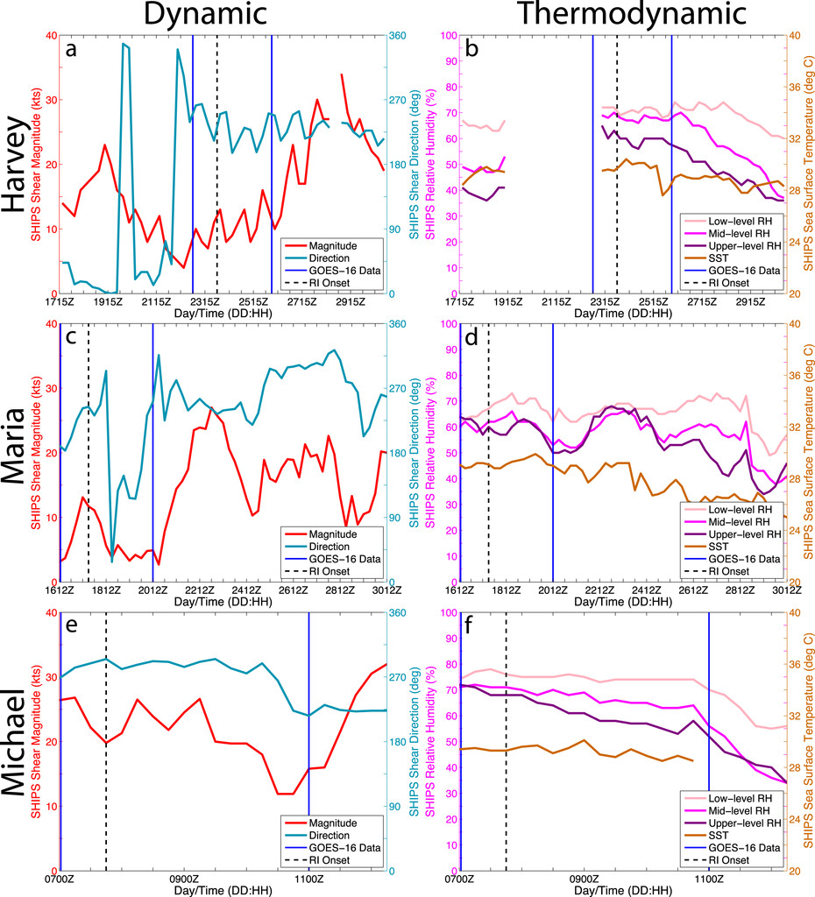
Overview of each TC
Low-level (850–700 hPa)
Midlevel (700–500 hPa)
Upper-level (300–500 hPa)

Slide 9
Hurricane Harvey
a: Downshear
b-d: More symmetric (upshear-left quadrant suppressed)
e: downshear-left (very nearly penetrating the upshear-left)
f: More symmetric (wavenumber 1 asymmetry)
g-j: Spatial extent of the storm increased in size
k-l: a clear eye, banded features of strong convection (peak intensity of 115 kt)
Notes:
Despite the asymmetric convective structure at this time, SHIPS analyses indicated that the environmental conditions were favorable for intensification; vertical wind shear was weak (5–10 kt; Fig. 2a), sea surface temperatures (SSTs) approached 30°C (Fig. 2b), and the relative humidity values in the Gulf of Mexico were reasonably favorable at all vertical levels (~65%–70%; Fig. 2b). For reference, in their climatology of North Atlantic RI TC cases, Kaplan and DeMaria (2003) found a mean vertical wind shear of 4.9 m s⁻¹, mean SSTs of 28.4°C, and averaged low-level relative humidity of 69.7%.
Although the SHIPS analyses indicate that the vertical wind shear increased throughout Harvey’s RI (Fig. 2a), shear remained at most moderate (~15 kt) allowing for uninterrupted intensification until landfall at 0300 UTC 26 August.

Slide 10
Hurricane Maria

Slide 11
Hurricane Michael

Slide 12
Percentage of T_{b} < 200 K

Slide 13
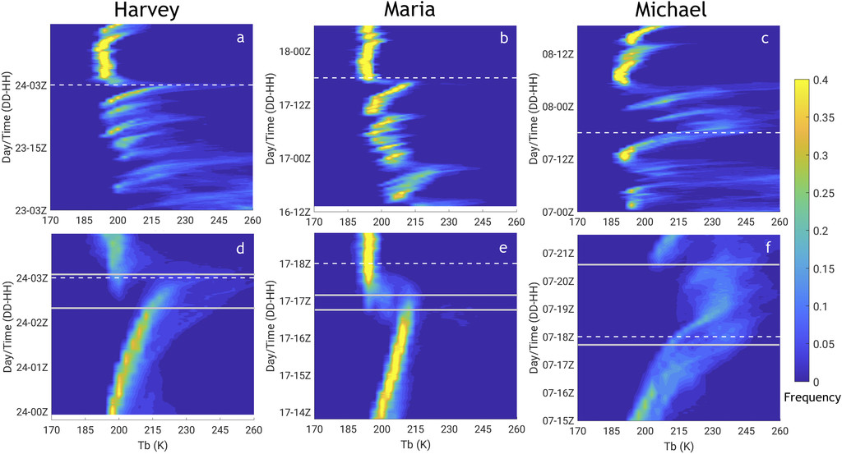

Slide 17
Conclusions
This study utilizes channel-14 (11.2 μm; IR longwave window band) T_{b}s as seen by the mesoscale-scan mode of the ABI on GOES-16, to perform an in-depth examination of the convective structures of Hurricanes Harvey, Maria, and Michael throughout a substantial portion of their lifetimes, including a period of RI in each TC.
Analysis techniques such as T_{b} threshold evolutions, T_{b} frequency distributions, and azimuthal mean and constant radius Hovmöller diagrams showed that little to no substantial convection occurred in association with the TCs in the 12–24 h prior to RI.
However, within 12 h of RI onset, bursts of inner-core convection began to occur. These periods of substantial convection occurred on time scales of 2–4 h, with a frequency of 3–9 h between bursts across the three TCs.
Shear-relative constant-radius Hovmöller diagrams reveal that these features were predominantly located downshear and propagated cyclonically toward the upshear quadrants as RI was approached.
It is likely that these periods of vigorous convection and their associated precipitation helps to moisten the inner core prior to RI, which promotes additional and more sustained convection that helps to further strengthen the developing vortex.

Slide 18
Conclusions

