Slide 1
Effect of Scale-Aware Planetary Boundary Layer Schemes on Tropical Cyclone Intensiﬁcation and Structural Changes in the Gray Zone
Chen, X., M. Xue, B. Zhou, J. Fang, J. A. Zhang, and F. D. Marks, 2021: Effect of scale-aware planetary boundary layer schemes on tropical cyclone intensification and structural changes in the gray zone. Mon. Wea. Rev., 149, 2079–2095.

Slide 2
Introduction
Turbulence within the tropical cyclone (TC) boundary layer is affected by the strong winds and inertial stability (e.g.,Eliassen 1971; Kepert 2001), making the TC boundary layer distinct from the traditional convective boundary layer.
parameterized boundary layer turbulent ﬂuxes can impact TC inﬂow strength and depth and further modulate TC intensity change (e.g., Braun and Tao 2000; Smith and Thomsen 2010; Gopalakrishnan et al. 2013; Zhang et al. 2015).
accurately representing turbulent ﬂuxes in the planetary boundary layer (PBL) schemes for TC simulations remains challenging:
scarcity of in situ turbulence measurements in high wind conditions
existing PBL schemes are generally tuned based on observations or large-eddy simulations of convective boundary layers over land
Notes:
However, accurately representing turbulent ﬂuxes in the planetary boundary layer (PBL) schemes for TC simulations remains challenging.
This is in part due to the scarcity of in situ turbulence measurements in high wind conditions, especially those over the ocean, and to the fact that the existing PBL schemes are generally tuned based on observations or large-eddy simulations of convective boundary layers over land.

Slide 3
boundary layer turbulence is completely parameterized in coarse-resolution simulations ($∆≫{boundary height (Z}_{i})$), it becomes partially resolved by model grid points at gray-zone resolutions.
The direct use of traditional PBL schemes in the gray zone can result in overestimated turbulent mixing:
weakened resolved motions (Honnert et al. 2011; Ching et al. 2014)
broken or thinner convective rolls (LeMone et al. 2010; Shin and Hong 2015).
Notes:
The issue is further complicated with the increase in computing power, which enables horizontal grid spacings of global and regional numerical models at ~1 km or smaller.
Such grid spacings are comparable to the boundary layer height (z i ) of TCs,

Slide 4
The core essence of the scale awareness in these PBL schemes is to apply a predeﬁned empirical partition function of the dimensionless grid spacing $∆/{Z_{i}}$ to down-weight PBL-scheme-parameterized turbulent ﬂuxes in the gray zone.
This study is motivated to investigate the effect of the scale-aware PBL scheme on TC intensiﬁcation and structural changes within a set of WRF simulations of Hurricane Earl (2010) at subkilometer horizontal grid spacings.
PBL schemes:
YSU (Hong et al. 2006): one of the most popular PBL schemes used for TC simulations
Shin–Hong (SH; Shin and Hong 2015): similar parameterization of turbulent ﬂuxes as YSU but with the inclusion of scale awareness.
Notes:
Although these empirical functions generally lack a solid theoretical basis (Zhou et al. 2017), they have been shown to have the desired effects on the
convective boundary layer
This study is motivated to investigate the effect of the scale-aware PBL scheme on TC intensiﬁcation and structural changes within a set of WRF simulations of Hurricane Earl (2010) at subkilometer horizontal grid spacings.
The sub-kilometer grid spacing is selected because observational analysis of in situ dropsondes indicates that the TC boundary layer height in terms of the mixed-layer depth 1 is generally less than 1 km (Zhang et al. 2011b).
Two PBL schemes are selected in
this study, namely, the YSU (Hong et al. 2006) and Shin–Hong
(below abbreviated as SH; Shin and Hong 2015) schemes. YSU
is one of the most popular PBL schemes used for TC simula-
tions (Kepert 2012), and SH adopts similar parameterization
of turbulent ﬂuxes as YSU but with the inclusion of scale
awareness.

Slide 5
scientiﬁc questions:
What is the effect of the scale-aware SH scheme on the structural and intensity changes of TCs at gray-zone resolutions?
When and where does the scale awareness play an important role?
What is the physical mechanism responsible for the differences in the structural and intensity changes?

Slide 6
A brief comparison between the YSU and SH PBL schemes
YSU PBL scheme:
The subgrid-scale vertical turbulent ﬂuxes below the diagnosed boundary layer height ($z≤z_{i}$) are parameterized as follows (Hong et al. 2006):
entrainment flux
C: prognostic variables (U,V, $θ$, q)
$K_{c}$: vertical eddy diffusivity
$γ_{c}$: a correction to the local gradient
h: inversion layer
Notes:
YSU is a ﬁrst-order, K-proﬁle parameterization (KPP)-type PBL scheme that does not involve any prognostic equations for turbulence quantities
The subgrid-scale vertical turbulent ﬂuxes below the diagnosed boundary layer height ($z≤z_{i}$) are parameterized as follows (Hong et al. 2006):

Slide 7
K-proﬁle parameterization (KPP)-type PBL scheme
Vertical viscosity for momentum:
P: the profile shape exponent (= 2)
k: von h$\acute{a}$rm$\acute{a}$n constant (= 0.4)
z: height from the surface
h : PBL height
$w_{s}$: mixing layer velocity scale
Eddy diffusivity for temperature and moisture:
$$K_{h}={K_{m}}/{Pr}$$
Pr: Prandtl number defined as the ratio of momentum diffusivity to thermal diffusivity

Slide 8
Scale-aware SH scheme
$$=−K_{c}\frac{∂C}{∂Z}+K_{c}γ_{c}+\overline{\left(w^{′}C^{′}\right)}h{(\frac{z}{z_{i}})}^{3}$$
$P_{L}, P_{NL}:$scale-aware coefﬁcients for local and nonlocal turbulent ﬂuxes

Slide 9
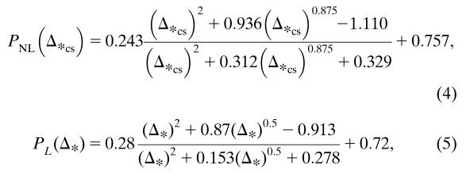
The P_{NL} and P_{L} approach unity at mesoscale spacings ( $∆_{∗}≫$1) and the scale-aware PBL scheme restores to the original PBL scheme.
As the model grid spacing decreases to that of large-eddy simulation (LES) ($∆_{∗}≪$1) where large turbulent eddies are well resolved, P_{NL} and P_{L} are gradually tapered off.
The nonlocal and local functions for potential temperature are
$∆_{∗cs}=∆_{∗}/C_{cs}$
$∆_{∗}$: $∆/Z_{i}$
$C_{cs}$: stability function, whose value depends on ${u_{∗}}/{w_{∗}}$
$u_{∗}$: surface frictional velocity
$w_{∗}$: convective velocity scale

Slide 10
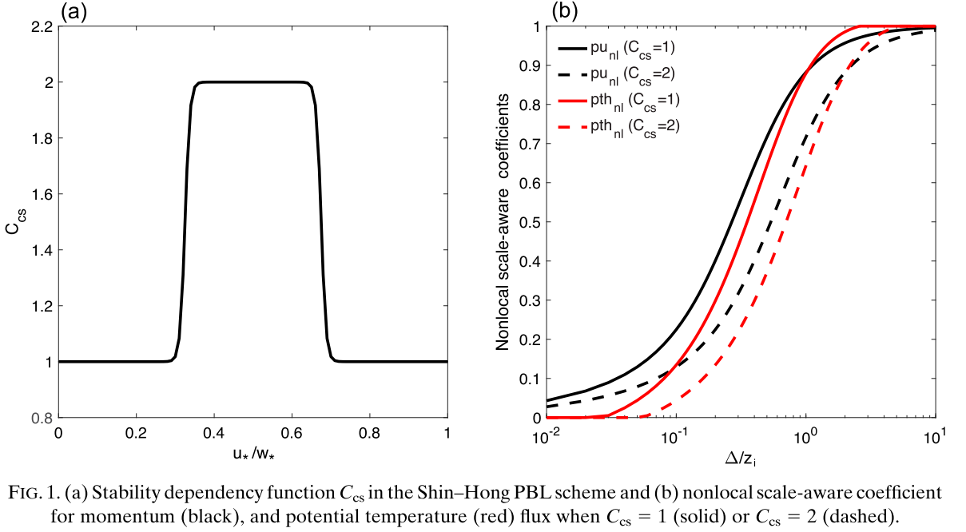
$∆_{∗cs}=∆_{∗}/C_{cs}$
$C_{cs}$: stability function, whose value depends on ${u_{∗}}/{w_{∗}}$
$u_{∗}$: surface frictional velocity
$w_{∗}$: convective velocity scale
Earlier LES studies (Sykes and Henn 1989; Moeng and Sullivan 1994) have found that organized convective rolls form when u*/w* $∈$ [0.35, 0.65].
Notes:
The P_{NL} for momentum is slightly larger than that for u in the gray zone.

Slide 11
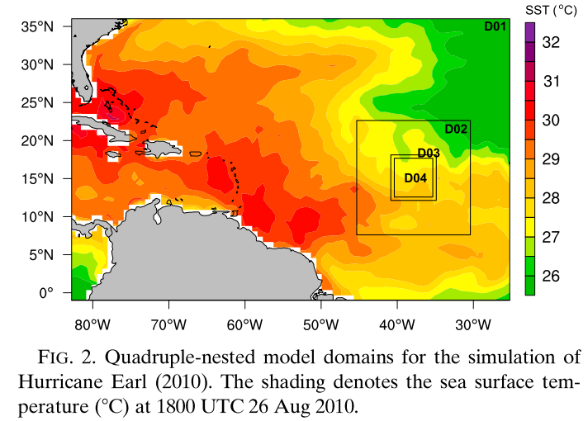
Data, experiment design, and model setup
WRF, version 3.8
Two-way interactive
Quadruple-nested model domains
Grid sizes: 12, 4, 1.33, and 0.444 km
Grid points: $502×346$, $391×409, 469×487, and 1189×1243$
51 sigma levels with the top level at 50 hPa
inner three domains move with the model TC
The outer three domains run from 1800 UTC 26 August to 1800 UTC 31 August, while the innermost domain is activated 18 h later
Inertial and lateral boundary conditions: ERA-Interim (${0.702}^{°}lat×{0.703}^{°}lon$, 37 pressure levels)

Slide 12
Kain–Fritsch cumulus parameterization scheme (Kain and Fritsch 1993) in the outermost domain,
Thompson microphysics scheme (Thompson et al. 2008)
the Dudhia shortwave radiation (Dudhia 1989)
Rapid Radiative Transfer Model (RRTM) longwave radiation scheme (Mlawer et al. 1997)
Revised MM5 Monin–Obukhov (RMO) surface layer scheme

Slide 13
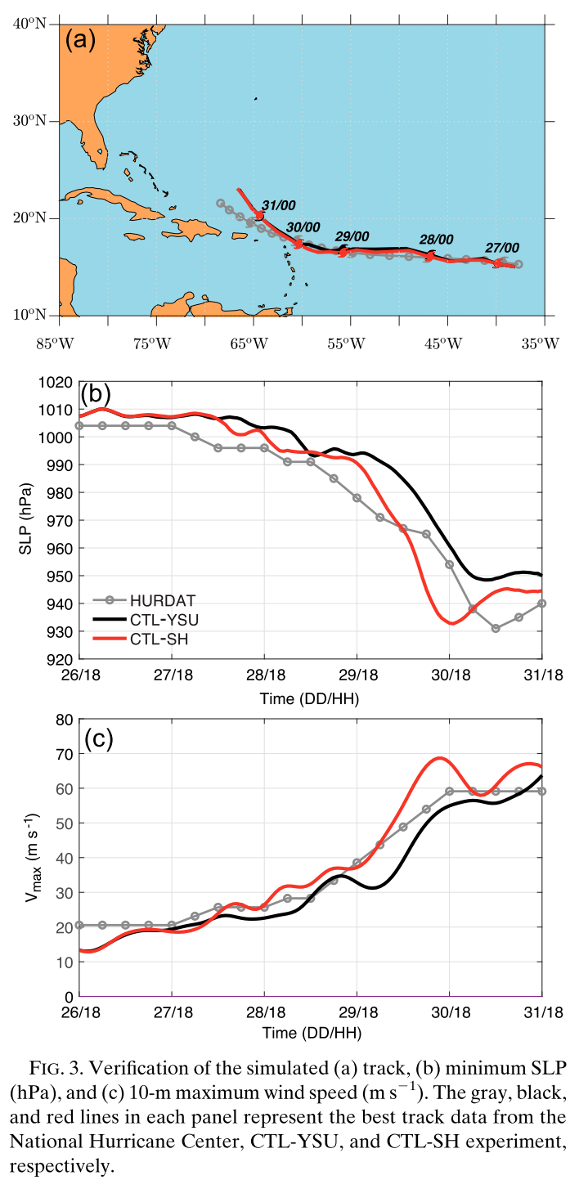
warm sea water, weak-to-moderate vertical wind shear
Eyewall replacement
RI
Notes:
The RI onset in both simulations is approximately 1800 UTC 29 August, 12 h later than that in the best track data.
The minimum sea level pressure at the peak intensity in CTL-SH is closer to the best track.
the CTL-SH TC has a higher intensiﬁcation rate than the best track while the CTL-YSU TC intensiﬁes at a lower intensiﬁcation rate.
both simulations generally reproduce the track, RI, and eyewall replacement cycle (not shown), and the simulation datasets provide a chance to gain insight into the effect of the scale-aware SH scheme on the TC intensity and structural changes.

Slide 14
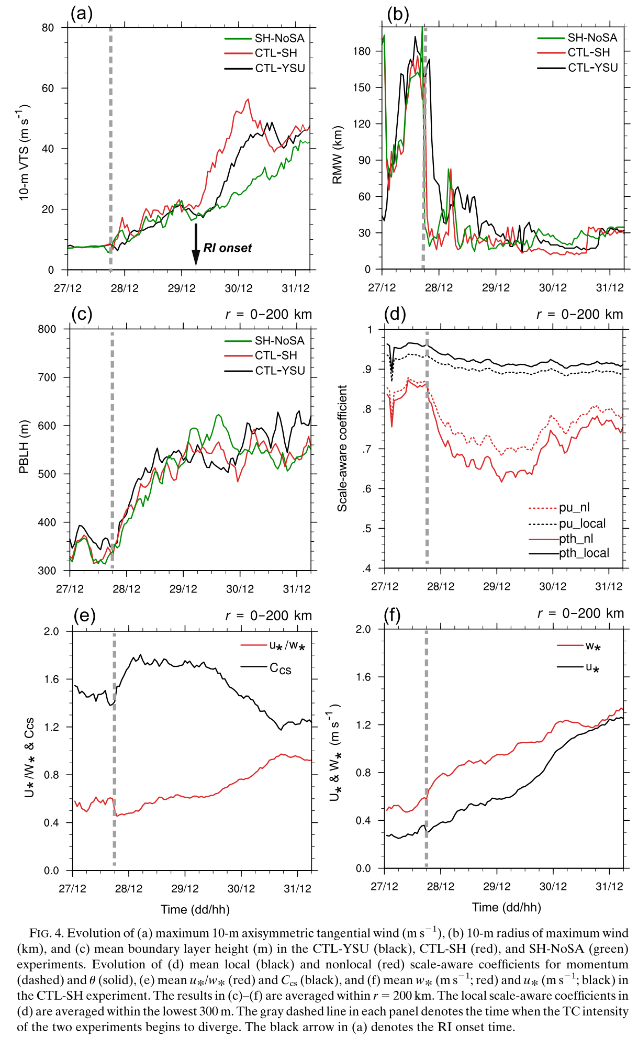
Impact of scale-aware SH PBL scheme on TC intensity and structural changes
Notes:
The stronger CTL-SH TC after 0600 UTC 28 August is accompanied by a more rapid contraction of the radius of maximum wind (RMW) at 10-m height (Fig. 4b).
The increase in the TC intensity after 0600 UTC 28 August is accompanied by a steady increase in the mean boundary layer height averaged within the radius of 200 km in both experiments (Fig. 4c).
Before RI onset of the CTL-SH TC, the evolution of the TC intensity and RMW at 10-m height as well as the mean boundary layer height in CTL-SH and SH-NoSA is very similar.
However, the SH-NoSA TC subsequently intensiﬁes at a much slower rate than both CTL-SH and CTL-YSU TCs.
During the RI period of the CTL-SH TC, the 10-m RMW and mean boundary layer height of the SH-NoSA TC generally remain larger than those of the CTL-SH and CTL-YSU TCs.

Slide 15
$∆_{∗cs}=∆_{∗}/C_{cs}$
$∆_{∗}$: $∆/Z_{i}$
$C_{cs}$: stability function, whose value depends on ${u_{∗}}/{w_{∗}}$
$u_{∗}$: surface frictional velocity
$w_{∗}$: convective velocity scale
Notes:
Figure 4d shows the evolution of local and nonlocal scale-aware coefﬁcients for both momentum and u averaged within the 0–300-m layer.
We select this layer to ensure that the local scale-aware coefﬁcients are averaged within the boundary layer height.
Figure 4d shows that the local scale-aware coefﬁcients decrease slightly as the boundary layer height increases, while the nonlocal coefﬁcients rapidly
decrease and reach a minimum of 0.6–0.7 at nearly 1500 UTC 29 August.
Given the small difference between the local and nonlocal coefﬁcients for theta when C cs = 1 (Fig. 1b), the relatively large discrepancy between them in Fig. 4d is indicative of the modulation of the nonlocal scale-aware coefﬁcients by the stability function (C cs = 2).
This hypothesis is conﬁrmed by Fig. 4e.
The mean Ccs is ~1.5 before 0600 UTC 28 August and it rapidly increases toward 2.0 afterward.
Consistently, the mean u*/w* is ~0.6 prior to 0600 UTC 28 August and subsequently decreases to ~0.45 (Fig. 4e), falling in the middle of the stability range where convective roll exists (Fig. 1a).
A closer examination shows that the decrease in u*/w* is mainly due to the faster increase of w* than u* (Fig. 4f).
The faster increase of w* is traced back to 2100 UTC 27 August, which is mainly attributed to the increase of surface heat ﬂuxes (not shown) as the near-surface winds steadily increase (Fig. 3c).
The rapid growth of boundary layer height after 0600 UTC 28 August is another factor accounting for the more rapid increase of w* [see Eq. (6)].
The nonlocal scale-aware coefﬁcient gradually increases after 0300 UTC 30 August (i.e., in the middle of the RI period), since the mean C cs steadily decreases as the mean u*/w* exceeds 0.65 (Fig. 4e).
This is attributed to the rapid increase of the mean u* as the storm intensiﬁes rapidly (Fig. 4f).

Slide 16
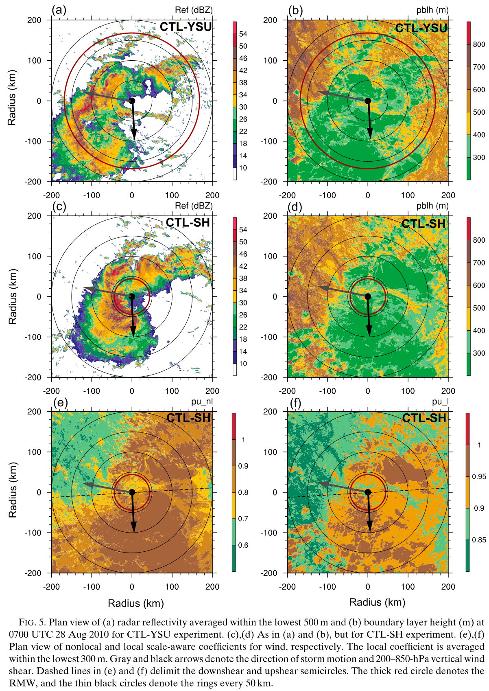
To examine where the scale-aware effect is most signiﬁcant in the TC circulation
the nonlocal and local scale-aware coefﬁcients are smaller in the dry region, indicative of a stronger scale-aware effect
storm motion
Vertical wind shear
Notes:
In both experiments, a convective rainband, which is closely related to vortex tilt (not shown), is located in the front half of the storm relative to the storm motion with a left-of-motion maximum in radar reﬂectivity.
The strongest convection is also located in the downshear-right quadrant, suggesting both the storm motion and deep-layer shear may play a role in determining the precipitation asymmetry at the early stage
Figures 5b and 5d reveal a front-back asymmetry in the boundary layer height
The dry (i.e., nonprecipitation) region ahead of the storm and radially outward of the convective rainband has the maximum boundary layer height. Accordingly, the nonlocal and local scale-aware coefﬁcients are smaller in the dry region, indicative of a stronger scale-aware effect.

Slide 17
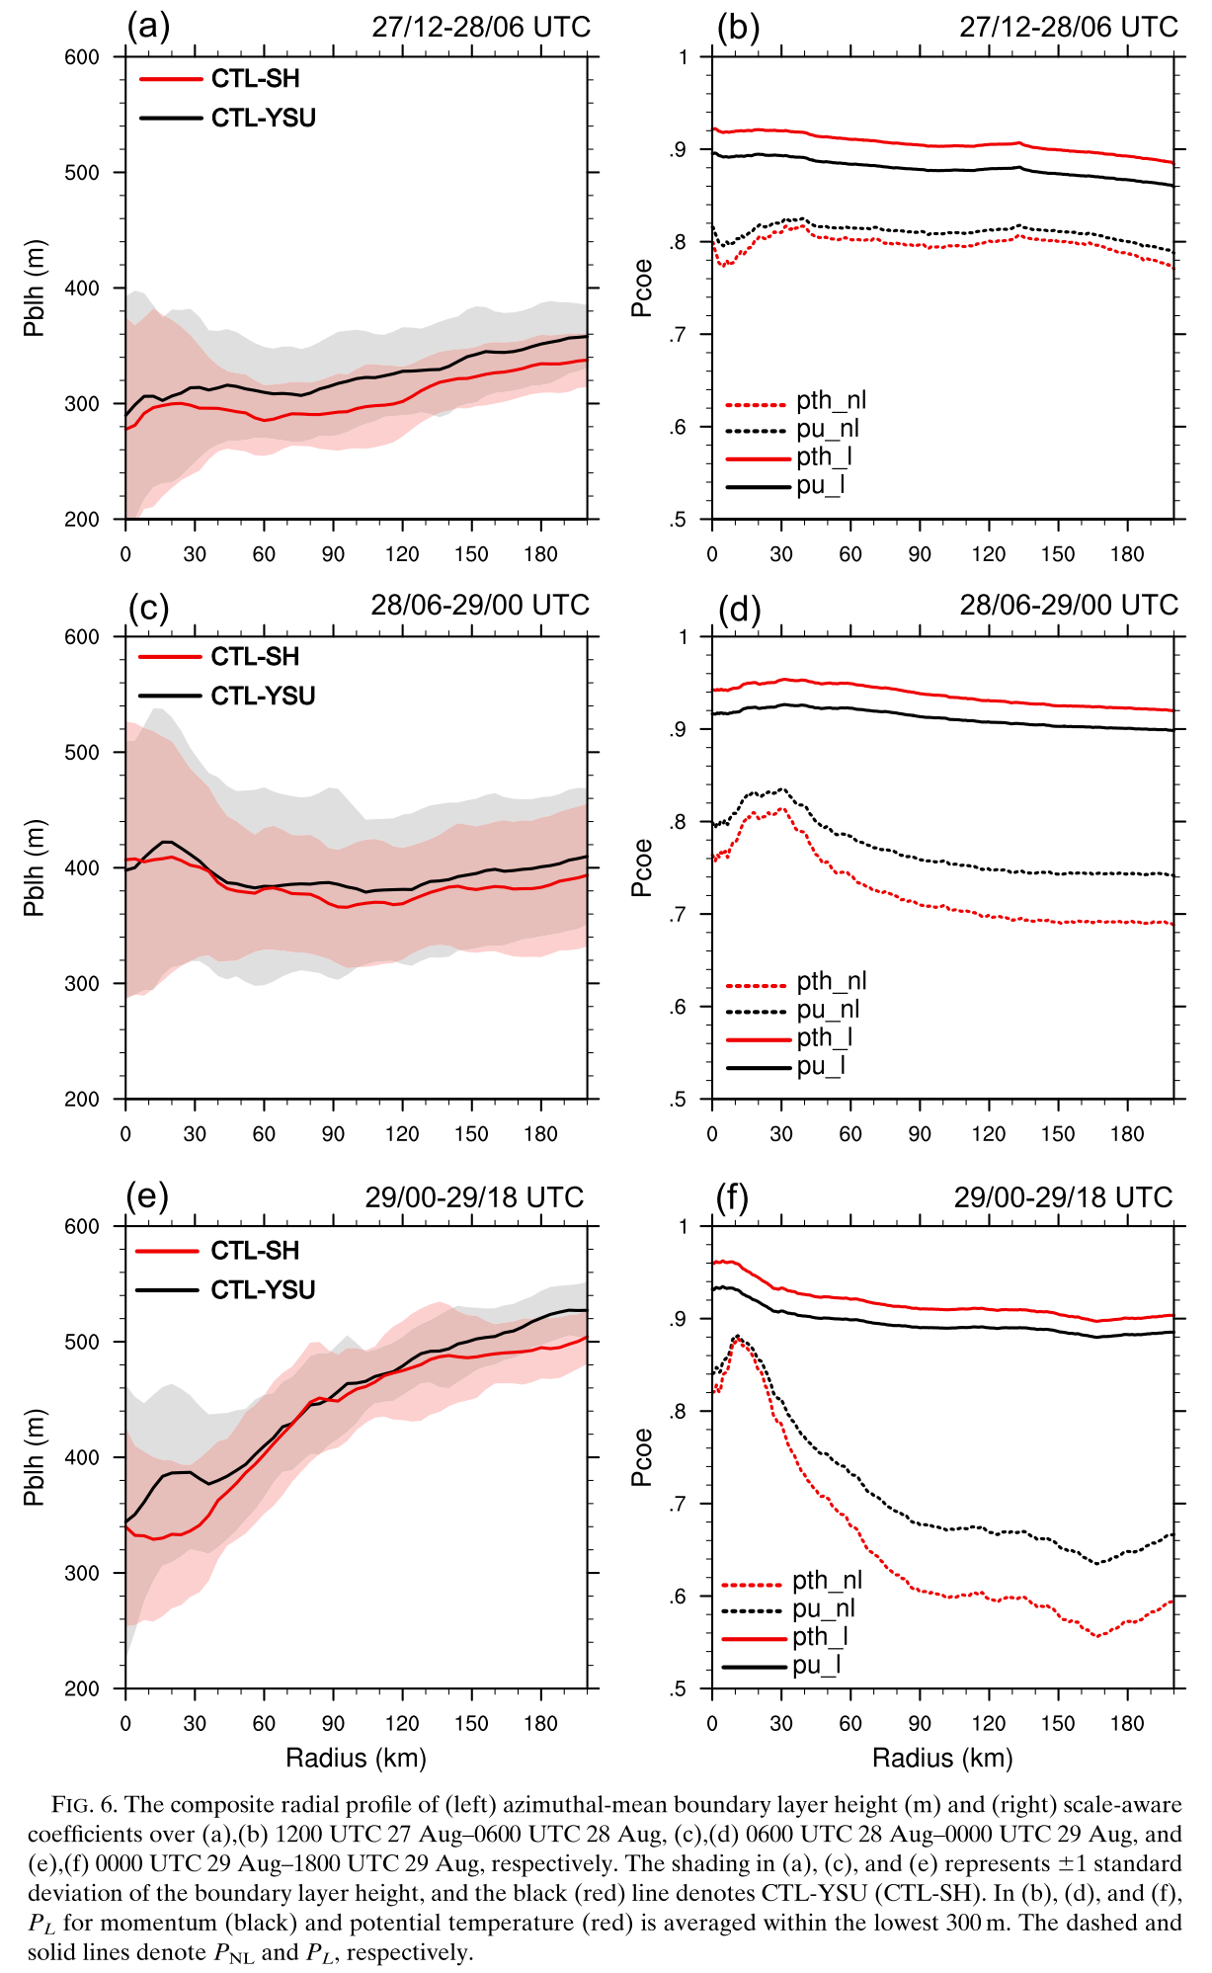
The relationship of boundary layer height and scale-aware coefﬁcients in the TC circulation
Notes:
The mean boundary layer height in CTL-SH is generally shallower than that in CTL-YSU over the three periods.
The boundary layer height increases with radius and correspondingly the scale-aware coefﬁcients decrease with radius.
Over periods 1 and 2 (i.e., from 1200 UTC 27 August to 0000 UTC 29 August), the radial gradient of the boundary layer height is weak within the innermost 120-km radii (Figs. 6a,c).
A strong radial gradient of the boundary layer height builds up over period 3 (i.e., from 0000 UTC 29 August to 1800 UTC 29 August) immediately before RI onset, with lower values of boundary layer height at smaller radii (Fig. 6e).
The sharp radial gradient of boundary layer height implies the effect of strong rotation on the mixed-layer depth or thermodynamic stability.
A strong radial gradient of the scale-aware coefﬁcients also appears over period 3 (Fig. 6f).
The large discrepancy in the azimuthal-mean nonlocal and local coefﬁcients again supports the notion that the scale-aware effect for the nonlocal ﬂuxes is more prominent due to the modulation of the stability function C cs .

Slide 18
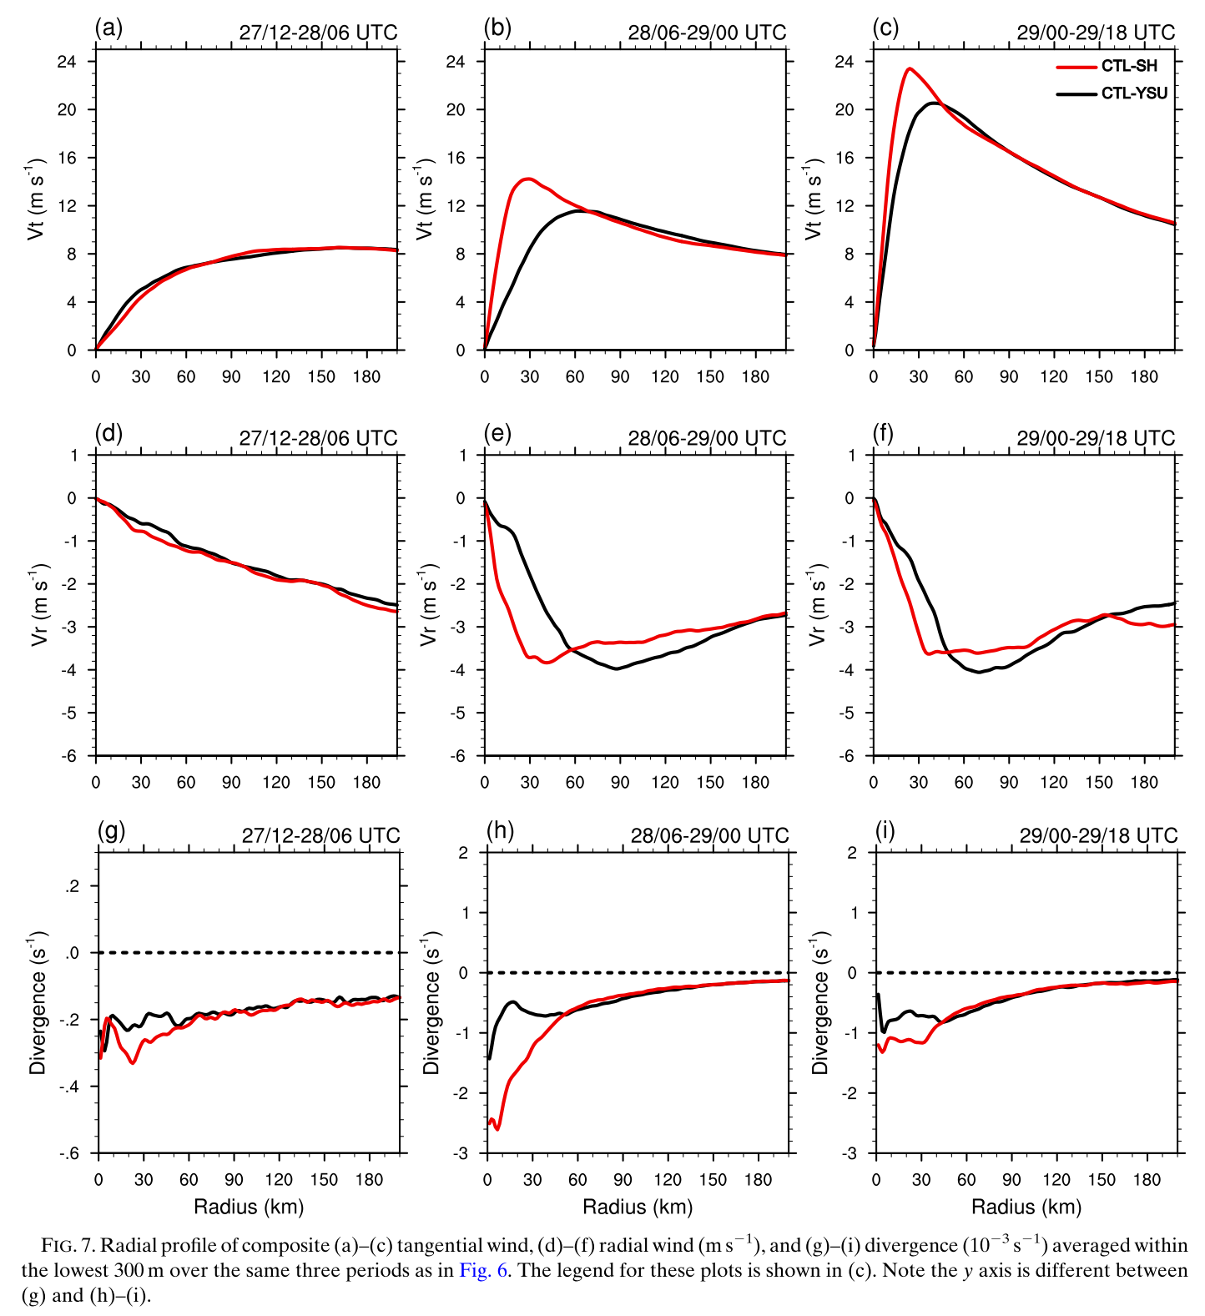
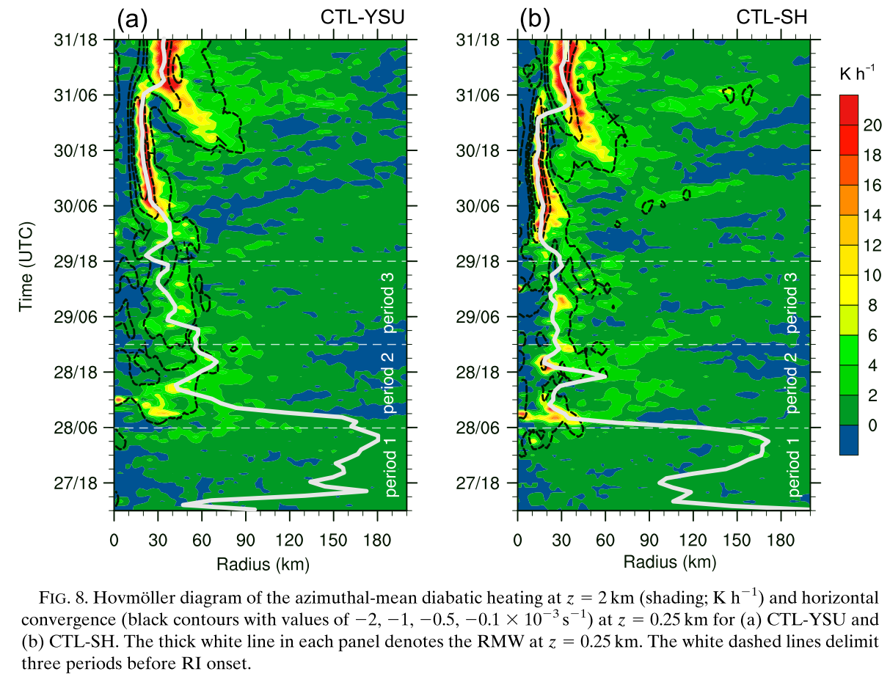
Period 1
Period 2
Period 3
Notes:
In CTL-SH, the tangential wind is slightly weaker and radial wind is slightly stronger within r=50 km (Figs. 7a,d), and the stronger inﬂow corresponds to the stronger convergence therein (Fig. 7g).
The stronger convergence in CTL-SH precedes stronger diabatic heating at 2-km height over period 2 (Fig. 8), indicating the role of boundary layer convergence in initiating the convection therein.
The RMW of the CTL-SH TC contracts inward more rapidly and the tangential wind increases at a higher rate within r=50 km (Fig. 7b) over period 2, which can be explained by a response to the stronger diabatic heating near and inside the RMW according to balanced dynamics
The discrepancy in the magnitude of radial inﬂow (Fig. 7e) and convergence (Fig. 7h) between the two experiments signiﬁcantly increases over period 2. The maximum convergence near the TC center in CTL-SH is nearly 2 times of that in CTL-YSU over period 2.
The averaged diabatic heating near the RMW at 2-km height over period 3 (i.e., 0000 UTC 29 August–1800 UTC 29 August) is smaller than that over period 2 (Fig. 8), and the radial wind and convergence averaged in the lowest 300-m layer in CTL-SH are weaker than that over period 2 (Figs. 7f,i). Nevertheless, the CTL-SH TC still has a smaller inner core and stronger intensity than the CTL-YSU TC over period 3 (Fig. 7c).

Slide 19
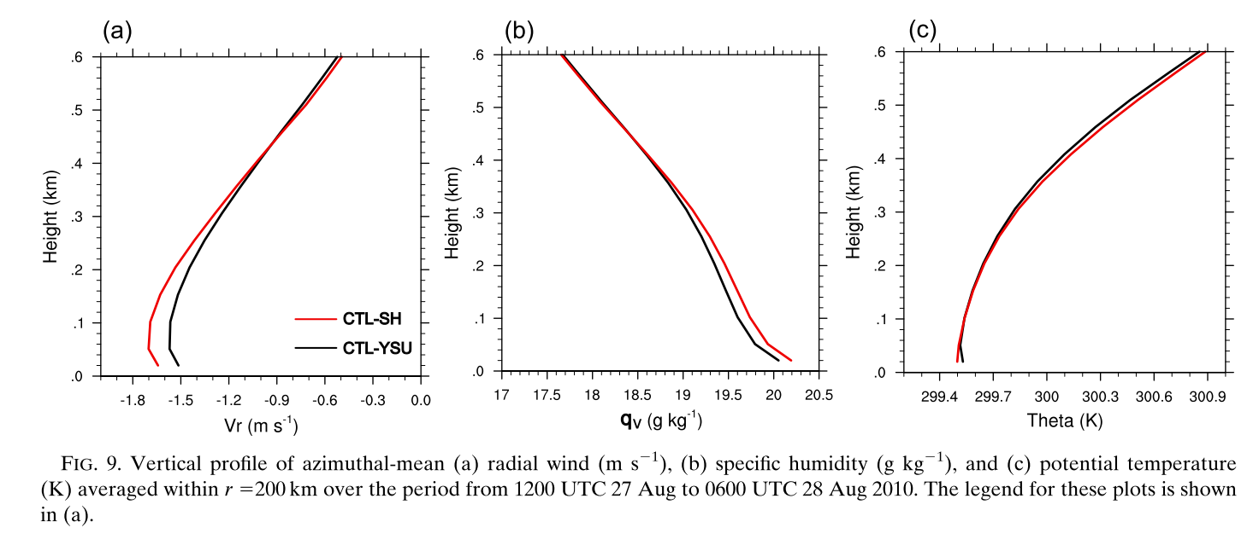
The faster intensiﬁcation rate during the RI period in CTL-SH:
diabatic heating at smaller radii can draw large absolute angular momentum inward to smaller radii and thereby spin up the storm circulation above the boundary layer more effectively than diabatic heating at larger radii (Smith and Montgomery 2016).
Notes:
more water vapor is retained in the boundary layer of the CTL-SH TC (Fig. 9b).
In CTL-SH, the stronger radial inﬂow carries more water vapor inward, inducing stronger horizontal convergence and diabatic heating near the TC center, as seen in Fig. 8b.
The stronger moisture convergence and diabatic heating at smaller radii in CTL-SH beneﬁts a faster contraction of the low-level RMW preceding RI onset (Figs. 4b and 8).
While the low-level RMW in CTL-YSU manages to contract to a similar size as that in CTL-SH at RI onset, the mean RMW of the CTL-SH TC is smaller during the RI (Fig. 4b).
The faster intensiﬁcation rate during the RI period in CTL-SH can be explained by the stronger boundary layer inﬂow and stronger diabatic heating within the more compact inner core based on an existing theory: diabatic heating at smaller radii can draw large absolute angular momentum inward to smaller radii and thereby spin up the storm circulation above the boundary layer more effectively than diabatic heating at larger radii (Smith and Montgomery 2016).

Slide 20
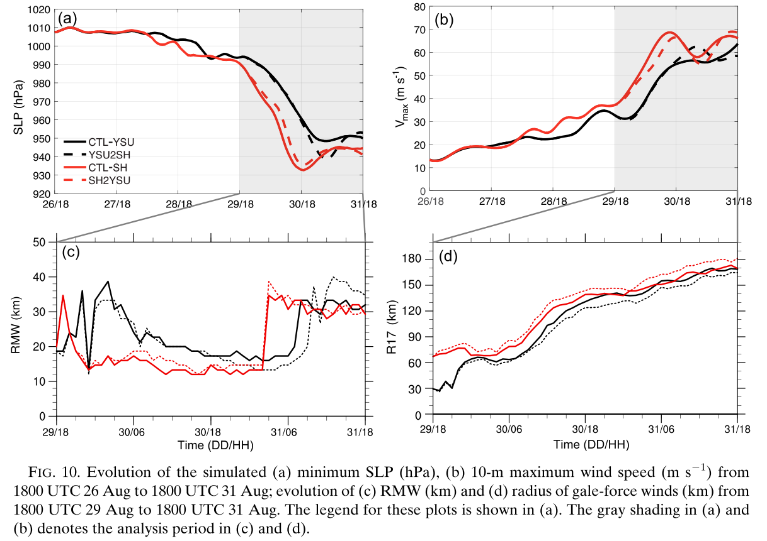
To exclude the effect of the vortex structure and clearly identify the effect of the scale-aware SH scheme in the intensity and structural evolution during the RI period
SH PBL scheme tends to produce a stronger vortex with smaller inner-core size
vortex structure at RI onset is the main controlling factor in the rate of intensiﬁcation
gale-force winds (R17)
Notes:
At RI onset (i.e., 1800 UTC 29 August), the RMW in CTL-SH and CTL-YSU is very similar (Fig. 10c), while the CTL-SH TC has a much larger ( ~40 km) radius of gale-force winds (R17) (Fig. 10d).
The RI period in YSU2SH extends to 0300 UTC 31 August (Fig. 10b), approximately 9 h longer than in CTL-YSU, and maximum 10-m wind is ~10 m/s
Stronger at the end of the RI.
Compared to CTL-YSU, the RMW and R17 in YSU2SH further decrease by ~4 km and ~10 km, respectively, during the RI period (Figs. 10c,d).
In parallel, the comparison between CTL-SH and SH2YSU indicates that the TC intensiﬁcation rate in SH2YSU is slightly reduced (Figs. 10a,b).
The RMW in SH2YSU increases by ~5 km, and the R17 in SH2YSU increases by ~10 km compared to those in CTL-SH during the RI period (Figs. 10c,d).
consistently show that the SH PBL scheme tends to produce a stronger vortex with smaller inner-core size throughout the early stage to the end of RI
However, differences in the TC intensiﬁcation rate by switching the PBL scheme at RI onset is much smaller than those between the two control simulations, suggesting that the vortex structure at RI onset is the main controlling factor in the rate of intensiﬁcation.
the larger radius of gale-force winds in CTL-SH than in CTL-YSU during the RI period is attributed to the differences in the vortex structure at RI onset, while the SH scheme itself tends to produce a smaller R17 if the same vortex structure as in CTL-YSU is provided at RI onset.

Slide 21
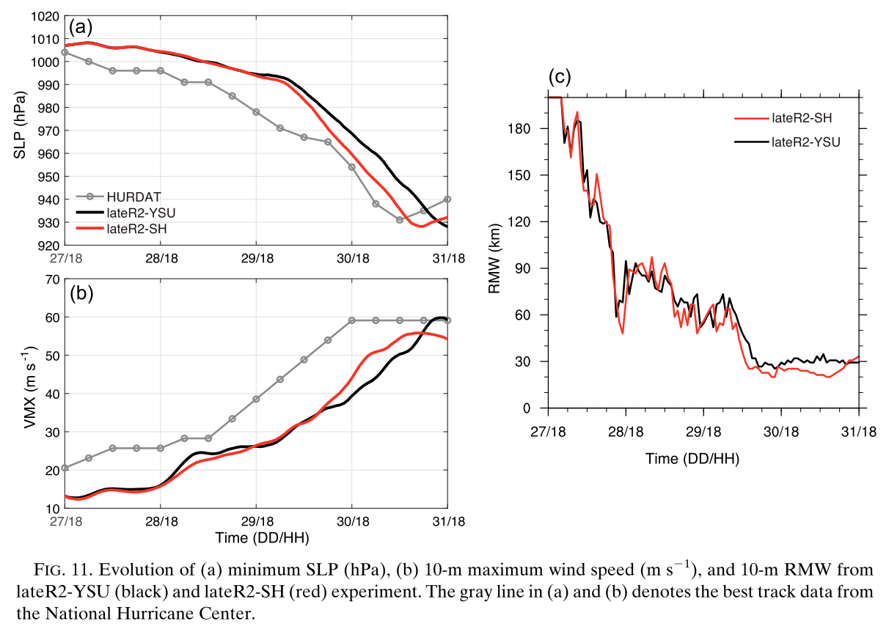
Sensitivity to different start time
The late-R2 experiments exhibit a similar RI onset timing as in CTL experiments.
SH TC has a smaller RMW (Fig. 11c) and exhibits higher intensiﬁcation rate during RI than the YSU TC.
Notes:
The late-R1 experiments do not show a RI until near the end of the simulations and thereby the maximum intensity of the simulated TCs is much
weaker than the best track.
However, at the end of the simulations, the maximum wind of the SH TC is 12 m/s larger than that of the YSU TC and the RMW of the SH TC is also
smaller (not shown). The late-R2 experiments exhibit a similar RI onset timing as in CTL experiments.
Results consistently show that the SH TC has a smaller RMW (Fig. 11c) and exhibits higher intensiﬁcation rate (Figs. 11a,b) during RI (i.e., from 0000 UTC 30 August to 0600 UTC 31 August) than the YSU TC.
After 0900 UTC 31 August, the SH TC undergoes an inner-core process similar to eyewall replacement (not shown) with the RMW expanding and the intensiﬁcation paused.

Slide 22
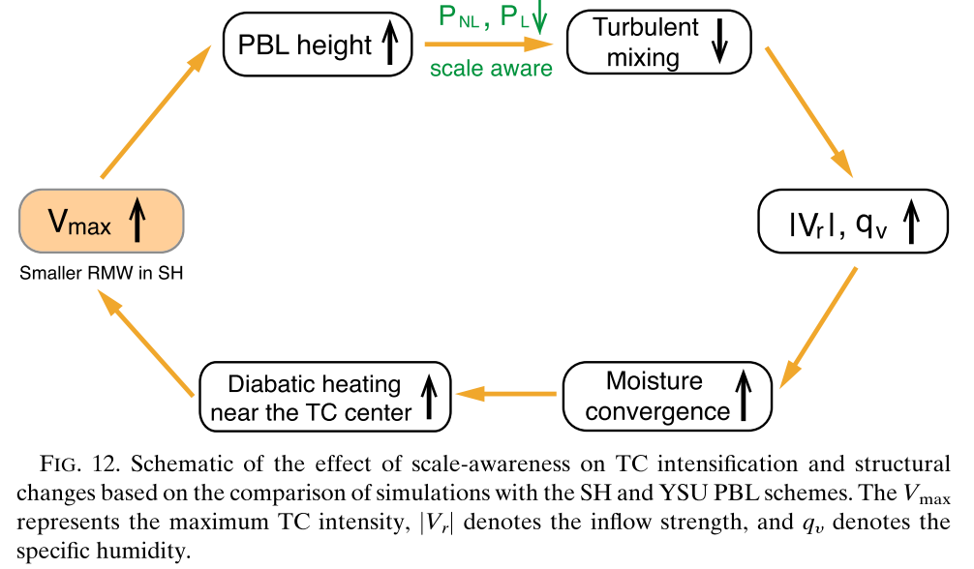
Discussion: Related mechanisms
large absolute angular momentum inward
Notes:
In SH, the response of the scale-aware coefﬁcients to the changing boundary layer height leads to a dynamical adjustment of the vertical diffusivity at different stages of the TC evolution.
The associated weakening in vertical turbulent mixing or increase in frictional deceleration induces stronger boundary layer inﬂows due to the gradient-wind imbalance in the boundary layer.
The stronger radial inﬂows advect larger absolute angular momentum to smaller radii, which facilitates the spinup of tangential winds at smaller radii as well as a more notable RMW contraction in the TC boundary layer.
Meanwhile, the weakened vertical turbulent mixing helps retain more water vapor within the boundary layer.
The resulting stronger moisture convergence and diabatic heating near the TC center also help draw the large absolute angular momentum inward and spin up the TC circulation above the boundary layer more efﬁciently

Slide 23
Suggestions for the improvement of YSU and SH schemes in TC simulations
the vertical viscosity and nonlocal turbulent ﬂuxes in SH was formulated based on the LES of a typical convective boundary layer over land.
the enhancement of scale-aware effect within a speciﬁc range of u*/w* that mimics the effect of convective rolls is another potential issue
whether the mixed-layer depth can represent the top of the boundary layer in hurricane environments is another important issue needing further investigation
Notes:
Several potential issues of using the SH PBL schemes in the TC simulations should be noted.

Slide 24
Conclusions
The essence of the scale-awareness in SH is to reduce the subgrid-scale (SGS) vertical turbulence mixing in the gray zone (more turbulent ﬂuxes can be explicitly resolved at ﬁner horizontal resolutions).
When and where does the scale awareness play an important role?
the early stage to the middle of RI:
The scale-aware effect is most prominent ˗ nonlocal turbulent ﬂuxes are substantially reduced due to the effect of parameterized convective rolls.
In the late RI and subsequent eyewall replacement:
the scale-aware effect dwindles ˗ the rapid increase in the surface frictional velocity during RI such that the large ratio of u*/w*( > 0.65) becomes unfavorable for the ‘‘convective roll formation,’’
scale-aware effect is stronger in the non-precipitation region
maximum boundary layer height
ahead of the storm and radially outward of the convective rainband

Slide 25
The effect of scale-aware PBL scheme on the TC intensity and structural evolution:
The reduced vertical mixing induces stronger radial inﬂows and helps retain more water vapor in the lower boundary layer.
stronger moisture convergence and convective diabatic heating closer to the TC center beneﬁt faster RMW contraction before RI onset and higher intensiﬁcation rates during RI.

Slide 27
ABSTRACT
By performing WRF simulations of Hurricane Earl (2010) at subkilometer grid spacings, this study investigates the effect of the scale-aware Shin–Hong (SH) scheme on the tropical cyclone (TC) intensiﬁcation and structural changes in comparison to the non-scale-aware YSU scheme it is built upon.
SH tends to produce a stronger TC with a more compact inner core than YSU.
At early stages, scale-aware coefﬁcients in SH gradually decrease as the diagnosed boundary layer height exceeds the horizontal grid spacing.
This scale-aware effect is most prominent for nonlocal subgrid-scale vertical turbulent ﬂuxes, in the nonprecipitation regions radially outside of a vortex-tilt-related convective rainband, and from the early stage through the middle of the rapid intensiﬁcation (RI) phase.
Both the scale awareness and different parameterization of the nonlocal turbulent heat ﬂux in SH reduce the parameterized vertical turbulent mixing, which further induces stronger radial inﬂows and helps retain more water vapor in the boundary layer.
The resulting stronger moisture convergence and diabatic heating near the TC center account for a faster inner-core contraction before RI onset and higher intensiﬁcation rates during the RI period.

Slide 29
In addition to the scale-aware effect, the weaker vertical turbulent mixing in CTL-SH is also in part attributed to the slightly lower z i (Fig. 4c), especially before RI onset, since the maximum value of K m is proportional to the z i in the KPP PBL schemes (e.g., Kepert 2012).
The parameterization of nonlocal vertical heat ﬂuxes w*theta NL in the SH scheme that has a maximum at z = 0.075z i as mentioned in section 2, while in the YSU scheme the maximum nonlocal vertical heat ﬂuxes is maximized at z = 0.5z i .
Thus, in the SH scheme, the vertical turbulent mixing of theta near the surface is enhanced while the vertical turbulent mixing of theta in the mid-to upper boundary layer is weakened.
The weakened vertical turbulent mixing in the mid- to upper boundary layer helps account for the slightly larger vertical gradient of theta proﬁle in CTL-SH.
Note that the surface heat ﬂux in the CTL-SH and CTL-YSU experiments over period 1 (not shown) is similar and so is the theta-v excess at the lowest model level that is used to diagnose the boundary layer height [see Eq. (2) in Hong et al. 2006] in YSU and SH.

