Slide 1
Exploring convection-allowing model evaluation strategies for severe local storms using the finite-volume cubed-sphere (FV3) model core.
Gallo, B. T., J. K. Wolff, A. J. Clark, I. Jirak, L. R. Blank, B. Roberts, Y. Wang, C. Zhang, M. Xue, T. Supinie, L. Harris, L. Zhou, and C. Alexander, 2021: Exploring convection-allowing model evaluation strategies for severe local storms using the finite-volume cubed-sphere (FV3) model core. Wea. Forecasting, 36, 3–19.
Notes:
A major point discussed in this work is that subjective choices (i.e., techniques, thresholds, ﬁelds, etc. used) still play a role in objective veriﬁcation.
探討使用FV3高解析度的convection-allowing model模擬劇烈天氣的預報得分

Slide 2
Introduction
Convection-allowing models (CAMs) can be particularly helpful in forecasting severe convective weather, since the small grid spacing ( ~3 km) allows for simulation of storm-scale structures such as supercells (Kain et al. 2006).
Forecasters determine expected convective mode by looking at the reﬂectivity structure of a storm, as well as whether or not the storm is rotating [updraft helicity (UH)].
UH is an integral of the updraft speed and the vertical vorticity taken over a speciﬁed vertical layer.
CAMs output the hourly maximum UH over the 2–5-km layer such that forecasters can determine whether a simulated midlevel mesocyclone is occurring; if the hourly maximum ﬁeld shows a relatively continuous swath of high UH values, the model is likely producing a simulated supercell (Kain et al. 2010).
Notes:
As convective mode plays a key role in determining the convective hazard type (e.g., a linear convective mode is more likely to produce severe winds than severe hail; Smith et al. 2012), forecasters can use CAMs to forecast threat types prior to convective initiation.

Slide 3
this work attempts to provide a multifaceted veriﬁcation (ROC, FSS, Brier score, critical success index) approach to four different deterministic CAMs [three FV3-based models, High-Resolution Rapid Refresh version 3 (HRRRv3)].
The purpose of this work is not only to compare and verify the performance of these speciﬁc CAMs during the spring convective season, but also to demonstrate different veriﬁcation techniques and what can be gleaned from them.

Slide 4
Data and methodology a. Model conﬁgurations
This study examines three CAMs that use the FV3 dynamical core, as well as a CAM that uses the Advanced Research version of WRF (WRF-ARW) dynamical core.
All of these models were run during the 2018 Spring Forecasting Experiment (SFE), which occurred on week-days from 30 April 2018 to 1 June 2018 (excluding Memorial Day), resulting in 24 cases.
The objective metrics were computed for 21 cases where a complete dataset was present for all of the models examined herein (Table 1).

Slide 5
GFDL-FV3:
Geophysical Fluid Dynamics Laboratory
13-km global grid, 3-km nested grid over the CONUS
6-category GFDL scheme (GFDL-6cat; Chen and Lin 2013; Zhou et al. 2019)
NSSL-FV3:
National Severe Storms Laboratory
25-km global grid, 3.3-km grid over the CONUS
Thompson microphysics scheme
CAPS-FV3:
Center for the Analysis and Prediction of Storms
13-km global grid, ~3.5-km nested grid covered the CONUS
Thompson microphysics scheme

Slide 6
Each model was initialized at 0000 UTC, and had forecasts extending to 36 h.
FV3-based conﬁgurations were cold start (i.e., no hydrometeors in the initial conditions).
the HRRRv3 uses grid point statistical interpolation (GSI; Wu et al. 2002; Kleist et al. 2009) hybrid data assimilation, including the latest 3D radar reﬂectivity.
The HRRRv3 data assimilation includes conventional observations, as well as Tropospheric Airborne Meteorological Data Reporting (TAMDAR; Daniels et al. 2006) aircraft observations, and lightning ﬂash rates (Benjamin et al. 2016).
Initial conditions come from the Rapid Refresh (RAP; Alexander et al. 2017), and the lateral boundary conditions come from GFS forecasts (GFSf).
Notes:
All model conﬁgurations had horizontal grid spacing of ~3 km over a CONUS domain (Table 2).
Each model was initialized at 0000 UTC, and had forecasts extending to 36 h.
FV3-based conﬁgurations were cold start (i.e., no hydrometeors in the initial conditions).
Conversely, the HRRRv3 (which became operational on 12 July 2018) uses grid point statistical interpolation (GSI; Wu et al. 2002; Kleist et al. 2009) hybrid data assimilation, including the latest 3D radar reﬂectivity.
The HRRRv3 data assimilation includes conventional observations, as well as Tropospheric Airborne Meteorological Data Reporting (TAMDAR; Daniels et al. 2006) aircraft observations, and lightning ﬂash rates (Benjamin et al. 2016).
Initial conditions come from the Rapid Refresh (RAP; Alexander et al. 2017), and the lateral boundary conditions come from GFS forecasts (GFSf).

Slide 7
Surrogate severe fields:
the native 2–5-km UH output from each model is ﬁrst regridded to an 80-km grid
maximum 2–5-km UH
the UH value at each grid point is tested to determine whether or not it exceeds a user-deﬁned UH threshold, resulting in a binary grid of ones (did exceed the threshold) and zeroes (did not exceed the threshold).
A smoother using a Gaussian kernel density weighting function is then applied to each point to create a smoothed probability ﬁeld.
Two tunable parameters exist in the surrogate severe ﬁelds: the UH exceedance threshold and the $σ$ used in the Gaussian kernel density smoother.
Notes:
To generate surrogate severe ﬁelds spanning the convective day (deﬁned as 1200–1200 UTC the following day), the native 2–5-km UH output from each model is ﬁrst regridded to an 80-km grid (speciﬁcally, the NCEP 211 grid).
The maximum 2–5-km UH value during the convective day and within each 80-km gridbox is assigned to the grid box (i.e., a neighborhood maximum during a 24-h period).
During the 2017 SFE, it was found that the FV3-based CAMs generally produced higher UH values than CAMs using the WRF-ARW dynamical core when using the same horizontal grid spacing (Potvin et al. 2019).
To account for different model climatologies, UH thresholds used to construct the surrogate severe ﬁelds were based on percentile values of the UH from each model rather than from ﬁxed thresholds.
Percentiles used to generate the surrogate severe ﬁelds range from the 70th percentile to the 99.7th percentile, in increments of 0.3, and sigma values range from 40 to 300 km in increments of 5 km.

Slide 8
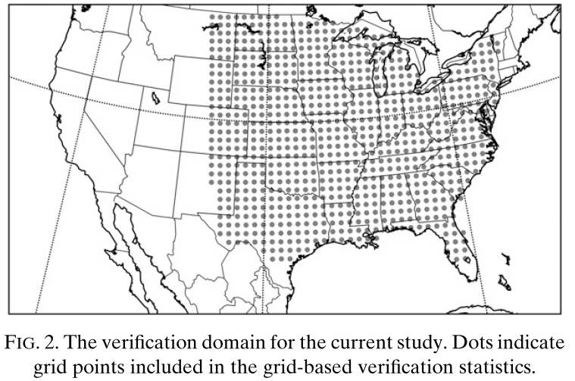
c. Veriﬁcation data and metrics
Veriﬁcation was performed across the eastern 2/3 of the CONUS (to mitigate the effect of having many zero values of UH or other storm attributes)
Surrogate severe ﬁelds were veriﬁed using local storm reports (LSRs), regridded to the same NCEP 211 80-km grid.
Multi-Radar Multi-Sensor (MRMS; Smith et al. 2016) composite reﬂectivity data were used to verify the simulated composite reﬂectivity at the top of each forecast hour.
Verification metrics: relative operating characteristics (ROC), fractions skill score (FSS), brier score (BS), critical success index (CSI)
Notes:
Multi-Radar Multi-Sensor (MRMS; Smith et al. 2016) composite reﬂectivity data were used to verify the simulated composite reﬂectivity at the top of each forecast hour.
All three types of LSRs (hail, wind, and tornadoes) were included in the regridding, as 2–5-km UH has been shown to be a good proxy for all convective hazard types (Sobashet al. 2011).

Slide 9
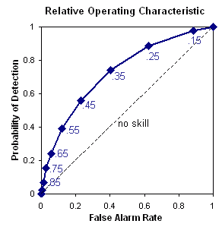
ROC (relative operating characteristics)
 |  | OBS
 |  | T | F
forecast | T | TP | FP
 | F | FN | TN
Hit rate
$$hit rate=\frac{TP}{TP+FN}$$
$$false alarm rate=\frac{FP}{FP+TN}$$
ROC area: The area under the ROC curve
from website: https://www.cawcr.gov.au/projects/verification/verif_web_page.html
Notes:
A ROC area of 1 indicates a perfect forecast, and a ROC area at or below 0.5 has no skill

Slide 10
FSS(fractions skill score )
$FSS=1−\frac{\frac{1}{N}\sum_{i}{\sum_{j}{{\left[F_{0}\left(i,j\right)−F_{m}\left(i,j\right)\right]}^{2}}}}{\frac{1}{N}\sum_{i}{\sum_{j}{\left[{F_{0}\left(i,j\right)}^{2}+{F_{m}\left(i,j\right)}^{2}\right]}} }$
o: observation
m: model
Threshold: 70th percentile of UH
3X3 gird box, F = 4
0 | 1 | 0
0 | 0 | 1
1 | 1 | 0
Reference: Roberts NM, Lean HW. 2008. Scale‐selective verification of rainfall accumulations from high‐resolution forecasts of convective events. Mon. Weather Rev. 136: 78–97.

Slide 11
$\text{Brier} \text{score} (BS)=\frac{1}{N}\sum_{t=1}^{N}{{(f_{t}^{}−O_{t}^{})}^{2}}$
a value of 0 is a perfect score and indicates a perfectly reliable forecast.
critical success index (CSI)

Slide 12
Notes:
The FV3-based models have similar UH climatologies on the 80-km grid until very high percentile values ( ; 95th percentile and above), while at the native resolution the differences between FV3-based models get smaller as the percentile increases.
In all cases, the differences between the FV3-based models and the HRRRv3 is much larger than the differences among the FV3-based models.
The differences in UH climatology reﬂect the need for comparing FV3-based models and WRF-ARW-based models using UH percentiles, rather than ﬁxed UH thresholds.
Simulated reﬂectivity was analyzed using object-based veriﬁcation at three thresholds: 20, 30, and 45 dBZ.
While two of these thresholds are relatively low for identifying convective storms, higher thresholds became quite noisy and patterns in the data were difﬁcult to discern.
Therefore, we only include one higher threshold, 45 dBZ.
A climatology of simulated reﬂectivity values on each model’s native grid was also generated across the cases within the 2018 SFE, using the maximum value across the day at each grid point to examine the magnitude of the strongest convection (Fig. 1b).
The 45-dBZ threshold is approximately the 95th percentile for each model, although it is a higher percentile for the HRRRv3 than the FV3-based models, indicating that higher reﬂectivity values make up a larger part of the distribution in the FV3-based models compared to in the HRRRv3.
The reﬂectivity climatology shows smaller intramodel differences than the UH climatologies throughout most of the distribution, although the HRRRv3 has a smoother distribution (Fig. 1b).
The FV3-based models have higher reﬂectivities at most of the larger percentiles, starting at about the 90th percentile.

Slide 13
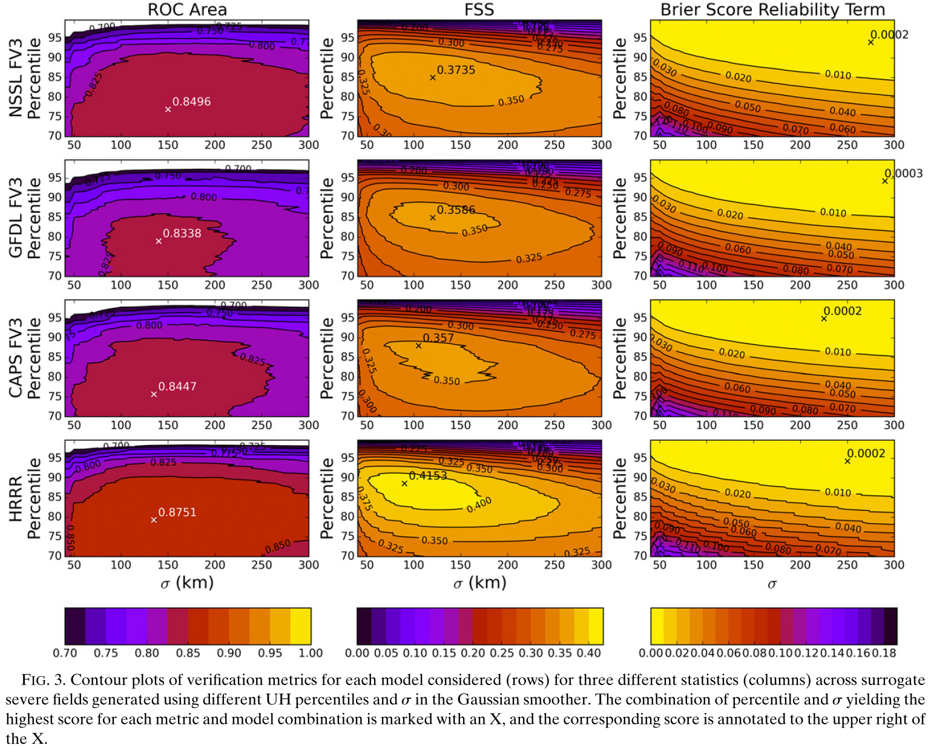
Notes:
In terms of ROC area and FSS, the HRRRv3 outperformed all three FV3-based models with a large swath of the UH percentile/ sigma space having higher values than the corresponding space in the FV3-based models.
Optimal smoothing levels (as indicated by s ) for the ROC area performance was similar between all four models examined, with the NSSL-FV3 achieving its highest ROC area at a slightly larger sigma than the other three models.
However, the HRRRv3 and the NSSL-FV3 had larger parameter space areas of higher ROC area than the CAPS-FV3 or the GFDL-FV3.
The ROC area is clearly more a function of UH percentile than of sigma, showing the importance of POD in the rare event scenario to the calculation of the ROC area
A similar pattern emerges with the FSS results, although the FSS shows more sensitivity to sigma than the ROC area does, and is optimized at lower sigma values than the ROC area
the HRRRv3 requires much less smoothing than the FV3-based models to achieve its highest FSS ( sigma=90 km).
Lower smoothing values preserve information provided by the model regarding which areas are most at risk, as smoothing lowers the maximum probability value and distributes the probability over a larger area.
So, the less smoothing required to achieve the maximum score, the more useful the original information from the model.
Of the FV3-based models, the CAPS-FV3 requires the least smoothing to achieve its highest score ( sigma~105 km).
The NSSL-FV3 scores highest of the FV3-based models in FSS, but alongside the GFDL-FV3 requires the most smoothing to maximize FSS ( sigma=120 km).
However, the HRRRv3 has FSS scores better than the best FV3-based model score (0.3735) across a wide variety of percentile and sigma variations.
The minimum reliability component of the Brier score (Fig. 3) was extremely similar between models, indicating that a highly smoothed ﬁeld generated using a high UH threshold achieved the best results for all four models.

Slide 14
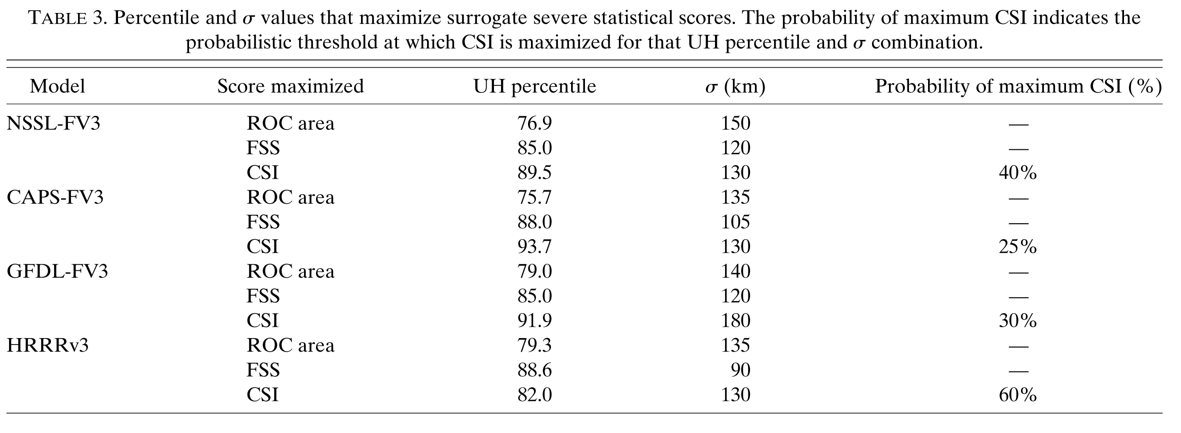

Slide 15
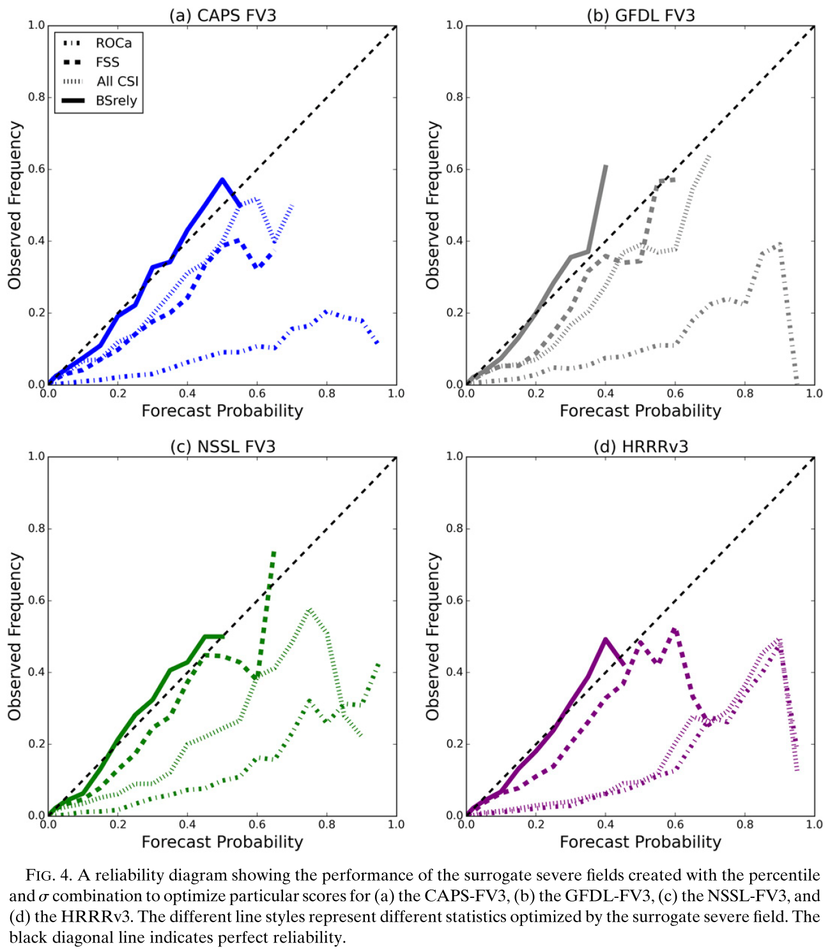
Notes:
The reliability diagram for the surrogate severe ﬁelds generated using the optimal combinations of UH percentile and s for each model show the high reliability of the smoothed ﬁelds that give the minimum BS rely (Figs. 4a–d).
However, these probabilities never get higher than 40%–55% due to the large amount of smoothing.
The reliability diagram also shows the large overforecasting that goes along with maximizing ROC area, with overforecasting occurring at all probability levels for each of the models examined.
The ﬁelds maximizing the FSS overforecast slightly, but fall much closer to the line of perfect reliability than the ﬁelds optimizing the ROC area.
Optimizing the CSI (calculated at each potential probability threshold) led to more overforecasting than optimizing the FSS for the HRRRv3 and NSSL-FV3, but similar reliability for the GFDL-FV3 and CAPS-FV3 (Fig. 4a) between the two optimized ﬁelds.
The CAPS-FV3 (Fig. 4a) and GFDL-FV3 (Fig. 4b) tended to have similar reliability when optimizing FSS and CSI, whereas the reliability of the HRRRv3 ﬁeld that optimized CSI was more similar to the ﬁeld that optimized the ROC area.
The reliability of the NSSL-FV3 (Fig. 4c) optimized by CSI was in between the optimized FSS and optimized ROC area ﬁelds.

Slide 16
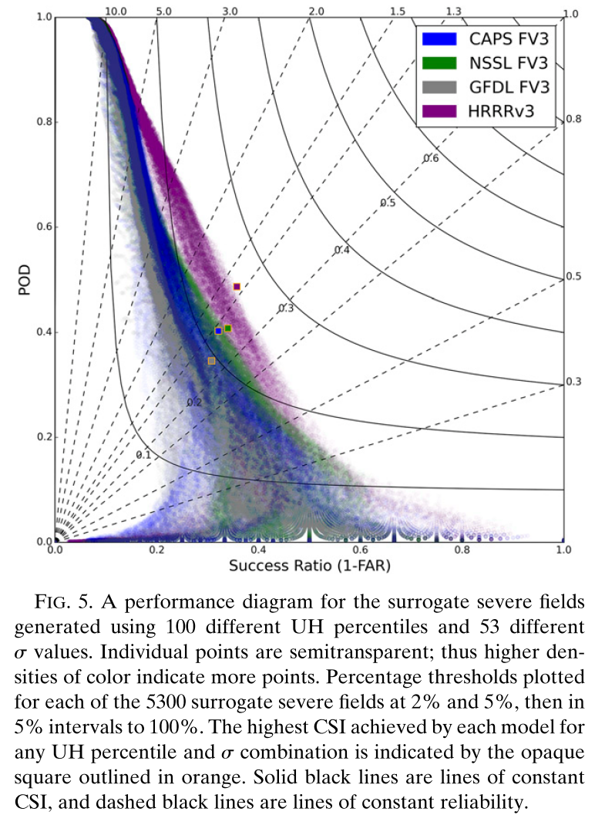
Notes:
The HRRRv3 consistently has higher PODs and success ratios than any of the FV3-based runs, particularly where bias is between 5.0 and 0.5.
Probabilities maximizing CSI in all of the FV3 models had a bias closer to 1 than the probability maximizing the CSI of the HRRRv3.
While the overall performance of the HRRRv3 is consistently better according to

Slide 17
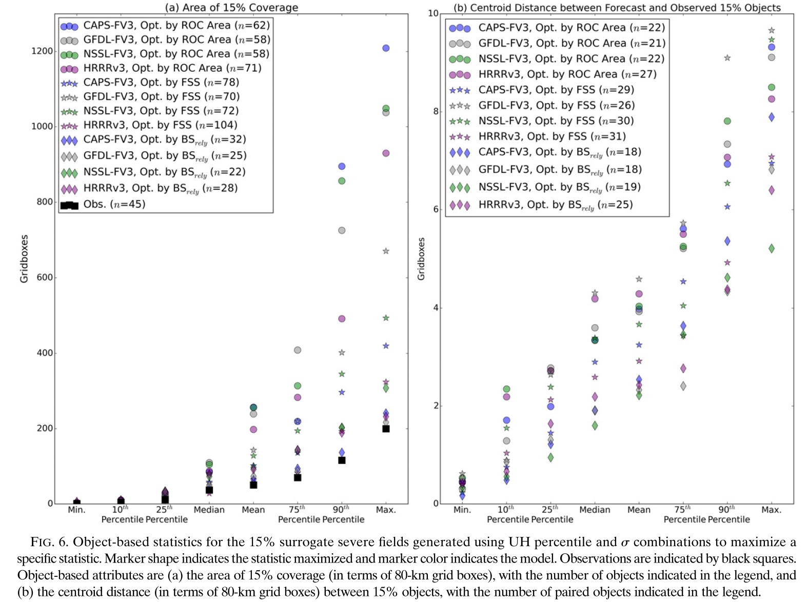
c. Object-based results
Object-based veriﬁcation was performed using Method for Object-Based Diagnostic Evaluation (MODE；Davis et al. 2006, 2009)
Notes:
The mean, 75th, 90th, and maximum area generated by the models was larger than the observations in all cases (Fig. 6a), suggesting that the areas are
generally too large
While the lower end of the distribution—the smaller areas—compare relatively well to the observations, the distribution of the model ﬁelds is overall shifted toward higher values compared to the observation distributions.
Maximizing the reliability generally resulted in areas closest to the observations because the increased smoothing decreased the amount of area covered by the 15%.
The FV3-based models also tended toward larger 15% areas compared to the HRRRv3 at the higher ends of the distribution.
In terms of numbers of 15% objects, maximizing by the FSS and ROC area resulted in too many areas relative to the number of observed 15% areas (n = 45
In comparing the models, the FV3-based models produced fewer 15% areas than the HRRRv3.
Optimizing by the reliability component of the Brier score created too few areas compared to observations.
Optimizing by the reliability component of the Brier score created the smallest differences between areas throughout the distribution of differences, but also the smallest number of matched pairs for a given ensemble.
Maximizing by the ROC area generally created the largest differences for all models except the GFDL-FV3, and optimizing by FSS yielded the highest amount of matched objects for all given models. Within each optimized statistic, the HRRR produced more matched pairs than the FV3-based models, although this difference was much narrower for the FSS than for the other metrics.

Slide 18
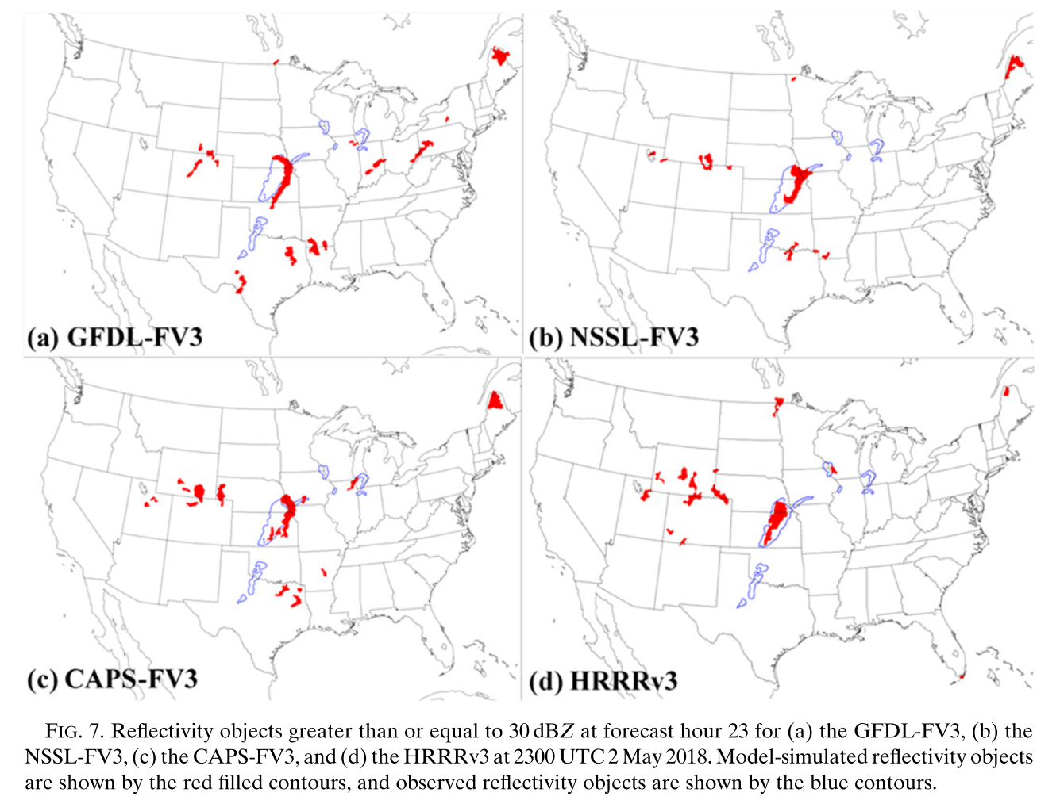
Notes:
reﬂectivity objects allow for examination of ﬁner temporal scales (i.e., hourly) and of the evolution of convective systems throughout the day.
Reﬂectivity objects greater than or equal to 30 dBZ from 2 May 2018 show how the HRRRv3 (Fig. 7d) captured the extent of the system across Kansas and Nebraska better than any of the FV3-based models (Figs. 7a–c), but also produced more areas of false alarm across Colorado and Wyoming.
Additionally, the storms in Oklahoma and Texas were not captured well by any of the models, although the FV3-based models at least had reﬂectivity objects near the Texas and Oklahoma border.

Slide 19
Notes:
Aggregating across the SFE 2018 cases, at the peak of the diurnal cycle the FV3-based models improve on the overall number of objects compared to the HRRRv3 at the 20- and 30-dBZ thresholds throughout the diurnal cycle.
At the 20-dBZ threshold, all models overpredict the number of reﬂectivity objects (Fig. 8a), with the HRRRv3 and the GFDL-FV3 having the largest overprediction at the peak of the diurnal cycle, around forecast hours 21–25.
For most of the time, the NSSL-FV3 is the closest to MRMS observations, although it does not maintain enough objects after the peak convective cycle.
Similar patterns hold for the 30-dBZ threshold (Fig. 8b), although the GFDL-FV3 at this threshold is more similar to the other FV3-based models than it is to the HRRRv3 during the peak of the convective cycle.
The peak of the convective cycle for the GFDL-FV3 is also shifted earlier than in the observations.
The CAPS-FV3 overpredicts the number of objects for most forecast hours up to hour 25.
The NSSL-FV3 initially has too many objects at early forecast hours, but does not have enough objects at the peak of the convective cycle and continues this underprediction through the end of the analyzed run time.
At the highest reﬂectivity threshold (45 dBZ), the HRRRv3 does much better than the other models, generating roughly the same number of objects as reality.
All FV3-based models at the 45-dBZ threshold overpredict the number of objects, particularly early in the forecast cycle (e.g., forecast hours 2–12), perhaps indicating too intense of reﬂectivity values being produced by nonconvective storms.
Additionally, the data assimilation used by the HRRRv3 likely contributes to the more realistic number of storms, since the FV3-based models are ‘‘cold start.’’ Early overprediction could occur in this scenario
There is only slight overprediction by the FV3-based models in forecast hours 13–19, but then the overprediction is ampliﬁed again during forecast hours 21–36: the peak time for severe convection in the diurnal cycle.
At this point in the forecast cycle, spinup issues from cold-start initialization are not expected.
Therefore, for convective reﬂectivity objects, the HRRRv3 is still performing better than the FV3-based models.
One potential concern with reﬂectivity objects is that a model with more small-scale detail may produce more but smaller continuous regions over a certain threshold, which may help explain the behavior of the FV3-based models.

Slide 20
Notes:
The area statistics are more similar to observations than the object count statistics.
Therefore, since the models were generally overforecasting the number of objects, the storms produced by the models would necessarily be smaller than the observed storms for most individual storms.
All models underforecast the area of 20-dBZ objects from forecast hours 19–30 (Fig. 9a), covering the peak convective coverage of the day.
The HRRRv3 has the smallest ﬂuctuation in area covered over the course of the day, relative to the rest of the models.
At higher reﬂectivity thresholds, differences between the models and the observations lessen.

Slide 21
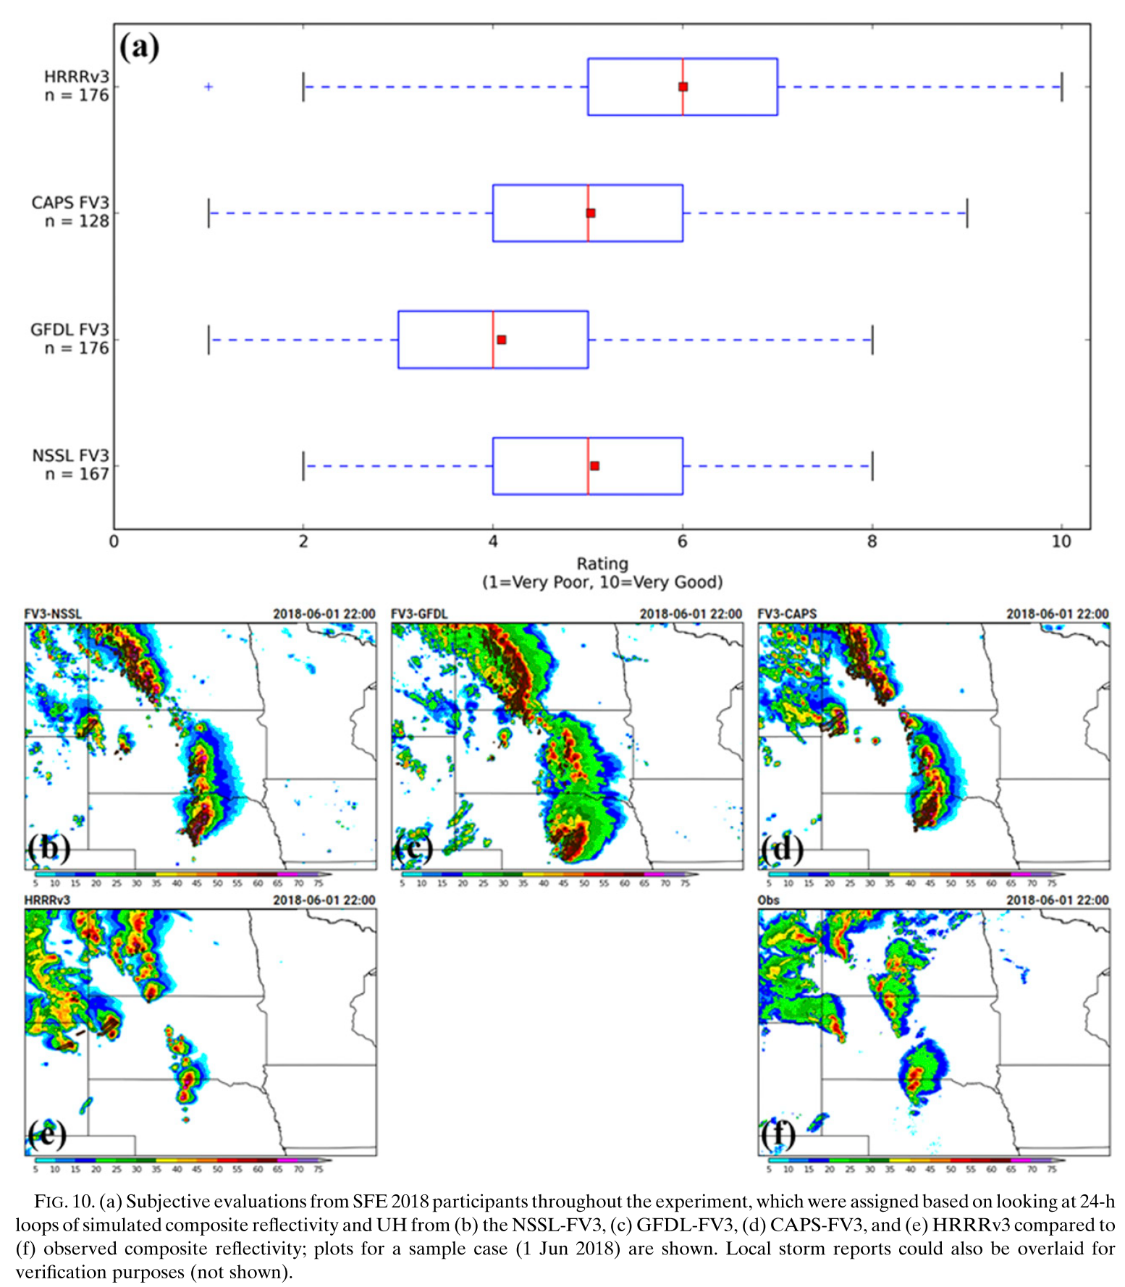
d. Subjective analyses
subjective evaluation by participants in the 2018 SFE took place via a survey, which asked them to rate forecasts of simulated composite reﬂectivity overlaid with 2–5-km UH greater than 75 m²s⁻² from each model on a scale from 1 (very poor) to 10 (very good).
Notes:
Participant ratings of the models showed a similar pattern to the contingency table–based metrics of the surrogate severe ﬁelds, with the HRRRv3 ratings distribution having the highest median score (6/10; Fig. 10a).
The CAPS-FV3 and NSSL-FV3 were often rated similarly, and the GFDL-FV3 was typically rated lowest of the four models in question.
Participant comments often focused on overforecasting the coverage and intensity of convective storms compared to the observations.
Overforecasting was an issue common to all of the FV3-based models (Figs. 10b–d), but participant comments most often mentioned the GFDL-FV3 (Fig. 10c).
This overforecasting likely led to a lower subjective score for the GFDL-FV3 compared to the other FV3-based models.
Subjective scores help us understand how forecasters and other end-users of the model output interrogate the model output, which can help target areas for improvement that could be less evident from the bulk statistics.
For example, the rapid and intense upscale growth mentioned by participants in their survey responses may also inﬂuence objective veriﬁcation metrics, giving model developers a mechanism to investigate when trying to improve the overall objective veriﬁcation statistics.

Slide 22
e. Illustration of methods: 30 May 2018
Notes:
Maximizing the ROC area (Fig. 11a) results in broad swaths of high probability and an abundance of false alarm area.
While all of the reports fall within areas of probability >5%, the forecaster would be hard-pressed from this depiction to determine which area of the CONUS is most at threat for severe weather.
Optimizing by FSS maintains low probabilities across much of the CONUS, but decreases probabilities in the eastern part of the domain, where less observed severe weather occurred.
However, a relative maximum remains in the south-east, shifted just east of where the reports occurred.
High probability areas across the Oklahoma and Texas panhandles are also maintained.
This area, which was the area of focus during the SFE that day and thus had the highest anticipated threat for severe weather, maintains high probabilities when optimizing by either the ROC area or the FSS.
Finally, optimizing by the reliability component of the Brier score (Fig. 11c) leads to large swaths of relatively low probability across the southern Plains and the northern Rockies, completely eliminating the area across the southeast and the area with many reports in the Midwest.
While the area of most concentrated reports is encompassed within the area of highest probability, the probability is only between 15% and 30% and lacks speciﬁcity compared to the other optimization methods, covering all of Oklahoma, half of Kansas, and all of the Texas Panhandle.

Slide 23
Conclusions
The NSSL-FV3 and CAPS-FV3 create more realistic diurnal cycles of numbers of storms at lower reﬂectivity thresholds than the current operational HRRRv3, although those storms may be smaller than the storms in the observed MRMS dataset.
The surrogate severe ﬁeld areas tended to be larger than corresponding areas of practically perfect probability generated using LSRs.
Contingency table–based veriﬁcation metrics show that the FV3-based models still need work to achieve the bulk statistical skill of the HRRRv3
Objective veriﬁcation scores such as the POD, success ratio, FSS, and ROC area mirrored the subjective evaluations carried out by participants in showing the HRRRv3 scoring best, followed in order by the NSSL-FV3 and CAPS-FV3, with the GFDL-FV3 generally scoring the lowest.
Notes:
This work examined numerical weather prediction forecasts made as part of NOAA’s Hazardous Weather Testbed SFE in 2018, including three experimental convection-allowing models using the FV3 dynamical core.
Since FV3 will serve as the dynamical core of the U.S. Uniﬁed Forecast System, evaluating its performance for forecasting severe convection is critical.
The NSSL-FV3 and CAPS-FV3 create more realistic diurnal cycles of numbers of storms at lower reﬂectivity thresholds than the current operational HRRRv3, although those storms may be smaller than the storms in the observed MRMS dataset.
However, work remains to improve the performance of the FV3-based systems at the higher reﬂectivity thresholds that are more indicative of convective processes.
The surrogate severe ﬁeld areas also tended to be larger than corresponding areas of practically perfect probability generated using LSRs.
Contingency table–based veriﬁcation metrics, however, show that the FV3-based models still need work to achieve the bulk statistical skill of the RRRv3.
Even when testing surrogate severe ﬁelds generated using a variety of UH percentiles and sigma values, the highest scores achieved by FV3-based models were lower than those produced by the HRRRv3.
Objective veriﬁcation scores such as the POD, success ratio, FSS, and ROC area mirrored the subjective evaluations carried out by participants in showing the HRRRv3 scoring best, followed in order by the NSSL-FV3 and CAPS-FV3, with the GFDL-FV3 generally scoring the lowest.
While reﬂectivity climatologies were similar between all of the models, the UH of FV3-based systems tended to contain much higher values than those of the HRRRv3.
This work also demonstrates the impact of a critical facet of designing veriﬁcation of any system destined for widespread adaptation: score selection. Computing the surrogate severe ﬁelds based on what metric was maximized resulted in drastically different forecasts.
Integrating subjective evaluation may help make the decision of what score to maximize, but it may be that the tradeoffs made to optimize a
given metric could degrade other aspects of the forecast to the extent that the forecast is no longer useful.
For example, optimizing based on ROC area leads to large overforecasting, but optimizing based on the reliability component of the Brier score leads to broad swaths of relatively low probability and a decrease in sharpness of the forecasts.
Future work will examine how to best compute surrogate severe ﬁelds, and whether it is possible to design an optimized metric that combines aspects of multiple veriﬁcation scores in such a way that minimizes tradeoffs between important forecast aspects and matches subjective end-user impressions.

Slide 24
This work demonstrates the impact of a critical facet of designing veriﬁcation of any system destined for widespread adaptation: score selection.
Future work will examine how to best compute surrogate severe ﬁelds, and whether it is possible to design an optimized metric that combines aspects of multiple veriﬁcation scores in such a way that minimizes tradeoffs between important forecast aspects and matches subjective end-user impressions.
Notes:
While reﬂectivity climatologies were similar between all of the models, the UH of FV3-based systems tended to contain much higher values than those of the HRRRv3.
This work also demonstrates the impact of a critical facet of designing veriﬁcation of any system destined for widespread adaptation: score selection. Computing the surrogate severe ﬁelds based on what metric was maximized resulted in drastically different forecasts.
Integrating subjective evaluation may help make the decision of what score to maximize, but it may be that the tradeoffs made to optimize a
given metric could degrade other aspects of the forecast to the extent that the forecast is no longer useful.
For example, optimizing based on ROC area leads to large overforecasting, but optimizing based on the reliability component of the Brier score leads to broad swaths of relatively low probability and a decrease in sharpness of the forecasts.
Future work will examine how to best compute surrogate severe ﬁelds, and whether it is possible to design an optimized metric that combines aspects of multiple veriﬁcation scores in such a way that minimizes tradeoffs between important forecast aspects and matches subjective end-user impressions.

