Slide 1
Mesoscale Processes during the Genesis of Hurricane Karl (2010)
Paper review
mainly refer to
Michael M. Bell and Michael T. Montgomery
Wei-Ting Fang
2021.06.01
Other reference:
Lin, K. J., S. C. Yang, and S. S. Chen, 2018: Reducing TC position uncertainty in an ensemble data assimilation and rediction system: A case study of Typhoon Fanapi (2010). Wea. Forecasting, 33, 561–582.

Slide 2
Outline
Introduction
Data and methodology
PREDICT analysis
Time series analysis
Meso-α- and meso-β-scale structure
Convective and stratiform contributions to genesis
Circulation dynamics on the meso-α scale
Discussion and conclusions

Slide 3
Introduction(1/2)
An understanding of tropical storm formation requires insight into processes occurring at multiple spatial and temporal scales.
A synoptic-scale tropical wave can provide a protective environment and background vorticity for a predepression, but does not guarantee that the predepression will intensify into a strong tropical cyclone (Frank 1970; Dunkerton et al. 2009, hereafter DMW09).
A new model for cyclogenesis in tropical waves developed by DMW09 describes a recirculation region within the critical layer of the parent wave where air tends to be repeatedly moistened by cumulus convection, protected to some degree from lateral intrusion of dry air and deformation by horizontal or vertical shear, and able to keep pace with the parent wave until the dominant vortex has strengthened into a self-maintaining entity.
The combination of the associated genesis sequence and the overarching framework for describing how such hybrid wave–vortex structures become tropical depressions is likened to the development of a marsupial infant in its mother’s pouch (see DMW09; Montgomery et al. 2010; Wang et al. 2010a,b).

Slide 4
Introduction(2/2)
In late summer 2010 the Pre-Depression Investigation of Cloud Systems in the Tropics (PREDICT) field campaign was conducted to improve our understanding of how tropical waves transition into tropical cyclones and test the principal hypothesis that tropical storm formation is greatly favored in the critical-layer region of the synoptic-scale predepression disturbance (Montgomery et al. 2012).
The specific role of the midlevel and low-level circulations, enhanced temperature and moisture at midlevels, and the relative importance of deep, congestus, and stratiform convection in the development process are still under debate.
Most of these observations consist of snapshots or short time samples, and it has been difficult using observations only to piece together the cumulative effects of deep convection in the pregenesis period.

Slide 5
Data and methodology (1/2)
The NSF–National Center for Atmospheric Research (NCAR) Gulfstream-V (GV) aircraft collected high-altitude (~13–14 km) in situ and full-tropospheric dropsonde observations in a meso-α-scale region encompassing the pouch and its nearby environment.
Two NOAA WP-3Ds (P3s) were available for three missions that collected low-altitude (~3 km) in situ and dropsonde observations, and added Doppler radar observations.
The SAMURAI variational analysis package (Bell et al. 2012; Foerster et al. 2014; Lussier et al. 2014; Foerster and Bell 2017) was used to composite the research observations at horizontal node spacings of 25 and 2 km to examine the predepression structure at meso-α and meso-β scales, respectively

Slide 6
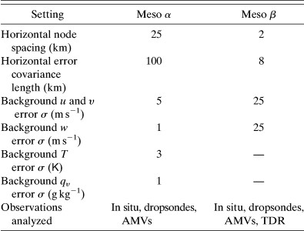
Data and methodology (2/2)
For this study, the 0.25° European Centre for Medium-Range Weather Forecasts (ECMWF) analyses were used as an initial estimate for the 25-km Cartesian grid analyses. The SAMURAI meso-α-scale analyses were then calculated using dropsondes and satellite-derived atmospheric motion vectors (AMVs; Velden et al. 2005) in a 6-h window around the mission on each analysis day.
Circulation equation:
Mean stretching + Eddy stretching + tilt
+ friction

Slide 7
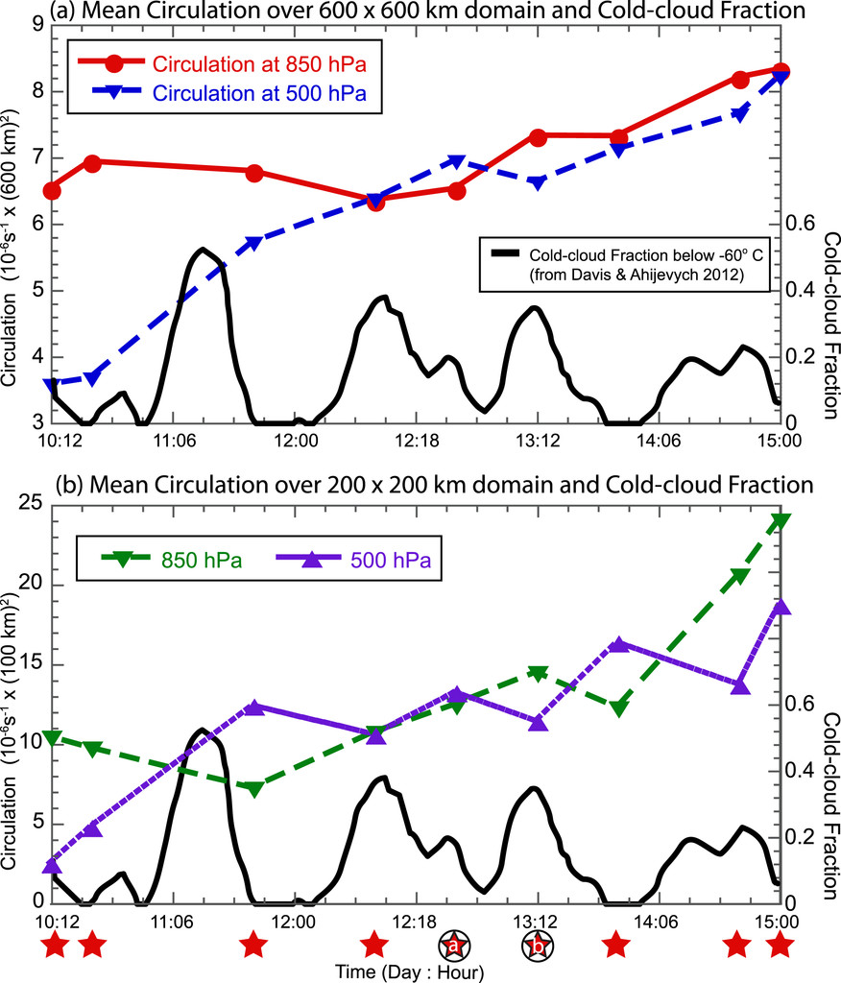
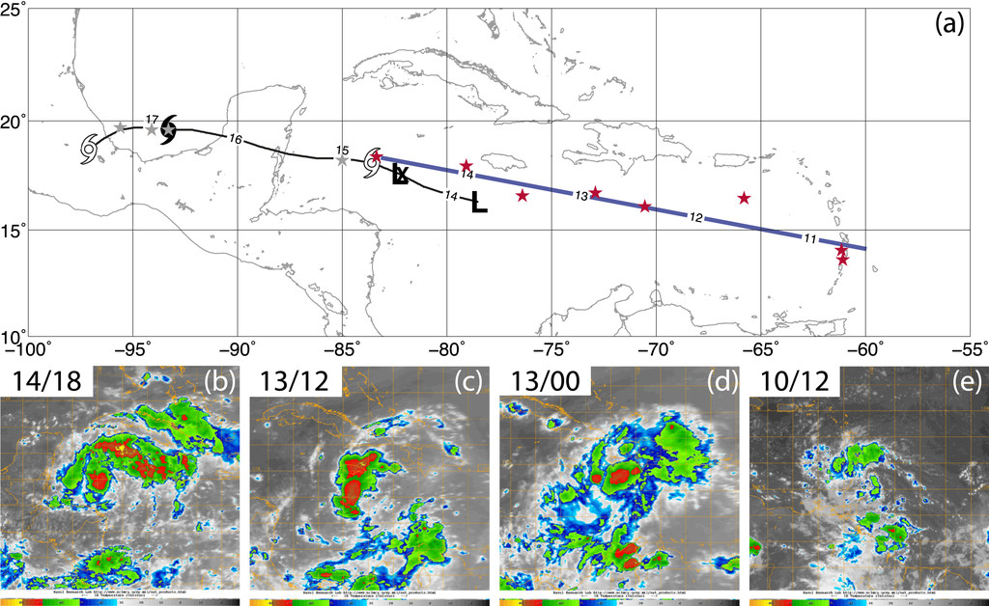
PREDICT analysis
Time series analysis
The sweet spot is defined by the intersection of the critical latitude (where the zonal flow is equal to the wave phase speed) and the wave trough axis (where the meridional velocity is zero).

Slide 8
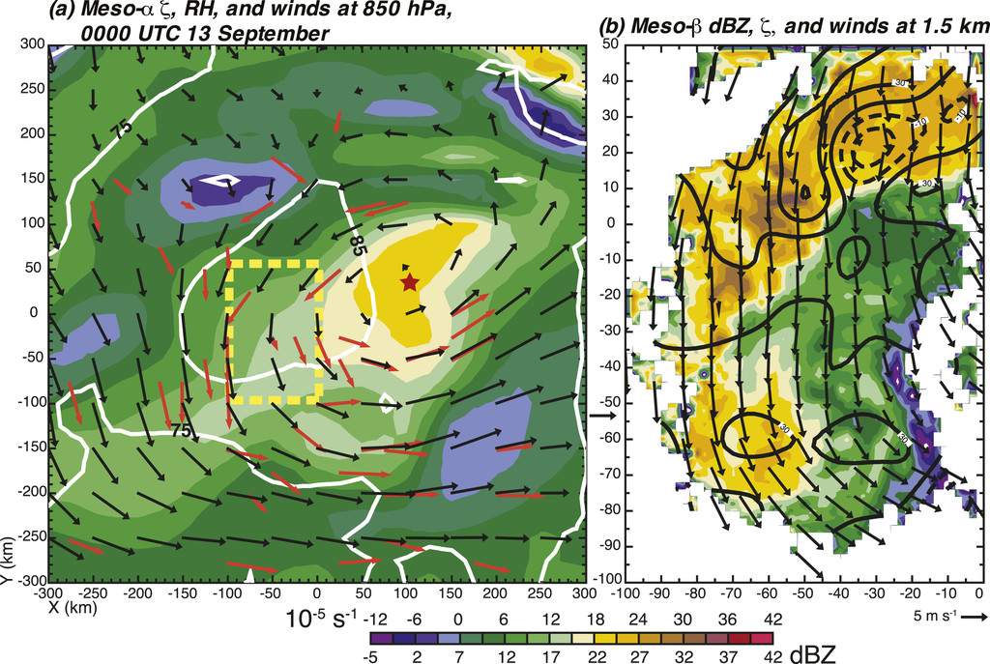
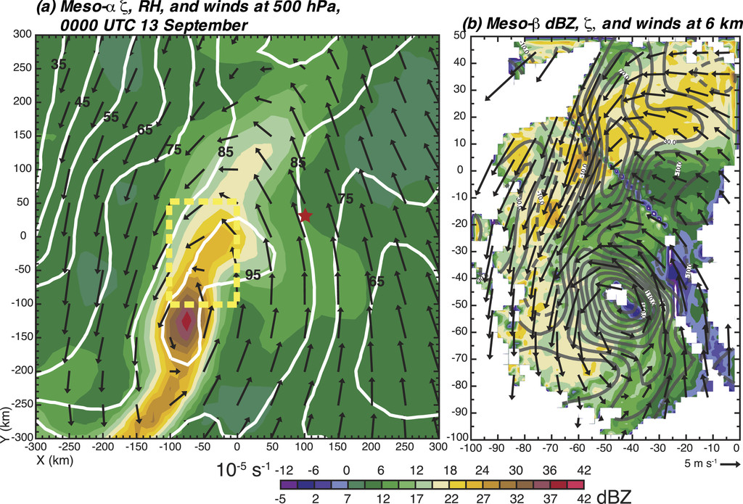
PREDICT analysis
Meso-α- and meso-β-scale structure
850 hPa
13 0000 UTC
500 hPa
Notes:
For the purposes of this paper, we define “low levels” to be below 700 hPa or 3-km altitude, “midlevels” to be between 700 and 400 hPa or 3–8-km altitude, and “upper levels” to be above 400 hPa or 8 km.

Slide 9
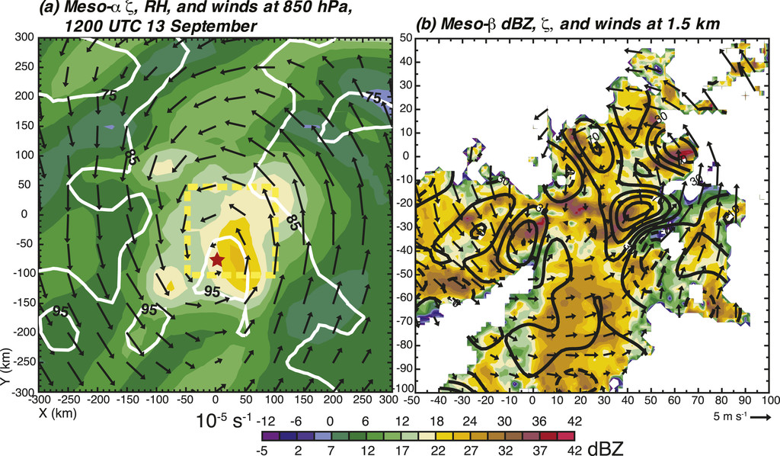
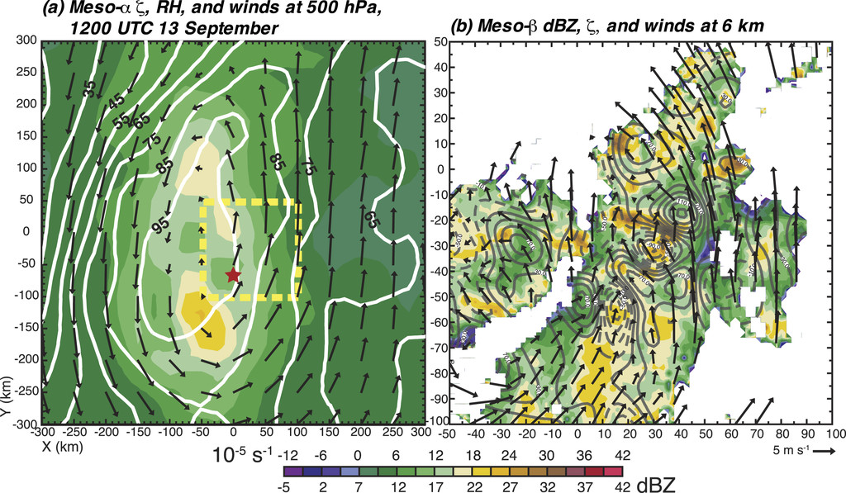
PREDICT analysis
Meso-α- and meso-β-scale structure
850 hPa
13 1200 UTC
500 hPa

Slide 10
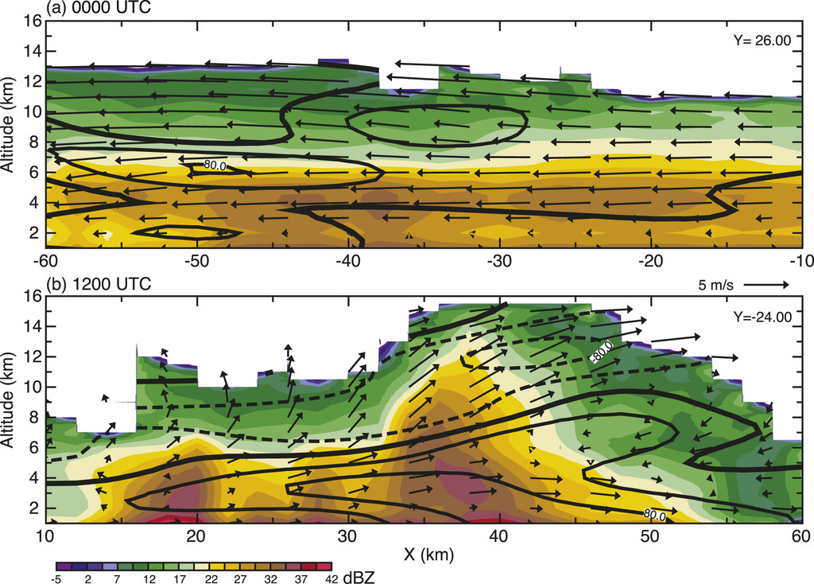
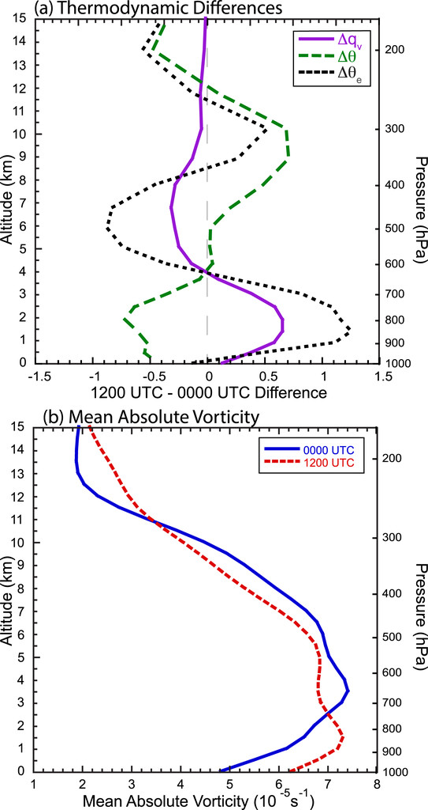
PREDICT analysis
Convective and stratiform contributions to genesis
The SAMURAI analysis at 0000 and 1200 UTC suggests a shift from predominately stratiform to predominately deep convective activity on 13 September that has profound implications for vortex development at these times.

Slide 11
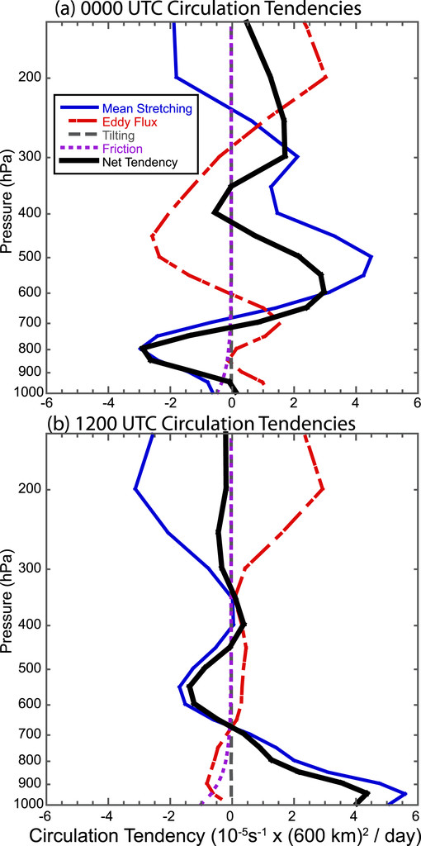
Circulation dynamics on the meso-α scale

Slide 12
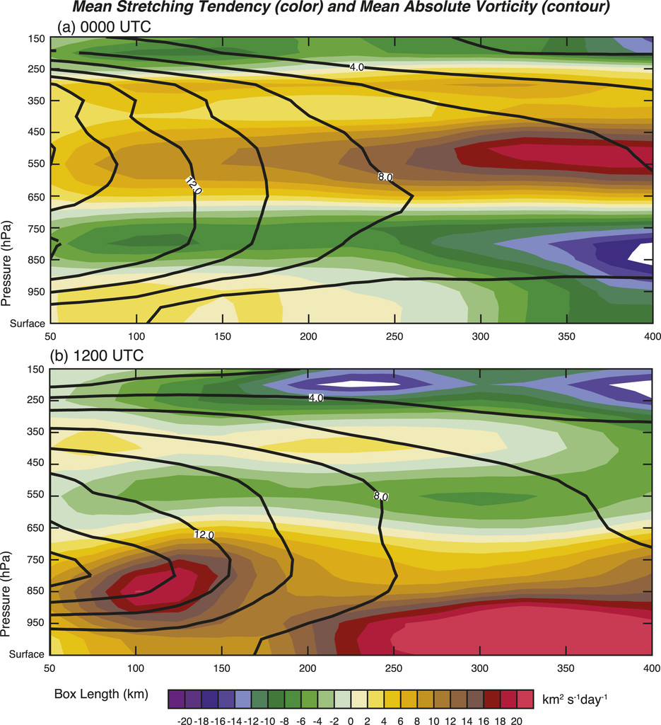
Sensitivity to box lengths

Slide 13
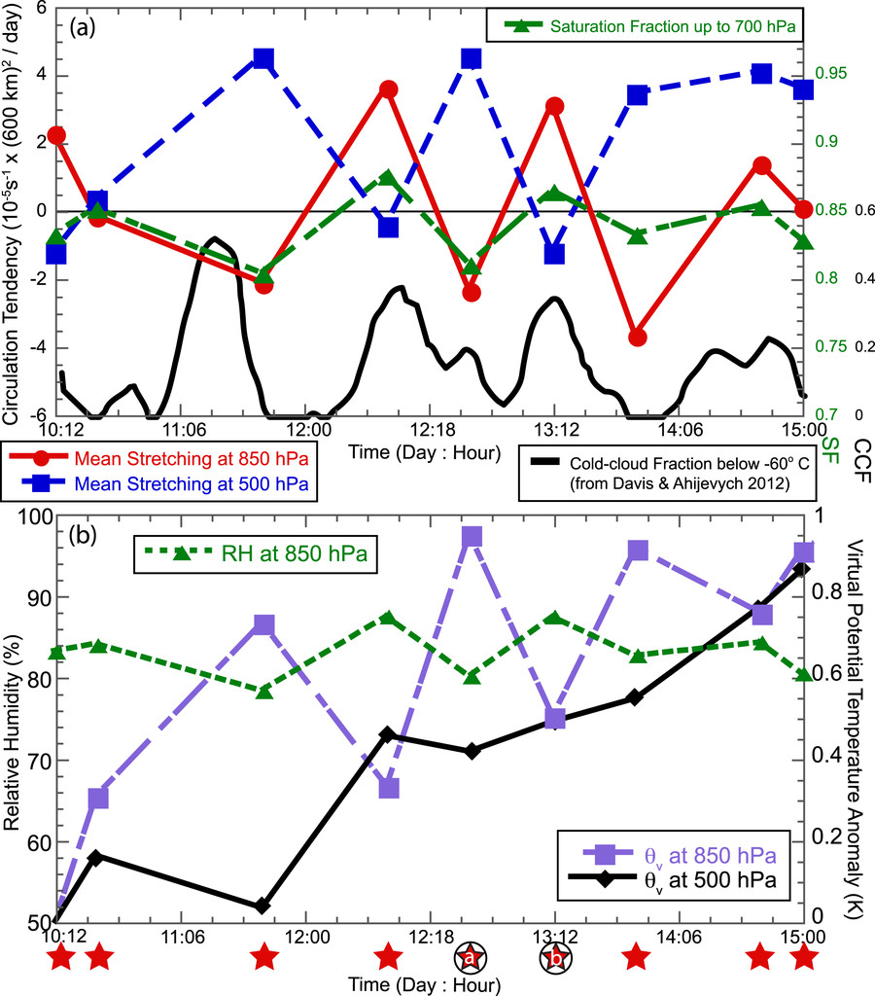
Time series of the meso-α-scale characteristics

Slide 14
Discussion and conclusions (1/2)
Low-level spinup of the meso-α-scale cyclonic circulation occurred during periods of more active deep convection, with circulation analysis indicating that the positive tendencies were largely due to vortex tube stretching from mean convergence of perimeter-averaged vorticity. Deep convective periods were also characterized by spindown of the midlevel circulation associated with mean divergence.
As the convective bursts waned and transitioned to predominately stratiform mesoscale convective systems, the circulation tendencies transitioned to a complementary signature of low-level spindown and midlevel spinup corresponding with the divergence profile of stratiform precipitation.

Slide 15
Discussion and conclusions (2/2)
The initial environment for the development of deep convection was a modest low-level circulation on the meso-α scale with no substantial midlevel circulation on 10 September.
A strong convective burst then erupted in the vorticity-rich environment on the morning of 11 September that enhanced the low-level circulation.
As the convection waned, the resulting transition to stratiform MCSs strengthened the midlevel pouch through midlevel convergence and vortex stretching associated with ice microphysical processes, and protected the disturbance from the intrusion of dry environmental air.
Low-level divergence associated with the stratiform rain acts to spin down the low-level circulation, but surface moisture fluxes and cooling associated with rain evaporation and the diurnal minimum helps to increase the relative humidity, lower the level of free convection, and condition the environment for another burst of deep convection.
Once the column saturation reaches a critical value, a subsequent convective burst below the midlevel circulation further enhances the low-level circulation, and the convective cycle repeats.

