Slide 1
The Impacts of Horizontal Grid Spacing and Cumulus Parameterization on Subseasonal Prediction in a Global Convection-Permitting Model
Weber, N. J., C. F. Mass, and D. Kim, 2020: The impacts of horizontal grid spacing and cumulus parameterization on subseasonal prediction in a global convection-permitting model. Mon. Wea. Rev., 148, 4747–4765.

Slide 2
Introduction
At short (hourly to daily) time scales, convection is the dominant feature of local tropical weather, ranging from diurnal land/sea breeze showers (e.g., Kikuchi and Wang 2008) to organized, propagating mesoscale convective systems (MCSs; e.g., Houze 2004).
At subseasonal to seasonal time scales (several days to several months), organized convective systems, often associated with convectively coupled equatorial waves (CCEWs), the Madden–Julian oscillation (MJO; Madden and Julian 1972; Zhang 2013), and/or sea surface temperature (SST) anomalies, can affect the weather in remote locations through global-scale circulation anomalies (teleconnections) triggered by their associated divergent ﬂows (Wallace and Gutzler 1981; Sardeshmukh and Hoskins 1988; Brunet et al. 2010).
At longer climate time scales (annual to decadal), tropical convection acts as a major control on Earth’s energy budget and large-scale circulation due to cloud radiative effects and vertical/horizonal moist static energy transport (e.g., Bony et al. 2015).

Slide 3
The fairly coarse horizontal grid spacing ( ~9–25 km) incurrent operational global models necessitates the parameterization of subgrid-scale convection, an approach that often produces errors and biases in the models’ simulated convection, including poor representation of the diurnal cycle (Yangand Slingo 2001; Guichard et al. 2004), near-ubiquitous light tropical precipitation (DeMott et al. 2007; Stephens et al.2010), and unrealistic MJO structure, variability, and/or propagation (Kim et al. 2009; Kerns and Chen 2014; Kim et al.2014; Jiang et al. 2015; Ahn et al. 2017).
In recent years, researchers and forecasters have turned to convection-permitting models (CPMs) to circumvent the issues associated with convective parameterization.
many studies and operational applications have utilized regional CPMs to reduce the grid size
Notes:
contemporary numerical weather prediction (NWP) models and global climate models (GCMs) often fail to realistically capture the characteristics of tropical convective phenomena (e.g., Lin et al. 2006; Seo et al. 2009; Brunet et al. 2010; Straub et al. 2010; Weaver et al. 2011) and, presumably, their global impacts.

Slide 4
Global CPMs are potentially of great value for subseasonal prediction because, unlike limited-domain models, they simulate both local phenomena (e.g., organized tropical convection) and their remote impacts (e.g., teleconnections).
which aspect of a CPM is most important for properly simulating convective dynamics and their global response? high spatial resolution or the absence of a cumulus scheme?
can global forecast beneﬁts be achieved by only using convection-permitting resolution in the tropics?
This paper presents four monthlong cases simulated by a global model using several different grid-spacing and cumulus parameterization combinations, with the goal of appraising the impact of horizontal grid spacing and convection scheme application on simulated tropical precipitation, MJO propagation, and extended predictive skill.
Notes:
This paper presents four monthlong cases simulated by a global model using several different grid-spacing and cumulus parameterization combinations, with the goal of appraising the impact of horizontal grid spacing and convection scheme application on simulated tropical precipitation, MJO propagation, and extended predictive skill.

Slide 5
Data and methods
Model for Prediction Across Scales (MPAS; Skamarock et al. 2012), developed at the National Center for Atmospheric Research (NCAR)
55 vertical levels in a hybrid sigma coordinate system
Thompson microphysics scheme
the NOAA/NCEP–Oregon State University–Air Force Research Laboratory–OAA/Ofﬁce of Hydrology land surface model (Noah),
Mellor–Yamada–Nakanishi–Ni ñ o (MYNN) boundary layer and surface layer parameterizations
Rapid Radiative Transfer Model for global climate models (RRTMG) longwave and shortwave radiation schemes
Xu–Randall cloud fraction
the 2D Smagorinsky subgrid-scale mixing scheme
Yonsei University (YSU) gravity wave drag.

Slide 6
All simulations were initialized using NCEP Final Operational Global Analyses
SSTs were held constant at their initial values to avoid giving the model any future information
All runs were integrated for 28 days in order to capture the period of a typical subseasonal forecast (weeks 1 through 4).
The ﬁrst case began on 22 November 2011 and captured the second MJO of the Dynamics of the Madden–Julian Oscillation (DYNAMO) ﬁeld campaign (Gottschalck et al. 2013)
Cases 2, 3, and 4 were initialized on 8 February 2013, 2 December 2003, and 8 December 2013, respectively.
Notes:
M15 was run with a globally uniform 15-km mesh and the experimental new Tiedtke cumulus parameterization from the Weather Research and Forecasting (WRF) Model, version 3.8.1.
to assess how convection-permitting resolution inﬂuences subseasonal prediction in a global model.
M3 was conﬁgured with global 3-km grid spacing (more than 65 million cells in the horizontal dimensions) and no convection scheme.
M15noCu, in order to assess the role of cumulus parameterization at NWP-like horizontal resolution.
‘‘tropical channel’’ mesh (Mchannel), with 3-km horizontal grid spacing in the tropics (equatorward of 20 8 N/S) smoothly transitioning to 15-km spacing in the extratropics; the scale-aware Grell–Freitas convection scheme (Grell and Freitas 2014) was implemented in Mchannel to deal with the range in grid cell size.
All meshes in these experiments used 55 vertical levels in a hybrid sigma coordinate system.

Slide 7
observational and analysis datasets
Precipitation: Tropical Rainfall Measuring Mission (TRMM) multisatellite 3 B42 product (Huffman et al. 2007; TRMM 2011;),
low-level winds: Cross-Calibrated Multi- Platform (CCMP) wind estimates (Ricciardulli et al. 2017)
ﬂux equivalent brightness temperatures : 4-km-resolution infrared (IR) satellite data (Janowiak et al. 2001) from the Climate Prediction Center (CPC)
Extratropical surface forecasts: the NWS Automated Surface/Weather Observing System (ASOS/AWOS) network in the United States.
ERA5 reanalyses (Hersbach et al. 2020)
Notes:
Brightness temperature data from all
datasets are ﬁrst conservatively interpolated to a 0.125 8 grid
and then smoothed with a uniform 0.5 8 ﬁlter. Features are
identiﬁed using a brightness temperature threshold of 208 K
and a minimum area of 5000 km
2

Slide 8
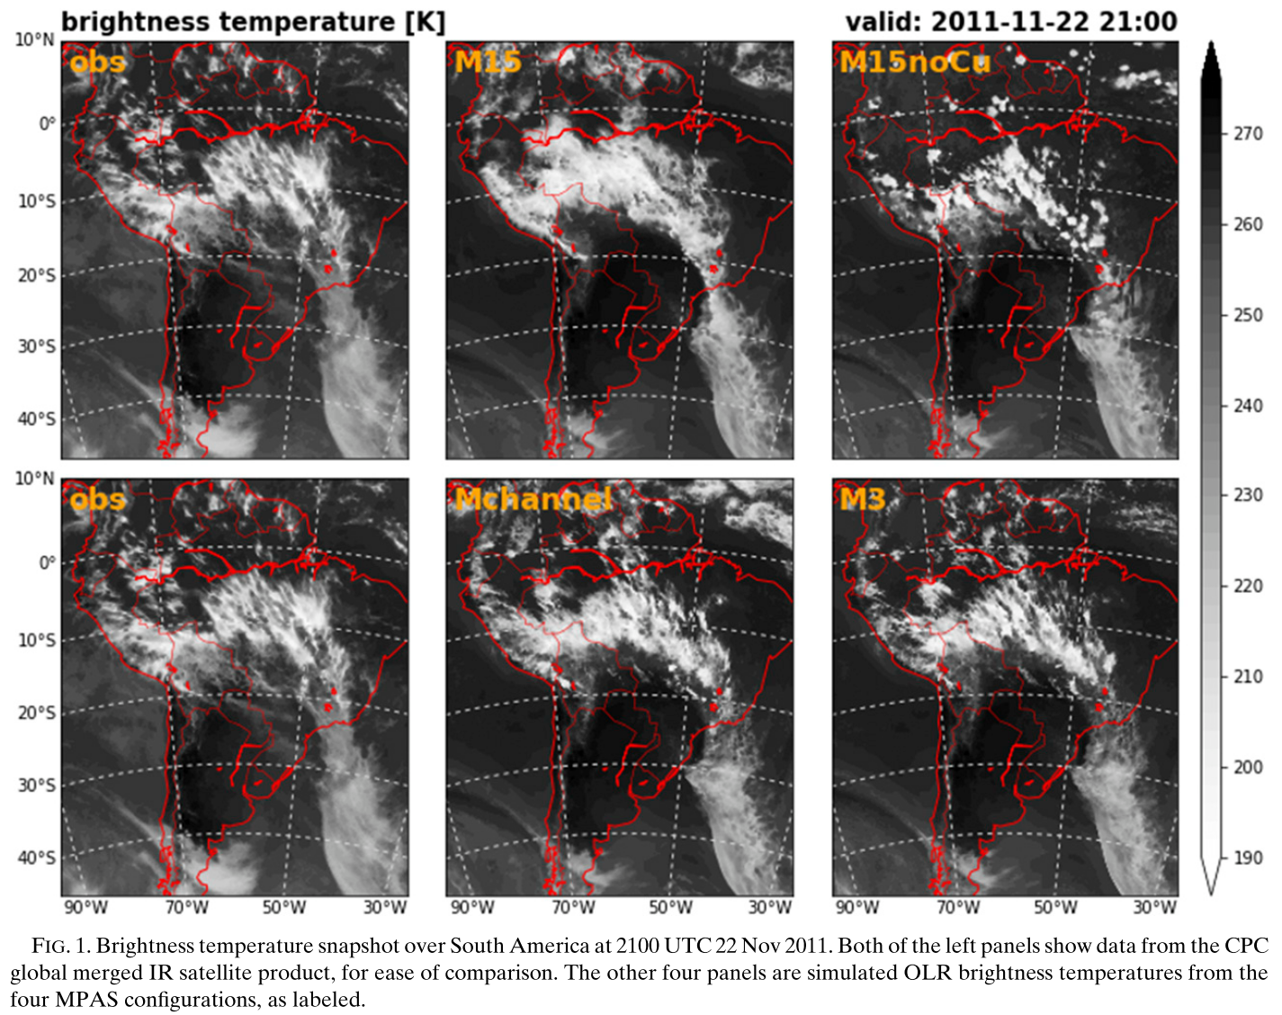
Notes:
IR brightness temperatures over South America during case 1 at a forecast lead time of 21 h.
M15 produces a broad, nearly uniform swath of high cloud over the region
M15noCu features more scattered, popcorn-like structures.
M3 and Mchannel more closely resemble the intricate, banded structure seen in the satellite image.
There are notable differences between the MPAS conﬁgurations over the tropical ocean (upper right corner of each panel); M3 captures
the observed scattered, small-scale cloud features, while the other conﬁgurations produce more widespread convection.

Slide 9
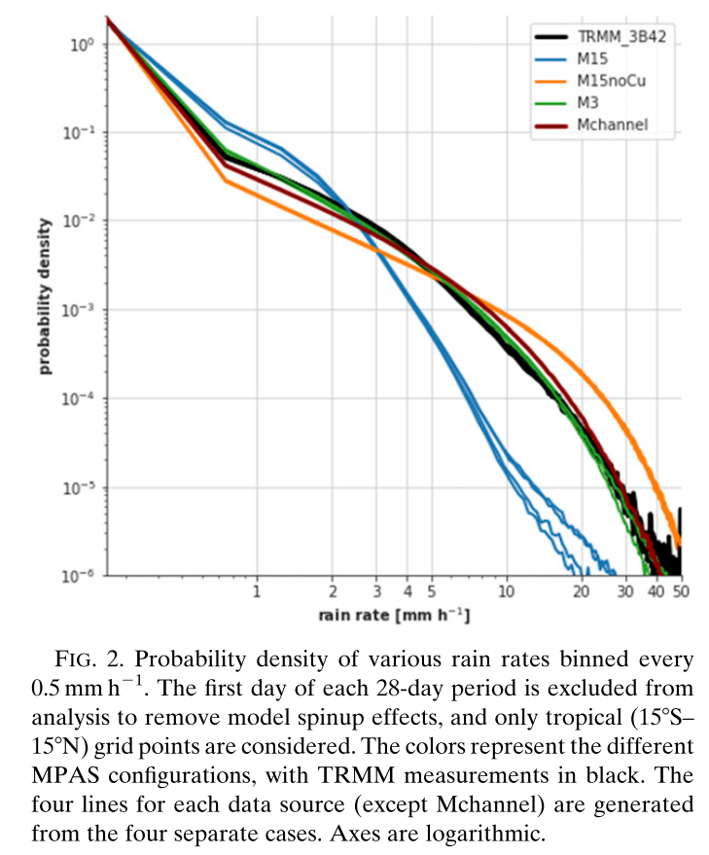
Normalized precipitation rate frequency distributions
Notes:
M15 produces light rain too frequently and heavy rain too infrequently.
M15noCu exhibits the opposite problem: excessive heavy rain and too little light rain.
M3 matches the TRMM precipitation distribution quite well.
Mchannel, like M3 (both of which use convection-permitting resolution in the tropics), matches observations fairly well, although with slight a bias
toward heavier rain rates.

Slide 10
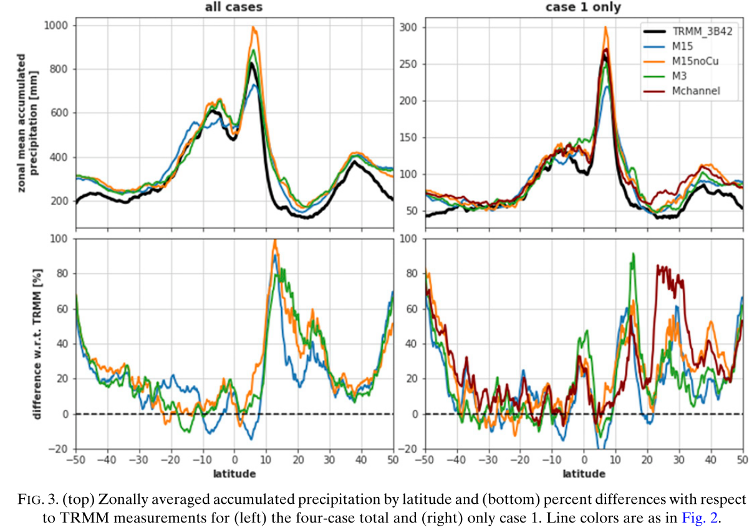
Notes:
The zonal mean accumulated precipitation (Fig. 3) reveals that MPAS simulations overpredict precipitation for most latitudes, with the greatest overprediction in the northern subtropics and midlatitudes poleward of 40 8 N or S.
The overproduction of total tropical precipitation (10%–15% bias) in M3 and Mchannel, despite their realistic distribution of rain rates, suggests that the model simply produces precipitating tropical systems of various intensities too frequently

Slide 11
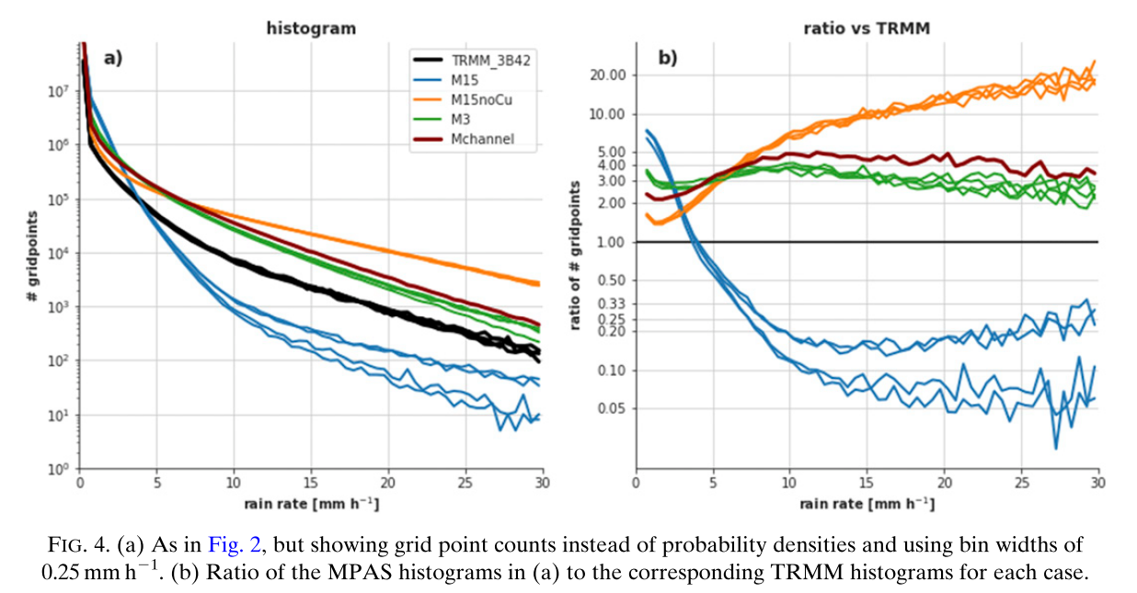
Notes:
Figure 4a shows the number of grid points within a range of rain-rate bins for TRMM and the MPAS simulations.
this distribution looks similar to that in Fig. 2, except the positive precipitation bias in M3 and Mchannel is now apparent.
Displaying this information as a ratio relative to TRMM (Fig. 4b) reveals the regime-sensitivity of the models’ precipitation biases.
As hypothesized above, the positive precipitation bias in M3 and Mchannel is not due to a tendency toward particular rain rates; both conﬁgurations
produce rain, at all intensities, roughly 2–5 times as frequently as in TRMM.
It is possible that the duration, intensity, and/or frequency of tropical convection in these simulations may have been erroneously ampliﬁed by the
lack of surface ﬂux feedbacks caused by the ﬁxed SSTs (Hirons et al. 2018), which would account for the general overabundance of convective systems (Fig. 8) in the CPM conﬁgurations and the associated positive precipitation bias (Fig. 3).
This is not the case in the 15-km simulations.
M15 produces very light precipitation ~7 times as frequently as in TRMM, and heavy precipitation at ; 1/10th the rate.
M15noCu performs reasonably for low rain rates but simulates heavy rain 10–20 times as often as in TRMM.

Slide 12
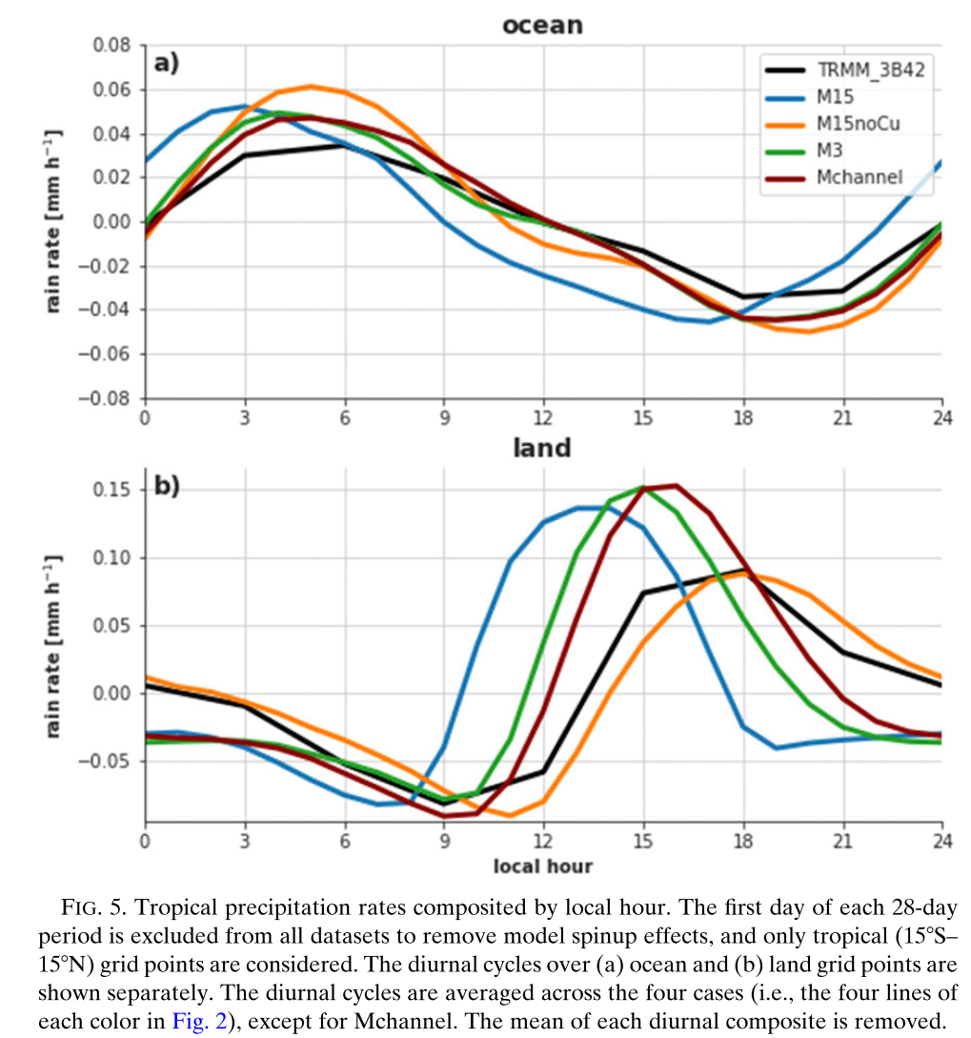
Notes:
Over the ocean the morning (evening) diurnal maximum (minimum) in precipitation is triggered roughly 3 h too early in M15, while the other three MPAS conﬁgurations match the observed diurnal phase quite well (although M15noCu overestimates the amplitude).
The diurnal cycle over land is 3–4 h out of phase in M15, with the afternoon peak overampliﬁed.
M3 and Mchannel improve the timing of this peak by about 2 h, resulting in a diurnal maximum that is slightly out of phase with observations and overampliﬁed.
Interestingly, M15noCu, using a relatively coarse grid and no convective parameterization, simulates a terrestrial diurnal cycle whose phase
and amplitude correspond quite well with observations.

Slide 13
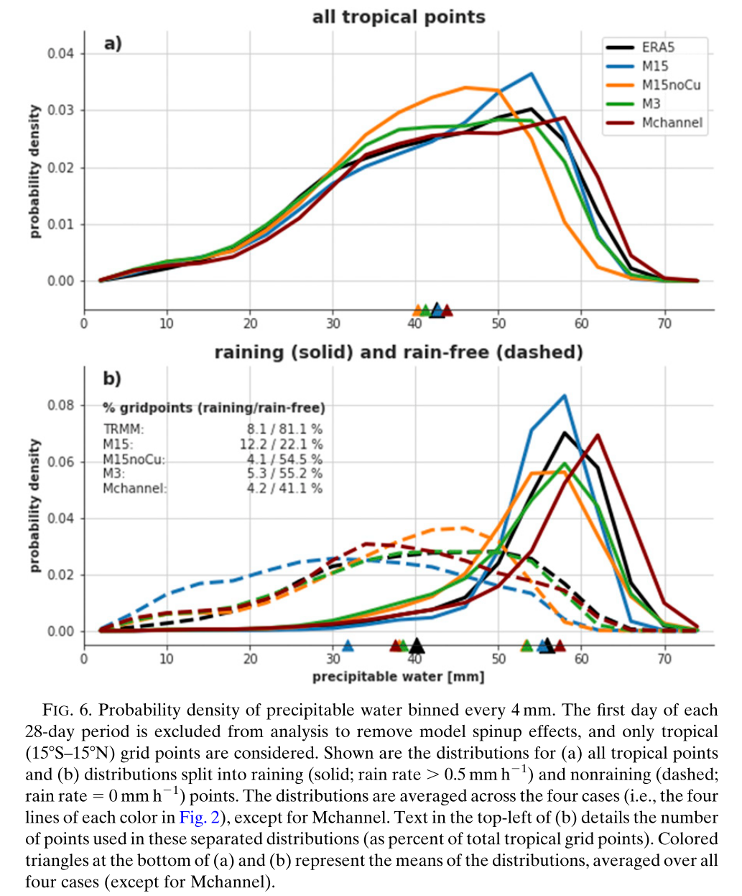
Notes:
Figure 6a indicates that the distribution of tropical precipitable water varies by model conﬁguration.
M3 and M15noCu slightly underestimate tropical moisture (M15noCu more so), while Mchannel slightly overmoistens tropical atmosphere.
M15noCu exhibits an unrealistically large fraction of grid points with moderate precipitable water values in the 30–50-mm range, but too few points with higher ( . 55 mm) values.
M3, whose mean precipitable water also indicates a dry bias, does not exhibit such a preference for intermediate column moisture values.
The positive moisture bias in Mchannel is a result of too many values in 55–65 mm range.
The mean tropical precipitable water in M15, in contrast to the other MPAS conﬁgurations, matches that of ERA5 quite well despite the model producing too many values in the 50–60-mm range.
Separating these distributions into their contributions from ‘‘raining’’ and ‘‘nonraining’’ grid points (Fig. 6b) suggests that the dry moisture bias in M3 and M15noCu is equally present within and outside of convection.
Biases in other conﬁgurations, however, are sensitive to the presence of convection.
M15, for example, is far too dry in nonprecipitating grid points. This, along with its much smaller fraction of rain-free tropical grid points (see text in Fig. 6b), suggests that M15 triggers convection far more readily (and in drier environments) than the other conﬁgurations.
M15 produces near-ubiquitous very light precipitation, possibly associated with parameterized entrainment that results in erroneously undiluted, and thus abundant, shallow cumulus.
Mchannel is also too dry in nonprecipitating regions and too moist within precipitating features (which accounts for its overall bias shown in Fig. 6a).
M3—which, like Mchannel, uses convection-permitting resolution in the tropics—exhibits an opposite-signed moisture bias within
precipitating features, signifying that the Grell–Freitas scheme in Mchannel has signiﬁcant impacts on its convection/moisture.

Slide 14
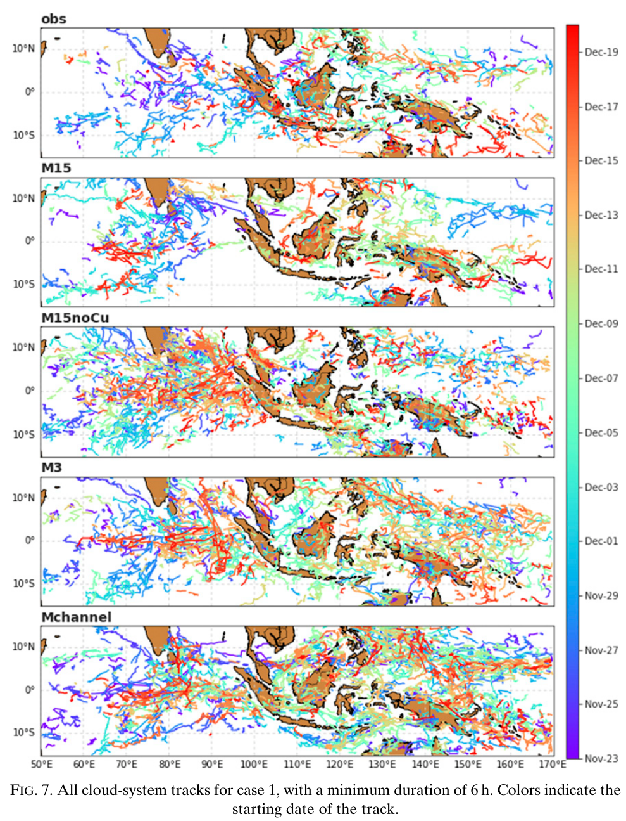
cloud brightness temperature feature-tracking algorithm
Crocker and Grier (1996)
Features are identiﬁed using a brightness temperature threshold of 208 K and a minimum area of 5000 km² (following Williams and Houze 1987 and Chen et al. 1996).
Notes:
The tracked objects in the satellite observations reveal a spatially heterogeneous distribution of convective systems, including the gradual eastward propagation of the MJO-associated convective clouds
While none of the MPAS simulations are able to replicate the spatiotemporal distribution of the tracked cloud systems (Fig. 7),
M15 seems to be the only conﬁguration that does not overestimate the number of these propagating features (Fig. 9).

Slide 15
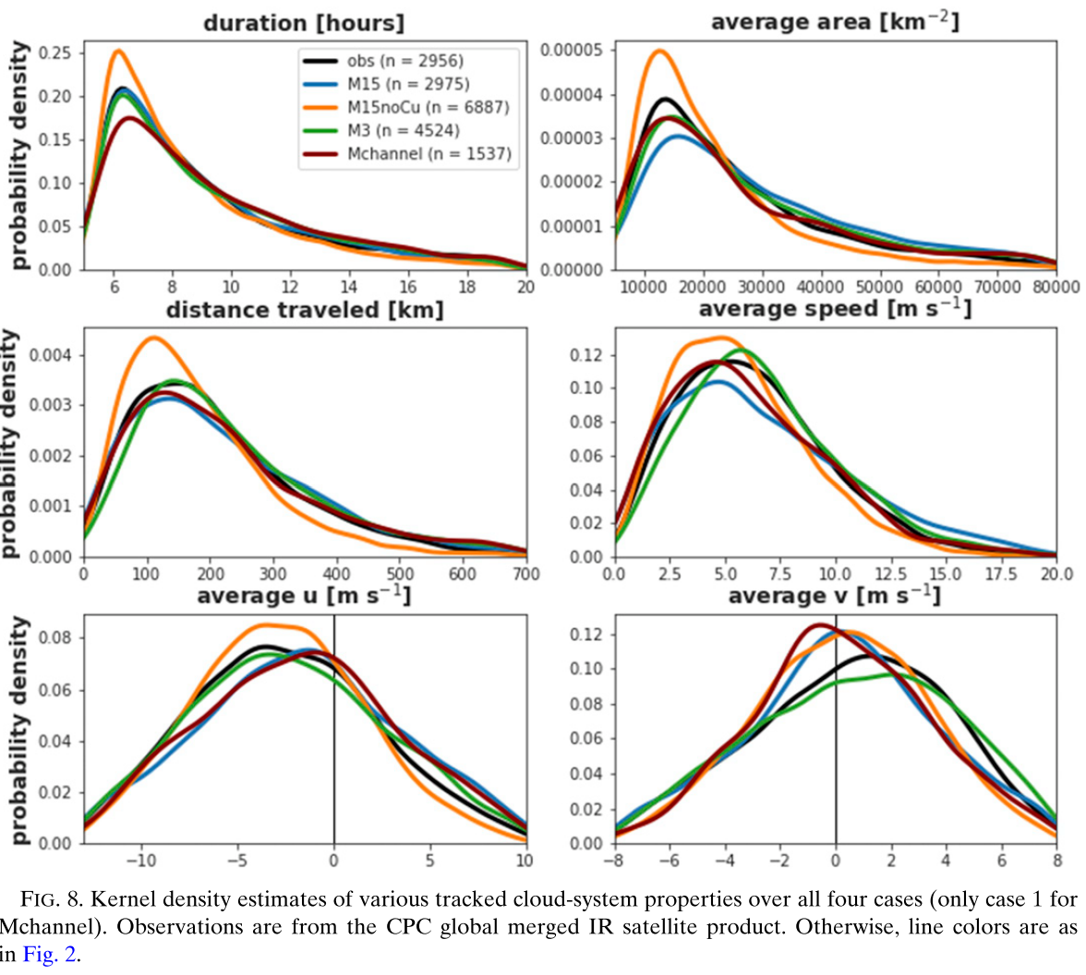
Notes:
M15noCu: convective clouds being too short-lived, small, and stationary compared to satellite observations (and the other MPAS simulations).
M15noCu produces excessive amounts of very intense, small-scale, short-lived convection.
The rapid growth and decay of the abundant, transient convective systems in M15noCu (Fig. 8) is suggestive of conditional instability of the second kind (CISK), which prefers very small scales (Lindzen 1974).
Environmental moisture perturbations trigger convection which, because of the minimum 15-km plume width, is associated with excessive
vertical motion and thus surface convergence; this unrealistically strong surface moisture convergence intensiﬁes/deepens the convection until vertical motion proﬁle becomes top-heavy (and normalized gross moist stability is positive), at which point the system rapidly decays due to the intense precipitation and minimal moisture import.
The other MPAS conﬁgurations’ cloud systems are more similar to the satellite observations
M15 does not produce as many small convective systems as seen in M3, Mchannel, and the satellite observations.
M3: The propagation characteristics of these systems—their total distance traveled, total speed, zonal speed, and meridional speed—are most accurately captured by M3.

Slide 16
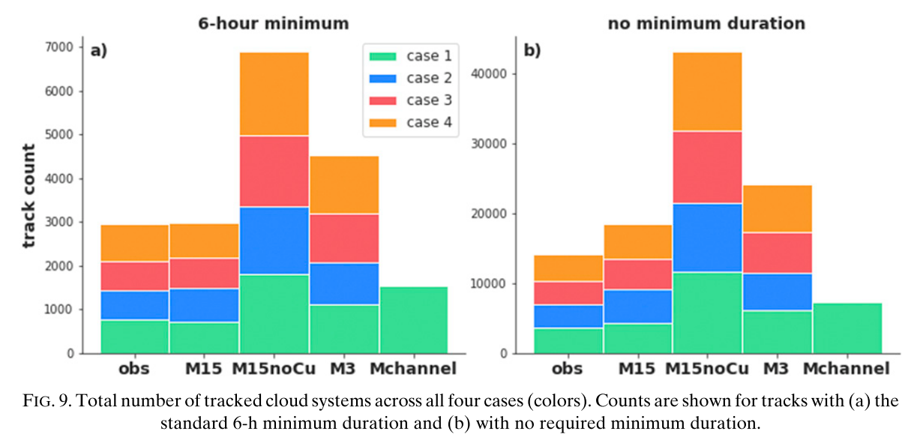
Notes:
M15 seems to be the only conﬁguration that does not overestimate the number of these propagating features (Fig. 9).
the number of cloud systems in all MPAS simulations except M15 is too high compared to observations (Fig. 9a).
M15noCu produces far too many deep convective clouds compared to observations and other model conﬁgurations
(b) M15 and M15noCu still produce the smallest and largest number of convective systems, respectively, but the relative number of systems in these 15-km simulations—when compared with observations, M3, and Mchannel—increases.
That is, the 15-km simulations unrealistically favor very short-lived convective features.
The general overproduction of deep convective systems in the convection-permitting simulations—which might be associated with the lack of air–sea
coupling (see section 4)—is consistent with the positive tropical precipitation biases in these conﬁgurations,

Slide 17
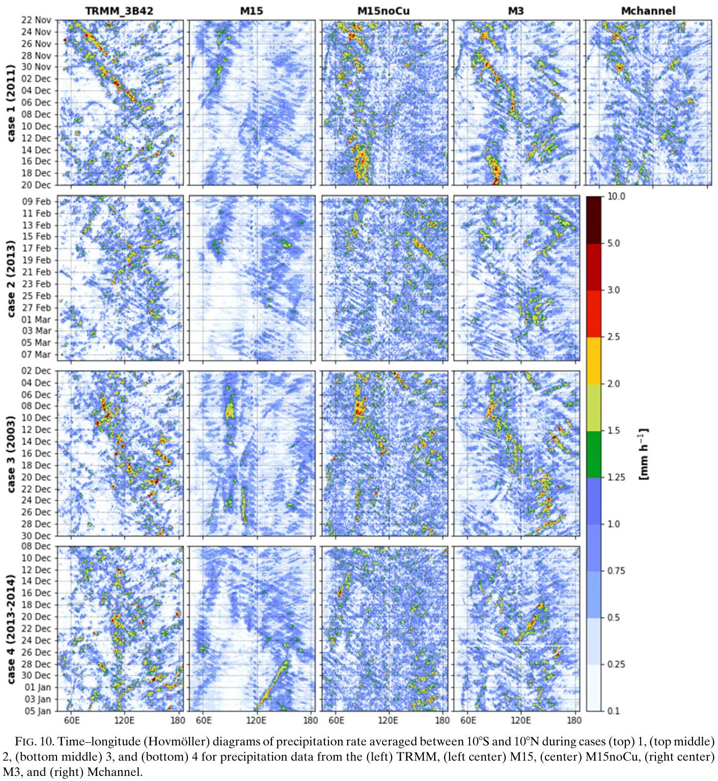
Notes:
For each of the four cases, a broad region of moderate-to-heavy precipitation slowly propagates east-ward from the Indian Ocean ( ~70 E) to at least the eastern Maritime Continent ( ~130 E) in the TRMM satellite measurements (Fig. 10, ﬁrst column).
This packet of MJO convection is entirely absent in all four of the M15 simulations (Fig. 10, second column), which favor stationary or even westward-propagating large-scale convection.
M15noCu (Fig. 10, third column), which produces heavy and moderate precipitation too frequently (as discussed above), also largely fails to reproduce the eastward-moving MJO convection, instead favoring stationary and near-ubiquitous precipitation.
M3 generally produces an eastward-propagating MJO precipitation signal similar to that observed by TRMM, with the exception of case 2.
Interestingly, Mchannel (Fig. 10, ﬁfth column), which also uses 3-km grid spacing in the tropics, does not capture the eastward propagation of the DYNAMO MJO, stalling convection in the Indian Ocean.
In summary, the global CPM conﬁguration is able to accurately simulate the convectively coupled eastward-propagating signal of the MJO,

Slide 18
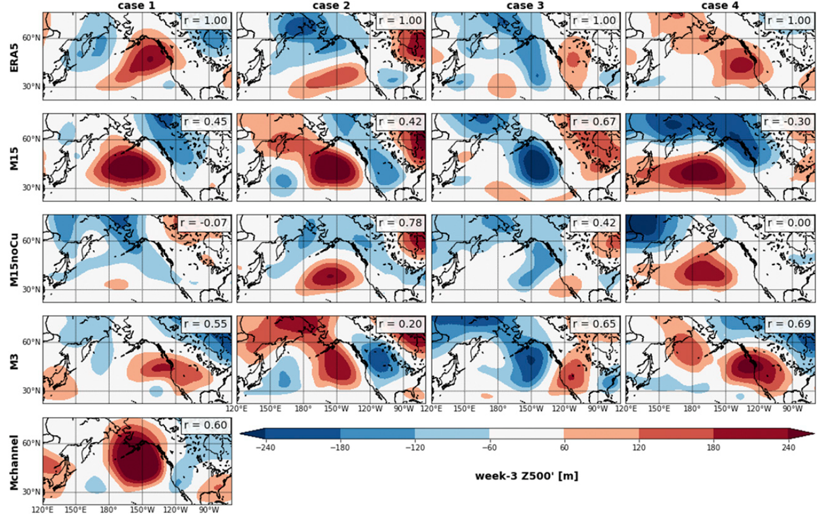
Paciﬁc–North American (PNA)
The PNA region is particularly impacted by MJO convection as associated Rossby wave propagate beyond the tropics (e.g., Mori and Watanabe 2008)
Notes:
Extratropical prediction performance
The PNA region is particularly impacted by MJO convection as associated Rossby wave propagate beyond the tropics (e.g., Mori and Watanabe 2008)
MPAS conﬁgurations exhibit varying degrees of success in capturing the anomaly patterns seen in the ERA5 reanalysis

Slide 19
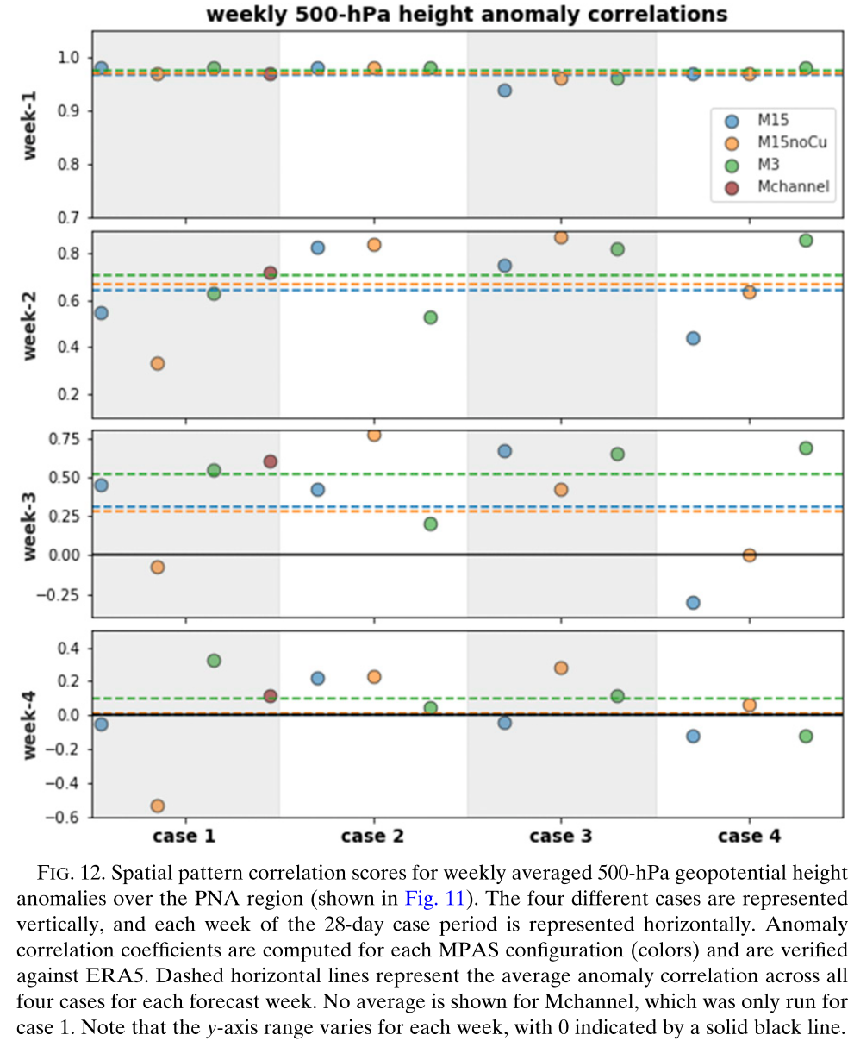
Notes:
week 1, all MPAS conﬁgurations perform comparably well due to the dominance of initial conditions and lack of error growth at such short lead times and large spatial scales.
In week 2, with M3 performing slightly better than M15 and M15noCu.
in week 3, where the average M3 correlation coefﬁcient exceeds 0.5, while M15 and M15noCu both show an average score around 0.25.
week 4, deterministic predictability has diminished, and the forecasts generally score below 0.25.
M3 slightly outperforms the other conﬁgurations in week 4, though this is chieﬂy due to its high case 1 correlation score (0.33).
Mchannel performed comparably to M3 for case 1 despite the differences in its simulated tropical convection.
For case 2, M3 exhibited neither an improved MJO nor more skillful extratropical prediction compared to the other forecasts

Slide 20
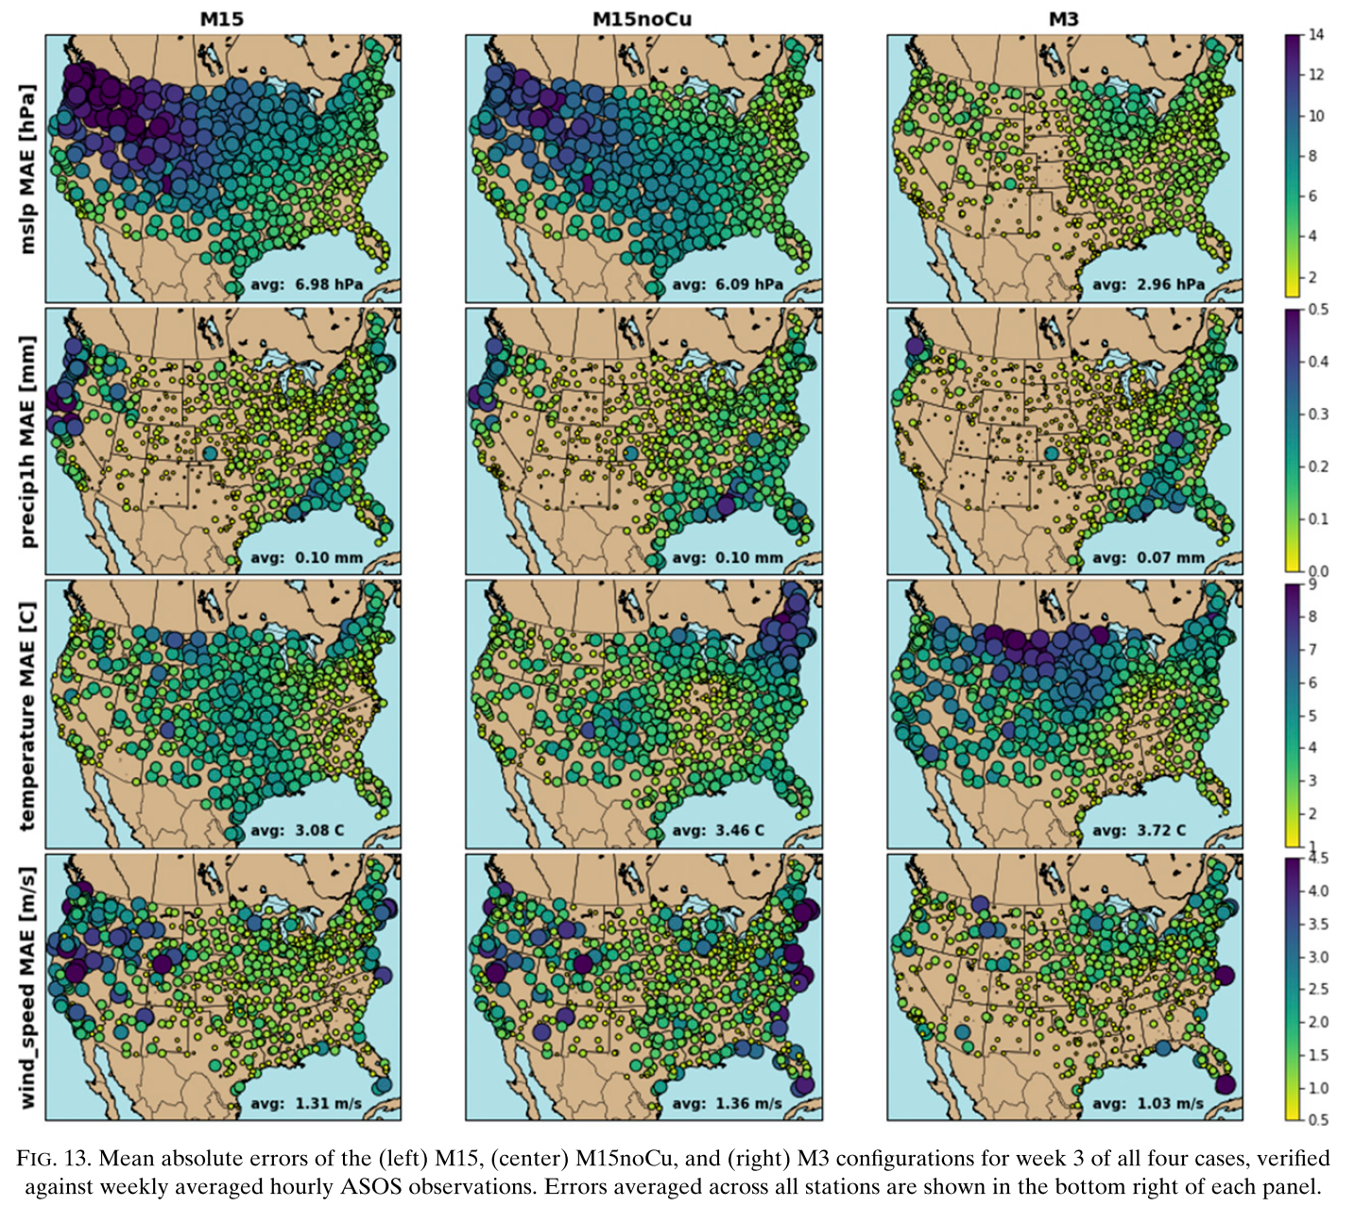
Notes:
To identify whether these differences in upper-level forecast performance impact surface weather predictions, the MPAS simulations were veriﬁed against Automated Surface Observing Systems (ASOS) stations throughout the United States for all four cases.
the largest errors in MSLP in the 15-km simulations are near the complex terrain of the Rocky Mountains,
while the largest errors in precipitation occur where its natural variability is largest—in the Paciﬁc Northwest and throughout the eastern United States.
Wind speed exhibits a more spatially uniform error pattern,
while the temperature error patterns vary between the MPAS conﬁgurations.
With the exception of precipitation in the Paciﬁc Northwest, the M15noCu forecasts generally do not improve upon, or perform worse than, the M15 predictions.
For MSLP, M3 hindcasts produce much smaller errors than the 15-km simulations, especially in the vicinity of mountain ranges; the bulk of this improvement come from the reduction of a negative MSLP bias in M15 and M15noCu (not shown), presumably linked to resolution of the terrain in the different conﬁgurations.
The precipitation errors are also reduced in M3 compared to M15 and M15noCu, with the largest reductions occurring in the aforementioned regions of high natural variability.
In M3, temperature errors are also lower in the southeastern United States, but are increased in the upper Midwest.
This increase in error is largely due to erroneous upper Midwest cold air outbreaks in M3 during weeks 3 and 4 of cases 1 and 2 (not shown).
Wind speed errors are generally reduced in M3 as well, especially near terrain or coastlines.
M3’s improvement in forecasts of precipitation in the Paciﬁc Northwest, MSLP near terrain, and surface wind speed throughout most of the
United States.

Slide 21
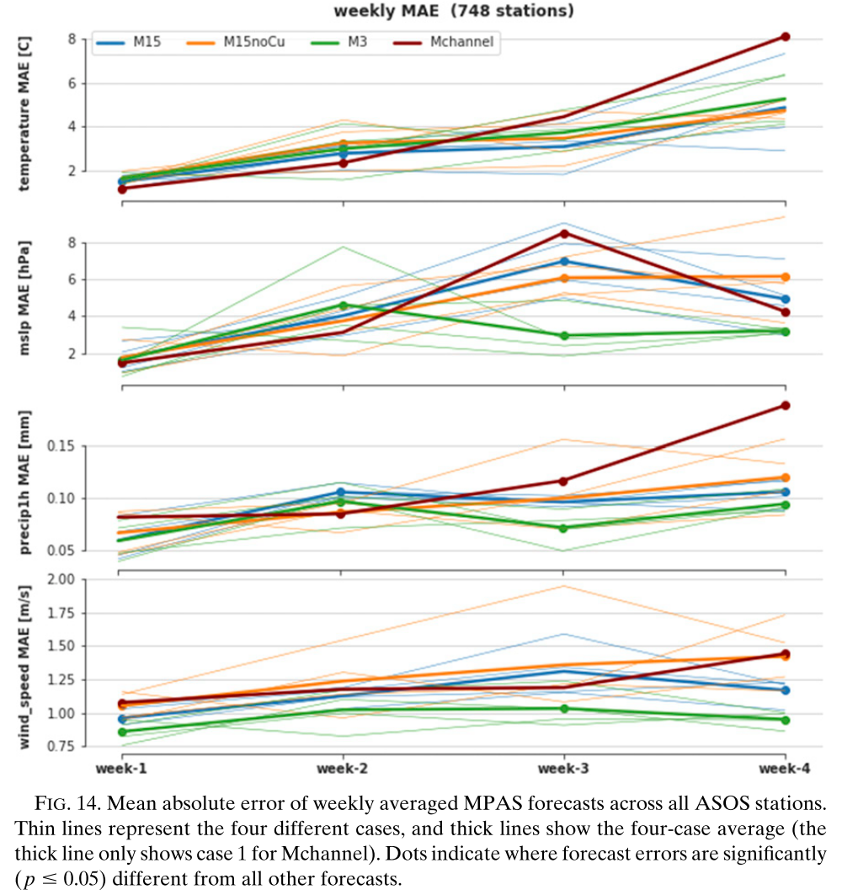
Notes:
To identify how errors evolve with lead time
M3 exhibits a statistically signiﬁcant improvement in low-level pressure, precipitation, and wind speed forecasts in week 3 (and even week 4).
There are fewer signiﬁcant differences between the forecasts’ skill at early lead times, or for temperature and wind speed in general.
M3 exhibits the curious behavior of error reduction after week 2 (for pressure, precipitation, and wind speed), which is likely due to the
combined effect of week 2/3 error saturation (e.g., Weber and Mass 2017) and poor sampling of various ﬂow regimes in these four cases.

Slide 22
tropical convection :
Convection in M3 and Mchannel more closely resembles observed convection.
precipitation intensity, diurnal cycle, and cloud-system properties are well captured
Too much precipitation associated with too many convective cloud systems
MJO:
The 15-km models’ preference for westward-propagating large-scale organized convection suggests either an afﬁnity for convectively coupled equatorial Rossby wave activity or a lack of Kelvin waves.
M3 captured the eastward propagation of the MJO in three out of the four cases, suggesting more realistic variability and structure of its convective features.
Mchannel does not fully predict the MJO’s eastward propagation in case 1.
subtropical/extratropical processes that are less-resolved in Mchannel
the Grell–Freitas scheme, which functions as a shallow cumulus scheme at high resolution (Fowler et al. 2016).
large-scale extratropical circulation:
M3 predictions were more skillful than the 15-km simulations, particularly in forecast week 3.
the three cases where M3 exhibited superior extratropical week-3 skill (cases 1, 3, and 4) were the same three cases in which M3 simulated an organized, eastward-propagating MJO that was missing from the other simulations.

Slide 23
Conclusions
the global 3-km simulations outperform the NWP conﬁguration with regard to the representation of tropical precipitation statistics, propagating convective phenomena like the Madden–Julian oscillation, and subseasonal extratropical hindcast skill
The 15-km simulations without a convective parameterization simulate unrealistically abundant, short-lived, and intense convection that fails to organize into an MJO.
The tropical channel model largely reproduces the realistic tropical precipitation statistics seen in the global CPM but fails to fully capture the MJO’s eastward propagation.

