Slide 1
On the Contributions of Incipient Vortex Circulation and Environmental Moisture to Tropical Cyclone Expansion

Slide 2
Outline
2
Introduction
3
4
Results
5
Methods
Discussion and Conclusion
1
Abstract

Slide 3
Abstract

Slide 4
Abstract
1. To investigate the contribution of incipient vortex circulation and midlevel
moisture to Tropical Cyclone(TC) expansion.
2. Incipient vortex circulation place primary constraint on TC expansion. Large vortex expand more quickly. Increasing midlevel moisture further promotes expansion but mostly expedites the intensification process.
3. Incipient vortex decreases, outer-core convection is relatively scarce, and
characterized by small-scale, isolated convective elements. On the contrary,
incipient vortex increases, outer-core convection is characterized by
relatively large rain bands and MCSs.

Slide 5
Introduction

Slide 6
Introduction
The process contributing to variable TC sizes are not fully understood.
1. Complex multiscale interactions occurring between a TC and its
ambient environment.
2. TC size distributions amomg various ocean basins will shift toward
larger TCs amidst Earth’s warming climate system (Knutson et al., 2015)
Notes:
TC的增強和 環境的影響 和 颱風內部動力有關
環境 包括了VWS SST 環境水氣量
內部動力 則包括了 正壓不穩定 和 眼牆的動力

Slide 7
Introduction
Some metrics of “size” needed to be described.
1.Radius of the outermost closed surface isobar
(ROCI; Brand, 1972; Kimball & Mulekar, 2004; Merrill, 1984)
2. Radius of hurricane‐force winds (64 kt Hill & Lackmann, 2009)
3.radius of damaging‐force winds (50 kt Kimball & Mulekar, 2004; Xu & Wang, 2010)
4.equivalent radii of tropical storm force and gale force winds
(34 kt Chan & Chan, 2012; Kilroy & Smith, 2017)

Slide 8
Introduction
Define TC size as the maximum extent of the azimuthally averaged tangential velocity equal to the radius of gale force winds (34 kt) 1 km above the ocean surface (henceforth, $R_{gales}$).
Furthermore, we define TC expansion as the process whereby $R_{gales}$ increases and conversely, contraction as the process whereby $R_{gales}$ decreases.

Slide 9
Introduction
Relationship between TCs size and intensity
－The two tails of the global TC size distribution
1.When weak typhoons with compact circulations, referred to as “midget” typhoons (Arakawa, 1952; Harr et al., 1996). On the same tail of the TC size distribution are intense TCs with compact circulations, referred to as “microhurricanes” (Hawkins & Rubsam, 1966)
2. The opposite tail of the TC size distribution is characterized by TCs such as Super Typhoon Tip (1979), which at its most intense stage possessed a maximum sustained wind speed of ∼85 m/s and a radius of gale force winds exceeding 1,100 km (Dunnavan & Diercks, 1980)
3.Weak relationship between TCs size and intensity.

Slide 10
Introduction
Such as sea surface temperatures and moisture, are certainly among the many factors underlying observed differences in TC size.
For example, Knaff et al. (2014) concluded that small TCs are favored when vertical vorticity is supplied by the incipient vortex disturbance rather than the synoptic environment.
Liu and Chan (2002) found that large TCs in the western North Pacific tend to be associated with a southwesterly surge of environmental flow into the vortex at 850 hPa resulting from cross‐equatorial monsoonal flow, whereas small TCs tend to be embedded within easterly flow.

Slide 11
Introduction
Hill and Lackmann (2009) demonstrated that environmental humidity is an important factor contributing to TC size.
Increasing the environmental humidity
Promote radially outward
propagating spiral rainband
Generate greater amount PV
and subsumed by inner core
PV tower
Increasing its lateral extent
and spinning up the outer
core cyclonic wind field

Slide 12
Introduction
Xu and Wang (2010) demonstrated that increasing the Radius of Maximum Wind (RMW) of incipient vortices.
Varying the RMW of incipient vortices has a larger influence on the final size of a TC compared to varying the environmental moisture.
Resulting in larger
outer core surface fluxes
Promoting stronger diabatic
heating within spiral rainbands
Increase RMW
Spinning up the outer-core
circulation
Promoting more
boundary layer
vorticity convergence

Slide 13
Introduction
Chan and Chan (2015) demonstrated that TC expansion rates are not sensitive to the initial vortex intensity, but rather TC expansion rates exhibit sensitivity to the outer‐core wind profile radially outward of the RMW.
Absolute Angular Momentum (AAM)
Broadening outer core
tangential wind
Producing greater amount
of AAM.
Promoting quicker
expansion rate
Converged toward
TC center

Slide 14
Introduction
The foregoing discussion demonstrates there are several internal and external factors contributing to TC expansion; however, our understanding of how these factors evolve together and contribute to TC expansion remains limited.
Here we choose to examine the contributions of incipient vortex circulation and environmental moisture to TC expansion; that is, one “internal” and one “external” factor, respectively.
Several past studies have noted a proclivity for relatively small TCs to stay small and relatively large TCs to stay large The results presented herein reproduce this finding and indicate potential for additional new insights regarding TC expansion.

Slide 15
Data and Method

Slide 16
Data and Method
Two method were executed to determine to investigate the influences
of incipient vortex circulation.
Incipient
Vortex Circulation
Varying the RMW
Fix RMW and vary the
radial vortex shape outward of the RMW

Slide 17
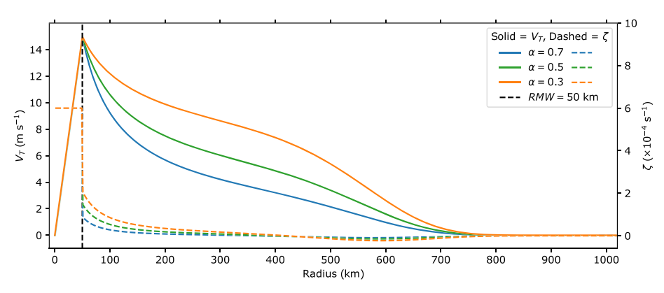
α are chosen as 0.3, 0.5, and 0.7, in accordance with observations of North Atlantic basin TCs (Mallen et al., 2005).
where $V_{0}$(r) denotes the initial modified Rankine vortex profile given by (1), r is the radius, and R is chosen as 600 km.
Radial decay function following Nolan (2007)
to ensure that the total circulation is zero.
A linear vertical decay function is applied that reduces the tangential velocity to zero at an altitude of 20 km.

Slide 18
Data and Method
climatological studies demonstrating that tropical moisture variance is maximized near the midtroposphere (e.g., Dunion, 2011; Holloway & Neel, 2009)
Previous studies has develop one method to investigate the influences
of environmental moisture.
Climatological studies demonstrating that tropical moisture variance is maximized near the mid-troposphere. (e.g., Dunion, 2011; Holloway & Neelin, 2009).
Relatively high mid-tropospheric moisture content within tropical waves has been shown to be an important factor contributing to cyclogenesis (Davis & Ahijevych, 2013; Komaromi, 2013).
Environmental
Moisture
Fix temperature profile,
and vary the mixing ratio

Slide 19
Data and Method
Beginning with the Dunion moist‐tropical sounding (Dunion, 2011), we fix the temperature profile and systematically vary the vertical structure of moisture to produce a set of three sounding.
The Dunion moist‐tropical sounding is first interpolated to 40‐m vertical intervals between the surface and 10‐km altitude. This region is smoothed using a 3‐km low‐pass Lanczos filter with 35 weights.
Variations to the smoothed moisture profile are then introduced by applying a Hanning window with a multiplicative factor such that the relative humidity (H)is set to 20%, 40%, or 60% at 4,960‐m altitude (∼560 hPa; Figure 2a)

Slide 20
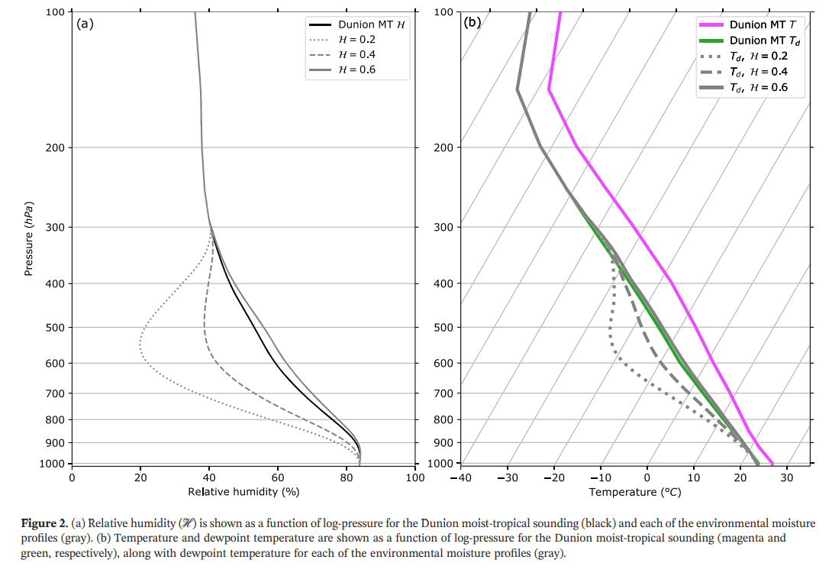

Slide 21
Data and Method
Numerical model setup
1.Nonhydrostatic, fully compressible Cloud Model 1 (CM1) version 19.7 (Bryan & Fritsch, 2002)
2. 9 combinations, 9 experiments
-> Two ways to simulate.
(1) 4 of experiments (large/small with dry/moist)
-> Simulated with full 3D configuration of CM1
(2)Each experiment with 10 ensembles
-> Simulated with axisymmetric simulation.
-> With random moisture perturbation (+-0.5 g/kg) to the lowest 500m
Environmental Moisture
H = 20% 、40% 、60%
Incipient Vortex Circulation
$α$= 0.3、0.5 、0.7

Slide 22
Data and Method
 | Axisymmetric | 3D Simulation
Horizontal Grid | Span 3050 km in radius Uniform 1 km spacing in the innermost 300 km Gradually stretches to 10 km spacing at boundary | Span 2040km x 2040 km in horizontal Uniform 2.5 km spacing in the innermost 1200 km Gradually stretches to 11.5 km spacing at boundary
Vertical Grid | Span 28 km in altitude Stretching from 50 to 500m in lowest 5.5km Uniform 500m above 5.5km | Span 28 km in altitude Stretching from 50 to 500m in lowest 5.5km Uniform 500m above 5.5km
Integated period | 8 days | 8 days
Microphysics Scheme | Morrison double moment scheme | Morrison double moment scheme
Sub-grid Turbulent parameteriztion | Louis PBL scheme | Louis PBL scheme

Slide 23
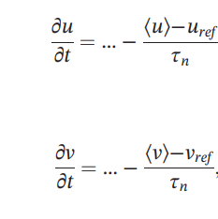
Data and Method
Other information
On a f plane
Sea surface temperature(SST) fixed at 29℃
Radiative process with 2K/day Newtonian relaxation to the
base temperature profile (Rotunno & Emanuel, 1987)
24 hr after deep moist convection was construct , impose 5 m/s westerly flow
throughout the domain.

Slide 24
Result

Slide 25
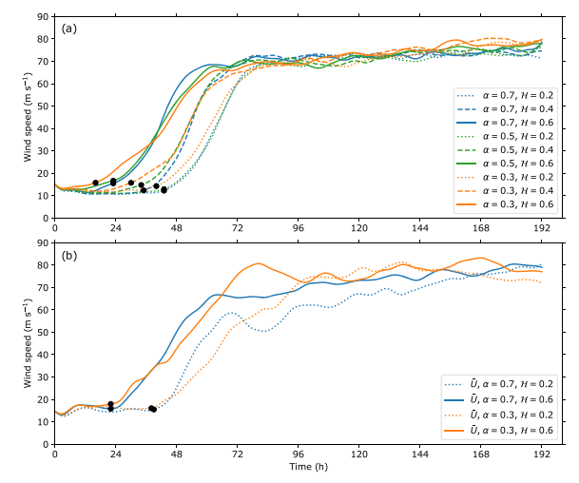
Result
Intensity is approximated as the
maximum azimuthally averaged wind speed
at the lowest model level (25 m)
Consistent with previous studies,
larger tropospheric moisture content
expedites the development phase
and initiation of RI as the incipient vortex
is more quickly moistened,
thereby promoting deep convection
(e.g., Kilroy & Smith, 2017; Tao & Zhang, 2014)
Axis-symmetric
3D-simulation
Notes:
黑點點是RI 開始的點

Slide 26
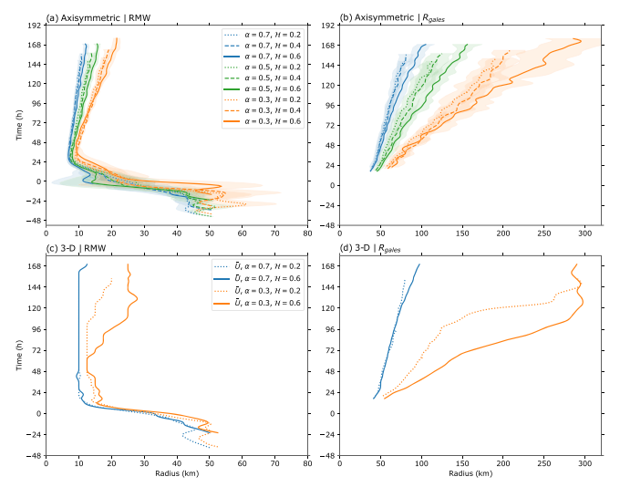
The shading in Figures 4a and 4b represent
1 standard deviation from the axisymmetric
ensemble‐mean RMW and $R_{gales}$
Principal finding of this study:
1. The incipient vortex circulation places
the primary constraint on TC expansion,
and in part establishes the expansion rate.
2. An initially large vortex (α = 0.3 )
expands more quickly than its relatively
smaller counterpart (α = 0.7)
3. Expansion rate is only slightly
modulated by increasing the
environmental moisture.
RI onset
RI onset
Notes:
增強時候RMW 縮小到10KM 然後再逐漸放大, 但小TC(藍線 alpha=0.7) RMW 跟Rgale 放大的較不明顯
在潮濕環境的TC 有較大的RMW 軸對稱模式有 但是3D模擬時 小TC 此差異沒有出現
主要發現有三 1.初始渦旋大小 影響較大 2. 一開始大的擴張率較快 3. 較濕的雖然擴張大，但影響較小，尤其在３Ｄ模擬小ＴＣ

Slide 27
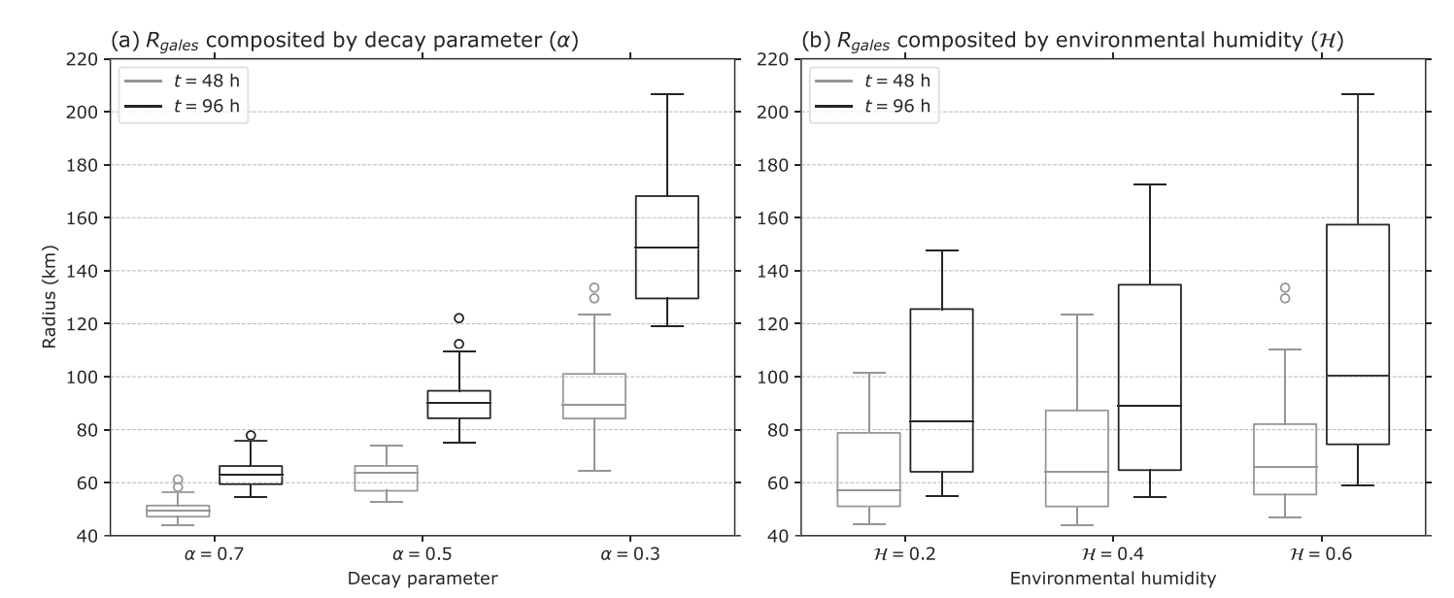
For axis-symmetric
Inter quartile range(IQR)
->Smaller for incipient vortex variation, larger for moisture variation
Median for radius variation,
->Larger for incipient vortex variation, smaller for moisture variation
Notes:
濕度的IQR明顯較大
同時不同大小SIZE Radius的差異 具有統計顯著性，反之濕度沒有
初始大小不同的ｔｃ，差異隨時間放大

Slide 28
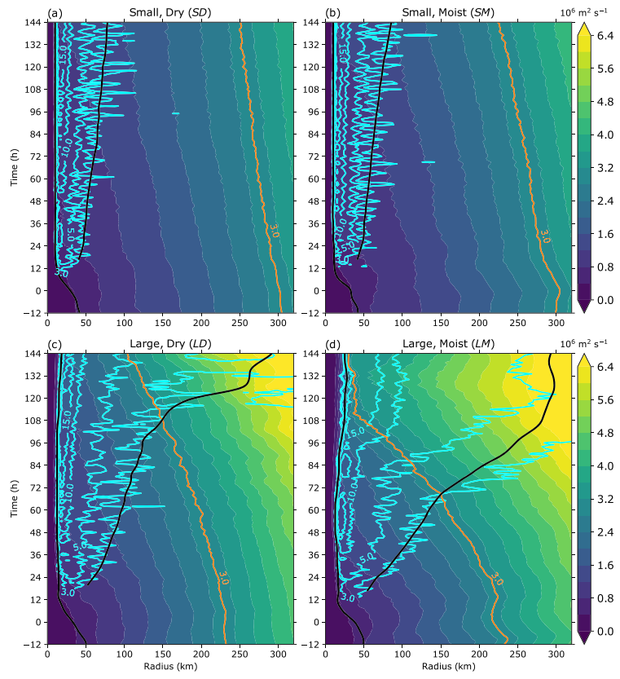
For 3D-simulation
1.TC expansion is inextricably linked to convectively driven convergence of AAM
toward the TC center of circulation.
2.The large TCs begin with a greater amount of outer‐core M compared to the small TCs
3.The extent of radial inflow is a function of incipient vortex circulation, such that the small TCs do not have radial inflow exceeding 3 m/s beyond 100‐km radius
The shading is azimuthally averaged AAM at 1km
0–1‐km altitude layer‐averaged radial inflow magnitude
(cyan contours at 3, 5, 10, and 15 m/s)
AAM surface corresponding to 3.0 × ${10}^{6} m^{2}s^{−1}$(orange)
Inner black curve: RMW; Outer black curve $R_{gales}$

Slide 29
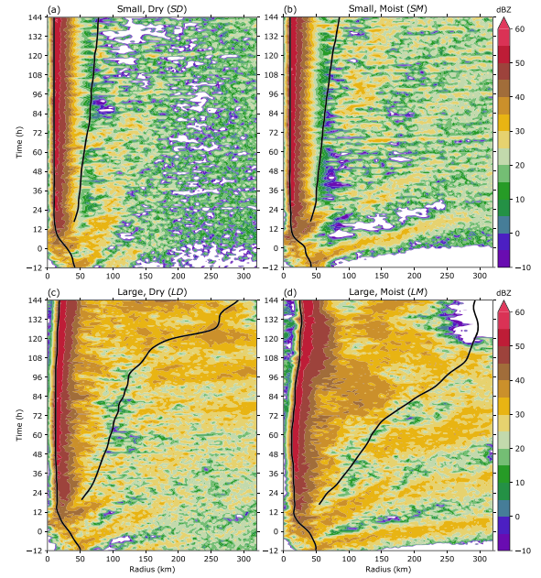
For 3D-simulation
Choose 2‐km altitude to capture the contributions from a bottom heavy updraft mass flux profile to
lower‐tropospheric convergence that draws in AAM,
thereby providing a direct relationship between convective activity and expansion.
Decreasing the incipient vortex circulation strength or environmental moisture
-> weaker azimuthally‐averaged convection
out of RMW.
The shading is Radar reflectivity (dBZ) at 2‐km altitude
Inner black curve: RMW; Outer black curve $R_{gales}$

Slide 30
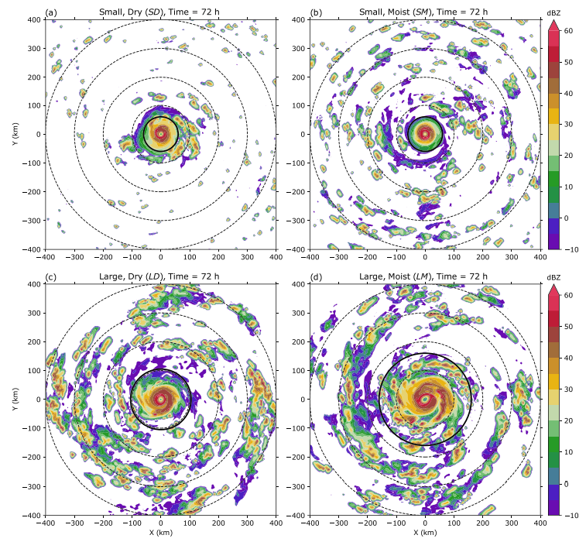
For 3D-simulation
Cartesian snapshots of radar reflectivity at 2‐km,
72 hr after the initiation of RI
Incipient vortex circulation is decreased
->small‐scale, isolated convective elements
Incipient vortex circulation is increased
->relatively large‐scale rainbands and MCS
Increasing the environmental moisture
->Increases the amount of convection but to
a relatively minor extent in comparison to
increasing the incipient vortex circulation.
The shading is Radar reflectivity (dBZ) at 2‐km altitude
Dashed black curve: Radius rings in increments of 100 km from TC center.
Solid black curve : $R_{gales}$

Slide 31
Quantify how the scale of outer‐core convection varies with the incipient vortex circulation and environmental moisture
by representing the radar reflectivity at 2‐km altitude
given by Z(r, j, t), as a Fourier series along the azimuthal dimension.

Slide 32
Cumulative normalized power spectra
at 48 and 72 hr after the initiation of RI for each simulation
1.Median cumulative power of outer‐core reflectivity occurs
large TCs :between azimuthal wave numbers 4–8
small TCs : above azimuthal wave number 9
larger scales of convection (i.e., smaller azimuthal wave numbers)
2.large TCs tend to develop relatively large‐scale convection in the outer‐core region, regardless of the environmental moisture
3.outer‐core convection for the small TCs exhibits a greater scale‐dependence on environmental moisture compared to the large TCs

Slide 33
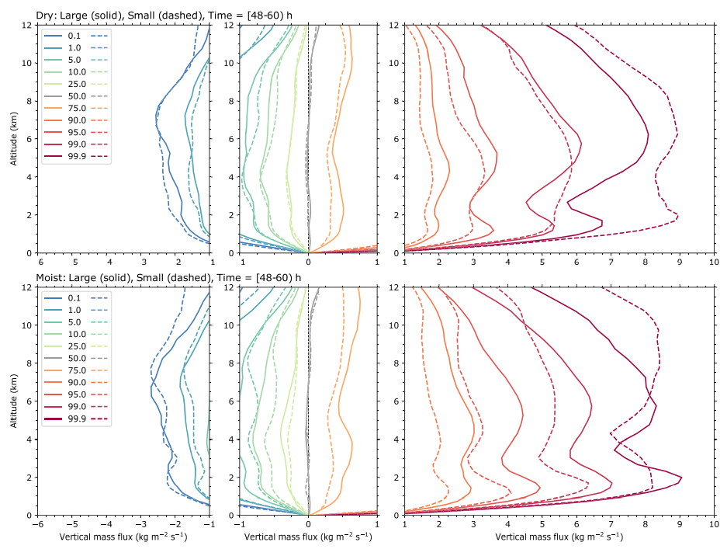
Inner‐core (r ≤ 50 km)
Individual quantiles from the
inner‐core (r ≤ 50 km) vertical mass flux
distribution for each TC between
48–60 hr after the initiation of RI.
.;pl
LD TC is characterized by a higher frequency of modest‐to‐strong inner‐core updraft mass fluxes
(75,90,95,99 percentile)
SD TC has a higher frequency of the strongest
inner‐core updraft mass fluxes (99.9% percentile)
Moist environment is quite similar for
large and small TC to dry environment.
Strongest updraft mass fluxes for the SM TC is only
found above 8‐km altitude rather than throughout
the troposphere as in the dry environment.

Slide 34
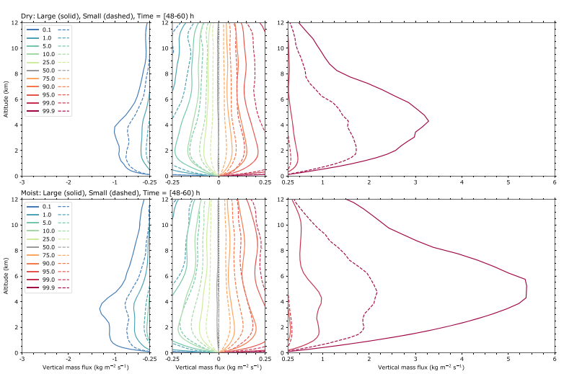
Outer‐core (100 ≤ r ≤ 300 km)
Individual quantiles from the
outer‐core (100 ≤ r ≤ 300 km) vertical mass flux distribution for each TC between 48 and 60 hr
after the initiation of RI.
Large TCs are characterized by stronger
outer‐core updraft and downdraft mass fluxes compared to the small TCs.
In contrast to the inner‐core vertical mass flux analysis, large TCs exhibit a higher frequency
of outer‐core updraft and downdraft mass
fluxes for all quantiles.

Slide 35
Absolute Circulation Evolution
C is the absolute circulation
${\text{η}}_{z}$ is absolute vertical vorticity
δ is the area‐averaged horizontal divergence
within the area (A) bounded by the integration circuit
u is the radial velocity v is the tangential velocity
w is the vertical velocity
overbar denotes the azimuthal mean
primes denote deviations from the azimuthal mean
circulation
/A
eddy flux
stretching
vorticity
tilting
friction

Slide 36
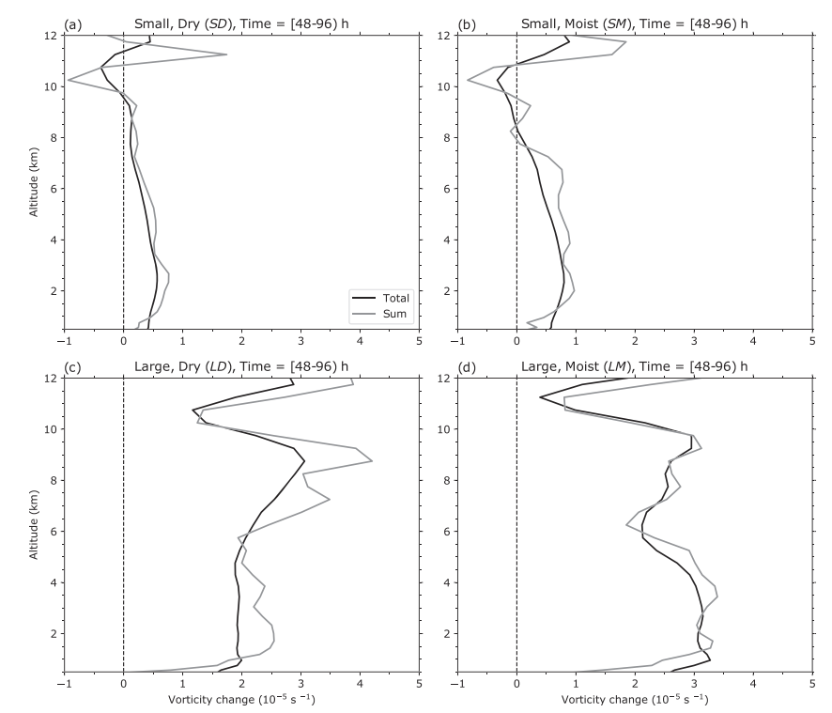
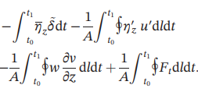
Absolute Circulation Evolution
Ensemble‐average analysis centered on the 300‐km radius circuit to assess contributions from both
the inner‐ and outer‐core convection to the area‐averaged vorticity change
Black line :
Grey line :
Compare LHS and RHS of Eq (9), to make sure
we are able to ananlysis RHS of Eq (9) term by term.
Vorticity(96hr) - Vorticity(48hr)
Notes:
RI 開始後 48小時 和 96小時的變化
The ensemble‐average approach is designed to mitigate biases introduced from convective activity concentrated along the circuit
To produce an ensemble of circuits, we perturb the radial extent of the circular integration domain ±12.5 km. Terms on the right‐hand side of Equation 9 are then evaluated along each of the circuits and the ensemble average is defined by the area‐weighted contributions from all of the circuits.

Slide 37
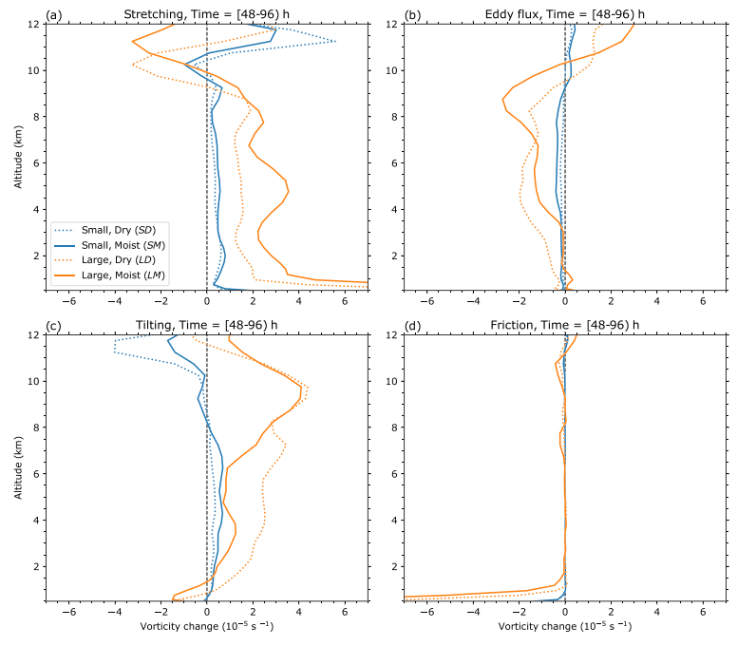
stretching
eddy flux
Incipient vortex or moisture
→stretching
Increasing moisture has a stronger effect
on larger TCs .
Large TCs have a greater amount of outer‐core convection and therefore larger tilting
contributions to the net area‐averaged
vorticity change.
The eddy vorticity fluxes provide a negative contribution to the net area‐averaged vorticity.
Large TC → Stronger upper level updraft
→ Greater eddy flux term
tilting
friction

Slide 38
Outer‐core (100 ≤ r ≤ 300 km)
Notes:
重複講 大TC mass flux 較大的事情

Slide 39
Discussion and Conclusion

Slide 40
Discussion and Conclusion
Hill and Lackmann (2009) demonstrated that environmental humidity is an important factor contributing to TC size.
Increasing the environmental humidity
Promote radially outward
propagating spiral rainband
Generate greater amount PV
and subsumed by inner core
PV tower
Increasing its lateral extent
and spinning up the outer
core cyclonic wind field
the fundamental processes underlying its premise appear in previous studies that vary the incipient vortex circulation while fixing the environmental moisture
Authors found that increasing the environmental moisture for large TCs produces a relatively larger contribution to their expansion rates compared to small TCs.
Notes:
先前intro提過
這邊補充認為其實 颱風大小是前提 大或小會影響到增加水氣的影響程度

Slide 41
TCs memory?
TCs possess a sort of “memory” with respect to their incipient circulation
(Knaff et al., 2014; Rotunno & Emanuel, 1987), which underlies the statement that
→ large TCs stay large and small TCs stay small
Authors further demonstrated that a cumulatively greater AAM convergence over time permits an initially large vortex to expand more quickly than its relatively smaller counterpart.
Yet, Schenkel, Lin, Chavas, Vecchi, Oppenheimer, et al. (2018) demonstrated that this memory is largely preserved prior to TCs attaining their lifetime maximum size, but it is attenuated afterward as TCs begin contracting

Slide 42
Limitation of this study
1.Begin with an axisymmetric incipient vortex circulation and horizontally homogeneous environmental conditions, but precursor disturbances are intrinsically asymmetric
and embedded within spatially inhomogeneous environments
(e.g., Chang et al., 2017; McTaggart‐Cowan et al., 2008, 2013)
2.Excluding contributions from cloud radiative forcing which have been shown to aid the expansion of TC wind fields by producing weak, sustained ascent in the outer‐core region that promotes and enhances convective activity (Bu et al., 2014; Fovell et al., 2016).
3. Limited by imposing a uniform flow throughout the simulation domain instead of introducing vertical shear flow. Previous studies have demonstrated that a low‐level flow vector oriented along the upshear‐right quadrant of a TC embedded in vertical shear flow favors larger expansion rates (Chen et al., 2018, 2019)

Slide 43
We direct future work
→ toward elucidating the relationship between the incipient vortex circulation and the upscale growth of outer‐core convection
Surmise that
→Scale and duration of outer‐core convection are interdependent; thus,
their combined influence may in part account for the variable expansion rates
Expecting that
→ Relatively large‐scale convection with a long duration to have a stronger influence on the net area‐averaged vorticity change, and hence expansion rate, compared to relatively small‐scale convection with a short duration

Slide 44
Some final conclusions
Azimuthally averaged strength of convection varies monotonically with the
incipient vortex circulation.
2. large TCs are characterized by radially propagating convection that contributes to an
expanding eyewall and further enhances the outer‐core expansion rate
3. large TCs exhibit a higher frequency of stronger outer‐core updraft and downdraft mass fluxes
4. Increasing the azimuthal scale, amount, and strength of outer‐core convection, associated with increasing the incipient vortex circulation, results in approximately
2–4 times larger stretching and tilting contributions.

Slide 45
Some final conclusions
5.Increasing the midlevel environmental moisture further promotes convection, but varying the environmental moisture mostly acts to delay or expedite the intensification process in our idealized modeling setup.
6. As the incipient vortex circulation increases, variations to the midlevel environmental moisture have more pronounced contributions to the expansion rate.
7.Varying the incipient vortex circulation has a stronger influence on the azimuthal scale of outer‐core convection in contrast to varying the mid‐level environmental moisture.
(Final, but most important conclusion in my personal opinion)

