Slide 1
Asymmetric Rainband Processes Leading to Secondary Eyewall Formation in a Model Simulation of Hurricane Matthew (2016)
Yu, C.-L., A. C. Didlake Jr., F. Zhang, R. G. Nystrom, 2021: Asymmetric Rainband Processes Leading to Secondary Eyewall Formation in a Model Simulation of Hurricane Matthew (2016). J. Atmos. Sci., 78,29-49.

Slide 2
Introduction
Secondary eyewall formation (SEF) in tropical cyclones (TCs) is an inner-core process that initiates an eyewall replacement cycle (ERC), which can cause significant intensity and structural changes of the storm, such as a broader wind field and a larger eye. (Willoughby et al. 1982; Black and Willoughby 1992)
Montgomery and Kallenbach (1997) hypothesized SEF as the consequence of outward-propagating vortex–Rossby waves (VRWs) being stagnated at a critical radius.
The potential vorticity (PV) anomalies near the secondary eyewall radius are either generated locally or sourced from spiral rainbands at larger radii. (Qiu et al. 2010; Judt and Chen 2010)
Huang et al. (2012) proposed a progressive boundary layer control pathway, in which the unbalanced supergradient force decelerates the boundary layer inflow and forces enhanced boundary layer convergence.
Didlake et al. (2018) found a mesoscale descending inflow (MDI) in Hurricane Riat (2005) and Earl (2010), which had a robust vertical updraft on its inward side that contributed to the subsequent SEF.

Slide 3
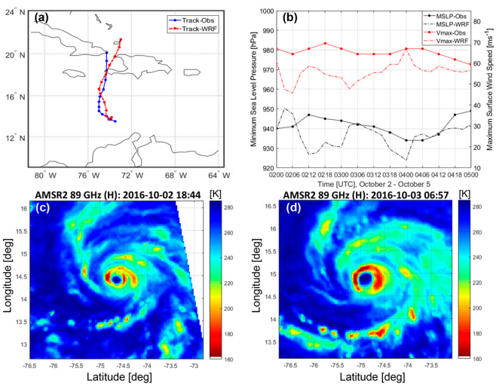
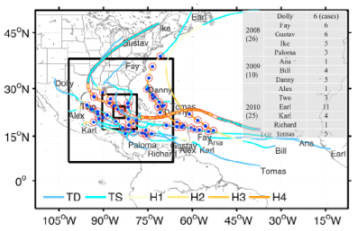
Model and data
WRFv3.5.1
Four two-way nested domain (vortex following)
Δx: 27,9,3,1-km (innermost domain 499×499 grid points),43 eta levels
Physics: WSM6, YSU, Grell-Devenyi(outermost only)
IC: EnKF analysis mean at 00Z 2 Oct 2016
BC: GFS Forecast
slightly weaker
Zhang et al. (2011)
SEF
EnKF cycling data assimilation
09/25
18Z
3-hr cycling freq.
Conventional obs.
Airbone Doppler radar
Dropsodes …
10/02
00Z
10/03
00Z
before ERC
D_{eye} = 9 km
after ERC
D_{eye} = 17 km

Slide 4
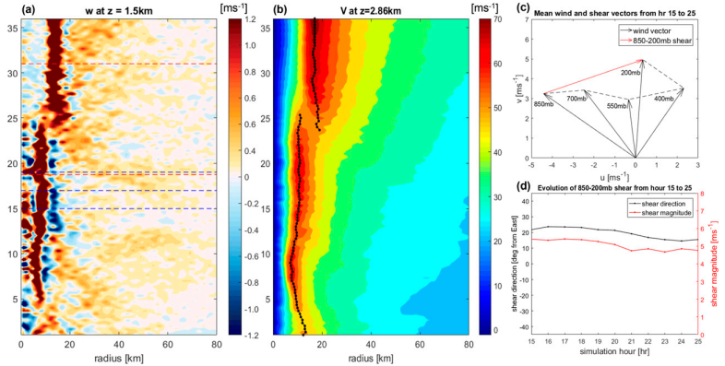
Overview of SEF in the Matthew simulation
forecast hours
r: 200-500 km

Slide 5
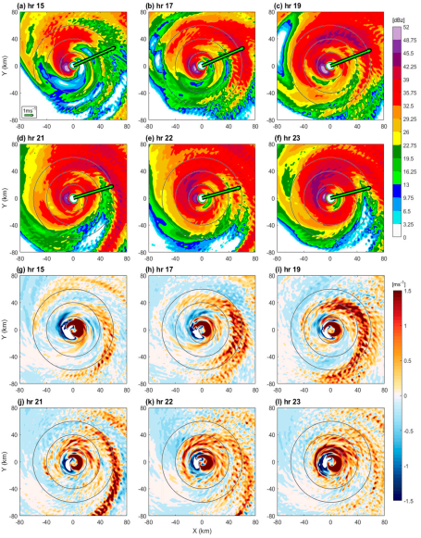
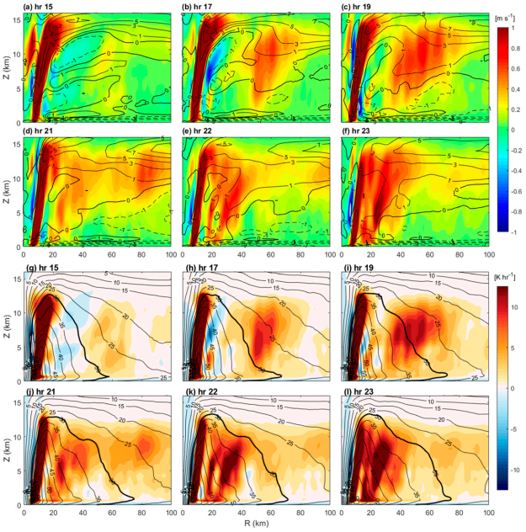
w; V_{r}
dBZ
Q; V_{T}
w

Slide 6
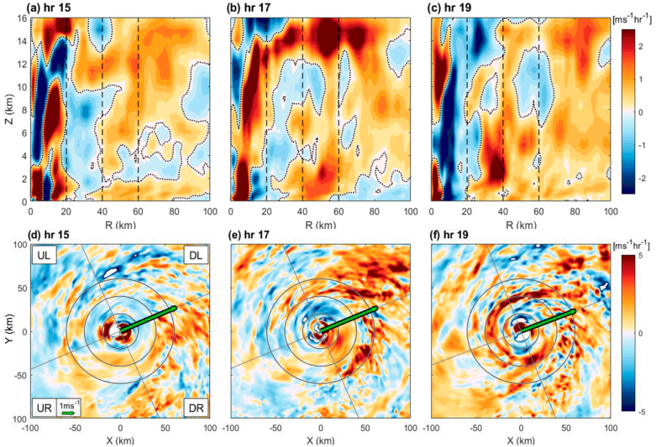
Storm-scale changes in tangential velocity and angular momentum
a_{T}
azi. averaged
inward-
descending
pattern
a_{T}
averaged
Z = 2-6 km

Slide 7
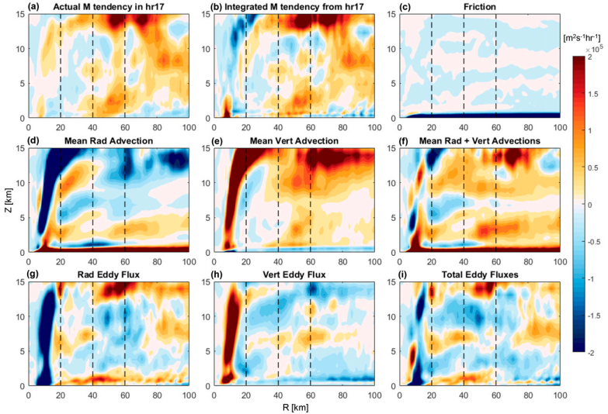
angular momentum budget analysis
$$M_{ST}=rv_{ST}+\frac{1}{2}fr^{2}$$
2 modes in DR and DL

Slide 8
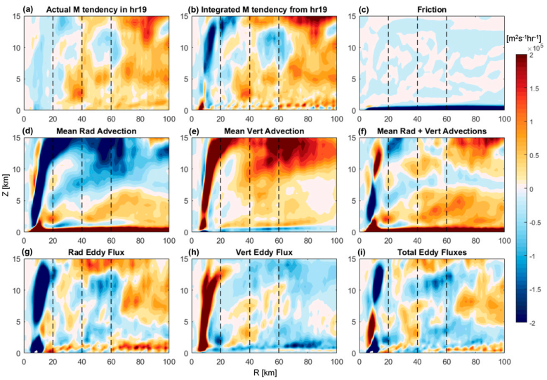
angular momentum budget analysis
$$M_{ST}=rv_{ST}+\frac{1}{2}fr^{2}$$
Increase of midlevel
mean radial inflow
weaker

Slide 9
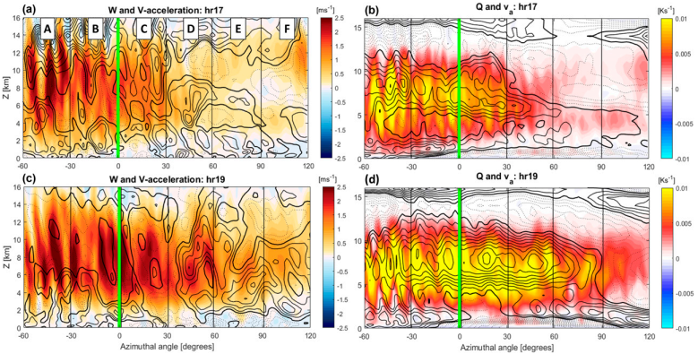
Asymmetric along-band structure
$$v_{a}=\overset{⃑}{v_{ST}}−\overset{⃑}{v_{env}}−\overset{⃑}{v_{azi}}$$
Top-heavy
Bottom-heavy
Bottom-heavy
Notes:
17hr
下風切處對流強，下風處對流減弱(color W & Q)
AB: 切向風加速度平流至高層(10km)，下風處降到3公里高 19hr
對流由DR延伸至DL，aT & Va downwind shift
aT集中在DL(D-F)
aT被Va抵銷，表示非對稱風強度達到peak，開始風場軸對稱的過程

Slide 10
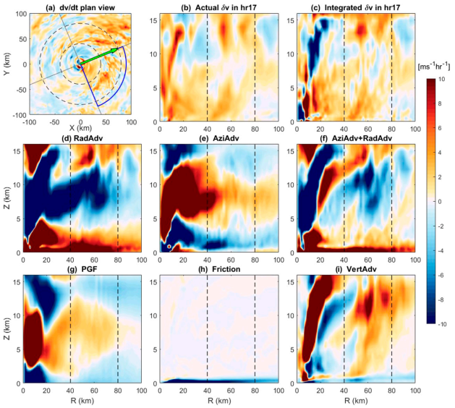
Quadrant-averaged tangential wind budget analysis
Notes:
目的：看不同象限的加速度來源，所以沒有分mean & eddy項

Slide 11
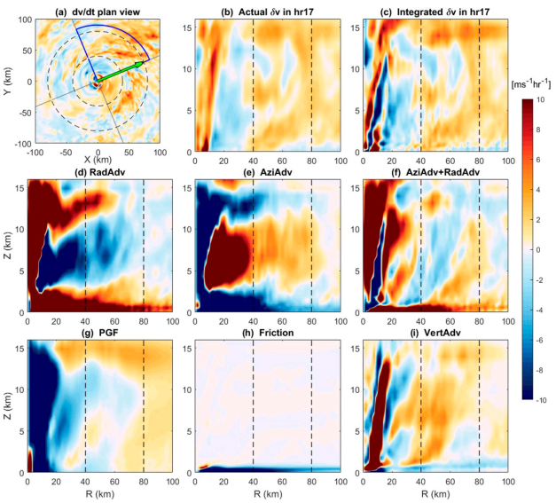
Quadrant-averaged tangential wind budget analysis
Outward-sloping
v_{a}
Angular momentum
inward transport by radial inflow

Slide 12
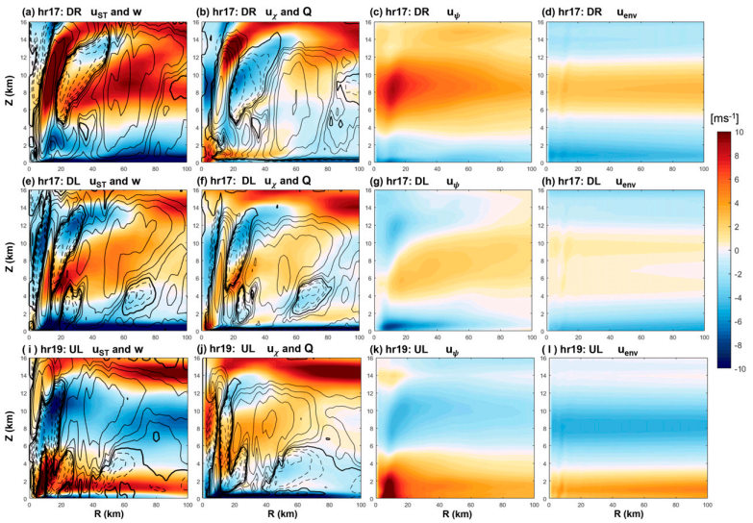
Inflow & w irrotational & Q nondivergent environment (shear)
Stratiform
diabatic
cooling
Mesoscale descending inflow
(MDI)

Slide 13
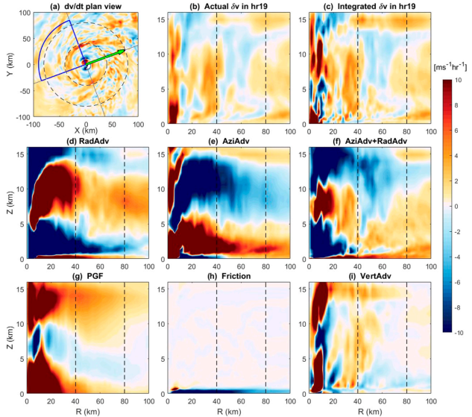
Quadrant-averaged tangential wind budget analysis
Notes:
此時是次眼牆開始軸對稱化的初始時期

Slide 14
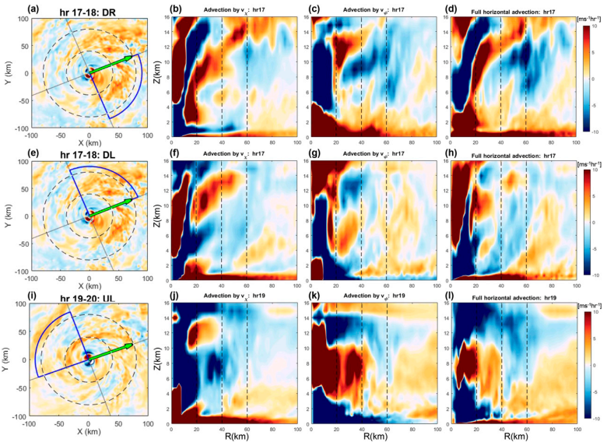
a_{T} HAD HAD
by irrotational by nondivergent Total HAD
Notes:
DR: b圖，convective heating下方的低層convergence驅動
DL: f圖，stratiform diabatic forcing讓inflow形成MDI產生中層convergence
UL: j圖，stratiform cooling更顯著，連結到PBL。k圖，由radial eddy flux貢獻

Slide 15
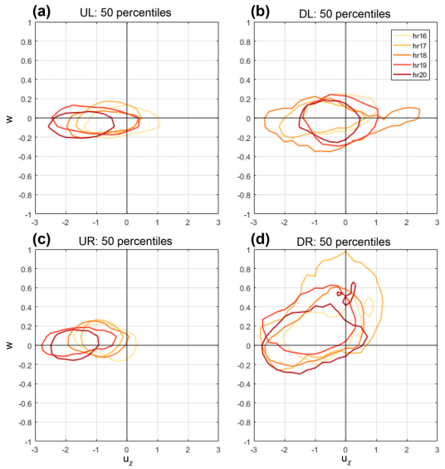
Evolution of MDI
40 km < r < 80 km
2 km < z < 6 km
30º azimuthal moving averaging
Volumetric weighted (r×dr×dz)
Existence of MDI
w (-), u_{χ} (-)
convective rainband activity
w (+), u_{χ} (-)

Slide 16
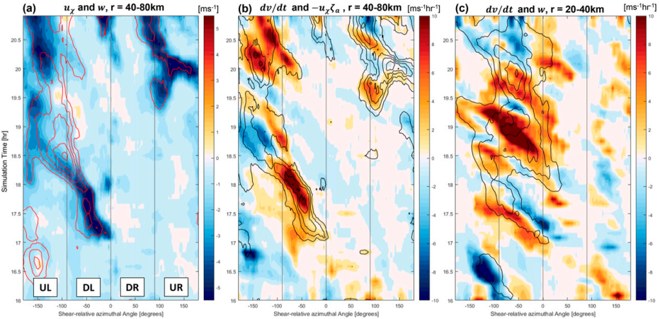
30 min moving averaging
u_{χ} & (-)w
a_{T} & HAD by irrotational
a_{T} & (+)w
Notes:
C: MDI從PBL激發對流，透過垂直平流產生aT

Slide 17
Conclusions
Downshear Right
In the downshear-right (DR) quadrant where the rainband complex is more convective, the acceleration is more upright and concentrates within a band of 20 km wide centered at 50 km radius. A quadrant-averaged tangential wind budget over the DR confirms that vertical advection is the dominant contributor here, resulting in a local acceleration pattern that resembles the mean vertical advection in the angular momentum budget.
Downshear Left
In the downshear-left (DL) quadrant, the acceleration is similarly intense but more widespread, extending from 40 to 120 km radius. Here, horizontal advection plays a more important role in shaping the total acceleration structure than vertical advection. The emergence of the MDI (associated with diabatic cooling in stratiform precipitation) in the DL quadrant is also the primary reason of the inward descending pattern in the axisymmetric acceleration outside of 40 km radius.
Upshear Left As the MDI traverses into the upshearleft (UL) quadrant at hour 19, it becomes more widespread, and so as the associated acceleration at large radii. We note that the UL is also the quadrant where the MDI seemingly interacts with the boundary layer. At the inner edge of the descending inflow, new convective updrafts are triggered, which are found to be important to the axisymmetric tangential acceleration at low levels and the following axisymmetrization of the secondary eyewall.

