Slide 1
A Convection Parameterization for Low-CAPE Environments
McTaggart-Cowan, R, P. A. Vaillancourt, L. Separovic, S. Corvec, and A. Zadra, 2020: A convection parameterization for low-CAPE environments. Mon. Wea. Rev., 148, 4917–4941.

Slide 2
introduction
Many of global NWP systems employ schemes that relate the deep convective activity directly to the convective available potential energy (CAPE) of the near-storm environment (Yano et al. 2013)
The potential for vigorous moist convection in low-instability environments represents a predictability and detection challenge (McCann 1978; Vescio and Thompson 2001; Davis and Parker 2014).
Convective activity in low-CAPE condition:
Sufficient potential instability and moisture
warm sectors and frontal boundaries of midlatitude cyclones (Jewett and Wilhelmson 2006; Clark 2009; Evans 2010).
strong synoptic and mesoscale forcing for ascent in the pre-convective environment [van Den Broeke et al. (2005)]
Notes:
The potential for vigorous moist convection in low-instability environments represents a predictability and detection challenge because traditional conceptual models and severe weather indices fail to identify such regions of possible convective activity (McCann 1978; Vescio and Thompson 2001; Davis and Parker 2014).
In the low-CAPE context (including the zero-CAPE limit), the ﬁrst two of these are typically associated with the warm sectors and frontal boundaries of midlatitude cyclones (Jewett and Wilhelmson 2006; Clark 2009; Evans 2010).
The importance of strong synoptic and mesoscale forcing for ascent in the pre-convective environment is emphasized by van Den Broeke et al. (2005) in relation to the quasi-linear mesoscale convective systems that can develop parallel to cold fronts under low-CAPE conditions.
Along the leading edge of these fronts, the poleward transport of moisture in the warm conveyor belt (Carlson 1980; Eckhardt et al. 2004) contributes to satisfying the moisture requirement of the ingredients-based perspective (King et al. 2017).

Slide 3
precipitation bull’s-eyes:
the gridscale condensation scheme depicts latent heating at the base of the potentially unstable layer as the grid cell-averaged relative humidity nears saturation in the ascending airstream (Teixeira 2001; Quass 2012).
Models that employ a class of convective schemes whose activity depend on moisture convergence (Bougeault 1985; Tiedtke 1989; Banacos and Schultz 2005) have the potential to represent better the effects of convection in low-CAPE environments.
all relationships to the large-scale state weaken as model resolution increases.

Slide 4
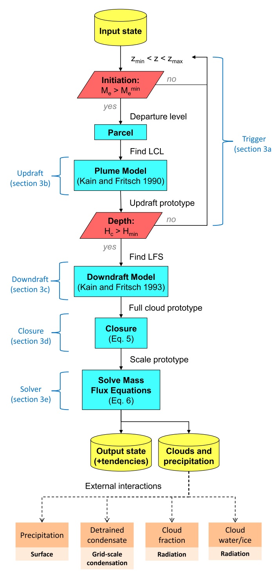
A low-CAPE convection scheme (based on Tiedtke (1989) scheme)
Notes:
To avoid the double-counting of moist convective effects, the new scheme is only tested for possible activity where CAPE values are below 250 J kg 2 1.

Slide 5
Trigger function
$ρ:$ density
$∆x$: model grid length
$$M_{0}=7×{10}^{6}kgs^{−2}$$
$$f≥1×{10}^{−6} s^{−1}$$
vertical wind speeds (w) can become large as gravitational or symmetric instabilities are released, particularly when the gridscale condensation scheme predicts latent heating in ascending airstreams.
The justiﬁcation for the scaling (f) is based on the presence of off-equatorial ascent driven by inertial instability(Tomas and Webster 1997).
Notes:
The justiﬁcation for this scaling is based on the presence of off-equatorial ascent driven by inertial instability that is not associated with low-CAPE convection (Tomas and Webster 1997).

Slide 6
A low-CAPE convection scheme (based on Tiedtke (1989) scheme)
r = 500 m (Bechtold et al. 2001)

Slide 7
Updraft speed ($w^{u}$) :
Parcel buoyancy is generally small in low-CAPE proﬁles,
cloud-base updraft speed (w _{LCL} ) that serves as the lower boundary condition plays an important role in determining the depth of the cloud layer.
$T_{v}$:virtual temperature
$ε$: entrainment rate
$λ$: 0.5 (empirically derived constant)
$Δ$: difference between two adjacent model levels
$\overline{()}$: an average over the same layer
$D_{p}$: the drag on updraft acceleration resulting from condensate loading

Slide 8
A low-CAPE convection scheme (based on Tiedtke (1989) scheme)
$$overshooting cloud top: w^{u}=0 (m/s)$$
$$H_{min}=2000 (m)$$
Notes:
To avoid the double-counting of moist convective effects, the new scheme is only tested for possible activity where CAPE values are below 250 J kg 2 1.

Slide 9
downdraft
The top of the downdraft [the level of free sink (LFS)]:
minimum environmental saturation equivalent potential temperature
initial downdraft mass ﬂux:
an extraction of updraft air scaled by precipitation efﬁciency (Ep) as
Between the LFS and the top of the detrainment layer, the downdraft grows through a constant fractional entrainment rate of 0.03
downdraft characteristics:
cold pool formation
potential secondary initiation
$$E_{p}:0.4$$

Slide 10
A low-CAPE convection scheme (based on Tiedtke (1989) scheme)
Notes:
To avoid the double-counting of moist convective effects, the new scheme is only tested for possible activity where CAPE values are below 250 J kg 2 1.

Slide 11
Closure
$$ρ_{LCL}πr^{2}W_{LCL}=ρ_{LCL}W_{LCL}∆x^{2}$$
$$factor=\frac{∆x^{2}}{πr^{2}}$$
cloud population size
grid-scale vertical motion: a key ingredient for low-CAPE convection.

Slide 12
A low-CAPE convection scheme (based on Tiedtke (1989) scheme)
Tendencies for gridscale variables:
$Ψ$:gridscale variable
Notes:
To avoid the double-counting of moist convective effects, the new scheme is only tested for possible activity where CAPE values are below 250 J kg 2 1.

Slide 13
model description
Global Environmental Multiscale (GEM) model:
operational applications at the Canadian Meteorological Centre
semi-Lagrangian dynamical core
log-hydrostatic-pressure type (Girard et al. 2014).
0.09。 ( ~10 km) grid spacing
300-s time step
84 levels
Model top at 0.1-hPa
Physical parameterizations (McTaggart-Cowan et al. 2019a):
gridscale condensation scheme: Sundqvist 1978)
Convection scheme: include the shallow and midlevel convection schemes [Bechtold et al. (2001)]
Notes:
ERA5: 0.25 degree

Slide 14
Data
In situ data: radiosonde and surface observations available over the Global Telecommunication System.
Precipitation: Multi-Radar Multi-Sensor (MRMS) system
ERA-Interim (0.5 degree; Dee et al. 2011)
higher-resolution ERA5 (0.25 degree; Hersbach et al. 2018) for the analysis of mesoscale structures

Slide 15
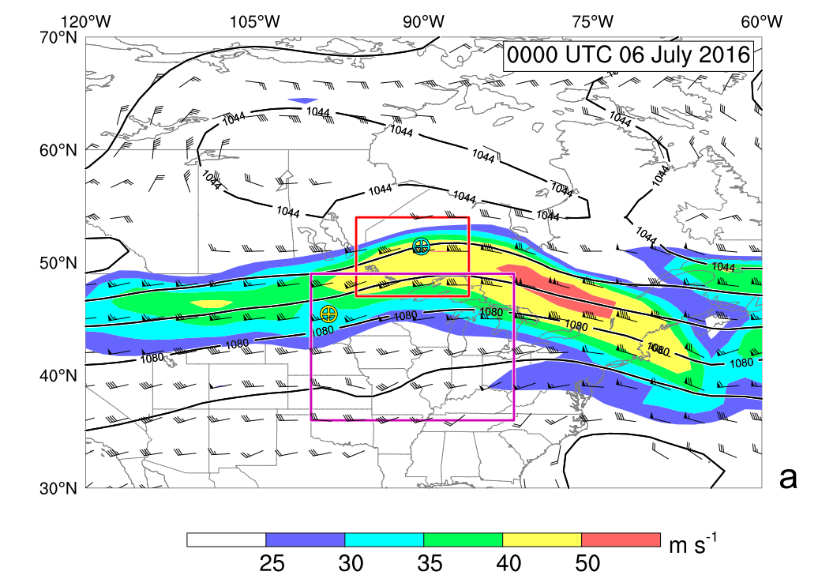
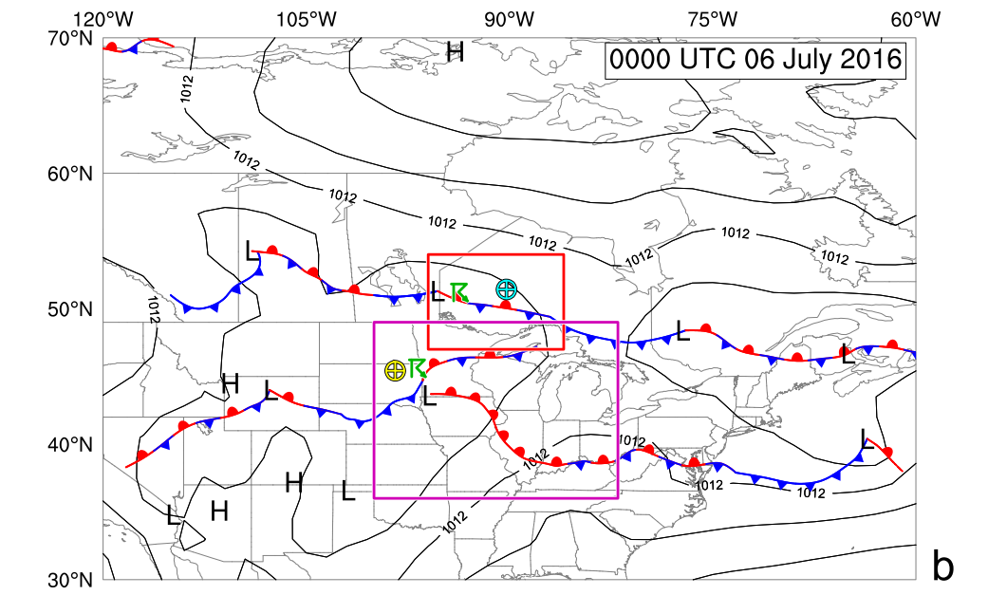
Heavy precipitation case study
Heights (contours), winds and wind speeds (color) at 250 hPa
surface
Ontario,
Pickle Lake sounding station
Quebec
Aberdeen station
Ontario: isolated convective cells
midwestern United States: long-lived squall line
Notes:
A jet streak centered over Quebec places both of the areas of interest in the conﬂuent entrance region (Fig. 2a).
The midwestern squall line develops in the equatorward jet entrance, an optimal location for quasi-geostrophic forcing for midtropospheric ascent (Namias and Clapp 1949; Uccellini and Johnson 1979; Bluestein and Thomas 1984).
The baroclinicity that supports the anomalous jet appears in the form of a pair of zonally oriented fronts that straddle
the international border (Fig. 2b).
Both convective events are initiated in close proximity to these fronts, consistent with conceptual models of convective development in low-instability environments (van Den Broeke et al. 2005; Sherburn et al. 2016).

Slide 16
Isolated convection in northern Ontario
Quantitative precipitation estimates (color; in mm/h) from the MRMS dataset
Pickle Lake sounding station
Notes:
Isolated convective cells develop over northwestern Ontario at 2100 UTC 5 July (1700 local time), immediately poleward of the warm-frontal boundary in the region.
The storms remain anchored to this feature at 0000 UTC (Fig. 3b), despite their rapid eastward progression under a strong westerly ﬂow aloft (Fig. 2).
By 0400 UTC (local midnight), the cells have largely dissipated, although scattered showers remain throughout the area.

Slide 17
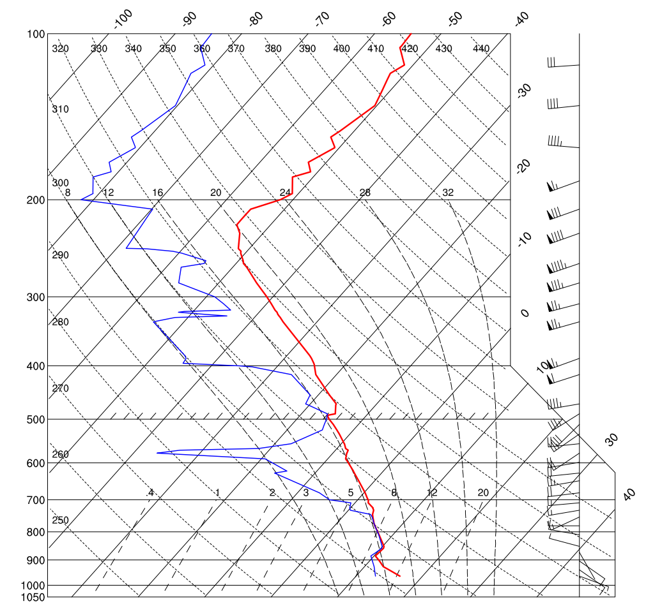
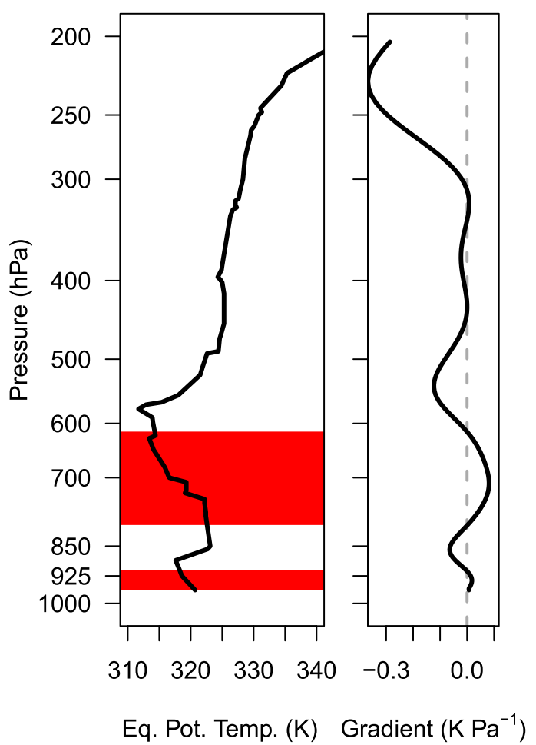
0000 UTC 6 July
Pickle Lake sounding station
the baroclinic zone near 850 hPa
ample moisture for convection
warm advection (‘‘frontal overrunning’’)
attendant quasigeostrophic forcing for ascent.
nearly moist adiabatic above 850-hPa (devoid of CAPE)
drying in the 750–550-hPa layer leads to a negative vertical gradient in $θ_{e}$ (potential instability)
Notes:
The 0000 UTC 6 July Pickle Lake sounding is taken to be representative of conditions poleward of the surface front in the preconvective environment (Fig. 3d), wherein the radiosonde intersects the baroclinic zone near 850 hPa (Fig. 4).
The sounding provides preliminary evidence that the three ingredients for convective initiation are present.
The saturated layer above the frontal inversion contains ample moisture for convection, while the veering wind proﬁle across this layer implies warm advection (‘‘frontal overrunning’’) and attendant quasigeostrophic forcing for ascent.
The source of instability is less clear, as daytime heating has failed to warm the boundary layer sufﬁciently to overcome the convective inhibition of the 850-hPa inversion.
The proﬁle is nearly moist adiabatic above this level, devoid of appreciable CAPE.
However, drying in the 750–550-hPa layer leads to a negative vertical gradient in equivalent potential temperature (u e ) that is indicative of potential instability (Fig. 5).

Slide 18
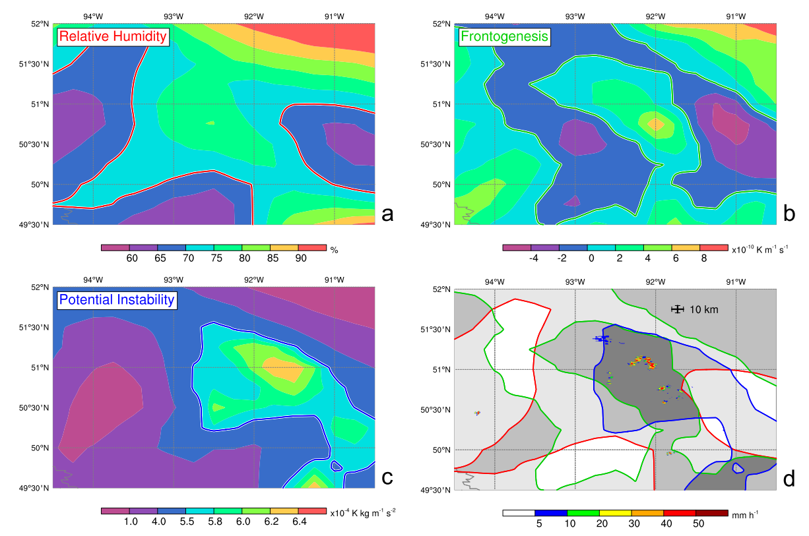
near-storm environment averaged over the 850–750-hPa layer at 00UTC 6 Jul 2016
Red line: RH>70%
green line:
frontogenesis > 0 ( K m⁻¹s⁻¹)
Blue line: $\frac{∂θ_{e}}{∂P}>0$
Notes:
The release of potential instability requires layer lifting via forced ascent that may occur at synoptic scales or at the mesoscale.
A local maximum in relative humidity is indicative of available moisture (Fig. 6a); however, values remain generally below 80% in the region of interest and may serve as a limiting factor on the areal extent of convection.
A similar maximum in frontogenesis (Fig. 6b) implies a forcing for mesoscale ascent in the secondary circulation across the baroclinic zone (Keyser
et al. 1988).
The ﬁnal convective ingredient, instability, is assessed as ›u e /›p, which is positive in areas of potential instability (Fig. 6c).
Combining these three ingredients with a set of thresholds determined by inspection of this case, it becomes clear that the bulk of convective activity occurs in the area where the local extremes of the convective ingredients overlap (Fig. 6d).
This suggests that the observed convection in this low-CAPE region forms in response to frontogenetic forcing in a relatively moist, potentially unstable environment.

Slide 19
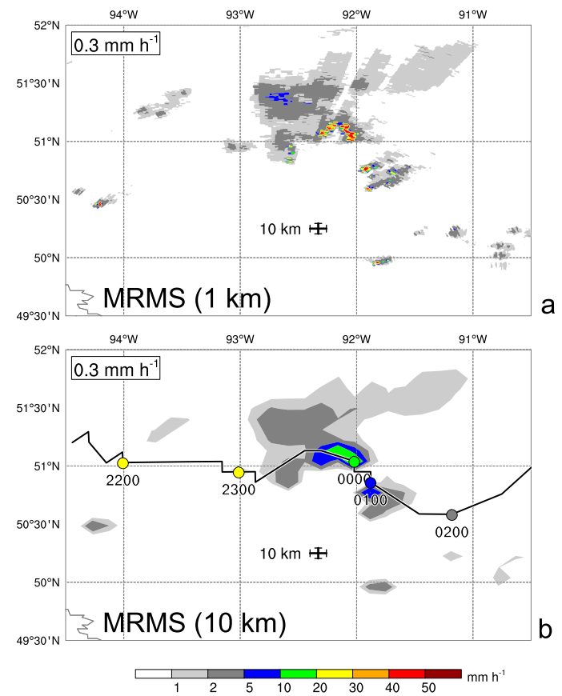
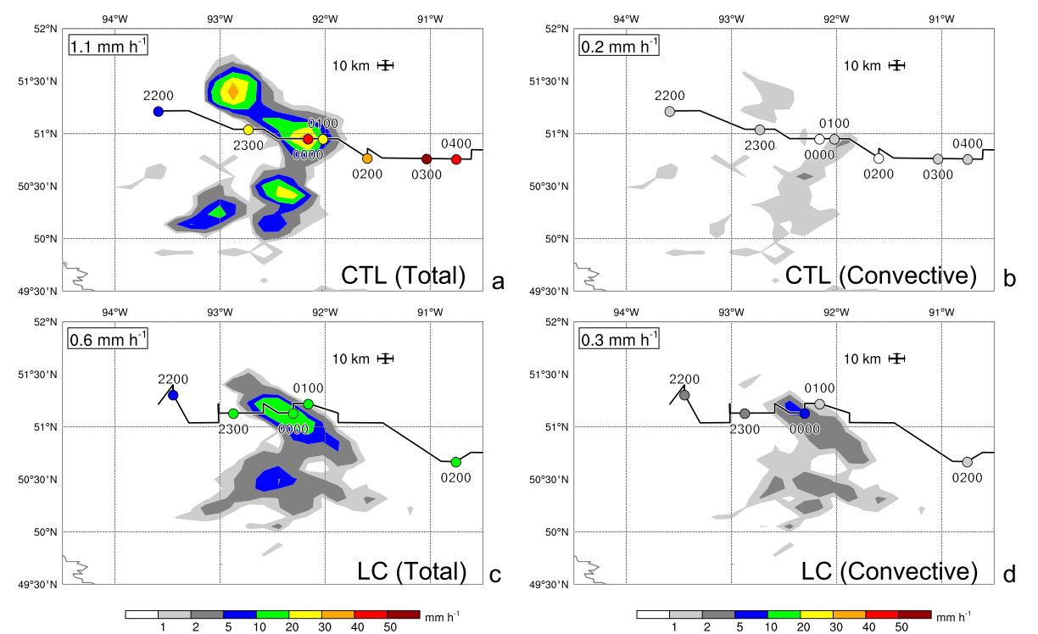
Precipitation rate (mm/hr)
at 0000 UTC 6 Jul 2016 over the northern Ontario region
Black line: the track of the precipitation maximum with hourly markers
Notes:
The CTL model integration for this event successfully simulates the development of precipitation in northern Ontario in the short-range forecast (Fig. 8a). However, bull’s-eyes in which precipitation rates exceed 30mm/hr are apparent in the precipitation ﬁeld.
Although such rainfall intensities are consistent with the localized maxima estimated in the full-resolution MRMS dataset (Fig. 7a), they are clearly excessive on a 10-km grid (Fig. 7b).
This broadening of the precipitation cores leads to area-averaged CTL rainfall rates that nearly double the observational estimate (Figs. 7b and 8a).
the CTL model is releasing the potential instability via the gridpoint storm mechanism.
When the low-CAPE convection scheme is activated, the isolated precipitation maxima of the CTL integration are replaced by an extended area over which rainfall rates approach 20 mm/h, in line with the MRMS estimate (cf. Figs. 7b and 8c).
Although the regionally averaged convective rainfall rate only increases by 0.1 mm/h, the ratio of convective to total precipitation rises from , 20% to 50% in this integration (based on domain-average precipitation rates annotated in Fig. 8).

Slide 20
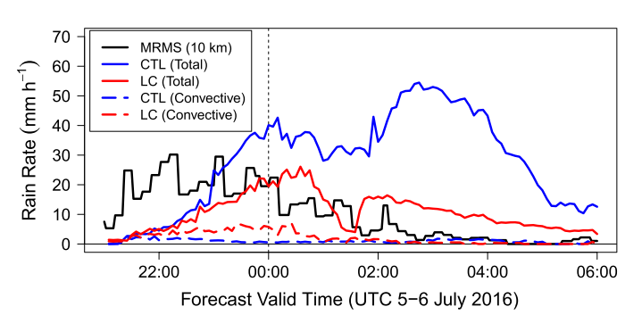
Time series of maximum total (solid) and convective (dashed) precipitation rates
following the convective event
Notes:
The dramatic reduction in precipitation rates predicted by the gridscale condensation scheme is an indication that the potential instability is processed through parameterized moist turbulence in the low-CAPE convection scheme, rather than being extracted through an underresolved interaction between gridscale condensation and model dynamics.

Slide 21
Squall line in the midwestern United States
Quantitative precipitation estimates (color; in mm/h) from the MRMS dataset
Notes:
The evolution of an intense squall line over the mid-western United States is outlined in this section.
The cold pool generated by initially elevated cells promotes the development of surface-based deep convection and plays an important role in establishing squall-line structure in simulations with the low-CAPE scheme activated.
This case highlights the indirect impact that the scheme can have on convective organization.
The convective cells that represent the beginnings of the midwestern squall line form over western Minnesota at 1700 UTC 5 July 2016
The length of the squall line increases after transition, and a large region of trailing stratiform precipitation develops by 0900 UTC (Fig. 10e).
By 1800 UTC the latter has disappeared, but the remnant bowing line extends for over 700 km across southern Illinois and Indiana (Fig. 10h).

Slide 22
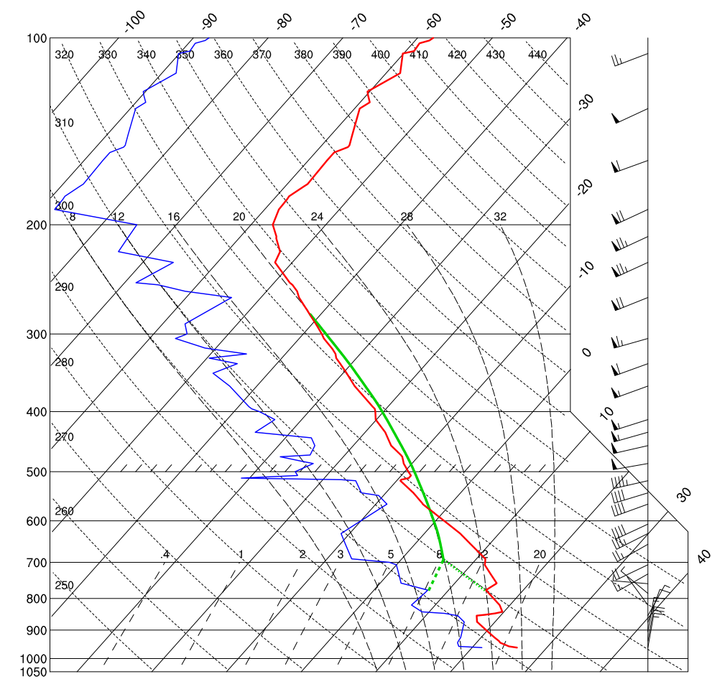
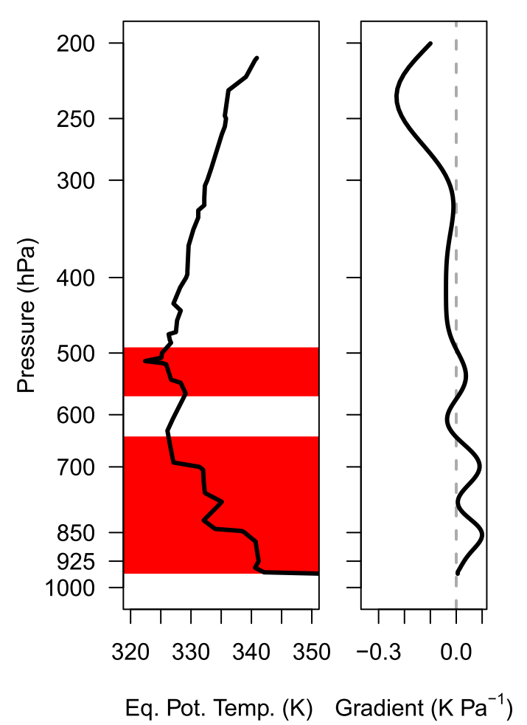
Aberdeen sounding for 1800 UTC 5 Jul
150 km to the west of the convective initiation
cold northerly ﬂow undercuts the warmer air above the 850-hPa frontal inversion to create large CIN (-300 J kg⁻¹).
$\frac{∂θ_{e}}{∂p}=10 K between 850 and 650 hPa$
$\text{synoptic}\text{−}\text{scale} \text{ascent}\text{ (}\text{jet} \text{entrance} \text{region}\text{)}→\text{initially} \text{elevated} \text{cells}$ $→\text{cold} \text{pool}→$ $\text{mesoscale} \text{ascent}$ $→$surface- based deep convection
Morris Municipal Airport (KMOX): cloud bases ~ 700 hPa, consistent with parcels that have undergone forced ascent from above the frontal inversion
Notes:
The convective cells that represent the beginnings of the midwestern squall line form over western Minnesota at 1700 UTC 5 July 2016
Instead, the Aberdeen sounding represents an environment on the cold side of the surface front that is conducive to the development of elevated convection (Horgan et al. 2007).
Parcels ascending from this level still need to overcome a 100-hPa layer of strong negative buoyancy before beginning free convective ascent in a ‘‘tall and thin’’ low-CAPE environment (Blanchard 1998).

Slide 23
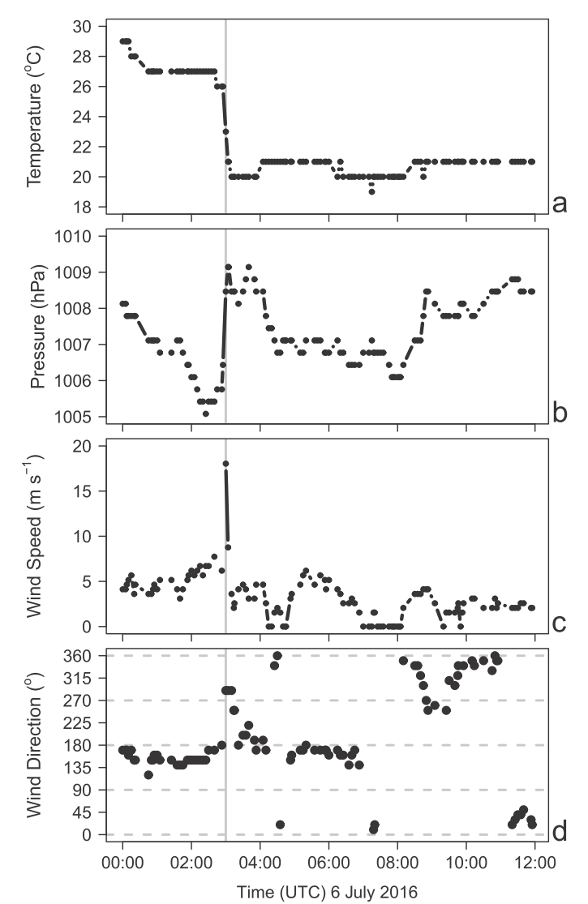
Time series of surface METAR observations at La Crosse, Wisconsin
a robust cold pool is evident at the surface
Notes:
As the elevated squall line passes through La Crosse, Wisconsin (ceilings are ; 3000 m above ground during the 0300 UTC passage), a robust cold pool is evident at the surface (Fig. 13).
Screen-level temperatures drop by 6C as the squall line passes, as winds turn to the north and increase to 18m/s(gusting to 30 m/s).
This evolution closely follows the conceptual squall-line model of Johnson and Hamilton (1988), and yields a density current that is capable of lifting near-surface air along the gust front to facilitate the initiation of surface-based convection (Wakimoto 1982).
Observed cloud bases in the squall line drop to below 1 km as convection moves through Rockford, Illinois, shortly after 0600 UTC (Fig. 10), indicative
of a completed transition from elevated to surface-based convection.

Slide 24
SIMULATED EVOLUTION
CTL simulation
black contour: position of the observed squall line
Notes:
In the CTL integration, precipitation maxima bracket the observed location of the developing squall line at 0000 UTC 6 July (cf. Figs. 10b and 14a).

Slide 25
Low-CAPE convection scheme (LC)
LC simulation
Notes:
When the low-CAPE convection scheme is activated, a coherent precipitation maximum appears in the region, although the convective mode does not reﬂect the linear structure of the observed rainfall (Fig. 15a).
Despite being the only difference between the CTL and LC integrations, the low-CAPE convection scheme is not directly responsible for the difference in precipitation patterns at 0000 UTC 6 July (Figs. 14a and 15a), and is active only around the periphery of the rainfall maximum (Fig. 16b).
However, the parameterization plays an important role in promoting the organization of this feature, as evidenced by its widespread activation in the region just 1 h earlier (Fig. 16a).
This elevated convective initiation is consistent with both the environmental sounding (Fig. 11) and the observed cloud bases at this early stage of the squall-line life cycle.

Slide 26
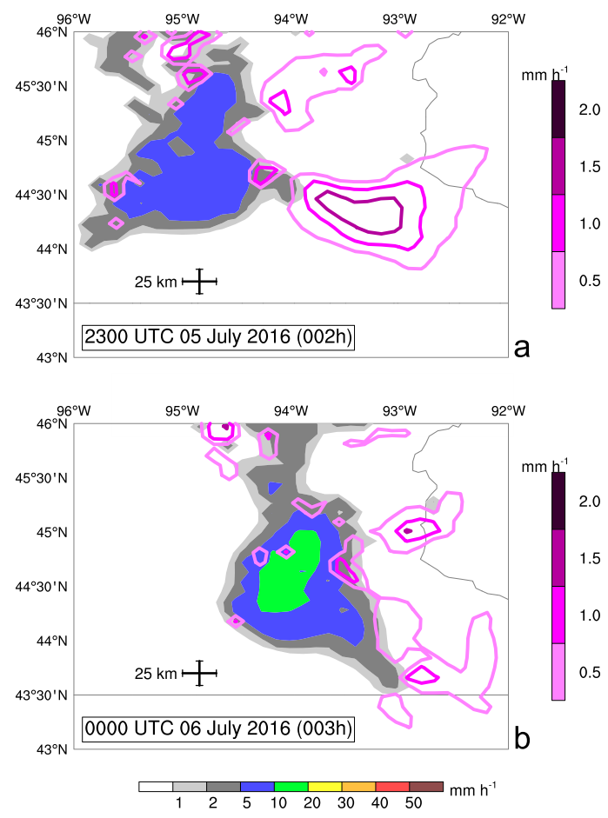
For low-CAPE convection scheme
Contours:
Subgrid-scale precipitation rate (mm/hr)
Color:
Remainder of precipitation
Notes:
low-CAPE convection scheme is active only around the periphery of the rainfall maximum (Fig. 16b).
However, the parameterization plays an important role in promoting the organization of this feature, as evidenced by its widespread activation in the region just 1 h earlier (Fig. 16a).

Slide 27
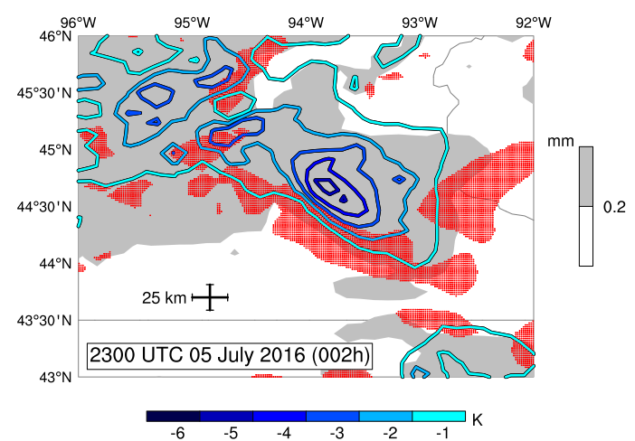
Cold pool enhancement after 2 h of integration, valid at 2300 UTC 5 Jul 2016
Red-stippled: Vertical motion enhancement (LC-CTL>0.5 Pa/s) at the 0.85 hybrid-coordinate model level
shaded: Total accumulated precipitation (mm)
Color: LC-CTL screen-level temperatures (K)
Notes:
The cold pool processes involved in the transition from elevated to surface-based convection appear to be well represented in the LC simulation, although they occur at least 3 h earlier than observed.
The cold pool formed by downdrafts in the low-CAPE convection scheme extends across southeastern Minnesota after 2 h of integration (Fig. 17). Enhanced upward motion is evident along the leading edge of this feature, consistent with forced ascent at the head of a density current (Wakimoto 1982).
The fact that precipitation is light or absent in these areas (less than 0.2 mm of accumulation after 2 h as shown in Fig. 17) suggests that the enhanced ascent is acting to relatively moisten and destabilize the preconvective environment, rather than simply identifying regions in which condensation is fueling buoyant updrafts.
Consistent with the transition process described by Marsham et al. (2011), the cold pool is thereby facilitating the initiation of surface-based convection early in the LC integration.
Cloud bases drop to 1000 m above ground after just 3 h of integration (0000 UTC 6 July), indicating the completion of the transition well before the developing squall line passes La Crosse, Wisconsin.
This represents a transition timing error in the LC integration
however, the lack of elevated convection in the CTL conﬁguration means that these processes are entirely absent in that simulation.

Slide 28
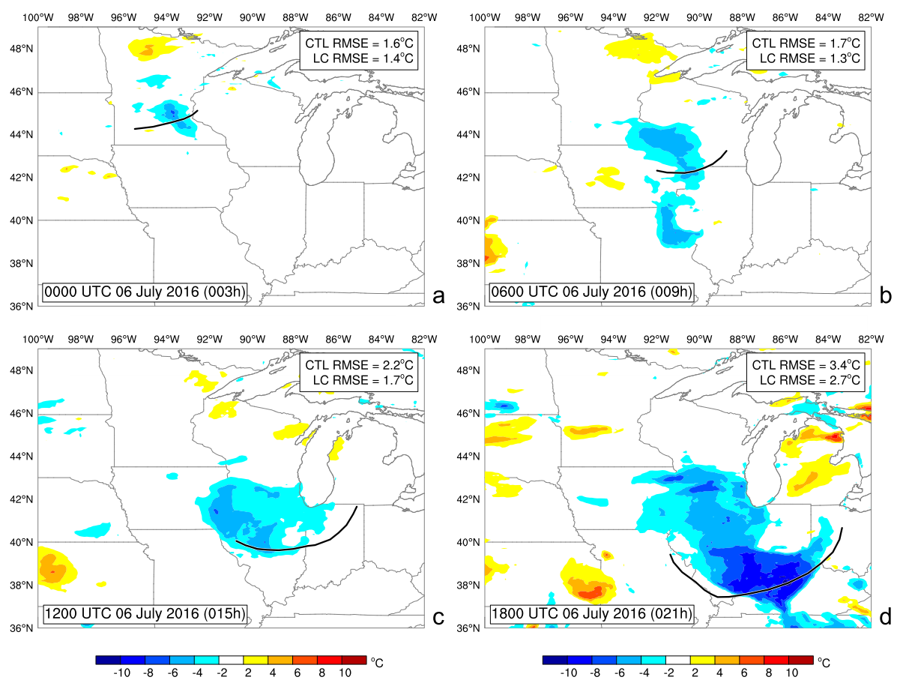
Color: difference in temperature between LC and CTL at the 0.85 hybrid-coordinate model level
black contour: position of the observed squall line
Notes:
Without a robust initiating cold pool, precipitation patterns in the CTL integration remain relatively disorganized throughout the remainder of the integration (Fig. 14).
This behavior stands in stark contrast to the LC simulation, in which widespread rainfall is predicted along the path of the observed squall line (Fig. 15). The enhanced cold pool in the LC simulation, deﬁned as the LC-minus-CTL difference in screen level temperature, evolves in a manner that aligns with the structural differences in rainfall (Fig. 18).
The cold pool difference increases to 6 C in the 6-h forecast (valid at 0300 UTC), consistent with the magnitude of the storm-related cooling observed
at La Crosse (Fig. 13).
A precursor cold pool also appears ahead of the squall line over northeastern Missouri at this time (Fig. 18b), where the low-CAPE convection scheme accurately predicts convective activity that is absent in the CTL integra-tion (not shown).
The enhancement of the primary cold pool increases to a maximum of 8C by the end of the squall-line life cycle, with cold air extending across Illinois and Indiana behind the well-positioned decaying squall line in the LC integration.
Screen-level temperature errors are reduced by ~20% across the region at all lead times (Fig. 18), a result that is indicative of improved cold pool structure in the LC simulation.

Slide 29
Impact on NWP guidance
July-August 2016 period

Slide 30
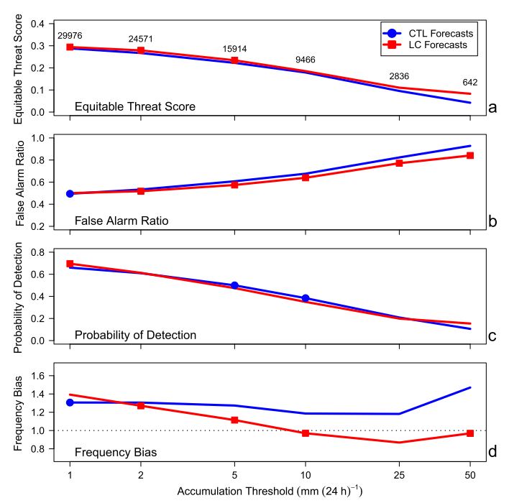
Precipitation scores for day-2 24-h accumulations (24–
48-h forecast time) over North America from 1200 UTC initializations in the summer 2016 forecast sequence (21 cases total)
 | Y | N
Y | H | F
N | M | O
OBS
FCST
False alarm ratio $=\frac{F}{H+F}$
probability of detection $=\frac{H}{H+M}$
frequency bias = $\frac{H+F}{H+M}$
Notes:
The ETS is improved at most accumulation thresholds (Fig. 19a), largely as a result of a reduction in the number of false alarms for thresholds of 2 mm/24 h and above (Fig. 19b).
The decrease in the false alarm ratio is not accompanied by an equivalent reduction in the probability of detection (Fig. 19c), an indication that the parameterization is acting to eliminate spurious precipitation events in a selective manner.
This is particularly encouraging given the dramatic reduction in the frequency of occurrence of accumulations of 5 mm/24hrand greater (Fig. 19d).
The latter is consistent with the impact of the parameterization on the convective cells analyzed in northern Ontario case study (section 4a), determined to be a consequence of the parameterized release of potential instability and the suppression of the gridpoint storm feedback.

Slide 31
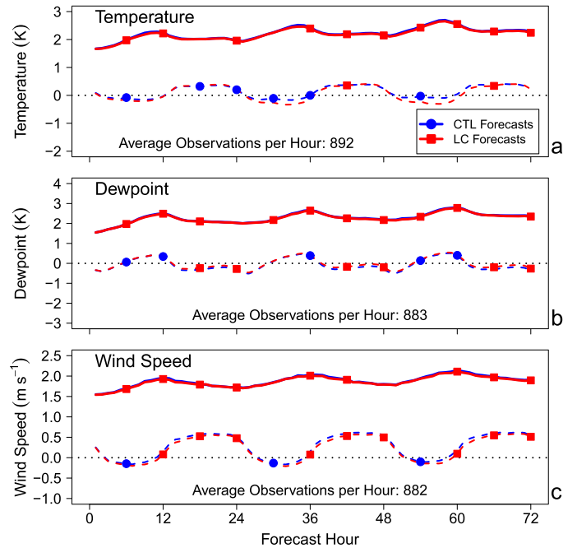
North American near-surface scores from 1200 UTC initializations in the summer 2016 forecast sequence (21 cases total)
(2-m)
Observations: combination of the synoptic and METAR networks
dashed lines: bias
Solid lines: error standard deviation
(2-m)
(10-m)
Notes:
The impact of the low-CAPE convection scheme on predictive skill for near-surface atmospheric variables is smaller than it is for precipitation (Fig. 20). Improvements to the error standard deviation of 2-m temperature and moisture, and 10-m winds rise to the level of statistical signiﬁcance at most lead
times, but the change in guidance quality is small enough to be of little practical utility.
The same is generally true for changes to mean errors, although daytime cooling leads to a 0.3-K increase in the cold bias of the LC guidance compared to the CTL (Fig. 20a).
This change in 2-m temperature is consistent with the cold pool enhancement noted in the midwestern squall-line case study (Fig. 18

Slide 32
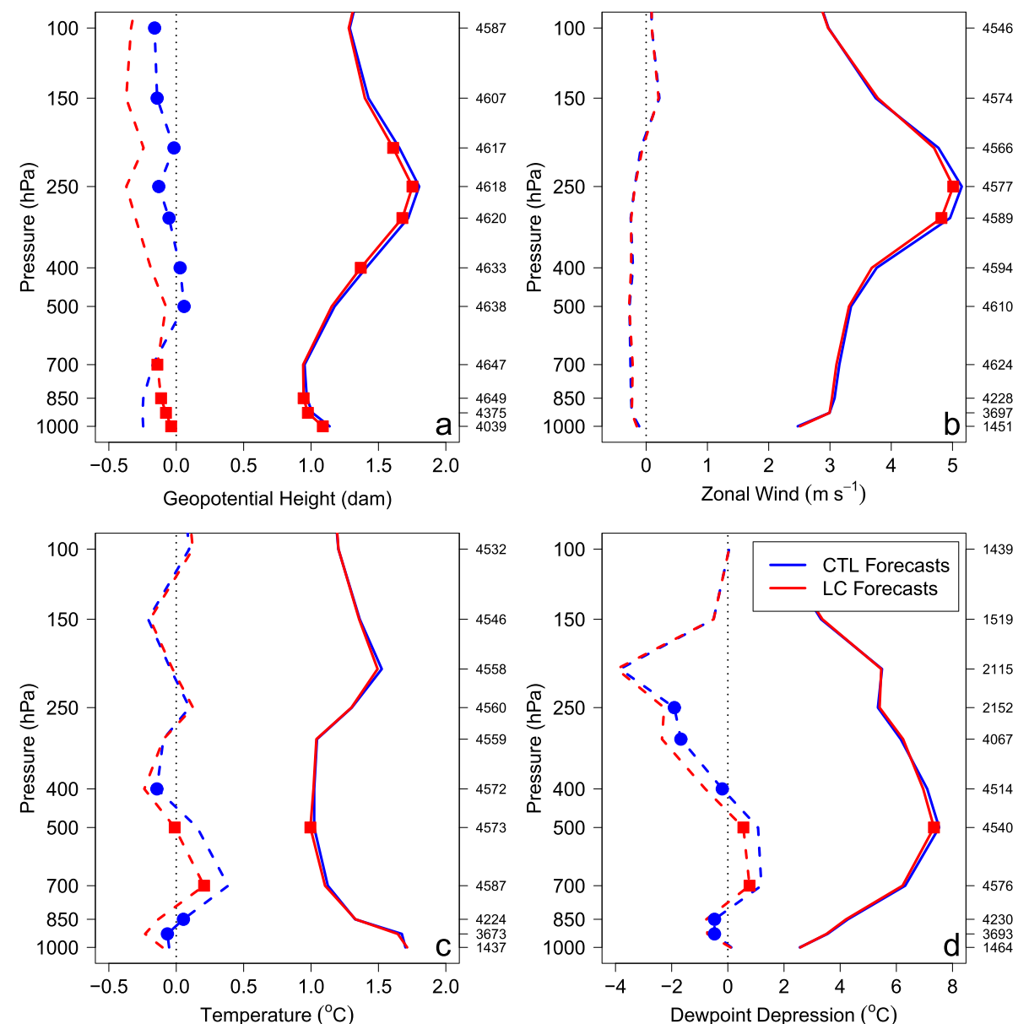
profile of error standard deviation and bias against North American radiosonde observations
dashed lines: bias
Solid lines: error standard deviation
Notes:
The effects of parameterized low-CAPE convection on upper-air scores are more pronounced, with improvements in error standard deviation clearly visible in height and wind predictions near the tropopause (Figs. 21a,b).
However, a reduction in the midtropospheric warm bias (Fig. 21c) leads hydrostatically to a 3-m decrease in upper-tropospheric heights that is evaluated as a degradation compared to radiosonde-observed values.

Slide 33
Conclusions
Low-CAPE convection scheme:
connection of triggering and closure components to the gridscale vertical motion
release instabilities in low-CAPE environments
improve precipitation structure under low-CAPE conditions (precipitation bull’s-eyes are eliminated)
enhanced cold pool
improvements in guidance skill
a particularly strong relationship between $M_{e}^{min}$(triggering) and quantitative precipitation forecasts.
model’s long-standing positive precipitation bias has been over reduced in convectively active regions.

Slide 35
Models that employ a class of convective schemes whose activity depend on moisture convergence (Bougeault 1985; Tiedtke 1989; Banacos and Schultz 2005) have the potential to represent better the effects of convection in low-CAPE environments.
This assertion is supported by results of Suhas and Zhang (2015), who conclude that closures based on this quantity yields the highest correlation with observed convection
however, they note that all relationships to the large-scale state weaken as model resolution increases.
Schemes that are particularly well suited to represent the release of potential instability are those that can act in low-CAPE environments in response to elevated synoptic and mesoscale forcings for ascent.
Such ‘‘midlevel’’ convection schemes are employed in operational systems run at both ECMWF (Tiedtke 1989) and UKMO (Gregory and Rowntree 1990); however, their impact on predictions of convection and overall guidance quality have not been documented extensively in the literature.

Slide 36
ABSTRACT
Most of cumulus schemes are designed to represent the dominant class of cumulus convection that is driven by latent heat release in a conditionally unstable proﬁle with a surplus of convective available potential energy (CAPE).
an important subset of events occurs in low-CAPE environments in which potential and symmetric instabilities can sustain moist convective motions.
Case studies show that the scheme eliminates the ‘‘bull’s-eyes’’ in precipitation guidance that develop in the absence of parameterized convection, and that it can represent the initiation of elevated convection that organizes squall-line structure.
Notes:
Potential and symmetric instabilities

Slide 37
A low-CAPE convection scheme
The formulation of the low-CAPE convection scheme described here is based loosely on the ECMWF (2018) description of the midlevel variant of the Tiedtke (1989) scheme.
The utility of such a Lagrangian updraft model in low-CAPE environments was ﬁrst demonstrated by Kreitzberg and Perkey (1976), who investigated the parameterization of moist convection in the presence of potential instability.
To avoid the double-counting of moist convective effects, the new scheme is only tested for possible activity where CAPE values are below 250 J kg 2 1.
This limit that is more restrictive than the 500 J kg 2 1 typically used to identify HSLC events (Sherburn and Parker 2014)
Unlike HSLC severe storm studies; however, no wind shear condition is applied because the intent of the scheme is to represent the full range of low-CAPE convective intensities

Slide 38
Lateral mixing ($ε and δ$) is represented in the low-CAPE scheme using the buoyancy sorting technique introduced by Kain and Fritsch (1990)
A zone of forced detrainment lies above the level of neutral buoyancy ($T_{v}^{u}=\overline{T_{v}}$), followed by the overshooting cloud top where $w^{u}=0 ms^{−1}$.
Over this layer, the updraft horizontal momentum is adjusted to account for the pressure gradient across the ascending plume (Gregory 1996), as described for the model’s deep convection scheme by McTaggart-Cowan et al. (2019b).
A minimum cloud depth of 2000 m is required for this form of precipitating convection (Niziol et al. 1995; Kain 2004), with shallower prototypes failing this component of the trigger requirement for precipitating convection and returning for further evaluation (section 3a) until the potential triggering level exceeds 10 km above ground (ECMWF 2018).

