Slide 1
Improved Prediction of Landfalling Tropical Cyclone in China Based on Assimilation of Radar Radial Winds with New Super-Observation Processing
Paper review
mainly refer to
Jianing Feng, Yihong Duan, Qilin Wan, Hao Hu, and Zhaoxia Pu
Wei-Ting Fang
2021.03.16
Other reference:
Lin, K. J., S. C. Yang, and S. S. Chen, 2018: Reducing TC position uncertainty in an ensemble data assimilation and rediction system: A case study of Typhoon Fanapi (2010). Wea. Forecasting, 33, 561–582.

Slide 2
Outline
Introduction
Methods
a. Model and data assimilation configuration
b. Radar velocity data of the evenly spaced thinning method (ESTM)
c. Experiment design and data description
Results of the case study—TC Mujigae
a. Case overview
b. SO characteristics of RSTM and ESTM
c. Track and intensity analysis and forecast
d. Analysis increments
e. Rainfall forecast after TC landfall
Performance of ESTM-EnKF and RSTM-EnKF with nine landfalling TCs
a. TC cases and experimental design
b. Track and intensity
c. Quantitative precipitation forecasting (QPF)
Conclusions and discussion

Slide 3
Introduction(1/2)
Currently, operational model resolutions are still too coarse compared to the density of raw radar observations, leading to much of the information in raw data creating noise for model backgrounds (Janjić et al. 2018).
Generally, super-observation (SO) processing can 1) reduce the random instrumental error of raw observations, 2) partly remove representative error (Janjić et al. 2018) by decreasing the volume of observations as well as by balancing the spatial distribution of observations and the model background, and 3) lessen the computational expense (Alpert and Kumar 2007).
Various methods to create Vr SOs have been discussed in the literature, and they can be roughly divided into two categories (Waller et al. 2019): one involves calculating innovation in the model background to modify raw observations, after which these modified raw data are applied in a specific small region (Daley 1993; Simonin et al. 2014); the other, which is more commonly used, simply averages the observations under some conditions (Xiao et al. 2008; Salonen et al. 2009; Zhang et al. 2009; Weng and Zhang 2012; Bick et al. 2016; Lippi et al. 2019; Waller et al. 2019).

Slide 4
Introduction(2/2)
The default SO processing (Alpert and Kumar 2007) in the Gridpoint Statistical Interpolation system (Shao et al. 2016) was refined by Lippi et al. (Lippi et al. 2019). They revealed that the operational thinning settings somehow oversmoothed the observations and discarded potentially valuable information, and a precipitation prediction was enhanced by averaging observations over a smaller spatial box.
In this study we first use a new SO processing method to generate evenly distributed SOs. Then, the differences between the two methods regarding the SO characteristics and their impacts on track, intensity, and rainfall forecasts are analyzed. Moreover, we also investigate the impact of assimilating Chinese Doppler radial wind observations with the new SO processing on landfalling TC rainfall forecasts with multiple TC cases.

Slide 5
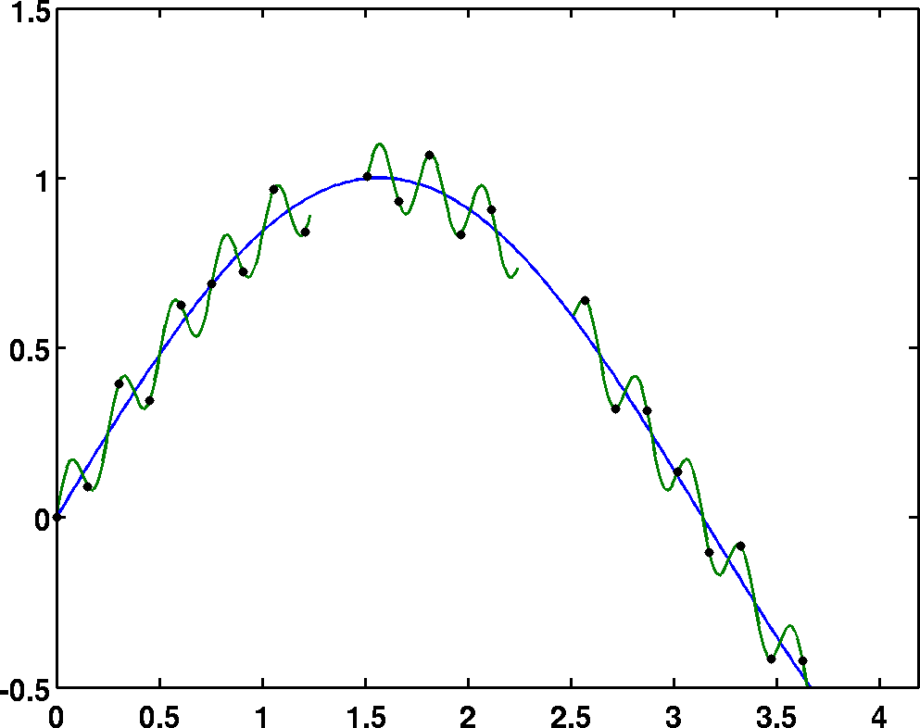
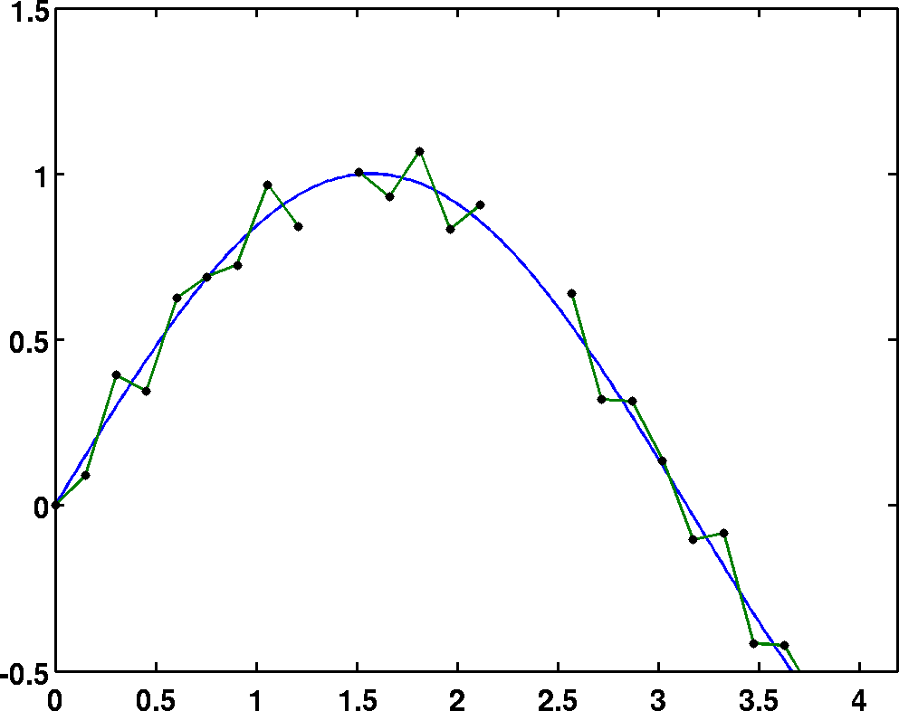
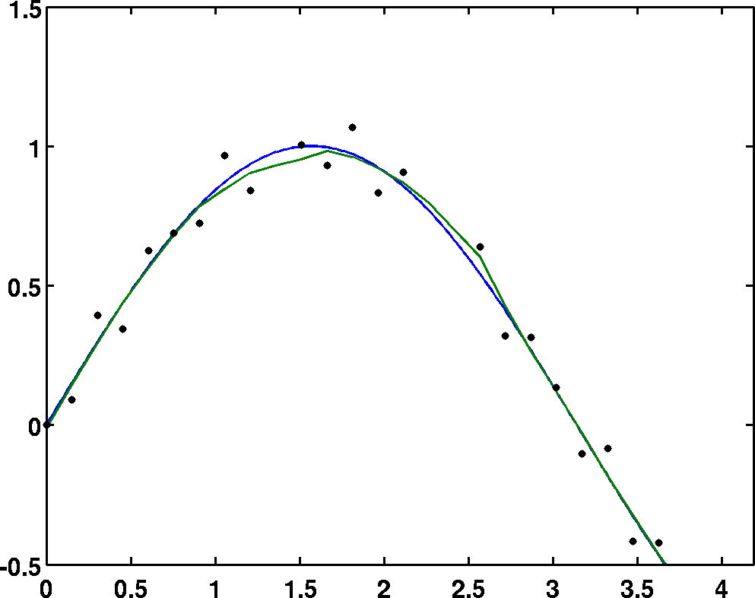
Sampling
Filling / smoothing

Slide 6
Model and data assimilation configuration
Version 3.8.1
3 two-way nested domains
Horizontal spacing is 40.5 km (120×100 grid points), 13.5 km (151 × 151 grid points), and 4.5 km (169 × 169 grid points)
43 vertical levels (model top is 50 hPa)
Longwave and shortwave radiation scheme: RRTMG PBL scheme: YSU Microphysics scheme: WSM6 Cumulus parameterization: Kain–Fritsch scheme (for the outer domain)

Slide 7
Data assimilation
RSTM
(Radially Spaced Thinning Method)
ESTM
(Evenly Spaced Thinning Method)

Slide 8
Radially Spaced Thinning Method (RSTM)
Traditional method
The following measures are implemented to generate an SO with RSTM (Zhang et al. 2009):
discount any raw observations with values smaller than 2 m s⁻¹ or greater than 70 m s⁻¹ or a distance from the radar of less than 4 km,
if a raw Vr observation deviates from the average of all raw observations within a bin up to 2 times the standard deviation, discount it,
there should be at least four valid Vr raw observations in an averaging bin,
there will be no SO for a bin whose standard deviation is twice the average of the standard deviations in all bins, and
the final SO value of the bin will be the average of at most 10 raw observations closest to the center of the bin.
QC

Slide 9
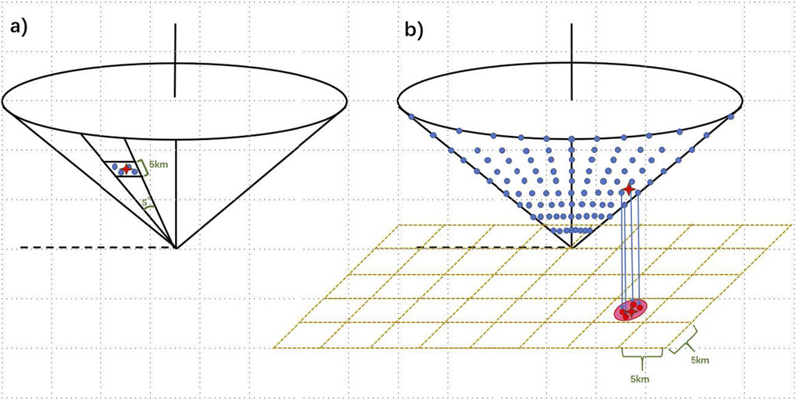
Evenly Spaced Thinning Method (ESTM)
new method
discount any raw data within 10 km of the radar center or with a value smaller than 4 m s⁻¹;
split one azimuth direction scanning range into many bins whose length is 5 km in the radial direction;
discount any bin whose valid raw data number is less than 4;
sweep out any raw observation if its deviation from the mean of the data in one bin is greater than twice the standard deviation of all raw valid observations in that bin;
calculate the mean of all raw observations now left in the bin;
project the averaged observations vertically onto a grid with 5 km × 5 km resolution, and the observation closest to the median of all data in one grid is treated as the SO.
RSTM
ESTM

Slide 10
Doppler radar velocity observations
TC Mujigae (2015)
Only the observations in the second–sixth elevation layers are assimilated.
velocity de-aliasing
RSTM
RSTM

Slide 11
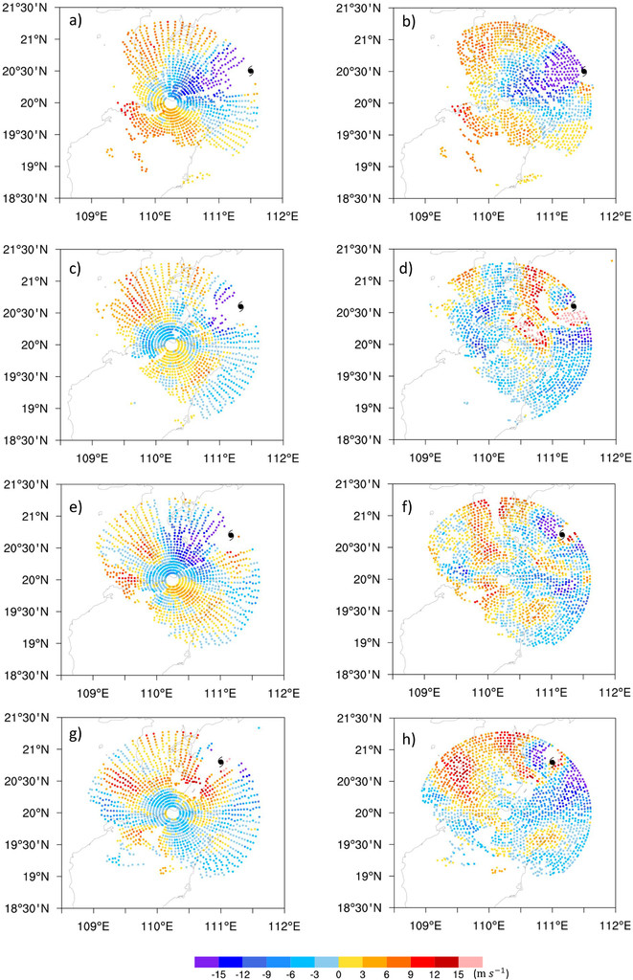
Observation minus background (OMB)
RSTM
ESTM
1st DA cycle
2nd DA cycle
3rd DA cycle
4th DA cycle

Slide 12
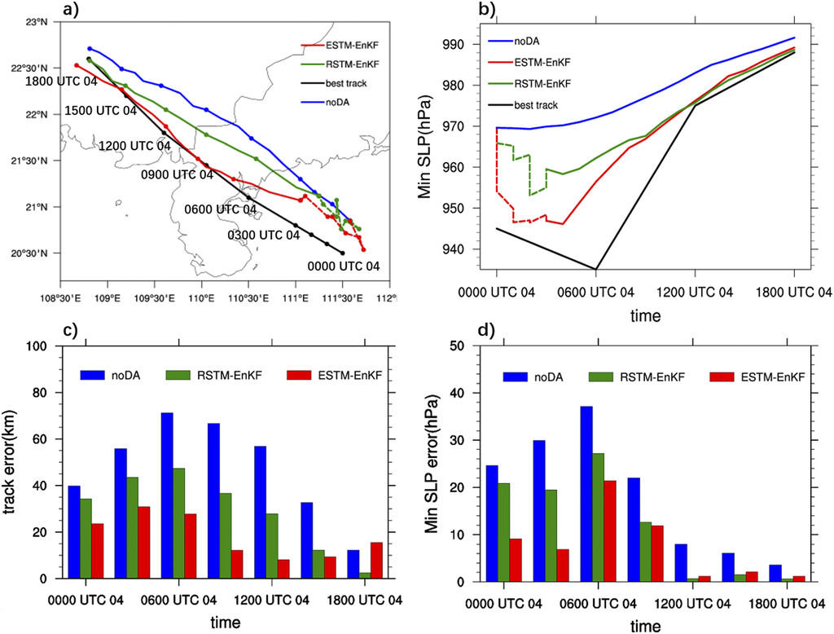
Track and intensity
Free forecast
Free forecast

Slide 13
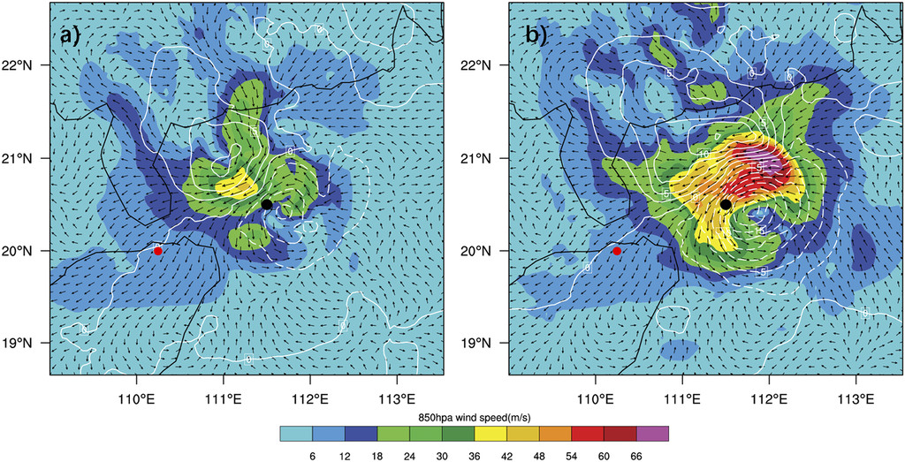
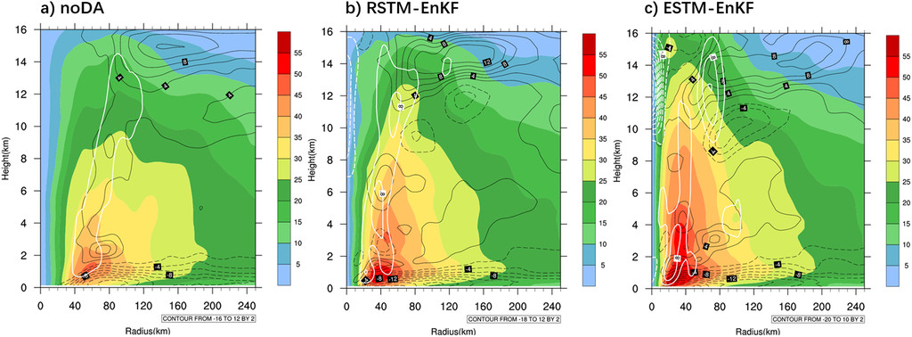
Analysis increments
Wind speed increment at 850 hPa
(First DA cycle at 0000 UTC 4 Oct 2015)
O-B (RSTM)
O-B (ESTM)
RSTM-EnKF
ESTM-EnKF
Azimuthal mean speed of tangential wind (After four DA cycles)

Slide 14
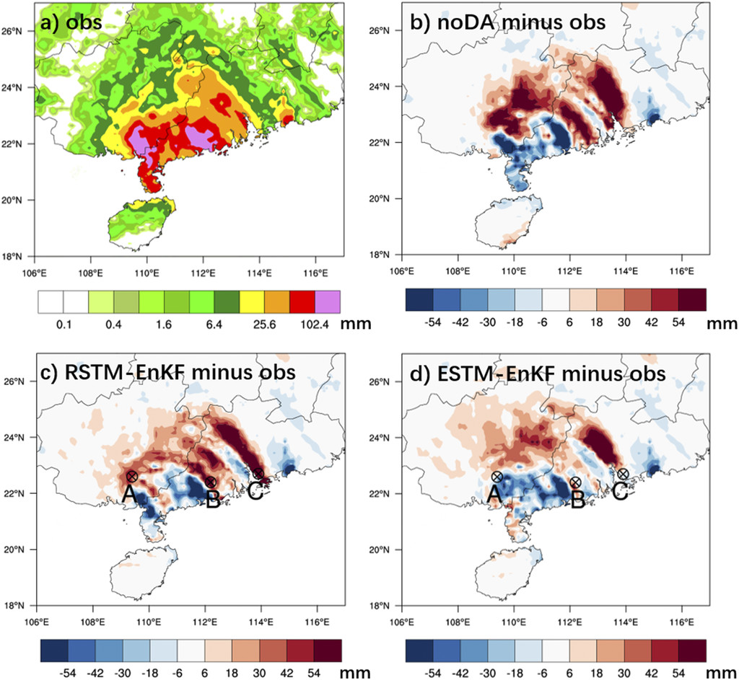
Rainfall forecast after TC landfall
The rainfall observations we select are 0.1° × 0.1° satellite precipitation products (Shen et al. 2014) merged with Chinese hourly rain gauge data, which are called the CPC Morphing technique (CMORPH) precipitation product.
9-h precipitation accumulation after Mujigae made landfall

Slide 15
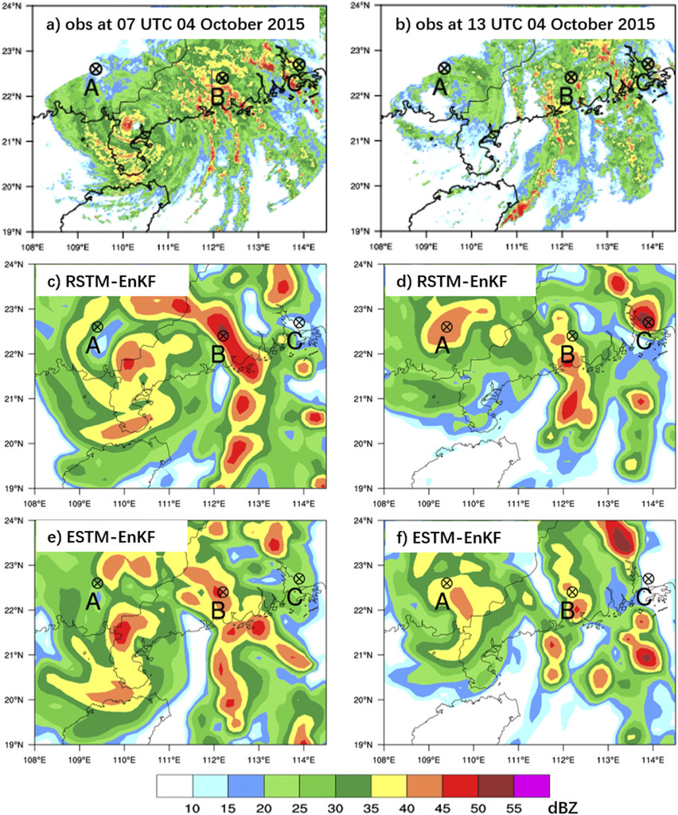
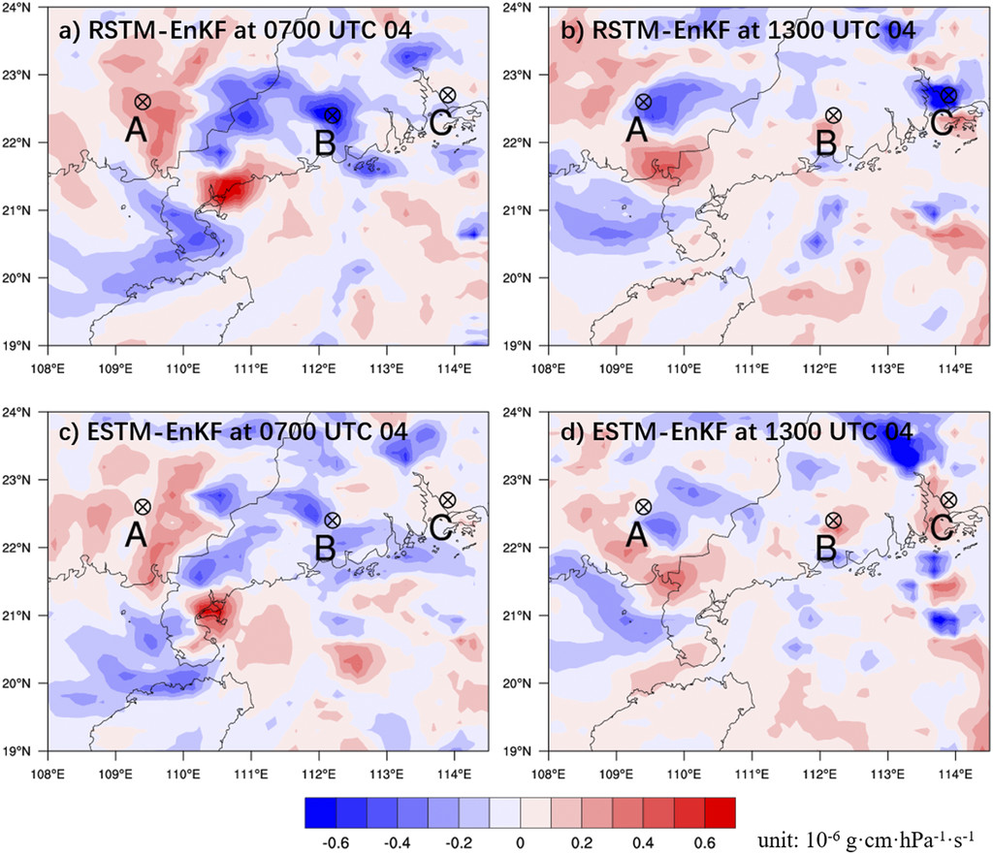
Rainfall forecast improvement
Radar composite reflectivity
850-hPa water vapor flux divergence

Slide 16
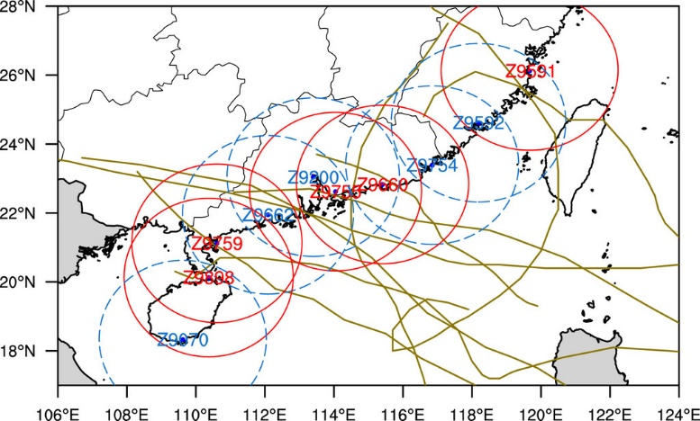
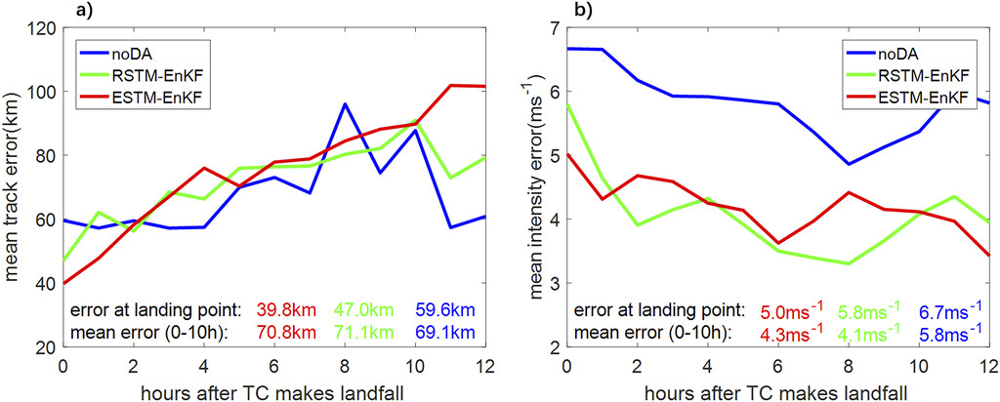
Performance (9 landfalling TCs)
The velocity data of the “first” radar that observes the TC inner-core region are assimilated.
Apart from the landing point, the performance of ESTM-EnKF is almost equal to that of RSTM-EnKF, which means that the different SO algorithms do not affect TC track and intensity forecasts when the prediction time is longer than 2 h.

Slide 17
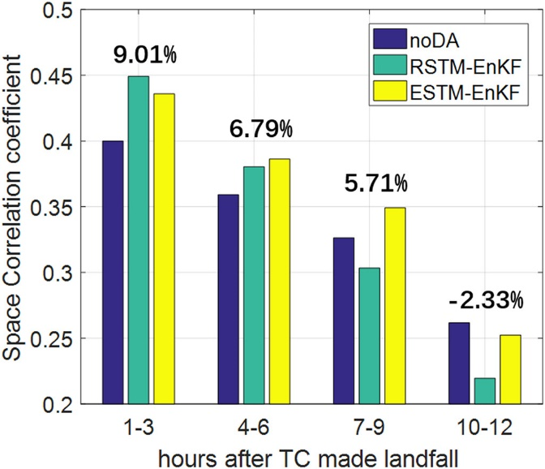
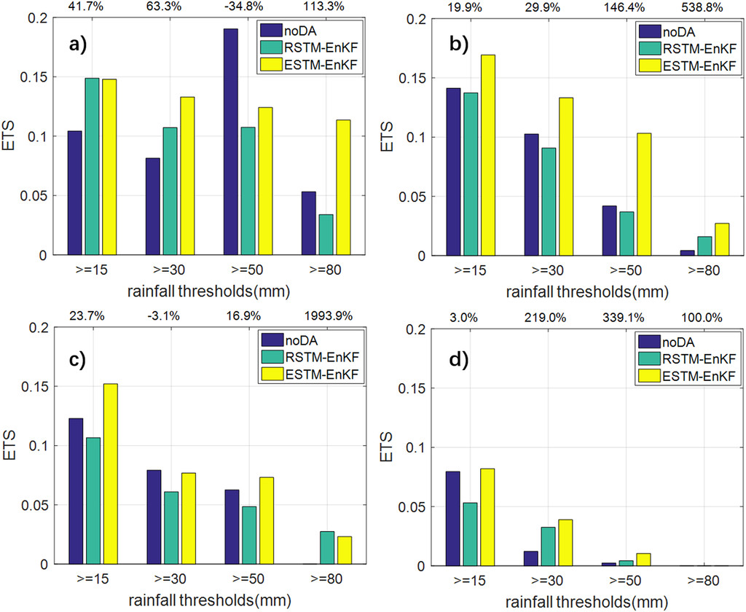
Verification
Space Correlation coefficient
ETS
1-3 hr
4-6 hr
This phenomenon may be partly due to rapid error growth relative to the small-scale motion in the model and indicates that the life expectancy of radar velocity data in model rainfall prediction is up to about 9 h.
7-9 hr
10-12 hr

Slide 18
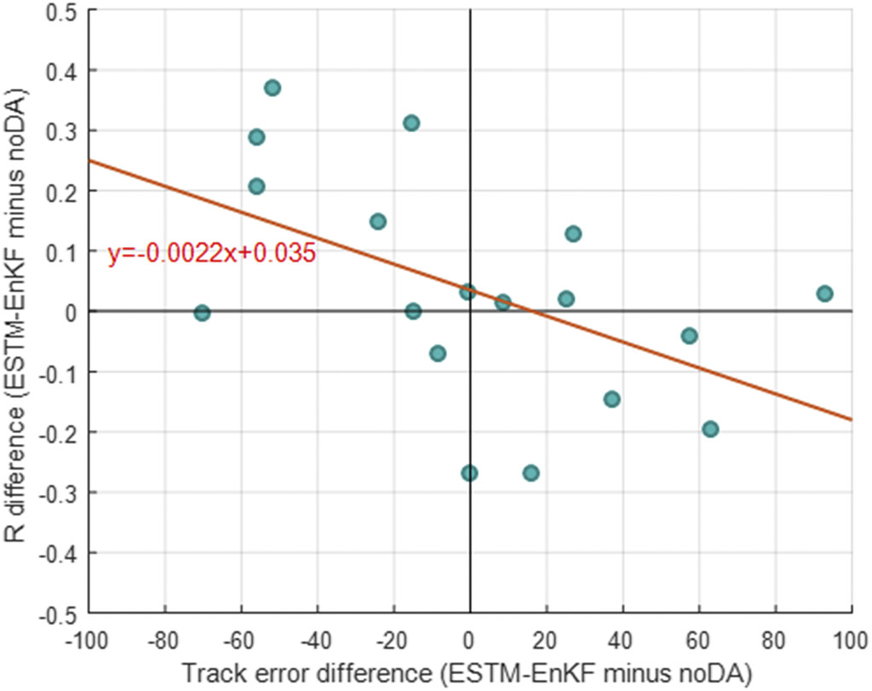
Track error vs. spatial rainfall pattern
correlation coefficient = −0.51
Broader range are needed to correct large-scale atmospheric fields.

Slide 19
Conclusions and discussion (1/2)
A new Doppler radar velocity observation super-observation processing method, the evenly spaced thinning method (ESTM), is demonstrated, in which the density of SOs is almost equal in one radar scanning volume and more information near the TC center is involved.
Mujigae’s landing position forecast error is reduced by 64% in ESTM EnKF compared to noDA, which is much higher than that of RSTM EnKF (~29%).
The increments in the TC eyewall are much larger in the ESTM-EnKF experiment, mainly because there are more SOs in the TC inner core, though the total number of SOs is almost equal.
Eight landfalling TCs in 2017 + Mujigae (2015)
Landfalling location error is reduced by 33% compared with noDA.
Intensity error is steadily reduced by about 25%.

Slide 20
Conclusions and discussion (2/2)
The overall spatial correlation coefficients between model forecasts and CMORPH rainfall observations are enhanced by 9.0%, 6.8%, and 5.7%, respectively within 1–3, 4–6, and 7–9 h of TC landfall.
The improvement is reduced with longer forecast lead times, which indicates that the error at small scales grows quickly and the “correcting effect” of radar observations in TC rainfall forecasts can be sustained for only about 10 h.
The results of rainfall ETS show that radar assimilation can improve moderate [30 mm (3 h)⁻¹] and heavy [80 mm (3 h)⁻¹] rainfall forecasts.
A negative impact on rainfall forecasts in some cases may be derived from the track error.

Slide 21
Thanks

