Slide 1
Using Satellite Observations to Evaluate the Relationships between Ice Condensate, Latent Heat Release, and Tropical Cyclone Intensification in a Mesoscale Model

Slide 2
Outline
2
Can WRF Capture the Signal of TC intensification?
Introduction
3
4
Relationship between Latent Heating and Frozen Hydrometeors
5
Data and Methods
Evaluation of Simulations by Comparison to Observations
6
1
Abstract
7
Conclusion

Slide 3
Abstract

Slide 4
Abstract
To examine and validate the relationship between frozen hydrometeors and
latent heating in model simulation .
To evaluate the capability of WRF to reproduce the frozen hydrometeors
and the relationship between frozen hydrometeors and TC intensification.
WRF output result indicated that latent heating is strongly related to the
amount of ice water content(IWC) which can serve a observable proxy
for latent heating in mid-to-upper troposphere.
4. Model captures the signature of increased IWC for intensifying TCs,
suggesting that observations of IWC provide a useful diagnostic for
understanding and evaluating model simulation of TC intensification.
Notes:
1.檢驗冰相粒子 和 潛熱 在模式當中的關係
2.評估WRF 重現冰相粒子能力 和 冰相粒子和 颱風增強之間的關係
3.WRF模擬顯果顯現潛熱和IWC的量有強烈的相關，接接提供一個觀測中高層潛熱的媒介
4.模式掌握到 IWC的增加 -->> 會增強的TC
意味著觀測IWC是一個可用來評估診斷模式對於TC增強的指標

Slide 5
Introduction

Slide 6
Introduction
The evolution of TC intensity is modulated by both environmental
effects and internal dynamics.
1.Environmental effects
Include vertical wind shear, sea surface temperature, and ambient
water vapor (DeMaria 1995; Kaplan andDeMaria 2003; Emanuel et
al. 2004; Kaplan et al. 2010),
2.Internal processes
Include barotropic instability and eyewall dynamics (Montgomery and
Kallenbach 1997; Schubert et al. 1999; Hendricks et al. 2010; Wu et al. 2016)
Notes:
TC的增強和 環境的影響 和 颱風內部動力有關
環境 包括了VWS SST 環境水氣量
內部動力 則包括了 正壓不穩定 和 眼牆的動力

Slide 7
Introduction
Environment effects
and internal dynamic
affect
Amount of latent heat
release in storm
Amount and location of latent heat release in storm
affect
TCs intensification
However, there are no observations that can directly measure latent heat
release in TCs (Cecil and Zipser 1999; Nolan et al. 2019).
Latent heat release and condensates are generated simultaneously in the
upward branch of a convective system, so the release of latent heating is
directly proportional to the production of condensate (Yanai et al. 1973)
Notes:
環境和內部動力因子 影響了 颱風內部 潛熱的釋放
而潛熱的釋放的量值和位置 影響了 颱風的增強
然而 沒有觀測可以直接量測TC內部潛熱的釋放
Yanai在1973提出潛熱的釋放和凝結在對流系統的上升區是同時發生的，因此潛熱的釋放和凝結量呈正比

Slide 8
Introduction
Radar reflectivity
microwave brightness temperatures
provide
Satellite
retrieve
Amount of liquid and frozen hydrometeors
Notes:
藉由衛星酬載的儀器 提供的微波亮溫資訊
酬載的雷達 可以提供我們雷達回波資訊
可以去反演水相和冰相的量

Slide 9
Introduction
TCs with greater areal extent of reflectivity exceeding 20 dBZ
tend to intensify in the future (Zagrodnik and Jiang 2014, Tao and Jiang 2015).
2. Harnos and Nesbitt (2016) used 37 and 85 GHz microwave measurements to
demonstrate that deep convective clouds are more vigorous in rapidly
intensifying TCs than in non-intensifying TCs in higher shear environment,
although no clear differences were found between TCs that underwent slow
and rapid intensification.
3. Inability to measure the vertical distribution of hydrometeors is a crucial
factor that limits the effectiveness of such models.
Notes:
TC 的範圍如果有較大的回波>20dBZ的，未來容易增強
Harnos and Nesbitt (2016) 使用微波當中 37 85GHZ的資料，
發現了在高風切的環境中，快速增強的颱風較沒有增強的颱風有更劇烈的深對流雲系
雖然 慢速和快速增強的TC之間沒有特別的發現
3.然而無法量測水相粒子的垂直分布 影響的以上模式的效力

Slide 10
Introduction
The CloudSat Cloud Profiling Radar(CPR) provides vertically resolved
measurements of hydrometeors, cloud ice and liquid water, which can
serve as a reference to validate model simulations (Austin et al. 2009,
Tourville et al. 2015)
Greater IWC throughout the entire ordinate of composites tend to
intensify in the subsequent 24 hours (Wu and Soden, 2017)
Though the narrow swath of CloudSat overpasses limits the spatial and
temporal coverage of TCs, these high-resolution measurements have a
potential to benefit the prediction of future TC intensity.
Notes:
相較於前者，
CloudSat酬載的CPR提供了垂直解析的 冰水粒子 雲冰 液態水 可以用來驗證模式的模擬結果
如果在composite中 有較大的IWC 在未來24小時，颱風容易增強
雖然CloudSat的 swath很窄，他所掃描的範圍比較少 只能暫時掃過TC 甚至無法掃到整個TC
但是空間的高解析度，此項資料還是有發展預測颱風未來強度的潛力

Slide 11
Introduction
Numerical models can simulate the evolution of TCs. A recent study
showed that volume-integrated latent heating is closely correlated with
volume-integrated condensates in TCs (Nolan et al. 2019)
However, how well latent heating relates to frozen hydrometeor
concentration, especially where the energy transformation efficiency for
TCs is higher, has not been specifically addressed.
Notes:
1.數值模擬可以模擬颱風的發展，近期的研究發現
volume-integrated latent heating is closely correlated with volume-integrated condensates in TCs
2.然而 潛熱和冰相粒子濃度的關係如何,特別是在何處ＴＣ的能量轉換（潛熱釋放）是特別有效率 還沒有被仔細探討
這也點出 作者後續想幹的事情

Slide 12
Introduction
Examine how well the evolution of
simulated latent heating relates to the
concentration of frozen hydrometeors
How well WRF reproduces frozen
hydrometeors seen in the observations
Apply WSM6 and Thompson
microphysics schemes in order to
account for the influence of different
schemes on the production of cloud ice
This
study
Examine the performance of the WRF model
in vertical and horizontal distributions of
frozen hydrometeors and the relationships
between frozen hydrometeor concentrations
and TC intensification.
Notes:
1.檢測 模擬潛熱的變化(量 位置)和 冰相粒子濃度的關係有多大
2.WRF模擬冰相粒子能力有多好? 和觀測相比呢?
3.檢測不同雲微物理參數化方案 對於雲冰的產量影響有多大 Thompson 只有 雲冰和rain 只double moment (除了mixing ratio也預報 number of concentration)
4.檢測 WRF對於冰相粒子 在 垂直和水平方向分別的表現如何?
以及TC增強和冰相粒子濃度之間的關聯

Slide 13
Data and Method

Slide 14
Data and Method
10 years of CloudSat retrieval IWC
This
study
5 years of passive microwave
(SPARE-ICE)retrieval IWP
WRF simulated
idealized TCs

Slide 15
Data and Method
Equipped with cloud profiling radar
that retrieves vertically resolved
cloud ice and IWC.
Horizontal resolution:
2.5 km(along track)×1.4 km (cross track)
Vertical resolution : 0.24km
CloudSat
Pick only those (1500cases)
overpasses whose distance from the point of closet approach(PCA) to the TC center is less than 300km
Notes:
Frozen hydrometeors 包含 冰 雪 軟雹
CloudSat 把這些都納入 IWC的計算

Slide 16
Data and Method
IWP is retrieved using a combination of infrared and microwave data.
Resolution:
16 km near the swath center
52x27 km at the swath edge
SPARE-ICE
Channel
Infrared: AVHRR
Microwave: 183 GHz water vapor absorption frequency at 183 ±1, ±3, and ±7 GHz (AMSU-B)
or 190 GHz (MHS)
Notes:
Synergistic Passive Atmospheric Retrieval Experiment‐ICE. SPARE‐ICE is the first Ice Water Path (IWP) product combining infrared and microwave radiances
Advanced Very High Resolution Radiometer

Slide 17
Data and Method
Using IBTrACS to identify the location and intensity of storms with 6-h time intervals.
Since the retrieval time is asynoptic, linearly interpolating
is apply.
SPARE-ICE
Two criteria to select TCs (544cases)
The distance from maximum IWP to the TC center has to be less than 100 km
IWP has to be greater than 0 over at least half of the area

Slide 18
Data and Method
Intensify : Max wind speed increases over 2.57m/s(5kts) in 6 hrs
Weaken : Max wind speed decreases over 2.57m/s(5kts) in 6 hrs
Intensify
Weaken
TD : <18m/s
TS : 18～33m/s
Minor TC : 33～50m/s
Major TC : >50m/s
Storm
Category

Slide 19
Data and Method
WRF3.7 perform
a series of 7-days simulation
WRF
simulation
Microphysics schemes
WSM6: 270 ensemble members
Thompson: 5 ensemble members

Slide 20
Data and Method
VWS: 0～12.5m/s (interval 2.5m/s)
Translation speed :
2.5～12.5m/s (interval 2.5m/s)
Initial TC intensity: 10,15,20 (m/s)
Initial size: 90,150,210 (km)
Resolution: 2km with 40 vertical layers.
WSM6
VWS: 0～12.5m/s (interval 2.5m/s)
Translation speed :
2.5～12.5m/s (interval 2.5m/s)
Initial TC intensity: 5 (m/s)
Initial size: 90,150,210 (km)
Resolution: 2km with 40 vertical layers.
Thompson

Slide 21
Data and Method
Azimuthal average
WRF Averaging
method
CloudSat-footprint-like slicing

Slide 22
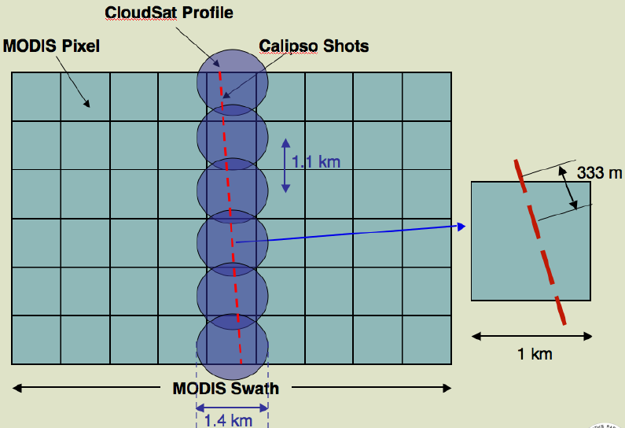
Data and Method

Slide 23
Data and Method
Non-precipitating : ice crystal
Frozen
Hydrometeors
Waliser et al.(2009) : precipitating condition data from CloudSat and CALIPSO
Chen et al.(2011) ; Deng et al.(2018) : utilize particle size.
Precipitating : graupel snow

Slide 24
Relationship between Latent Heating
and Frozen Hydrometeors

Slide 25
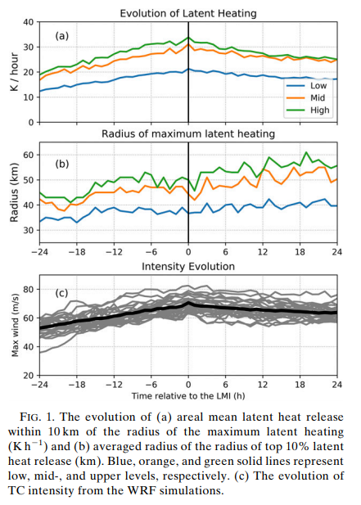
Relationship between Latent Heating and Frozen Hydrometeors
Calculate vertically averaged latent heating
24 h prior to and after the Lifetime Maximum
Intensity (LMI) for three levels
low level is 0–3 km (surface–700 hPa)
midlevel is 3–6 km (700–500 hPa)
upper level is 6–9.5 km (500–300 hPa)
Notes:
這張是wrf模擬
計算垂直上平均 latent heating
在LMI 前後24小時

Slide 26
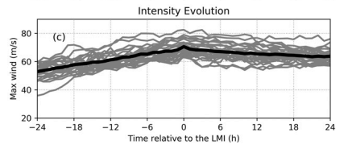
Relationship between Latent Heating and Frozen Hydrometeors
Examine 24-h prior and to and after
LMI, only those storm with
LMI >30m/s
On average, TC intensity grows by
～10m/s 24 hours prior to LMI, and
weaken by～5m/s hours after LMI
(Fig 1c)
Notes:
只有 LMI >30M/S的TC被考慮

Slide 27
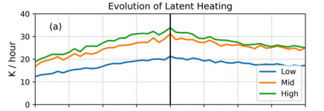
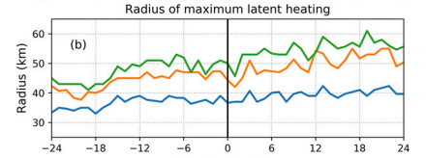
Relationship between Latent Heating and Frozen Hydrometeors
Notes:
中低層 在LMI前後六小時的走勢大致對稱
.低層（２Ｋ，２Ｋ） 中層（３.９，３.８）
高層的潛熱變化，ＬＭＩ前六小時緩慢上升２．６ 但後六小時下降快４．７
MLT 的 半徑 (前10% Latent heating)
低層 LMI前後十二小時 不太變 中層跟高層 緩慢擴大 （中層５高層９）

Slide 28
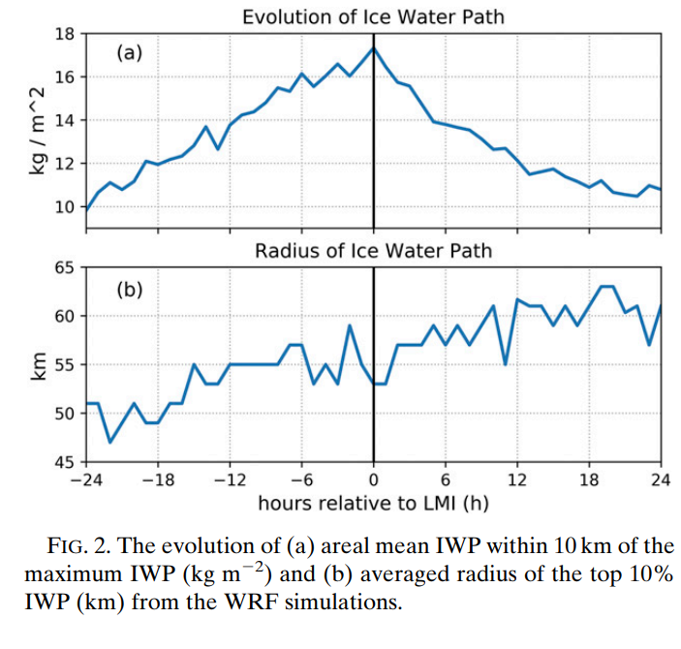
Relationship between Latent Heating and Frozen Hydrometeors
Examine 8-h prior and to and after
Lifetime Maximum Intensity(LMI),
maximum of IWP increases steadily
beform LMI, drop sharply after LMI.
Radius of IWP move outward with
respect to time. This may due to the
tilt of eyewall with the secondary
circulation(before LMI)
and expansion of eyewall(after LMI).
Notes:
IWP 前8 上升1.9KG/M^2 後8 下降 3.8
IWP 和高層 潛熱量 關係 0.98 半徑0.94
中低層 潛熱量 0.9 半徑0.89 這邊沒圖 只有敘述

Slide 29
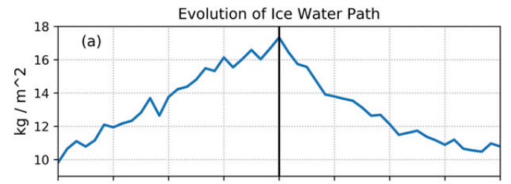
Relationship between Latent Heating and Frozen Hydrometeors
1. Such evolving patterns of IWP
are nearly identical to that of
latent heating in the upper-level
2. IWP provides an accurate proxy
of upper-level latent heating
3. Upper-level latent heating
might have information
about future TC intensity
Notes:
只有高層潛熱跟IWP變化雷同,
IWP可以做為一個得知高層潛熱的媒介
高層的latent heating可能和颱風未來強度有關

Slide 30
Evaluation of Simulations
by Comparison to Observations

Slide 31
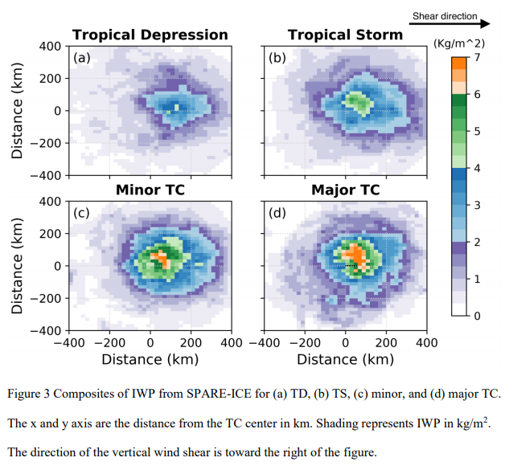
Evaluation of Simulations by Comparison to Observations
1. IWP horizontal distribution was rotated
to same direction of VWS
2. Composite of IWP from SPARE-ICE
3. IWP is concentrated at the TC center
and monotonically decreases outward.
4. Distribution is asymmetric, especially
for TD and TS, with maximum at DSL.
Notes:
這張圖是SPARE ICE的 IWP資料
旋轉為了處理垂直風切造成IWP 的不對稱分布
IWP以TC中心為中心 向外單調遞減
分布不對稱尤其TD TS 和動力分析所分析出的 最強的對流都一樣是在DSL

Slide 32
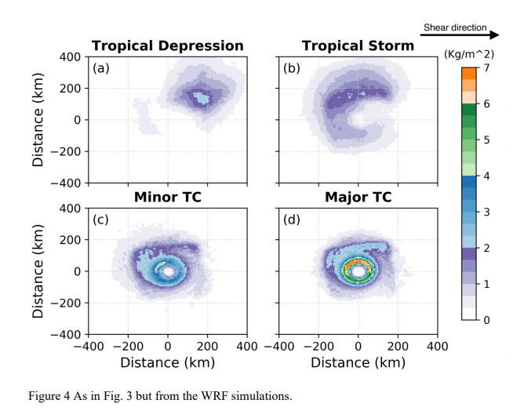
Evaluation of Simulations by Comparison to Observations
WRF
SPARE-ICE
Notes:
左圖是WRF模擬結果 右圖SPARE ICE
WRF模擬的結果 TD TS少了觀測三成(猜測model spin up導致)，major TC多了15%
觀測跟模擬一樣有不對稱性 由中間向外遞減, TD TS一樣在DSL有較大的IWP
MAX 值 隨著強度增加從DSL 往 USL 移動 和之前研究一致
WRF中當強度增加有高IWP值的面積下降 ; 和觀測相反，可能來自模式idealized configuration 減少了環境的增濕作用進而眼牆周圍雲冰的量值減少

Slide 33
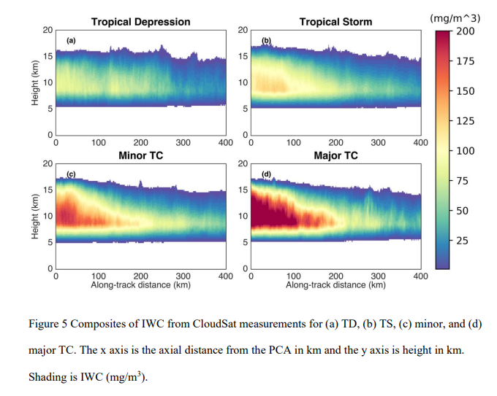
Evaluation of Simulations by Comparison to Observations
1. Vertical distribution of IWC from CloudSat
2. IWC is concentrated within 100km of PCA
at a height 5～15km
3. Maximum located near PCA
4. The greater IWC is, the stronger the TC is.
Notes:
極值 of IWC TD:106 TS:141 minor: 190 major:269
TC強度增加 ,IWP增加 尤其是在PCA 200公里內
和先前研究一致 TC強度和雲冰的量值呈正相關

Slide 34
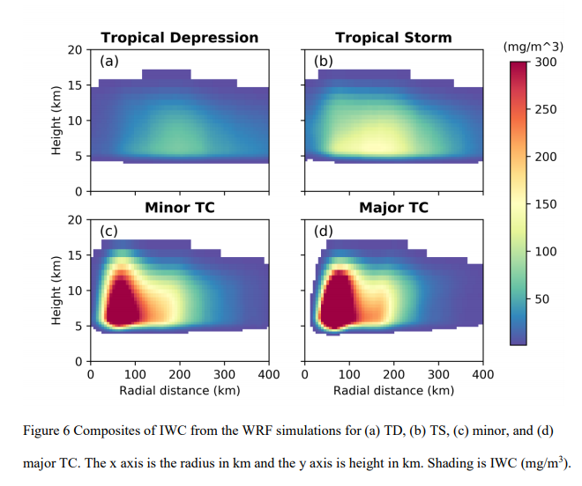
Evaluation of Simulations by Comparison to Observations
WRF
CloudSat
Notes:
WRF 是 azimuthal mean IWC集中在200KM PCA內 5~15公里高 和觀測一致
TD TS兩者量值差不多 minor 和 major simulated 最多多30%
觀測中 max of iwp延伸到原點 但 模式在進入RMW內 降到0
因為他取樣取到 穿越中心的緣故

Slide 35
Evaluation of Simulations by Comparison to Observations
CloudSat
footprint like slicing method
WRF
Notes:
這邊作者想知道如果 sampling的方式改成 cloudsat footprint like 的話
結果會有什麼不同? 下一頁是變成 cloudsat footprint like 的話

Slide 36
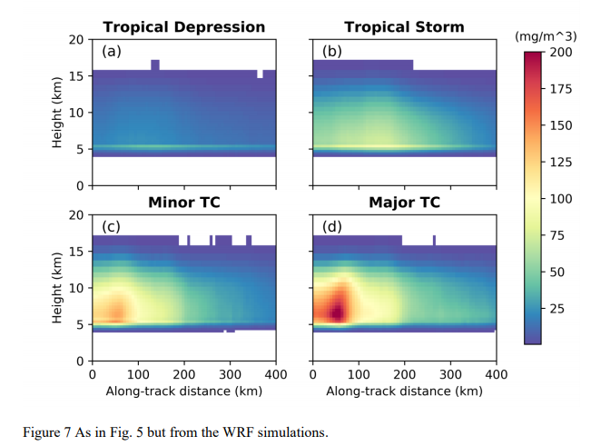
Evaluation of Simulations by Comparison to Observations
WRF-applied
CloudSat-like
slicing method
CloudSat
footprint like slicing method
Notes:
數字結果在下一頁
直接跳下一頁講

Slide 37
Evaluation of Simulations by Comparison to Observations
WRF-applied
CloudSat-like
slicing method
WRF
Notes:
修正後Max iwc
Minor TC 150 Major 210 , TD TS平均比觀測少40%
修正前 max of IWC
Minor: 190 major:269 (比觀測少20%)

Slide 38
Evaluation of Simulations by Comparison to Observations
WRF-applied
CloudSat-like
slicing method
CloudSat
Notes:
IWC max的高度太低 相較於觀測 (不論有沒有修正) 可能與WSM6有關 或初始場給定的環境導致
修正後平均大約比觀測的IWC 少25%

Slide 39
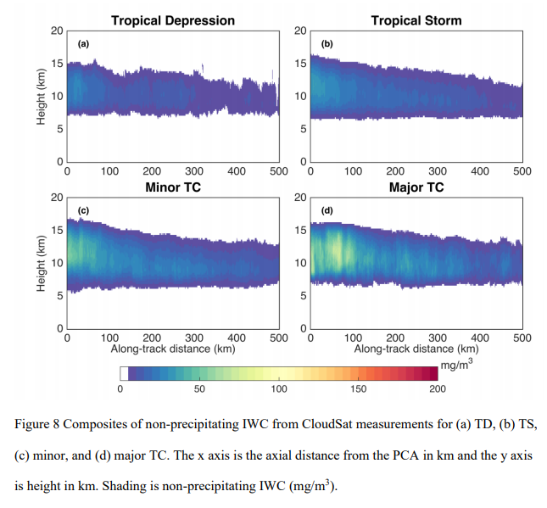
Evaluation of Simulations by Comparison to Observations
Distinguish precipitating or
non- precipitating IWC.
In convective system, precipitating IWC
account for 80% of total IWC.
(Waliser et al. 2009, Chen et al. 2011, Deng et al. 2018).
3. In these cases, CloudSat indicated that
precipitating IWC account for
85～90% of total IWC
Non-precipitating IWC is concentrated at
8～13km
Notes:
過去研究指出 降水型的IWC(雪跟雹) 佔整體IWC 80% CloudSat 說大概85~90
非降水型(cloud ice)的集中在8~13km 比整體的IWC 高3KM
和WRF比較(這裡沒附圖) 非降水佔15% 高度在8~14KM
和觀測差不多 不論是非降水型IWC的量或是分布

Slide 40
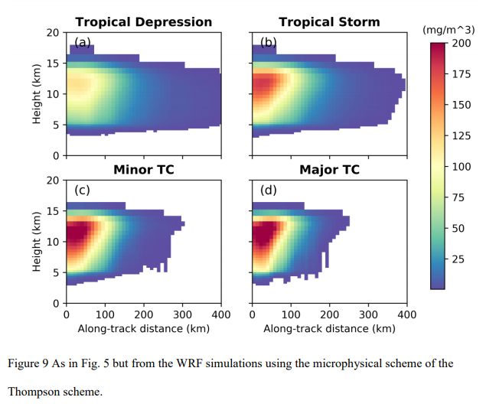
Evaluation of Simulations by Comparison to Observations
1. Vertical distribution of IWC from WRF
but with Thompson schemes.
2. Applied CloudSat-like slicing method.
3. The production of cloud ice in a full
physics model is regulated mainly
by the microphysics scheme.
The choice of scheme may change
the result of simulations.
( Bao et al. 2012; Alvey et al. 2015; Fovell et al. 2016)
Notes:
這邊的雲為物理參數化改成Thompson schemes
也有使用cloudsat 的sampling的方式
結果跟比較在下一頁

Slide 41
Evaluation of Simulations by Comparison to Observations
WSM6
Thompson
Notes:
1.平均而言 Thompson 比 WSM 的 IWP 多三成
2.TD TS 多三倍 minor major TC多50%
3.湯普生在高層能夠產生更多的 冰相粒子

Slide 42
Evaluation of Simulations by Comparison to Observations
Thompson
CloudSat
Notes:
Max of iwp 湯普生比 觀測多大約20%
Iwc的範圍也更集中在中心附近 可能跟在ensemble 中TC size 較小有關
湯普生當中較大值得IWC 隨高度增加 ,意味著在高處產生過多的冰水粒子 尤其是非降水的IWC(cloud-ice)

Slide 43
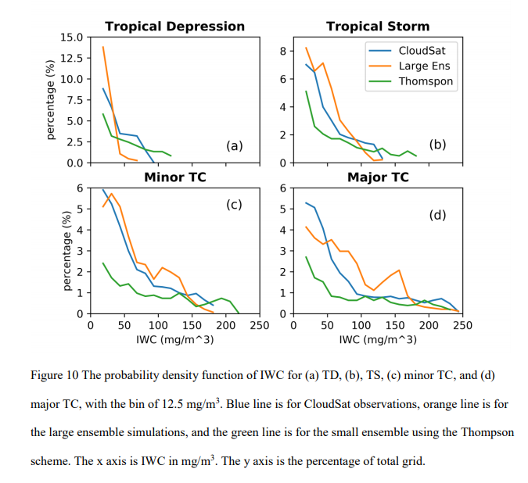
Evaluation of Simulations by Comparison to Observations
1. Blue for CloudSat
Orange for WSM6
Green for Thompson
2. Probability density function of IWC
within 400 km of the PCA.
Notes:
結果 跟範例都在下一頁
講完左邊的文字就可以跳下一頁

Slide 44
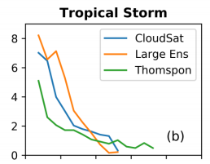
Evaluation of Simulations by Comparison to Observations
Thompson scheme tend to
Produce more cloud ice
(Varble et al. 2014)
Higher percentage(>70%) not shown
For the smallest bin (0～12.5)
Notes:
Cloudsat 跟WSM6 有70%落在 0~12.5 mg/m^3
Thompson有82%
Thompson出現較大的值
符合之前對此scheme的認知 容易產生過量的冰水粒子

Slide 45
Can WRF Capture
the Signal of TC Intensification?

Slide 46
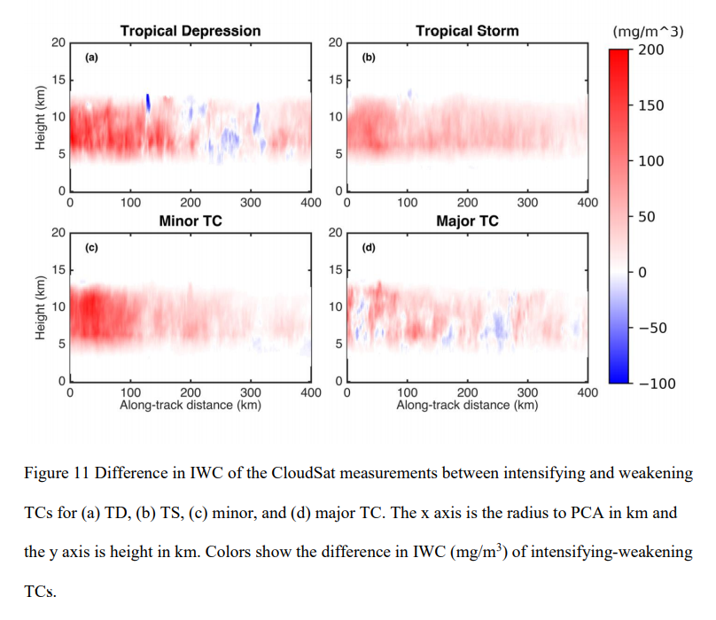
Can WRF Capture the Signal of TC Intensification?
1. Previous analyses of CloudSat
measurements found that intensifying
TCs tend to have greater IWC than that
of weakening TCs (Wu and Soden 2017)
2. To examine whether the WRF model
reproduces this signal, we create
composites of CloudSat-measured IWC
for intensifying (> 2.57 m/s; 5 knots) and
weakening TCs (< -2.57 m/s; -5 knots)
Notes:
增強中的 tc 減去 減弱中的tc得到的差值
此圖是CloudSat的結果
增強中的比減弱中的有更大的IWC，最大差值落差PCA 100KM內
除了major TC不均勻， 文章說可能是部分因為增強中的強度比減弱中的ＴＣ強度強，影響到ＩＷＣ的信號

Slide 47
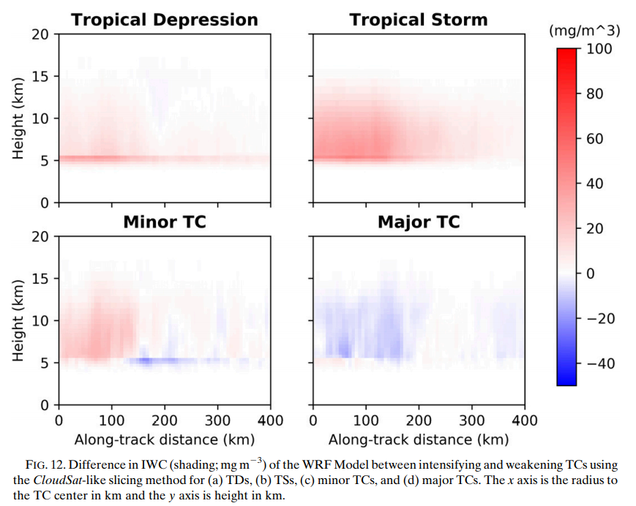
Can WRF Capture the Signal of TC Intensification?
WRF-applied
CloudSat-like
slicing method
CloudSat
Notes:
增強中的 tc 減去 減弱中的tc得到的差值
此圖是WRF模擬的結果
增強中的比減弱中的有更大的IWC
除了major TC
同時增強中與減弱中的整體平均(areal mean)差值，只有CloudSat觀測的一半 for TD TS minor TC
Minor TC 正差值在PCA 150KM明顯 in WRF 但是CloudSat 500km
Major TC 模擬中 整個都是負的 和 觀測不同
在理想化模式的框架下，當颱風對流系統逐漸發展，會使大氣的平均態變乾，
進而使得雲冰在TC外核產量減少，推測此原因造成負值

Slide 48
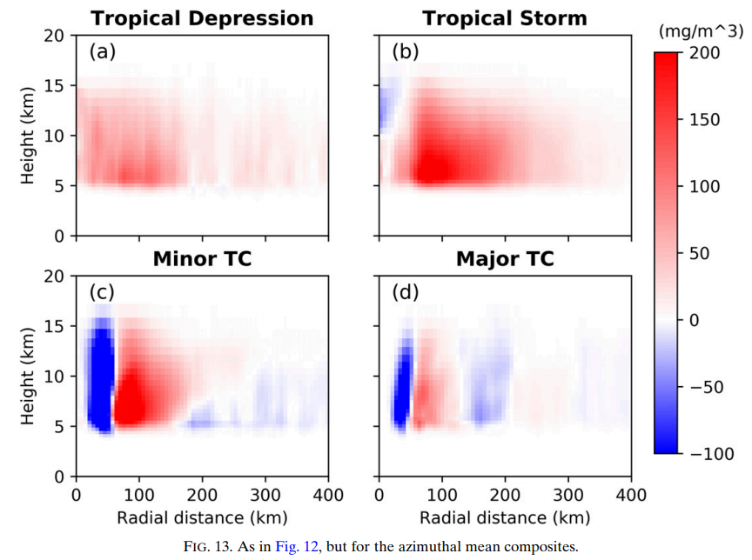
Can WRF Capture the Signal of TC Intensification?
WRF-applied
CloudSat-like
slicing method
WRF-applied
azimuthally averaged
Notes:
Areal mean IWC 在增強中的TCs仍大於減弱中的
分布跟使用cloudsat like slicing method的不同
在TD TS中 使用平均的 增強-減弱的差值更大
而在Minor Major TC中 出現了 dipole 在颱風的內核
增強-減弱 出現負值在接近TC中心處 而正值在距離50KM外
Dipole的原因有2 (1)TC在增強和減弱時 SIZE不同 (2)增強中的TC眼牆變強變濕 相對的 眼內變乾

Slide 49
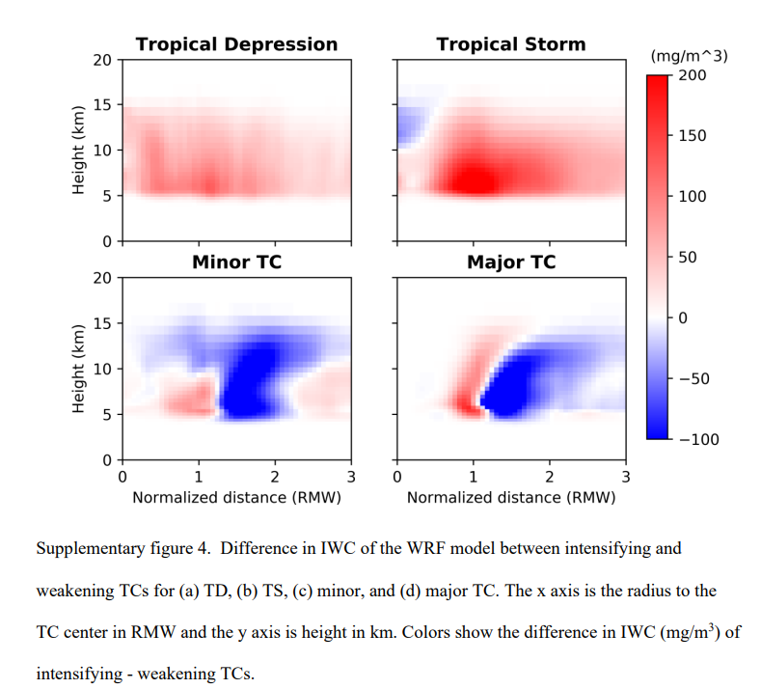
Can WRF Capture the Signal of TC Intensification?
1. To verify the reason for dipole pattern
applied axial distance normalized by RMW.
2. Intensify TCs have a greater IWC around
the radius one RMW for minor and major TCs.
Indicating that the eyewall in intensifying TCs
is stronger, resulting in greater IWC.
Axial distance normalized
by RMW
Notes:
軸距離經由RMW 標準化之後 發現
在Minor Major TC中 在1個RMW的位置有較大的IWC
意味著增強中的TC 眼牆比較強造就較大的IWC

Slide 50
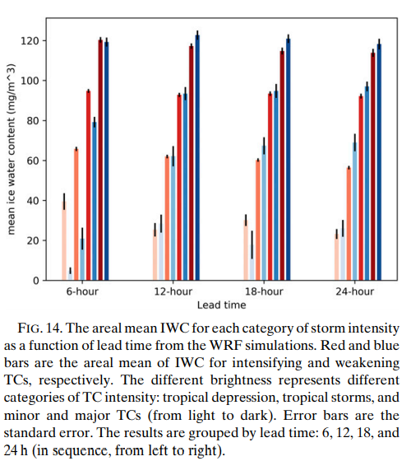
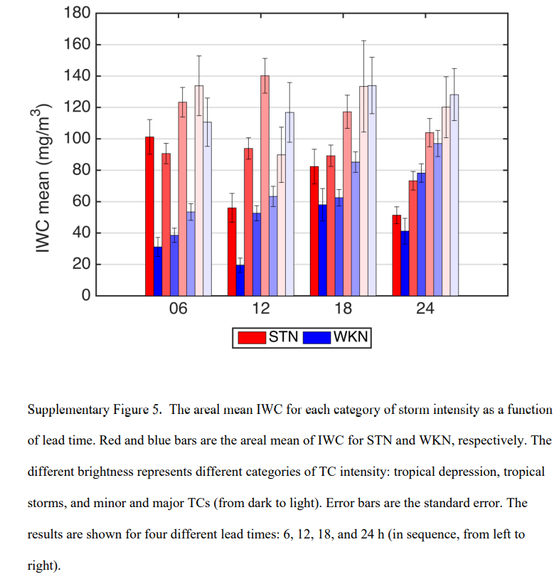
Can WRF Capture the Signal of TC Intensification?
1. Fig 14 shows areal mean IWC for intensifying
and weakening at four different lead-times
and four intensity categories.
2. From left to right(light to dark):
TD, TS, minor TCs, major TCs
3. For 6-h lead time before the intensity change,
the areal mean IWC of intensify TCs is greater
than weakening TCs.
4. While for lead times greater than 6-h, the
difference are not clear.
Notes:
由左至右 分別是 TD, TS, minor TCs, major TCs
紅色 代表增強中case 藍色代表減弱中的case error bar 則是 standard error
在WRF模擬中 只有在強度變化前六小時 ,增強-減弱的 值>0 的訊號才明顯
然而(按一下動畫)觀測資料中 在強度變化前24小時就明顯，可能與模擬的ＩＷＣ量值不同 或在理想化模擬中缺少對環境變異的掌握所導致
會影響到較長期預報的颱風增強訊號

Slide 51
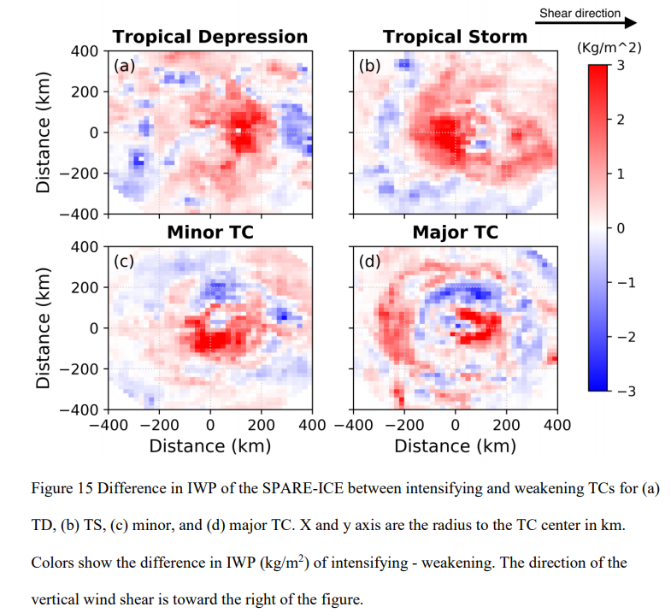
Can WRF Capture the Signal of TC Intensification?
1. Fig 15 shows the horizontal distrubution
difference between intensifying and
weakening TCs.
2. For TD and TS, intensifying TCs have
greater IWC in most of the area within
200 km radius.
3. Intensifying Minor and Major TCs
still have larger IWP than weakening TCs.
Ration of positive to negative :
Minor TCs 5:2
Major TCs 5:3
Notes:
這張圖是spare ice的結果
此圖將增強中的TC 和 減弱中的TC疊一起
並且將TC轉到和風切同方向
看正負面積的分布情形
TD和TS的 兩百公里半徑內 大多是正的(增強的比減弱的IWC大)
Minor 在domain 內 是5:2
Major 則是5:3
和先前研究相同，增強中的ＴＣ相較於減弱中的有較強的對流

Slide 52
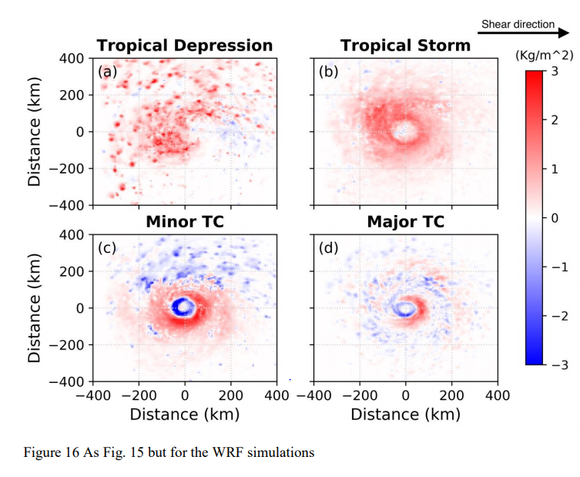
Can WRF Capture the Signal of TC Intensification?
WRF
SPARE-ICE
Notes:
使用WRF 模擬IWP 看是否有何 觀測有一樣的信號
1.每個強度 IWP mean 增強的都比減弱的強
2.TD TS在 整個domain 都是正面積
3.在mionr TC 中心30~60KM內 是負面積 但是 70~200KM 正面積
可能和增強中和減弱的TC不同所導致 或是增強中的眼牆較強所導致

Slide 53
Discussion and Conclusion

Slide 54
Discussion and Conclusion
1. Upper-level latent heating
might have information
about future TC intensity
Notes:
高層的潛熱 可能和ＴＣ未來強度有關

Slide 55
Discussion and Conclusion
2. In the WRF Model, IWP is correlated
with latent heating in the
mid- to high troposphere, and thus
has a potential to serve as a proxy of
latent heating in this level.

Slide 56
Discussion and Conclusion
3. The WRF Model reasonably reproduced the magnitude and distribution of the
observed frozen hydrometeors, with ～20% deviation from observational metrics,
suggesting that the model have microphysical deficiencies that needed to be improved.
WRF
CloudSat
Notes:
ＷＲＦ模式和模式對比可以大致合理的 重現ＩＷＣ 的量值和分布，大約有２０％的誤差
意味著模式 雲微物理參數化可能有改善空間

Slide 57
Discussion and Conclusion
4. The enhancement of frozen hydrometeors
in intensifying TCs is found in both the
satellite-based and simulated metrics,
though the model only captures the
observed signal up to 6-h lead time.
Notes:
增強的ＴＣ相較於減弱的ＴＣ 有較大的平均(areal mean)ＩＷＣ
然而模式在前六小時才能掌握到 但是 觀測前一天就有看到

Slide 58
Discussion and Conclusion
5. The dipole pattern occurs in the
difference between composites of
intensifying and weakening TCs,
indicating that a simple domain
average of frozen hydrometeors
is likely to obscure the clarity of the
signal of TC intensification.
WRF-applied
azimuthally averaged
Notes:
就像之前所說的
Dipole的原因有2 (1)TC在增強和減弱時 SIZE不同 (2)增強中的TC眼牆變強變濕 相對的 眼內變乾
顯示出 單純做domain mean 似乎會影響到TC增強的訊號

Slide 59
Discussion and Conclusion
Future:
Examine the cause of the increasing frozen hydrometeors
in intensifying TCs and to explore how to utilize this signal
to better predict future TC intensity.
Notes:
接下來要 探討為何 TC增強時 會有 冰相粒子 增加的訊號
以及如何運用這個信號去預報颱風的強度

