Slide 1
How Does Hurricane Edouard (2014) Evolve toward Symmetry before Rapid Intensification? A High-Resolution Ensemble Study
Paper review
mainly refer to
George R. Alvey III , Ed Zipser , and Jonathan Zawislak
Wei-Ting Fang
2020.12.22
Other reference:
Lin, K. J., S. C. Yang, and S. S. Chen, 2018: Reducing TC position uncertainty in an ensemble data assimilation and rediction system: A case study of Typhoon Fanapi (2010). Wea. Forecasting, 33, 561–582.

Slide 2
Outline
Introduction
Data and methods
Ensemble overview
Interconnection of vortex alignment, inner-core precipitation, and humidity
Summary

Slide 3
Introduction (1/2)
It is well known that vertical shear of the horizontal wind typically forces a wavenumber-1 azimuthal asymmetry in the precipitation distribution in TCs (Frank and Ritchie 1999; Corbosiero and Molinari 2002, 2003; Wingo and Cecil 2010; Hence and Houze 2011; Reasor et al. 2013; DeHart et al. 2014; Alvey et al. 2015).
Differential advection from vertical wind shear tends to tilt the vortex in the vertical (Jones 2000) triggering precipitation initiation downshear right (DSR), maxima downshear left (DSL), and minima in the upshear quadrants (Hence and Houze 2011).
Sheared TCs often initially have a vertically displaced or tilted vortex that for RI cases becomes aligned near onset (Munsell et al. 2017; Chen et al. 2018; Leighton et al. 2018).
While several previous modeling and observational airborne studies have placed more focus on the role of intense, deep convection (Braun et al. 2006; Guimond et al. 2010; Molinari and Vollaro 2010; Molinari et al. 2013; Rogers et al. 2013, 2015, 2016), satellite-based studies emphasize the role of other precipitation modes (i.e., stratiform, shallow, moderately deep convection) for TC intensification.

Slide 4
Introduction (2/2)
Despite progress in recent years, fundamental questions remain unanswered regarding the relationships between precipitation and intensity change when TCs are experiencing at least moderate vertical wind shear.
What are the dominant precipitation types, their spatial distributions, and the evolution of these features with respect to alignment and TC intensification?
What causes an azimuthal increase in precipitation, particularly in the upshear quadrants?
What is the relationship between vortex alignment and increased azimuthal precipitation symmetry upshear?

Slide 5
Edouard (2014) synopsis
Edouard reached tropical storm strength at 0000 UTC 12 September. Over the next 24–48 h, Edouard slowly intensified [<7.5 m s⁻¹ (24 h)⁻¹] under the presence of moderate (8–10 m s⁻¹) deep-layer vertical wind shear and marginally conducive SSTs (Zawislak et al. 2016). According to the best track, Edouard experienced a period of RI [13 m s⁻¹ (24 h)⁻¹], from 1200 UTC 13 September through 14 September.

Slide 6
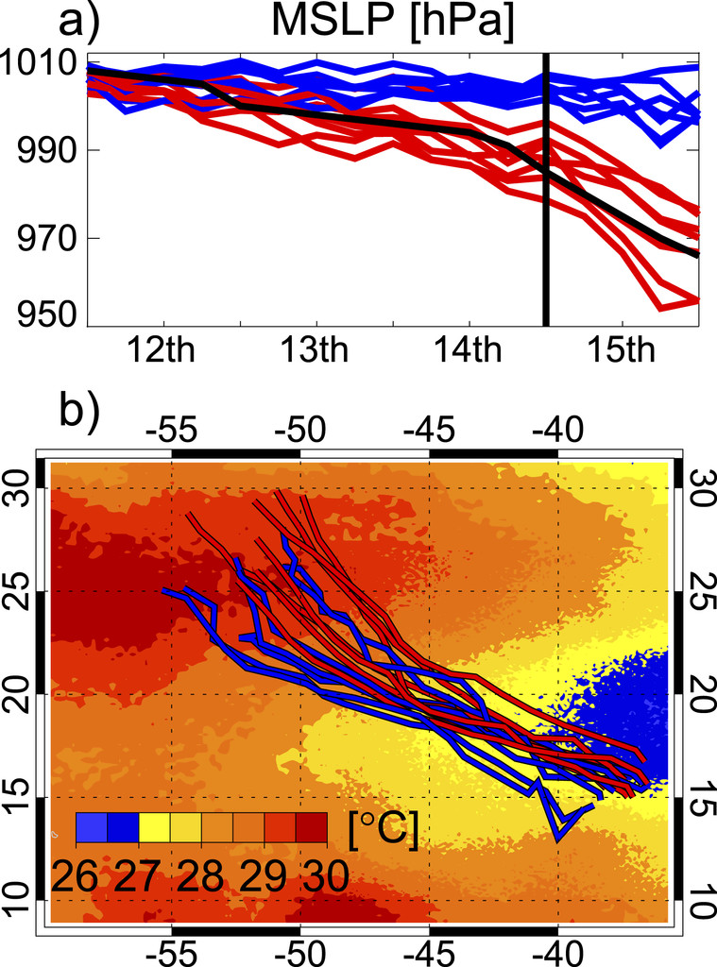
Experimental setup
Initial and lateral boundary conditions from 14 Global Ensemble Forecast System (GEFS) members from the 1200 UTC 11 September
WRF: Version 3.7.1
The three two-way nests have a horizontal resolution of 9, 3, and 1 km and 55 vertical levels (27 km Outer domain)
Thompson microphysics scheme
Kain–Fritsch cumulus scheme
YSU planetary boundary layer scheme

Slide 7
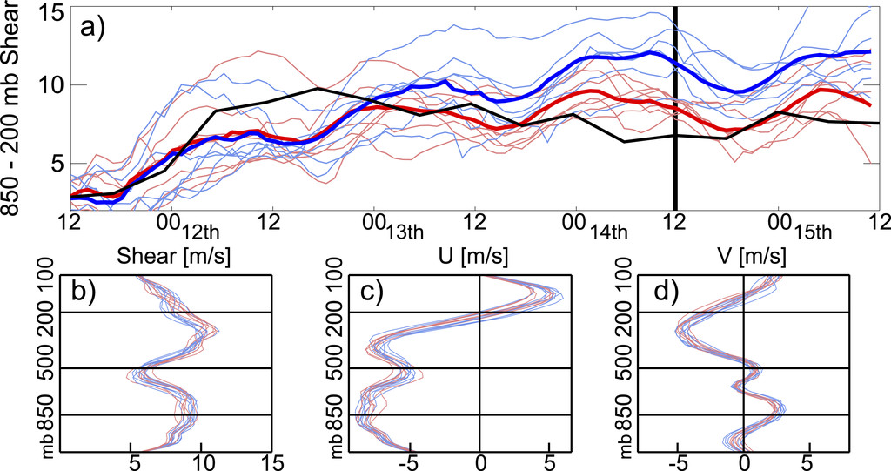
Environmental conditions
0–500-km vertical wind shear
Deep-layer vertical wind shear alone is not responsible for the success or failure of capturing intensification

Slide 8
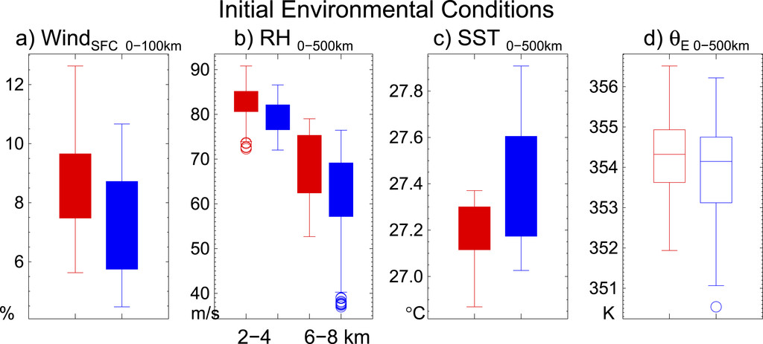
Initial environmental conditions
1200 UTC 11 Sep–0000 UTC 12 Sep (first 12 h after initialization)

Slide 9
Vortex tilt
for at least 6 consecutive hours
How the successful members evolve from a tilted vortex to one that is vertically upright
95th percentile of 24-h pressure changes: <−23 hPa (24 h)⁻¹
Notes:
Vortex center locations are calculated at 25 vertical model levels throughout the depth of the troposphere in 15-min intervals using a variant of Nguyen et al.’s (2014) pressure centroid method.
42 hPa day⁻¹ 15.4 m s⁻¹ day⁻¹

Slide 10
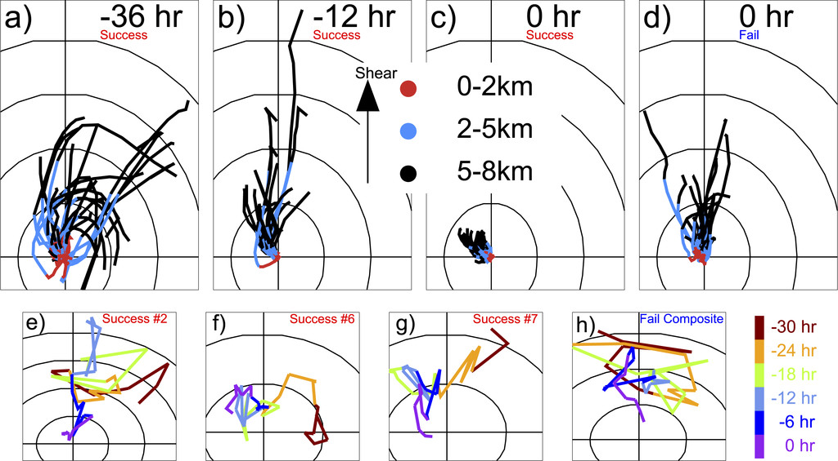
H1: The tilted vortex exhibits horizontal precession toward the upshear quadrants(Reasor et al. 2004)

Slide 11
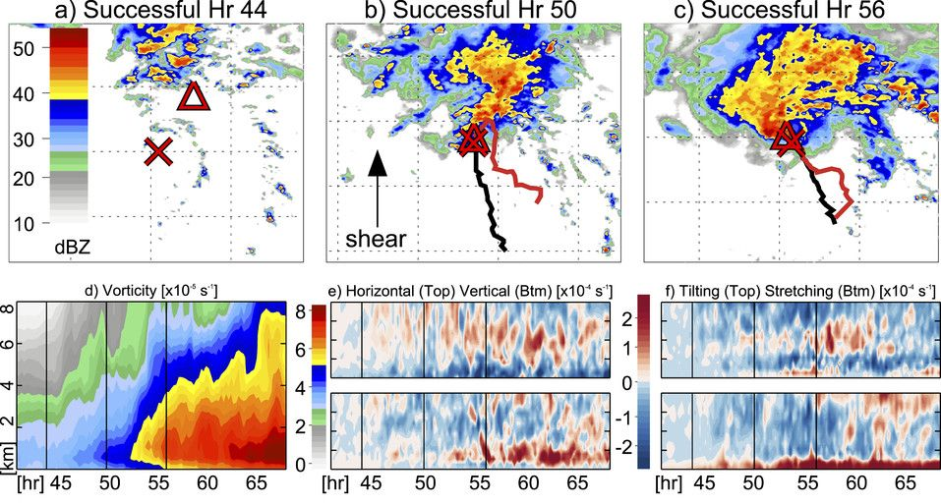
Successful member
Alignment
Notes:
ζ budget is calculated within 0–50 km

Slide 12
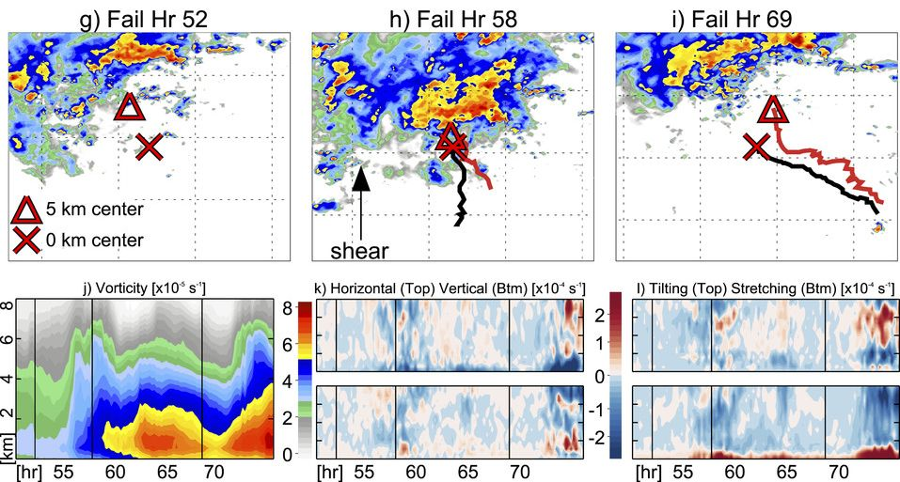
Failed member

Slide 13
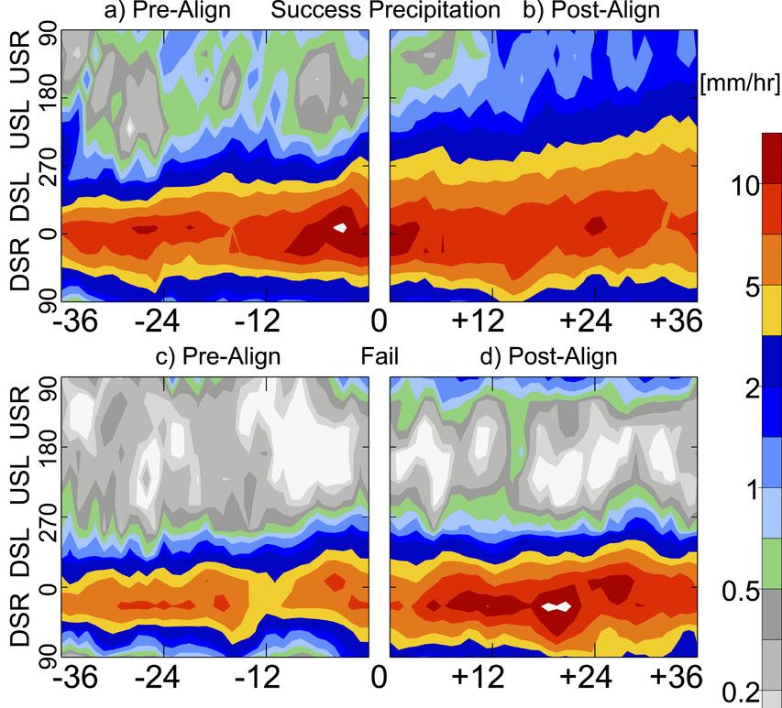
H2: Shallow and moderately deep precipitation USL (Nguyen et al. 2017) transitions into stronger, deep convective updrafts intensifying a vortex through a bottom-up pathway (Montgomery et al. 2006)
Notes:
inner core refers to 200-km radial averages

Slide 14
Convective asymmetry (Schecter 2013)
This metric indicates that successful (decrease in asymmetry) and failed (greater asymmetry) composites diverge ~18 h before alignment.
σ: vertically integrated rain mass density
numerator: 0.5 ≤ radius/RMW ≤ 1.5
denominator: 0.5 ≤ radius/RMW ≤ 4

Slide 15
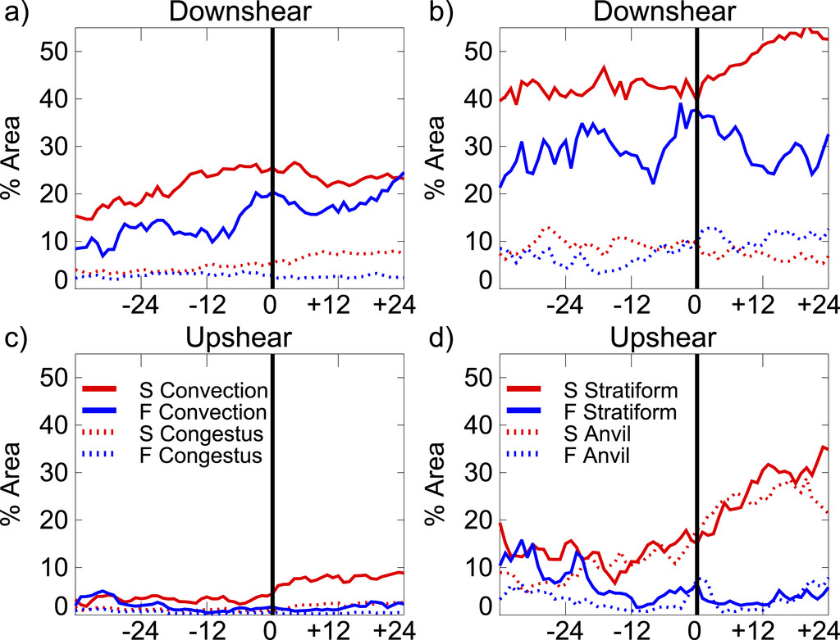
Precipitation classification
Congestus, deep convection, stratiform and anvil
Notes:
Any grid cell with simulated radar reflectivity that is >40 dBZ at 2.5 km, or sufficiently greater than nearby pixels [defined as “peakedness” in Steiner et al. (1995)] is classified as convective.
Those convective grid cells with a 15-dBZ echo top of <8.5 km are classified as congestus, which is similar to shallow to moderate convection defined by Fritz et al. (2016).
Any nonconvective grid cell with 2.5-km reflectivity >10 dBZ is classified as stratiform and any remaining grid cells <10 dBZ at 2.5 km are classified as nonprecipitating.
Following Feng et al. (2011), we define the anvil by all nonprecipitating grid cells with any positive reflectivity top >6 km.
failed composite precipitation increase tends to be more episodic, lacking persistence
the larger, more apparent prealignment differences between successful and failed composites first appear in the downshear precipitation, followed by differing evolutions (increases) in the anvil and stratiform precipitation upshear

Slide 16
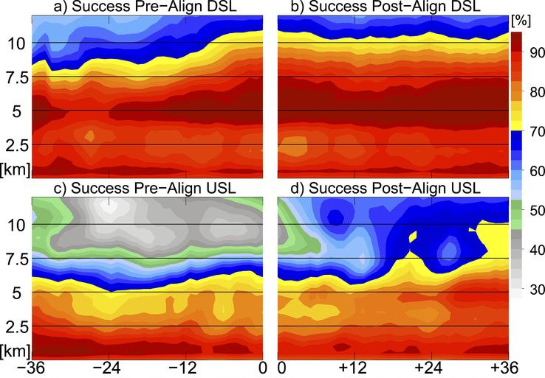
H3: An MLC-ULC with stratiform precipitation increases low–midtropospheric RH via evaporation and penetrates downward toward the boundary layer through a top-down pathway (Bister and Emanuel 1997)
Notes:
composite within 200 km

Slide 17
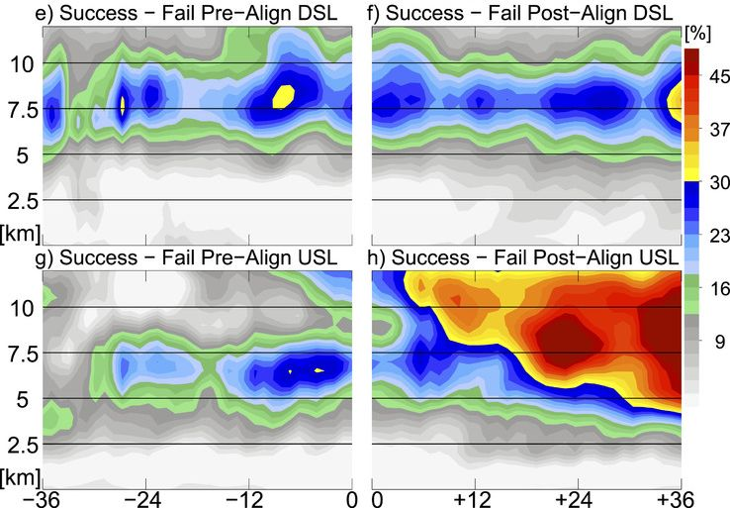
Successful minus failed member composites
anvil
deep convection
stratiform
Notes:
the largest differences between the successful and failed composite are initially in the upper troposphere (6–12 km) DSL (15%–30% difference), associated with more persistent deep convection than failed members.
Composite differences USL (10%–25%) are initially maximized in the midtroposphere (4–8 km) prior to alignment (Fig. 10g), which likely reflects increased shallower precipitation (e.g., stratiform) in those quadrants in successful members (Fig. 9d).

Slide 18
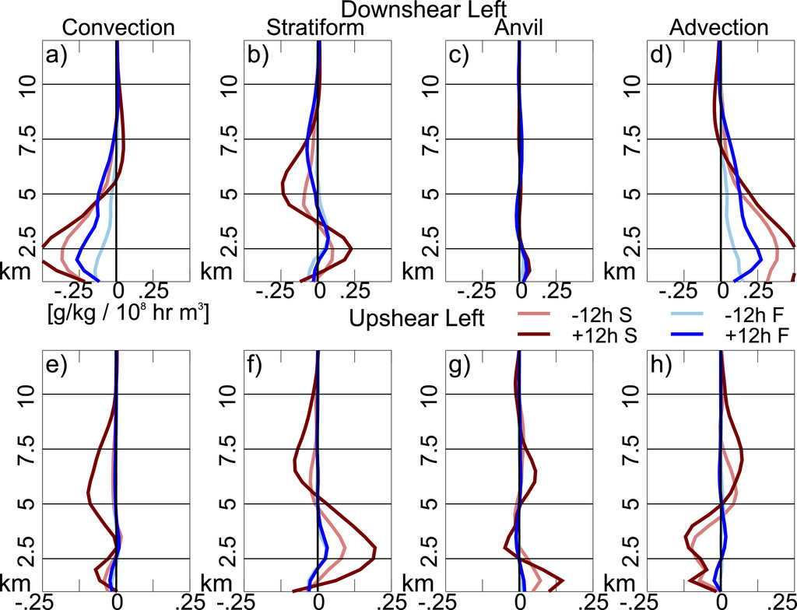
Water vapor mixing ratio budge
Primarily resulting from greater areal coverage of convection (Figs. 9a, 11a) and positive horizontal advection of q_{υ} (Fig. 11d).
Notes:
In our results, evaporation from stratiform precipitation provides a significantly greater positive q_{υ} contribution below 5 km
a decreasing vortex tilt shown in Figs. 4 and 6 promotes condensate advection from downshear to upshear
The humidified environment then favorably allows more sustained convection that propagates farther USL.

Slide 19
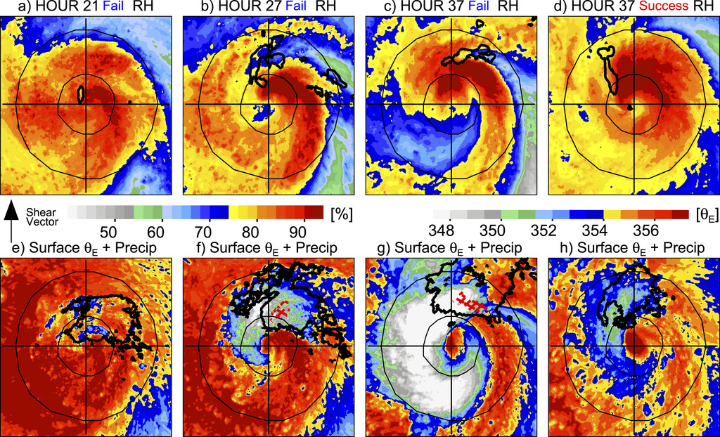
Propagation of lower-θ_{E} air
Notes:
low- to midtropospheric RH (1–4 km) for a composite of four failed members

Slide 20
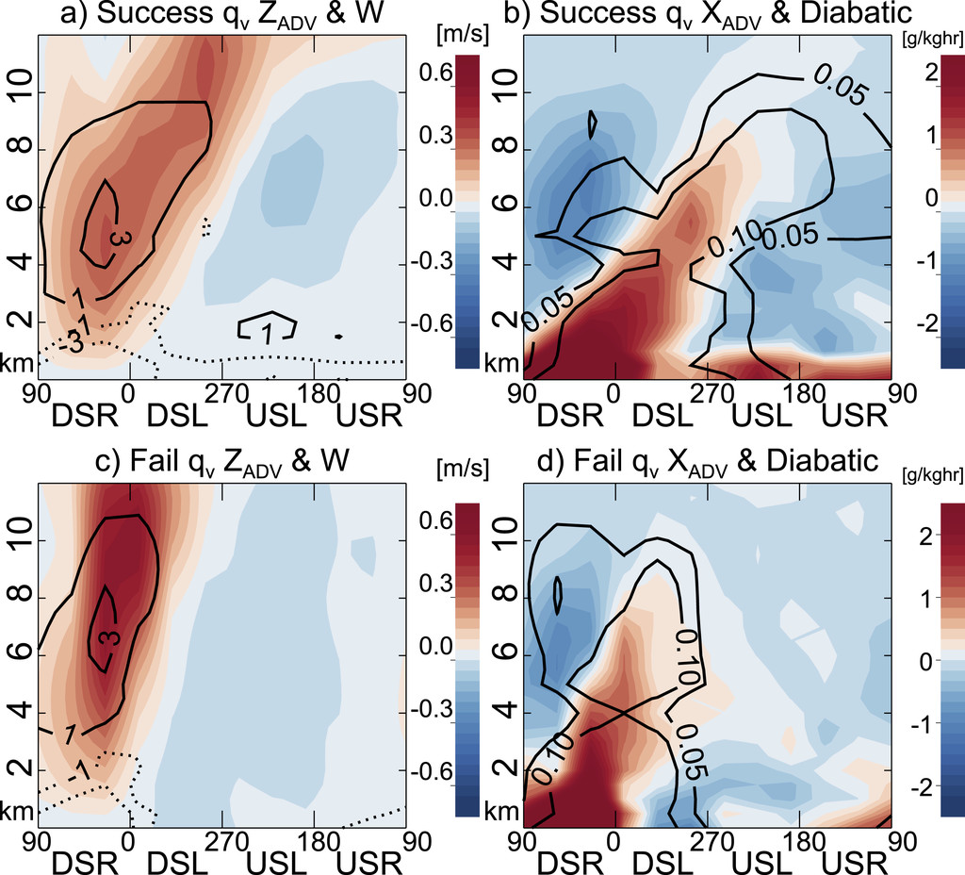
Postalignment
The aligned vortex → horizontal water vapor advection DSL to USL → further moistening the middle to upper troposphere (sublimates and evaporates USL). → more persistent precipitation.

Slide 21
Summary(1/2)
The 14-member ensemble results in 7 members that closely follow the observed intensification and 7 members that do not reproduce the intensification.
One of the key vortex-scale differences between successful and failed members is that more persistent convection in successful members increases lower-tropospheric vorticity via vortex stretching.
Failed members periodically have deep convection increases downshear comparable to successful members, but their convection is displaced farther downshear with the MLC and is less persistent.

Slide 22
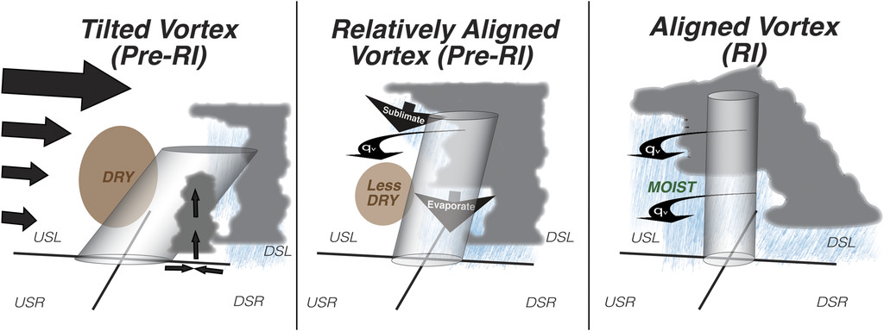
Summary(2/2)
Results from this study provide evidence that both stratiform precipitation and anvil clouds provide a net moistening, particularly as hydrometeors from DSL deep convection advect USL and fall out in stratiform-like precipitation.

Slide 24
Introduction(1/2)
It is well known that vertical shear of the horizontal wind typically forces a wavenumber-1 azimuthal asymmetry in the precipitation distribution in TCs (Frank and Ritchie 1999; Corbosiero and Molinari 2002, 2003; Wingo and Cecil 2010; Hence and Houze 2011; Reasor et al. 2013; DeHart et al. 2014; Alvey et al. 2015).
Differential advection from vertical wind shear tends to tilt the vortex in the vertical (Jones 2000) triggering precipitation initiation downshear right (DSR), maxima downshear left (DSL), and minima in the upshear quadrants (Hence and Houze 2011).

Slide 25
This study will complement the observational approach taken in Zawislak et al. (2016) and Rogers et al. (2016) to analyze the processes responsible for Hurricane Edouard’s (2014) intensification in moderate vertical wind shear.

Slide 26
???
Rather than analyze TCs with respect to RI onset (Zagrodnik and Jiang 2014; Tao and Jiang 2015; Munsell et al. 2017; Leighton et al. 2018; Miyamoto and Nolan 2018), here, we consider a coherent, relatively aligned vortex a critical characteristic of storms that experience RI. Therefore, analyses focus on the timing relative to the vortex alignment, rather than RI onset.
Though not unique to successful members, we speculate that Edouard’s vertical shear profile, concentrated in the upper troposphere (above ~300–400 hPa, Figs. 2b–d), may have helped enable intensification (Finocchio and Majumdar 2017) despite relatively high shear magnitudes (6–12 m s⁻¹). Somewhat surprisingly, aside from diurnal variations, the shear also features a clear upward trend throughout the intensification period as Edouard approaches a tropical upper-tropospheric trough (TUTT) to the west in all ensemble members.

