Slide 1
The Rapid Intensification and Eyewall Replacement Cycles of Hurricane Irma (2017)
Fischer, M. S., R. F. Rogers, and P. D. Reasor, 2020: The rapid intensification and eyewall replacement cycles of Hurricane Irma (2017). Mon. Wea. Rev., 148, 981–1004.

Slide 2
Introduction
RI -internal dynamic → ERC → SEF
：
：
ERC (eyewall replacement cycles)
Outer eyewall develops and inner eyewall contracts
Outer eyewall intensifies and inner eyewall decays (temporary period weakening)
Outer eyewall intensifies and contracts (broader TC vortex)
Willoughby et al. 1982; Black and Willoughby 1992; Sitkowski et al. 2011; Kossin and DeMaria 2016
SEF (secondary eyewall formatiom)
VRW (vortex Rossby waves) outward propagation (Montgomery and Kallenbach 1997)
Descending inflow associated with stratiform precipitation from rainbands (Fang and Zhang 2012)
Unbalanced boundary layer process with agradient forcing (Huang et al. 2012; Abarca and Montgomery 2013)

Slide 3
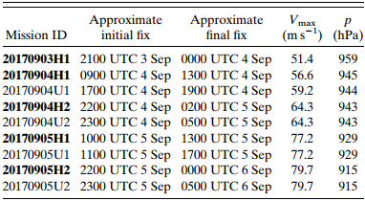
Datasets and methods
4 missions - Air Force WC-130
in situ
5 missions - NOAA WP-P3
in situ/C-band LFR/X-band TDR
Auto QC and dealiasing (Rogers et al. 2012)
Variational technique 3D wind retrieval (Gao et al. 1999; Reasor et al. 2009)
Cartesian grid
Δx=2-km
Δz=0.5-km
Swath=75-100-km
TC-centered cylindrical grid
Δr=1-km
Δθ=1-degree
Δz=0.5-km

Slide 4
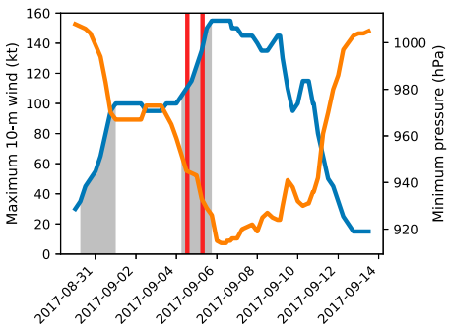
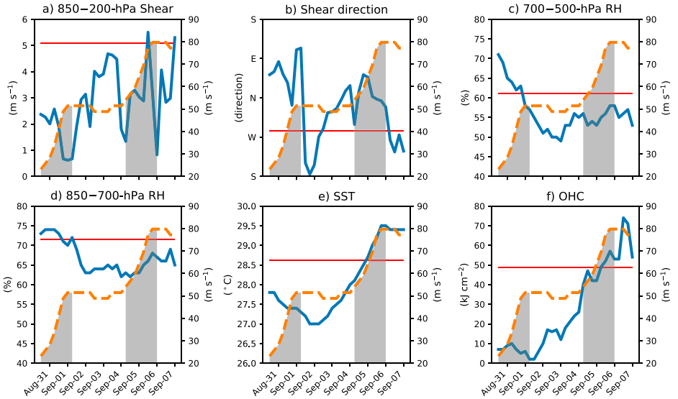
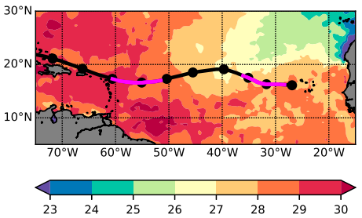
Synoptic history of Hurricane Irma /
Environmental influences on Irma’s intensification

Slide 5
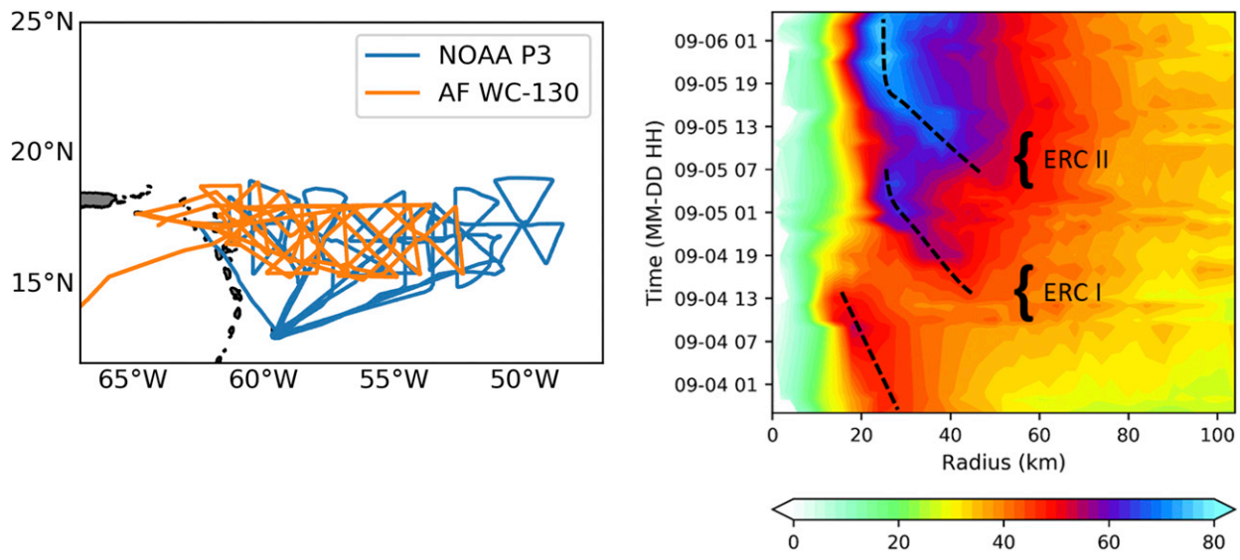
Vortex evolution during RI

Slide 6
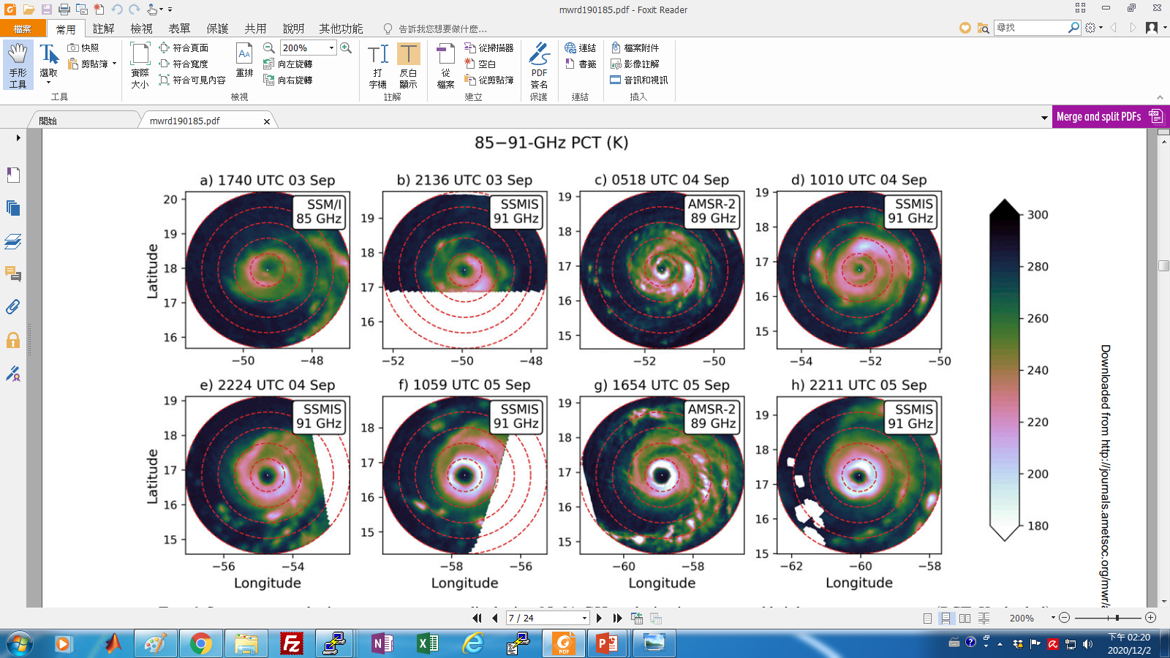
h
g
f
e
d
c
b
Notes:
B 南側下風切處對流增強
A-C 亮溫下降，眼牆收縮
D 雨帶包圍主眼牆
E 第一次眼牆置換完成，西北到東南的雨帶形成
F 第二次眼牆置換完成

Slide 7
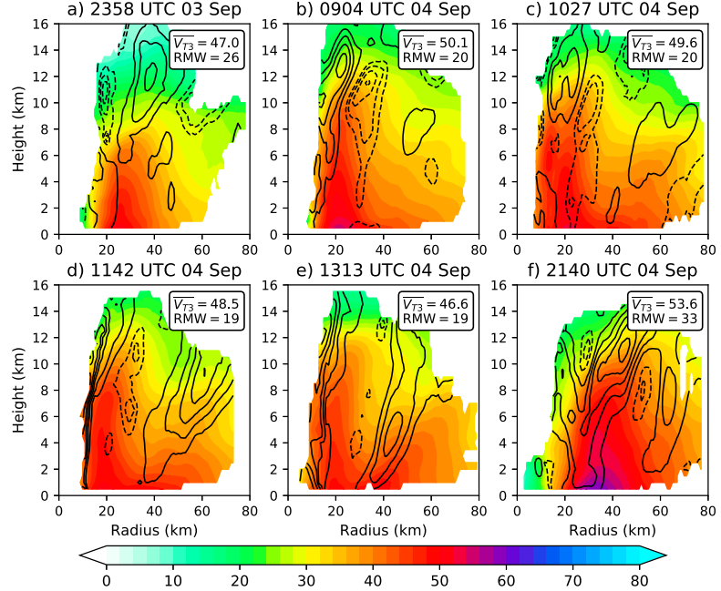
Vortex evolution during RI
ERC I

Slide 8
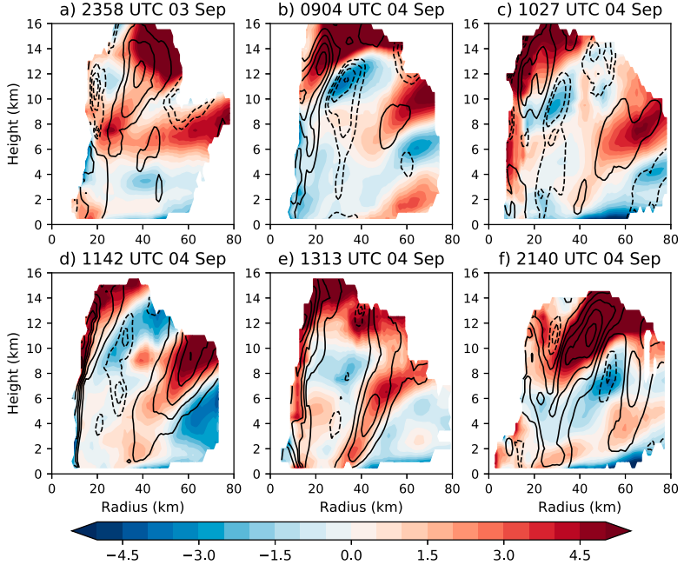
Vortex evolution during RI
ERC I
1. Outer eyewall developed at RMW x (2~3)
2. Moat formed between eyewall
3. Inner eyewall collapsed with brief V_{T}
weakening
x

Slide 9
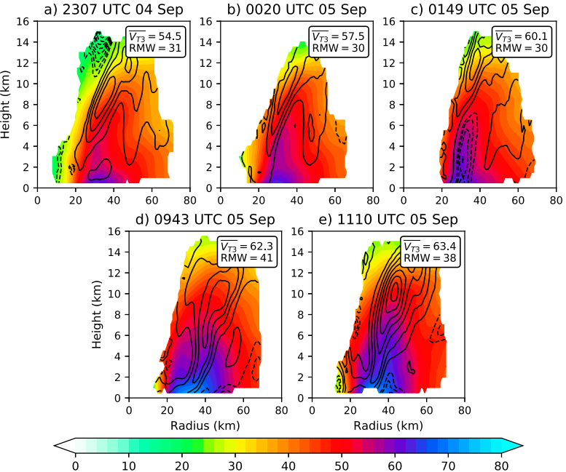
Vortex evolution during RI
ERC II

Slide 10
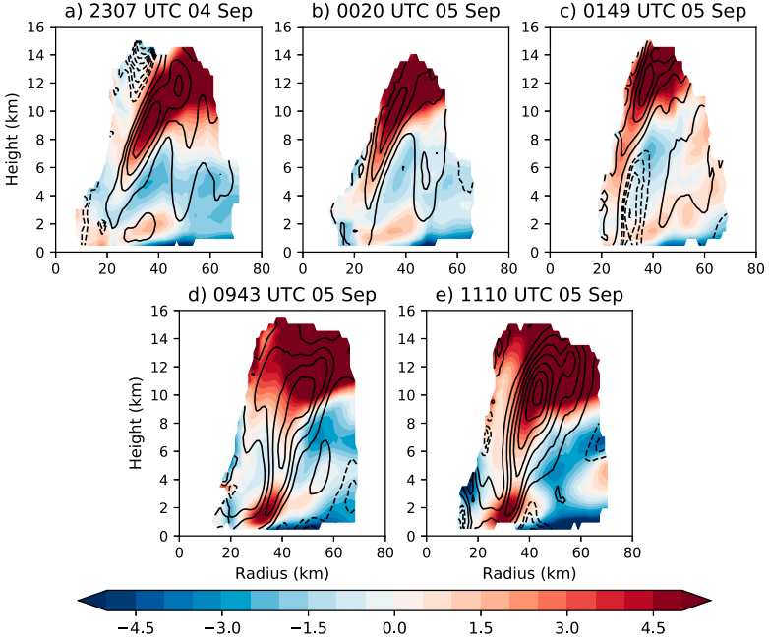
Vortex evolution during RI
ERC II
GBR
$$\frac{∂u}{∂t}=−u\frac{∂u}{∂r}−\frac{v}{r}\frac{∂u}{∂θ}−w\frac{∂u}{∂z}+\frac{v^{2}}{r}+fv−\frac{1}{ρ}\frac{∂p}{∂r}+F_{r}$$
GBR > 0 → supergradient wind → outward acceleration
GBR < 0 → subgradient wind→inward acceleration
(Didlake and Houze 2013)

Slide 11
0943 UTC 5 Sep
Vortex evolution during RI
ERC II
1. Double eyewall structure is evident
2. Outer eyewall has deeper V_{T} and echo
structure than inner
3. Lack of pronounced moat (eyewalls merging)
ERC I & ERC II
ERC I → V_{T} (traditional ERC)
ERC II → V_{T}

Slide 12
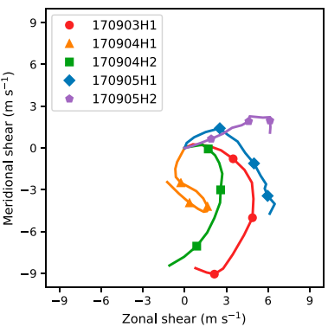
Potential mechanisms for secondary eyewall formation
Wind shear
P3: 5-9 m/s
SHIPS: < 5 m/s
h
f

Slide 13
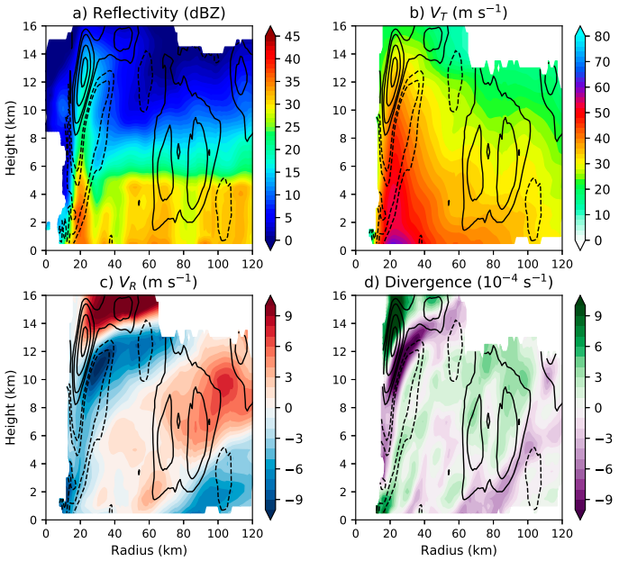
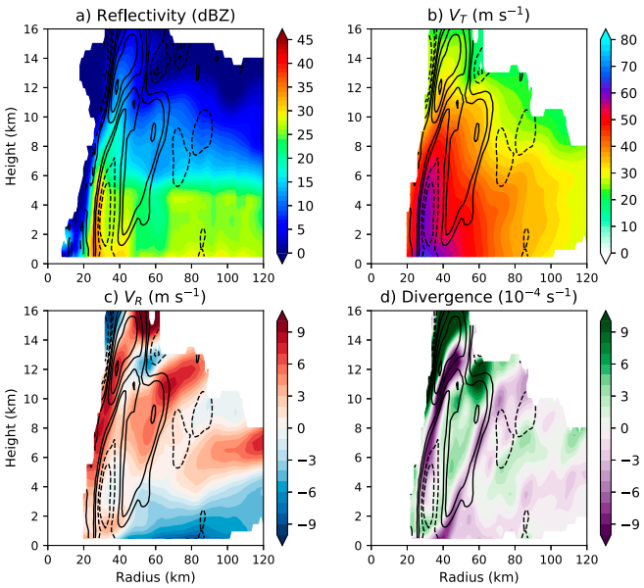
Potential mechanisms for secondary eyewall formation
Mesoscale descending inflow jet / unbalanced boundary layer processes
Notes:
偏弱的內眼牆，8km以下沉降，儘管回波大
次W/次VT/下沉入流/輻合一致
沒有下沉入流，入流被超梯度切向風產生的出流減速輻合

Slide 14
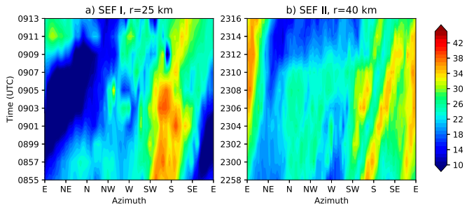
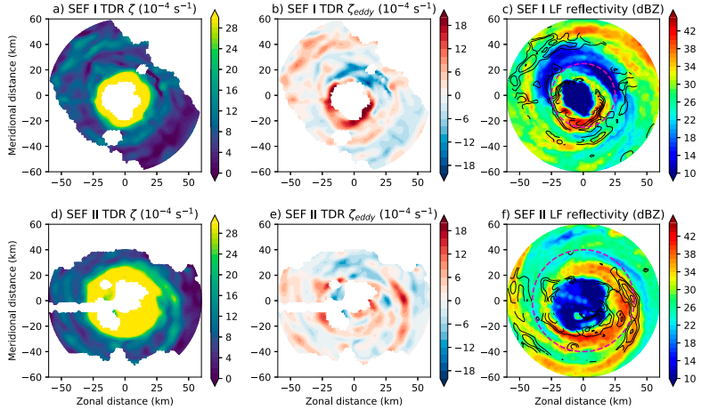
Potential mechanisms for secondary eyewall formation
Evidence of vortex Rossby waves
 | SEF I | SEF II
Phase speed | 26 m/s | 39 m/s
V_{T} | 49 m/s | 51 m/s

Slide 15
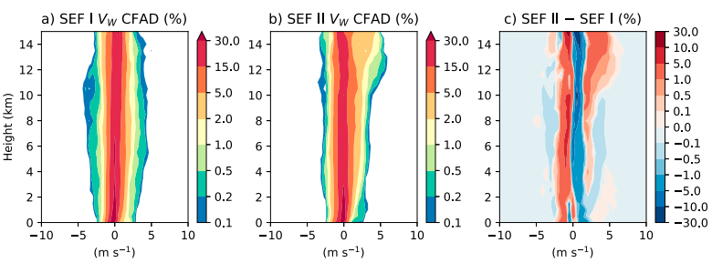
Descending inflow driven by evaporation cooling from stratiform precipitation
Supergradient flow near top of boundary layer, deeper inflow, more intense TC vortex

Slide 16
Conclusions
Two ERC episodes were observed during the RI of Hurricane Irma.
The first SEF event was linked to lower-tropospheric convergence along the leading edge of a descending inflow jet in the downshearleft quadrant of the TC. The second SEF event appeared to have originated from lower-tropospheric convergence associated with a presumed supergradient flow. In both events, it is plausible SEF was aided by the axisymmeterization of outward-propagating VRWs near the theoretical stagnation radius.
ERC I exhibited a relatively common vortex evolution, as the inner eyewall decayed at the expense of an intensifying outer eyewall. Alternatively, during ERC II, the two eyewalls appeared to merge together prior to the collapse of the inner eyewall, with no signs of the vortex weakening.
In each ERC, the time elapsed between the formation of a secondary wind maximum to the completion of the ERC was <12 h. This time period is significantly less than the mean ERC duration of 36 h (Sitkowski et al. 2011). Additionally, both ERCs featured a relatively small initial displacement between the primary and secondary eyewall (20–40 km), which is substantially less than the climatological mean of 71 km.

