Slide 1
Impact of Tropical Cyclone Initialization on Its Convection Development and Intensity: A Case Study of Typhoon Megi (2010)
Paper review
mainly refer to
Yi-Pin Chang; Shu-Chih Yang; Kuan-Jen Lin; Guo-Yuan Lien; Chien-Ming Wu
Wei-Ting Fang
2020.10.20
Other reference:
Lin, K. J., S. C. Yang, and S. S. Chen, 2018: Reducing TC position uncertainty in an ensemble data assimilation and rediction system: A case study of Typhoon Fanapi (2010). Wea. Forecasting, 33, 561–582.

Slide 2
Outline
Introduction
Overview of Typhoon Megi (2010)
Methodology
WRF TCC-LETKF system
The dropsondes
The axisymmetric surface wind structure
Experiment settings and design
WRF Model configuration and settings of the DA system
Experiment design
Results
The TC intensity and track
The analyzed TC structure
The convection development and TC intensification
The BOTH experiment
Summary and conclusions

Slide 3
Introduction(1/2)
TC intensity prediction remains challenging, especially for cases undergoing rapid intensification (RI), which is defined as an intensification rate of at least 42 hPa day⁻¹ (or 1.75 hPa h⁻¹) in minimum sea level pressure (MSLP) by Holliday and Thompson (1979) for western Pacific TCs and 15.4 m s⁻¹ day⁻¹ in maximum wind speed (VMAX) for Atlantic TCs by Kaplan and DeMaria (2003).
The weak-to-moderate convection and the positive feedback between primary circulation and secondary circulation could give rise to the onset of RI (Miyamoto and Takemi 2013; Chang and Wu 2017).
Difficulties in predicting RI may result from the poor representation of TCs’ inner-core structure (Emanuel and Zhang 2016, 2017) and the environmental condition (Wang and Wu 2004) in the model initial state, the complex interaction among multiscale dynamics (Judt et al. 2016; Judt and Chen 2016), and the improper parameterization of physics processes or boundary layer processes (Li and Pu 2008).

Slide 4
Introduction(2/2)
TC vortex initialization methods
Vortex bogusing (Ueno 1989; Leslie and Holland 1995; Pu and Braun 2001)
Dynamical initialization (Kurihara et al. 1993, 1995, 1998; Nguyen and Chen 2011)
Vortex relocation (Liu et al. 2000; Hsiao et al. 2010)
Data assimilation (DA): the only method that uses observations (Zou and Xiao 2000; Chen and Snyder 2007; Torn and Hakim 2009; Zhang et al. 2011)
Although assimilating real in situ observations (Lin et al. 2018) and synthetic vortex observations (Wu et al. 2010) in TC inner cores both showed promising results for TC intensity forecast, it is unclear how these two approaches take effect to benefit the prediction of TC intensity and RI.

Slide 5
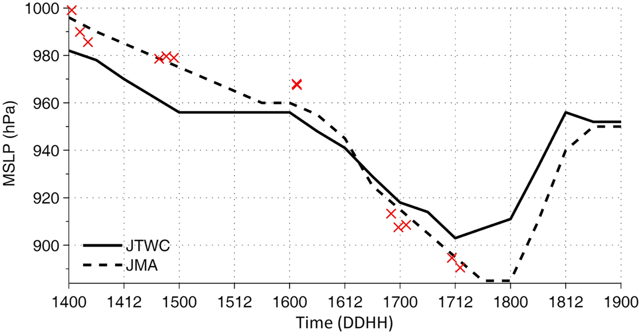
Overview of Typhoon Megi (2010)
Rapidly intensify at 0000 UTC 16 October [MSLP dropped 45 hPa in 1 day according to the Japan Meteorological Agency (JMA).
Reached its peak intensity around 0000 UTC 18 October before it made landfall at the Philippines.

Slide 6
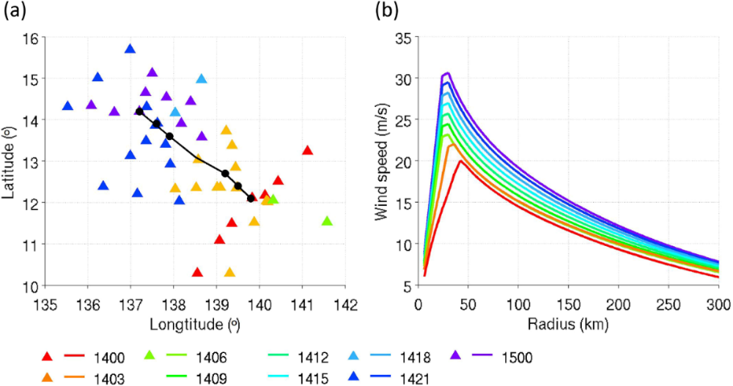
Methodology
WRF TCC-LETKF system
The dropsondes
Every 0.5 s with a vertical resolution of 5–10 m (two to four data points are assimilated at each model level)
Observation error for the wind is 2.2 m s⁻¹ from the surface to 800 hPa and increases to 2.8 m s⁻¹ at 700 hPa, 1 K for the temperature, and 10% for the relative humidity.
The axisymmetric surface wind structure

Slide 7
WRF Model configuration and settings of the DA system
Version 3.6.1
Two-way vortex-following nested domains
Horizontal spacing is 18 km (301 × 221 grid points, from 3°S to 33°N and from 110° to 158°E) and 6 km (121 × 121 grid points) during the DA period.
An additional nested domain with a 2-km grid spacing (277 × 277 grid points) is included during the forecast period.
36 vertical sigma layers (model top is 50 hPa)
Longwave and shortwave radiation scheme: RRTMG PBL scheme: YSU Microphysics scheme: WSM5 Cumulus parameterization: Kain–Fritsch scheme (for in the outer domain)

Slide 8
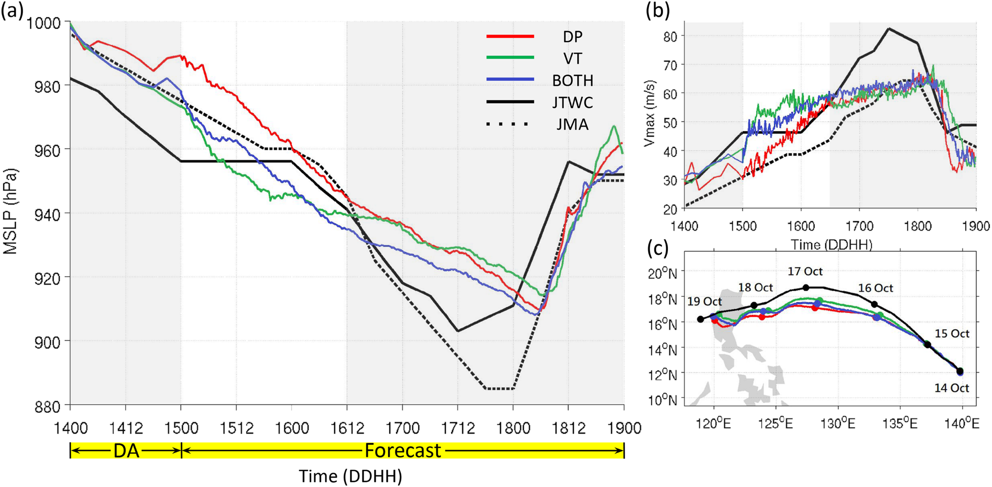
The TC intensity and track
Every 3 hr

Slide 9
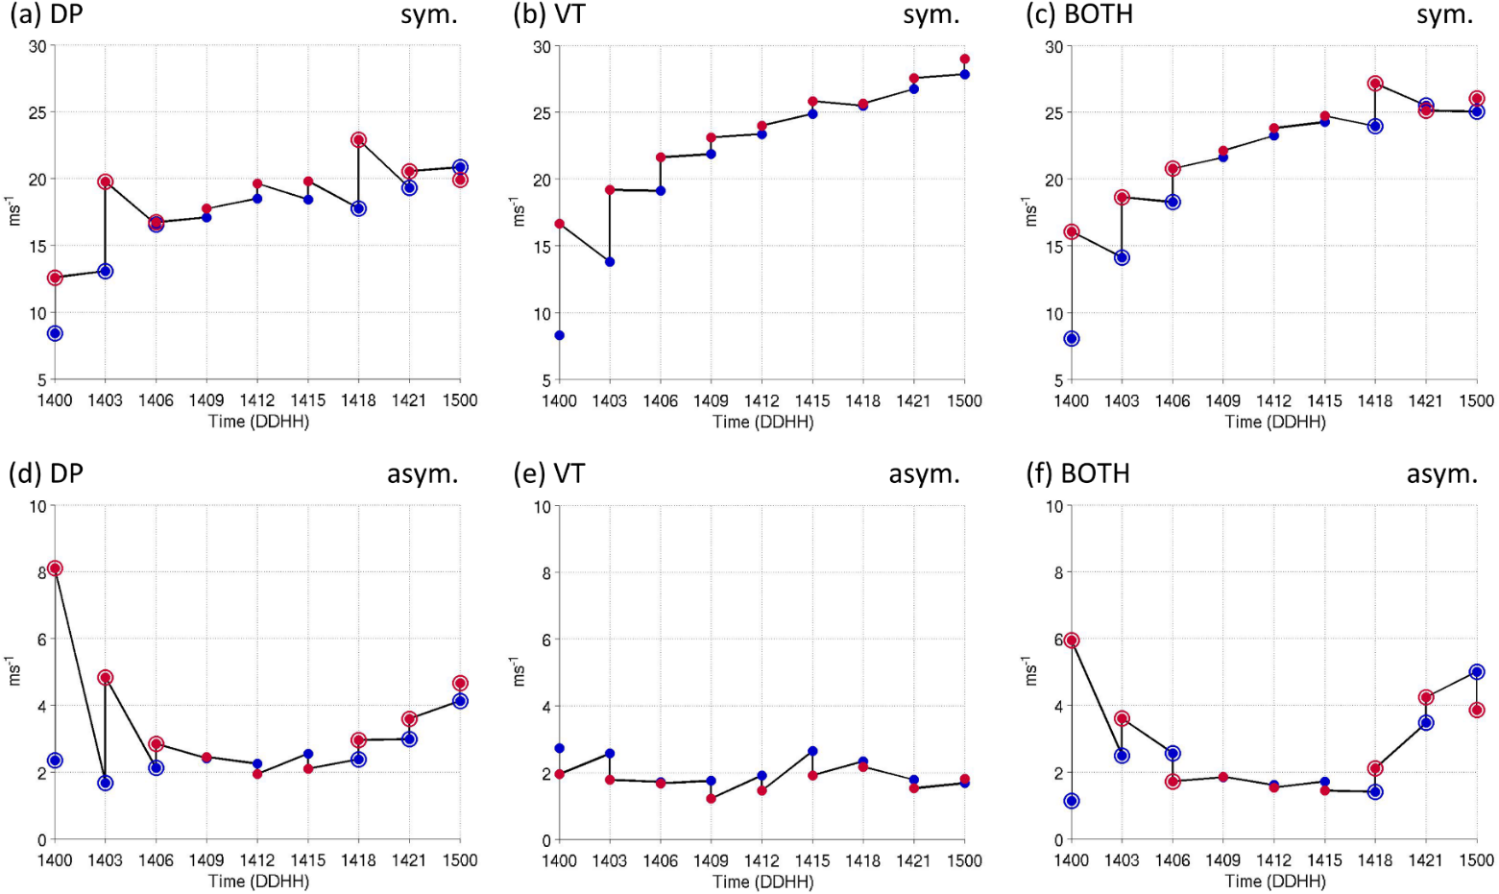
The analyzed TC structure
The symmetry and asymmetry of the TC are defined as the mean and standard deviation of the wind structure (at a 36-km radius).

Slide 10
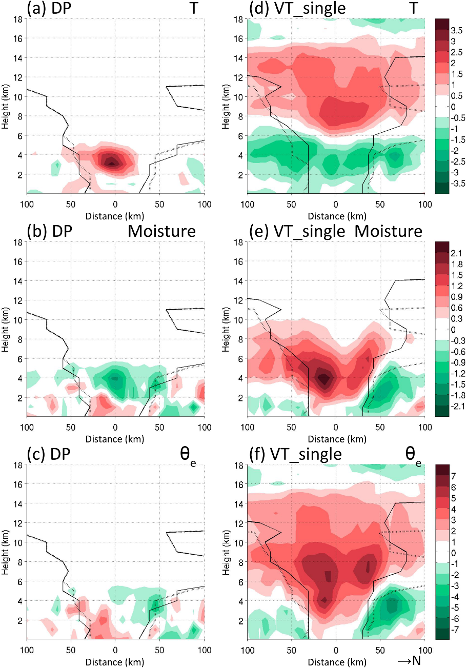
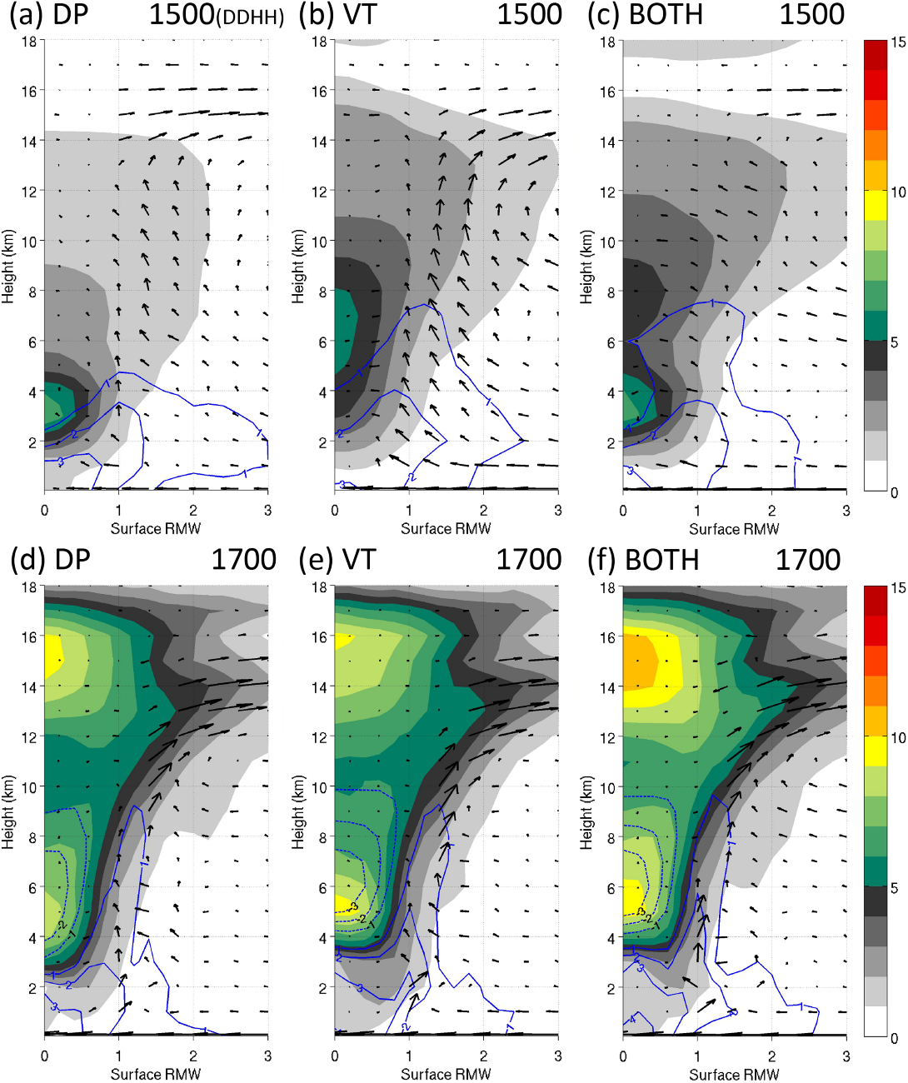
Vertical structures
North–south cross section of analysis increment
Azimuthal-mean
Notes:
The north–south cross section of analysis increment of (a) temperature (K), (b) water vapor mixing ratio (g kg⁻¹)
The azimuthal-mean temperature anomaly (K; shading) and water vapor mixing ratio anomaly (g kg⁻¹; contours)
The anomaly is defined as the deviation with respect to the mean within a 160–240-km annulus around the TC center
In summary, the dropsondes provide asymmetric information that potentially establishes a more realistic TC structure, and the tangential wind profiles can spin up the vortex structure with strong circulation and a well-developed warm core.

Slide 11
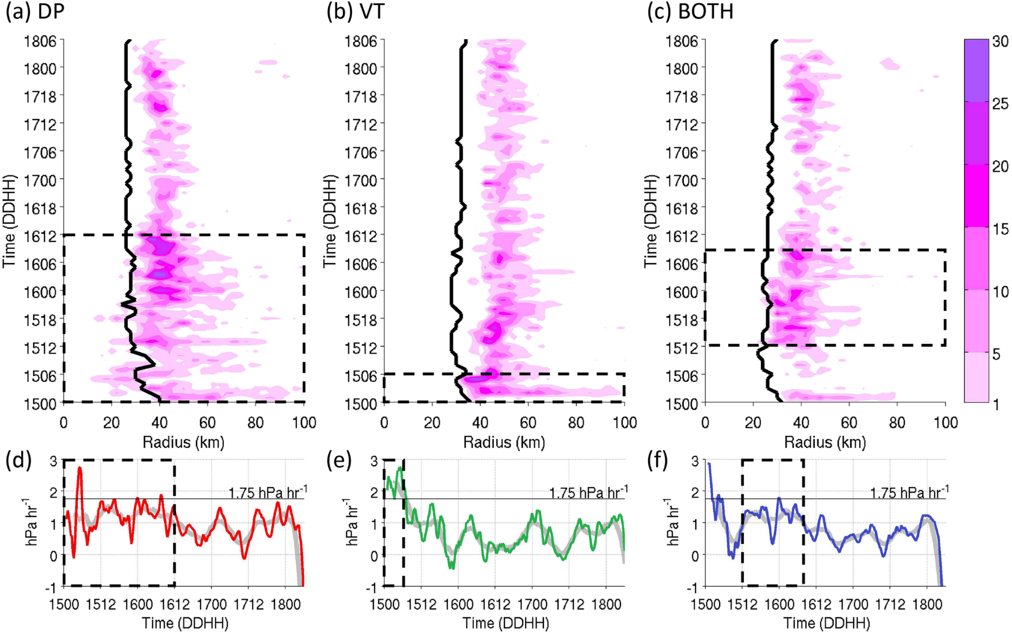
The convection development and TC intensification
CBs: The maximum vertical velocity from 8 to 16 km larger than 5 m s⁻¹ and the averaged reflectivity from 8 to 14 km larger than 20 dBZ.
Notes:
The RI period is quantitatively defined as the intensification rates reaching 1.75 hPa h⁻¹ (Holliday and Thompson 1979), and we define an additional threshold of its 6-h running mean staying above 1 hPa h⁻¹ considering that the rapid deepening of MSLP happens intermittently.

Slide 12
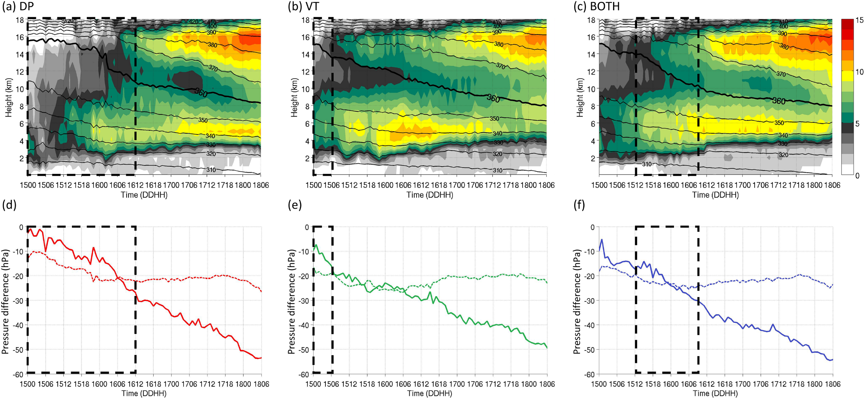
Midlevel and high-level Warm core

Slide 13
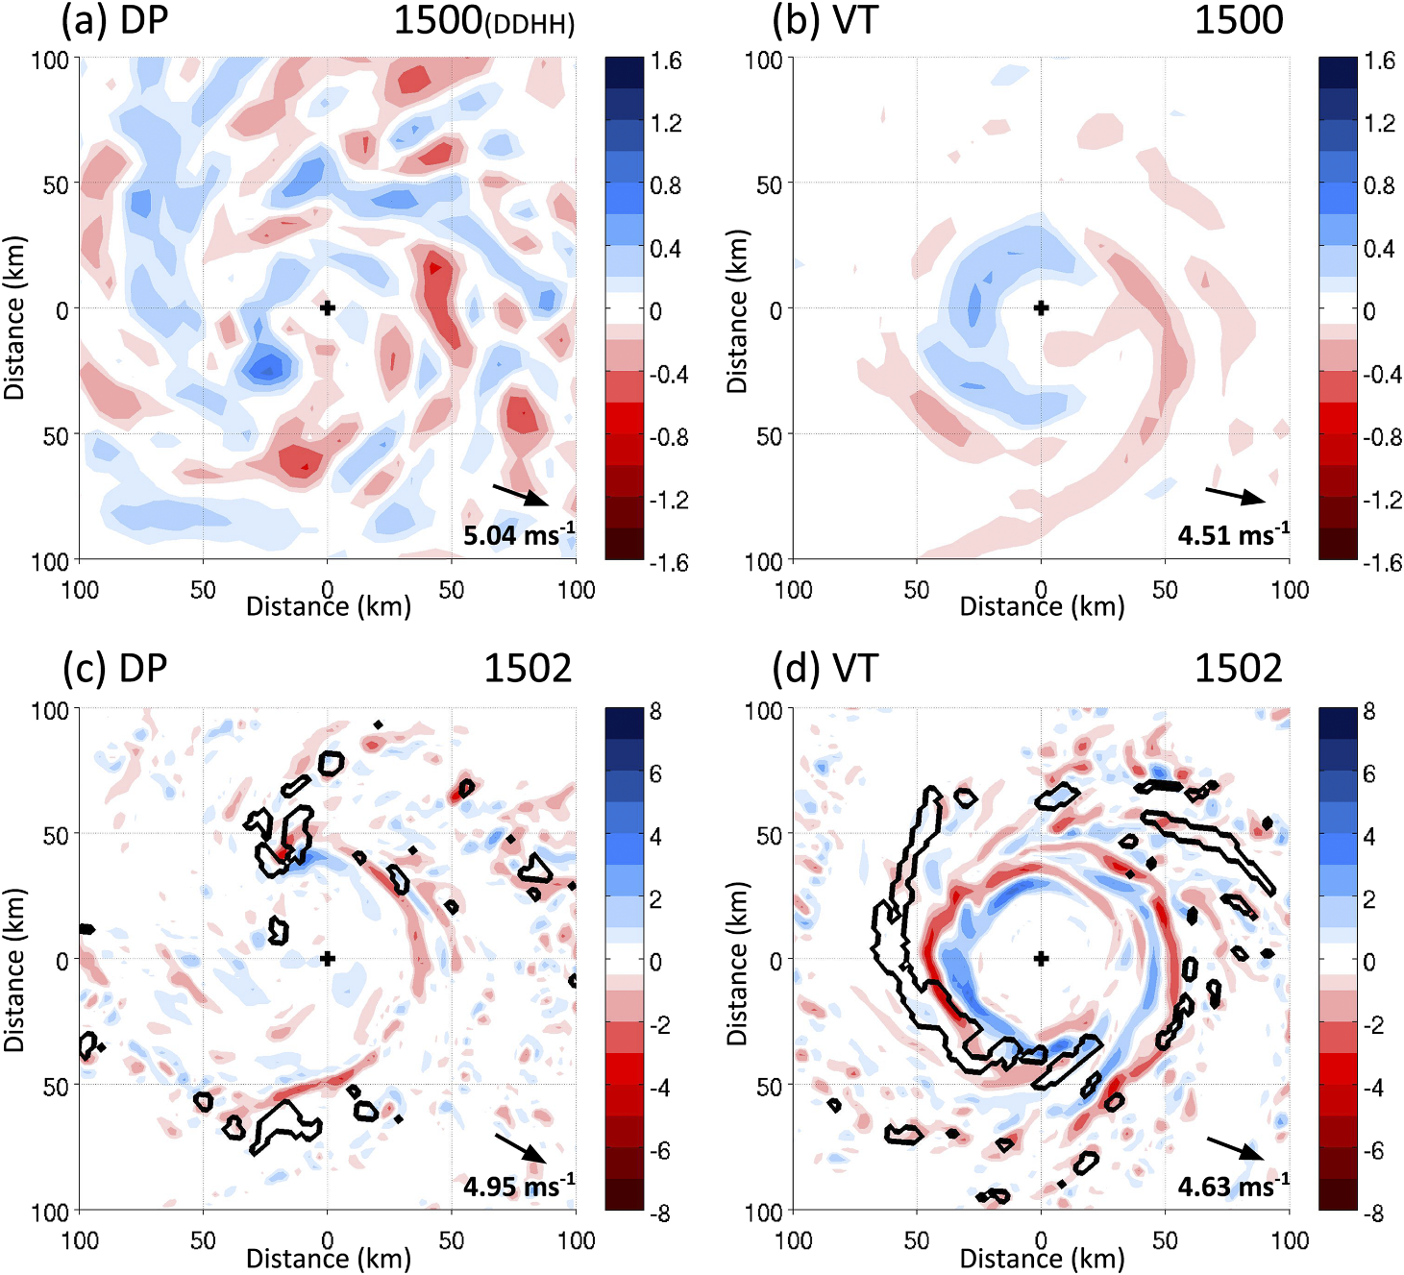
Small-scale features

Slide 14
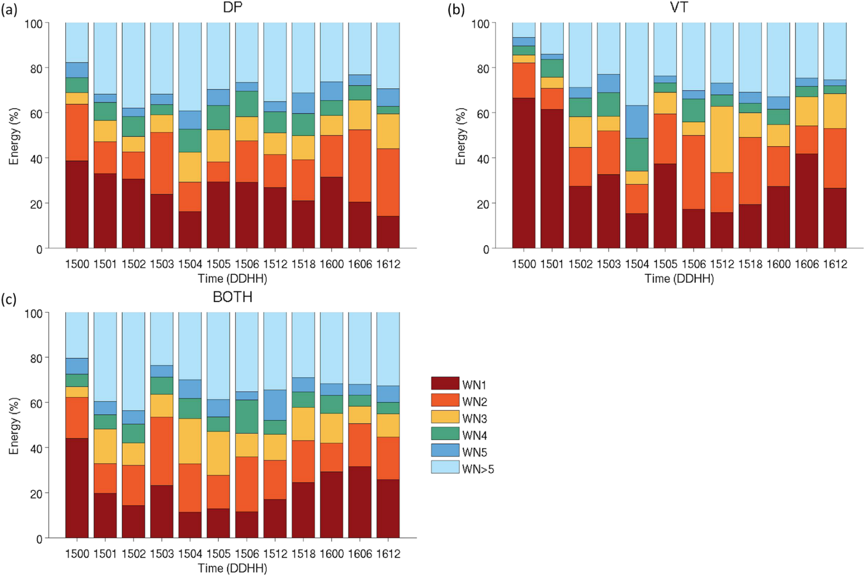
Fourier decomposition
Notes:
averaged over the annulus from 20 to 80 km from the TC center for 2-km water vapor mixing ratio
From 0100 UTC 15 October to 1200 UTC 16 October, wavenumbers 1–5 contribute 60%–75% of the total perturbation energy and wavenumbers larger than 5 contribute 25%–40% in both experiments (Figs. 13a,b)

Slide 15
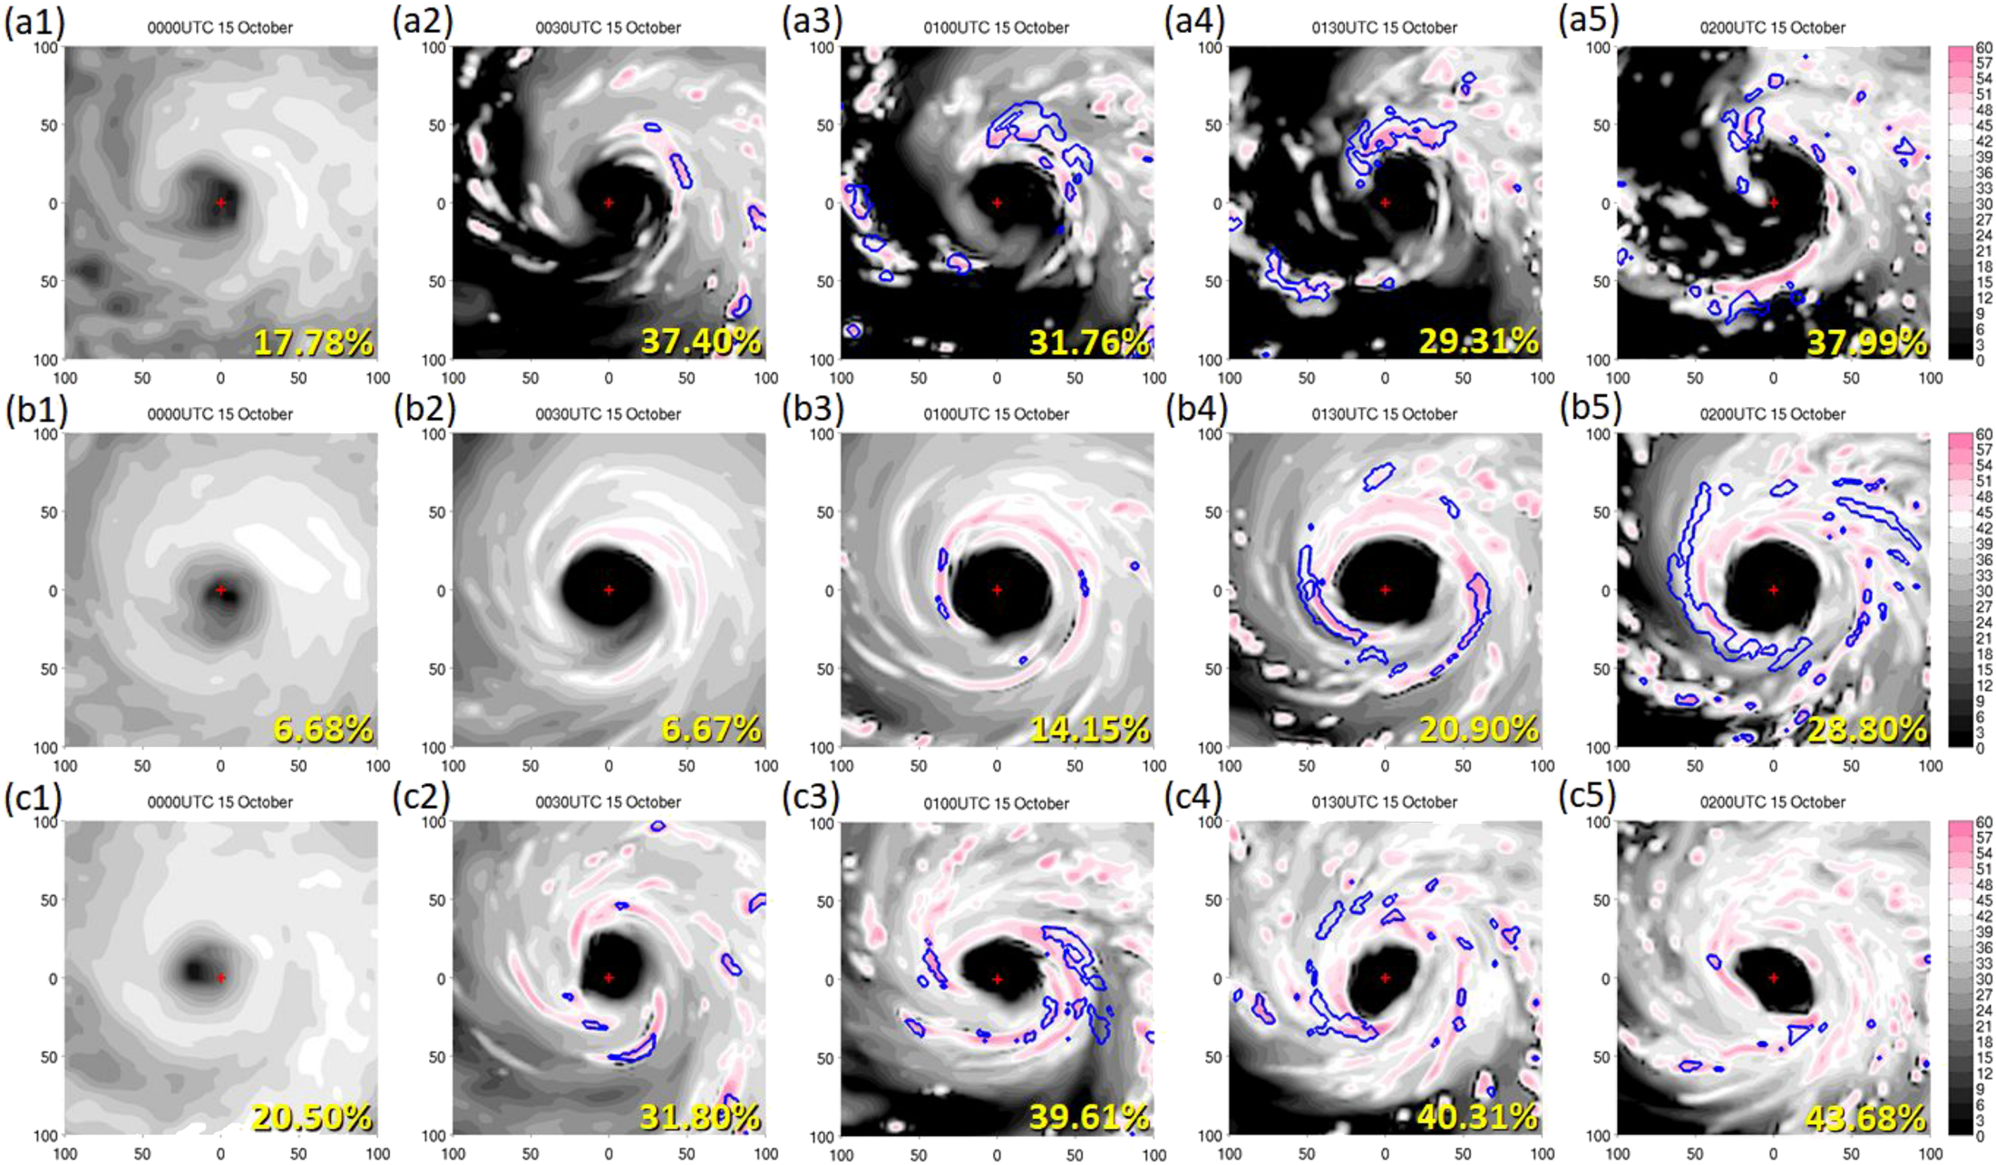
Reflectivities at 3-km

Slide 16
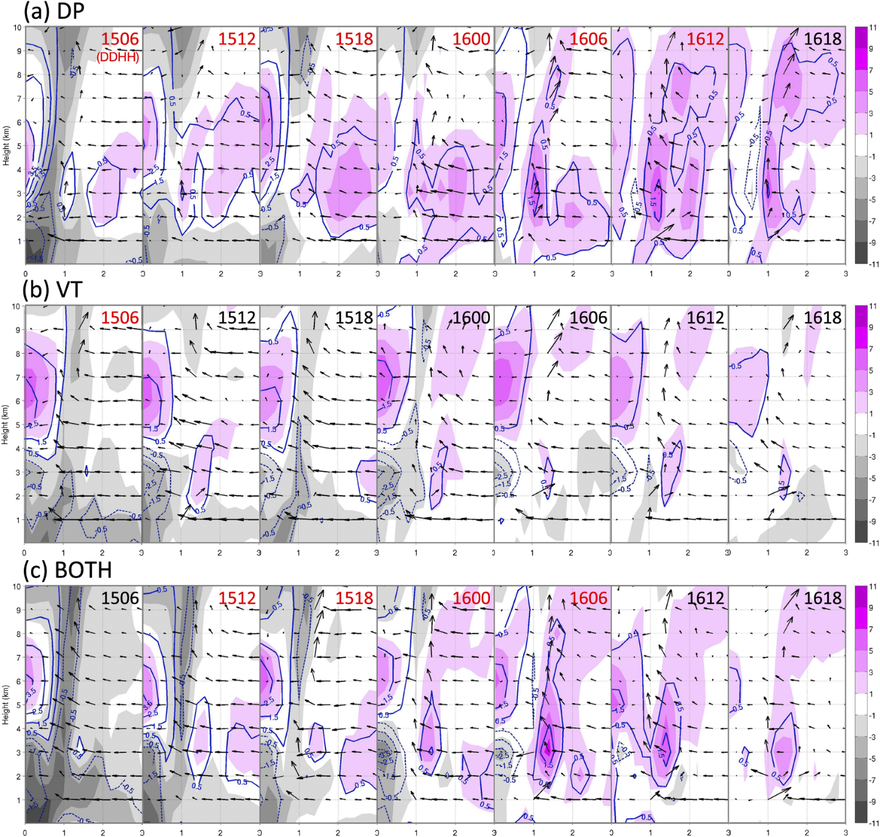
Differences in thermal fields
0000 UTC 17 October
Notes:
(a) The difference of water vapor mixing ratio anomaly (g kg⁻¹; contours) and equivalent potential temperature anomaly (K; shading)

Slide 17
Conclusions
This study investigates the impact of assimilating different types of inner-core observations, including dropsondes and tangential wind profiles, on predicting RI with a case study of Typhoon Megi (2010) under the WRF TCC-LETKF framework.
Asymmetry information not only helps maintain the realness of the TC structure, but it also leads to scattered convergence areas and affects the distribution of CBs, which is critical for Megi’s intensification.
The assimilation of tangential wind profiles efficiently enhances the axisymmetric component of the TC, including the symmetric circulation, the secondary circulation, and the MWC, and thus the TC spins up to an intensity close to the advisory data.
For the DP experiment, although the TC intensity is initially weaker than the advisory data, the gradual CB development gives rise to persistent RI for 1.5 days.
For the VT experiment, large convergences and abundant moisture near RMW contribute to exploding occurrences of CBs at forecast initial time. As the excessive coverage of CBs forms an early HWC, the CB activities near RMW are suppressed, and therefore the intensification process slows down within 6 h.

Slide 18
Thanks

Slide 19
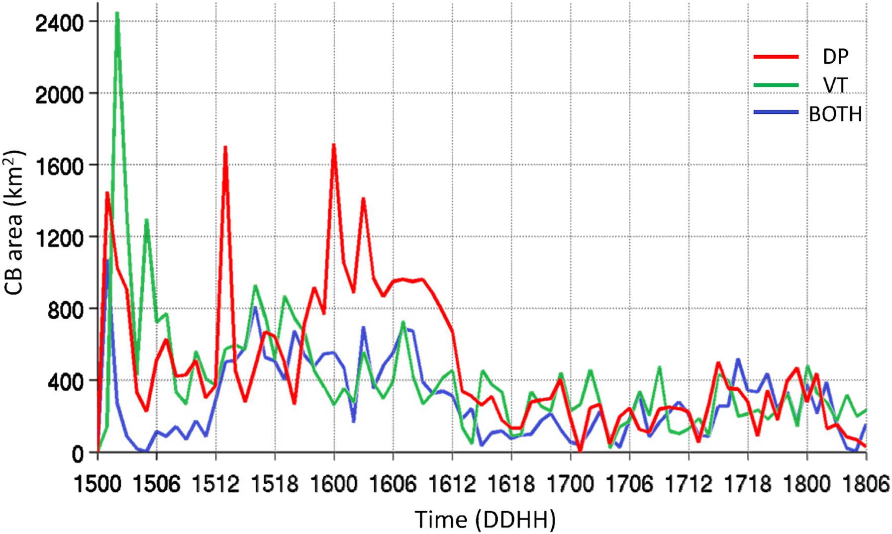
Notes:
Therefore, we hypothesize that VT lacks the small-scale asymmetries that lead to a condition unfavorable for persistent CB development.

