Slide 1
An Evaluation of Integrated Water Vapor, Wind, and Precipitation Forecasts Using Water Vapor Flux Observations in the Western United States
Darby L. S., A. B. White, D. J. Gottas, and T. Coleman

Slide 2
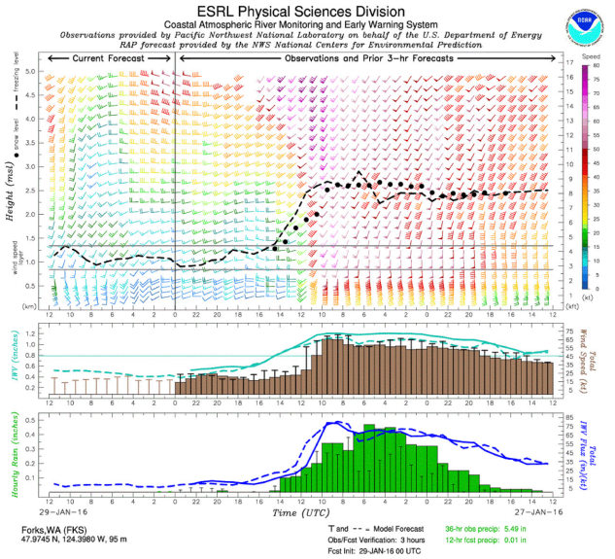
NOAA ESRL WVFT
Water vapor flux tool
California Land-falling Jets Experiments
(CALJET)
Pacific Land-falling Jets Experiments
(PACJET 2001-03)
Hydrometeorology Testbed-West
(HMT-WEST )
wind profiler
Controlling wind layer (upslope wind layer)
Instruments:
Radar wind profiler
Snow-level radar
GPS for IWV
Standard surface measurements
IWV
total wind speed
IWV flux
hourly rainfall

Slide 3
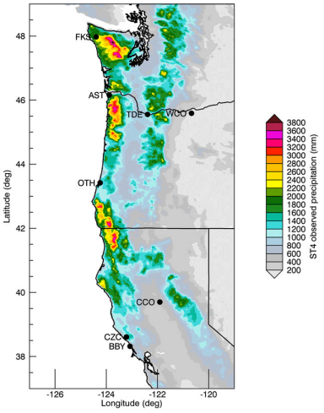
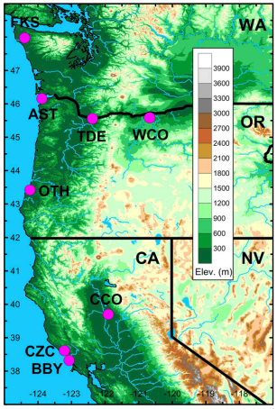
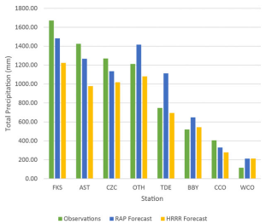
Observations
Dec 2015 – Mar 2016 (4 months)
Notes:
FKS CZC地形前方迎風面
TDE距海岸160km遠，Cascade迎風面
BBY(相當於無地形抬升的CZC)
CCO加洲谷地
WCO位於Cascade背風側

Slide 4
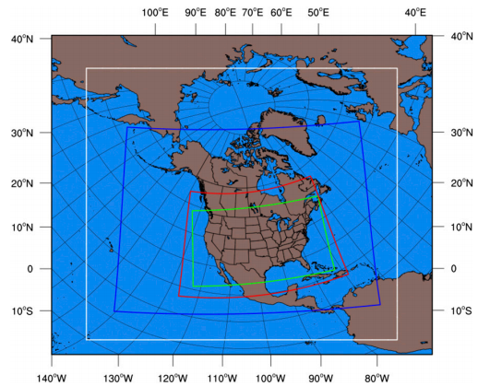
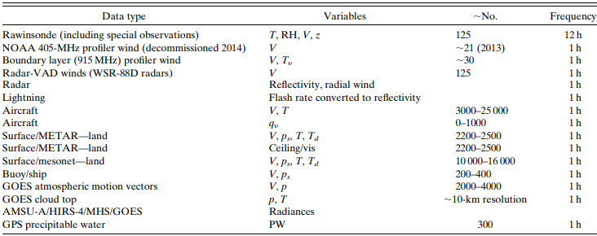
Forecasts
Rapid Refresh
RAP (RAP v2)
Δx = 13 km
High Resolution Rapid Refresh
HRRR
Δx = 3 km
NOAA Gridpoint Statistical Interpolation (GSI) analysis system
(Benjamin et al. 2016b)
(Benjamin et al. 2016b)

Slide 5
Metrics for evaluation
RMSE (root-mean-squared error)
RMSE_{UB} (unbiased root-mean-squared error)
σ_{obs}, σ_{f} (standard deviation)
ME (mean error)
FBS (frequency bias scores)
ETS (equitable threat score)
$$σ_{f}/σ_{obs}≅1$$
$$RMSE/σ_{obs}≤1$$
K&A criteria
$${RMSE}_{UB}/σ_{obs}≤1$$
Keyser and Anthes (1977)
0
1
1
$$ME=\overline{F_{f}−F_{obs}}$$
$$FBS=\frac{\# of forecasts ≥threshold}{\# of observations ≥threshold}$$
Obs
Fcst Rain No Rain
Rain A B
No Rain C D
$$ETS=\frac{A−E}{A+B+C−E}$$

Slide 6
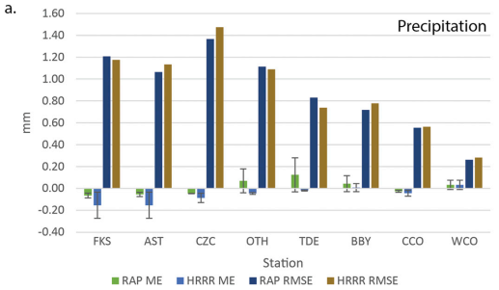
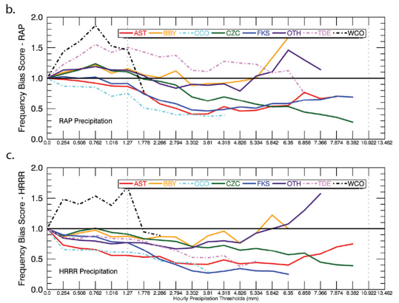
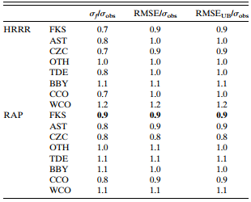
precipitation
Notes:
第一組(RAP/HRRR都低估: FKS/AST/CZC/CCO)
ME都是負值，CZC的RMSE最大。FKS的RAP預報符合K&A標準
FBS在雨量門檻提升之後都低估，FKS達到K&A標準是因為小雨的FBS=1
第二組(RAP高估/HRRR低估: OTH/TDE)
RAP-ME正值，HRRR-ME負值
RAP-FBS在小雨門檻有高估雨量的情形，HRRR-FBS多數時候低估雨量
第三組(RAP/HRRR都高估: BBY/WCO)
ME都是正值
RAP傾向高估降雨，HRRR低估降雨
多數測站沒有達到K&A標準，因為RMSE相對於標準差太大

Slide 7
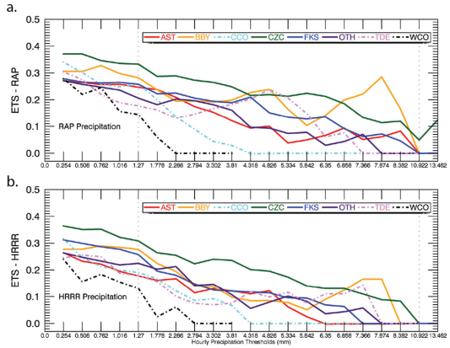
ETS (precipitation)

Slide 8
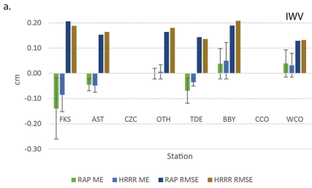
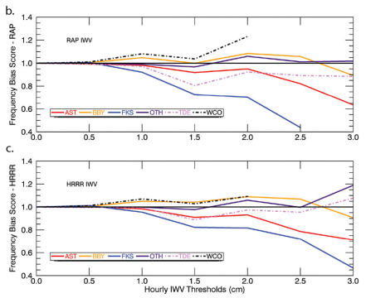
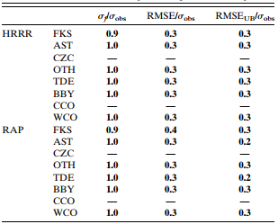
IWV

Slide 9
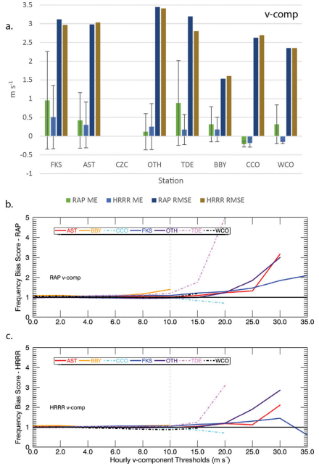
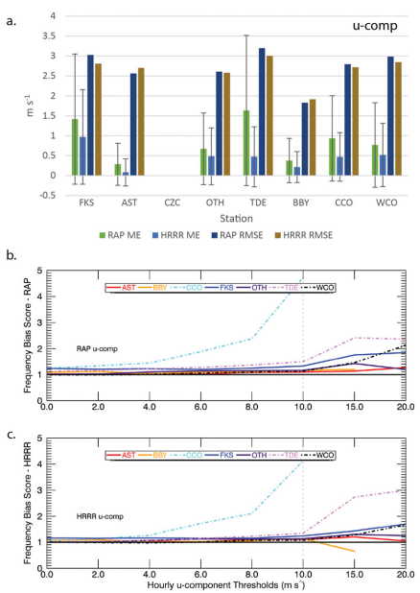
U/V
Sierra barrier jet
U component
V component
Notes:
Sierra barrier jet 讓CCO的u高估v低估
模式不能有效解析地形，讓TDE沒有報出低層的gap wind(東風)

Slide 10
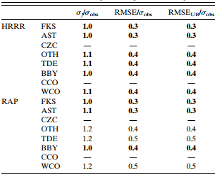
IWV flux
overpredictions
Notes:
IWV flux = Controlling wind layer x IWV
FKS/AST: IWV-ME負，UV-ME正，flux-ME~0
TDE: IWV-ME負，UV-ME正，flux-ME正
各個測站的RMSE都小，但未達K&A標準的OTH/TDE/WCO是因為RAP預報結果的spread太大
模式預報過少的水氣，過強的風，產生過多的flux

Slide 11
summary
The goal of the paper was to characterize and quantify the errors in the tool forecasts, with a particular interest in the operational RAP and HRRR 3-h lead-time precipitation forecasts.
The precipitation forecasts shown in the WVFT are likely to be underpredictions for larger hourly values of precipitation, despite IWV flux forecasts that approximately equaled or exceeded the observed in most cases.
Precipitation forecasts only met the K&A criteria at one site, whereas the winds, IWV, and IWV flux met the criteria at most or all sites.
The underforecast of IWV had a greater impact on the accuracy of the precipitation forecast than the resultant IWV flux forecast at these stations.

