Slide 1
Evaluation of Cumulus and Microphysics Parameterizations in WRF across the Convective Gray Zone
Chen, J.‐H., S.‐J. Lin, L. Zhou, X. Chen, S. Rees, M. Bender, and M. Morin, 2019: Evaluation of tropical cyclone forecasts in the next‐generation global prediction system. Mon. Wea. Rev., 147, 3409–3428.

Slide 2
Background and introduction
Traditional cumulus parameterization scheme:
designed to represent the subgrid-scale processes that are not explicitly resolved.
the convective updrafts balanced by downdrafts within the same grid box, and require the updrafts to cover only a small fraction (less than about 10%) of the grid box area (e.g., Arakawa and Schubert 1974; Tiedtke 1989; Kain and Fritsch 1990).
when decreasing the grid spacing below a certain value, previously unresolved scales become partially resolved and conventional closure assumptions break down
The gradually reduced cumulus activity in scale-aware schemes adjusts to this transition of scales and several studies (e.g., Mahoney 2016; Field et al. 2017; Hu et al. 2018) have shown superior performance in precipitation development when using such schemes.

Slide 3
microphysics parameterization scheme:
an expensive scheme is not needed for grid spacings coarser than about 10 km, while finer resolutions (starting with the convective gray zone) require enhanced complexity including the prediction of mixed phases (6-class schemes, including graupel) and number concentrations (double-moment schemes) (Bryan and Morrison 2012; Hong and Dudhia 2012; Han et al. 2019).
this study contributes to the body of knowledge on the benefits and usefulness of scale-aware cumulus schemes and sophisticated microphysics.
Notes:
The experiments investigate how conventional parameterization schemes designed for coarser resolutions compare to new scale-aware schemes as we
approach higher resolutions and enter the convective
gray zone, where scale-aware schemes are expected
to outperform traditional approaches. The different
levels of complexity of the tested schemes also
translate to different run times, and we discuss
whether their performance justifies their computational
expense. Hence, this study contributes to the
body of knowledge on the benefits and usefulness of
scale-aware cumulus schemes and sophisticated
microphysics

Slide 4
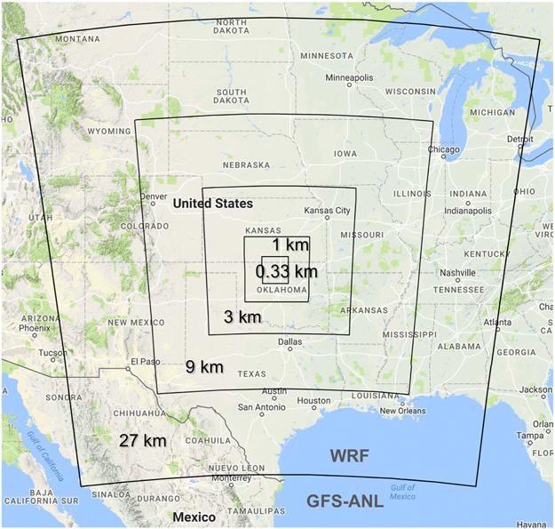
Model setup
five one-way-nested WRF Model domains
centered over the U.S. Southern Great Plains
WRF-ARW model (version 3.9.1.1)
initial and boundary conditions: ${0.58}^{°}×{0.58}^{°}$ Global Forecast System (GFS) analysis data, every 3 h
Vertical levels: model top at 50hPa, 51 levels
3 h time-staggered spinup, adding up to 15 h of total spinup time
The cases chosen are:
a mesoscale convective system to evaluate convective cumulus schemes
a warm frontal zone with stratiform precipitation to evaluate microphysics schemes.
OBS: the Atmospheric Radiation Measurement (ARM) Climate Research Facility, multisensor precipitation estimates (MPE) (4-km gridded analysis fields)

Slide 5
Two scale-aware cumulus schemes: Grell–Freitas and the multiscale Kain–Fritsch
Grell and Freitas (2014): adapts the scale awareness to the convective eddy transport equation
multiscale Kain–Fritsch scheme: lifting condensation level–based entrainment methodology that includes scale dependency.

Slide 6
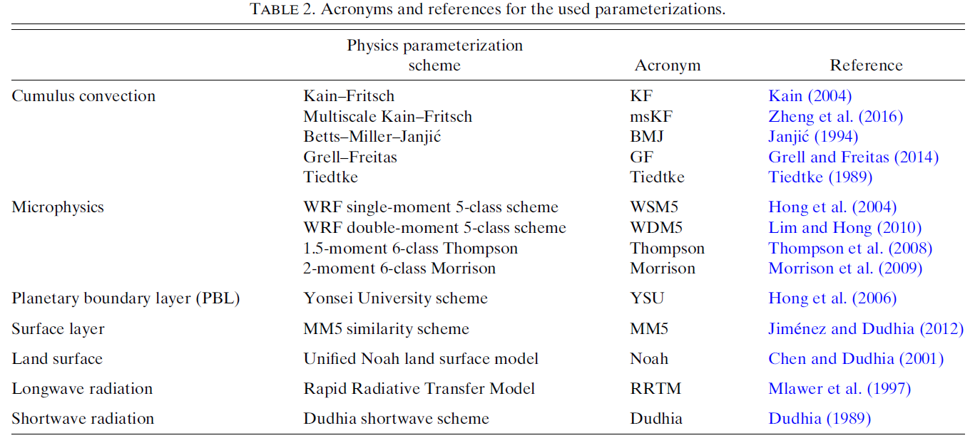

Slide 7
Results and discussion a. Case study 1: Cumulus parameterization in the convective gray zone
The quality controlled ARM ground stations available within the smallest WRF domain (0.33-km grid spacing) recorded the highest rainfall rates of about 35 mmh⁻¹ at a site in the 0000–0300 UTC period.
Notes:
In the afternoon (local time) on 3 July 2017, a mesoscale convective system (MCS) was initiated by a shortwave just behind a surface low pressure trough.
As the MCS moved southeast across the Southern Great Plains, it intensified, forming a bowlike structure (Fig. 2) and reaching a spatial extent of approximately 300 km X 150 km.
Embedded convective cells caused high local precipitation rates.
The quality controlled ARM ground stations available within the smallest WRF domain (0.33-km grid spacing) recorded the highest rainfall rates of about 35mmh21 at a site in the 0000–0300 UTC period (not shown).
The MPE analyzed local rainfall rates over 80mmh-1.

Slide 8
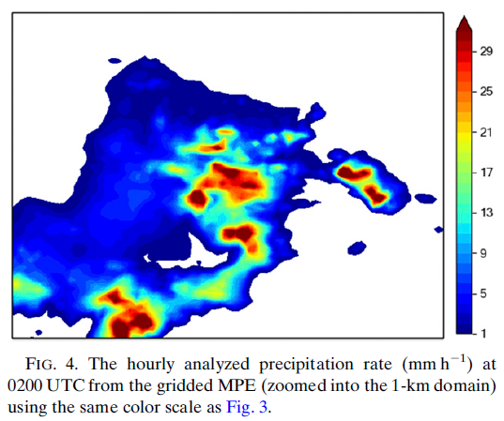
the time of the observed highest
precipitation rate (0200 UTC 4 July 2017)
Notes:
The coarser-resolution runs (especially the 27-km grid) are insufficient to represent the convective development at the correct location or intensity.
At a grid spacing of 3 km, the convective structure becomes resolved with individual embedded updrafts similar to those observed.
Simulations using a grid spacing of 3 km and finer seem to agree with each other better than the coarser 27- and 9-km results.
GF and the msKF match the MPE (Fig. 4) best for location, shape and intensity of the precipitation.
KF develops a weaker precipitation feature, which is delayed in time and therefore offset to the northwest of the location of the observed rainfall at the displayed time step.
BMJ and Tiedtke trigger the convection at finer resolutions too early (hence a shift toward the southeast), and simulate a second minor precipitation area behind it.

Slide 9
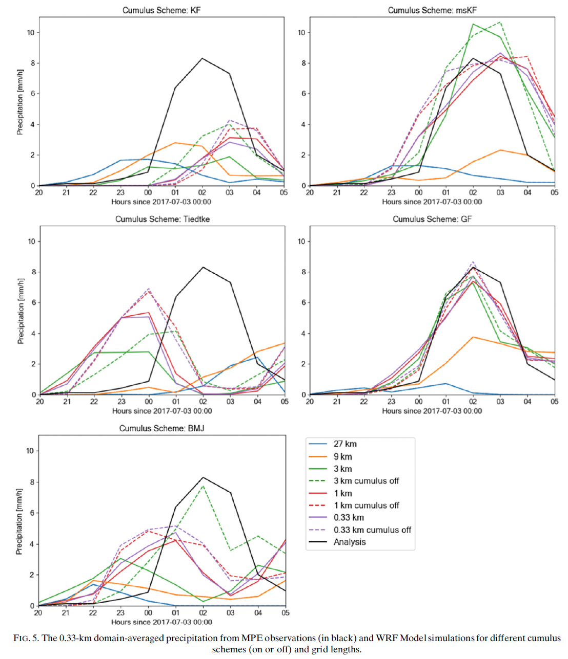
time series of domain-averaged precipitation rates
Notes:
GF high-resolution results (<3 km) follow the averaged MPE analysis (black) curve best, the 27-km domain barely produces any precipitation.
The 1- and 0.33-km domains of the Tiedtke scheme produce slightly lower rainfall rate averages, however, they do so 2–3 h too early.
Tiedtke’s coarser resolution simulations miss the first convective shower and produce increasing rainfall after the actual event.
A similar pattern is seen using the BMJ parameterization.
The conventional Kain–Fritsch scheme yields the smallest averaged precipitation rates overall.
Its better organized fine resolution results give precipitation 1–2 h too late and too weak, while coarse-resolution domains show reduced precipitation intensity and earlier triggering.
The multiscale Kain–Fritsch version exhibits significant improvement in precipitation intensity at high resolutions (<1 km) compared to its conventional equivalent.
However, its 3-km solutions overestimate the domain precipitation intensity, and the temporal offset seen for Kain–Fritsch is still present for all grids using the multiscale version.
Although the time shift is still present, the domain-averaged precipitation amounts are generally improved.
The peak precipitation intensity (which is often too low with the cumulus schemes turned on) becomes slightly higher for all fine-resolution runs.
The 3-km BMJ solution experiences significant improvement.
Notably, the Grell– Freitas simulation, which already performed well, matches the MPE data (black curve) even better.
This is because the Grell–Freitas scheme in WRF uses a maximum threshold of 0.9 for the convective coverage of a grid cell.
This prevents the scheme from turning itself off entirely, which for this case seems to be the better practice at these grids.
The only convection-permitting simulations for which hourly precipitation intensity is not improved is the multiscale Kain–Fritsch.
In these runs the precipitation lasts longer, which results in higher accumulations and reduced forecast skill.

Slide 10
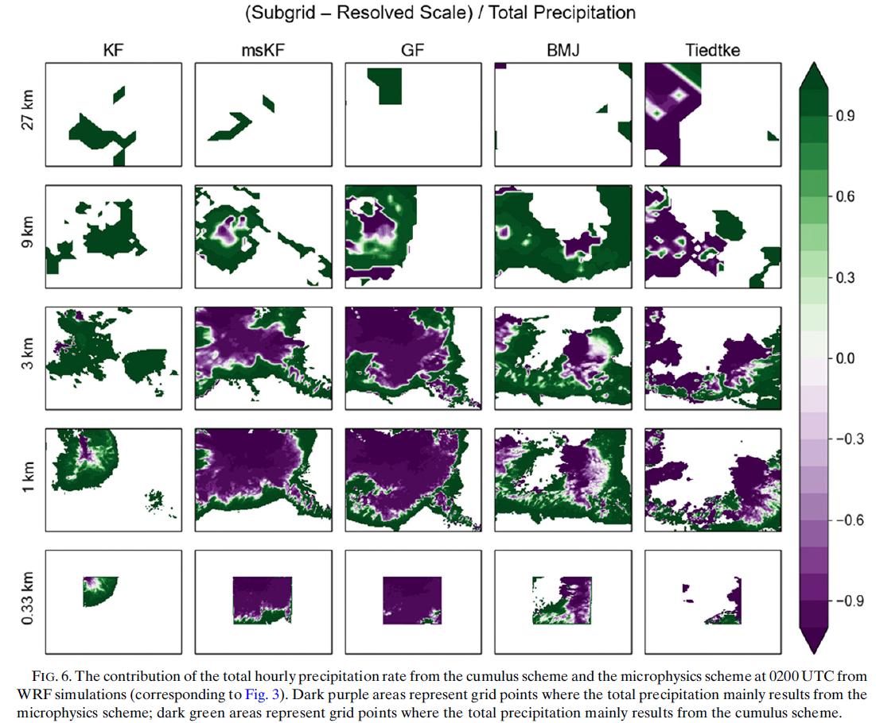
Notes:
the center of the convective system yields precipitation mainly from the microphysics scheme (purple) due to grid-cell saturation.
This is embedded in an outer zone of subgrid-scale convective updrafts where precipitation is increasingly dominated by the cumulus scheme.
While the total precipitation from the Kain–Fritsch simulation is dominated by the convective component almost,
the precipitation areas from GF and the msKF transition more smoothly from green to purple as the resolution increases.
The BMJ scheme shows a similar development, with more cumulus scheme precipitation (green) than seen for the scale-aware schemes.
Tiedtke’s total precipitation has the largest contribution from resolved-scale precipitation (purple) at coarse resolutions compared, and its convective precipitation areas (green) does not shrink at finer resolutions.
Averaged over the 0.33-km domain area and the time span of the case study (10 h from 2000 UTC
3 July 2017 to 0500 UTC 4 July 2017),

Slide 11
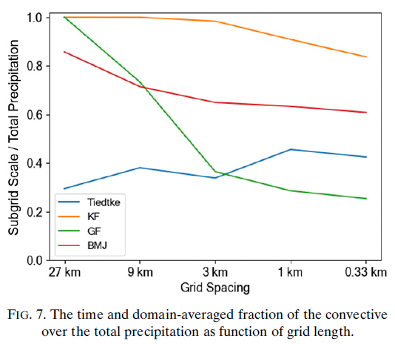
Averaged over the 0.33-km domain area and the time span of the case study (10 h from 2000 UTC 3 July 2017 to 0500 UTC 4 July 2017),
Notes:
The precipitation from the WRF runs using GF, KF, and msKF comes exclusively from the cumulus scheme at the 27-km grid scale.
As grid length decreases below 9 km, Kain–Fritsch’s total precipitation gradually includes more contributions from the microphysics scheme.
The scaleaware schemes (especially Grell–Freitas), on the other hand, show a far more rapid change toward a resolvedscale- dominated precipitation at 3 km and below.
BMJ shows a similar gridscale dependency to that of Kain– Fritsch, although it contains microphysics precipitation even at the coarsest resolutions. Tiedtke yields the opposite gridscale dependency in this case, with a higher convective precipitation contribution at finer resolutions.
This could be a result of the small sample size of grid points used to estimate the average value at coarse resolutions (5 X 5 grid points of the 27-km grid over a 10-h evaluation period).

Slide 12
Grell–Freitas shows the best agreement with observations since it reduces its convective precipitation component significantly at fine resolutions.
The conventional convective (mass-flux) parameterization formulations balance updrafts with subsidence within the same grid cell.
This can suppress the full convective development at fine resolutions, when updrafts cover a considerable portion of the grid cell area and the downdrafts of the convective movement should instead be redistributed over neighboring grid points.
Turning conventional schemes off at the critical resolution (here 3km) can help to minimize this problem.
Notes:
In summary, all convective cumulus schemes show poor agreement with observations at coarser resolutions (27–9 km).
For finer resolutions, Grell–Freitas shows the best agreement with observations.
Since Grell–Freitas reduces its convective precipitation component significantly at fine resolutions, it appears logical that other runs using schemes that do not reduce their convective component automatically (because they are not scale aware) perform better when turned off manually.
The conventional convective (mass-flux) parameterization formulations balance updrafts with subsidence within the same grid cell.
This can suppress the full convective development at fine resolutions, when updrafts cover a considerable portion of the gridcell area and the downdrafts of the convective movement should instead be redistributed over neighboring grid points.
Turning conventional schemes off at the critical resolution (here 3km) can help to minimize this problem.
However, the gray zone problem suggests that the necessary transition cannot be represented by a single grid length.

Slide 13
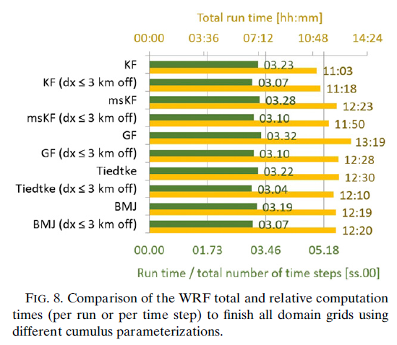
the Intel-compiled WRF code was run on an HPC cluster
using Open MPI and no hyperthreading on two Intel Xeon CPU E5–2683 v4 (2.10GHz) compute nodes, which each has 32 cores.
The WRF run of 36 model forecast hours on a total of 64 cores
Grell–Freitas, which shows the strongest convective development with higher horizontal wind speeds and vertical updrafts requires a smaller time step to avoid numerical instability
Grell–Freitas requires about 17% more computational time than Kain–Fritsch per numerical time step
Notes:
with the Grell–Freitas scheme turned on throughout all resolutions, took 13 h and 19 min of run time (using 2 full compute nodes) and was the longest of all executed runs (see yellow bars in Fig. 8).

Slide 14
Case study 2: Microphysics parameterization in the convective gray zone
Four microphysics parameterization schemes of different complexity using single or double moments and 5 or 6 classes of hydrometeors were tested for 15–16 January 2017.
Notes:
This case investigates an area of stratiform precipitation
with embedded convection associated with an inverted
trough extending northward from a surface
low. The band of light to moderate precipitation moved
across the high-resolution WRF domains from 0000 to
1000 UTC (Fig. 9).

Slide 15
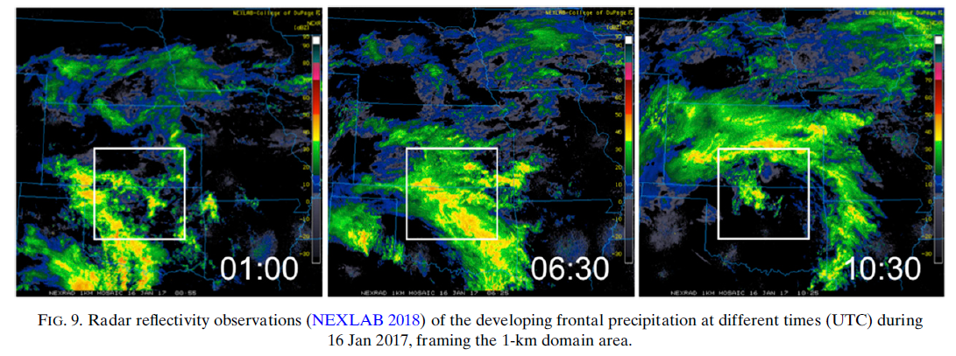
warm frontal zone
The band of light to moderate precipitation moved across the high-resolution WRF domains from 0000 to
1000 UTC
Notes:
This case investigates an area of stratiform precipitation
with embedded convection associated with an inverted
trough extending northward from a surface
low. The band of light to moderate precipitation moved
across the high-resolution WRF domains from 0000 to
1000 UTC (Fig. 9).

Slide 16
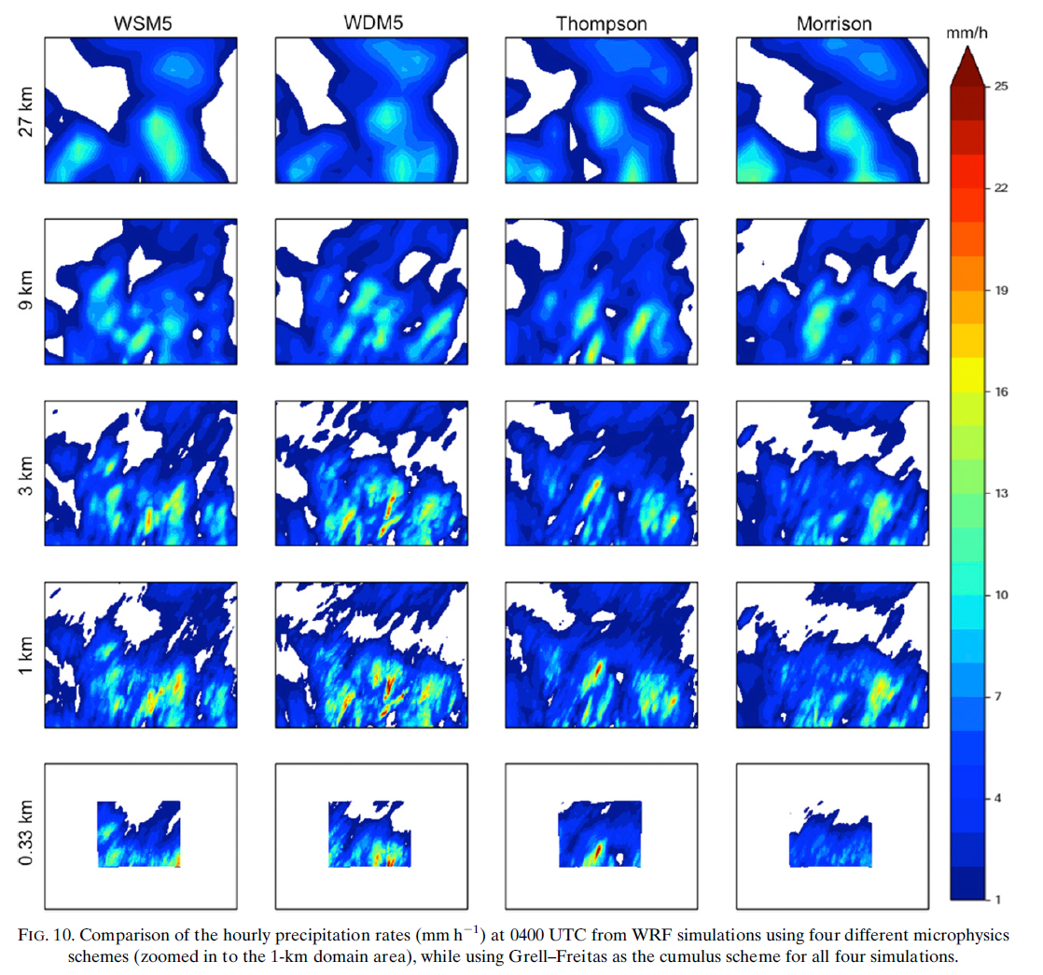
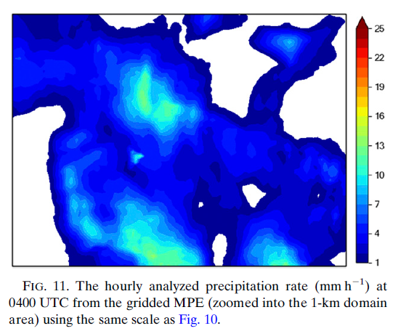
Using GF scheme for all simulations
Notes:
It becomes evident that the choice of the microphysical parameterization makes little difference to the precipitation field, whereas the
grid spacing and the cumulus scheme (not shown) have a larger impact.
The modeled precipitation fields look more and more fissured with increasing resolution using both Kain–Fritsch (not shown) and Grell–Freitas for the
convective parameterization.
The smoothness of the observed precipitation is best represented by the simulations for the 9- and 3-km grid.
The 27-km domain washes out the details seen in the observed fields, while the finer-resolution domains produce a rough structure with jagged edges
and embedded cells of much higher rainfall rates than observed.

Slide 17
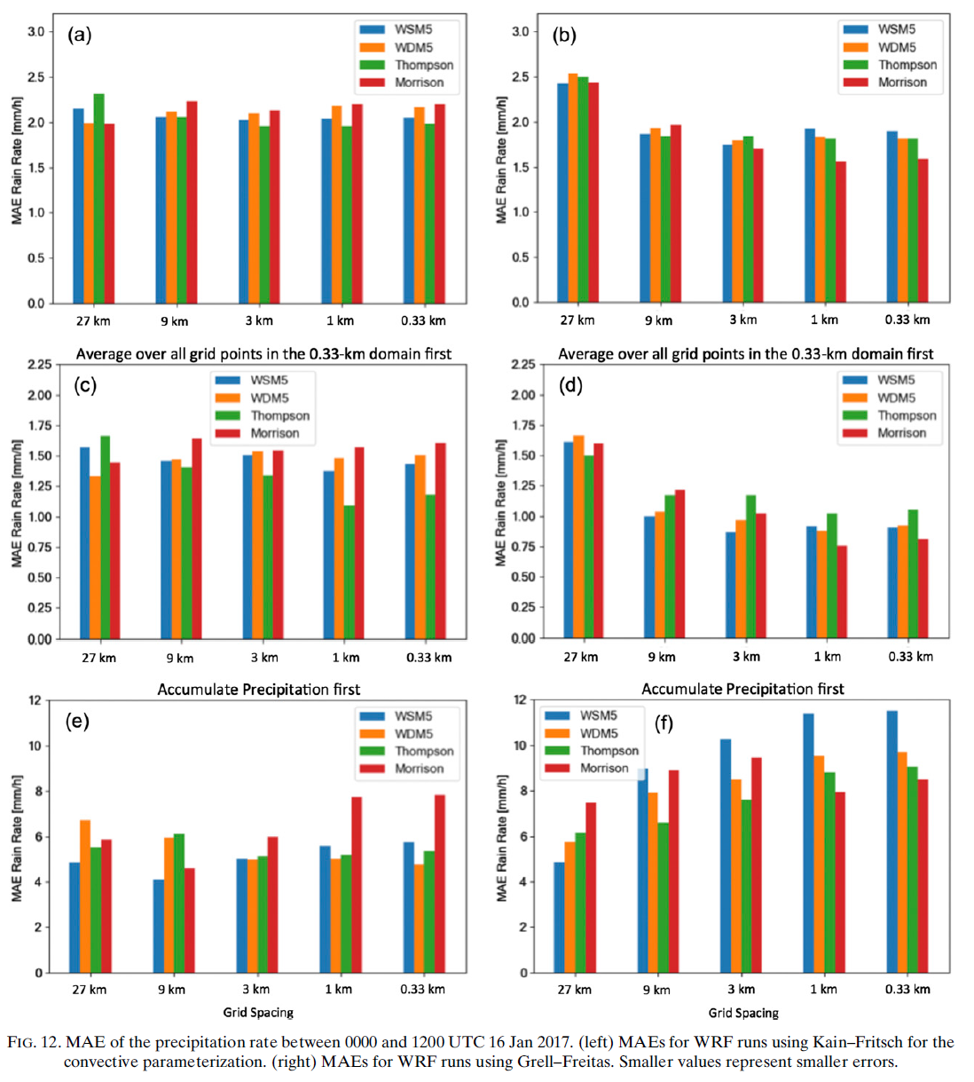
each grid point inside the 0.33-km domain
Using KF scheme
Using GF scheme
(Temporal error)
12-h accumulated
precipitation
(Spatial error)
Notes:
The Kain–Fritsch simulation errors have no significant grid-length dependence, whereas the scale-aware Grell–Freitas errors do (Fig. 12).
The Grell–Freitas runs have a slightly worse MAE than Kain–Fritsch at 27 km, but are generally better at all finer-resolution domains.
The exception is when precipitation is first accumulated over time (Figs. 12e and 12f).
This suggests that Grell–Freitas errors result more from location than timing of precipitation features for this case.
Two exceptions to the similar performance of all microphysics schemes are as follows:
the WSM5 scheme has a particularly large spatial error using Grell–Freitas
the Morrison scheme exhibits noticeably larger errors when using the Kain–Fritsch at finer resolutions.
Overall, the Thompson microphysics parameterization seems to perform slightly better than the other schemes at finer resolutions when using Kain–Fritsch for the cumulus parameterization (Figs. 12a and 12c).
The Thompson scheme also gives comparatively small spatial errors for the accumulated precipitation using Grell–Freitas (Fig. 12f). However, the spatially averaged rainfall rates using Grell–Freitas (Fig. 12d) show a higher temporal error for Thompson.
In the fine resolution Grell–Freitas domains, the Morrison scheme performs best compared to all other microphysics schemes.
For the fine-resolution Kain–Fritsch domains, however, Morrison performs worse than the other microphysics scheme.

Slide 18
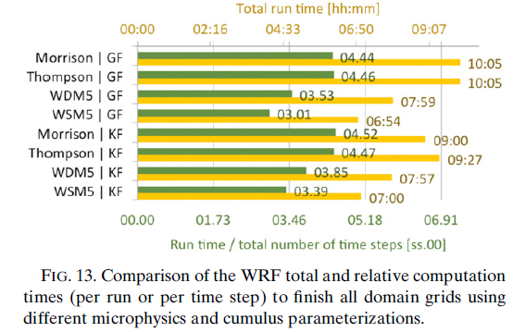
most time-consuming simulations: GF + Morrison, GF + Thompson
quickest run: GF + WSM5 (save 46% of the run time)
more sophisticated schemes are not always worth their computational expense
The costly Thompson and Morrison schemes showed different errors behavior depending on the applied cumulus scheme
simulating 27 forecast hours
more case study analyses are necessary to discover the dependency and interaction between convection and microphysics parameterizations.
no definite correlation between the performance of the microphysics schemes and grid spacing was found.
Notes:
The most time-consuming simulations were the configurations using the Grell–Freitas cumulus scheme with either Thompson or Morrison for the microphysics scheme (Fig. 13).
Both runs, simulating 27 forecast hours (including 15 h of time-staggered spinup time), took 10 h and 5min to run. Interestingly, the quickest run was also using Grell–Freitas, although this time combined with the single-moment WSM5 microphysics scheme.
This run would save 46% of the run time versus the more advanced microphysics schemes.
Considering the large differences in run time depending on the choice of microphysics parameterization together with the small difference in forecast performance seen in this case study, this suggests that more sophisticated schemes are not always worth their computational expense.
The costly Thompson and Morrison schemes showed different errors behavior depending on the applied cumulus scheme.
The simpler WSM5 and WDM5 microphysics schemes did not stand out, but neither did they disappoint in their performance.
Considering the significant run-time savings, these schemes could offer sufficient accuracy in a time-sensitive (e.g., operational) framework.
Additionally, no definite correlation between the performance of the microphysics schemes and grid spacing was found.

Slide 19
Summary and conclusions
The scale-aware schemes (especially Grell–Freitas) produced the smallest errors, outperforming other conventional cumulus schemes in timing and intensity of the precipitation.
resulted from their smooth transition from subgrid (cumulus) to resolved-scale (microphysics) precipitation.
the best-performing Grell–Freitas scheme was also the most time-consuming scheme
The microphysics option by itself did not make a considerable difference for the stratiform precipitation event
For convective cases where the microphysics scheme produces most of the heavy precipitation in the center of the system, scheme choice may have more of an impact.
Notes:
Although the differences between different microphysics options are small and the results are based on a single case study only, we found that lowest
MAEs were associated with the Kain–Fritsch cumulus scheme in combination with the Thompson microphysics scheme at fine resolutions.
The lowest MAEs with the Grell–Freitas scheme are found at fine resolutions when it is combined with the Morrison scheme.
However, when Grell–Freitas is chosen, the cumulus scheme is rarely triggered, so the vast majority of precipitation is produced by the microphysics scheme.
Precipitation errors associated with Grell–Freitas runs had a greater dependence on grid spacing because the microphysics scheme is more active in producing precipitation

Slide 21
Only 6-class microphysics schemes are able to represent graupel. Hence, both (single- and double moment) WSM5 andWDM5 schemes are missing this species.
The time- and space-averaged mixing ratios of the hydrometeors in the vertical column (not shown) shows that the Morrison scheme simulates more graupel than Thompson, and the graupel content increases with higher resolutions.
The Thompson microphysics scheme produces the largest snow mixing ratios at all grid lengths and for both cumulus schemes.
However, it rarely indicates any cloud ice, which all other schemes produce at the top of the cloud.
While the cloud ice average from the WSM5 schemes reaches down to a pressure level of about 700 hPa, the Morrison scheme restricts it to higher altitudes (above approximately 400 hPa).
The WSM5 and WDM5 schemes produce generally very similar vertical structures.
Notes:
Morrison scheme simulates more graupel than Thompson scheme
Thompson scheme produces the largest snow mixing ratios but rarely indicates any cloud ice.

Slide 22
The bias and mean absolute error (MAE) are calculated from quality-controlled ARM station data, soundings, and from 4-km gridded analysis fields based on multisensor precipitation estimates (MPE, where applicable) (Lin 2011).

Slide 23
ABSTRACT
The aim is to investigate the ability of different cumulus and microphysics parameterization schemes to represent precipitation processes throughout the transition between parameterized and resolved convective scales (e.g., the gray zone).
The cases include the following:
1) a mesoscale convective system causing intense local precipitation
2) a frontal passage with light but continuous rainfall.
different microphysics schemes produce very similar outcomes, yet some of the more sophisticated schemes have substantially longer run times.
This suggests that this additional computational expense does not necessarily provide meaningful forecast improvements, and those looking to run such schemes should perform their own evaluation to determine if this expense is warranted for their application.
The best performing cumulus scheme overall for the two cases studies here was the scale-aware Grell–Freitas cumulus scheme.
It was able to reproduce a smooth transition from subgrid- (cumulus) to resolved-scale (microphysics) precipitation with increasing resolution.
It also produced the smallest errors for the convective event, outperforming the other cumulus schemes in predicting the timing and intensity of the precipitation.

