Slide 1
Climatology of Flood-Producing Storms and Their Associated Rainfall Characteristics in the United States
Erin Dougherty and Kristen L. Rasmussen
Cidny Ramirez

Slide 2
Introduction
Previous studies looked at “ingredients-based approach” (Doswell et al. 1996)
P = RD (P: rainfall accumulation, R: average rainfall rate, D: rainfall duration)
High rain rate due to precipitation efficiency enhancement (ample moisture, lifting mechanisms)
Long duration can be due to quasi-stationary convective/ synoptic systems
Characteristics present at extreme events and majority of urban flash floods over CONUS

Slide 3
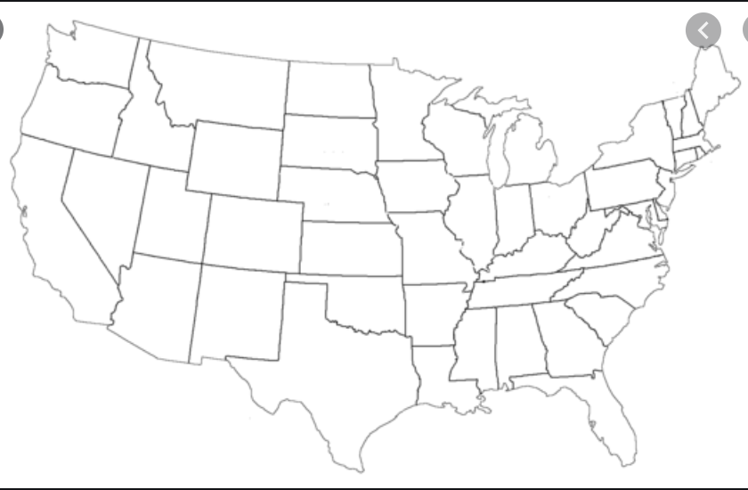
Rainfall peaks in summer CONUS because of:
Extra-TCs
MCSs
Monsoon
TCs

Slide 4
Gourley et al. (2013) created FLASH: Flooded Locations and Simulated Hydrographs
USGS streamflow observations, NWS storm reports, two years survey responses documenting flash floods
Shen et al. (2017) created comprehensive database of over 0.5 million floods over CONUS from 2002 to 2013
USGS streamflow measurements and Stage IV rainfall data

Slide 5
Flood patterns over CONUS
East:
High discharge and precipitation associated with warm-season convective rainfall or hurricanes
West:
Occur in steeper sloped basins in West Coast winter due to extratropical cyclones
Southwest summer due to monsoon
W
E
SW

Slide 6
Goal is to produce climatology of rainfall characteristics in flood-producing storms in CONUS using NCEI Storm Events Database
Most previous studies look at hydrological processes, or only consider flash floods
Fill gaps in rainfall characteristics using NCEI which identifies where flooding occured and groups floods by associated meteorological system
Shen et al. (2017) for gauge identified floods and Stage IV precipitation
Provides first step in understanding overall climatology for future research

Slide 7
Data and Methods

Slide 8
According to National Weather Service (NWS, 2007)
A flood is “the inundation (泛藍) of normally dry area caused by an increased water level in an established watercourse, or ponding (積水) of water, generally occurring more than six hours after the causative event, that poses a threat to life and property.”
The paper then on refers to flood as slow-rise floods
A flash flood is “a rapid and extreme flow of high water into a normally dry area, or rapid water level rise in a stream or creek above a predetermined flood level, beginning within six hours of the causative event (e.g. intense rainfall, dam failure, ice jam–related)”
Hybrid Floods: when reports (or events) within the same episode were labeled as both flash and slow-rise floods

Slide 9
NCEI Storm Events Database
NCEI: National Centers for Environment Information
Receives details on location, date, time of events from NWS and other sources
Full database includes other events like blizzards, hurricanes, etc.
Study uses flood reports from 2002 to 2013
Cases were then matched to Shen et al. (2017) to associate flood reports to streamflow-identified floods

Slide 10
Merging Storm Reports with the Shen et al. (2017) database
Comprehensive flood database over CONUS from 2002 to 2013 using characteristic point method (CPM)
CPM: automated method to identify flood events by rising and recessing branches of hydrograph using instantaneous USGS streamflow values
Only values over 80th percentile used
Basin averaged Stage IV precipitation to associate peak in streamflow with flood triggering precipitation

Slide 11
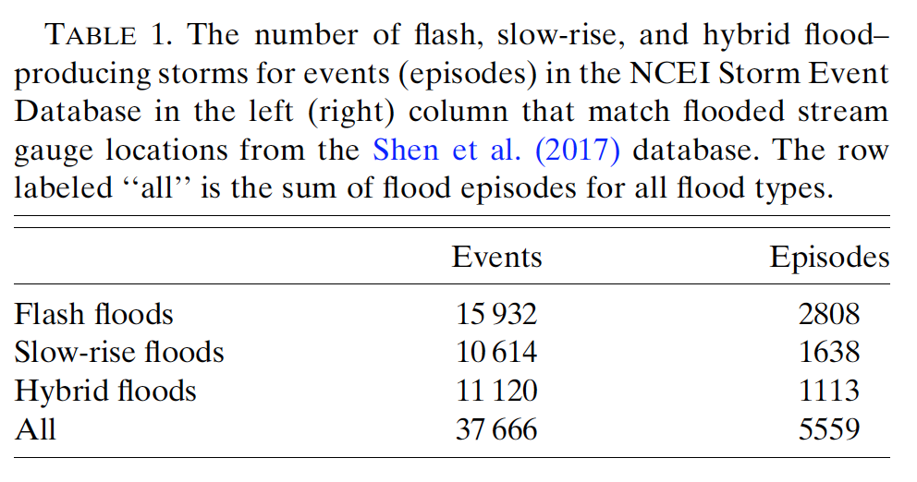
Three day period chosen to account for a lag between start times in Shen et al. (2017) and NCEI databases
200km buffer was selected based on average distances across various river basins providing confidence that river basins in both databases were the same (and same event)
South Platte (CO), Wabash (IN), Willamette (OR) basins
In Table 1 of the hybrid floods, 61% were labeled as flash floods and 39%were labeled as slow floods

Slide 12
Stage IV Precipitation Data
Data available at 4-km hourly resolution since 2001 multisensor (radar estimated rainfall combined with rain gauge data) precipitation analysis (MPE) produced by twelve River Forecast Centers (RFCs) over CONUS
Considered the benchmark precipitation estimate over CONUS used to validate other precipitation data and high resolution simulations
Necessary for transient, small scale events like flash floods

Slide 13
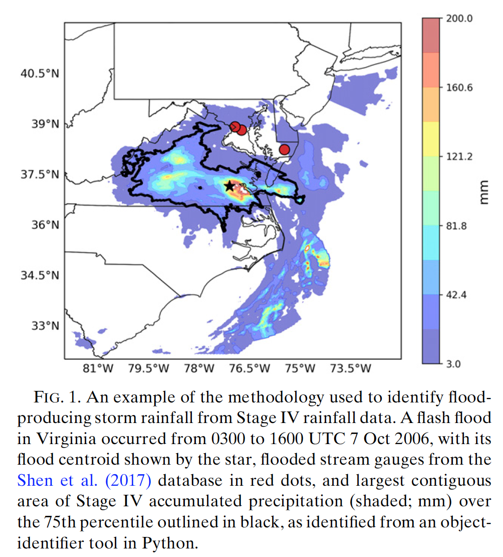
Stage IV
Centroid of each flood episode was calculated based on geographic information obtained from merging storm reports with county shapefiles
Hourly Stage IV rainfall data for radius of +/- 5º radius from the episode centroid for flash and hybrid floods
Every three hours for slow-rise floods
When hourly files not available (PNW), six hourly files used
Buffer of +/- 1 hours for flash floods
6 hours for slow and hybrid floods
Python identifier allows isolated convective, as well as larger scale synoptic (MCS, fronts, extratropical) rainfall to be captured

Slide 14
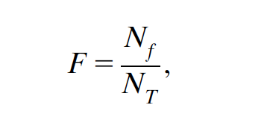
Accumulated rainfall, area, and duration of largest contiguous rainfall area exceeding 75th percentile of accumulation, averaged over 12 year period for
Each Stage IV 4-km grid cell
All episodes by flood type
Number of floods per grid cell also summoned over 12 year period to find episode frequency
Variables were multiplied by scaling factor, Nf is number of flood episodes per Stage IV grid cell, Nt is total number of flood episodes over CONUS

Slide 15
Results

Slide 16
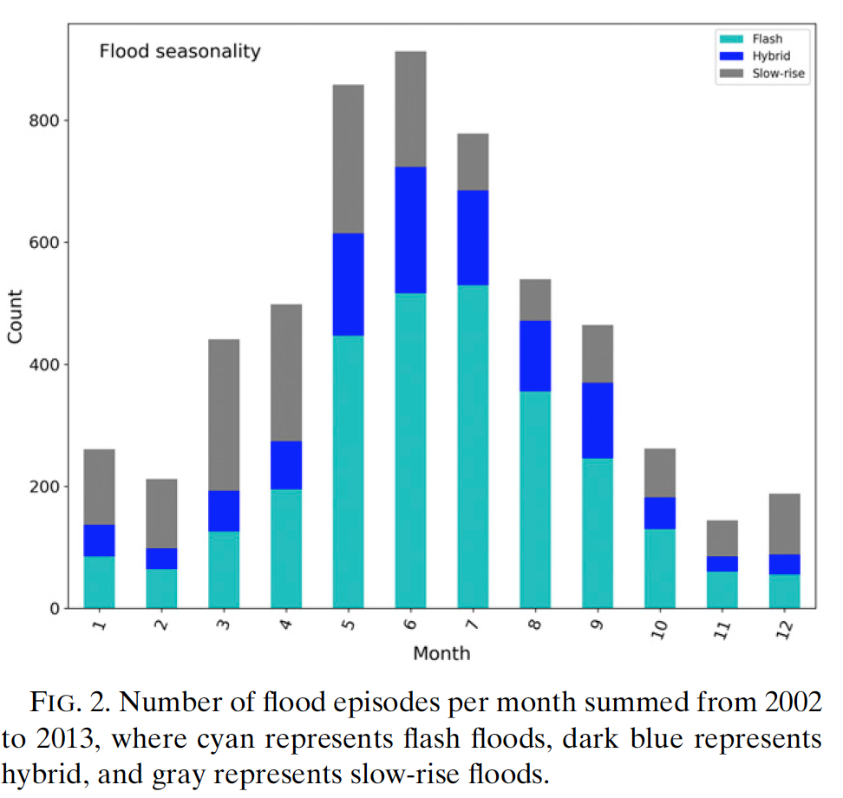
Seasonal and Geographical Distribution of Floods
Warm season maximum
Synoptic rainfall MCS
Rain-on-snow events

Slide 17
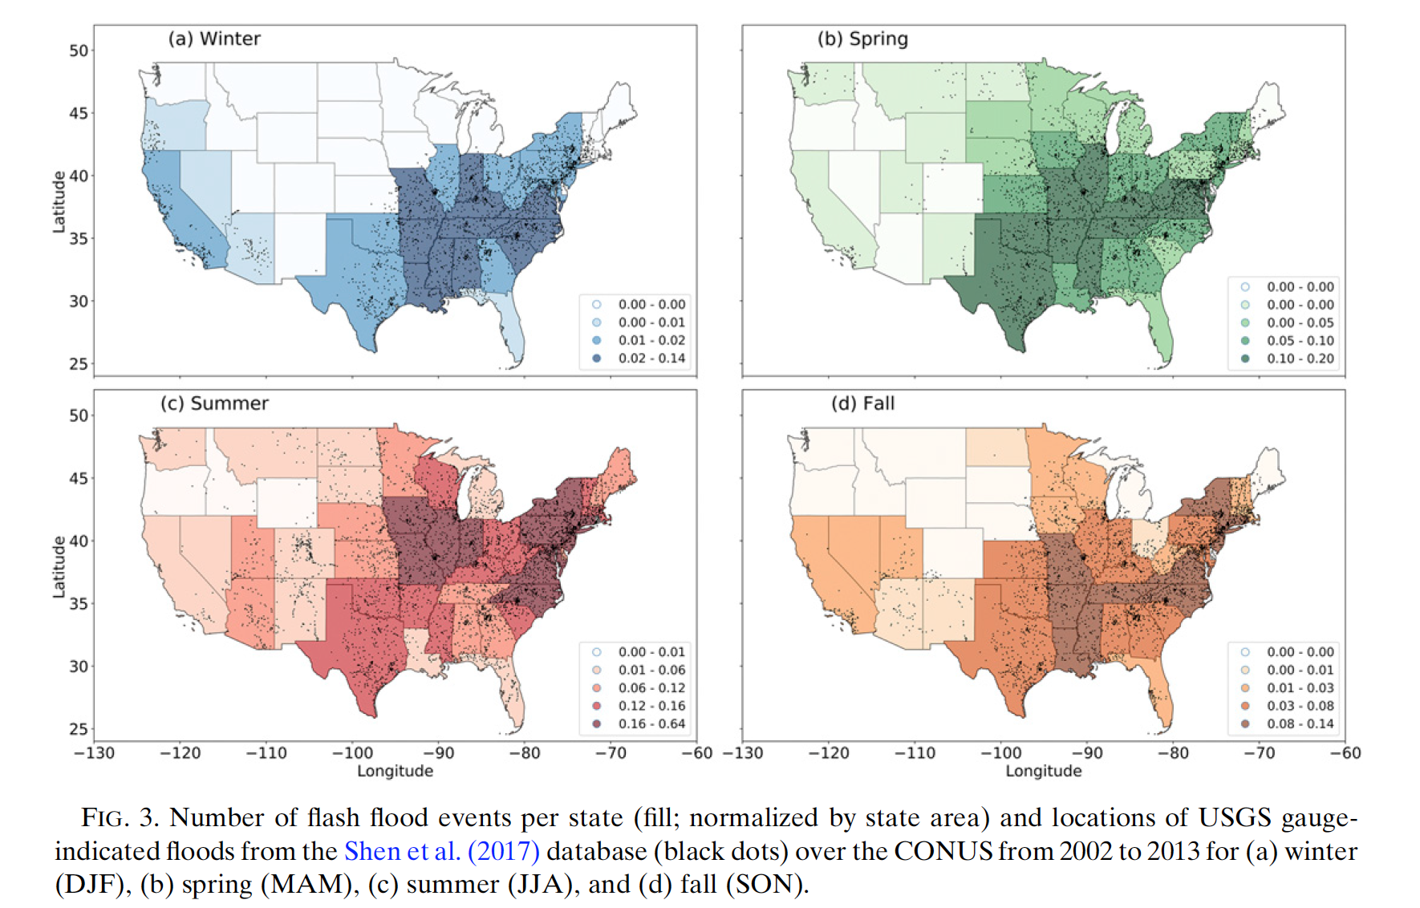
Warm season convection,
MCS
AR
NA
Monsoon
Notes:
Maximum in flash floods in midwest and plain is due to mcs

Slide 18
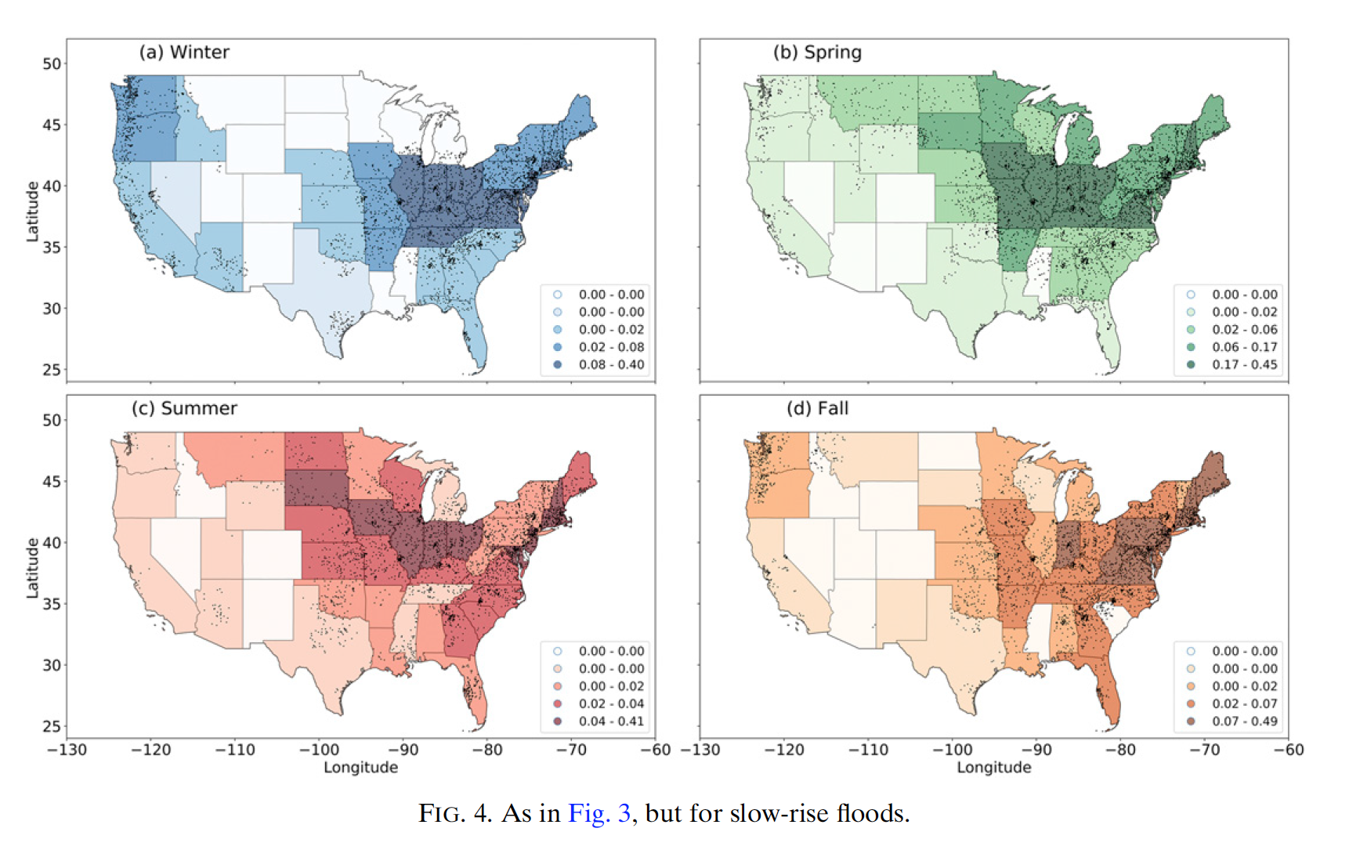
Rain-on-snow,
Synoptic systems
AR,
rain-on-snow,
Extratropical cyclones
Fronts and extratropical cyclones
AR
Rain-on-snow, upslope convection
Fronts and extratropical cyclones
TC,
Synoptic systems, MCS

Slide 19
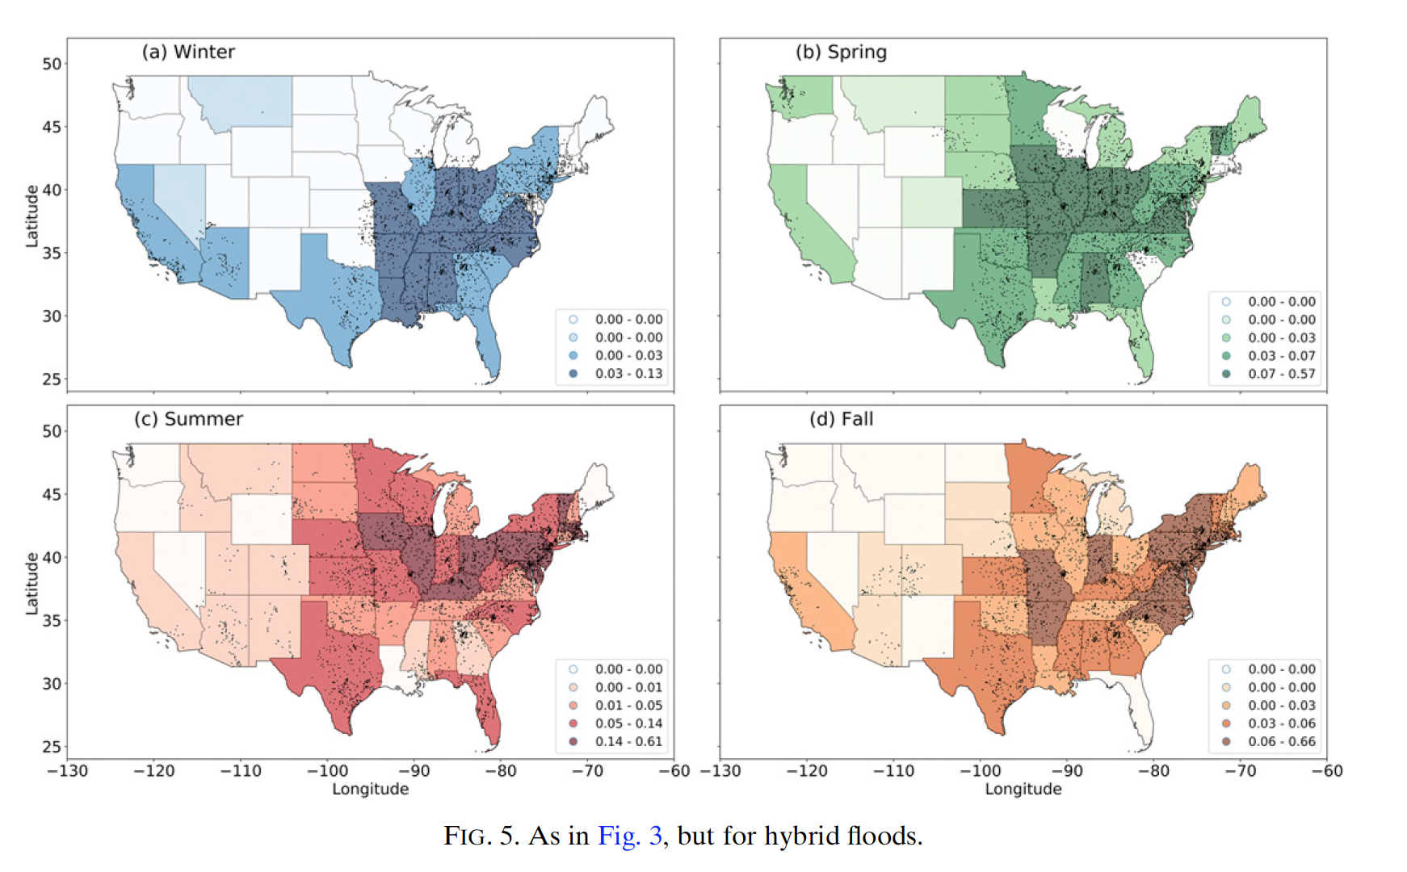
Rain-on-snow,
Warm season
AR
AR
TC,
Synoptic systems, MCS
Fronts,
TC

Slide 20
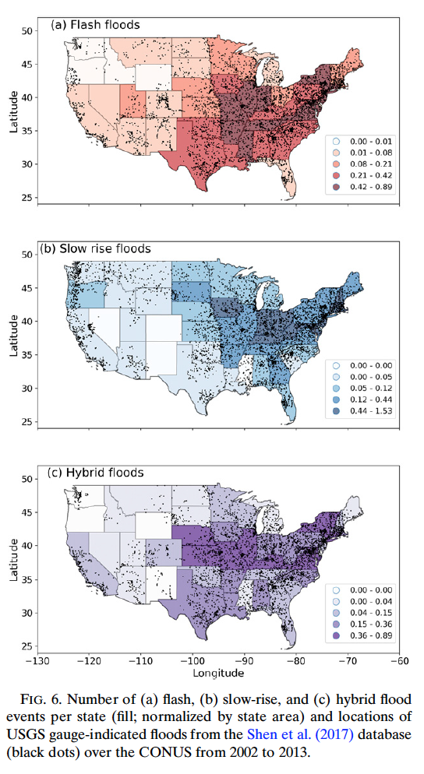
Warm season convective and monsoon signals
Rain-on-snow, and ARs

Slide 21
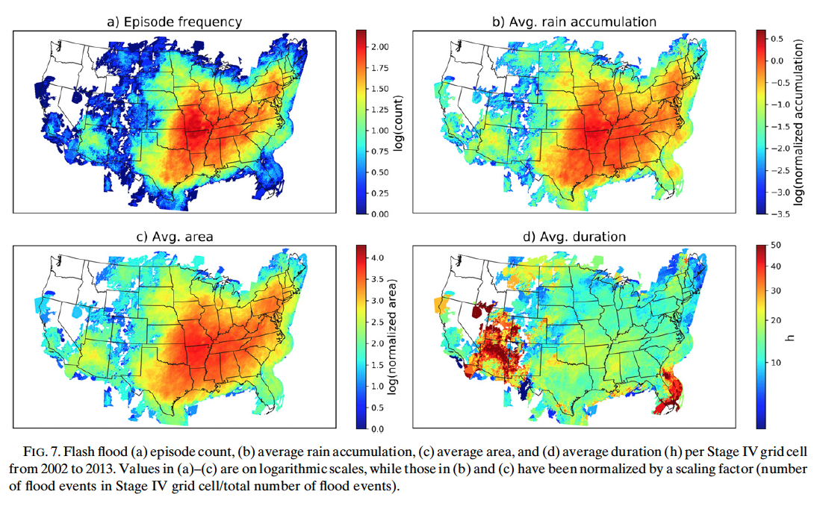
Rainfall Characteristics of Flood-Producing Storms
Notes:
Most frequently occur in Miss and Ohio RIver valleys, also highest avg rainfall accumulation, largest average area
Missouri and arkansas also hotspots bc of MCS
In SW asso with long lived storms (jan, July-Oct), terrain enhanced

Slide 22
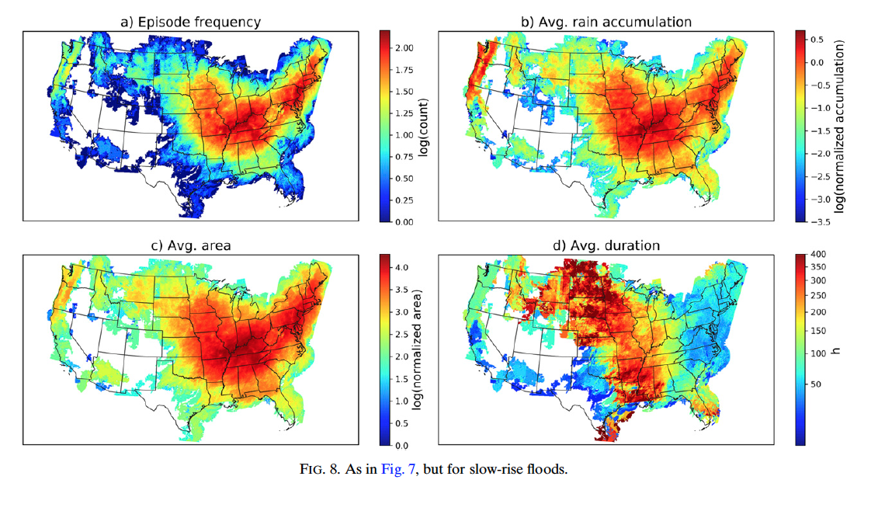
Notes:
NE, ohio riv valley, midwest, most frequent, highest avg accumulation, largest area
DUration synoptic, long lived MCS
Long duration (>250 hours), great plains and miss riv; MCS and rain on snow
Cool season synoptic cyclones
Modreate in PNW bc of ARs and rain on snow

Slide 23
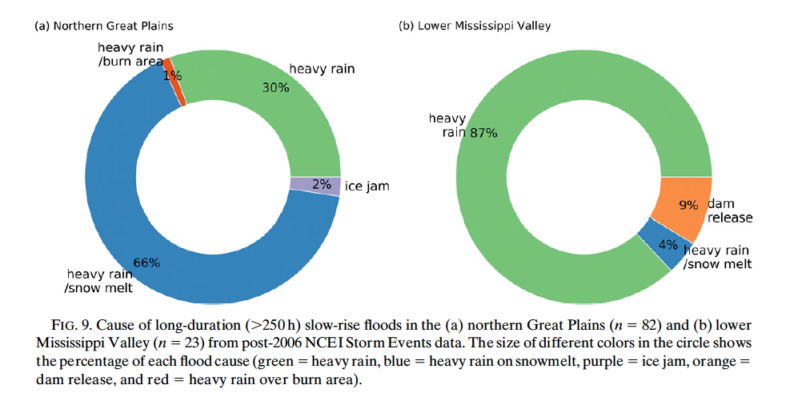

Slide 24
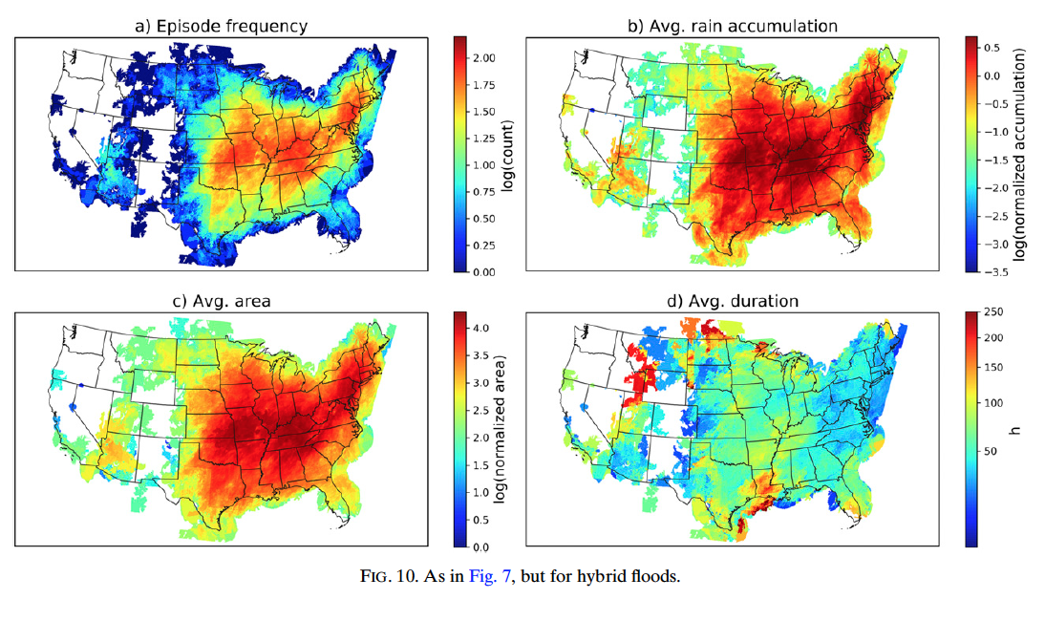
Notes:
Ohio riv valley and mid atlantic, location of max slow rise anf flash floods
Highest avg rainfall accumulation, are largest, mod durations
Hybrid floods were often obvsered by storm reports- likely long lived convection, tropical cyclones, frontal passages
Longest hybrid in gulf coast likely from slow moving TCs

Slide 25
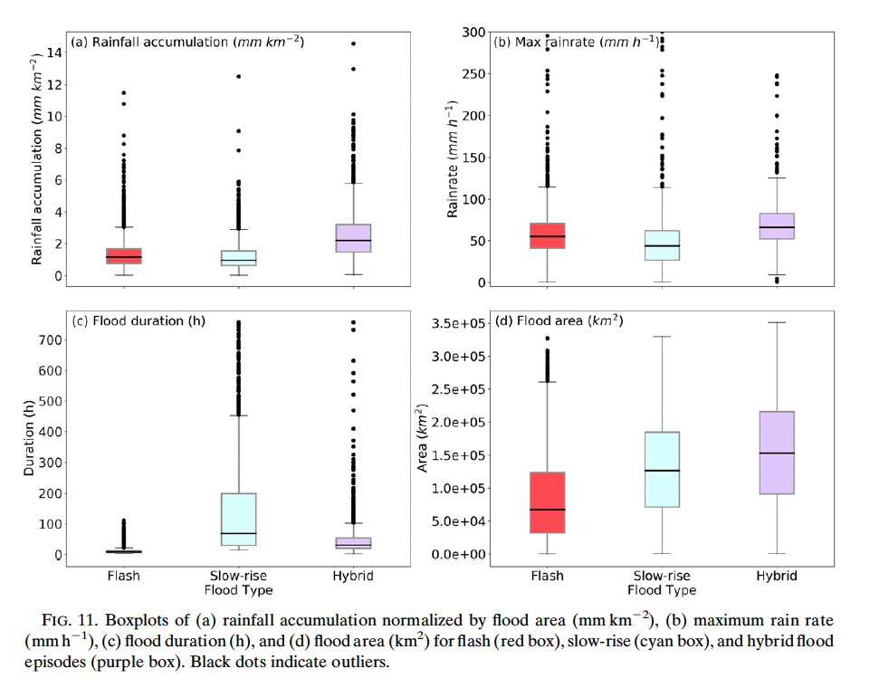
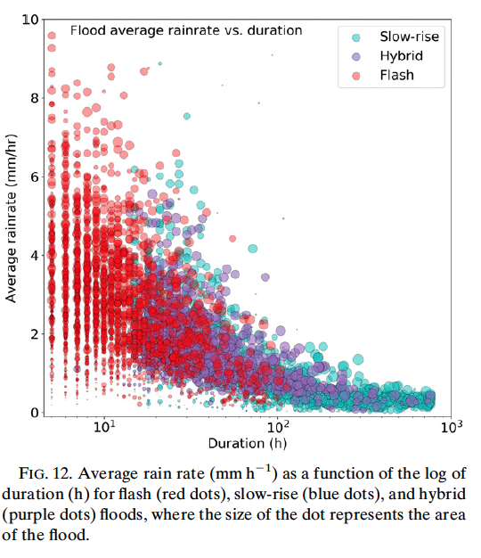
Comparison of Rainfall Characteristics in Flood-Producing Storms
Notes:
Flash floods, shortest duration, smallest area, transient nature, max rain rates lower than hybrid
Hybrid have convective characteristics of flash, but lifetime of slow rise, longer duration and larger area
Slow rise have lower max rain rate, longer duration and similar sizze to hybrid

Slide 26
Conclusions

Slide 27
