Slide 1
Microphysical Process Comparison of Three Microphysics Parameterization Schemes in the WRF Model for an Idealized Squall-Line Case Study
Speaker: Yu-Tai Pan
4/14
Notes:
題目: 理想模擬颮線個案中，比較WRF中不同雲微物理方案的研究

Slide 2
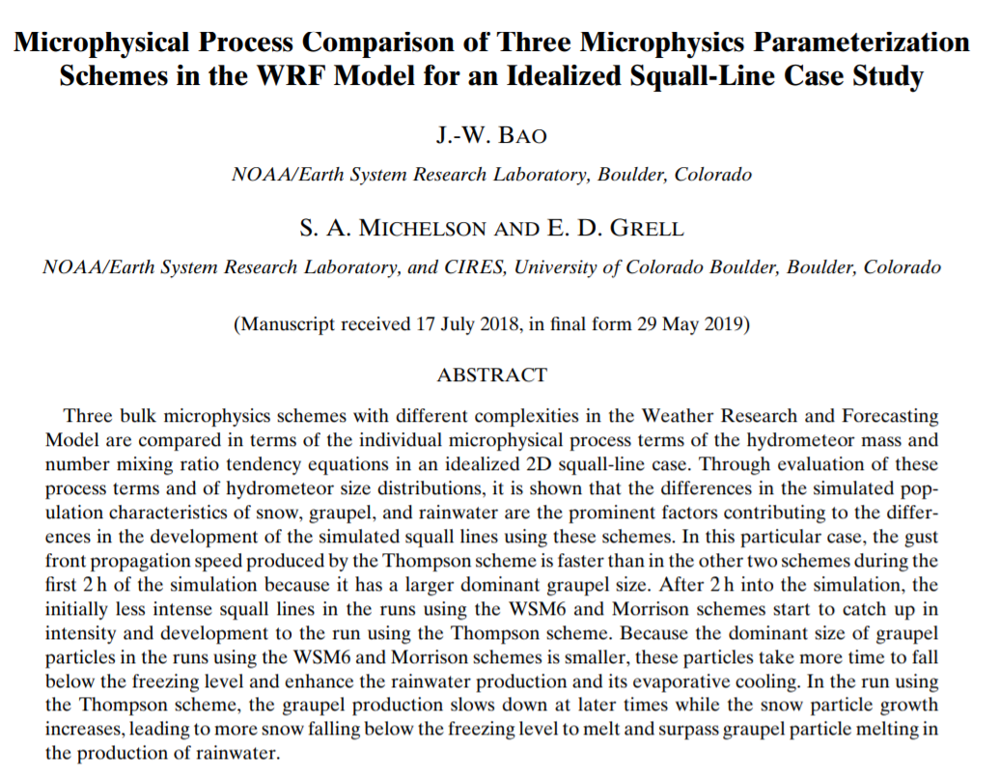

Slide 3
Introduction
Single-moment (1M) scheme includes prognostic equations for the mass mixing ratio, while a double-moment (2M) scheme will have prognostic equations for the number concentration and number mixing ratio.
Differences in the rain drop size distributions between the 1M and 2M schemes led to different rates of rainwater evaporation, produce different surface precipitation rates in the trailing stratiform region, and result in different intensity of cold pools behind the surface gust front.
(Morrison et al. (2009) and Van Weverberg et al. (2012))
Notes:
1.1M(單矩量)只預報混合比 ，而2M(雙矩量)則還能預報粒子數量濃度分佈等
2.1M(單矩量)和2M(雙矩量)會產生不同的雨滴大小分佈，造成雨水蒸發冷卻的不同，進而影響颮線強度

Slide 4
Introduction
Bryan and Morrison (2012) showed that the use of the 2M schemes in the WRF Model overall improved the idealized squall-line simulation compared to observations by improving the overall rainwater evaporation which is critical to the squall-line development.
Rain drop size distribution and the properties of rimed ice (either graupel or hail) in terms of density and fall speed were the two microphysical processes that affect the squall-line structure the most.
(Bryan and Morrison (2012) )
Notes:
他們發現模擬颮線時，2M比1M模擬的還來的好，主要是因為2M改善了整體雨水蒸發的表現
雨水的粒徑分佈以及冰相粒子(軟雹或者冰雹)的”落速”和”密度”是影響颮線結構最深的因素。

Slide 5
Purpose of this study
Compare the squall line development using different microphysical schemes
The hydrometeor mixing ratio tendency equations
The size distribution of the simulated hydrometeors
Notes:
本篇的目的就是比較不同雲微物理方案對颮線的發展，其中又藉由
1. 水物混合比的趨勢方程式
2. 水物的粒徑分佈

Slide 6
Model setting
WRFV3.7, 2D idealized squall line
Grid size: 1 km for x direction(600 km)
Time step: 3 s
Vertical layer: 80 levels
Boundary: open boundary
How to initiate squall line: +3K warm bubble
Compare between
1. WSM6 (1M)
2. Thompson(2M)
3. Morrison(2M)

Slide 7
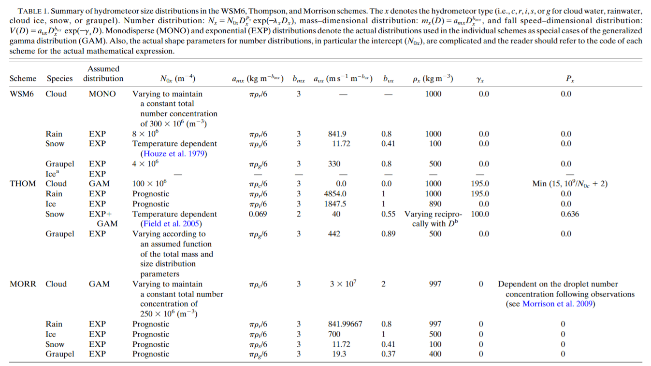

Slide 8
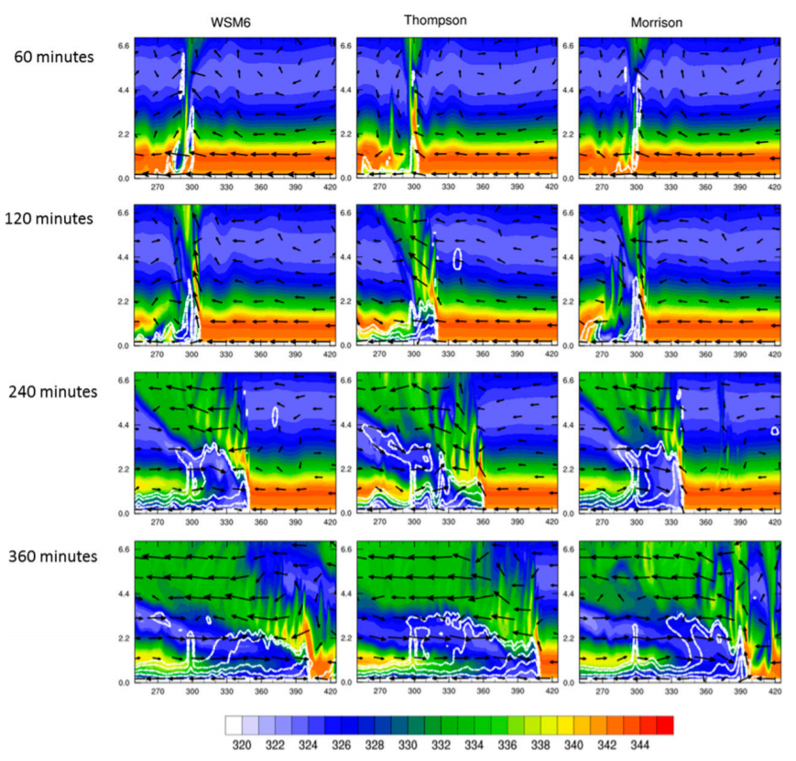
Results
Downshear
Upshear
Downshear
All become mature, upshear tilt
The Thompson scheme developed faster than the others at first 2 h
After 2h, WSM6 and Morrison catch up the intensity
Notes:
1.60分鐘之前，只有湯姆森達到成熟時期，另外兩個還沒
2.到了120分鐘之後大家都達成熟時期了
3.這裡主要是要強調第二小時之前，湯姆森發展最快
顏色，位溫。
白色，位溫擾動(-1K/interval 2K)
風場

Slide 9
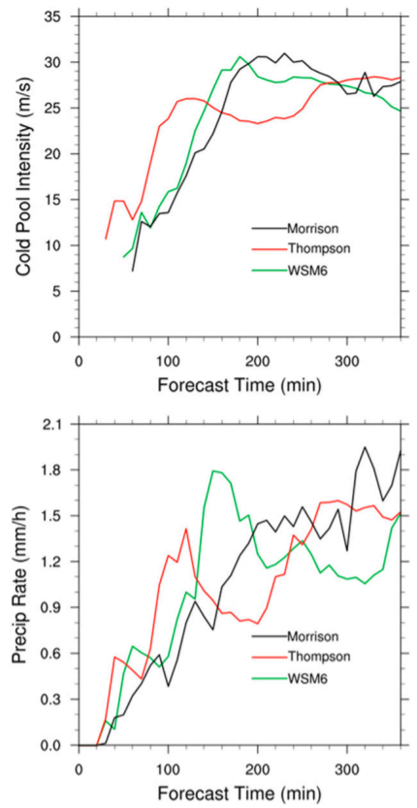
Cold pool speed
First 2h , Thompson scheme showed a stronger squall line.
2 h
The reason why the Thompson developed faster is the different cold pool intensity
(different hydrometeors process)
Notes:
這邊一樣是要強調前兩小時湯姆森發展最快，接下來就是要解釋為什麼湯姆森比較快
降水為domain平均然後10分鐘平均

Slide 10
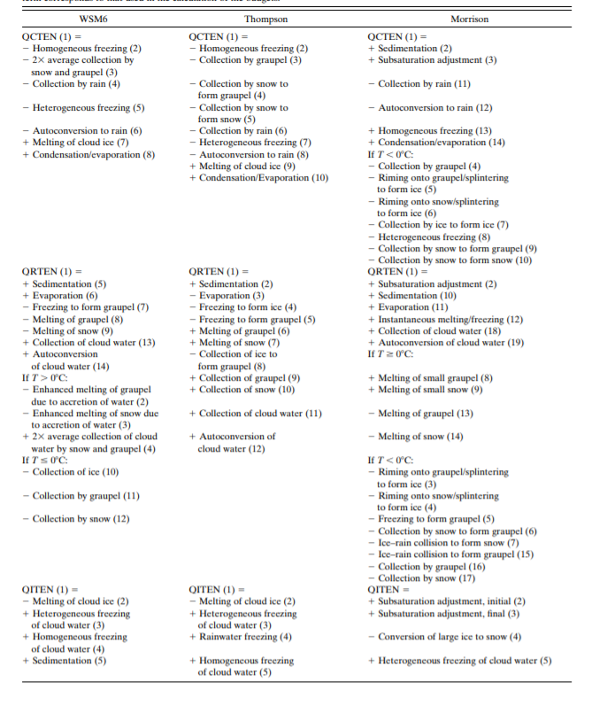
Analyze the tendency equation of Qc/Qr/Qi/Qs/Qg
I.e. dQx/dt, x denotes the different hydrometeors
(cloud,rain,ice,snow,graupel)
Notes:
所以就從分析不同水物的趨勢方程來找出為什麼有不同的冷池強度，導致不同的颮線發展

Slide 11
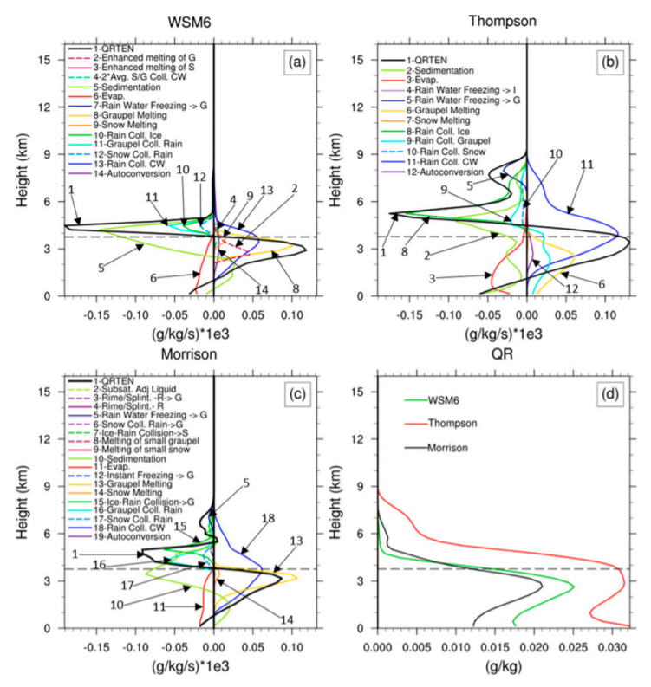
Warm rain processes in the first 2 h
Qrain tendency (averaged space and first 2h)
Main production terms(+):
Thompson: rain collecting cloud water, graupel melting, rain collecting graupel and autoconversion
Morrison and WSM6: rain collecting cloud water and graupel melting are similarly dominant
The rain collecting cloud water process is the most important part!
The higher evaporation rates in Thompson suggests smaller rain drop mean size
Notes:
Rainwater的趨勢方程:
1.三個方案中，雨水收集雲滴皆為最大項，又以Thompson最大。 ((但其雨水的sedimentation並非最大，導致其雨水能夠在溶解層以上存活較久
2.此外也能注意到graupel melting的位置，thompson深度較廣和其他兩者差距很多，意味著其graupel粒徑大小和另外兩者大相逕庭
3. 可以注意到Thompson的蒸發項是裡面最大的->也意味著湯姆森裡面的雨滴較小。
Qr tendency (averaged over domain and during the first 2h)

Slide 12
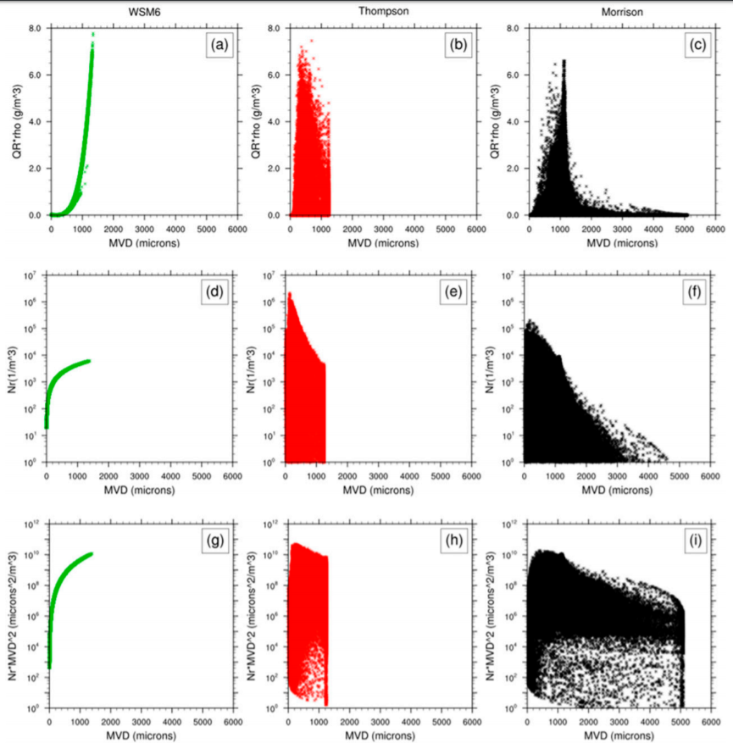
Rain water content
(g/m3)
Smallest
MVD
Thompson:
Smaller rain drop size
-> stonger evaporation
Number concentration(1/m3)
Effective total evaporation area
(um2/m3)
Notes:
為前2小時內所有粒子的總量
1.雲水含量(g/m3) 2.數量濃度分佈 3.有效蒸發面積
至於為什麼Thompson有一個1250um的界線是因為他模式設定有一定值
越強的蒸發就會造成越強的冷池->颮線發展較快
Thompson因為有較多小粒徑粒子，所以會有較強的有效蒸發區域evaporation area

Slide 13
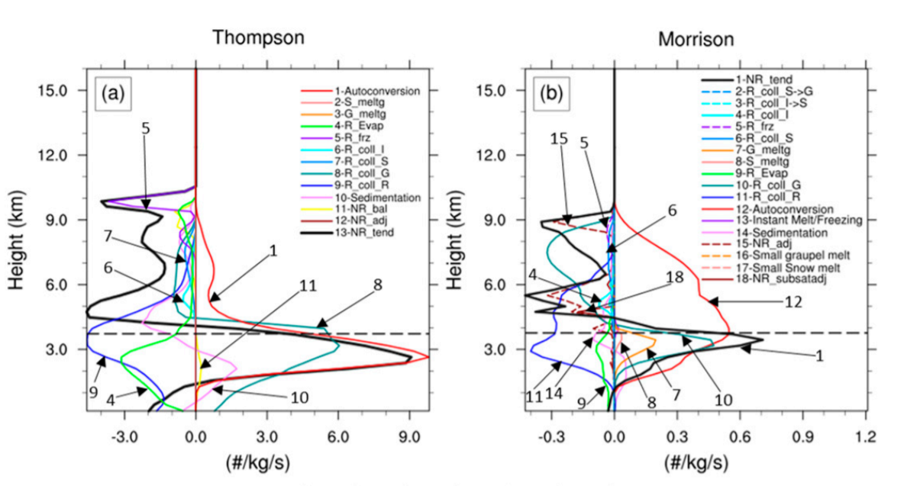
Number concentration
Thompson:
More smaller rain drop
->Large number concentration
Note that:
All these explain why there is more evaporation below 1 km in the Thompson than in the other two runs.
Notes:
Thompson在數量濃度當中是最多的，這也暗示著先前提到的，其雨水粒徑較小，
而Thompson之所以有那麼多小粒子主要是因為shedding(雨水在收集graupel時造成的破碎(8))
->小結:總之就是在解釋為什麼湯姆森為什麼在前兩小時會有較強的低層蒸發!

Slide 14
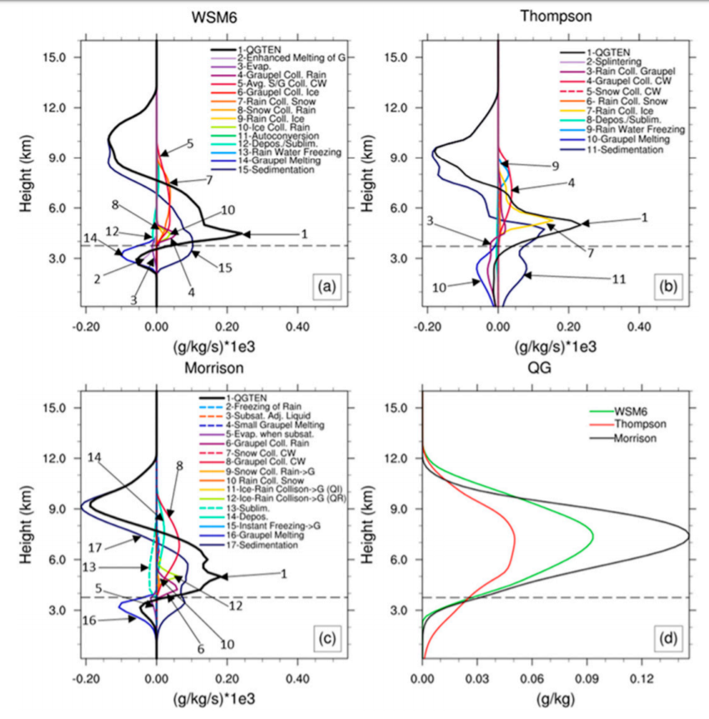
Cold rain processes in the first 2 h
Qg tendency (averaged space and first 2h)
(graupel)
Main production terms(+):
Thompson: collection of cloud water by graupel, freezing of rainwater
Morrison: collection of cloud and rainwater by graupel, collection of snow by rainwater
WSM6: graupel and snow collecting cloud water, rain collecting snow
The Thompson has a greater reduction pathway of rainwater collecting graupel
(->more rainwater)
Notes:
軟雹的趨勢方程:
1.(10號)可以發現軟雹融化項在Thompson內可以來到地面附近，而WSM6(14)和Morrison(16)則在上層就融化
2.此處可以注意到在Thompson內，rainwater collect graupel很強->所以產生較多雨水->較強冷池
3.Thompson scheme，在低層有較多的軟雹->意味著在Thompson裡，軟雹較大顆

Slide 15
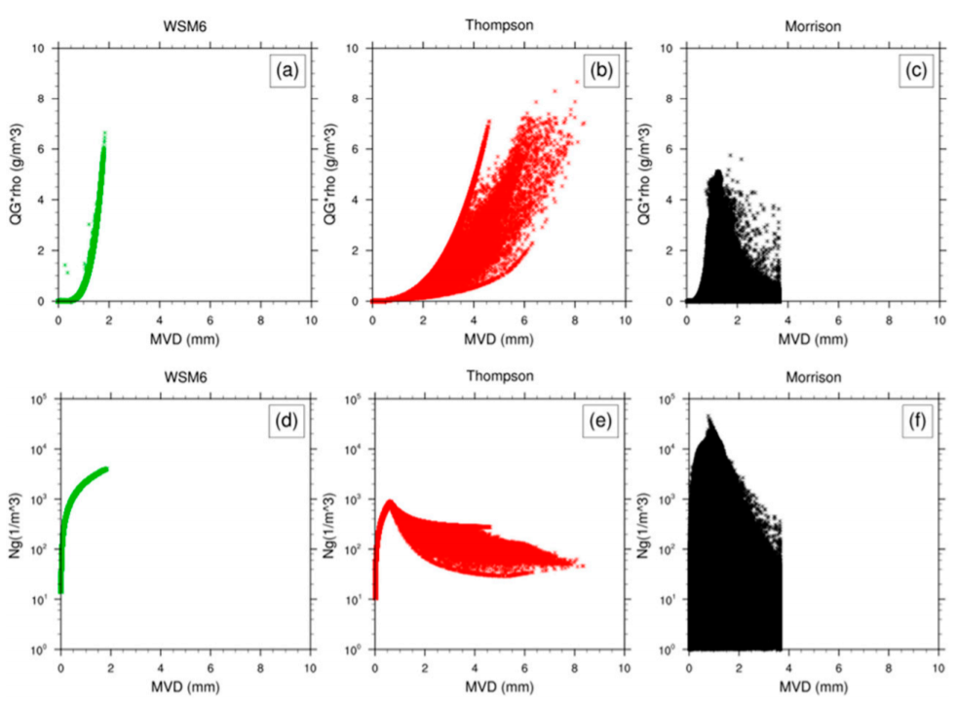
For graupel
More large size graupel
Rain water content
(g/m3)
Number concentration(1/m3)
Notes:
發現Thompson有較多大顆的軟雹

Slide 16
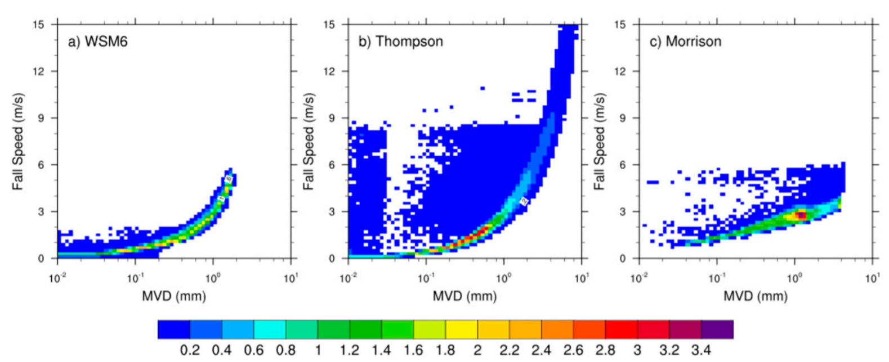
Fall speed of graupel
*1000
The larger graupel in Thompson scheme fall faster, and
the graupel can reach ground before melting
Notes:
較大顆的軟雹有較強的落速，因此軟雹在Thompson方案中可以降落到地面

Slide 17
Overall, during the first 2h
Thompson scheme:
1. Smallest dominant size of rainwater particles
2. Largest dominant size of graupel particles
Produce the most intense squall line with the greatest propagation speed
Notes:
1.雨水越小，越容易蒸發，冷池越強，颮線發展越強
2.Graupel越大能形成越多“軟颮融化成雨水的過程”

Slide 18
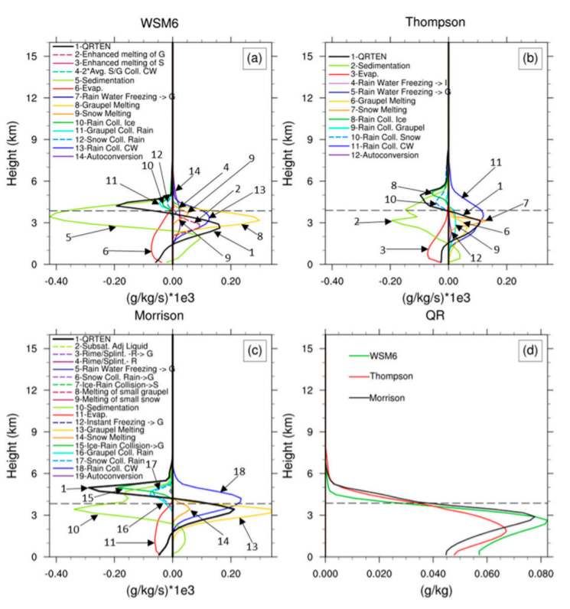
Qr tendency
(Averaged over 2-4 h)
The evaporation rate of WSM6 and Morrison catch up the Thompson(6/3/11).
This is due to the smaller graupel and snow in WSM6 and Morrison runs falling below the freezing level and melting, enhancing evaporation.(8/6/13)
The graupel melting in Thompson reduced a lot, and the snow melting increased(through riming)
Notes:
1.此時WSM6(6)和morrison(11)的蒸發已經趕上thompson(3)，是因為WSM6和Morrison較小的冰相粒子(snow and graupel)開始降落到溶解層以下，開始融解，增強蒸發效率。
2.此時的WSM6和morrison的graupel meltin開始增強(但thopmpson已經沒有graupel melting)
此時的thompson已經轉為融化雪為主

Slide 19
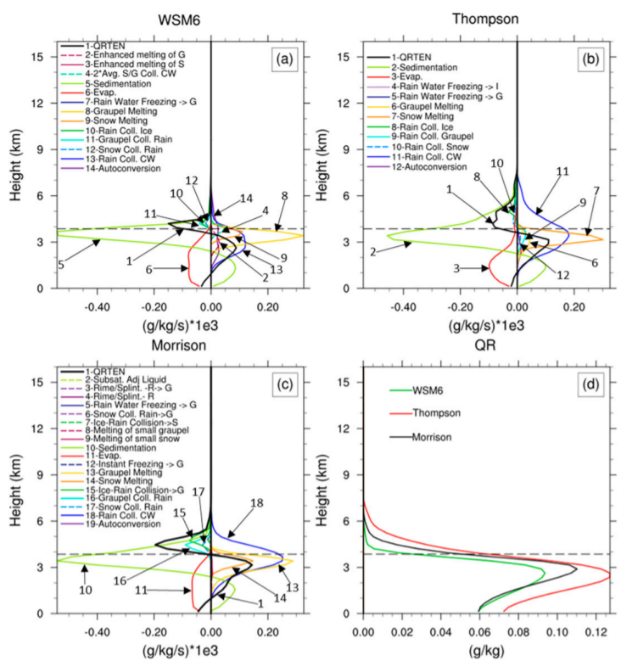
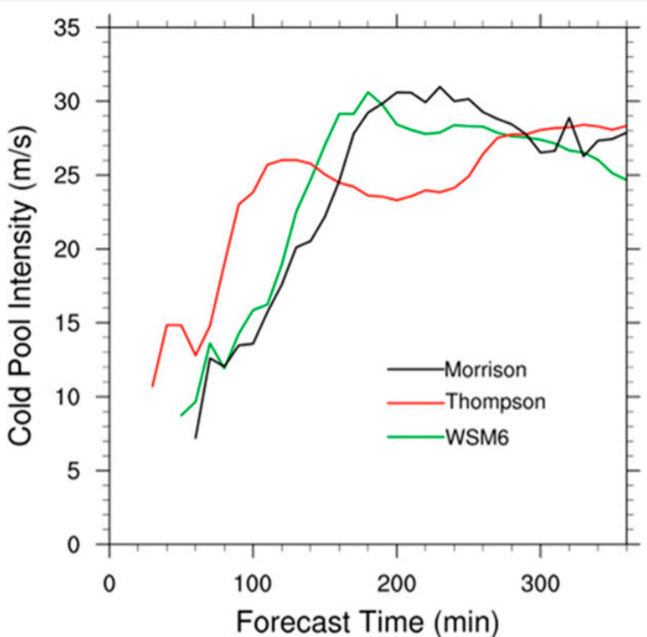
Qr tendency
(Averaged over 4-6 h)
The melting of snow in Thompson increases significantly because the snow particles grow large enough to fall below the freezing level and melt
2 h
4 h
6 h
Notes:
到了後期由於Thompson內的雪長的夠大了，於是開始轉為snow melting為主，所以Thompson內的雨水又開始變成最多的
->因此，雨水蒸發+雪的溶化使Thompson內的冷池又開始增強，開始又追上WSM6和Morrison

Slide 20
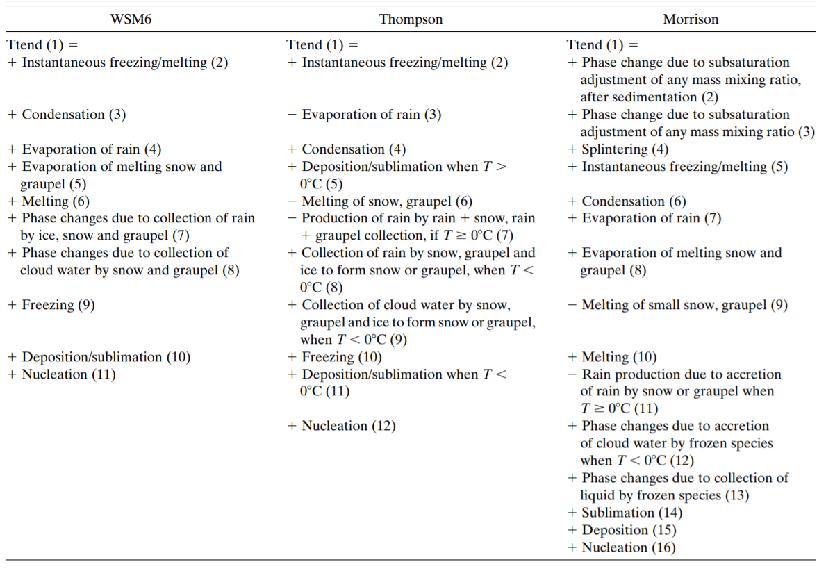
Temperature tendency equation

Slide 21
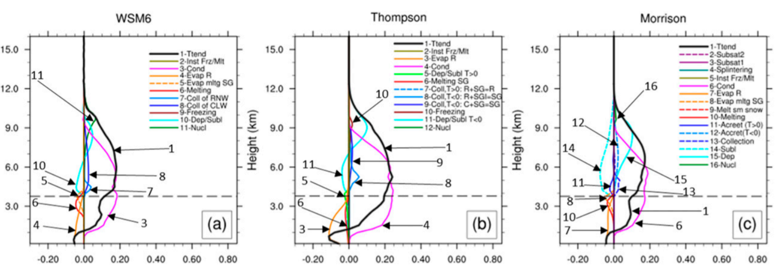
Temperature tendency (0-2 h)
Stronger cooling due to rainwater evaporation
Notes:
Thompson在一開始有最強的cooling effect due to evaporation
而melting(graupel在湯姆森裡面較大，要花較多時間融化)在Thompson->導致evaporation cooling在Thompson裡面很顯著

Slide 22
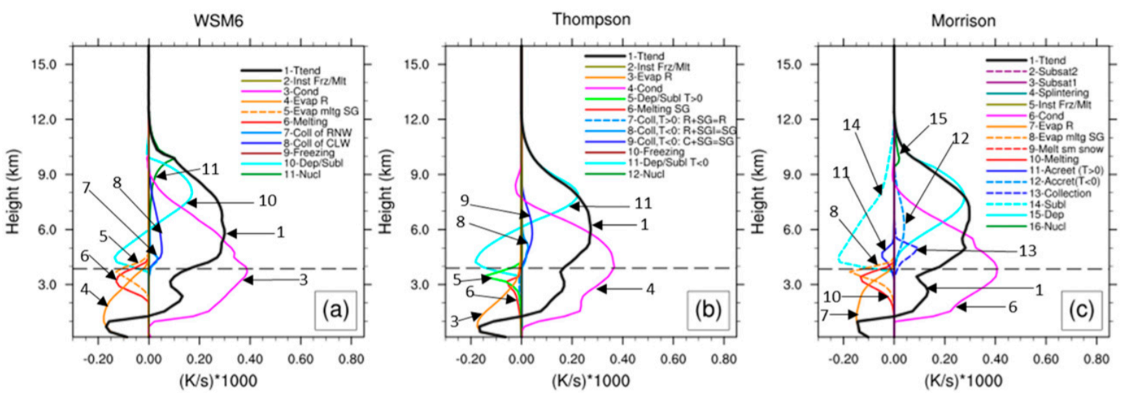
Temperature tendency (2-4 h)
Notes:
此時對於Thompson來說，snow的量變多了，melting主要是snow的效應
而WSM6和Morrison的melting之所以較多是因為原本落速較慢的graupel和snow現在才開始融化

Slide 23
Conclusions
1. The simulated squall-line structure is most sensitive to the sizes of graupel, snow, and rainwater particles and the pathways to their production/reduction.
(consistent with previous studies(e.g., Fovell and Ogura 1988, Rutledge and Houze 1987, and Wu et al. 2013))
2. The Thompson run has the most intense squall line at first 2h because it produces graupel with larger dominant size, and rainwater particles with smaller dominant size.
->Result in more production of rain through graupel melting and thus more evaporation of rainwater
Notes:
模擬的理想颮線對於軟雹/雪/雨水的粒徑大小最為敏感
前兩小時內，因為Thompson裡面的軟雹粒徑較大且雨水粒徑較小，所以能夠產生較多的雨水蒸發，較強冷池，較強颮線

Slide 24
Conclusions
3. After 2h, WSM6 and Morrison catch up Thompson scheme because the graupel particles of smaller dominant size and snow particles fall below the freezing level and start to enhance the rainwater production and its evaporative cooling.
4. Meanwhile, after 2 h, the graupel production in the Thompson run slows down, resulting in less rainwater production and evaporation.
5. As the snow particles in the Thompson run grow large enough to fall below the freezing level and melt, the rainwater production increases again.
Notes:
3.兩小時之後，由於原本在WSM6和Morrison裡面粒徑較小的軟雹和雪已經開始降到溶解層以下，開始融解，所以增加雨水含量，同時增加蒸發率，其冷池強度趕上Thompson
4.在此同時，由於Thompson裡面一開始已經融化較多的軟雹，所以軟雹的貢獻度開始降低。
5. 反而是雪的部分開始增長而導致雪的貢獻度開始提升

Slide 25
Conclusions
Graupel density
Thompson & WSM6: 500 kg/m3
Morrison : 400 kg/m3
6. The density difference of the graupel is small between the schemes, it is the differences in the simulated dominant size and fall speed of graupel particles that lead to differences in the amounts of rainwater evaporation during the first 2 h in this idealized case.
7. Since it remains difficult to measure hydrometeor production processes in nature, it is impossible to observationally validate the individual production processes compared in this study.
Notes:
6.由於軟雹在三個方案的密度差不多，影響其差異的為軟雹粒徑大小與落速，而越大的軟雹越快掉落到溶解層以下，
融化且變成雨水，增強低層蒸發效應。
7.由於在現實生活中無法正確的觀測到水物趨勢方程內的各項，所以無法從觀測上驗證此篇的一些理論，結論就是雲微物理在模式當中還是相當複雜值得探討。

