Slide 1
Evaluation of Tropical Cyclone Forecasts in the Next Generation Global Prediction System
Chen, J.‐H., S.‐J. Lin, L. Zhou, X. Chen, S. Rees, M. Bender, and M. Morin, 2019: Evaluation of tropical cyclone forecasts in the next‐generation global prediction system. Mon. Wea. Rev., 147, 3409–3428.

Slide 2
introduction
investigating the performance of global TC forecasts in fvGFS based on 363 cases of 10-day forecasts in 2015.
Verification:
TC track, intensity forecast errors, genesis forecasts

Slide 3
Model: fvGFS (C768)
Horizontal resolution: ~ 13km
Vertical levels: 63 levels
Model top : 0.64 hPa
10-day TC forecasts was investigated based on 363 cases from 16 January 2015 to 16 January 2016
0000 UTC initial time for each forecast.
Initial conditions: GFS analysis data
fixed sea surface temperature
FV3_zc: fvGFS + Zhao and Carr (1997)
FV3_mp: fvGFS + Chen and Lin (2011, 2013)
Notes:
nonhydrostatic solver is also included, with a semi-implicit approach for reating the vertically propagating sound waves

Slide 4
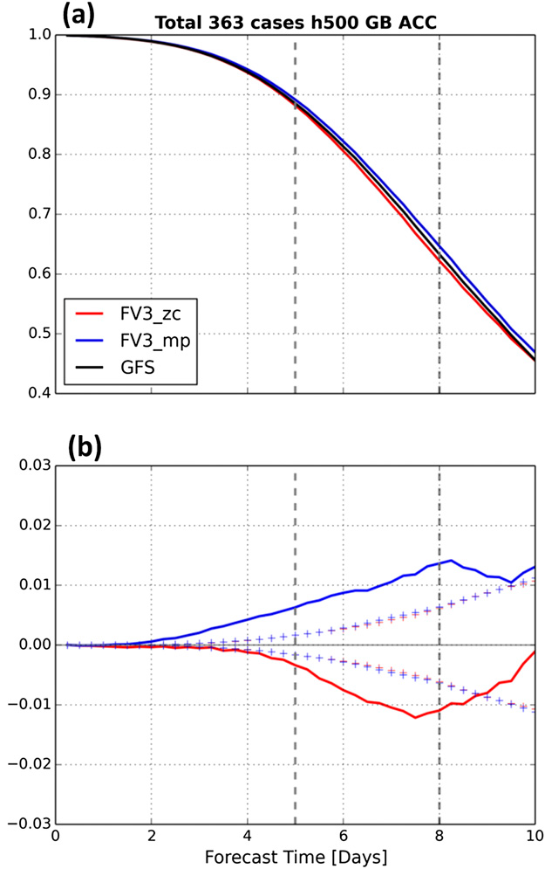
global anomaly correlation coefficients (ACC)
of 500-hPa height
(based on the NCEP analysis data)
Black lines: GFS
red lines: FV3_zc
Blue lines: FV3_mp
‘‘+++’’: 95% confidence intervals
Notes:
FV3_zc: shows a slightly degraded forecast skill

Slide 5
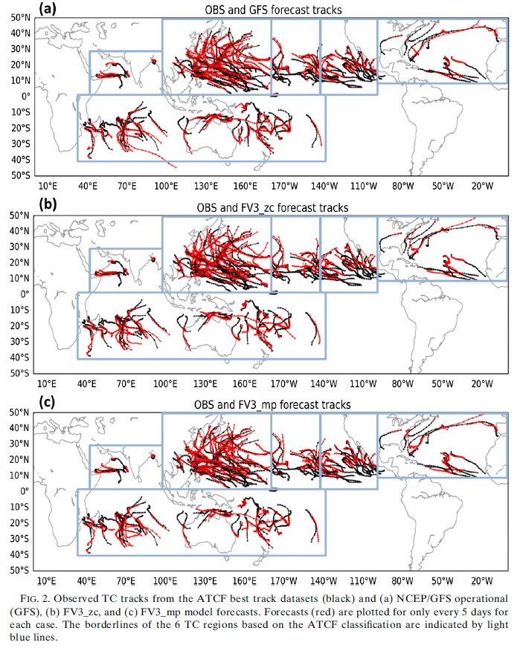
Track forecasts
Best track data:
Automated Tropical Cyclone Forecast (ATCF) dataset
The GFDL simple tracker (Harris et al. 2016) was
adopted for tracking TCs in the forecasts.
the model forecasts were initialized at or after the observed TC genesis time.
The GFS and both versions of the fvGFS demonstrate reasonable TC forecast tracks.
Notes:
105 TCs observed during the period of 16 January 2015 to 16 January 2016
six active TC basins based on the classifications of the Automated Tropical Cyclone Forecast (ATCF) dataset
results of TC forecast performance discussed in this section only
consider the model forecasts that were initialized at or after the observed TC genesis time.
Figure 2 shows best tracks of the 105 observed TCs

Slide 6
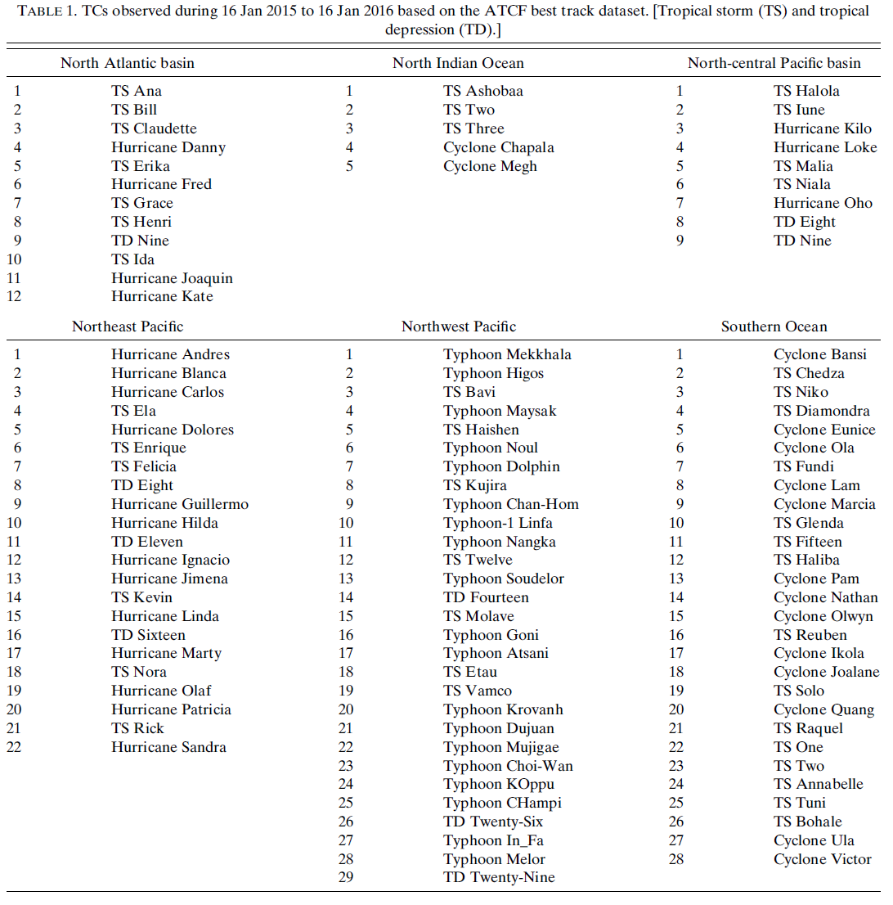

Slide 7
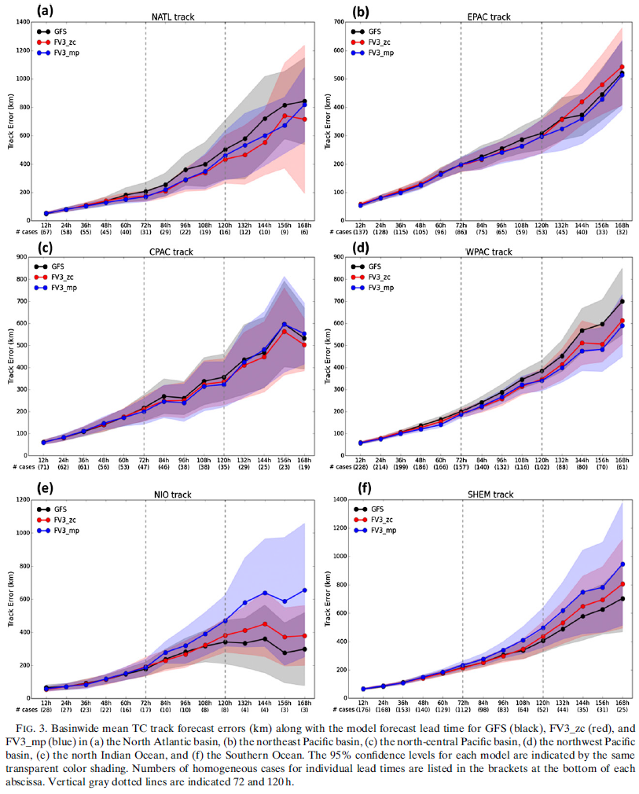
TC track
northeast Pacific
North Atlantic Ocean
north-central Pacific
northwest Pacific
north Indian Ocean
Southern Ocean
Notes:
A: In the North Atlantic Ocean (Fig. 3a), the GFS and the two fvGFS configurations show similar track errors in the first 48 h.
both FV3_zc and FV3_mp show improved track forecasts compared to the GFS after the 60-h lead time.
D: the TC track forecast errors of the two fvGFS forecasts are smaller than those of GFS after 48-h model lead time (Fig. 3d)
B,C: In the other two North Pacific basins, the track forecast errors of GFS and fvGFS are relatively close
E,F: The GFS shows better TC track forecasts than fvGFS runs in these two regions (Figs. 3e,f).
FV3_zc generally showed smaller TC track errors than FV3_mp in the north Indian Ocean and in the Southern Ocean (Figs. 3e,f).
Based on the 95% confidence levels shown in Fig. 3, none of the forecast shows statistically significantly better or worse results in any of the regions.

Slide 8
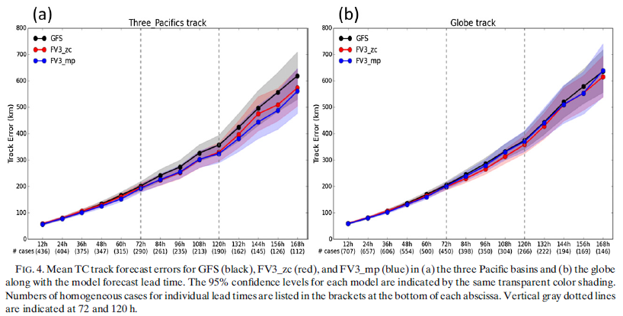
the impact to the TC track forecast from updating the FV3 dynamical core in the GFS is positive
Notes:
A:The improvements of FV3_mp compared to FV3_zc are apparent after the 120-h lead time.
B: The GFS produced slightly larger errors than the forecasts from the two fvGFS versions up to the 168-h lead time.
FV3_zc performed slightly better than FV3_mp after the 84-h lead time.
This indicates that the impact to the TC track forecast from updating the FV3 dynamical core in the GFS is positive. However, the updated version
of fvGFS with the GFDL microphysics scheme produced slightly degraded the performance of TC track forecasts.

Slide 9
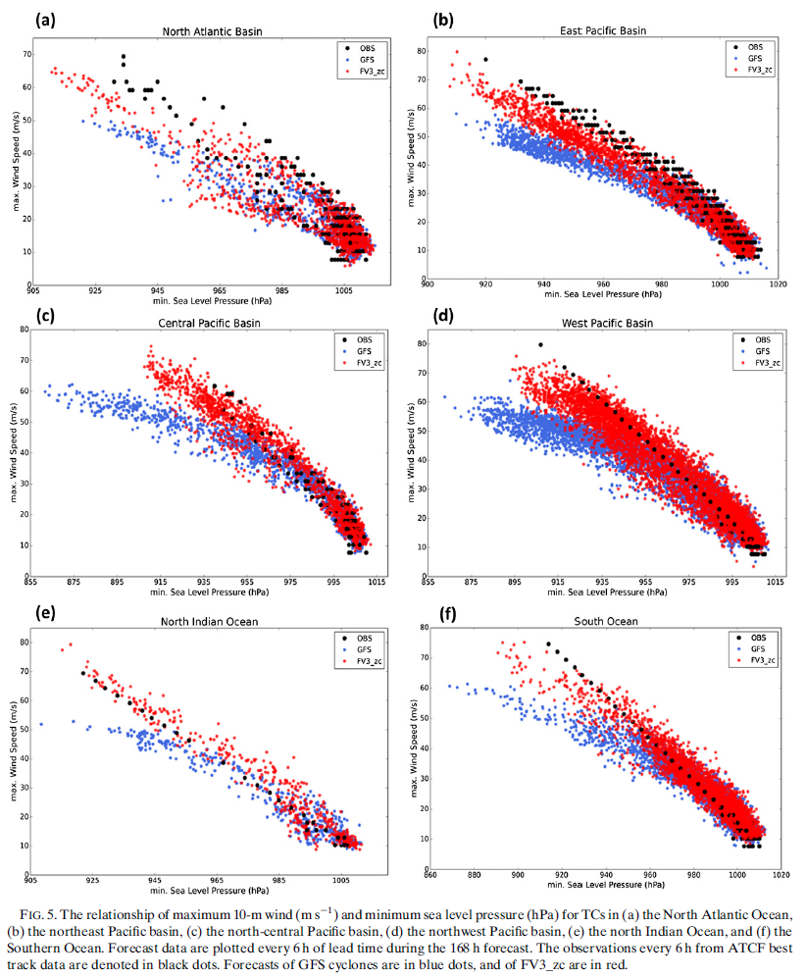
Intensity forecasts
FV3_zc:
a better relationship between SLP and maximum 10-m wind speed
overprediction of central pressure but underprediction of 10-m winds
more intense hurricanes/typhoons (with maximum wind speed over 60 m/s)
max. 10-m wind speed (m/s)
min. sea level pressure (hPa)
Notes:
For intense cyclones with observed intensities exceeding 40m/s, there is clearly a much better relationship between SLP and maximum 10-m wind speed for FV3_zc than for the GFS.
FV3_zc same physics package as the GFS. Horizontal resolution of two model are very close.
advanced dynamical core is contributing to improve pressure–wind relationship for TC
more intense hurricanes/typhoons (with maximum wind speed over 60ms21) in FV3_zc than observed in the northeast and north-central Pacific basins (Figs. 5b,c).
A: In the North Atlantic, the wind speeds of FV3_zc are slightly weaker than observed, despite the fact that the number of cyclones with minimum SLPs in the deepest range (<930 hPa) are overpredicted
B: This overprediction of central pressure but underprediction of 10-m winds is also found in the northeast Pacific basin
as well as in the northwest Pacific basin and the Southern Ocean(D,F)

Slide 10
the large number of overpredicted storm intensity values shown in FV3_zc is greatly reduced in FV3_mp in the north-central Pacific basin.
wind–pressure relationship of FV3_mp is also better matched to the observation
Notes:
Comparing Fig. 5c to Fig. 6c, we can see that the large number of overpredicted storm intensity values shown in FV3_zc is greatly reduced in FV3_mp in the north-central Pacific basin.
The wind–pressure relationship of FV3_mp is also better matched to the observation in Fig. 6c.

Slide 11
FV3_mp:
the large number of overpredicted storm intensity values is reduced
wind–pressure relationship is also better matched to the observation
Notes:
in the northeast Pacific, the northwest Pacific and the north Indian Ocean, the number of most intense storms in FV3_mp are
fewer compared to the observations (Figs. 6b,d,e).
Nonetheless, the wind–pressure relationships in these areas are still quite close to the observations.

Slide 12
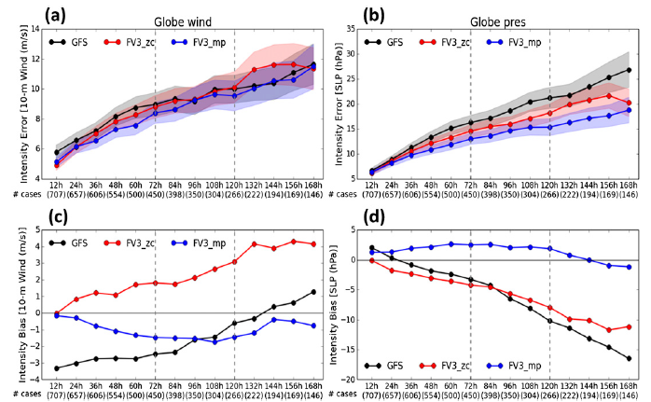
the main benefit of replacing the Zhao–Carr scheme with the GFDL microphysics scheme is the improvement in intensity prediction rather than track prediction.
Notes:
A:the differences in the absolute error of maximum 10-m wind among the three sets of forecasts are not significant.
C: the GFS underpredicted TC intensities through 132h
FV3_zc overpredicted intensities
FV3_mp shows very small negative intensity biases compared to FV3_zc.
D: FV3_mp shows the best intensity forecast performance of the three models and only a slight SLP bias during the 7-day forecasts
while both GFS and FV3_zc show a positive intensity bias with an increasing trend toward deeper pressures with increasing lead time.

Slide 13
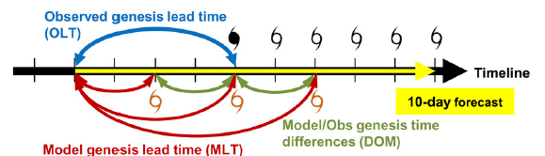
TC genesis forecasts in fvGFS
OLT: the difference in time between the forecast initial time and the time at which observed genesis occurs.
MLT: the time span from the model initial time to the model-predicted genesis lead time.
DMO: The differences between the MLT and OLT
The observed TC genesis times are based on the first tropical depression (TD) record in the ATCF best track data.
hit event:
the maximum time difference of model genesis and observed genesis is set to 72 h. (DOM)
The distance of model and observed storms needs to be within a 5。 by 5。 box centered at the observed storm at their first matched time.
false alarm: Model genesis storms which do not have tracks that match to observed TCs
total genesis events: hit events + false alarms
Notes:
TC生成時間點是根據ATCF best track data 第一個有td紀錄的時間
這邊只挑選tc生成之前的初始場模擬結果，且10 天的模擬須包含到tc生成的時間

Slide 14
Both FV3_zc and FV3_mp show more hit events and higher hit ratios than GFS over the globe
The FV3_mp shows the highest hit ratio in the five regions but not in the north-central Pacific basin, where the GFS performs the best.
Lines: hit events
Bars: ratios of model hits to total observed genesis events
Notes:
B: large differences of false alarms between the GFS and fvGFS are shown in the northeast Pacific basin

Slide 15
GFS forecasts show more false alarms in east Pacific basin than forecasts from the two fvGFS versions.
hit ratio of FV3_mp is 2 times larger than that of GFS, which can be explained by the false alarm results.

Slide 16
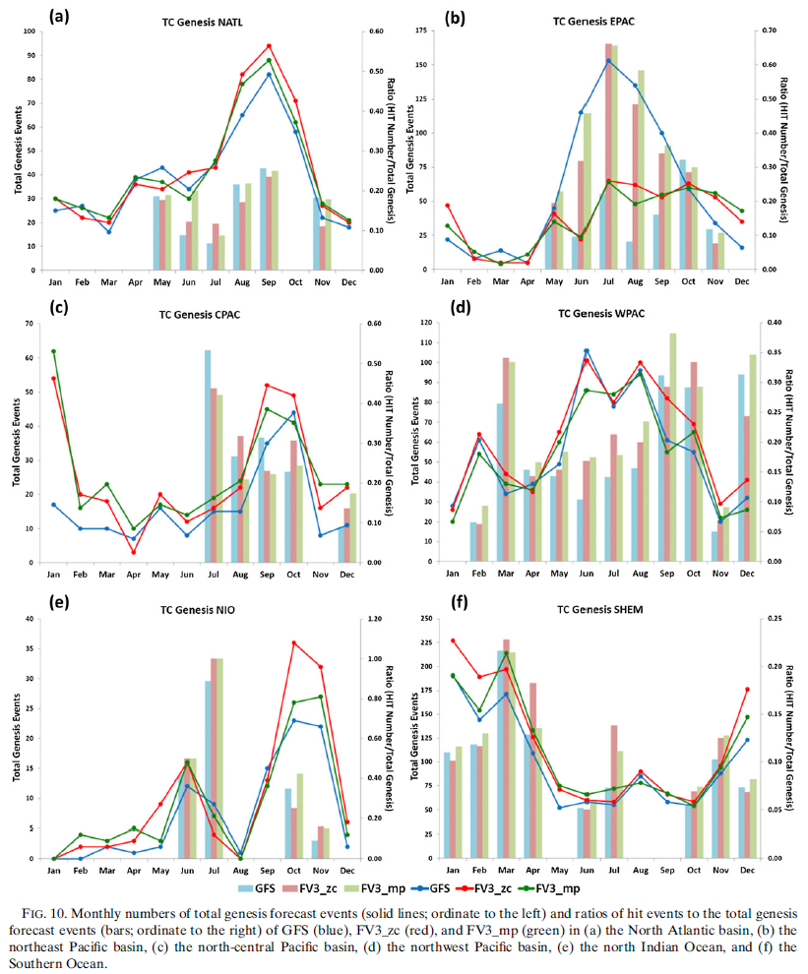
Lines: monthly numbers of total genesis events
Bars: ratios of hit events to total genesis events
Notes:
EPAC: FV3表現較好，因颱風季期間，GFS總TC生成個數過多，false alarm較多使得hit ratio明顯較FV3低
CPAC: FV3 在非颱風季期間有較多的false alarm個案，因此hit ratio較GFS低

Slide 17
the numbers of observed TCs and numbers of missed TCs for the genesis forecasts
Both fvGFS forecasts showed improvement in the three North Pacific basins, but missed 1 TC genesis in the North Atlantic basin.
Notes:
Table 2 lists the numbers of observed TCs and numbers of missed TCs for the genesis forecasts
Both fvGFS forecasts showed improvement in the three North Pacific basins, but missed 1 TC genesis in the North Atlantic basin.

Slide 18
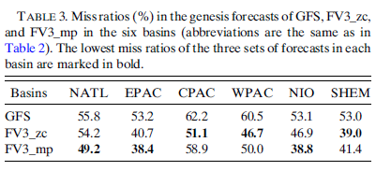
miss ratio: the ratio of number of missing cases to the number of expected genesis observations
The GFS shows the highest miss ratio in all basins
Notes:
The GFS shows the highest miss ratio in all basins
The FV3_zc produced lower miss ratios compared to the GFS and FV3_mp in the north-central Pacific basin, the northwest Pacific basin, and the Southern Ocean.
The FV3_mp shows the lowest miss ratio among the three sets of forecasts in the other three basins.

Slide 19
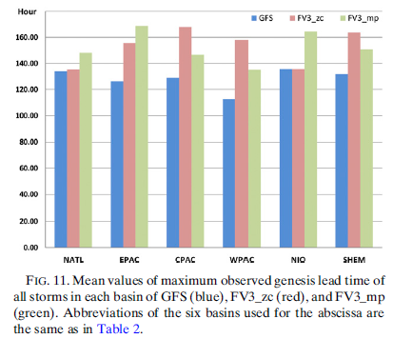
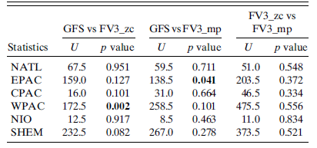
mean values of the maximum OLT of all observed TCs
If a model shows longer OLT, that means it can correctly predict TC genesis earlier than other models.
The Mann–Whitney U test is applied to test the significance between the OLTs from any of the two forecasts
statistically significant (p value < 0.05,two tailed)
Notes:
In other basins, both fvGFS forecasts also show longer OLTs than GFS
The longest OLTs (168 h) are achieved by FV3_mp in the northeast Pacific basin and by FV3_zc in the north-central Pacific basin.

Slide 20
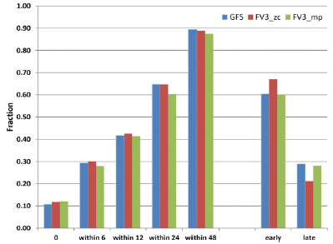
the fractions of global total hit events occurring within a certain DMO length for each model forecast
DMO = MLT - OLT

Slide 21
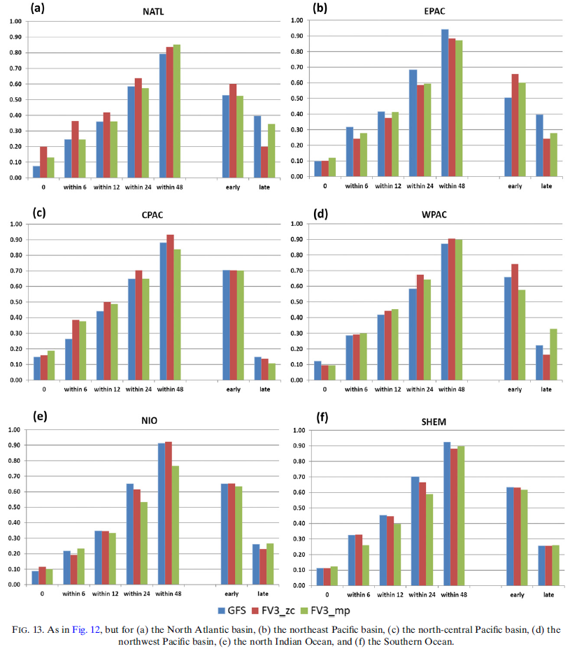
The fractions of hit events within different DMO lengths
the model predicted genesis events often occur during the precursor stage of the observed TC.
Notes:
A,C : In the North Atlantic and the north-central Pacific basins,
FV3_zc shows the highest fractions, except for hit events
within 48-h DMO in the North Atlantic and for those
within 0-h DMO in the north-central Pacific basin
In the northeast Pacific and Southern
Ocean, the GFS generally shows the highest fractions
among the three (Figs. 13b,f).
The FV3_mp shows generally
higher fractions than the GFS and FV3_zc in the
northwest Pacific basin (Fig. 13d).
However, in the north
Indian Ocean, FV3_mp shows lowest fractions for the
12-, 24- and 48-h DMOs compared to GFS and FV3_zc.
Meanwhile, the differences between GFS and FV3_zc
are relatively small in this basin (Fig. 13e).
All three sets of forecasts show more hit events occurring
before the observed TC genesis time rather than
after in all six basins. This is related to the choice of the
‘‘observed TC genesis time,’’

Slide 22
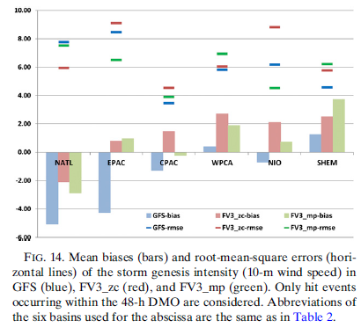
verification of strom genesis intensity
Notes:
All three sets of forecasts under predict their storm genesis intensities in the North Atlantic basin (Fig. 14). the two sets of fvGFS forecasts show smaller negative biases and smaller RMSEs compared to the GFS in this basin.
A similar underprediction of storm genesis intensities in the GFS forecasts is also apparent in the northeast Pacific, the north-central Pacific basins, and the north Indian Ocean.
In the northeast Pacific basin, the large negative bias shown in the GFS forecasts is greatly improved in the FV3_zc and FV3_mp forecasts, while the FV3_mp also shows the smallest RMSEs among the three sets of forecasts.
The GFS predicts the best storm genesis intensities in the northwest Pacific basin and in the Southern Ocean, with smallest biases and RMSEs among the three sets of forecasts.
Generally, the two fvGFS versions show larger positive bias than the GFS globally.
The overpredictions of TC genesis intensities also cause the relatively large RMSEs in the fvGFS forecasts.

Slide 23
Summary
TC track is better in both versions of fvGFS over the North Atlantic basin and the northwest Pacific Ocean.
TC intensity:
an advanced dynamical core is contributing to the reduction in TC intensity errors
FV3_zc overpredicts the intensities for strong storms
FV3_mp shows much smaller globally averaged intensity biases and absolute errors
TC genesis:
FV3_mp displays the best performance of the three set of forecasts in hit events, false alarms, and missing cases followed by FV3_zc.
Notes:
This demonstrates that simply using
the up-to-date dynamical core but keeping the
original physics package the same, the prediction of TC
genesis in the model can be improved. Moreover, the
upgraded cloud microphysics scheme can further improve
the model TC genesis performance with the
updated dynamical core.

Slide 24
Lead time lengths of hit events:
FV3_mp shows significantly longer OLT than the GFS in the northeast Pacific basin
FV3_zc shows significantly longer OLT than the GFS in the northwest Pacific basin
TC genesis intensity:
the two fvGFS versions show larger positive biases than the GFS
updating the GFS dynamical core to the nonhydrostatic FV3 can largely improve TC intensity forecasts.
The additional improvements in TC intensity and genesis forecasts when replacing the Zhao–Carr cloud microphysics scheme with the advanced GFDL cloud microphysics scheme.
The advection scheme used in the dynamical core has a large impact on TC intensity.

