Slide 1
Assessing the Influence of Convective Downdrafts and Surface Enthalpy Fluxes on Tropical Cyclone Intensity Change in Moderate Vertical Wind Shear
Nguyen L. T., R. Rogers, J. Zawislak, J. A. Zhang

Slide 2
Introduction
Shear can have a deleterious impact on TCs through a number of possible mechanisms, including:
(1) The tilting of the vortex away from vertical alignment and subsequent lack of realignment.
(Jones 1995)
(2) Intrusion of low entropy air into the vortex in the midtroposphere.
(Simpson and Riehl 1958; Cram et al. 2007; Tang and Emanuel 2010)
(3) The intrusion of low entropy air into the boundary layer via downdrafts.
(Riemer et al. 2010, 2013; Tang and Emanuel 2010; Molinari et al. 2013; Riemer and Laliberté 2015)
(4) The outward fluxes of potential vorticity and equivalent potential temperature in the upper troposphere.
(Frank and Ritchie 2001)

Slide 3
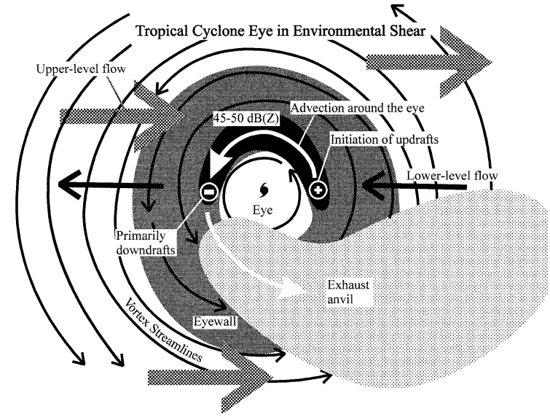
Introduction
A climatological study of storms in moderate shear by Rios-Berrios and Torn (2017) showed that intensifying storms had more midtropospheric moisture than steady-state storms, particularly on the upshear side. Humidification of the upshear quadrants can limit dry air entrainment into developing updrafts, allowing them to grow and persist as they propagate azimuthally around the TC center. The recovery of downdraft modified boundary layer air through surface enthalpy fluxes from the ocean can also help a TC become resistant to shear.
upshear
downshear
(Black et al. 2002)

Slide 4
Data and Methods
DSL
DSR
Shear: SHIPS (computed from CFSR (before 2000) and GFS (after 2000))
R < 500 km, 200 - 850 mb
SST: GHRSST (0.25 degree)
Dropsondes (vertical profile of P, T, qv, U/V) from 1996-2017
USL
USR
Notes:
相對TC坐標，分象限

Slide 5
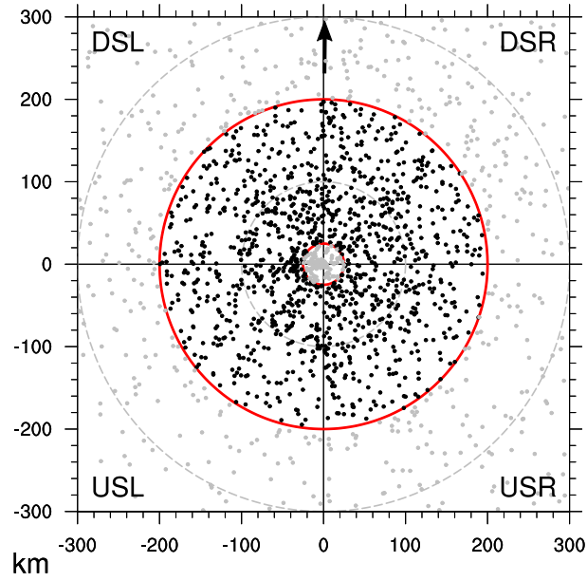
Data and Methods
Criteria
The dropsonde had to be located within a TC that had an
intensity <= 80 kt (41.2 m/s) (TD, TS, and category 1 hurricanes).
(2) The TC also had to be experiencing 4.5–11.0 m/s of
environmental vertical wind shear, defined as the 25th and 75th
percentile of shear experienced by TCs globally.
(3) To remove cases occurring over relatively cold water, such as subtropical cyclones and TCs undergoing extratropical transition, only dropsondes collocated with an SST of at least 25ºC were used.
(4) Dropsondes within TCs that made landfall within the subsequent 24-h time period were eliminated.
(5) Only dropsondes located within 25–200 km of the TC center were used.
(6) Dropsondes that exhibited a 0–1-km-averaged TC-relative wind speed of weaker than 10 m/s and were located within 75 km of the TC center were discarded from the study.

Slide 6
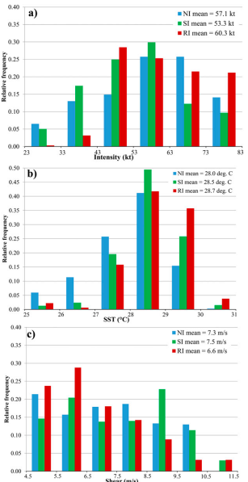
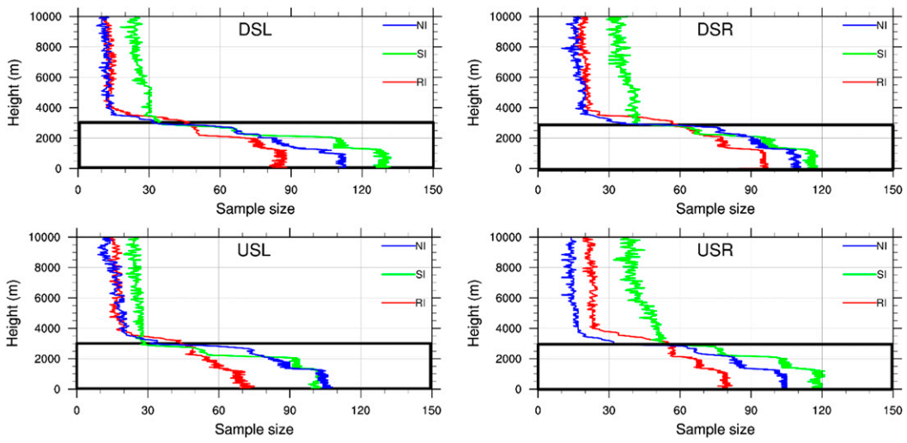
Data and Methods
intensity
RI: dV_{0-24h} >= +20 kt
SI: +5 kt <= dV_{0-24h} <= +15 kt
NI: dV_{0-24h} <= 0 kt
SST
Shear
Notes:
RI的intensity分佈靠強度高的右側
RI的SST比NI多0.7，RI偏向高溫
RI的個案偏向風切弱的一側

Slide 7
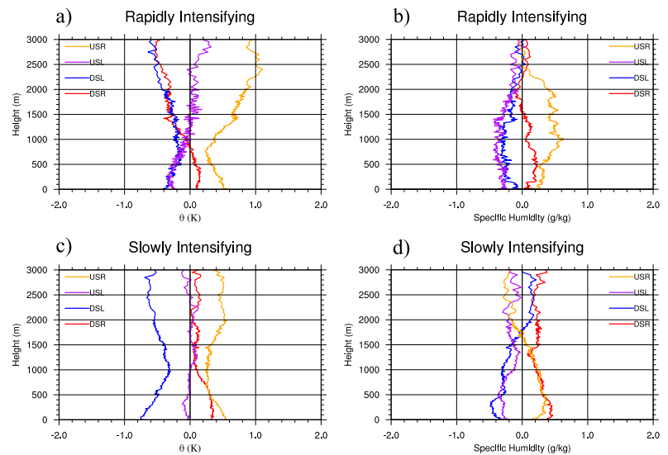
Lower tropospheric moisture and temperature
θe, θes
θ
qv
RI
SI
θes min
DSL
DSR
θes max
θe min
θe max
USL
USR
Notes:
RI，1公里以下，上風切右側THe max
1公里以下，上風切左側THe min
1公里以下，風切右側THes 大於風切左側
1公里以下，qv和TH都是上風切右側大於上風切左側
1公里以上，THe差異小
SI，1公里以下，THe和THes風切右側>風切左側

Slide 8
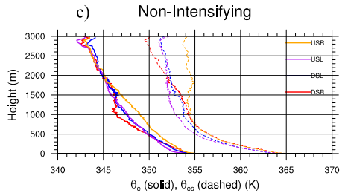
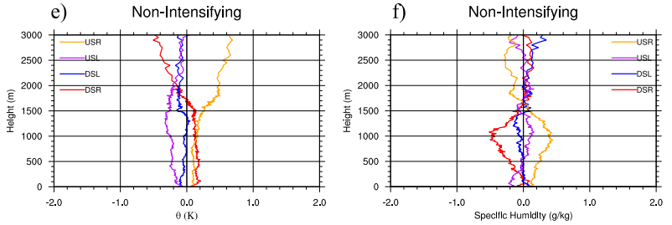
Lower tropospheric moisture and temperature
θe, θes
θ
qv
NI
Notes:
NI，THe降低，不同象限的差異小，USR還是最大的
不同象限差異小是因為Fh降低和Fp降低，使得低層THe和THes沒有復原

Slide 9
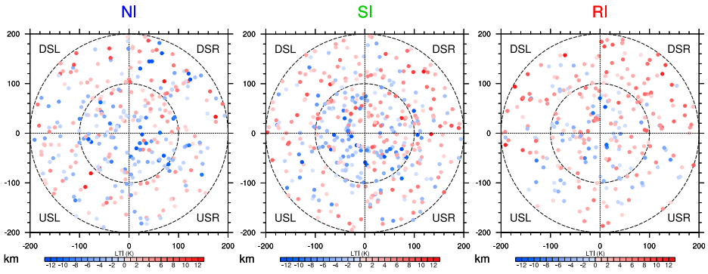
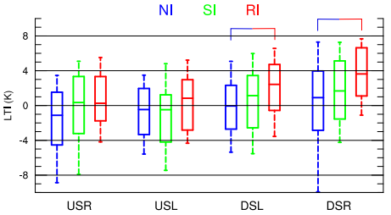
Lower tropospheric conditional stability
LTI = θ_{e,0-500m} – θ_{es,2km}
Notes:
LTI正值正浮力，條件不穩定，LTI負值負浮力，條件穩定
DSR正浮力比例大於USL，RI組有更多LTI正值的取樣
DSR是最不穩定的象限，USR和USL是最穩定的
USR變穩定是因為邊界層上Thes較暖
DSL較不穩定是因為邊界層上的空氣因為下風切處對流上升氣流的絕熱冷卻
DSR和DSL 不穩定度RI>SI>NI

Slide 10
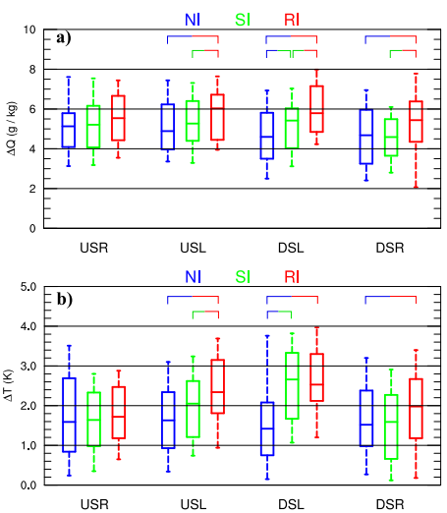
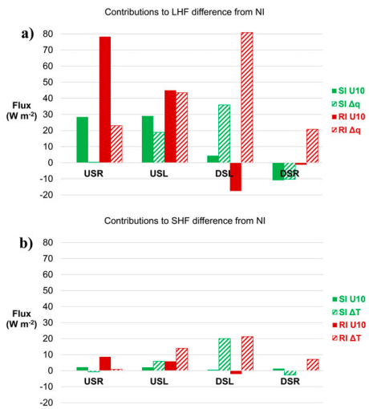
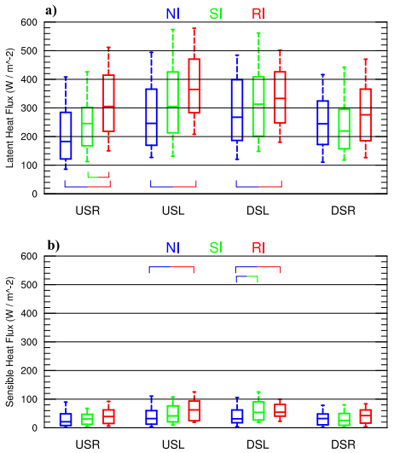
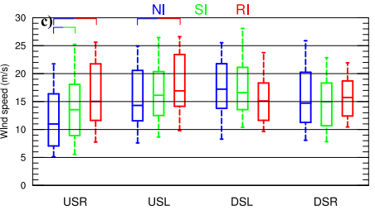
Surface enthalpy fluxes
DSL
DSR
θe min
θe max
USL
USR
Notes:
dq約3-7g/kg，dT約1-3K
8a.風切左側RI和NI的dq差1g/kg，風切右側差0.5-0.7g/kg
8b.風切左側RISI和NI的dT差0.75-1.25K，風切右側dT差0.5K以下
8c.上風切處dU差3-4m/s，下風切處較小且沒有統計顯著
Fq>Fh，風切左側>風切右側，RI有較大的surface flux
U10/dq/dT誰貢獻多，以NI為基準，看SI/RI
下風切由dq/dT貢獻多，U10少
DSL的dT多可能是SST較大或downdraft使大氣cooling/drying
USR的U10貢獻較多

Slide 11
Summary
Surface enthalpy fluxes play an important role in restoring moisture and heat to the boundary layer within sheared TCs.
The magnitude of surface latent and sensible heat fluxes in the upshear quadrants grew significantly larger with increasing intensification. The enhanced fluxes upshear were attributed mostly to stronger near-surface winds, with a smaller contribution from the larger air–sea contrast in specific humidity and temperature.
The lower-tropospheric conditional instability in the downshear quadrants was significantly larger in RI storms compared to NI storms.
Enhanced surface fluxes on the upshear side of RI storms enabled downdraft-modified boundary layer air to moisten and warm more quickly as it traveled cyclonically around the storm, so that by the time this air reached the downshear quadrants, its moist entropy became larger than it otherwise would have been.

