Slide 1
Jouan C., and J. A. Milbrandt

Slide 2
Case Overview
Midlatitude Continental Convective Clouds Experiment (MC3E)
Date: 20 May 2011
KS
OK
AR
TX
Marinescu et al. (2016)
ARM-SGP (Southern Great Plain site of the US Department of Energy’s Atmospheric Radiation Measurement program)
N_{act} = 600-2000 cm⁻³ with some peaks at 4000 cm⁻³ (supersaturation 0.85% - 1.08%)

Slide 3
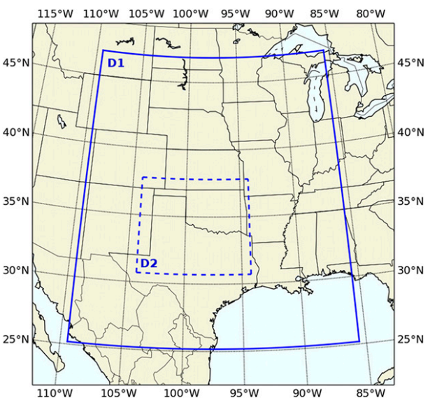
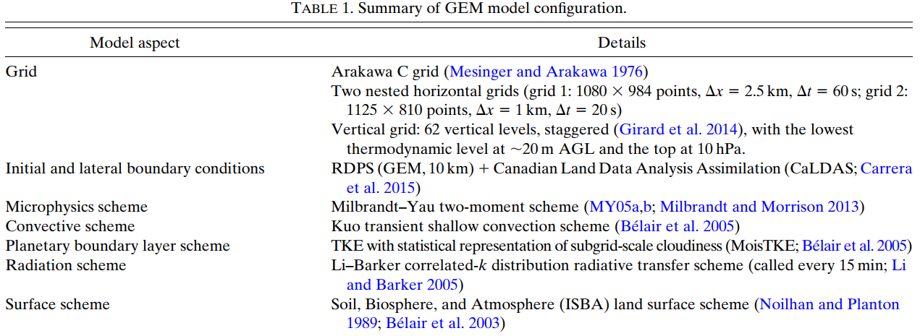
Model Configuration
Global Environmental Multiscale model (GEM)
00Z 20 May 2011-18Z 20 May 2011

Slide 4
Experiments
N_{CCN} (continental) = 842 cm⁻³
N_{CCN} (maritime) = 66.6 cm⁻³
N_{CCN} → N_{act}

Slide 5
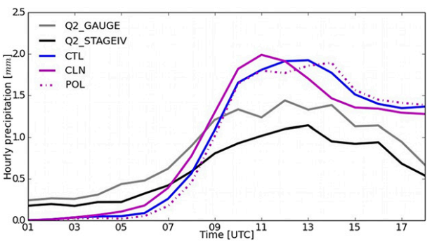
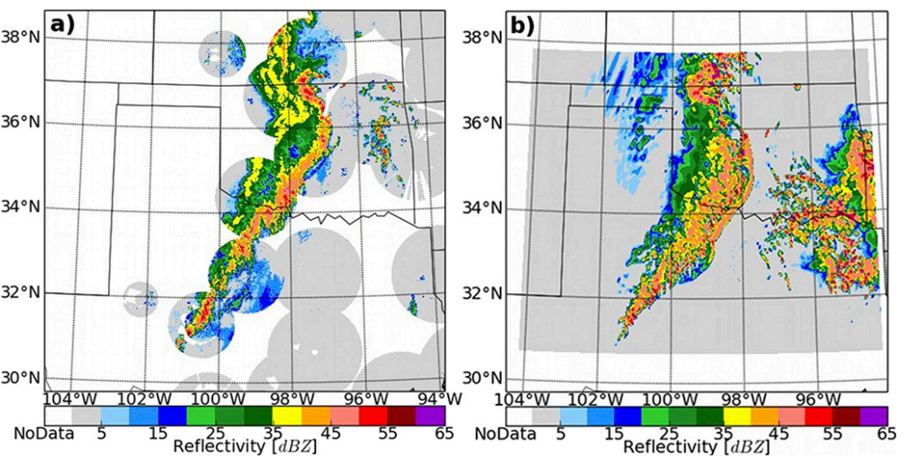
Overview of CTL simulation
1100 UTC 20 May 2011 (mature stage)
NSSL 3D mosaic NEXRAD
CTL
Q2_GAUGE
NEXRAD QPE product + rain gauge adjustment
dx = 1-km, dt = 1-hr
Q2_STAGEIV
Radar + rain gauge data
dx = 4-km, dt = 1-hr

Slide 6
Sensitivity of ice-phase processes to CCN concentrations
N_{CCN} (continental) = 842 cm⁻³
N_{CCN} (maritime) = 66.6 cm⁻³
N_{CCN} → N_{act}

Slide 7
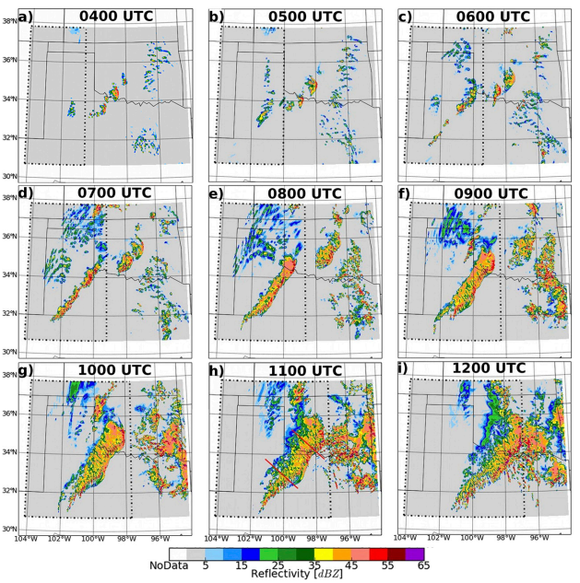
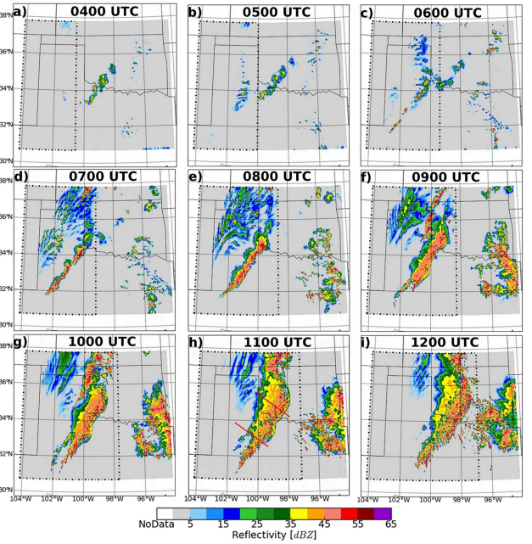
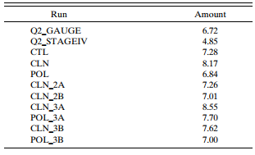
Reflectivity structure and precipitation
CLN
POL
Notes:
08Z開始回波出現差異，POL回波強
CLN比POL早1小時開始下雨，高CCN會延遲降水，可能因為暖雨過程延遲
06-12Z累積雨量 CLN/POL=1.39倍

Slide 8
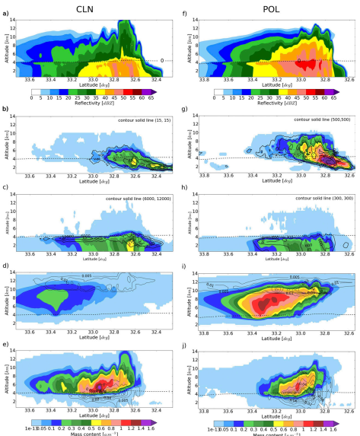
Vertical distribution of
hydrometeors characteristic
Contour: N_{c}
Color: q_{c}
Contour: N_{r}
Color: q_{r}
Contour: q_{i}
Color: q_{s}
Contour: q_{h}
Color: q_{g}
Notes:
CCN增加對流區qc增加
CCN增加對流區qr減少，層狀區qr增加
CCN增加qi/qs/qh增加，qg減少
CLN的qg分布較POL廣
POL的qg極值和總量下降且位置往下移，表示POL中qg長的較大，有較大的落速，並限制qg水平傳輸至層狀區，同時增加qh

Slide 9
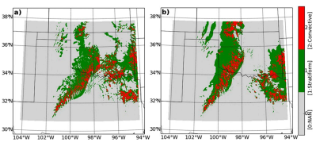
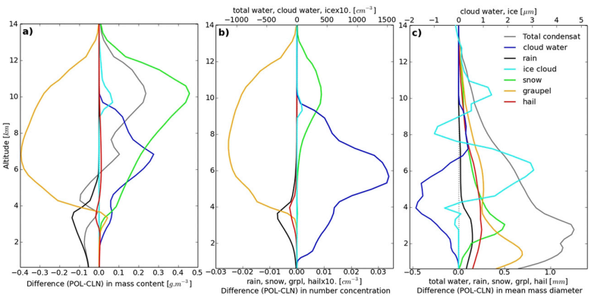
Microphysical budget study
CLN
POL
W (POL-CLN) N (POL-CLN) D (POL-CLN)
Notes:
CCN增加→凝結增加(CLN 78.12% vs POL 85.83%)
CLN qg凝固比16.99%，POL qs凝固比8.22%
CCN增加Ns和Ds增加，是因為CCN增加使得Dc降低(9c)，accretion和autoconversion降低，減少暖雨過程。
其中autoconversion和Dc大於15微米的雲滴有關。
因此CCN增加→雲滴粒徑降低→autoconversion無法轉換成雨滴→暖雨過程被抑制→空中/系統中有更多qc→傳到高層增加qi/qs/Ni/Di/Ns/Ds

Slide 10
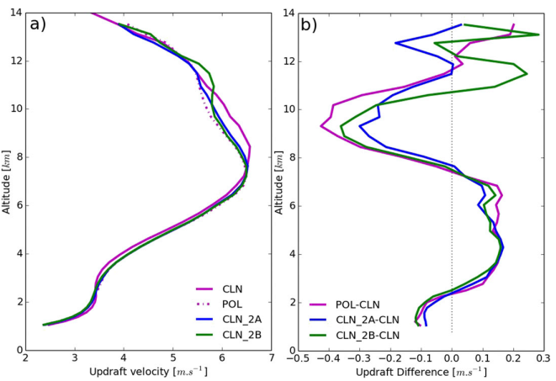
Microphysical budget study
 | CLN | POL
CLcg (riming) | 23.82% | 19.81%
w w (POL-CLN)
W (POL-CLN) N (POL-CLN) D (POL-CLN)
Notes:
前面提到qg在POL比較少，首先CCN增加，水氣凝固成qg下降(CLN=16.99%/POL=2.63%)
因為暖雨過程被抑制，雨滴和軟雹間碰撞結凍下降使qg減少，另外riming rate在POL也較低(少20%)，可能與雲滴和軟雹間的碰撞效率有關
SCE的計算和Ecg/Dc有關，但SCE是非線性，作者解釋若固定Ecg則POL有更多雲滴可以被收集，但收集效率在POL是降低的，表示Dc的影響較大。
POL在2.5-7.5km間，w增加，因暖雨過程減少，更多雲滴結冰潛熱釋放。但整體而言CCN對於垂直速度的影響較小。

Slide 11
Sensitivity of ice-phase processes to CCN concentrations
N_{CCN} (continental) = 842 cm⁻³
N_{CCN} (maritime) = 66.6 cm⁻³
N_{CCN} → N_{act}
(1) Cloud water autoconversion
(2) Graupel collection efficiency

Slide 12
Cloud Water
Autoconversion
Contour: N_{c}
Color: q_{c}
Contour: N_{r}
Color: q_{r}
Contour: q_{i}
Color: q_{s}
Contour: q_{h}
Color: q_{g}
Notes:
CLN_2A的降水粒子垂直結構較接近POL，qc/qi/qs較CLN提升
與POL相比，qr在層狀區增加，對流區減少。

Slide 13
 | CLN_2A | CLN | POL
CLcg | 28.05 | 23.83 | 19.81
CLgr | 7.69 | 16.68 | 5.49
CLgrg | 8.86 | 19.09 | 6.92
Notes:
軟雹收集雲滴增加，軟雹收集雨滴及軟雹和雨滴間碰撞結凍皆讓CLN_2A的結果從CLN靠近POL
表示autoconversion降低在CCN增加時是重要的過程

Slide 14
Graupel Collection
Efficiency
Contour: N_{c}
Color: q_{c}
Contour: N_{r}
Color: q_{r}
Contour: q_{i}
Color: q_{s}
Contour: q_{h}
Color: q_{g}
Notes:
2A和2B實驗中qc是相似的，因為兩者皆關閉autoconversion
因為2B的Dc較2A小，所以2B的Ecg較小，使得雲滴沒有被qg收集反而被qs收集
使得qg和qr比2A小，整個結果更接近POL

Slide 15
Sensitivity of the parameterization of graupel to CCN (I)
N_{CCN} (continental) = 842 cm⁻³
N_{CCN} (maritime) = 66.6 cm⁻³
ρ_{g}=400 kg/m³
N_{CCN} → N_{act}
Notes:
原先的參數化方案中軟雹密度為定值400，落速粒徑關係式也就為固定的參數。
新的方案軟雹密度調整也會使軟雹落速調整

Slide 16
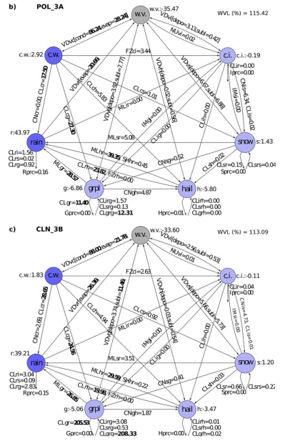
Contour: N_{c}
Color: q_{c}
Contour: N_{r}
Color: q_{r}
Contour: q_{i}
Color: q_{s}
Contour: q_{h}
Color: q_{g}
Notes:
CLN和CLN_3A結果差不多，CLN_3A的qg較少
POL和POL_3A的冰相則有明顯差異，qi/qs/qg皆變少
從微物理收支來看，autoconversion被抑制，雲滴收集率下降，使雲滴結冰形成雲冰並形成雪花。(和POL一樣)
軟雹密度調整後，軟雹密度變大，軟雹收集雲滴提升(19.81→27.3)
雖然將密度調整為預報變數，得到更真實的軟雹落速，但對於高CCN和低CCN的反應是不一致的

Slide 17
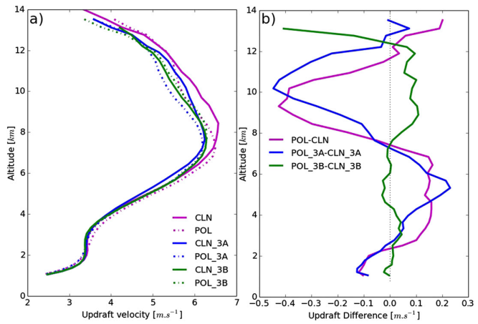
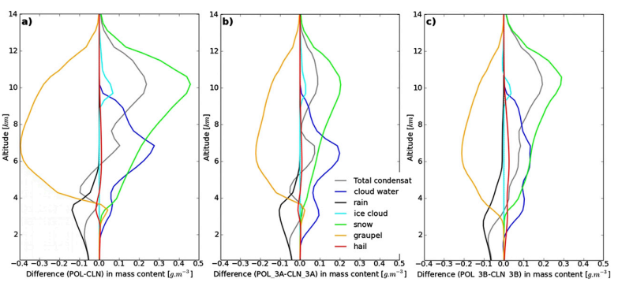
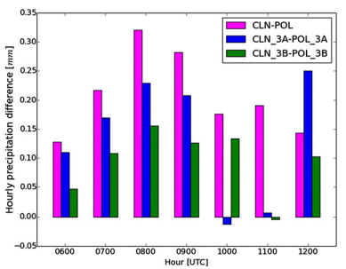
w w (POL_3A-CLN_3A)
W (POL-CLN) W (POL_3A-CLN_3A) W (POL_3B-CLN_3B)
Notes:
預報軟雹密度對CCN濃度的變化較不明顯，固定軟雹密度對於CCN濃度變化較明顯
預報軟雹密度和固定軟雹密度對垂直速度改變不大。降水方面，CCN減少，降水增加

Slide 18
Sensitivity of the parameterization of graupel to CCN (II)
N_{CCN} (continental) = 842 cm⁻³
N_{CCN} (maritime) = 66.6 cm⁻³
One moment
Fixed intercept parameter 4x10⁶ m⁻⁴
N_{CCN} → N_{act}

Slide 19
Contour: N_{c}
Color: q_{c}
Contour: N_{r}
Color: q_{r}
Contour: q_{i}
Color: q_{s}
Contour: q_{h}
Color: q_{g}
Notes:
POL和POL_3B接近，CLN和CLN_3B的冰相過程有明顯的差異。
作者認為SM的落速只靠qg決定，而不是DM中，中層Dm大落速大，高層Dm小落速小。
微物理收支中，CCN增加，FZci(雲滴結冰晶)和CNis(雪收集冰)提升

Slide 20
W (POL-CLN) W (POL_3A-CLN_3A) W (POL_3B-CLN_3B)
Notes:
SM對於CCN較不敏感，雨量上的差異也較小
若要將CCN的效應合理的模擬出來，冰相的參數化要盡量接近真實，尤其是riming。

Slide 21
Conclusions
The impacts of autoconversion with increasing N_{act} in POL explains a large part of the differences between CLN and POL.
If the ice-phase processes in the microphysics scheme being used are not parameterized with the correct dependency on cloud droplet size and number, the simulated responses to aerosols will not be completely correct, regardless of the complexity and accuracy of aerosol and liquid-phase components of the scheme.
The mean droplet size affects graupel growth directly through the collection efficiency between graupel and droplets.
It was also shown that whether the graupel category is one moment or two moment also has a notable impact on the response to CCN. Thus, changes to the level of detail in the parameterized ice microphysics, in particular for graupel, have a significant impact on the responses to changes in CCN concentrations for a simulated deep convective system

