Slide 1
Mesoscale Processes during the Genesis of Hurricane Karl (2010)
Bell, M. M., and M. T. Montgomery, 2019: Mesoscale processes during the genesis of Hurricane Karl (2010). J. Atmos. Sci., 76, 2235–2255.

Slide 2
In late summer 2010 the Pre-Depression Investigation of Cloud Systems in the Tropics (PREDICT) field campaign was conducted to improve our understanding of how tropical waves transition into tropical cyclones and test the principal hypothesis that tropical storm formation is greatly favored in the critical-layer region of the synoptic-scale predepression disturbance. (Montgomery et al. 2012)
Developers had higher equivalent potential temperature in the low to mid-troposphere due to both warmer and moister air, while nondevelopers had high convective available potential energy (CAPE) relative to the developers due to cooler and drier air at midlevels. (Smith and Montgomery, 2012)
Numerical simulations and large-scale analyses by Montgomery et al. (2010), Wang et al. (2010a, 2012), Wang (2012), and others have now provided abundant evidence that a deep, moist pouch is a necessary condition for the development of a tropical disturbance in the Atlantic basin, but the specific role of the midlevel and low-level circulations, enhanced temperature and moisture at midlevels, and the relative importance of deep, congestus, and stratiform convection in the development process are still under debate.
A key cloud-scale process identified by numerical studies (Hendricks et al. 2004; Montgomery et al. 2006; Nguyen et al. 2008; Zhang et al. 2011) is that low-level convergence driven by deep convection in a rotating environment amplifies preexisting vertical vorticity locally by vortex tube stretching, and that the amplified vorticity outlives the deep convection that produced it.

Slide 3
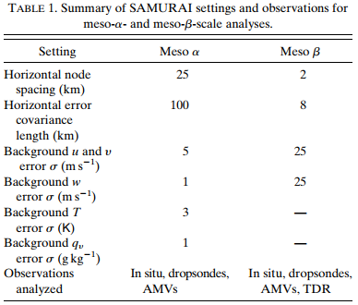
Data and Methodology
NCAR Gulfstream-V (GV) aircraft
Z: 13-14 km
In situ / dropsonde data
NOAA WP-3Ds (P3s) aircrafts
Z: 3 km
In situ / dropsonde data / X-band Doppler radar data
SAMURAI variational analysis package
Spline Analysis at Mesoscale Utilizing Radar and Aircraft Instrumentation
Meso-α and meso-β analyses
Cost function: mass continuity constrain
Optimizing: conjugate gradient method
 | SAMURAI meso-α | SAMURAI meso-β
Δx | 25-km | 2-km
Initial estimation | ECMWF 0.25º analyses | SAMURAI meso-α
Window | 6-hr | 15-min
Obs. Data | In situ / Dropsondes
 | Satellite-derived atmospheric motion vectors
 | X | Doppler radar

Slide 4
The area-averaged horizontal convergence of perimeter-averaged absolute vorticity
Reynolds stress at the perimeter
$$\frac{∂C}{∂t}=−\overline{η}\tilde{δ}A−\oint{η^{′}{\overset{⃑}{v}}^{′}}∙\hat{n}dl+\oint{ω\left(\hat{k}×\frac{∂\overset{⃑}{V}}{∂p}\right)}−\oint{(\hat{k}×\overset{⃑}{F})}∙\hat{n}dl$$
Tilting contributions at the perimeter
Eddy fluxes of vorticity at the perimeter

Slide 5
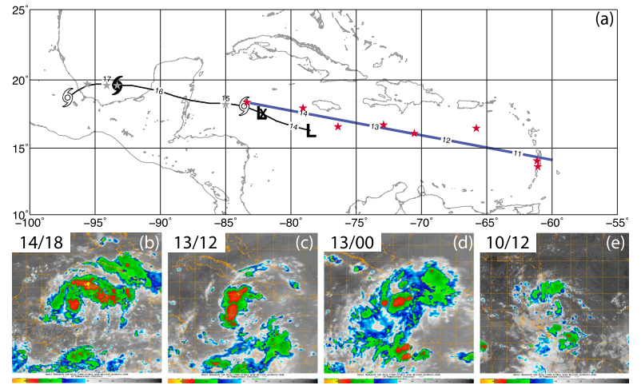
Estimate from ECMWF analysis
Y: critical latitude (zonal flow is equal to the wave phase speed)
X: wave trough axis (the meridional velocity is zero)
PREDICT analysis – time series analysis
Notes:
1.紅點藍線定義
2.低壓符號
3.衛星雲圖

Slide 6
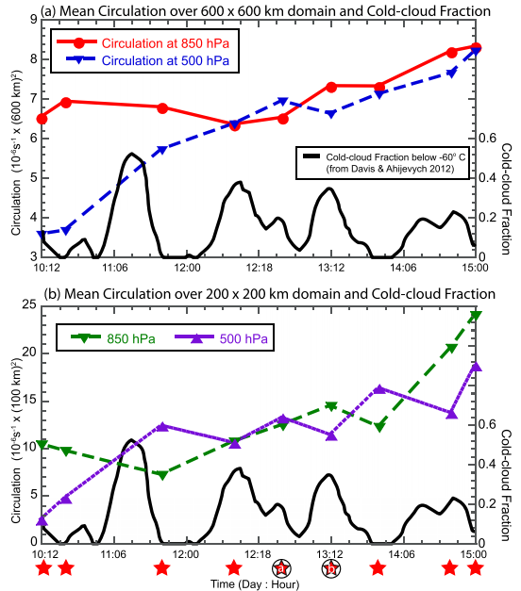
Notes:
高層環流弱、CCF大表示對流爆發，CCF下降表示對流到層狀的過渡
下圖out of phase
CCF上升 850上升 500等到CCF轉成層狀才上升

Slide 7
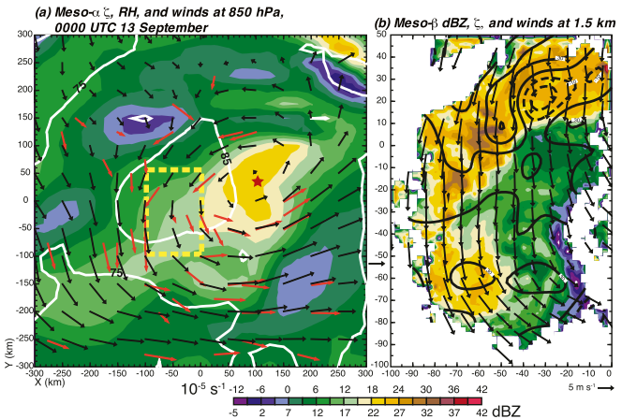
Meso-α and meso-β structure
Color: Vorticity
Contour: RH
Color: Radar echo
Contour: Vorticity
Notes:
A 6區域負渦度，中心渦度比f大3倍，RH多在75%之上。高渦度區和RH85%區域大致重合
B 北側風切渦度，南側曲率渦度。回波大範圍層狀區，2對流core，東北側有負渦度區為層狀降水區
B 南側有另一層狀降水區，為正渦度區

Slide 8
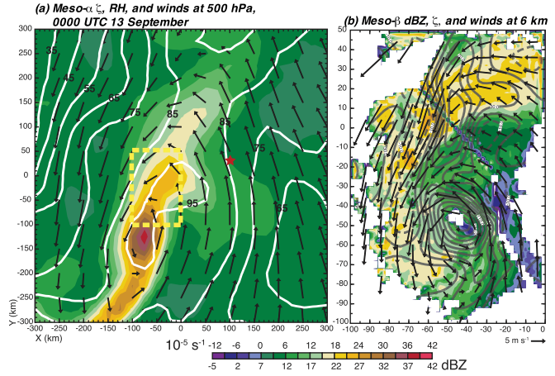
Meso-α and meso-β structure
Color: Vorticity
Contour: RH
Color: Radar echo
Contour: Vorticity
Notes:
A 500環流中心比低層中心偏移西南方225km，垂直風切4m/s(925-500)，環流呈南北拉伸，渦度max>3E-4，渦度和RH重合，東西向有很大RH梯度，中層乾空氣無法進入中心
B mesoBeta中心較alpha中心北偏75km，大範圍的正渦度，有2max值，北側dipole可能是減弱的對流降水，南側層狀降水區直徑約40km，現有觀測資料無法判斷是否是真的環流中心

Slide 9
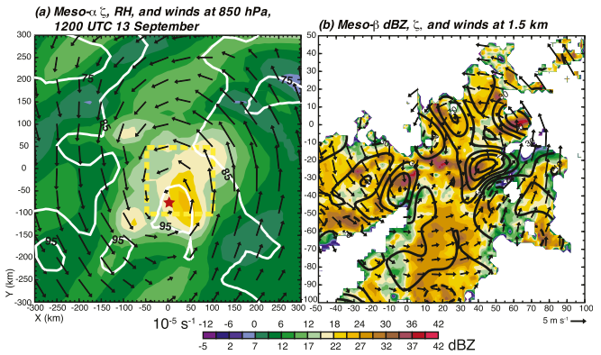
Meso-α and meso-β structure
Color: Vorticity
Contour: RH
Color: Radar echo
Contour: Vorticity
Notes:
A 渦度較12小時前增加，RH85範圍增加，RH95跟渦度max重合，有利於產生對流爆發
B 正渦度和強回波重合(對流core)，對流有胞狀結構，衛星雲圖有深對流出現。深對流位置靠近中心，提供背景高渦度透過深對流core的STR加強低層渦度

Slide 10
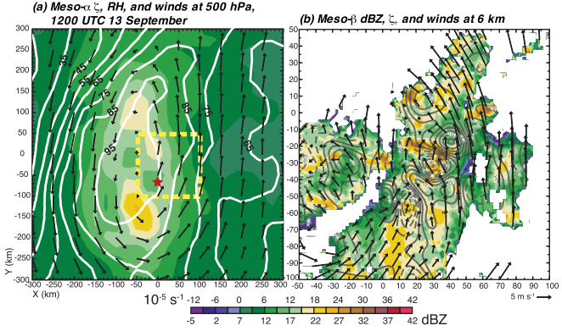
Meso-α and meso-β structure
Color: Vorticity
Contour: RH
Color: Radar echo
Contour: Vorticity
Notes:
A 渦度較12小時前下降(3->1.5E-4)，渦度和RH範圍縮小集中，RH東西向梯度明顯
B 胞狀對流核明顯，伴隨渦度dipole出現，由於水平渦管TILT

Slide 11
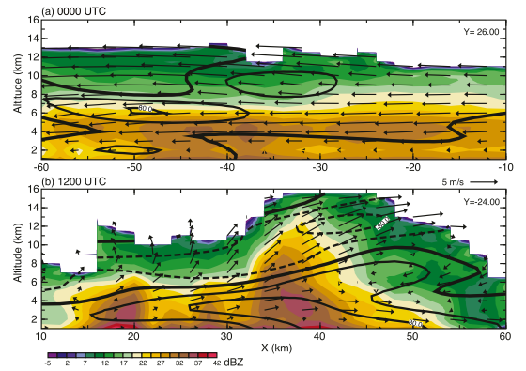
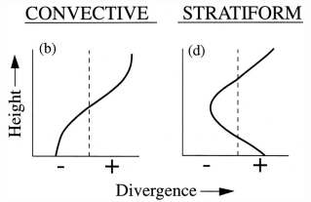
Convective and stratiform contribution to genesis
Color: Radar echo
Contour: Vorticity
(Houze, 1997)
Notes:
層狀變對流，表示有vortex生成
A 回波層狀結構，東風隨高度增強，w弱。渦度max在6km高，背景渦度+中層輻合產生正STR
B 胞狀回波，回波達40dBZ以上，深對流處回波高度可達16km以上，w強。對流處低層輻合，低層STR正，在低層產生渦度max，高層外流輻散壓縮渦管產生負STR，負渦度

Slide 12
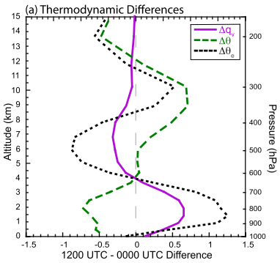
Convective and stratiform contribution to genesis
From a dynamical perspective, stratiform midlevel convergence increased the depth of the recirculating flow and the protective pouch that reduced environmental dry-air intrusions on the circulation.
From a thermodynamic perspective, evaporative cooling and moistening of the lower troposphere from stratiform rain that was positively phased with diurnal cooling provided an additional benefit for subsequent convection.
Notes:
A 低層位溫下降，輻射冷卻蒸發冷卻。中層位溫增加，長波增溫潛熱加熱梯度風調整。高層位溫降溫，輻射冷卻。
A 低層qv下降，蒸發冷卻/淺積雲detrainment/水氣輻合。中層qv下降，deposition/水氣輻散，低層整體的相當位溫是增加的

Slide 13
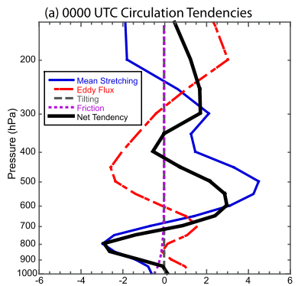
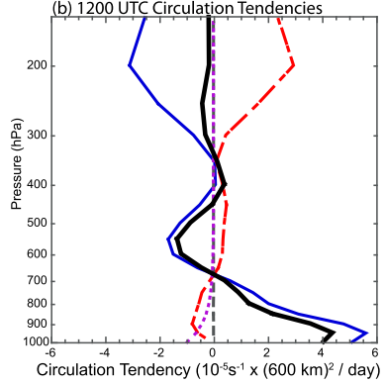
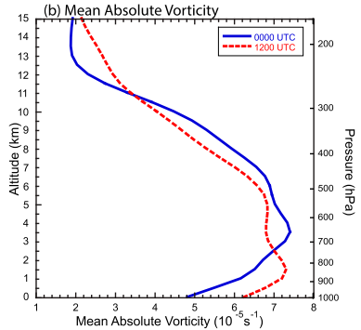
Circulation dynamics on the meso-α scale
(Houze, 1997)
Notes:
B 中低層交替spinup
環流分析中平均STR和Eddy flux是主要的兩項，Eddy小
A 中層輻合，高低層輻散，使得中層spinup，高低層spindown，eddy項相反但效果次要
B 低層輻合產生強STR弱eddy flux，環流spinup，中高層輻散spindown

Slide 14
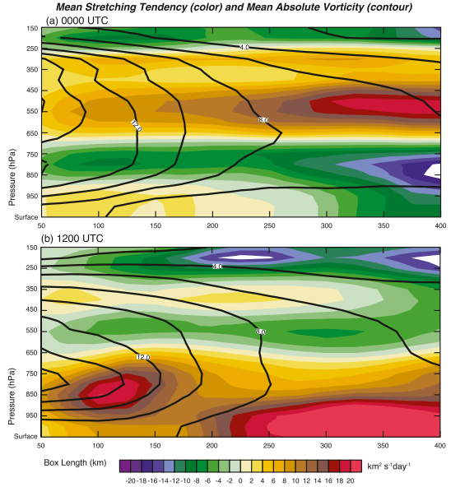
Circulation dynamics on the meso-α scale
Color: STR
Contour: Vorticity
Notes:
檢驗box大小的敏感度
A L<250km 低層STR正，L>250km 低層STR負。其他對box不敏感。整體而言，中層STR正，對應到中層的渦度極大值及廣大的層狀降水區
B L<150km STR極大值位置稍高，整體的正STR往上延伸至650mb。渦度量值兩者差距不大。

Slide 15
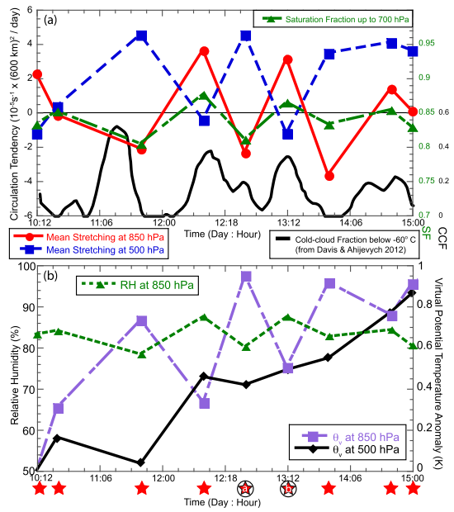
Notes:
之前看到的是snapshot，作者認為Karl是經歷一系列的深對流爆發
A STR850和STR500相位相反，低層環流spinup對應到CCF的peak，表示低層STR和深對流爆發有關。中層spinup則對應到層狀過渡。
A SF和低層STR趨勢一致，作者認為SF0.85可能是個決定是否產生深對流爆發的critical value
B 850虛位溫因為日變化和對流變化震盪，但隨時間增加。500虛位溫跟850虛位溫反向也隨時間增加

Slide 16
Conclusions
A strong convective burst erupted in the vorticity-rich and moisture-rich environment that enhanced the low-level circulation.
As the convection waned, the resulting transition to stratiform MCSs strengthened the midlevel pouch through midlevel convergence and vortex stretching associated with ice microphysical processes, and protected the disturbance from the intrusion of dry environmental air.
Low-level divergence associated with the stratiform rain acts to spin down the low-level circulation, but surface moisture fluxes and cooling associated with rain evaporation and the diurnal minimum helps to increase the relative humidity, lower the level of free convection, and condition the environment for another burst of deep convection.
The results from this study suggest the convective cycle in Karl alternately built the low- and midlevel circulations leading to genesis as summarized in the following sequence of events.

