Slide 1
On Relationships between Nonrecurving Western North Pacific Tropical Cyclones, the Madden–Julian Oscillation, and the East Asian Subtropical Jet

Slide 2
Data and event identification
CFSR 1979-2010 Fall(Sep.-Nov.)
CFSv2 2011-2012 Fall(Sep.-Nov.)
Horizontal grid size: 2.5 degree lat/lon
Time interval: 00Z/06Z/12Z/18Z
The long-term (1981-2010) mean and the seasonal cycle were removed
MJO events
Amplitude of the RMM index > 0.5 standard deviations
TC events
IBTrACS v3 (International Best Track Archive for Climate Stewardship)
Data: storm position/intensity/classification/basin/name…
Clustering: recurving/non-recurving (algorithm: Gaffney, 2004; Gloeckler and Roundy, 2019)
TCs were binned into geographical groups by constructing a 7.5º search radius

Slide 3
Zonal momentum budget procedure
The advection of intraseasonal zonal wind by background wind
$$\frac{∂u}{∂t}=−\overset{⃑}{V}∙∇u−\frac{∂Φ}{∂x}+fv+\frac{uv tanφ}{a}+X$$
The advection of background zonal wind by intraseasonal wind
The intraseasonal filtered advection of intraseasonal zonal wind by intraseasonal wind
transient
intraseasonal
background
The intraseasonal filtered advection of transient zonal wind by transient wind
20 days
100 days
$$\frac{∂u^{∗}}{∂t}≈−\overline{u}\frac{∂u^{∗}}{∂x}−u^{∗}\frac{∂\overline{u}}{∂x}−{\left[u^{∗}\frac{∂u^{∗}}{∂x}\right]}^{∗}−{\left[u^{′}\frac{∂u^{′}}{∂x}\right]}^{∗}$$
$$−\overline{v}\frac{∂u^{∗}}{∂y}−v^{∗}\frac{∂\overline{u}}{∂y}−{\left[v^{∗}\frac{∂u^{∗}}{∂y}\right]}^{∗}−{\left[v^{′}\frac{∂u^{′}}{∂y}\right]}^{∗}$$
$$u=\overline{u}+u^{∗}+u^{′}$$
$$−\overline{ω}\frac{∂u^{∗}}{∂p}−ω^{∗}\frac{∂\overline{u}}{∂p}−{\left[ω^{∗}\frac{∂u^{∗}}{∂p}\right]}^{∗}−{\left[ω^{′}\frac{∂u^{′}}{∂p}\right]}^{∗}$$
# An intraseasonal band-pass filter is applied to the terms $−\overset{⃑}{V^{∗}}∙∇u^{∗}$ and $−\overset{⃑}{V^{′}}∙∇u^{′}$, which project onto the intraseasonal band in addition to shorter and longer time scale.
$$−\frac{∂Φ^{∗}}{∂x}+fv^{∗}+{\left[\frac{uv tanφ}{a}\right]}^{∗}$$

Slide 4
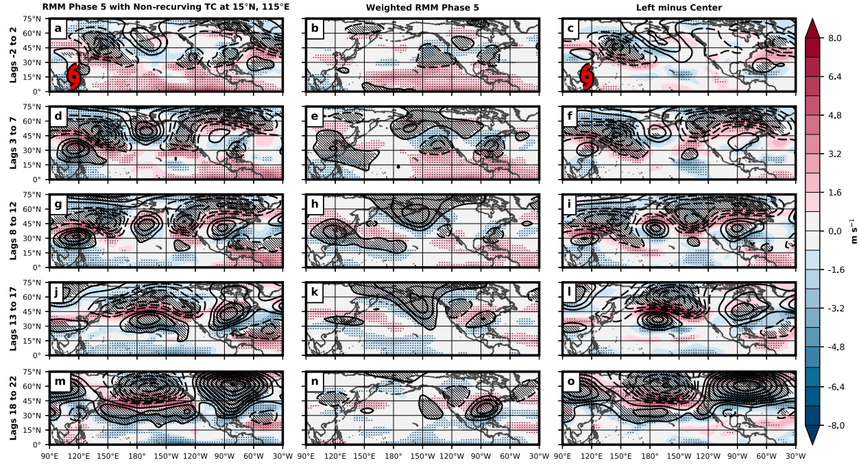
Large-scale pattern overview
color: u* anomalies (200 mb)
contour: geopotential height anomalies (200 mb)
Notes:
1.天數、TCc、FPc、diff
2.Rossby wave train兩組合成圖都有，差異在TC合成圖中的東亞出現副熱帶噴流，後續延伸到跨越太平洋

Slide 5
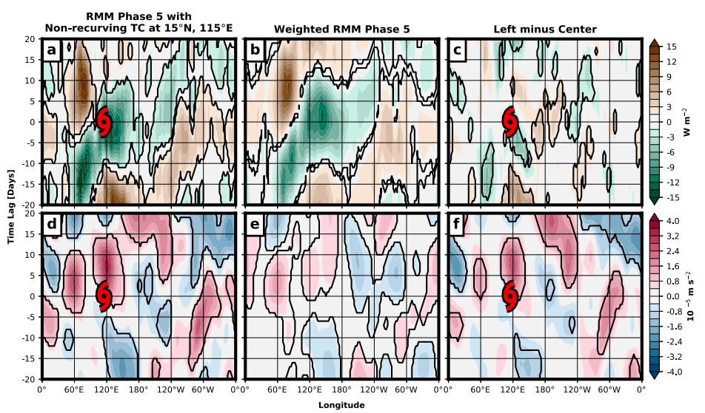
Hovmoller diagram
color: OLR (mean 0-15ºN)
outward longwave radiation
suppressed
convection
enhanced
convection
Hovmoller diagram
color: u* anomalies (200 mb, mean 30-50ºN)
Notes:
前兩圖MJO對流訊號向東傳，差值圖中有對流訊號向西傳，且訊號持續時間比TC長，從波譜分析找出其為頻率約10-100天、波數1-15向西移的ER(赤道Rossby wave)。
當MJO和ER重疊時產生容易生成TC的大尺度環境
\u* anomalies的極值在TC出現的幾天後出現
MJO對流和高層環流互相作用在MJO對流北方產生高層副熱帶反氣旋環流，加強jet並jet移至比氣候平均較北的位置
TCc的訊號是FPc的3倍以上

Slide 6
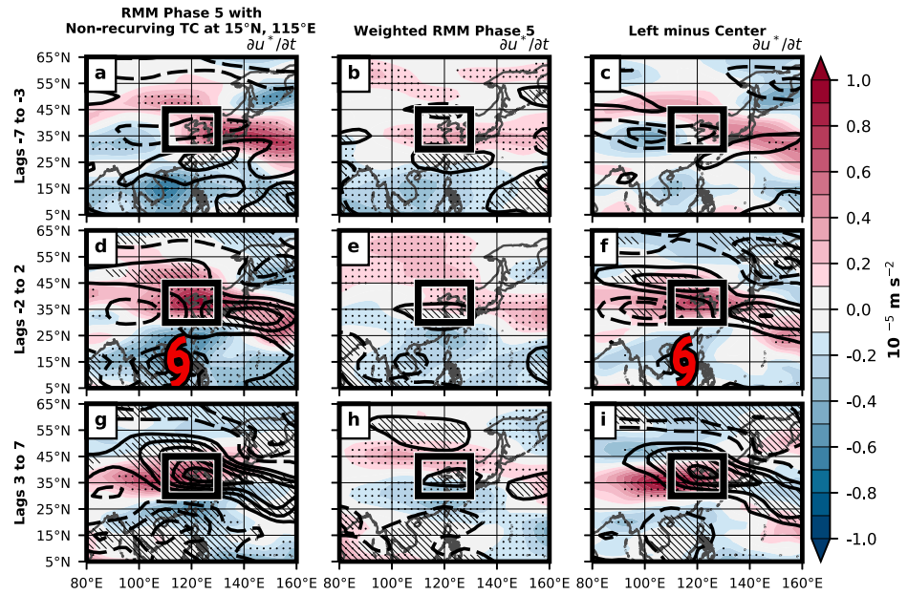
The east Asian intraseasonal subtropical jet response
Bounded area:
Lon: 110-130ºE
Lat: 30-45ºN
color: u* tendency at 200 mb
contour: u* anomalies at 200 mb
Zonal wind momentum budget is performed over the bounded area.
Notes:
1.框中正值表示熱帶對流導致jet amplification
2.TCc有較大的振幅

Slide 7
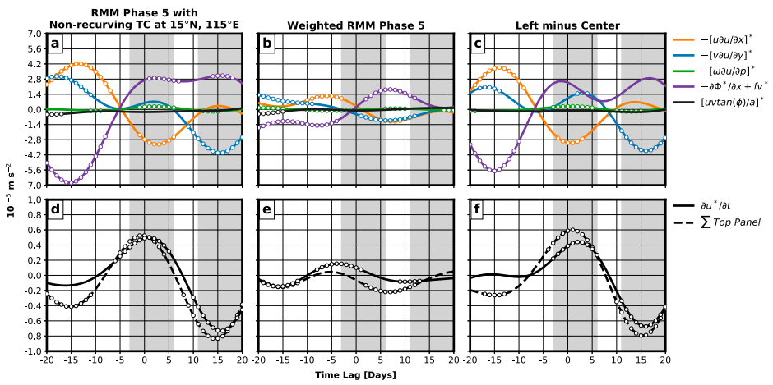
Primary momentum sources
$$\frac{∂u^{∗}}{∂t}≈−\overline{u}\frac{∂u^{∗}}{∂x}−u^{∗}\frac{∂\overline{u}}{∂x}−{\left[u^{∗}\frac{∂u^{∗}}{∂x}\right]}^{∗}−{\left[u^{′}\frac{∂u^{′}}{∂x}\right]}^{∗}$$
$$−\overline{v}\frac{∂u^{∗}}{∂y}−v^{∗}\frac{∂\overline{u}}{∂y}−{\left[v^{∗}\frac{∂u^{∗}}{∂y}\right]}^{∗}−{\left[v^{′}\frac{∂u^{′}}{∂y}\right]}^{∗}$$
$$−\overline{ω}\frac{∂u^{∗}}{∂p}−ω^{∗}\frac{∂\overline{u}}{∂p}−{\left[ω^{∗}\frac{∂u^{∗}}{∂p}\right]}^{∗}−{\left[ω^{′}\frac{∂u^{′}}{∂p}\right]}^{∗}$$
Shading: statistically significantly different (TC v.s. non-TC)
$$−\frac{∂Φ^{∗}}{∂x}+fv^{∗}+{\left[\frac{uv tanφ}{a}\right]}^{∗}$$
Notes:
1. TCc (a) 紫色(壓力梯度和科氏力)重要，FPc (b) 黃色(緯向風的緯向平流)重要

Slide 8
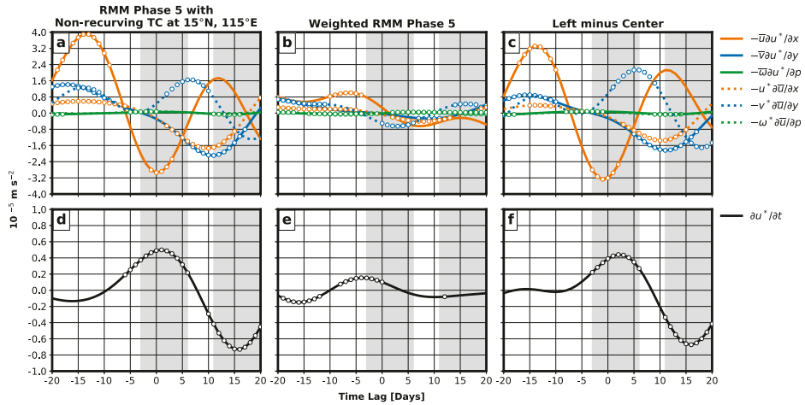
Primary momentum sources
$$\frac{∂u^{∗}}{∂t}≈−\overline{u}\frac{∂u^{∗}}{∂x}−u^{∗}\frac{∂\overline{u}}{∂x}−{\left[u^{∗}\frac{∂u^{∗}}{∂x}\right]}^{∗}−{\left[u^{′}\frac{∂u^{′}}{∂x}\right]}^{∗}$$
$$−\overline{v}\frac{∂u^{∗}}{∂y}−v^{∗}\frac{∂\overline{u}}{∂y}−{\left[v^{∗}\frac{∂u^{∗}}{∂y}\right]}^{∗}−{\left[v^{′}\frac{∂u^{′}}{∂y}\right]}^{∗}$$
Intraseasonal and background wind interaction
$$−\overline{ω}\frac{∂u^{∗}}{∂p}−ω^{∗}\frac{∂\overline{u}}{∂p}−{\left[ω^{∗}\frac{∂u^{∗}}{∂p}\right]}^{∗}−{\left[ω^{′}\frac{∂u^{′}}{∂p}\right]}^{∗}$$
Shading: statistically significantly different (TC v.s. non-TC)
$$−\frac{∂Φ^{∗}}{∂x}+fv^{∗}+{\left[\frac{uv tanφ}{a}\right]}^{∗}$$
Notes:
TCc 藍點線(背景緯向風被季內尺度經向風平流)，5天的phase shift表示這項的機制是維持jet的強度而不是增強
TCc 橘點線(背景緯向風被季內尺度緯向風平流)，out of phase
FPc 橘實縣(季內尺度緯向風被背景緯向風平流)，是FP主要的貢獻機制(也是上一頁橘實線)的主要貢獻項

Slide 9
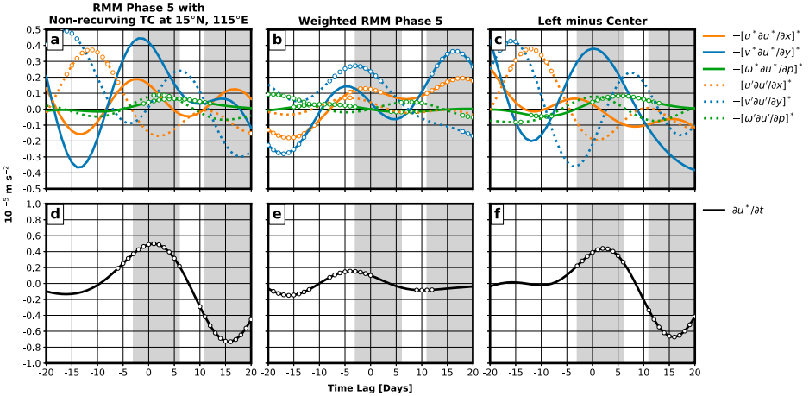
Primary momentum sources
$$\frac{∂u^{∗}}{∂t}≈−\overline{u}\frac{∂u^{∗}}{∂x}−u^{∗}\frac{∂\overline{u}}{∂x}−{\left[u^{∗}\frac{∂u^{∗}}{∂x}\right]}^{∗}−{\left[u^{′}\frac{∂u^{′}}{∂x}\right]}^{∗}$$
$$−\overline{v}\frac{∂u^{∗}}{∂y}−v^{∗}\frac{∂\overline{u}}{∂y}−{\left[v^{∗}\frac{∂u^{∗}}{∂y}\right]}^{∗}−{\left[v^{′}\frac{∂u^{′}}{∂y}\right]}^{∗}$$
Intraseasonal filtered intraseasonal and transient advection
$$−\overline{ω}\frac{∂u^{∗}}{∂p}−ω^{∗}\frac{∂\overline{u}}{∂p}−{\left[ω^{∗}\frac{∂u^{∗}}{∂p}\right]}^{∗}−{\left[ω^{′}\frac{∂u^{′}}{∂p}\right]}^{∗}$$
Shading: statistically significantly different (TC v.s. non-TC)
$$−\frac{∂Φ^{∗}}{∂x}+fv^{∗}+{\left[\frac{uv tanφ}{a}\right]}^{∗}$$
Notes:
藍實線(季內尺度下的季內尺度緯向風被季內尺度經向風平流)，在TCc中是最大貢獻，而且是最一開始讓jet加強的機制
(圖a點線)瞬間尺度的貢獻表示TC對於季內尺度副熱帶噴流的貢獻，但在(a)圖中貢獻都較不顯著
藍點線(季內尺度下的瞬間尺度緯向風被瞬間尺度經向風平流)，在FPc中是最大貢獻，而且是最一開始讓jet加強的機制

Slide 10
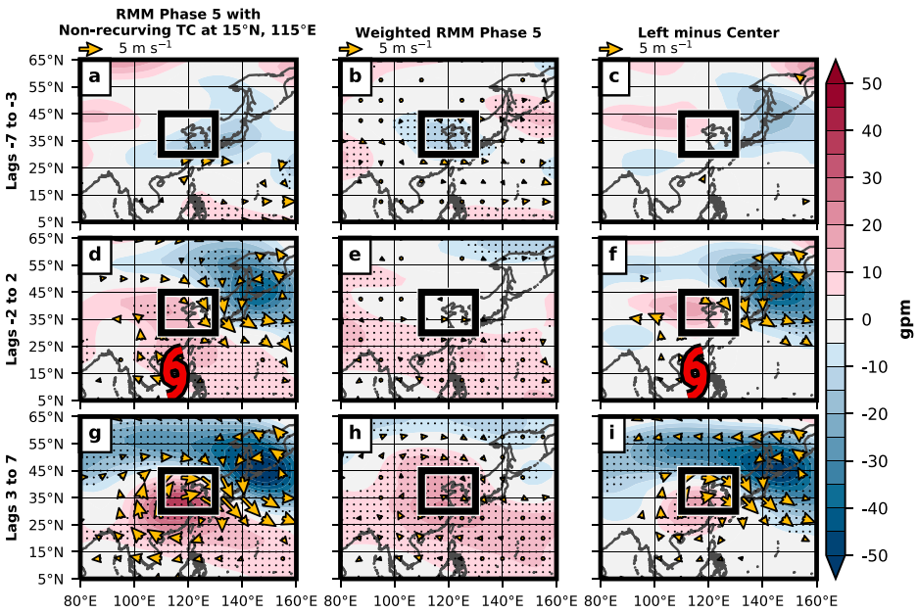
Relationship to TC presence
color: z* anomalies at 200 mb
vector: (u*,v*) anomalies at 200 mb
Notes:
TCc顯示了jet增強的過程
(a-c)顯示一開始TCc和FPc兩者差異不大
(d-f)顯示TCc中，TC出現後東亞和西北太平洋出現Rossby wave train，此差異與TC提升了對流有關係。FPc則沒有此訊號。
(d+f)日本上方(框東側)出現西北風的anomalies，是增強副熱帶jet的訊號
(g+i)風的anomalies和高度場的加強，使得TCc的波動訊號比FPc更強

Slide 11
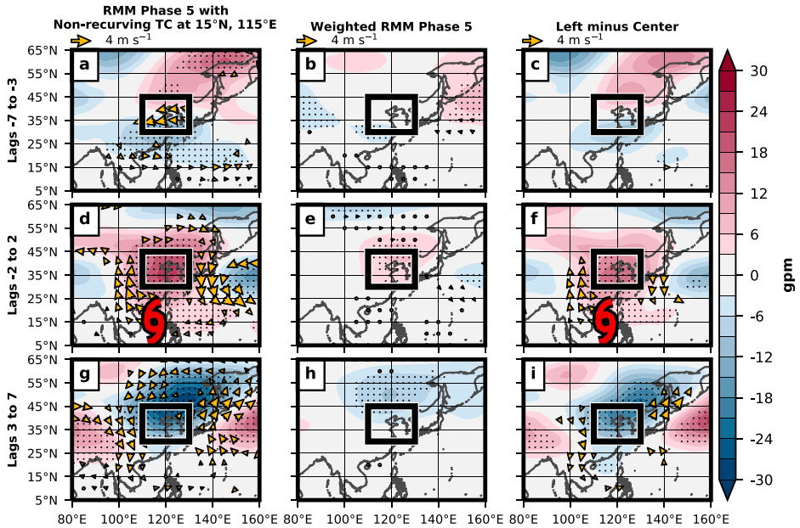
Relationship to TC presence
color: z’ anomalies at 200 mb
vector: (u’,v’) anomalies at 200 mb
Notes:
(d+f)TCc中顯示TC位置的北側高層(框框西側)有反氣旋式環流形成，是來自於TC非絕熱釋放的outflow。FPc則沒有訊號。

Slide 12
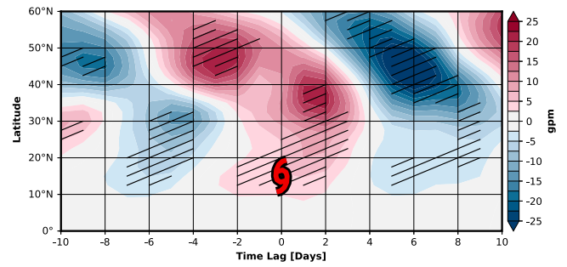
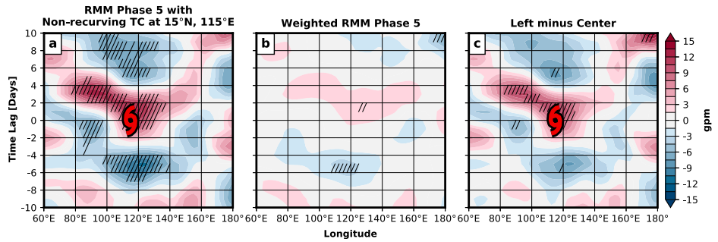
Relationship to TC presence
color: z’ anomalies at 200 mb
TC-based composite

Slide 14
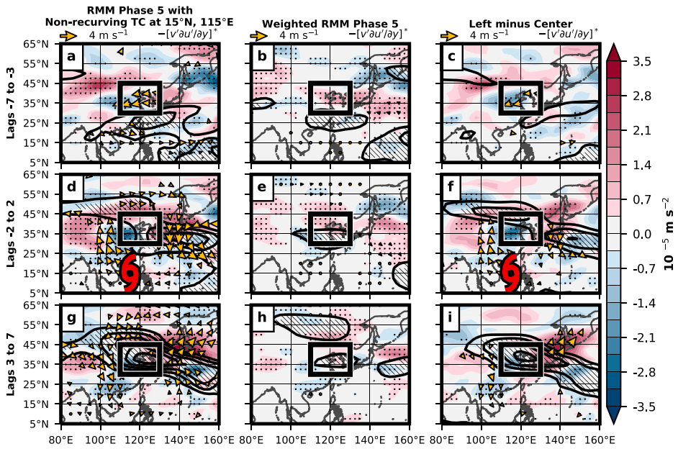

Slide 15
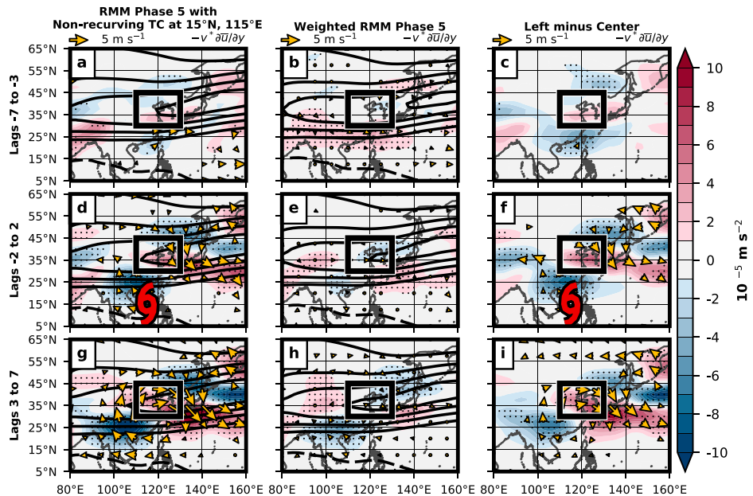

Slide 16
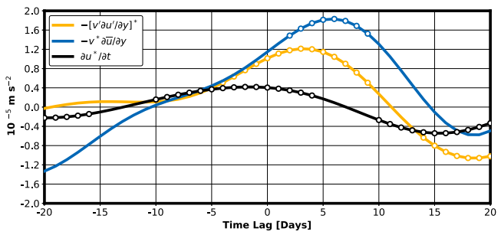

Slide 17
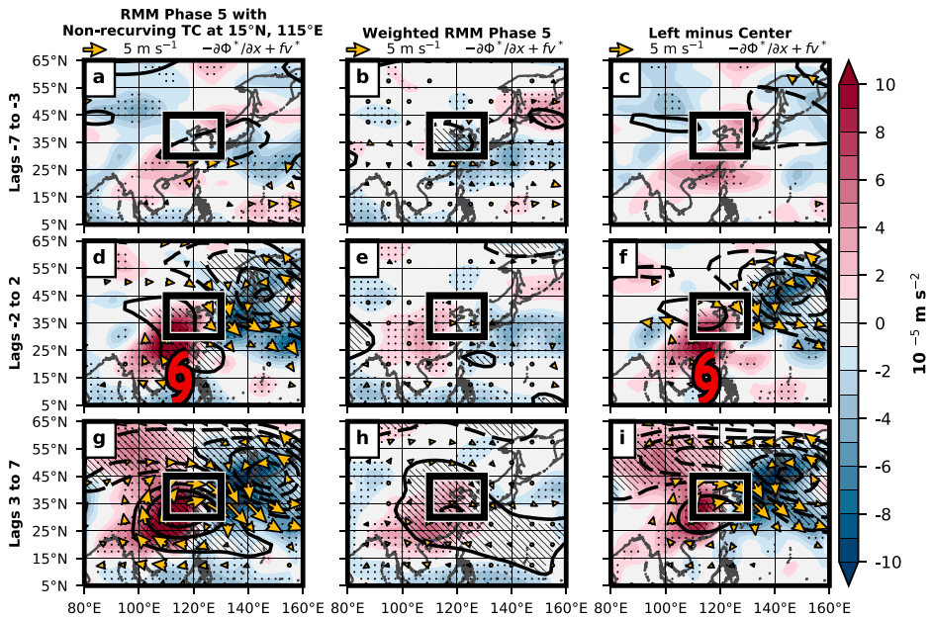

Slide 18
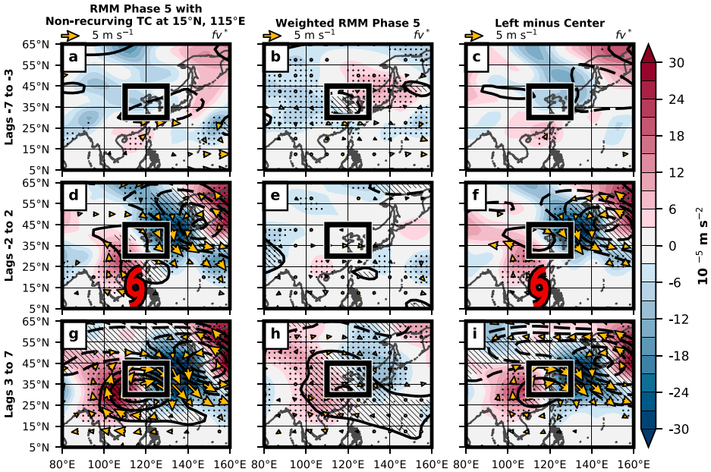

Slide 19
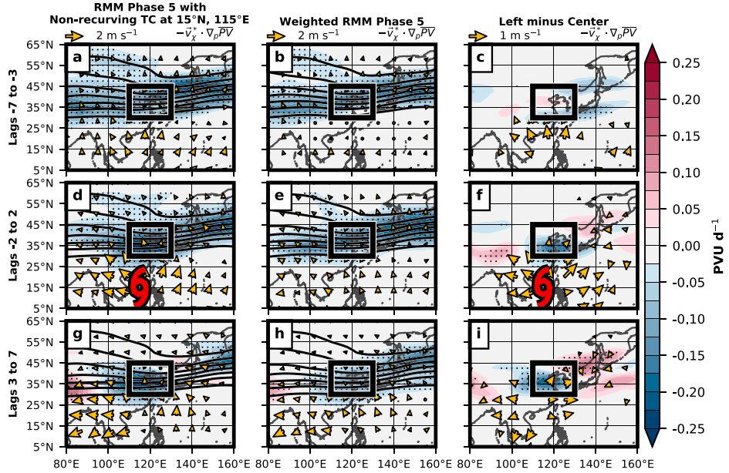

Slide 20
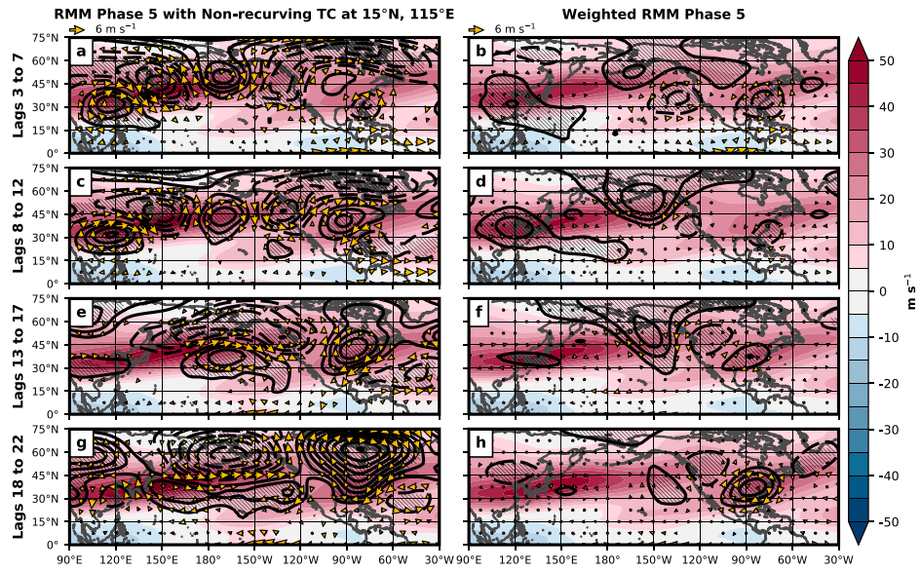

Slide 21
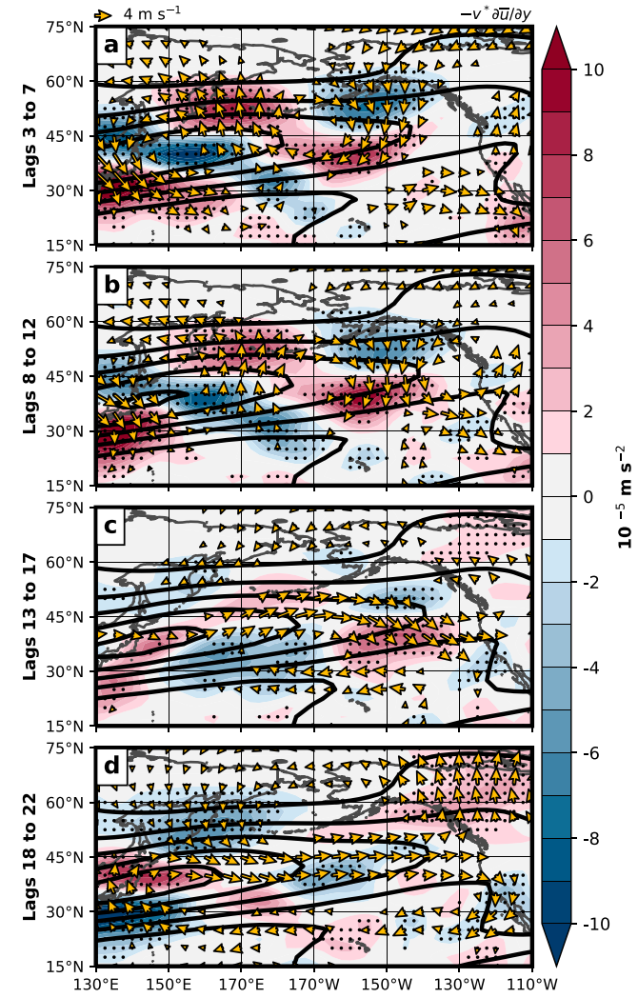

Slide 22
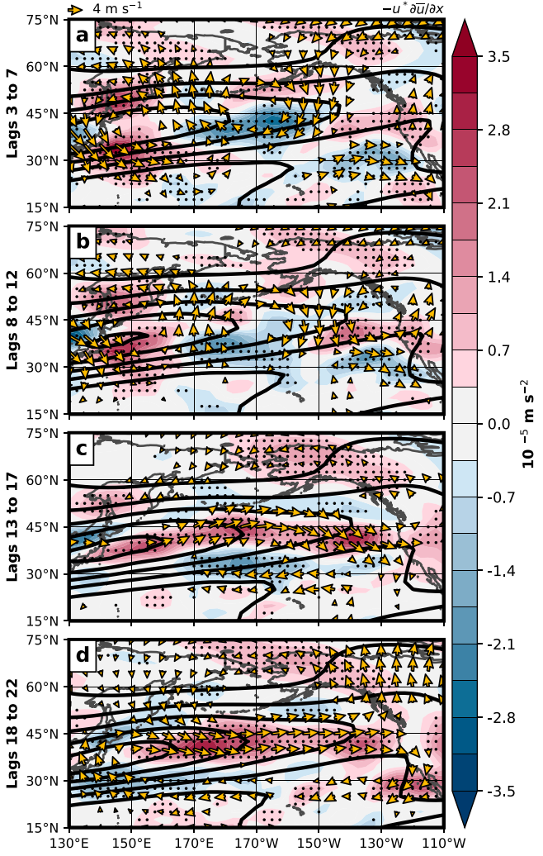

Slide 23
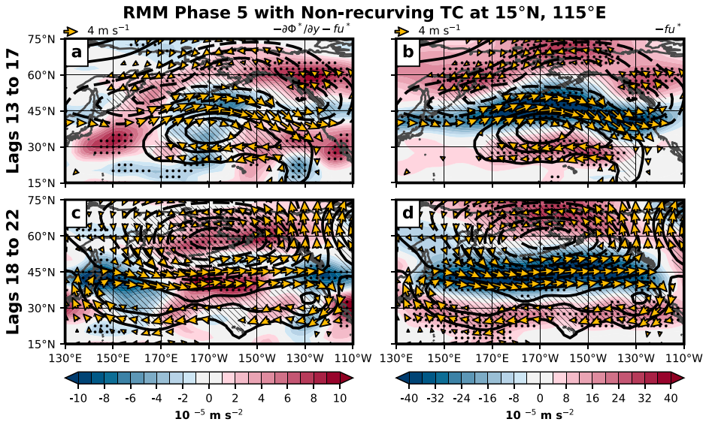

Slide 24
