Slide 1
Relationship between the Track and Structural Evolution of Hurricane Sandy (2012) Using a Regional Ensemble
Paper review
mainly refer to
Alex M. Kowaleski and Jenni L. Evans
方偉庭
2019.06.18
Other references:
Blake, E. S., T. B. Kimberlain, R. J. Berg, J. P. Cangialosi, and J. L. Beven II, 2013: Tropical Cyclone Report Hurricane Sandy (22–29 October 2012). Tech. Rep. AL182012, National Hurricane Center, 157 pp.
Evans, J. L., and R. E. Hart, 2003: Objective indicators of the life cycle evolution of extratropical transition for Atlantic tropical cyclones. Mon. Wea. Rev., 131, 909–925.
Hart, R. E., 2003: A cyclone phase space derived from thermal wind and thermal asymmetry. Mon. Wea. Rev., 131, 585–616

Slide 2
Outline
Introduction
Synoptic evolution of Hurricane Sandy
Data and development of the WRF ensemble
Selection of optimal cluster specifications
Results
Cluster-mean track and CPS characteristics
Timing of Sandy–trough interaction and extratropical transition
Landfall-relative differences in extratropical transition
Summary and conclusions

Slide 3
Introduction
The increase in Sandy’s size and intensity resulting from these the two trough interactions contributed to the massive storm surge at landfall.
Tropical cyclone–trough interaction: Tropical cyclone (TC) intensity evolution is highly sensitive to the relative position and/or structure of interacting troughs. (Hanley et al. 2001, Kimball and Evans 2002, Leroux et al. 2016)
The idealized simulations of Ritchie and Elsberry (2003, 2007) showed that a stronger midlatitude trough produced less TC weakening during ET, while TCs initially closer to a midlatitude trough reintensified more after ET completion.
This study investigates the processes governing the relationship between the track and structural evolution of Hurricane Sandy during ET.

Slide 4
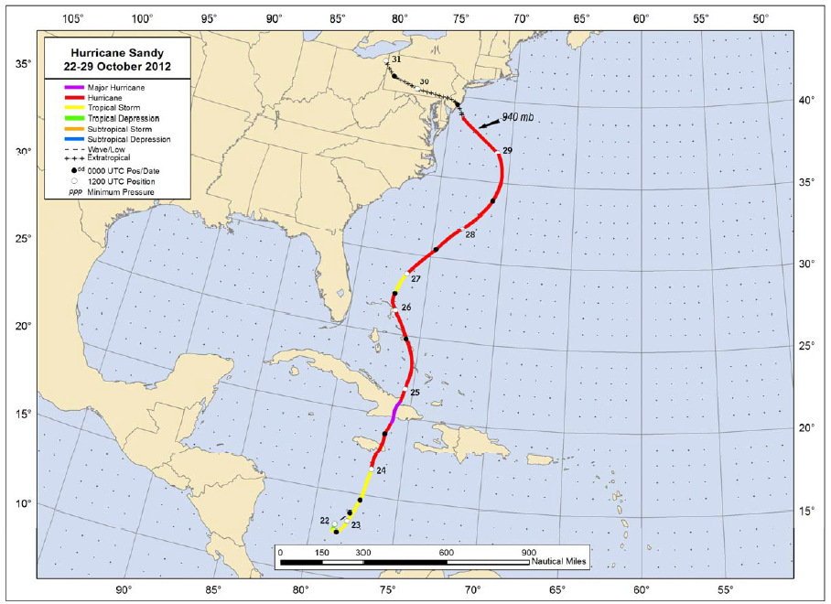
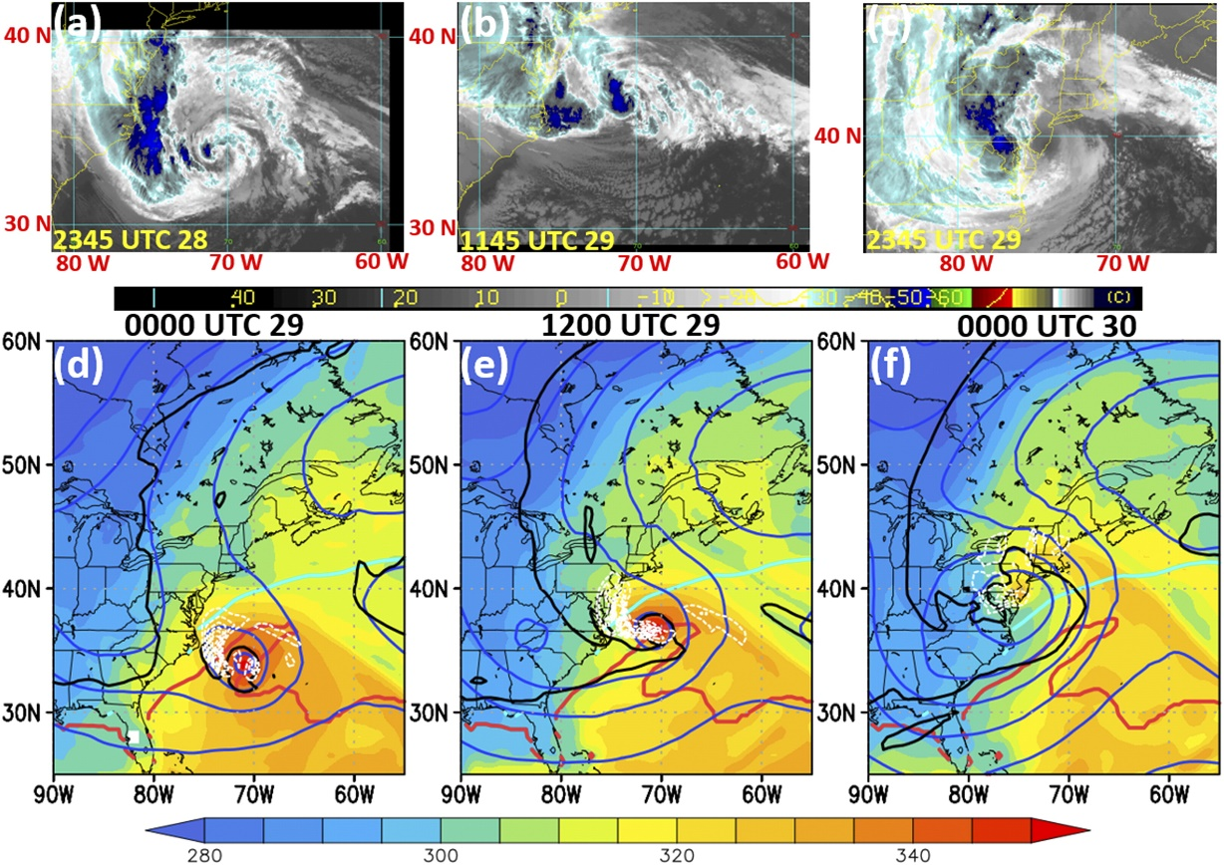
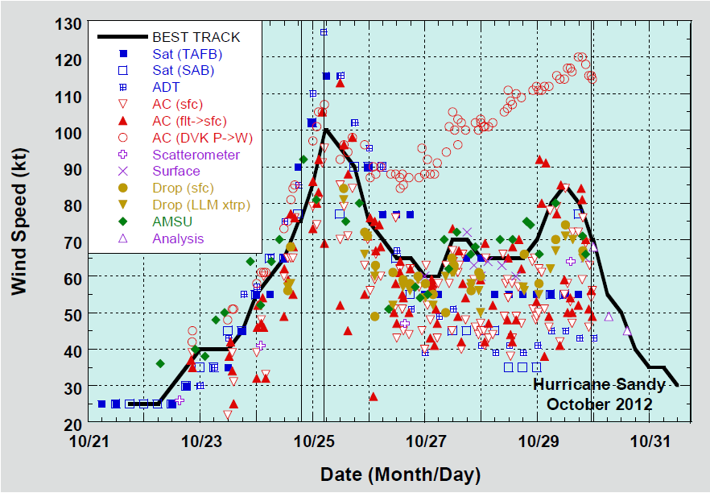
Hurricane Sandy (2012)
Blake et al. (2013)
850-hPa equivalent potential temperature (K; shaded)
500-hPa geopotential height (blue contours every 90 m)
325-K 2-PVU contour (black)
Integrated 850–200-hPa upward water vapor flux
(kg m⁻¹ s⁻¹; dashed white contours every 3 kg m⁻¹ s⁻¹ from 3 to 36 kg m⁻¹ s⁻¹)
SST (red and cyan contours at 26° and 20°C)

Slide 5
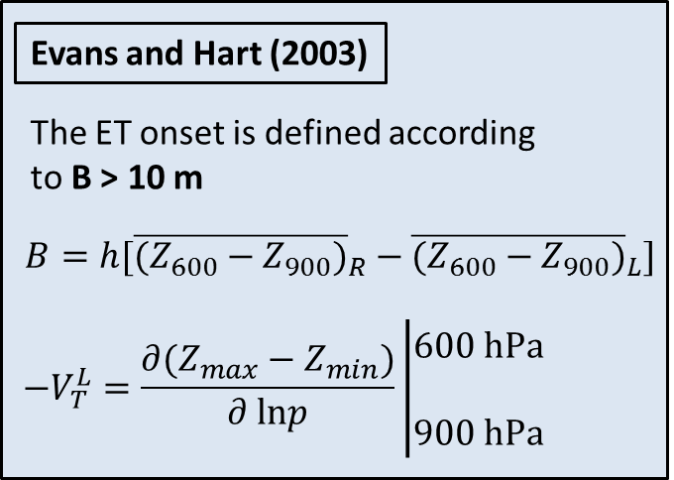
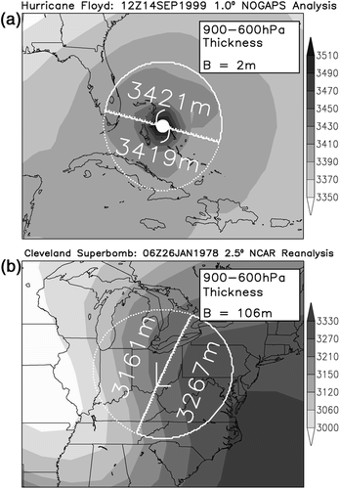
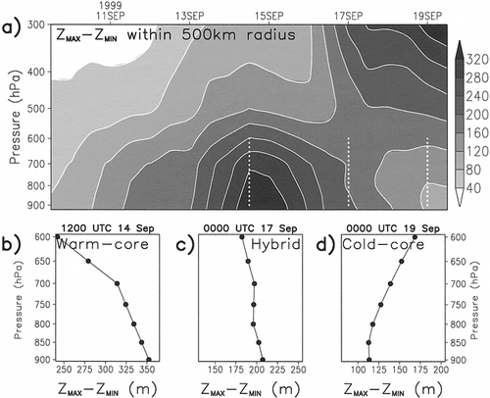
B and $−V_{T}^{L}$
B: transition onset
$−V_{T}^{L}$: transition completion
Evans and Hart (2003)
Hart (2003)

Slide 6
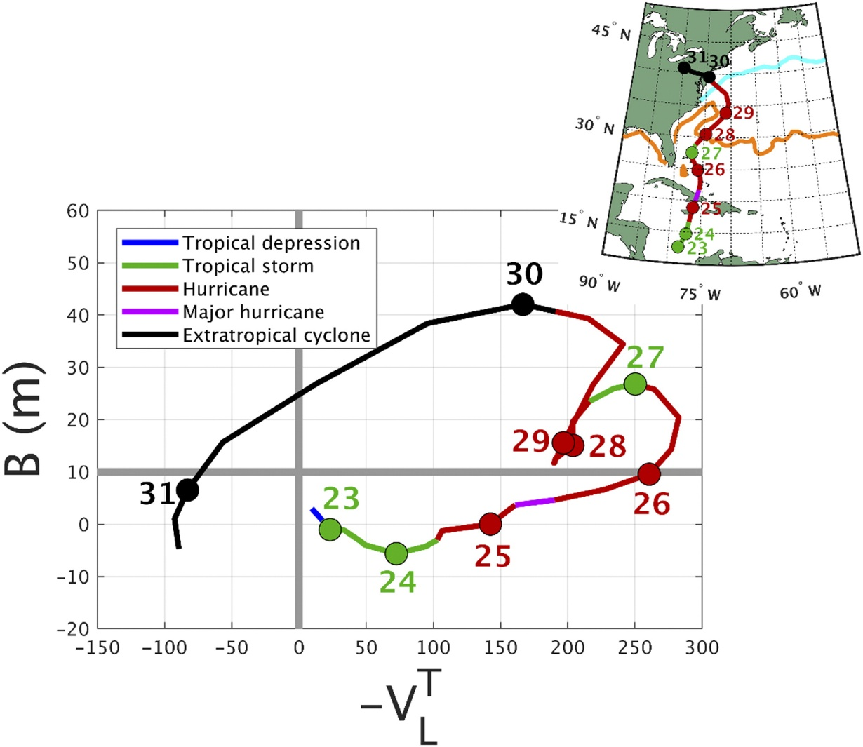
Synoptic evolution of Hurricane Sandy
cyclone phase space (CPS)
Asymmetric
Evans and Hart (2003)
The ET onset is defined according to B > 10 m
symmetric
$$B=h[{\overline{(Z_{600}−Z_{900})}}_{R}−{\overline{(Z_{600}−Z_{900})}}_{L}]$$
Cold core
Warm core
$$−V_{T}^{L}=\frac{∂(Z_{max}−Z_{min})}{∂ lnp}\left|\begin{matrix}600 hPa \\ \\ 900 hPa\end{matrix}\right.$$

Slide 7
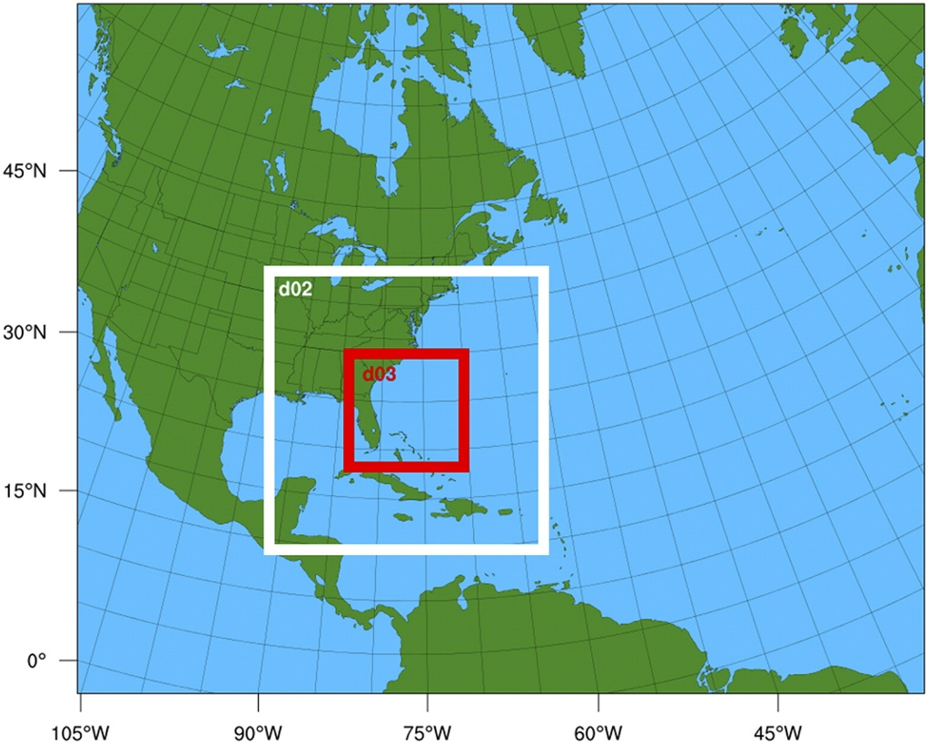
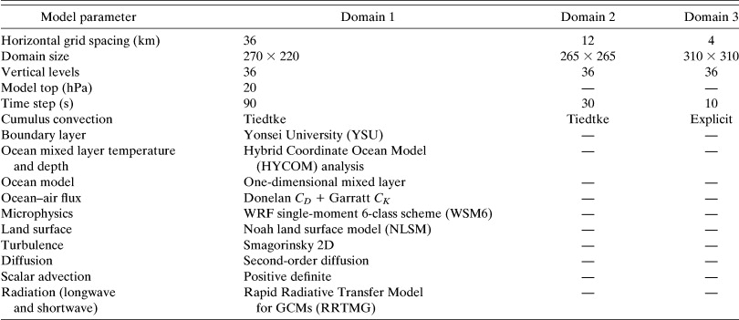
Data and development of the WRF ensemble
A total of 72 global ensemble simulations initialized at 0000 UTC 25 October:
ECMWF IFS (50 ensembles + control)
NCEP GEFS (20 ensembles + control)
WRF simulations are initialized at 0000 UTC 27 October

Slide 8
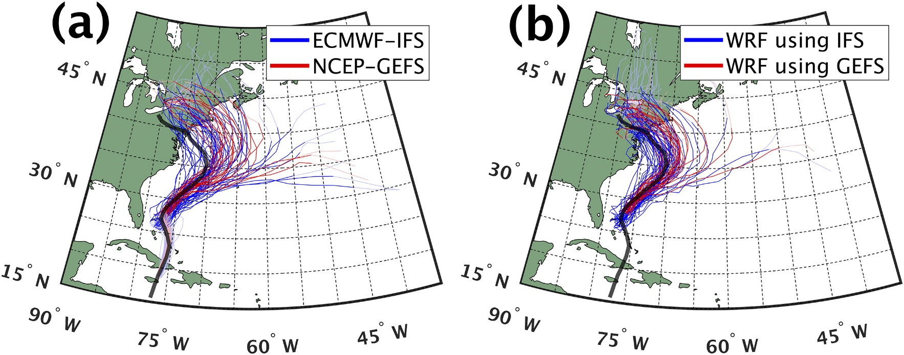
Optimal cluster specifications
Regression mixture models
Gaffney, S. J., A. W. Robertson, P. Smith, S. J. Camargo, and M.Ghil, 2007: Probabilistic clustering of extratropical cyclones using regression mixture models. Climate Dyn., 29, 423–440.
Kowaleski, A. M., and J. L. Evans, 2016: Regression mixture model clustering of multimodel ensemble forecasts of hurricane Sandy: Partition characteristics. Mon. Wea. Rev., 144, 3825–3846.

Slide 9
Cluster-mean track and CPS characteristics
Increasing B: Cool, midlatitude air encroaches on the west and south sides of Sandy Highly positive $−V_{T}^{L}$: Lower-tropospheric warm core remains intact
$−V_{T}^{L}$ drops rapidly: Cool air reaches the center of Sandy

Slide 10
Timing of Sandy–trough interaction and extratropical transition

Slide 11
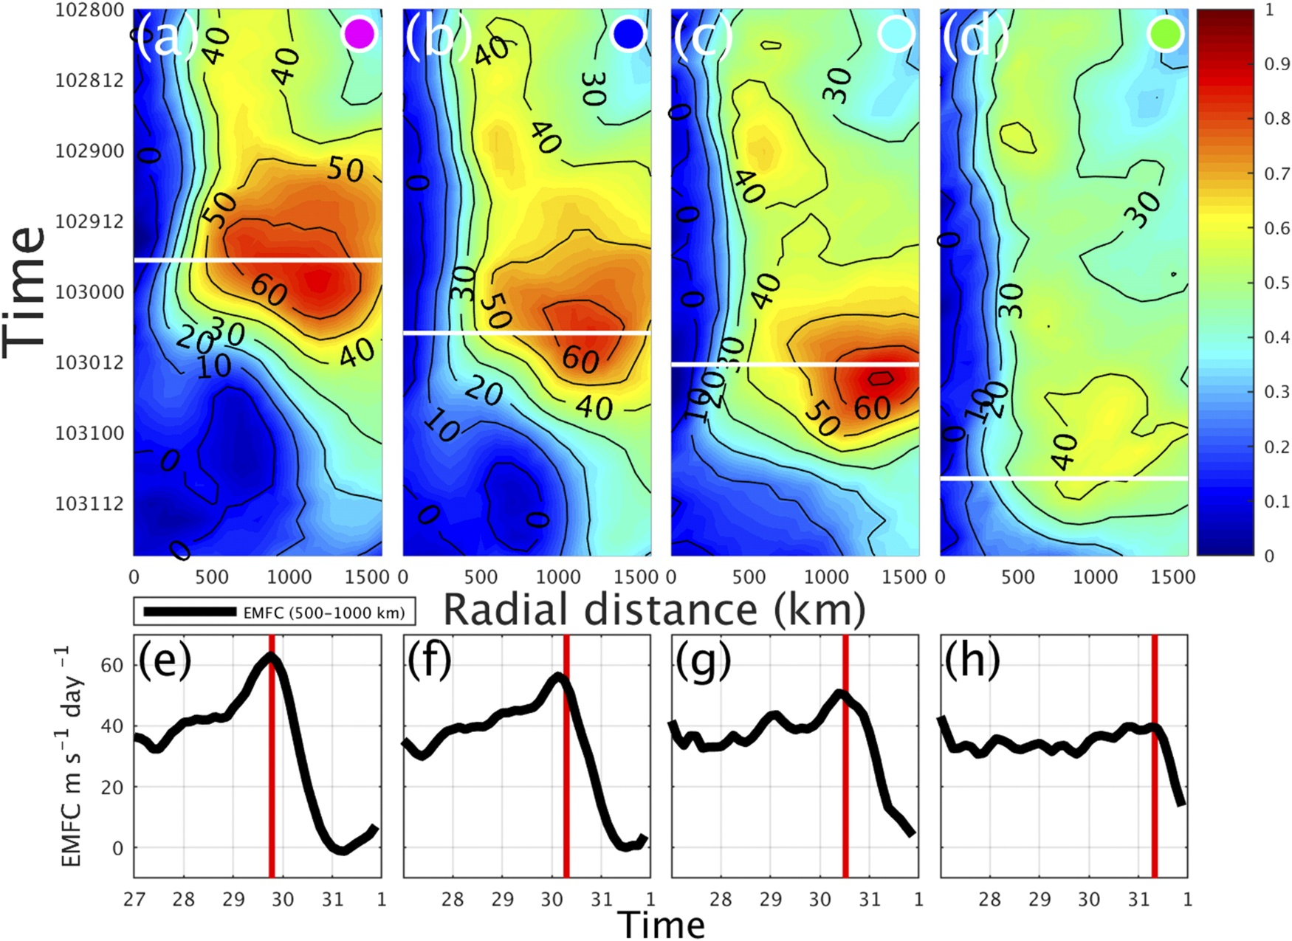
Eddy momentum flux convergence
EMFC (200–300-hPa)
more eastward clusters show a later increase

Slide 12
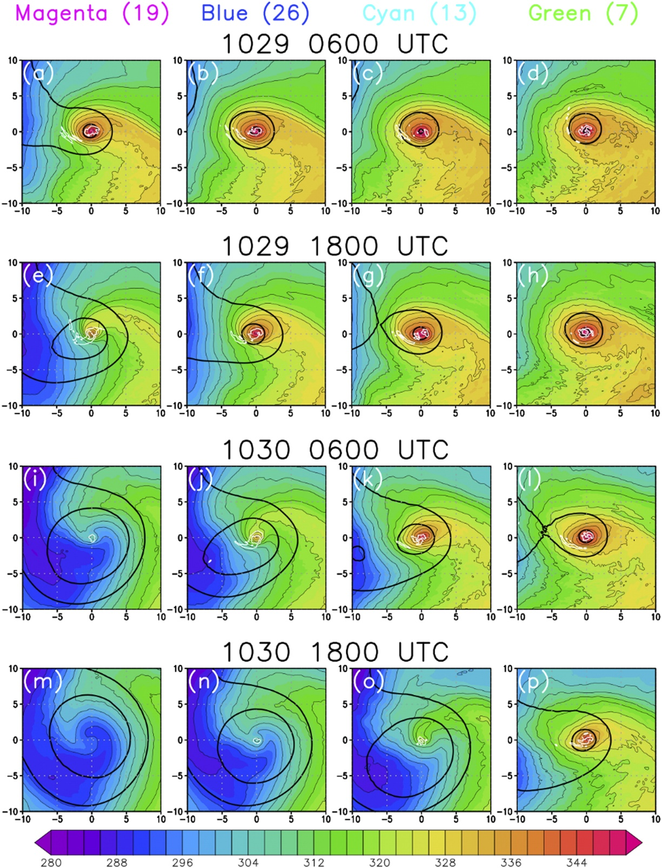
Storm–trough interaction
earlier warm seclusion formation and ET completion
850-hPa equivalent potential temperature
(K; shaded and thin black contours every 4 K)
500-hPa geopotential height
(thick black contours at 5440 and 5560 m)
700-hPa frontogenesis
(white contours at 1 and 2 K m⁻¹ s⁻¹ × 10⁷)
difference between 0–50 and 200–400 km at 850 hPa

Slide 13
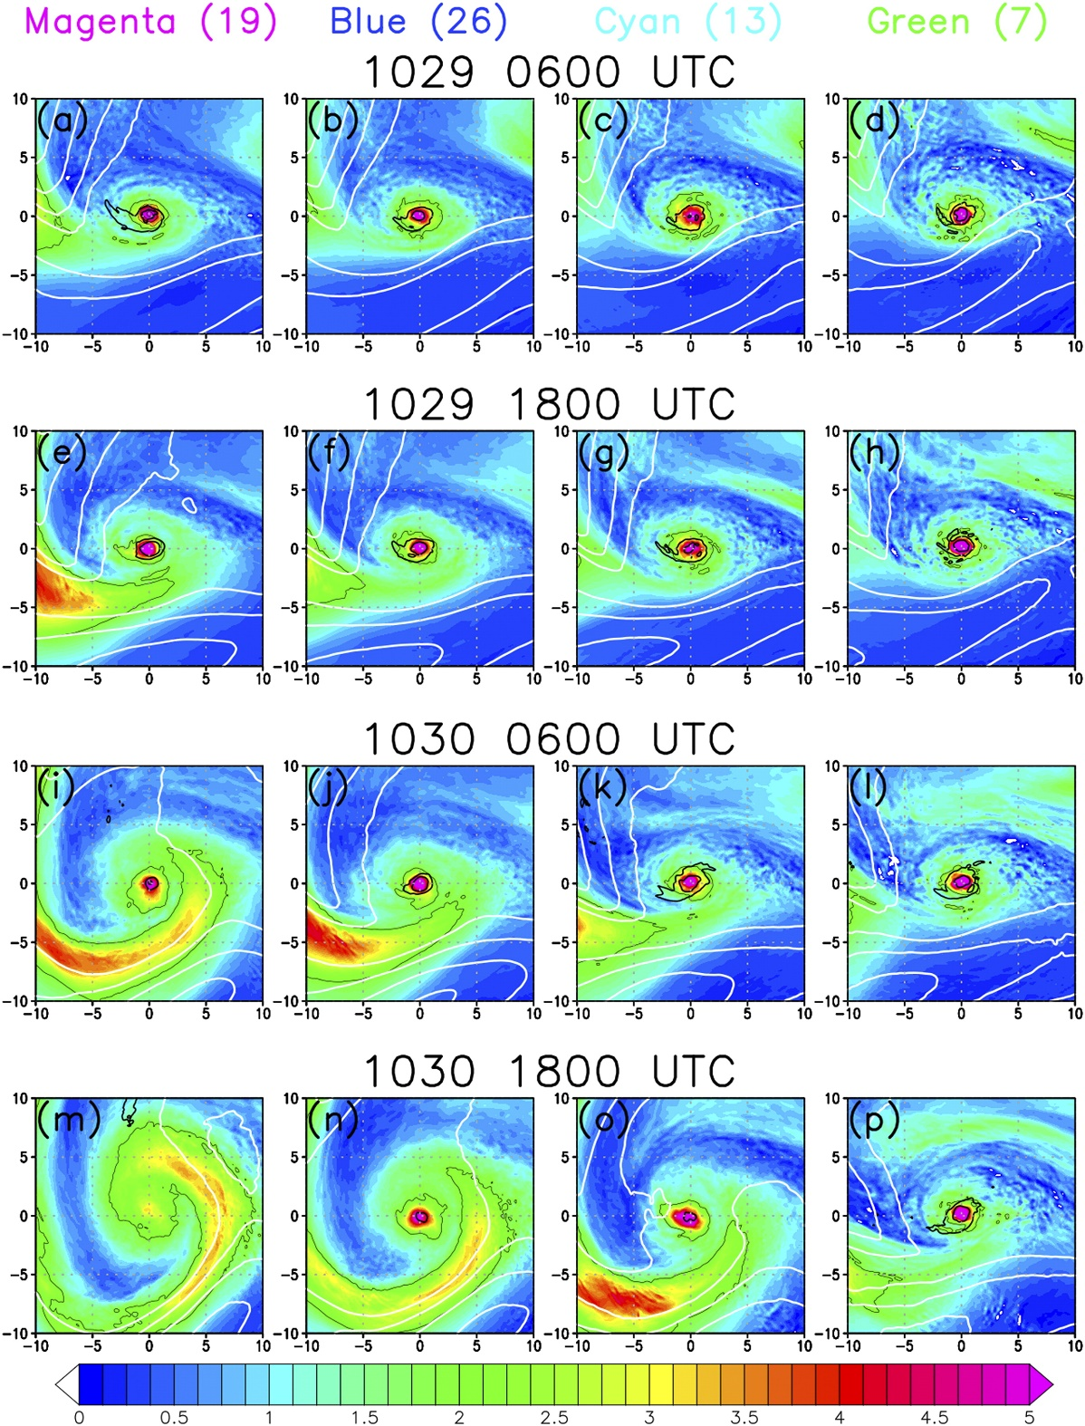
Storm–trough interaction
Potential vorticity on the 325-K isentrope (PVU; shaded and thin black contour at 2 PVU)
900-hPa potential vorticity
(thick black contours at 2 and 4 PVU), and 250-hPa wind speed
(white contours every 10 m s⁻¹ between 25 and 55 m s⁻¹)
1 PVU = 10⁻⁶ K kg⁻¹ m² s⁻¹
900-hPa potential vorticity 0–50 km

Slide 14
Landfall-relative differences in extratropical transition

Slide 15
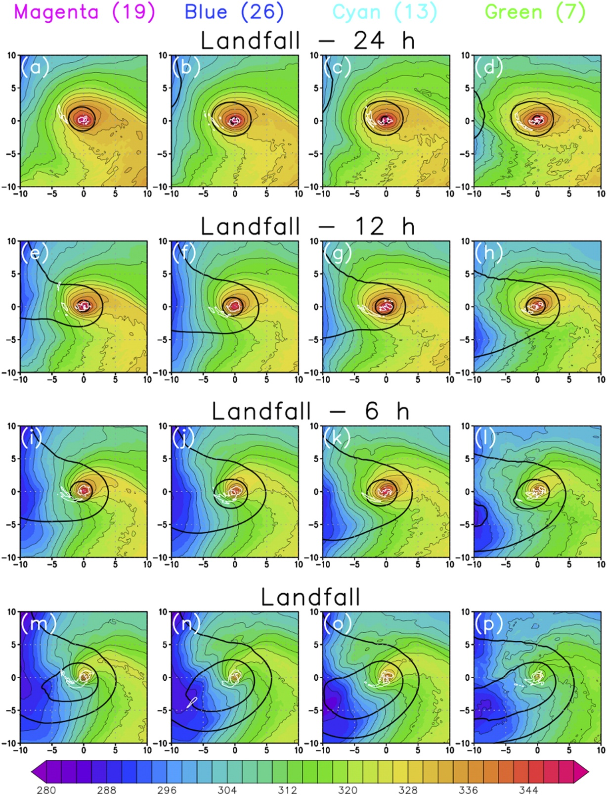
Storm–trough interaction
850-hPa equivalent potential temperature
(K; shaded and thin black contours every 4 K)
500-hPa geopotential height
(thick black contours at 5440 and 5560 m)
700-hPa frontogenesis
(white contours at 1 and 2 K m⁻¹ s⁻¹ × 10⁷)
difference between 0–50 and 200–400 km at 850 hPa

Slide 16
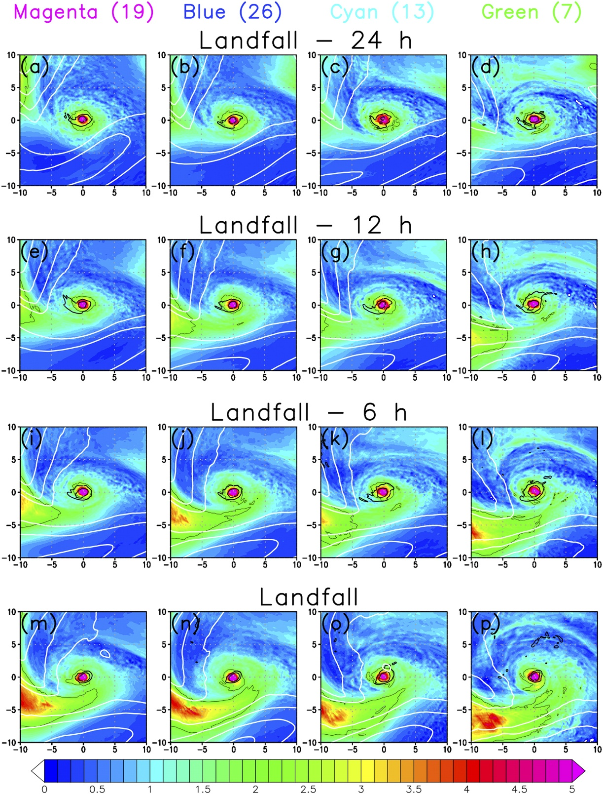
Storm–trough interaction
Potential vorticity on the 325-K isentrope (PVU; shaded and thin black contour at 2 PVU)
900-hPa potential vorticity
(thick black contours at 2 and 4 PVU), and 250-hPa wind speed
(white contours every 10 m s⁻¹ between 25 and 55 m s⁻¹)
1 PVU = 10⁻⁶ K kg⁻¹ m² s⁻¹
900-hPa PV averaged from
(a) 0–50 and (b) 100–200 km

Slide 17
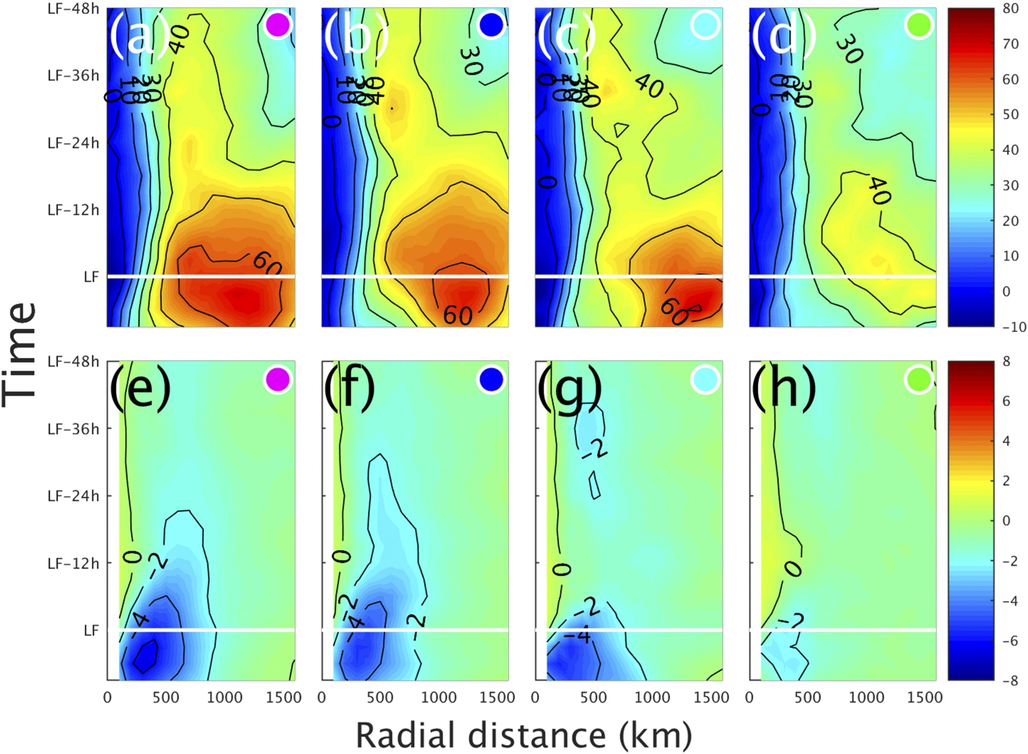
200–300-hPa EMFC 850-hPa radial wind speed

Slide 18
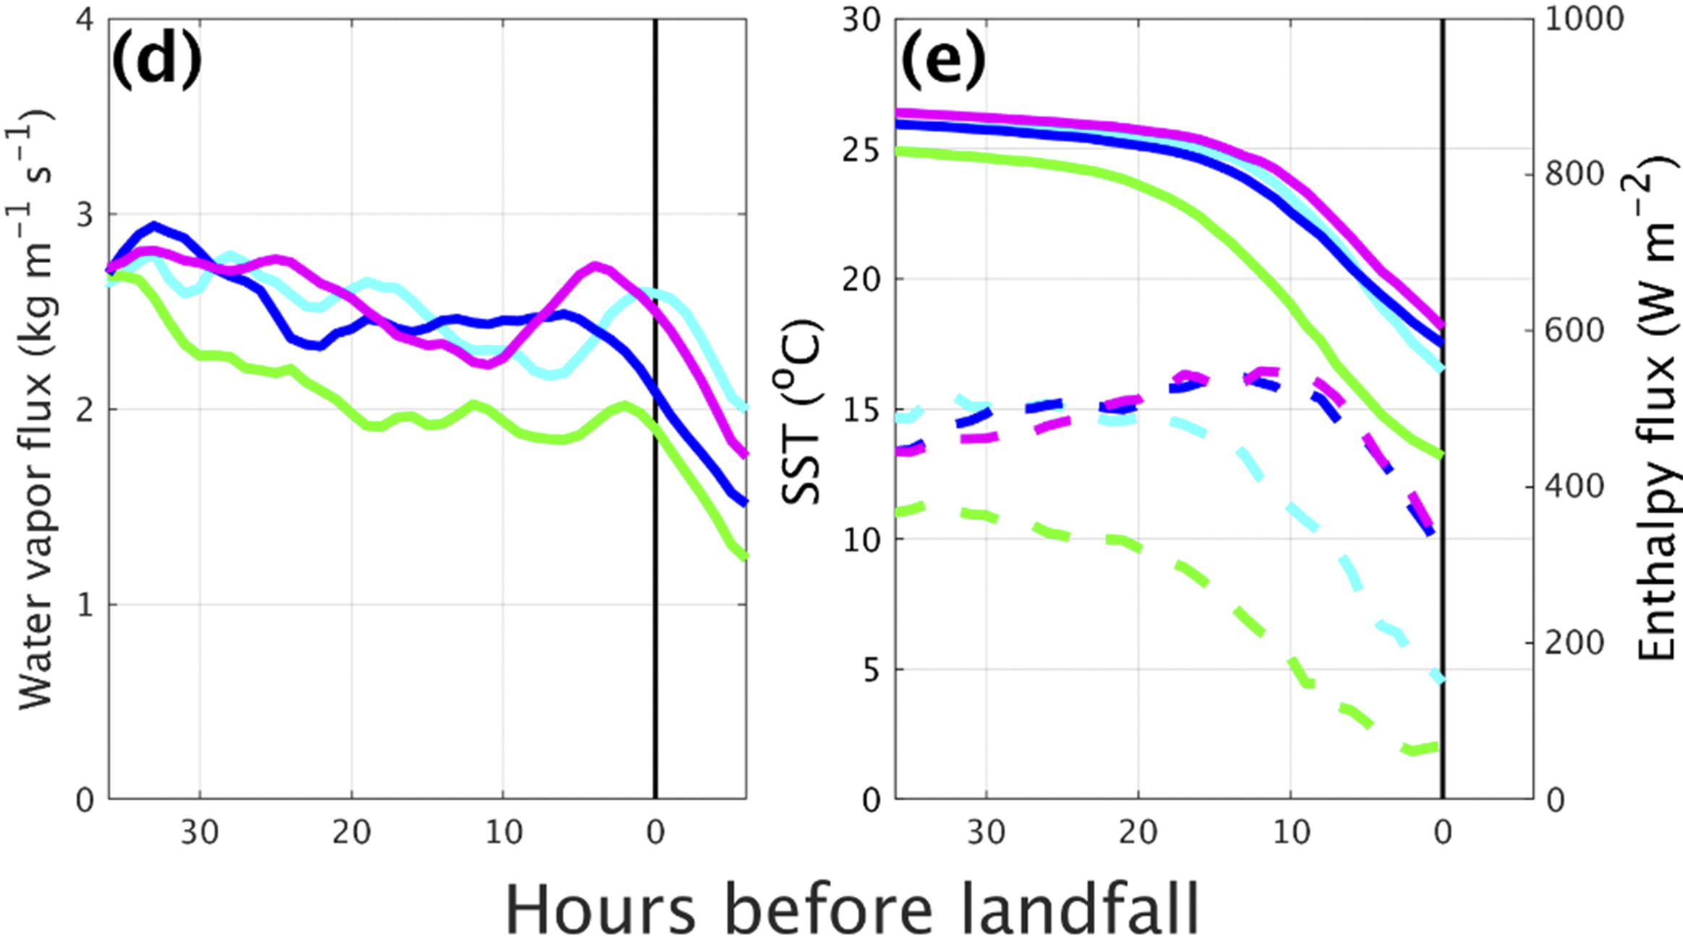
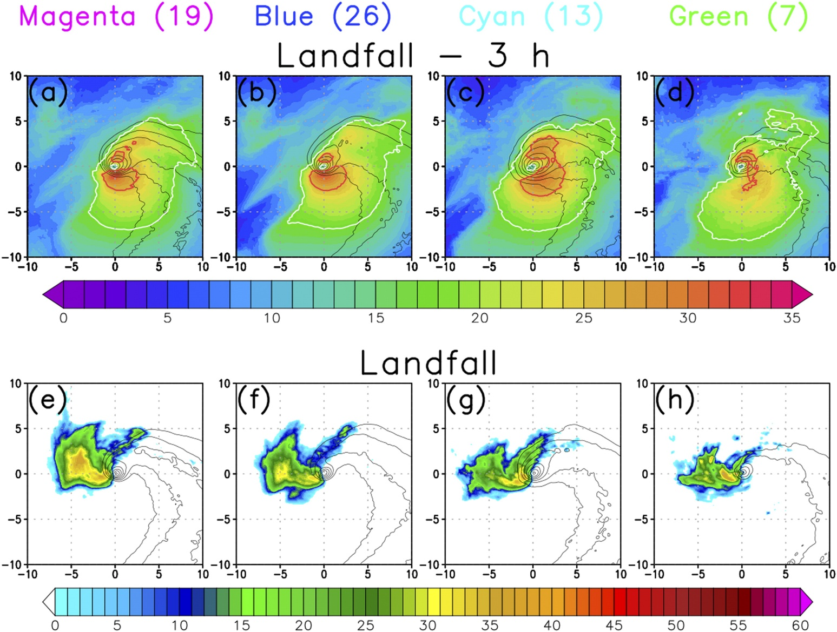
10-m sustained wind 850-hPa dBZ
17.5 m s⁻¹ and 25.7 m s⁻¹
Earlier Sandy–trough interaction relative to landfall yielded less precipitation over land (Munsell and Zhang 2014)

Slide 19
Summary
Sandy–trough interaction manifest in corresponding differences in the timing of PV wrap-up, warm seclusion formation, and seclusion contraction and decay.
Among the members of each cluster, Sandy makes landfall with a small, contracting warm seclusion and an intense, low-level PV core.
Green cluster
less intense storm–trough interaction  warm seclusion is weaker
lower sea surface temperatures and slightly earlier trough interaction
Cyan cluster
most intact warm seclusion
more expansive region of damaging winds
Blue cluster
slightly earlier trough interaction  greater warm seclusion decay and less intense precipitation
Similarity among ensemble members
The large size of both Sandy and the midlatitude trough

Slide 20
Thanks

