Slide 1
Sensitivity of Tropical Cyclone Intensification to Axisymmetric Heat Sources:
The Role of Low-Level Heating and Cooling
from Different Microphysical Processes
Paull, G., K. Menelaou, and M. K. Yau, 2018; JAS

Slide 2
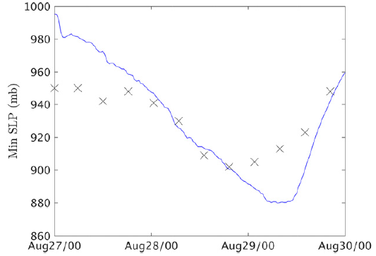
Model configuration
Real Hurricane Katrina Run
WRF
00 UTC 27 Aug 2005 – 00 UTC 30 Aug 2005 (72-hr)
Horizontal: 27/9/3-km (vortex-following)
Vertical: 27 eta levels (model top: 50 hPa)
Parameterization
Surface layer: Eta
PBL: MYJ
LW/SW-Radiation: RRTMG/Goddard
Cumulus: Grell-Devenyi (d01/d02)
Microphysics: Thompson (qv/qc/qr/qi/qs/qg)
IC/BC: NCEP FNL 1 deg mesh with 6-hourly
WRF
OBS
Coarse-resolution NCEP data
Inaccurate forecast SST
Weak model surface friction

Slide 3
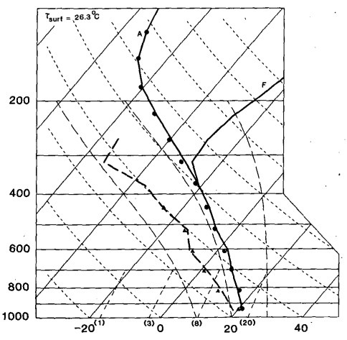
Model configuration
Idealized experiments
WRF
Horizontal: 2-km (600 km x 600 km)
Vertical: 28 levels (model top: 25 km)
Fixed f-plane: f = 5 x 10⁻⁵ (20ºN)
Rayleigh damping layer above 20 km
All parameterization scheme are excluded
IC:
Stationary barotropic balanced axisymmetric TC-like vortex
Sounding: Jordan (1958)
Uniform SST: 26º C
RMW: 65 km
Wind intensity: 50 m/s
BC: periodic
Forcing:
$$v\left(r,z,0\right)=\frac{z_{sponge}−z}{z_{sponge}}\left\langle {\left\{v_{m}^{2}{\left(\frac{r}{r_{m}}\right)}^{2}\left[{\left(\frac{2r_{m}}{r+r_{m}}\right)}^{3}−{\left(\frac{2r_{m}}{r_{0}+r_{m}}\right)}^{3}\right]+\frac{f^{2}r^{2}}{4}\right\}}^{1/2}−\frac{fr}{2}\right\rangle$$
Rotunno and Emanuel (1987)
Simulated Katrina at 11 UTC 28 Aug
$$\dot{θ}(r,z,t)=L(t)×{\dot{θ}}_{max/min}exp\left[−\frac{{(r−r_{c}−γz)}^{α}}{δ_{r}^{α}}−\frac{{(z−z_{c})}^{β}}{δ_{r}^{β}}\right]$$
Rotunno and Emanuel (1987)

Slide 4
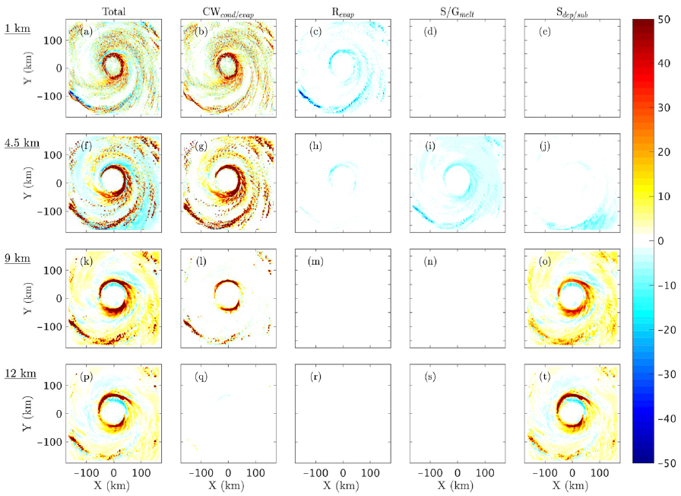
Real Hurricane Katrina simulation - Decomposition of diabatic MP processes
0500 UTC 28 August
PBL top
60 K/h
55 km
-30 K/h
Melting level
Mid troposphere
(Mixed phase)
Upper troposphere
(Cold MP processes dominate)

Slide 5
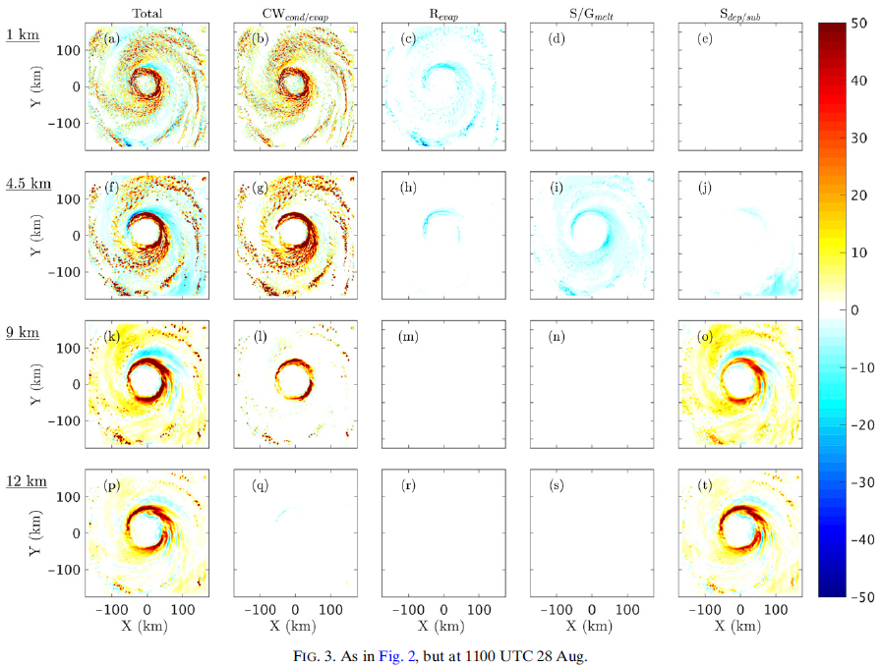
0500 UTC 28 August
1100 UTC 28 August

Slide 6
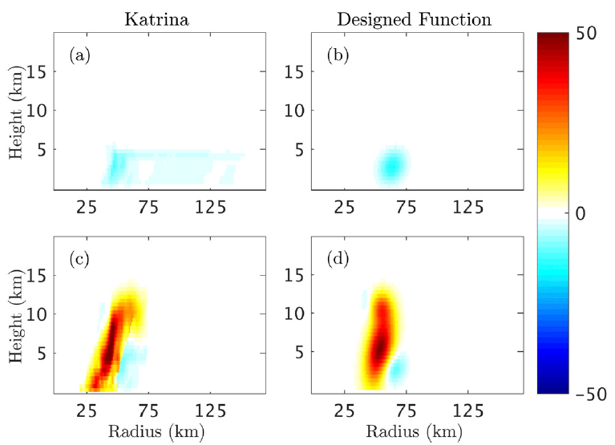
Low-level Heating (qc cond)
Low-level Cooling (qr evap + qs/qg melt)
Upper-level Heating (qs depo)
Upper-level Cooling (qs subm)
( )
/5
$$\dot{θ}(r,z,t)=L(t)×{\dot{θ}}_{max/min}exp\left[−\frac{{(r−r_{c}−γz)}^{α}}{δ_{r}^{α}}−\frac{{(z−z_{c})}^{β}}{δ_{r}^{β}}\right]$$

Slide 7
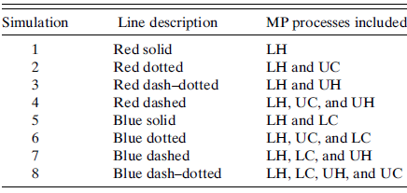
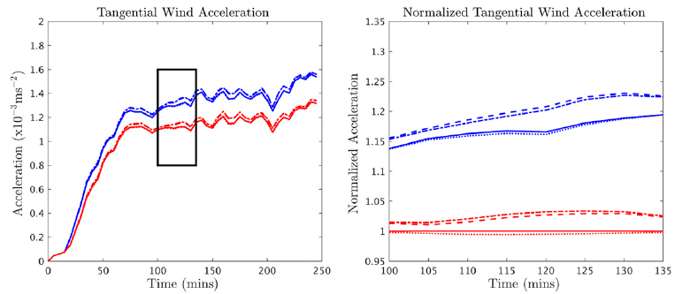
LH | LC | UH | UC
O | O | O
O | O | O | O
O | O
O | O |  | O
O |  | O
O |  | O | O
O
O |  |  | O

Slide 8
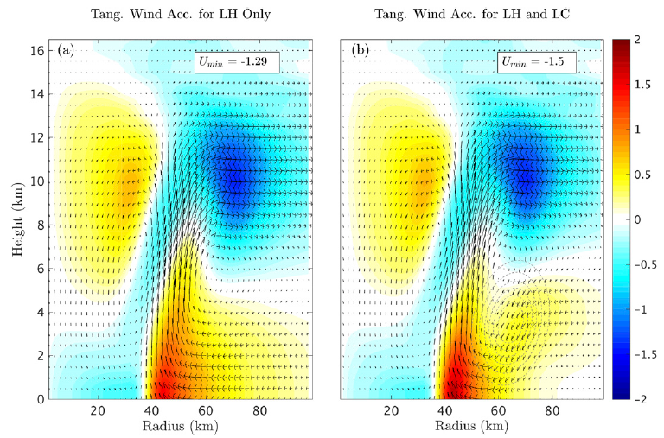
Stronger inflow implies larger radial transport of low-level absolute angular momentum, which further produces larger acceleration.

Slide 9
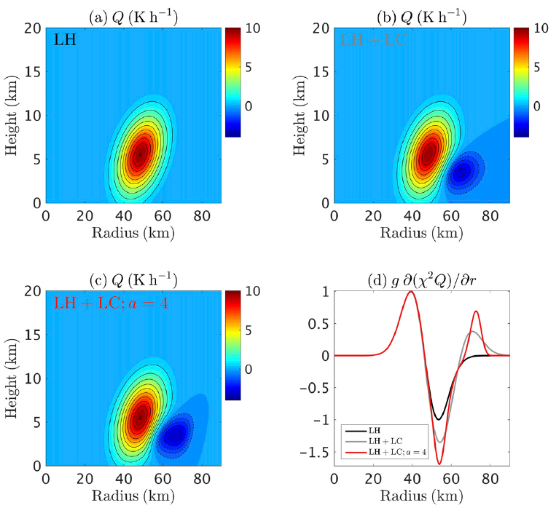
Why the cooling located outside the RMW with 1/3 of the magnitude of the heating can have such a strong impact?
Sawyer-Eliassen equation
$$χ=\frac{1}{θ}$$
$$C=fv+\frac{v^{2}}{r}$$
$$ξ=\frac{2v}{r}+f$$

Slide 10
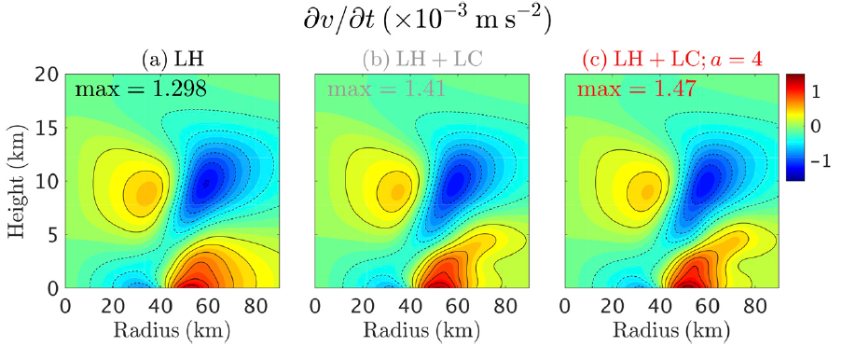
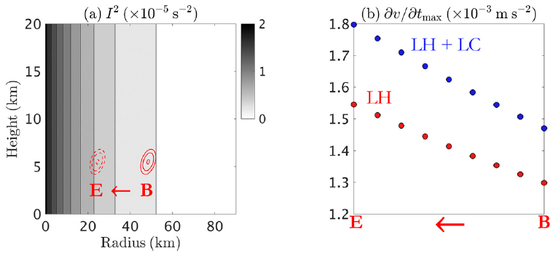

Slide 11
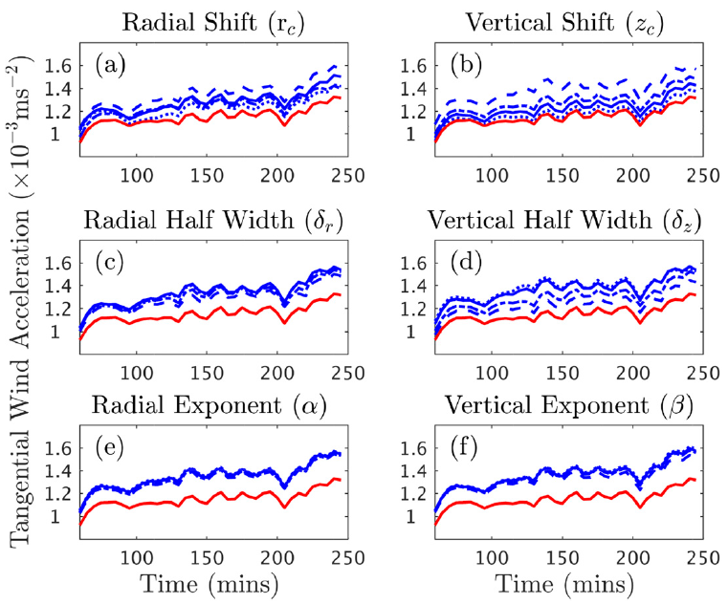
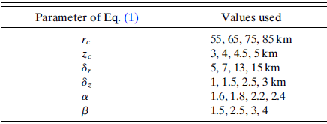
Modification of the LC forcing
small
large
small
large
60
3.5
10
2
2
2
large
small
large
small

Slide 12
$$\frac{∂\overline{v}}{∂t}=−\overline{u}\left(\overline{ζ+f}\right)−\overline{w}\overline{\frac{∂v}{∂z}}−\overline{u^{′}}\overline{ζ^{′}}−\overline{w′}\overline{\frac{∂v′}{∂z}}$$
$$I^{2}=\left(ζ+f\right)\left(\frac{2v}{r}+f\right)$$
$v_{max}=15,20,25…55 m/s$
$$r_{max}=55 km$$
I² (s⁻²) |  | u (m/s) | ζ (10⁻³ s⁻¹) | a (10⁻³ m/s²)
2.87 | LH+LC | -0.66 | 1.8 | 1.2
0.21 | LH+LC | -0.68 | 0.91 | 0.62
2.87 | LH | -0.54 | 1.9 | 1.0
0.21 | LH | -0.83 | 0.62 | 0.53

Slide 13
$$N^{2}=\frac{g}{θ}\frac{∂θ}{∂z}$$
$$\frac{∂\overline{v}}{∂t}=−\overline{u}\left(\overline{ζ+f}\right)−\overline{w}\overline{\frac{∂v}{∂z}}−\overline{u^{′}}\overline{ζ^{′}}−\overline{w′}\overline{\frac{∂v′}{∂z}}$$
reversing bottom 6-km N²
25/50/75/100% LH+LC
constant N²
25% LH
double N²

Slide 14
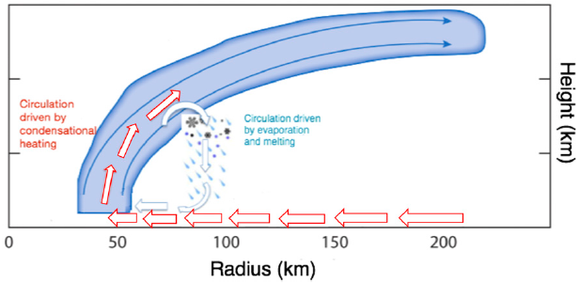
Conclusions
The addition of cooling enhances the lower-level inward radial winds, which in turn increases the acceleration of the lower-level tangential winds through an enhanced transport of absolute vorticity.
Sensitivity experiments on varying the structure of the cooling functions and the background state of the vortex demonstrate that the lower-level tangential wind acceleration is more sensitive to changes in the vertical structure and location of the cooling than the radial characteristics.
the lower-level acceleration is sensitive to variations in the inertial and static stabilities rather than the vertical tangential wind shear of the initial vortex and its environment.

Slide 15
Conclusions
PBL
Microphysics and Radiation
The addition of a planetary boundary layer would significantly alter the radial wind structure and thus the transport of absolute vorticity.
Ice-phase processes may play in influencing the temperature and moisture structures through cloud radiative feedback.

Slide 16
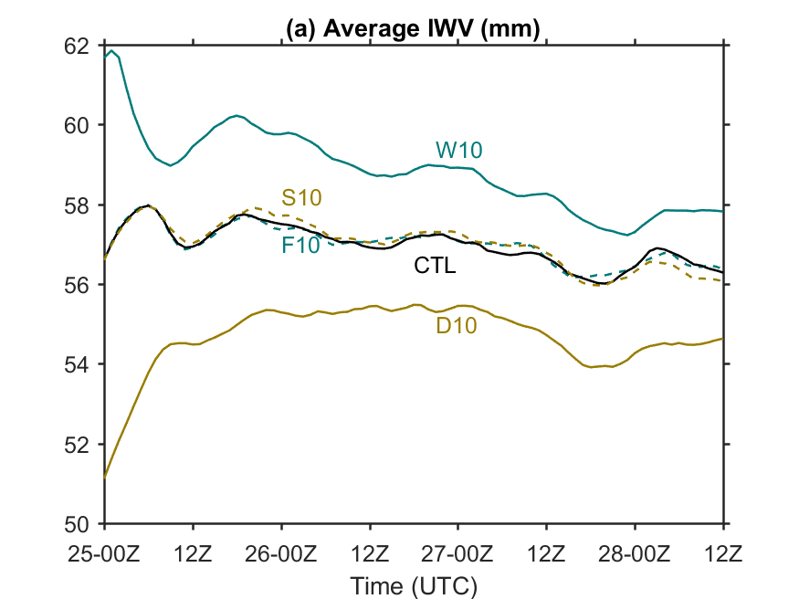
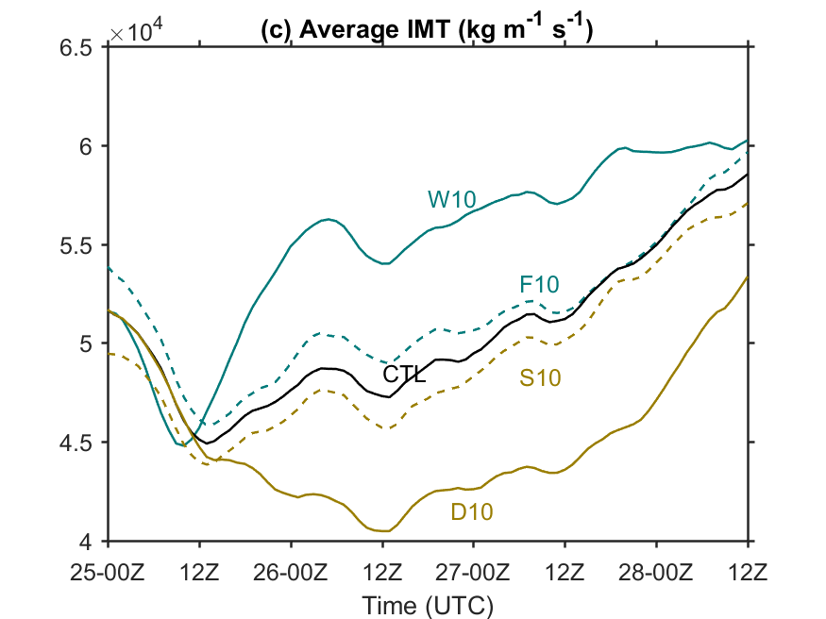
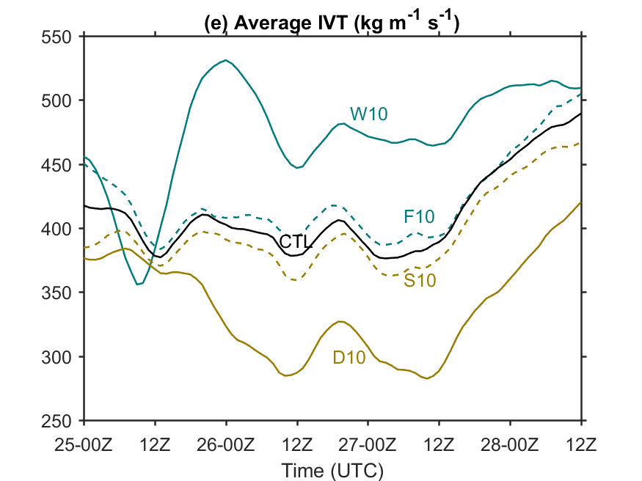
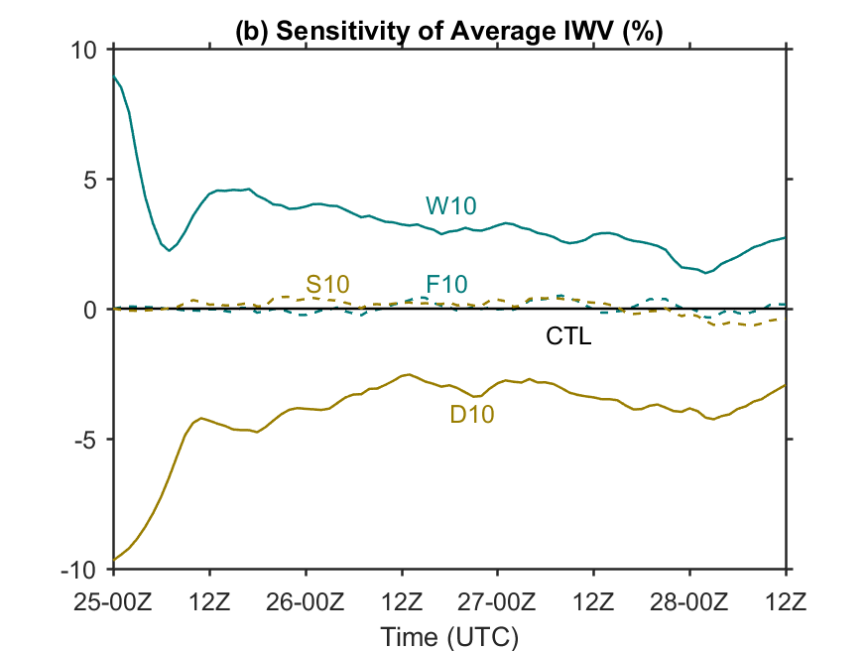
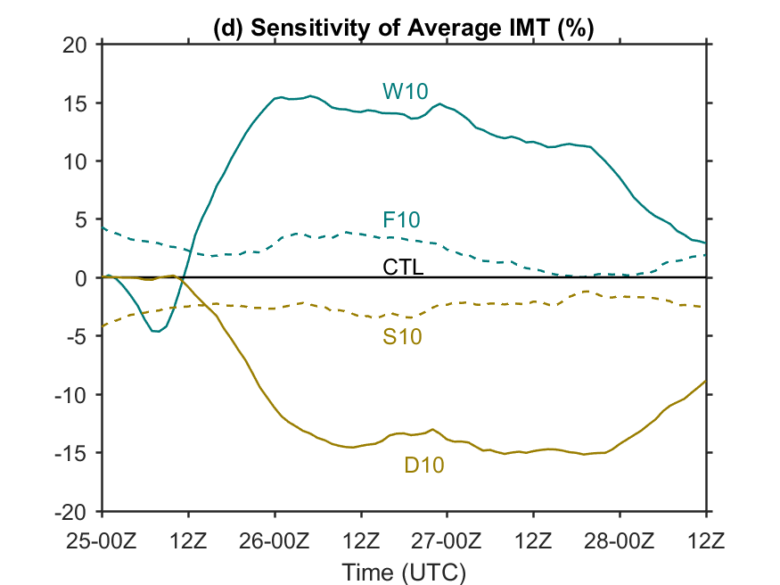
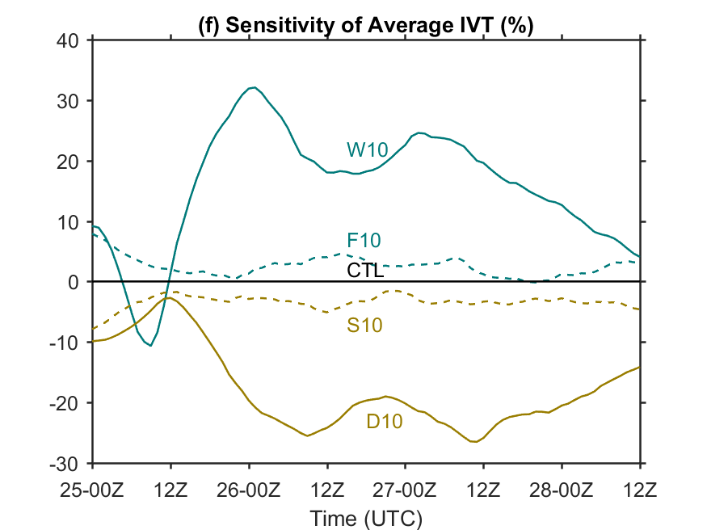
F10

Slide 17
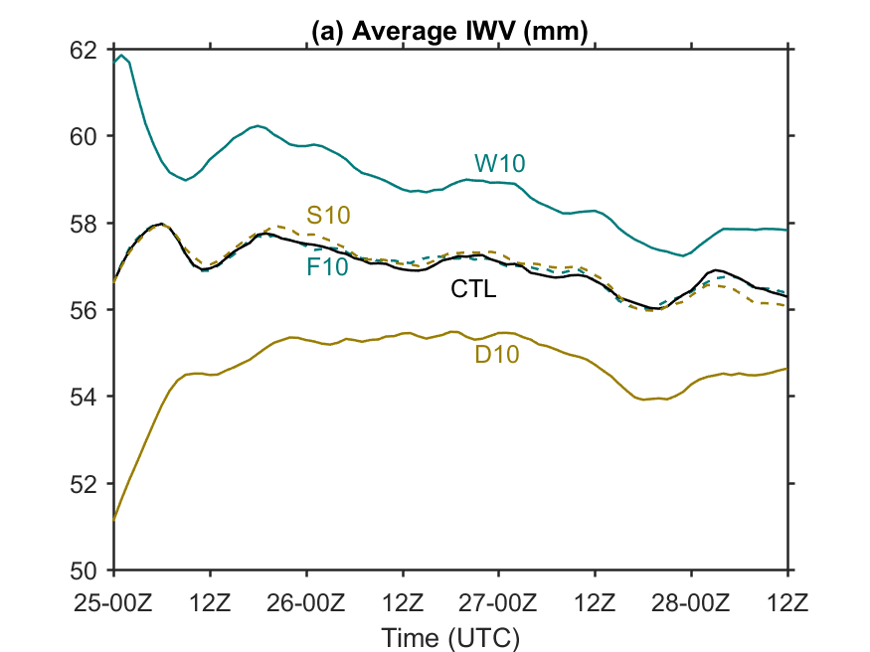
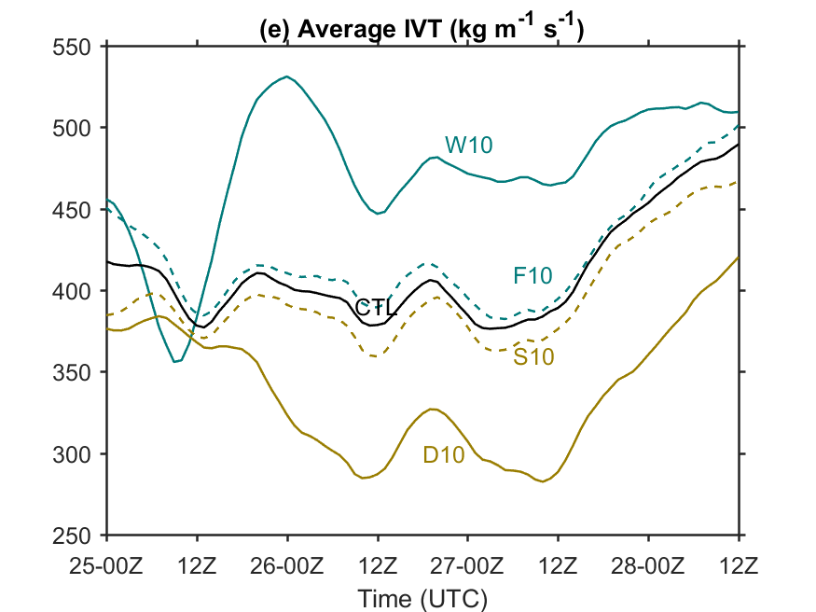
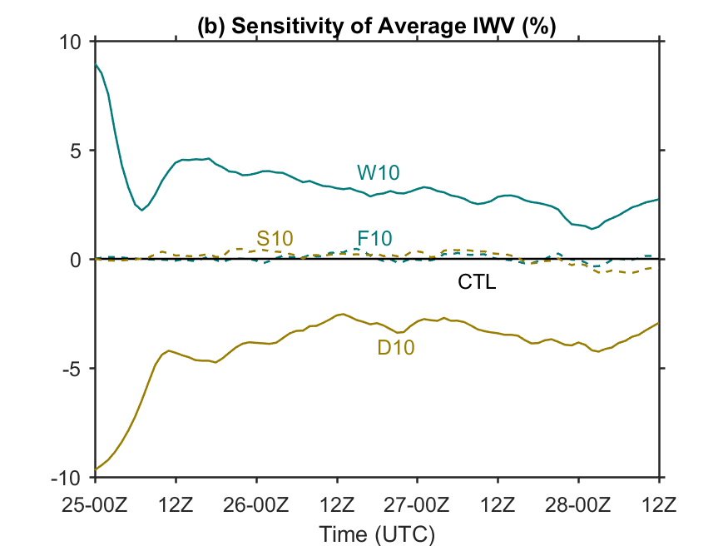
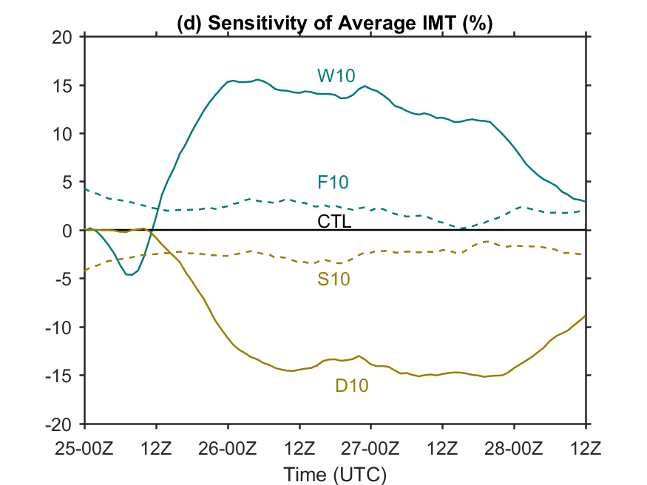
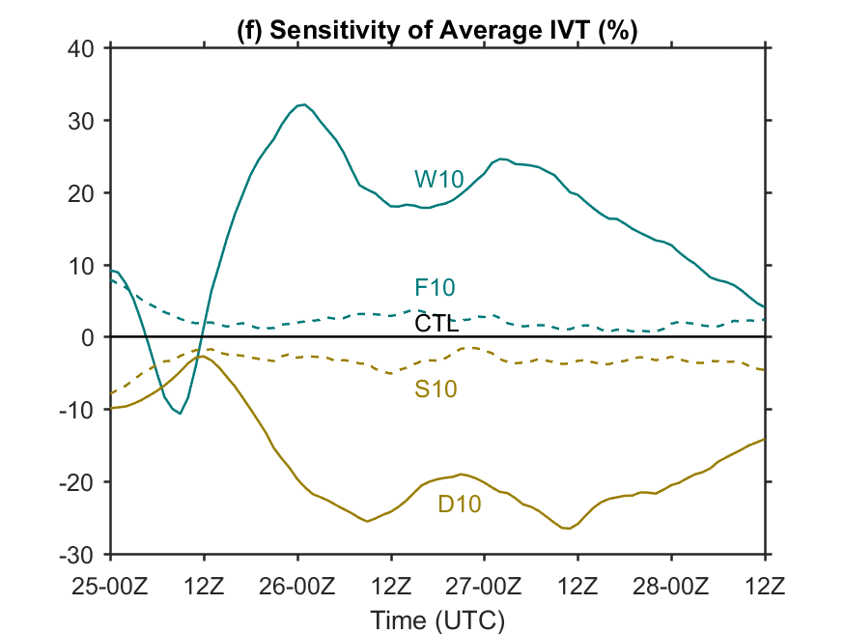
F10_PVinv

Slide 18
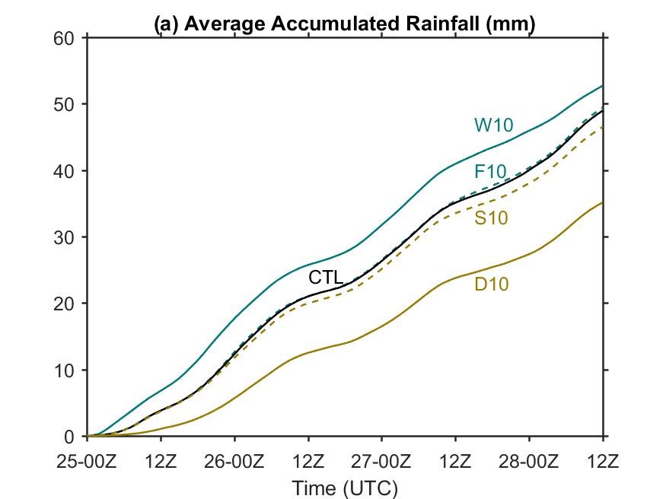
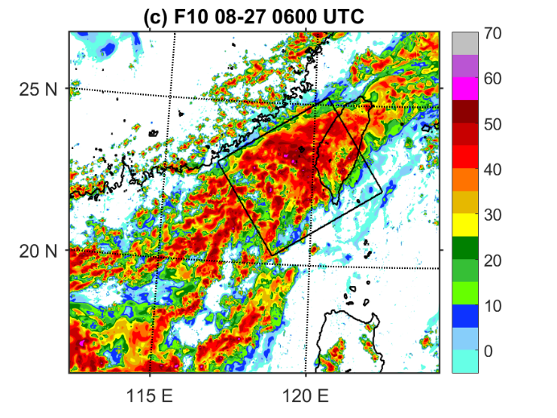
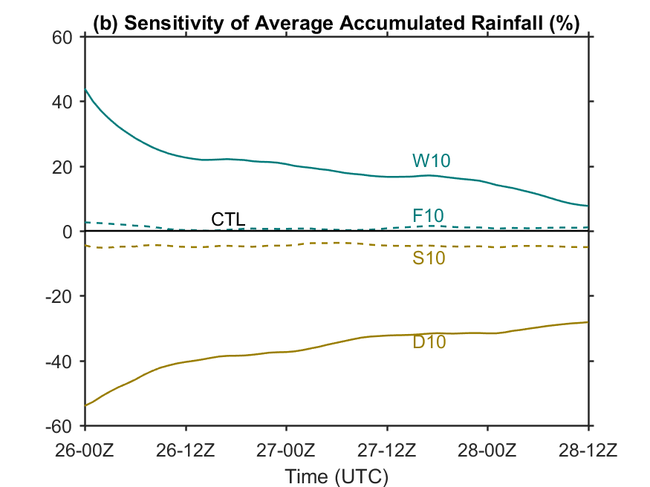
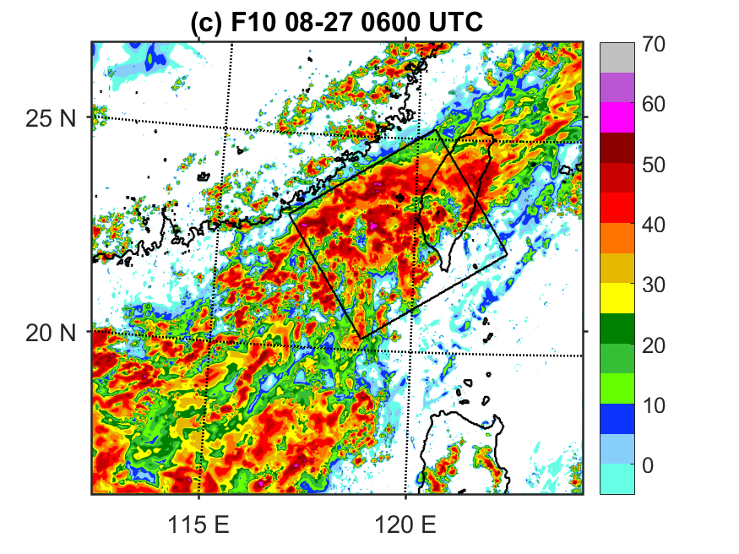
F10_PVinv
F10
F10_PVinv

