Slide 1
Increase in Precipitation Efficiency With Surface Warming in Radiative-Convective Equilibrium
Lutsko, N. J., and T. W. Cronin, 2018: Increase in precipitation efficiency with surface warming in radiative-convective equilibrium. J. of Advances in Modeling Earth Systems, 10, 2992–3010.
Notes:
在SST溫度上升的情況下，透過輻射與機雲之間交互作用後，造成降水效率的改變

Slide 2
Introduction
The precipitation efficiency of convection is a measure of how much of the water that condenses in a rising column of air reaches the surface as precipitation.
$$ε=\frac{P}{C}$$
P : surface precipitation rate (kg m⁻² s⁻¹)
C : column-integrated condensation rate (kg m⁻² s⁻¹)

Slide 3
Many factors contribute to the precipitation efficiency:
the various microphysical processes → autoconversion rate, the fall speeds of the hydrometeors
cloud-scale dynamics → entrainment rates
precipitation efficiency can be tuned quite precisely in some global climate models (GCMs; Zhao, 2014), and several recent studies have found a strong relationship between climate sensitivity and the response of 𝜖 to warming (Mauritsen et al., 2012; Tomassini et al., 2015; Zhao, 2014; Zhao et al., 2016).
the precipitation efficiency decreases in warmer conditions are able to maintain greater amounts of cloud cover and thus have a more negative cloud feedback (Sherwood et al., 2014; Zhao, 2014).
𝜖 is also an important factor in models’ projections of future changes in the hydrologic cycle, and influences the rate at which aerosols are removed from the atmosphere (Bailey et al., 2015).
Notes:
Primarily focus on the tropical-mean, or bulk, precipitation efficiency.
降水效率在氣候模式可以被調整，但對於氣候模式有很大的影響。
研究提出，暖化會減少降水效率，導致大氣中雲量變多。
降水效率對於水循環，和大氣中的懸浮粒子的改變。

Slide 4
Model and Experiments
Model: System for Atmospheric Modeling version 6.10.8 (SAM; Khairoutdinov & Randall, 2003).
Gravity waves are damped at the top of the domain
subgrid-scale fluxes are parameterized using Smagorinsky’s eddy diffusivity model.
A small amount of white noise added to the temperature field near the surface to initiate convection.
1. small domain simulation:
2. mock-Walker simulation:
Periodic domain
Y =96 km
fixed SSTs
Periodic domain
sinusoidal SST profile
Z = 64 levels (50 m →1 km)
$$5K$$
X = 24,576 km, $∆x=3 km$ (Periodic domain)
X = 96 km, $∆x=1km$
Notes:
vertical grid spacing increases from 50m at the lowest levels to roughly 1 km at the top of the domain
A variable time step is used, with maximum interval 10 s, and radiative fluxes are calculated every 40 time
steps using the CAM radiation scheme. The incoming solar radiation is fixed at 650.83 W/m2 with a zenith
angle of 50.5∘ (Tompkins & Craig, 1998), producing a net insolation close to the tropical-mean value, and
the simulations were initialized with a small amount of white noise added to the temperature field near the
surface to initiate convection.

Slide 5
in order to test the sensitivity of 𝜖 to the microphysical scheme
Two single-moment scheme:
Khairoutdinov and Randall (2003) → K03
“NOSEDAALIQ5” setup of Lopez et al. (2009)→ NA5
One double-moment scheme:
Morrison et al. (2005) → M05
Notes:
single-moment micro-physics schemes predicting the total mass concentration
second moment often include the prediction of total number concentration

Slide 6
Diagnostic Framework
a similar framework to Langhans et al. (2015) to diagnose the causes of changes in precipitation efficiency.
The total precipitation reaching the surface :
$α:$cloud condensate
$β:$ re-evaporation
C: column-integrated condensation rate
E : column-integrated sink of precipitation due to evaporation
$$β = E∕αC$$
$$ε=\frac{P}{C}$$
$$ε = α(1 − β)$$
Notes:
to diagnose the causes of changes in precipitation efficiency: decomposing the process of cloud condensate reaching the surface as precipitation into two steps.
First, a fraction 𝛼 of the cloud condensate is converted into precipitation, while (1 − 𝛼) stays suspended in the column and either forms a cloud or else is detrained from the convecting region and evaporates.
In the second step the precipitation falls to the surface, during which some fraction 𝛽 is re-evaporated and so we will refer to 1 − 𝛽 as the sedimentation efficiency
The total precipitation reaching the surface is then

Slide 7
Small Domain Simulations
single-moment scheme : K03, NA5
double-moment scheme : M05
Variation of 𝝐 With SST
$$ε$$
$$α$$
$$1−β$$
𝜖 increases monotonically as the SST is increased
In the simulations with the single-moment scheme 𝛼 increases monotonically with SST
The changes of $1−β$ are small
the increasing precipitation efficiency is due to the increasing conversion efficiency
Notes:
使用single-moment scheme, 降水效率與轉換效率隨著SST上升而提高, 且降水重新蒸發後，剩下實際降水的沉降效率，隨著溫度增加而減少。
因此，在SST上升情況下，造成降水效率提升的因素主要來自於雨水轉換效率提高的貢獻。

Slide 8
Small Domain Simulations
single-moment scheme : K03, NA5
double-moment scheme : M05
Variation of 𝝐 With SST
$$ε$$
$$α$$
$$1−β$$
Notes:
Double-moment scheme的MO05的模擬結果較為複雜。
沉降效率隨著SST的變化，先是下降，後上升接著由於再次蒸發過程增加使得沉降效率再次下降。
造成降水效率在SST 282.5~302.5之間上升，主要來自於沉降效率增加的影響，之後當溫度超過至302.5之後，降水效率提高的因素，變成由轉換效率提高為主要原因。
因為M05的雨水再次蒸發量明顯低於K03與NA5，而轉換效率高於K03，並與NA5相差較低，因此M05的降水效率最高。而K03由於轉換效率明顯較低，因此降水效率最小。
Returning to Figure 1c, the sedimentation efficiency decreases in the K03 simulations as the SST increases
because the fall time increases faster than the saturation deficit decreases, so more precipitation is
re-evaporated. In the NA5 simulations the saturation deficit decreases faster than the fall time for the colder
simulations, so 1 − 𝛽 increases at first, and then the fall time increases faster for the warmer simulations and
1 − 𝛽 decreases.
In the M05 simulations the large decreases in the fall speed in the colder simulations causes
1−𝛽 to increase for SSTs up to 302.5 K, and then it decreases in the warmest simulations when the precipitation
is dominated by rain.

Slide 9
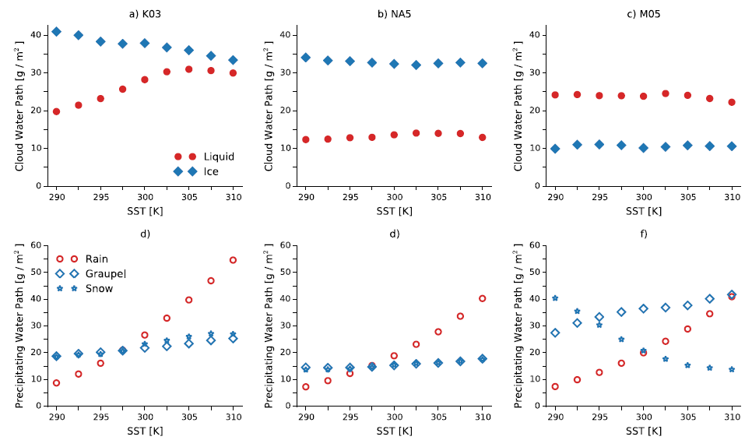
Notes:
不同降水粒子的質量
由single-moment scheme的模擬結果，當SST提高時，轉換效率提高，主要受到液態水轉換為降水過程的貢獻，而Graupel和snow沒有明顯變化。
M05的雲水較雲冰多，主要是由於此為物理參數化方案傾向於存在較多的過冷水。而兩個含量不隨溫度改變。
There is more liquid cloud water than cloud ice in the M05 simulations because the microphysics maintains more supercooled water (not shown), but the ratio of these stays constant across the simulations (Figure 2c).
The mass of graupel increases slightly as the SST is increased, and the mass of rain again increases rapidly, but
the mass of snow decreases substantially (Figure 2f ). This decrease in the mass of snow is responsible for the
nonmonotonicity in 𝛼, as the mass of cloud ice stays fixed.

Slide 10
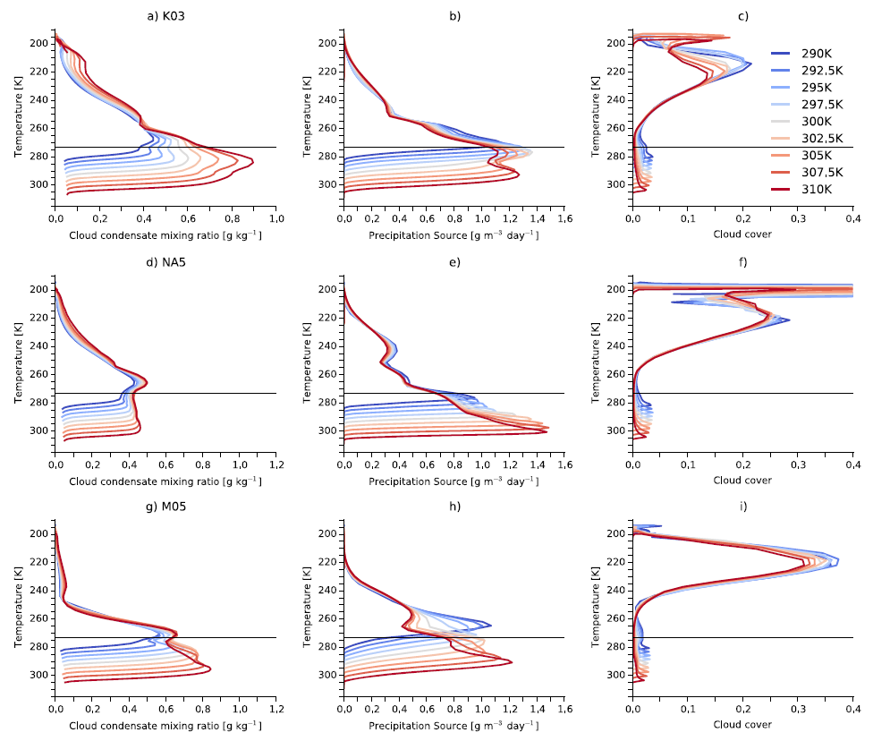
Black line: freezing level
Notes:
在所有高度層上的Cloud water/ice等等 隨SST溫度增加而增加。
而NA5地的cloud condensate混合比較小，且在freezing level下隨高度的變化較為一致。
隨著溫度增加，雲水明顯增加，而降水型態逐漸轉為暖雲降水，冷雲降水減少。
因此，當SST增加，雲冰逐漸轉為雲水。
而在M05模擬中，雖然雲水雲冰的垂直分布與single-moment scheme的結果類似，但在較低SST的實驗中卻有較多的冷元降水。
所以在M05中，參數化方案傾向於模擬較多的冷雲降水。
由cloud cover，當SST增加高層雲減少，雲底越低。

Slide 11
In the single-moment microphysics, autoconversion is carried out by a fractional removal scheme, which takes the form
q_{p} : mixing ratio of a precipitating species
𝜂 : autoconversion rate coefficient
q_{c} : mixing ratio of a cloud condensate
q_{c,0} : a threshold condensate mixing ratio
Notes:
在single-moment scheme中，當cloud water大於某個門檻值後，超過的部分乘以轉換率係數後，等於液態水的變化。

Slide 12
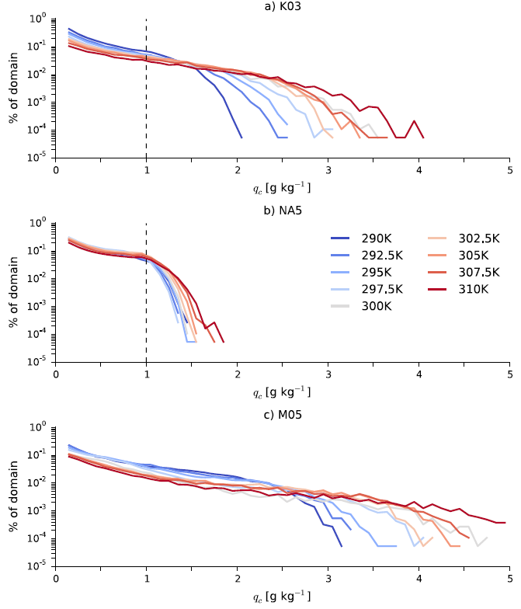
probability density functions of mixing ratio of cloud condensate
at the altitudes of maximum time-mean condensation
before reaching a cutoff value after which the probability density decays more rapidly
The slopes of the PDFs weaken, and the cutoff values increase as the underlying SST is increased
Dash line: q_{c, 0}
Notes:
Cloud condensate 的機率分布函數PDF，取時間平均於某個高度的最大值。
Cloud condensate呈現指數減少的分布，並且在超過qc0 也就是凝結的門檻值時，cloud condensate迅速減少
而當溫度增加時，cutoff value增加

Slide 13
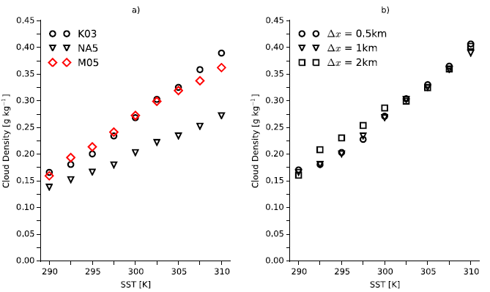
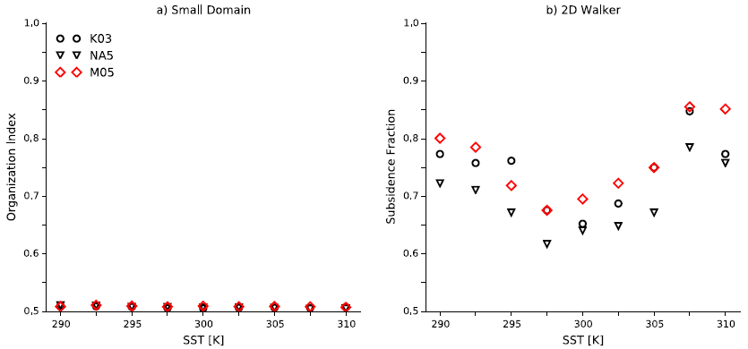
Notes:
使得cloud condensate增加的原因，可能來自於積雲對流發展較有組織性
但經過計算對流最大連通面積(500hPa omega > 0) 組織性幾乎沒有差異。
但cloud density的確隨溫度增加而增加。

Slide 14
Changes in Precipitation Evaporation
re-evaporation of falling precipitation:
RH : relative humidity
t : average fall time
h :the average height at which precipitation forms
w : the average fall speed
RH is calculated as the mean relative humidity weighted by the mass of falling precipitation at each level:
Overline : domain average
q_{p} : the sum of the mixing ratios of all precipitating species
average fall speed of the precipitation
Notes:
雨水再次蒸發過程，作者將此過程近似為未飽和的部分乘以降水掉落至地面的時間。
掉落至時間可透過降水粒子形成的高度除已掉落速度
其中RH 和 W 經過降水粒子的混合比進行標準化，並計算範圍平均後的平均值。

Slide 15
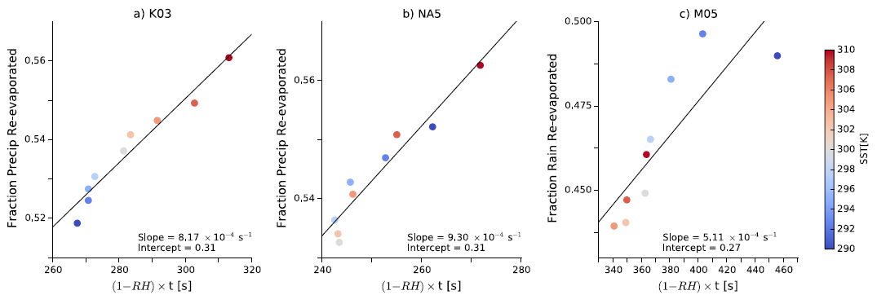
the M05 simulations reflect differences in the microphysics controlling how rain and snow are evaporated in the double-moment scheme
Notes:
透過近似與scaling後得到的beta值與模式輸出的結果有很高的相關性，而M05相關性較低，反映出double-moment scheme控制降水粒子重新蒸發的過程較為複雜。

Slide 16
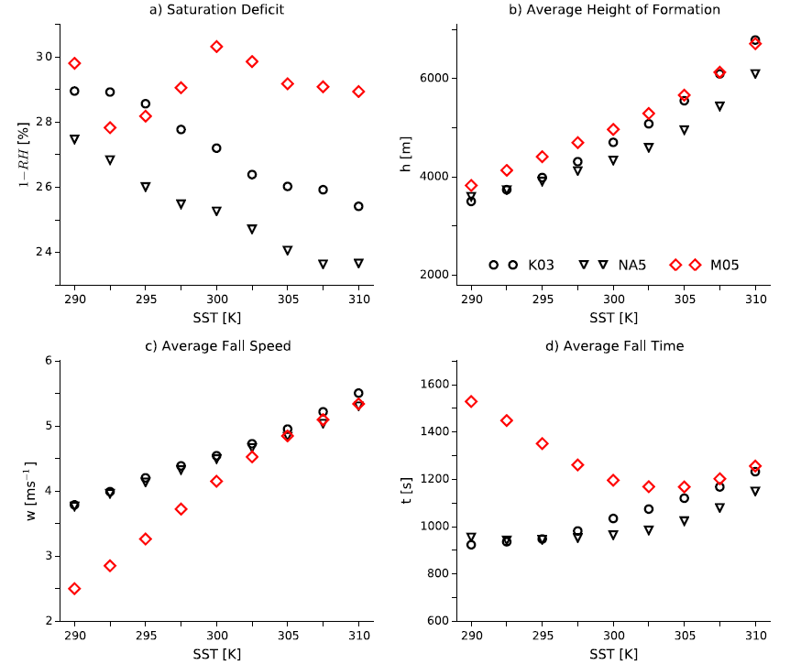
$$(1−RH)$$
h
$$1−β$$
w
t
Notes:
式中每一項隨SST的變化
兩個single-moment scheme的模擬結果趨勢方常類似:
當SST增加RH增加的結果造成第一項隨溫度減少，但降水形成的高度增加，且掉落速度也增加。
但高度增加的趨勢較掉落速度的增加的趨勢快，因此掉落時間增加
而M05在RH的變化較為複雜:
但是高度跟速度接隨時SST增加而增加。其中掉落速度在SST較低時，速度較慢，而溫度增加時，掉落速度明顯較快。
其原因主要是由於M05有較多的雲雪，當溫度增加後，降雪 減少，液態水增加後，造成平均掉落速度增加
所以，造成掉落時間由原本減少之後增加。
在single-moment scheme中，由於降水粒子的掉落時間增加趨勢小於(1-RH)的減少速度，因此沉降效率隨溫度降低。
在M05模擬中，粒子掉落速度減少造成沉降效率增加，之後降水型態逐漸轉為暖雲降水後，沉降效率降低。

Slide 17
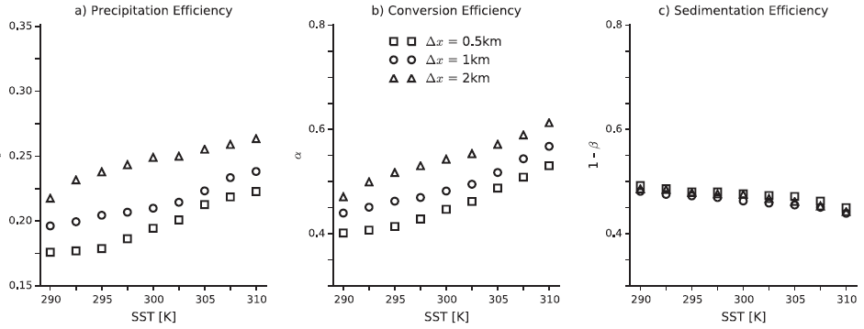
Sensitivity to Resolution
compares the precipitation efficiencies in simulations with the K03 microphysics and grid sizes of 0.5, 1, and 2 km.
The efficiencies decrease as the grid size decreases.
Re-evaporation is unaffected by changing the grid size.
Notes:
降水效率、轉換效率與沉降效率接隨著網格大小降低而減少。
而降水效率降低，主要受到轉換效率明顯隨著網格大小減小而降低的影響。
雨水再次蒸發過程受網格大小改變的影響較低。

Slide 18
the average cloud density decreases as the grid size decreases
the rate of entrainment of environmental air into convecting plumes increases as the grid size decreases, reducing the cloud condensate mixing ratios.
Notes:
雲的密度也隨著網格大小減少而降低。
其原因可能是由於當網格點減少後，空氣塊逸入率增加，使得cloud water/ice混合比減少。

Slide 19
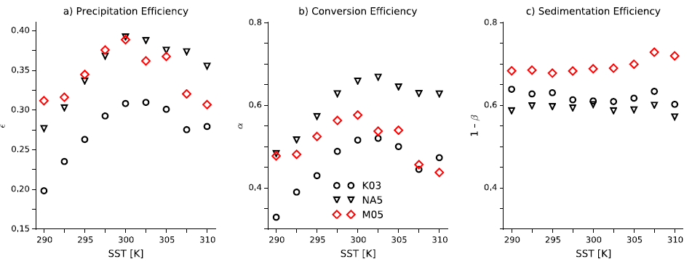
The 2-D Mock-Walker Simulations
𝜖
𝛼
1 − 𝛽
the precipitation efficiencies increase with warming up to 300 K and then decrease.
the sedimentation efficiency is larger in these simulations than in the small domain simulations because the relative humidity in the precipitating regions is higher and hence the saturation deficit is lower.
Notes:
降水效率於300K前增加，之後減少。
此趨勢主要由轉換效率主導，而沉降效率隨溫度的變化相對較低。

Slide 20
the subsidence fraction of the domain with 𝜔500 > 0, Coppin & Bony, 2015
the subsidence fraction decreases by∼15% when going from290 K to 297.5 K with all three schemes
and increases at warmer SSTs
Notes:
The changes in the conversion efficiency 𝛼 reflect substantial changes in the organization of convection.

Slide 21
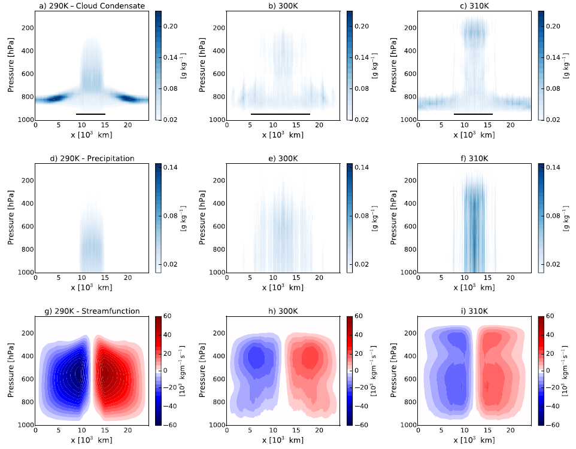
narrow regions of deep convection over the warmest SSTs and low clouds decks outside these regions
In the 300 K case the strongest convection is over the warmer SSTs, but it is less intense and the low cloud decks are less well defined
Although the low clouds have large cloud condensate mixing ratios, they have small precipitation efficiencies.
Notes:
在模擬的渥克環流環境下，模式中的積雲呈現在較暖海溫區域存在深對流雲，而兩邊海溫較低的區域為發展高度較淺的淺對流雲。
於300K海溫的模擬中，較暖海水區域的機雲對流發展強度相對較弱，而低雲的發展強度較不明顯。
雖然低雲的部分有較多的cloud condensate mixing ratio，但因為較低的降水效率，造成此範圍內的降水明顯較低，尤其是290K模擬此現象最為明顯。

Slide 22
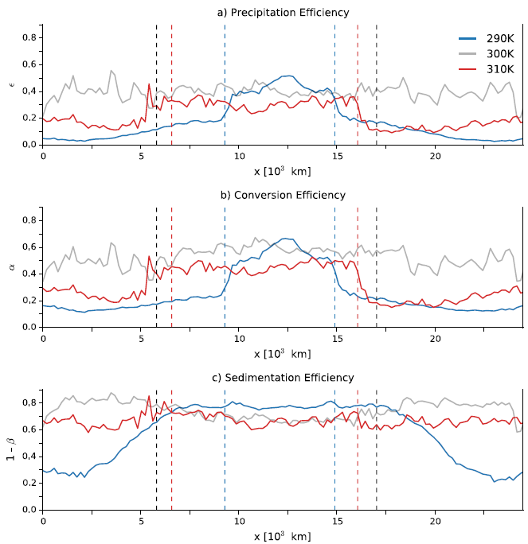
$$ε$$
The simulation results with K03 scheme
The values are averaged over 192-km blocks
the dashed lines separate regions of subsidence from regions of ascent, based on the pressure velocity 𝜔 at 500 hPa.
$$α$$
$$1−β$$
Notes:
在290K的模擬，降水效率、轉換效率和沉降效率三者皆在深對流區域較高，而低雲區域較低
在300K模擬中，三種效率在整個區域中階沒有明顯的變化。
而310K中，降水效率主要隨轉換效率改變，抬升區域降水效率高，下沉區較低，而沉降效率則沒有明顯變化。

Slide 23
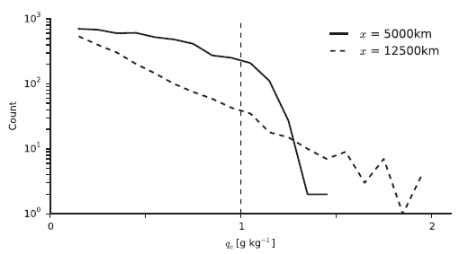
PDFs of qc for the 290 K simulation with the K03 scheme
→region of low cloud cover
→region of deep convection
Notes:
The PDFs are estimated for the altitudes of maximum time-mean qc at each location.
In the low cloud region there is a very sharp cutoff near qc,0, and there are no extreme events during which substantial amounts of precipitation are formed. Conversely, in the region of deep convection the average cloud density is lower, but the distribution is broader and there are periods during which the
clouds become very dense and large amounts of precipitation are formed.
So 𝛼 increases when going from 290 K to 300 K because of the erosion of the low cloud decks and then decreases as the low clouds reform with surface warming from 300 K to 310 K.

Slide 24
$$α$$
$$α$$
Notes:
轉換效率在溫度較低的時候，由於深對流雲的面積較小，因此在範圍平均後，轉換效率較低，
在溫度升高後，淺積雲轉換成較深的對流雲，轉換效率提高，
之後當溫度繼續上升後，淺積雲又重新生成，alpha又再次下降。
此變化與大尺度環流變化有關。

Slide 25
This progression is associated with changes in the large-scale circulation, which goes from a single, large overturning cell in the coldest simulations to a double-cell structure in the warmest cases
Notes:
Associated with these changes in aggregation are changes in the large-scale overturning circulation, which affect the stability of the boundary layer over the cold pool.
In the 290 K case strong subsidence creates a stronger inversion and hence more low cloud cover over the colder SSTs. In the intermediate cases the subsidence is weaker, leading to a weaker inversion over the cold part of the domain and more convection there. There is strong subsidence over the coldest SSTs in the warmest cases, and the low cloud decks return.

Slide 26
Summary and Conclusion
small domain simulations :
In the single-moment simulations, precipitation efficiency generally increases with warming
clouds become denser and so cloud condensate is converted more efficiently into precipitation
Changes in the re-evaporation of precipitation are small
In the double-moment simulations, large reductions in the amount of snow with warming for SSTs lower than 300 K
$SST↑, snow re−evaporates↑, rain↑, precipitation efficiency↑$
the precipitation efficiency decreases at finer resolutions because the cloud density decreases

Slide 27
in the 2-D Walker simulations:
The precipitation efficiency increases up to about 300 K and then decreases with further warming - large-scale circulation, organization of convection
the precipitation efficiency increases with surface warming but may decrease due to changes in the abundances of the different precipitating phases or in the degree of convective organization.

Slide 29
abstract
A particularly urgent question is how 𝜖 will change in warmer climates.
this study investigates the precipitation efficiency in simulations of radiative-convective equilibrium with a cloud-resolving model forced by a wide range of sea surface temperatures (SSTs).
The precipitation efficiency of convection generally increases with warming in the small domain simulations because of increases in the efficiency with which cloud condensate is converted into precipitation, with changes in the re-evaporation of falling precipitation playing a secondary role.
This picture is complicated in the 2-D simulations by substantial changes in the degree of convective organization as the underlying SSTs are varied.
𝜖 is found to decrease as convection becomes more organized, because convective organization results in relatively more low clouds, which have small (≤0.1) precipitation efficiencies, and relatively less high clouds, which have larger (∼0.4) precipitation efficiencies.

Slide 30
the only theoretical constraint on precipitation efficiency comes from Romps (2014), who showed that in the entraining plume model with condensation
𝜖 should decrease as relative humidity increases, but this is not a very stringent constraint, and applies only when convection behaves as a single entraining plume.
In simulations Romps found that 𝜖 was sometimes twice as large as the 1−RH lower bound.
𝜖e : precipitation efficiency calculated using the precipitation flux at height z
P(z) : precipitation flux at height z
C(z): the integrated condensation above the height z.
As z → 0, 𝜖e approaches the 𝜖 defined in the first paragraph.

Slide 31
Three sets of simulations were performed with each setup in order to test the sensitivity of 𝜖 to the microphysical scheme.
Two sets of simulations used the single-moment microphysics scheme implemented in SAM by Khairoutdinov and Randall (2003), one with the original parameter settings described by Khairoutdinov and Randall (2003), and one with the “NOSEDAALIQ5” setup of Lopez et al. (2009).
In this configuration there is no ice sedimentation, the ice autoconversion threshold is lowered by a factor of 100, and the autoconversion and accretion rates for liquid water are increased by a factor of 5.
Harrop and Hartmann (2016) showed that this configuration produces more realistic atmospheric cloud radiative heating profiles than the original configuration of Khairoutdinov and Randall (2003).
We will refer to the two sets of single-moment simulations as the “K03” and “NA5” simulations, respectively.
The third set of simulations used the double-moment scheme of Morrison et al. (2005) and will be referred to as the “M05” simulations.

Slide 32
A variable time step is used, with maximum interval 10 s, and radiative fluxes are calculated every 40 time steps using the CAM radiation scheme.
The incoming solar radiation is fixed at 650.83 W/m2 with a zenith angle of 50.5∘ (Tompkins & Craig, 1998), producing a net insolation close to the tropical-mean value, and the simulations were initialized with a small amount of white noise added to the temperature field near the surface to initiate convection.
Greenhouse gases are fixed at present day levels and the mean SST is varied in increments of 2.5 K from 290 K to 310 K in both setups.
Simulations with SSTs less than 300 K were run for 150 days, with averages taken over the last 50 days.
The simulations with higher SSTs equilibrated more quickly, and so these were run for 100 days, and averages were again taken over the last 50 days.
The SSTs in the mock-Walker simulations have a sinusoidal profile, with the difference between the warmest SSTs (plotted in the center of the domain) and the coldest SSTs kept fixed at 5 K, which creates a comparable SST gradient to the equatorial Pacific.

Slide 33
the main differences between the two schemes are as follows:
single-moment scheme:
the autoconversion of cloud condensate : Kessler formulation
droplet collection : continuous growth equations
double-moment Morrison scheme :
the autoconversion of cloud droplets to rain : stochastic collection of Beheng (1994)
the autoconversion of cloud ice to snow : a vapor diffusion growth rate
the collection of droplets by falling hydrometeors : a gravitational collection kernel
the phase of nonprecipitating and precipitating condensates:
single-moment scheme : diagnosed from the temperature
Morrison scheme : cloud ice is assumed to melt at 273.15 K,
homogeneous freezing of cloud liquid water and rain occurs for temperatures below 233.15 K,
the phase of condensates between these temperatures is simulated prognostically by the model.
the size distributions of precipitating hydrometeors :
the single-moment scheme: Marshall and Palmer (1948) distributions
Morrison scheme : gamma distributions
The two schemes have slightly different formulations of the terminal fall velocities of both rain and snow, as well as of the sedimentation rate of cloud ice.
In both schemes, the evaporation of rain and the sublimation of snow are modelled by vapor diffusion, but the formulations are different.

