Slide 1
Assessment of Numerical Weather Prediction Model Reforecasts of the Occurrence, Intensity, and Location of Atmospheric Rivers along the West Coast of North America
2019.03.19
Nardi K. M., E. A. Barnes and, F. M. Ralph, 2018; MWR

Slide 2
Atmospheric rivers (ARs) are narrow plumes of high water vapor transport in the atmosphere that account for a significant portion of total meridional moisture transport in the midlatitudes (Zhu and Newell 1994, 1998).
These filamentary structures in the lower troposphere are associated with transient extratropical storm systems, often appearing in the vicinity of the warm conveyor belt/low-level jet stream ahead of a cold front (e.g., Ralph et al. 2004; Bao et al. 2006; Ralph et al. 2017b), and can be formed from both local convergence of water vapor and direct transport from the tropics (e.g., Bao et al. 2006; Dacre et al. 2015).
Wick et al. (2013) demonstrated a general decrease of approximately 20%–30% in model skill from initialization
to 10 days in reforecasting the occurrence of landfalling ARs in the western United States.
DeFlorio et al. (2018a) examined European Centre for Medium-Range Weather Forecasts (ECMWF) AR reforecasts at leads of 1–14 days and found a similar decrease in prediction skill past 10 days over the North Pacific and western United States.

Slide 3
We expand on prior model verification studies by examining reforecasts (also known as hindcasts) of landfalling wintertime ARs from the control runs of nine state-of-the-art weather models at leads of 1–14 days.
We highlight three important components of an effective ar reforecast (AR occurrence, AR intensity, and AR landfall location) and quantify each model’s skill.
The performance of the models with respect to these three components is analyzed at varying lead times for the west coast of north america.

Slide 4
S2S database and reanalysis data
Subseasonal to Seasonal (S2S) International Project database (Vitart et al. 2017)
Horizontal grid size: 1.5º x 1.5º
Vertical: 1000/850/700/500/300 mb
Period: table below (dt: 24-hr in NDJF)
ECMWF ERA-Interim (ERAI)
Horizontal grid size: 1.5º x 1.5º
Vertical: 1000/850/700/500/300 mb
Period: 1 Jan 1979 - 31 Dec2016 (dt: 24-hr in NDJF)

Slide 5
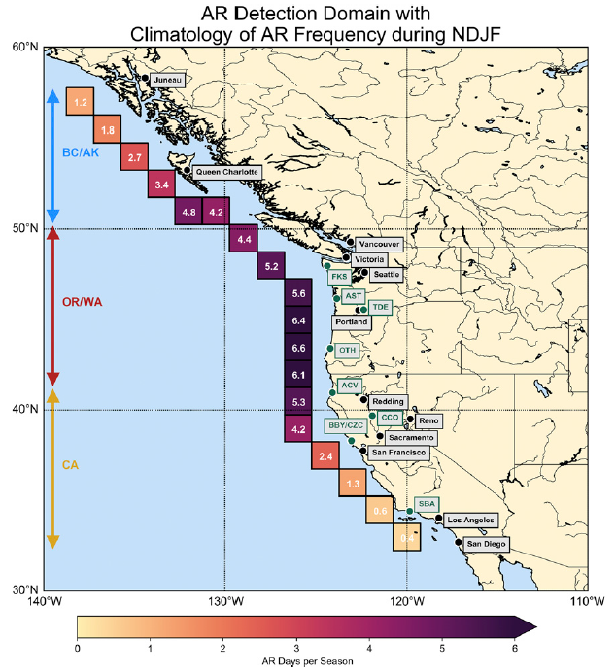
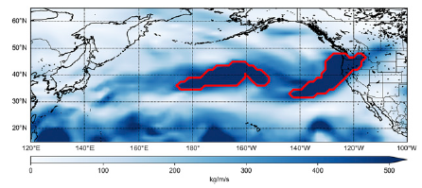
AR Detection
$$IVT=\sqrt{{\left(\frac{1}{g}\int_{1000}^{300}{qu}dp\right)}^{2}+{\left(\frac{1}{g}\int_{1000}^{300}{qv}dp\right)}^{2}}$$
Threshold: IVT > 500 (kg/m/s)
(Which is recognized as a lower limit for moderate to strong ARs)
Geometric criteria
1. Area > 300000 km²
2. Length > 1400 km
3. Aspect ratio > 1.4
Landfall region
0000 UTC 14 Oct 2016 from ERAI

Slide 6
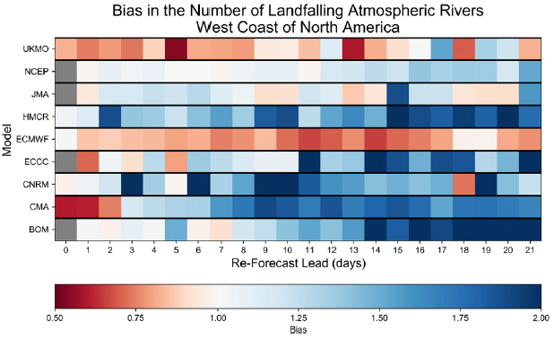
Occurrence-based model verification
 |  | Event Observed
 |  | Yes | No
Event Forecast | Yes | Hits (a) | False Alarms (b)
 | No | Misses (c) | Correct Rejections (d)
AR occurrence
$$B=\frac{a+b}{a+c}=\frac{Hits+False Alarms}{Hits+Misses}$$
Quiet ARs Active ARs
(fewer ARs Occurrence) (more ARs Occurrence)

Slide 7
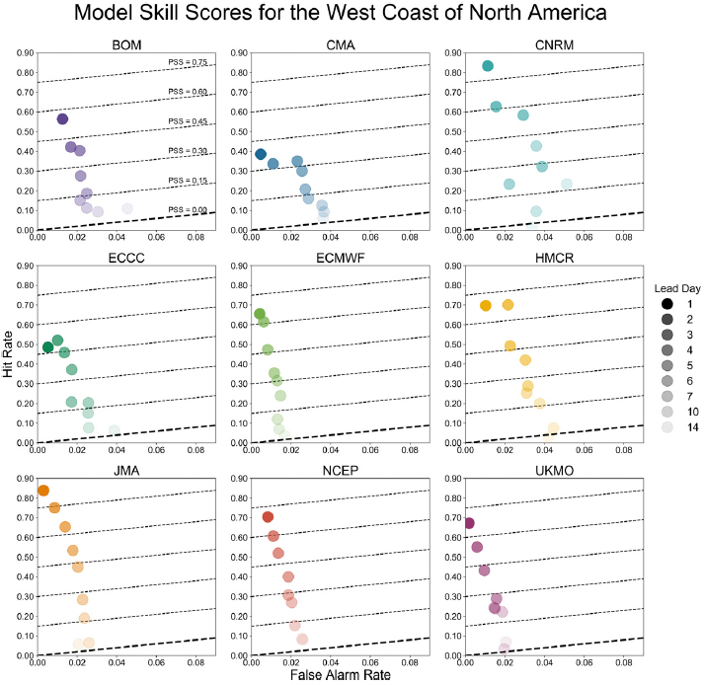
$$H=\frac{a}{a+c}=\frac{Hits}{Hits+Misses}$$
$$F=\frac{b}{b+d}=\frac{False Alarms}{False Alarms+Correct Rejections}$$
$$PSS=H−F=\frac{\frac{a+d}{n}−\left[\frac{\left(a+b\right)\left(a+c\right)+\left(b+d\right)\left(c+d\right)}{n^{2}}\right]}{1−\left[\frac{{\left(a+c\right)}^{2}+{\left(b+d\right)}^{2}}{n^{2}}\right]}$$

Slide 8
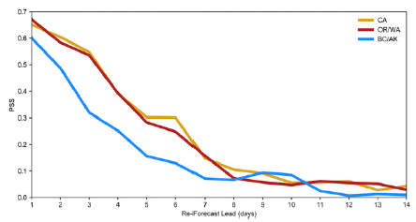
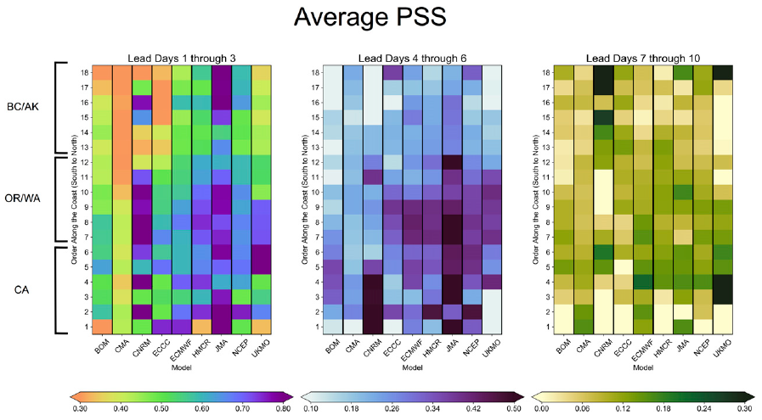
statistically significant at 95% using a bootstrapping analysis

Slide 9
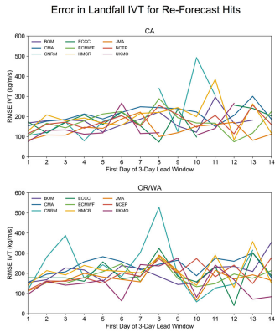
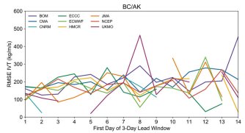
ARs intensity (IVT)

Slide 10
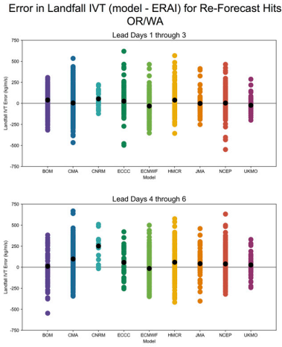
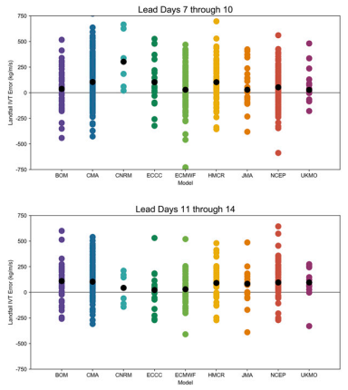
Higher ARs climatological frequency in NDJF

Slide 11
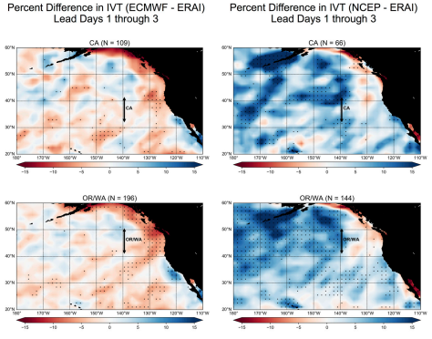

Slide 12
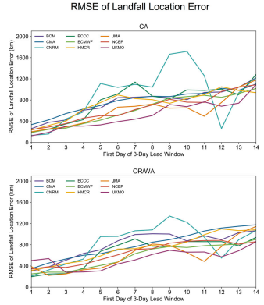
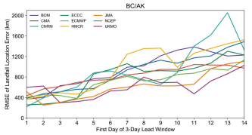
ARs landfall location
We define landfall location as the median latitude and longitude of the landfall grid cells with which the AR makes contact.

Slide 13
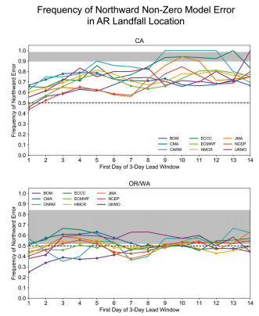
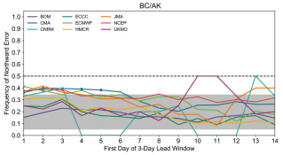
Perfect landfall location reforecasts are not included
Reforecast-reanalysis > 0: northward prediction
northward
BOM/NCEP/ECMWF
southward

Slide 14
Conclusions
Our study examines reforecasts of landfalling atmospheric rivers (ARs) along the west coast of North America from the control runs of 9 numerical weather prediction (NWP) models, each covering about 10–30 years of reforecasts.
Occurrence-based reforecast skill is examined for all 9 models in order to determine how often each model correctly reforecasts the presence of a landfalling AR.
Reforecast skill varies by subregion, with BC/AK having less occurrence-based skill than CA and OR/WA.
Our study also shows that ECMWF, on average, predicts fewer AR occurrences than reanalysis at all lead times for the entire west coast of North America.
AR intensity (IVT) RMSEs typically range from approximately 100–250 kgm⁻¹ s⁻¹. At leads of 1–3 days, positive and negative absolute IVT errors appear to be equally likely, though positive absolute IVT errors appear to be slightly favored at lead times beyond 3 days.
Errors in AR landfall location are examined. For all nine models, there is a pronounced increase in landfall location RMSE as lead time increases. At leads of 1–3 days, landfall location RMSEs generally range from about 100 to 600 km, with errors exceeding 1000km at leads greater than 14 days.

