Slide 1
Shallow-to-deep transition of continental moist convection: Cold pools, surface fluxes, and mesoscale organization
Kurowski, M .J., K. Suselj, W. W. Grabowski, and J. Teixeira, 2018
J. Atmos. Sci., 75, 4071–4090.

Slide 2
Introduction
The effects of cold pools include the deepening and widening of clouds yielding more precipitation because of a better organization of secondary convective cells forming at the edges of negatively buoyant density currents (Tompkins 2001; Khairoutdinov and Randall 2006; Schlemmer and Hohenegger 2014; Feng et al. 2015; Torri et al. 2015) and especially at their intersections (Böing et al. 2012).
A 2005 workshop on boundary layer parameterization (Teixeira et al. 2008) recognized the interaction between the subcloud layer and deep convection and the physics of cold pools as a key parameterization challenge.
Although important, the effects of cold pools are poorly represented in coarse-resolution global circulation models (GCMs). The development of organized convection still remain beyond the scope of contemporary 1-dim parameterizations.
The present study extends the approach used in Khairoutdinov and Randall (2006) by distributing evaporative cooling and moistening over the entire horizontal domain [as done in Böing et al. (2012)] and thus maintaining the mean nearsurface temperature and water vapor budgets. Moreover, we consider the impact of interactive surface heat fluxes on the shallow-to-deep convection transition.

Slide 3
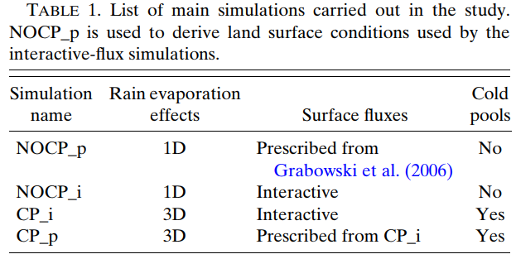
Numerical experiments
Idealized WRF simulation
computational domain: 70 km X 70 km X 21 km
Horizontal grid size: 100 m
vertical grid size: 60 m near the ground to 350 m near the top.
Periodic lateral boundary conditions
Initial condition: same as Grabowski et al. (2006).
Cloud microphysics: Lin et al. (1983) scheme

Slide 4
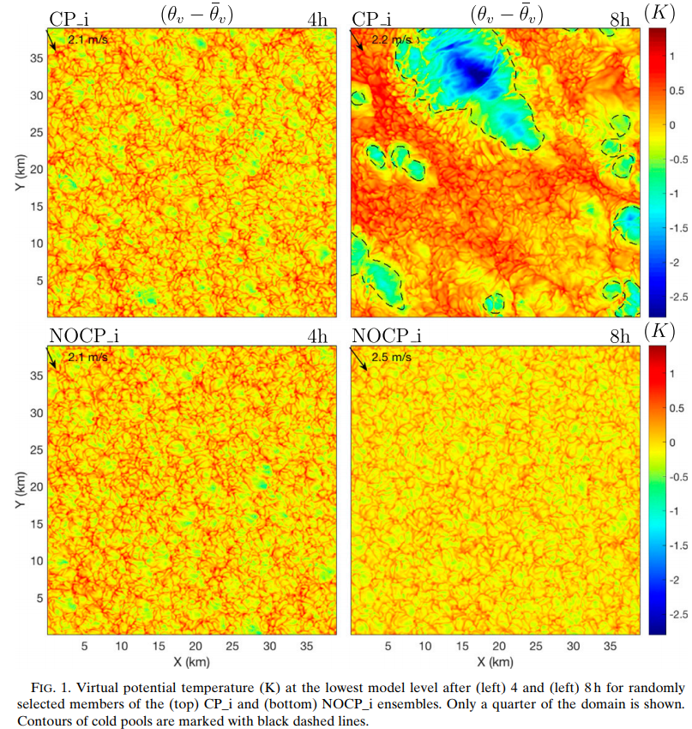

Slide 5
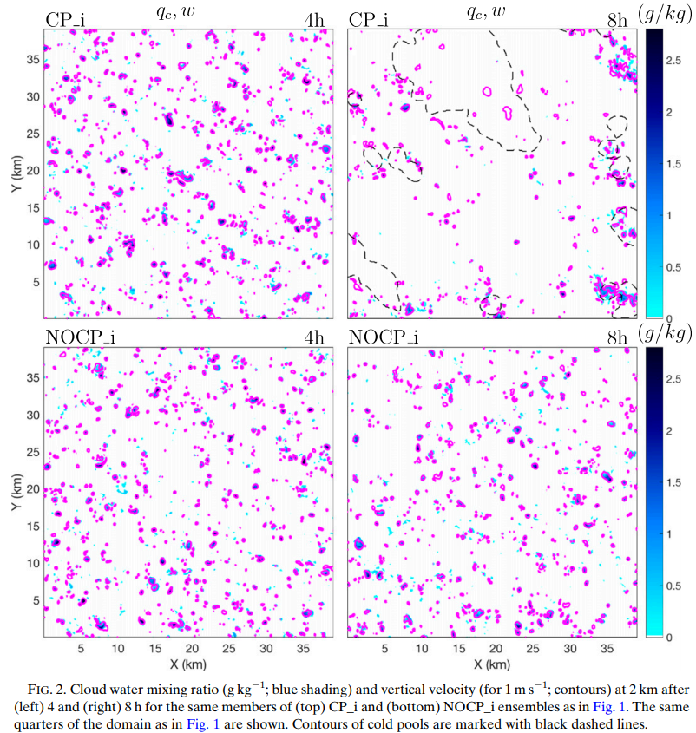

Slide 6
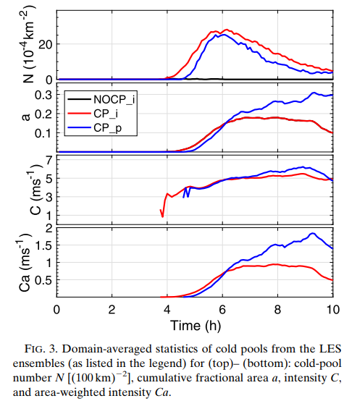

Slide 7
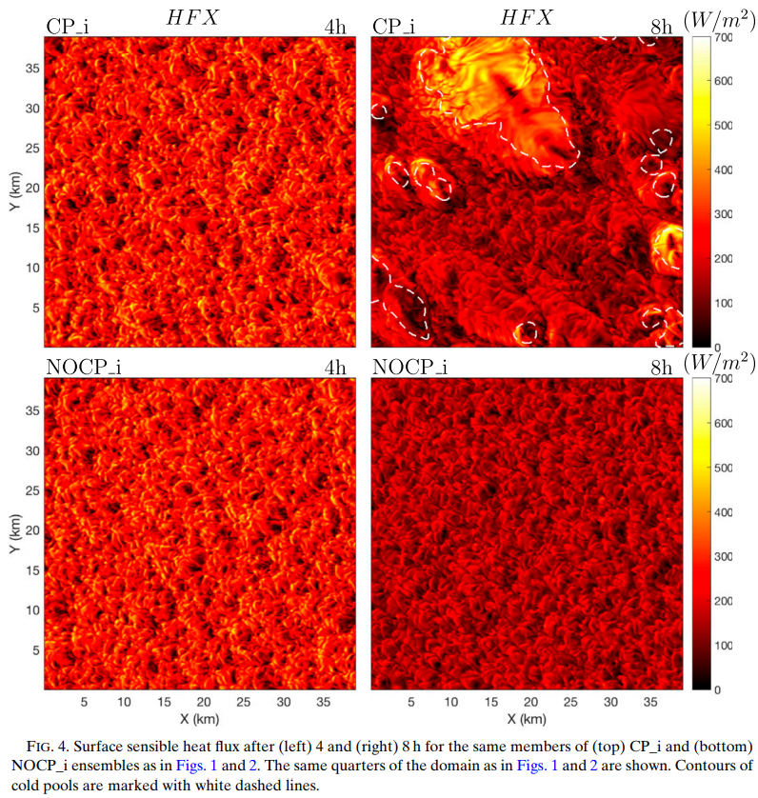

Slide 8
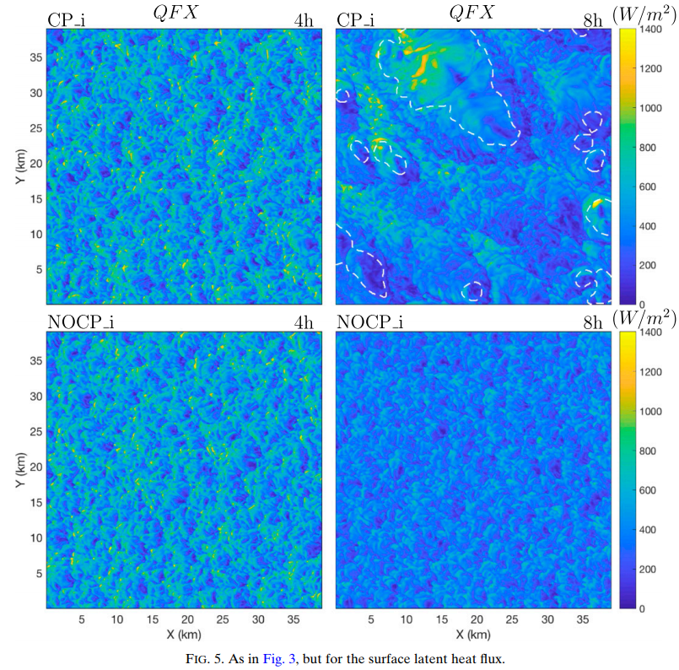

Slide 9
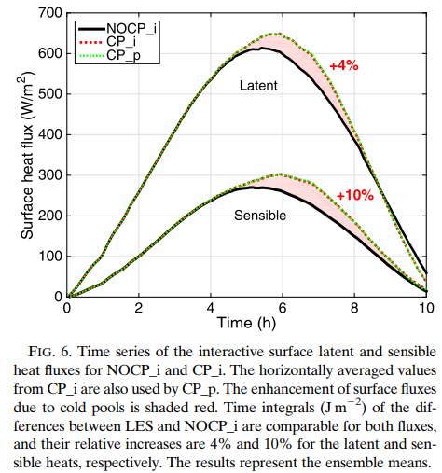

Slide 10
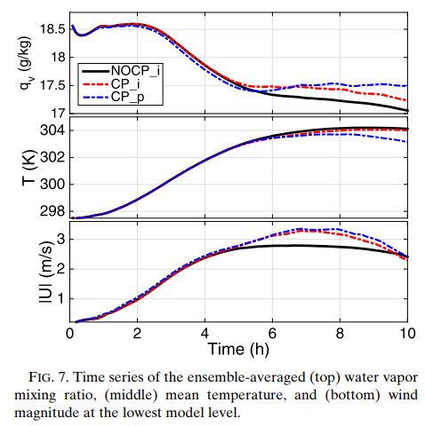
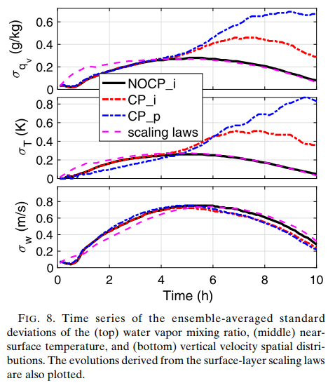

Slide 11
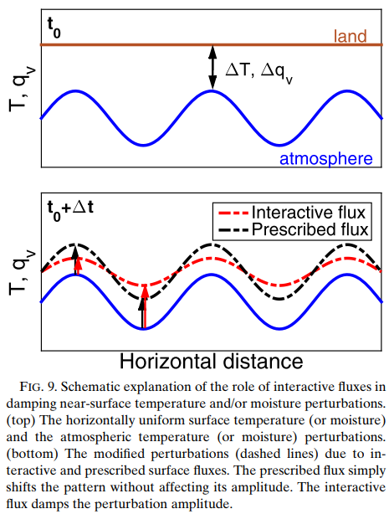

Slide 12
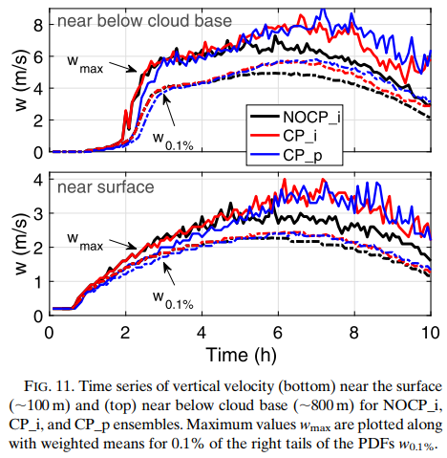

Slide 13
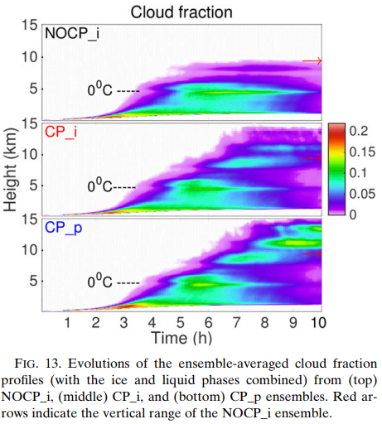
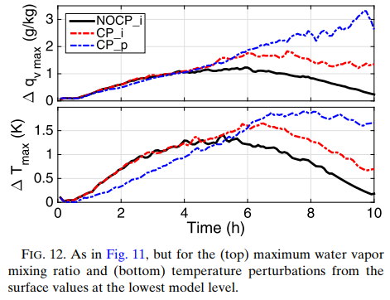

Slide 14
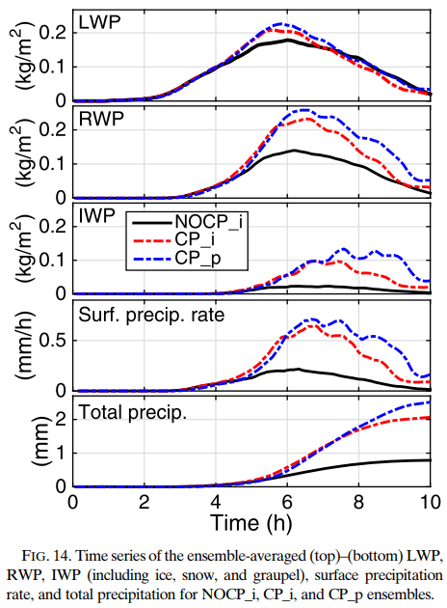

Slide 15
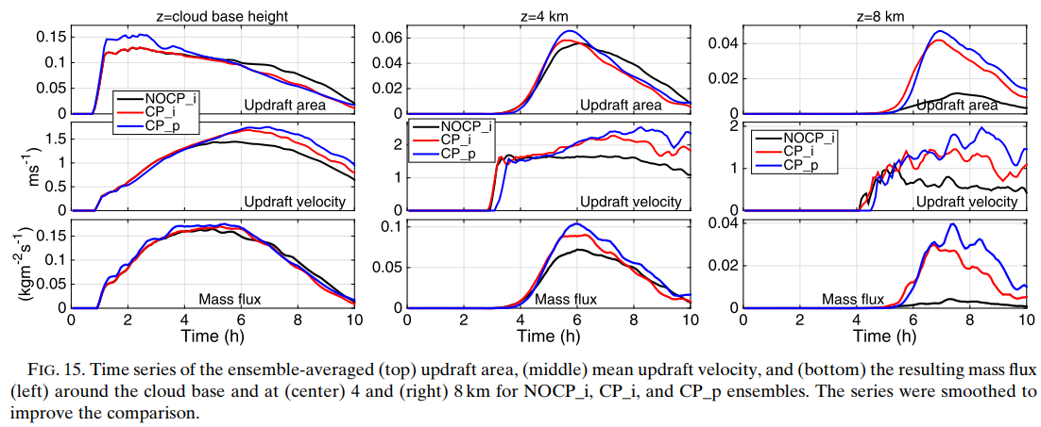

Slide 16
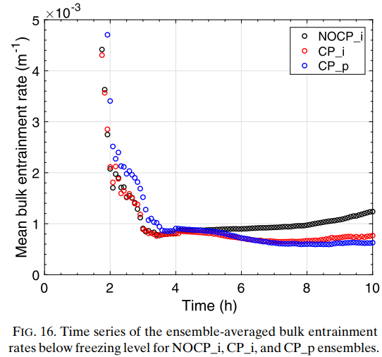

Slide 17
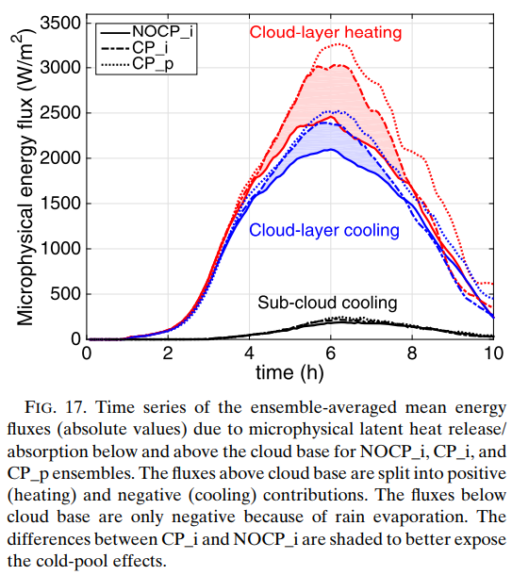

Slide 18
Conclusions
The present study uses a robust method to extract and quantify the impact of cold pools and interactive surface heat fluxes on shallow-to-deep convection transition over land in a large-eddy simulation (LES).
One of the most apparent direct impacts of cold pools is the enhancement of mean surface latent and sensible heat fluxes. The enhancement is driven mostly by the associated wind bursts as shown by additional analysis and sensitivity simulations. As a result, daily flux maxima in CP_i are delayed by about an hour when compared to the NOCP_i ensemble.
The near-surface standard deviations of air temperature and moisture spatial distributions are significantly larger when cold pools are present, while the near-surface vertical velocity standard deviation is only weakly affected. Although the mean and standard deviation of the near-surface vertical velocity are relatively weakly affected by the presence of cold pools, the maximum vertical velocities near the surface and especially at the cloud base increase significantly when cold pools are present.

Slide 19
Conclusions
Cold pools are found to strongly increase the convective heating rates in the cloud layer, while only slightly modifying the cloud-base convective mass flux. They also reduce the bulk entrainment rate aloft by up to 30%–40%, arguably because of convection organization. This translates into a few-kilometer-deeper cloud layer with cold pools, and notably increases the mean condensed water paths and the surface precipitation.
CP_p has larger values of the upper-tropospheric cloud fractions, rain, and ice water paths, as well as surface rain accumulations than CP_i. It also features larger near-surface temperature of moisture maxima and standard deviations of their spatial distributions. We argue that all these come from the damping mechanism associated with the interactive surface fluxes as schematically explained in the description of Fig. 9.

