Slide 1
Paper discussion
Professor:楊明仁
Speaker:潘鈺太

Slide 2
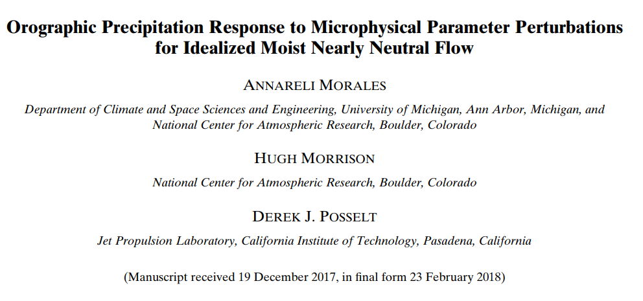

Slide 3
OUTLINE
1.Introduction
2.Method
3.Results and discussion
4.Summary

Slide 4
Introduction
1. Atmospheric rivers (ARs) have been observed to have high surface potential temperatures (approx. 285-289 K), strong wind speeds (low-level jet >20 m/s), high freezing level, and nearly saturated conditions (Ralph et al. 2005).
2. (Colle and Mass,2000) found lower snow fall speeds shifted precipitation from the windward to lee side of the barrier during an AR over the Pacific Northwest.
3.Wide barrier (>30-km half-width) will provide more time for snow growth aloft, while a narrower barrier will generate more graupel through the collection of supercooled cloud droplets (Colle and Zeng 2004b)

Slide 5
Introduction
4. Colder AR events have lower amounts of integrated water vapor, yet they result in a higher snow-to-rain ratio and higher overall precipitation values (Guan et al. 2010).
5. Past studies by MR05, MR06, and T15 have shown a non-linear dependence of simulated precipitation to parameters controlling mountain geometry, mean zonal wind speed, moist static stability, relative humidity, and surface potential temperature.
6. Their study focused on liquid-only microphysics. We extend this analysis to include ice microphysics and ask the following question:
how will the sensitivities to changes in microphysical parameters change with different environments?
Notes:
For example, increasing surface potential temperature did not result in higher rain rates on upwind slopes, since processes such as riming occur at lower temperatures and can contribute to surface precipitation (MR06)
T15 performed a more systematic analysis of the parameter space for mountain geometry and upstream conditions, finding non monotonic responses for mountain half-width, moist static stability, and mean zonal wind speed and monotonic responses to mountain height, relative humidity, and surface potential temperature

Slide 6
Model configuration
CM1 ,version17(CM1; Bryan and Fritsch 2002)
Domain X=1600km, resolution 2km . Domain Z=18 km, resolution 0.25km from surface to 9km, then increase to 0.5km between 9~10.5km, then remains constant(0.5km) to 18km.
Lateral boundary conditions are open radiative, with a no slip bottom boundary condition and free slip top boundary condition.
Radiative transfer and surface heat flux parameterizations are neglected.
Run 20 hours with time step = 3 s.
Use Morrison microphysics scheme version 3.4.

Slide 7
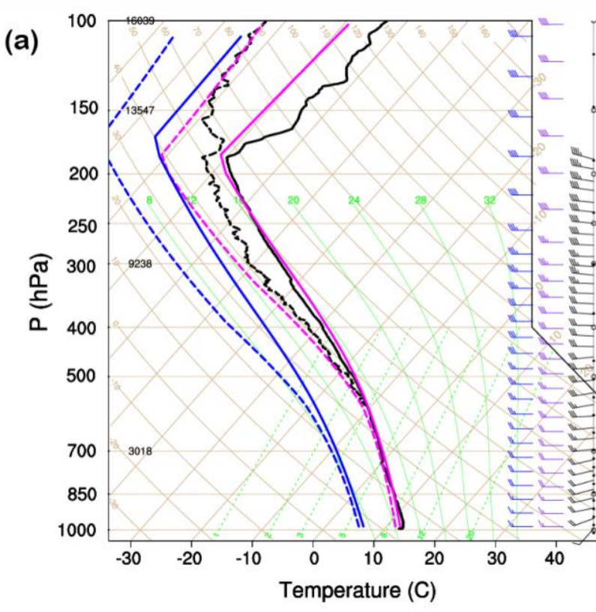
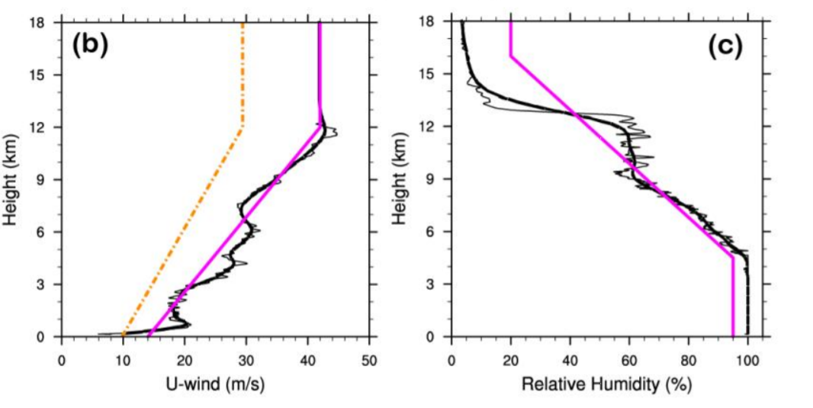
Experimental design: Control Run
1. Sounding are guided by observations of
an AR event during the Olympic Mountains
Experiment (OLYMPEX; Houze et al. 2016)
2. Wind profile & RH profile.
調整的原因:
黑線可能是已經過山的條件，所以達到100%
所以decrease95%還原未經山脈影響的情形
286K
14
42
Notes:
探空 風速 濕度 都符合ARs的條件
另外N^2>0 穩定的大氣條件

Slide 8
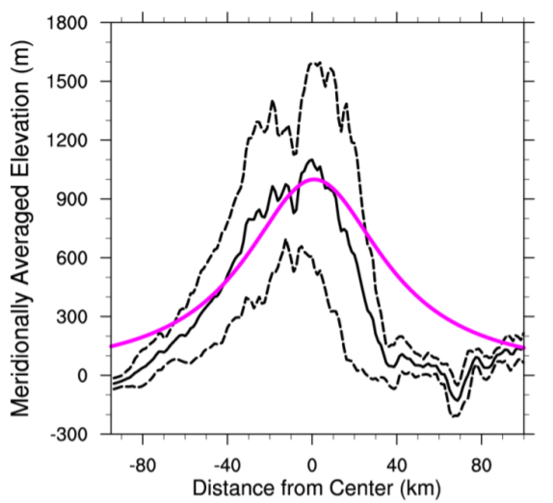
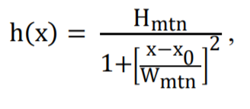
Experimental design: Control Run
1.Idealized mountain barrier is created using the following equation from MR05,MR06, and T15.
1.Hmtn=Mountain height = 1km
2.Xo= center of mountain
400km downstream of the center of
The domain(3/4 domain).
3.Wmtn=mountain half-width=40km
黑實:實際地形
黑虛:+-1個標準差
紫色:模式地形

Slide 9
Mountain with 6 averaging regions
The upwind foothills, slope, and top.
The downwind foothills, slope, and top

Slide 10
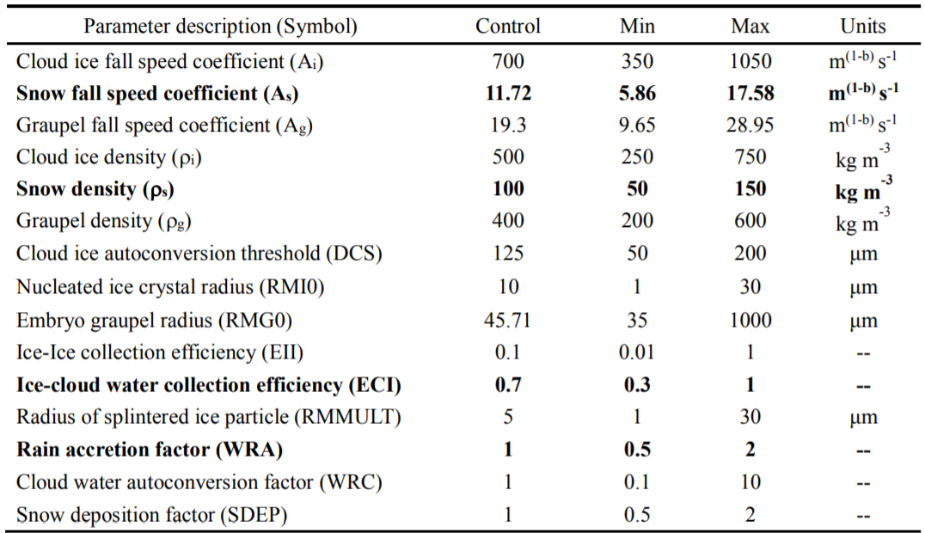
Microphysical parameters
1. MAX 2.MIDDLE 3.CTL 4. MIDDLE 5.MIN
Notes:
Morrison裡面的微物理參數(CONTROL)
所以敏感度實驗就是要每個參數都改變五個值。 MAX 2 CTL 4 MIN

Slide 11
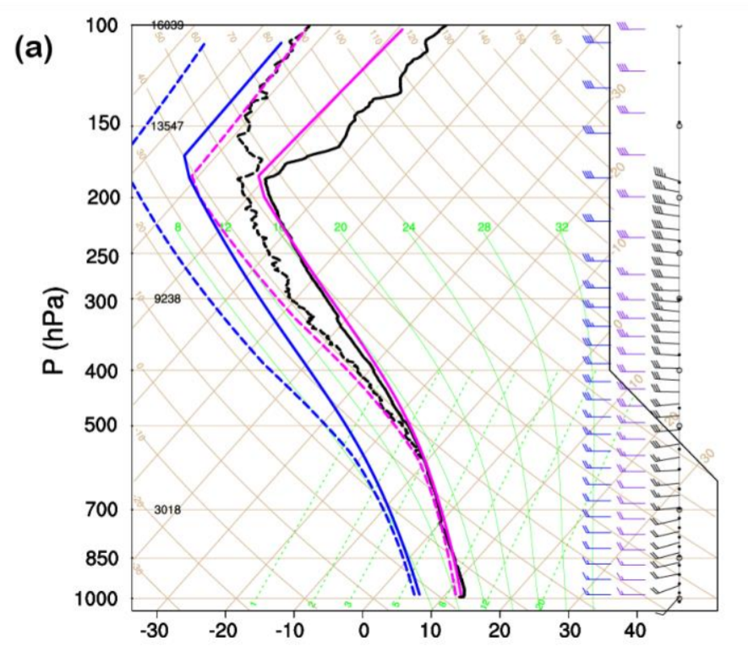
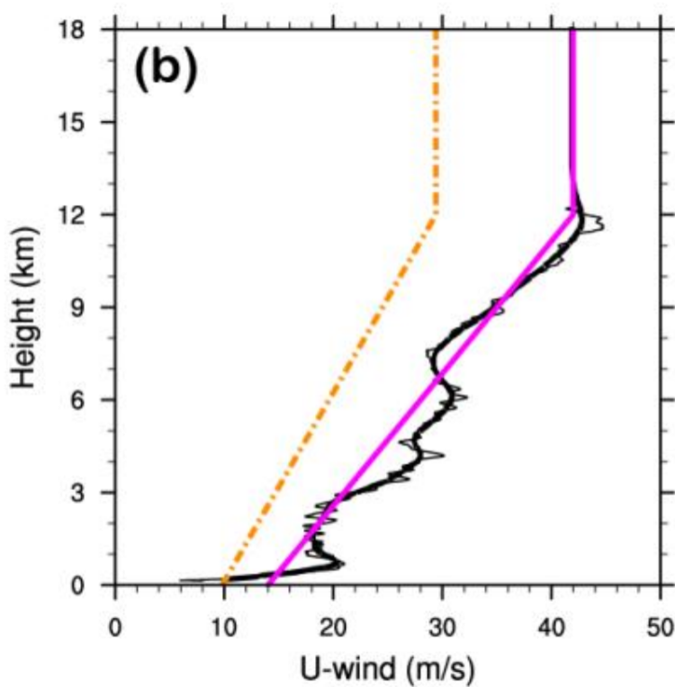
Environmental experiments
*Two additional experiments are performed to test if the sensitivities to changes in microphysical parameters remain the same with a different environment.
藍線 :減少6k (LowFL)
(lower Freezing level, cold rain dominates.)
橘線 :風速減小30%(LowU)
Dynamic problem.
Notes:
改變環境的條件，看看這些參數的改變是否對於降水等等造成的影響 是否雷同。

Slide 12
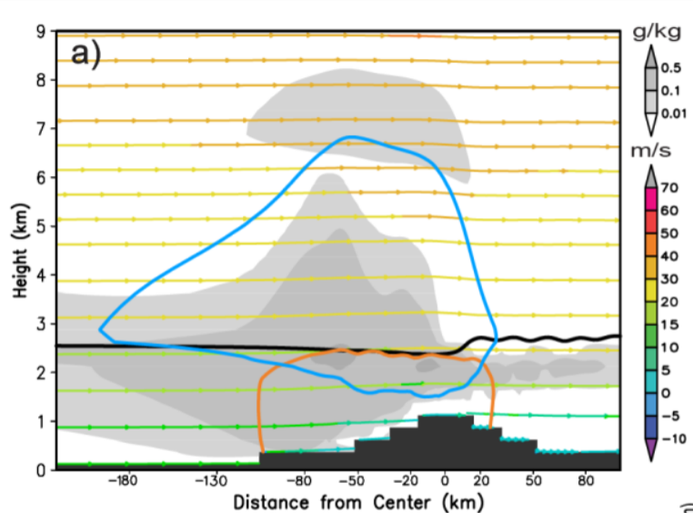
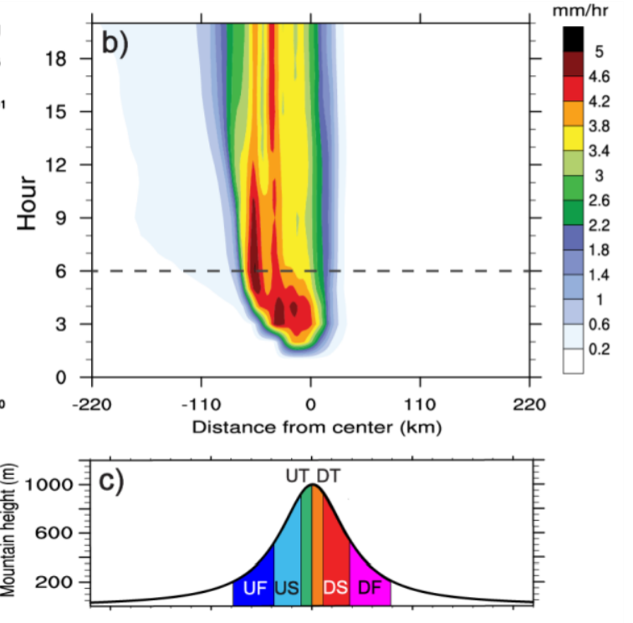
Result and discussion a. control simulation
Hovmoller diagram of
Precipitation rate(mm/h).
雪混合比
Adiabatic warming
雨混合比
Snow and grapuel
Temporally averaged graph(hours 6-20)
灰色:cloud water and ice mixing ratio(g/kg)
藍色:snow mixing ratio 0.05(g/kg)
橘色:rain mixing ratio 0.05(g/kg)
黑線: Freezing level
1h
Notes:
雪線2.5KM 讓上方的冰雲降水能夠有足夠的時間融化成水，造成地面降水。
The reason that average is beginning from hour 6(且降水趨於穩定)
→Graupel no longer occurs(前期0~6還有些grapuel transition期)

Slide 13
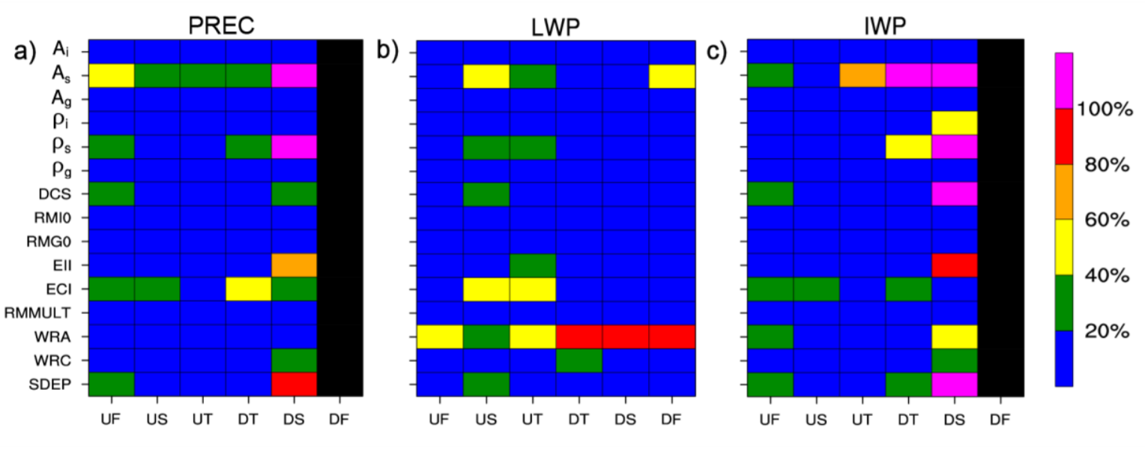
Result and discussion b. Microphysical parameter
LWP(Liquid water path):
Total amount of cloud water and rain between the surface and model top.
IWP(Ice water path):
The same but for cloud ice , snow and graupel.
顏色越深代表有越顯著的變化
(mm/hr)
(Kg/m2)
(Kg/m2)
Notes:
How to calculate this percentage relative
:100*(max-min)/(average for each 5-point), all value are temporally and spatially averaged over hours 6-20 for the six regions.

Slide 14
*Briefly explain these parameters
As=Snow fall speed coefficient
ρs =snow particle density
ECI =Ice-cloud water collection efficiency
WRA=Rain accretion multiplicative factor
This article is only discuss the PREC.

Slide 15
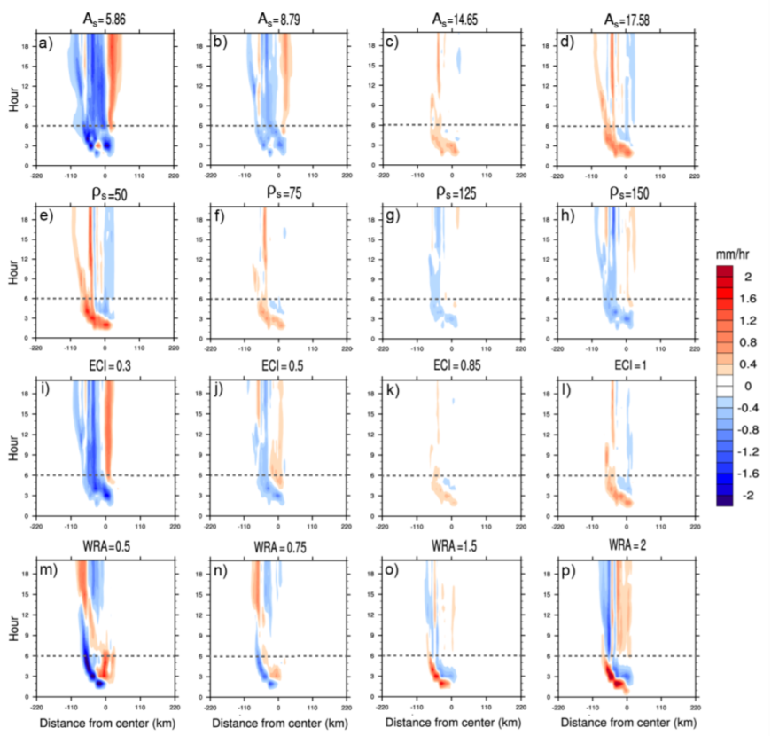
Difference between Experiments&control
CTL
For As, ρs, ECI: left two graphs.
For WRA: Max and Min.
2.Compared to As, ρs, and ECI, WRA pattern shifts with time(m,p)
Notes:
不同的parameter perturbation和control run相比，對於降水的最大變率主要再小的perturbation

Slide 16
Introduce how to calculate PREC
PREC=PE*<COND>
PREC(mm/h): Surface precipitation rate
PE: Precipitation Efficiency, if PE >1, due to net convergence of the condensed water horizontal advective fluxes across the subregion.
COND(mm/h): Vertically integrated total condensation rate.

Slide 17
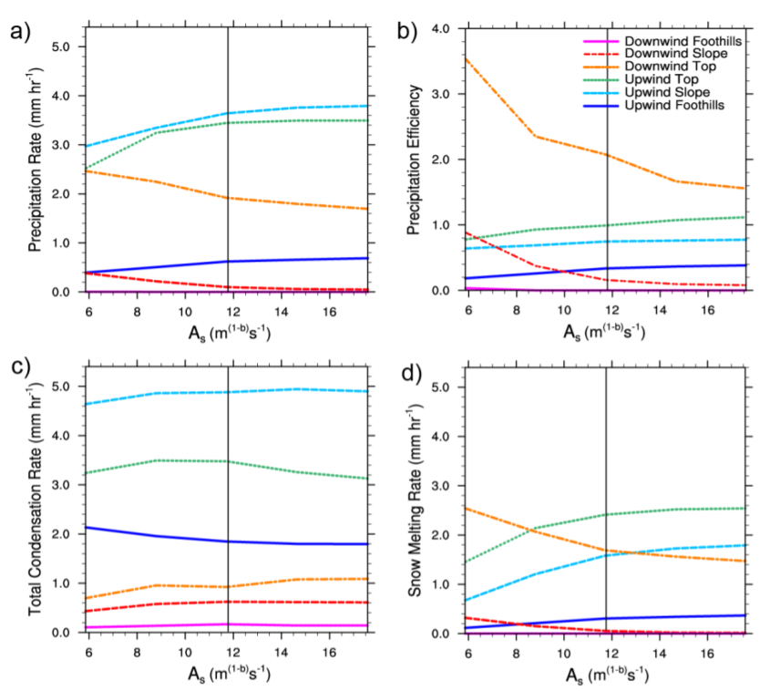
For As average(6~20hr)
PREC
PE
Vs=fall speed
As=fall speed coefficient
D=Diameter
Bs=exponent parameter
COND
Snow melting rate
As smaller → Vs smaller →Snow fall slowly
→Snow can be advected downwind side.
Notes:
COND沒啥變
PREC 和PE最有關聯
落速小 容易被背景風場帶到下游處. Snow melting rate代表那邊雪多 所以當然變大。

Slide 18
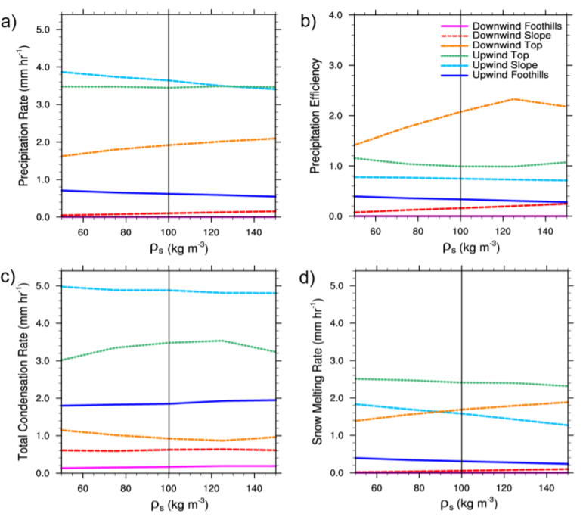
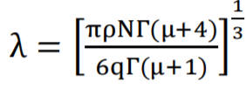
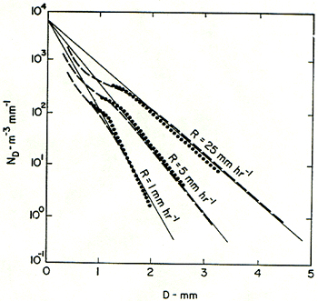
For ρs, average(6~20hr)
PREC
PE
(1):
(2):
1.According to (1), fall speed depends
on As, Bs, and Diameter, density indirectly
influence fall speed through the particle
size distribution.
2. (2), λ is slope parameter, which
describes the slope of the gamma particle
size distribution.
3. ρs bigger→ λ bigger →shift size
distribution toward smaller diameters→
smaller snow fall speed.
COND
Notes:
和AS差不多，但屬於間接影響.

Slide 19
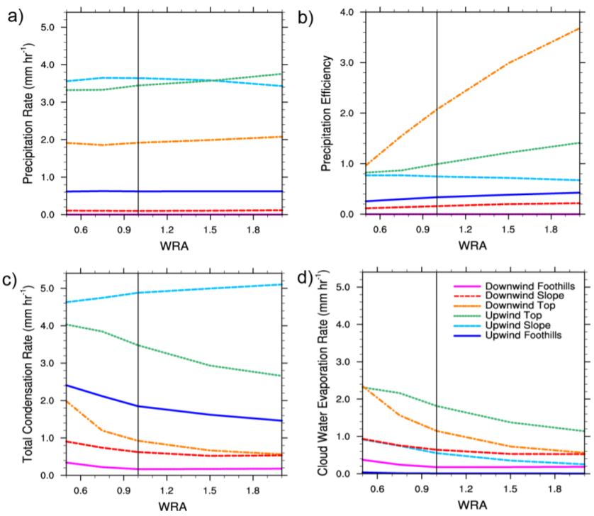
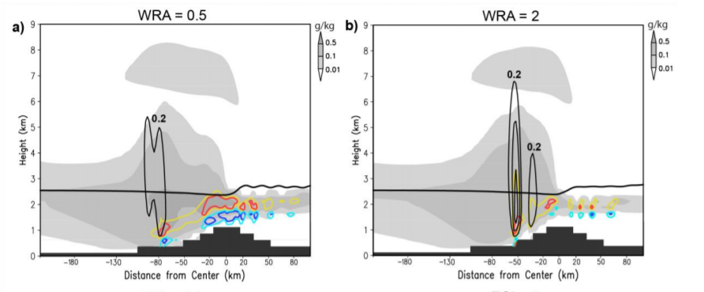
For WRA, average(6~20hr)
(PE) V.S (COND) effect, so there is no obvious change in PREP.
WRA is a multiplicative factor that acts to increase or decrease
rain accretion in simulation.
High WRA: Increase the accretion(cloud water to
rain water) process.
Low WRA: cloud water remains in atmosphere.
Red 凝結率
blue 蒸發率
Notes:
For WRA=2 ,upwind slope 的垂直速度較大，這是因為大部分的cloud water 被移除了，所以減少condensate loading，而這上升速度同時增加COND10%(只有這部分隨WRA增加其餘都下降。)
For 小的WRA，有更多的雲，這也代表有較多的水氣能夠被蒸發in downdraft，WRA小，雲會比較大朵，比較深且到達較地面。
雲較深，代表COND大，因為有較多可積分的地方
WRA大 rain accretion 大，PE大。

Slide 20
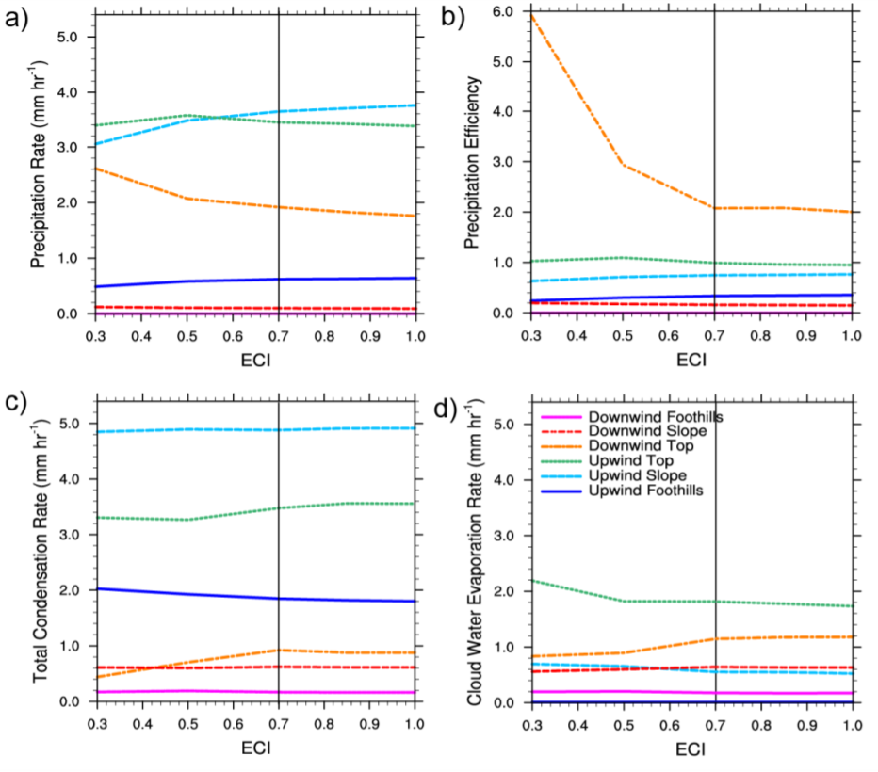
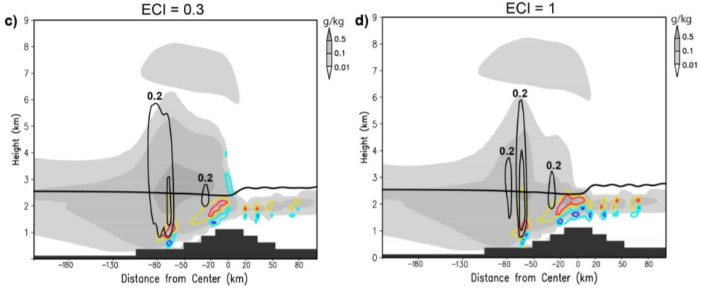
For ECI, average(6~20hr)
Unlike WRA, ECI do result in PREP, and it associates with PE.
Upwind slope &
downwind top
ECI also acts to remove cloud water from
the atmosphere, but through the riming
process occurring at temperatures below
freezing.
淞化後雲內冰晶減少
Notes:
ECI 越大，riming越強(限於0度C以上)，雪量越多，雪落下後融化，變成水，降水變多。 Upwind增加 所以 downwind相對來說減少，因為再向上坡已經先下完了。
COND change a little(因為ECI跟WRA差不多，只是ECI是跟零度線以上有關的，此部分不太造成雲底的變化，所以COND相對於WRA變化小.)
RIMING，過冷水滴(cloud water)減少.
PREC和PE走向一樣。

Slide 21
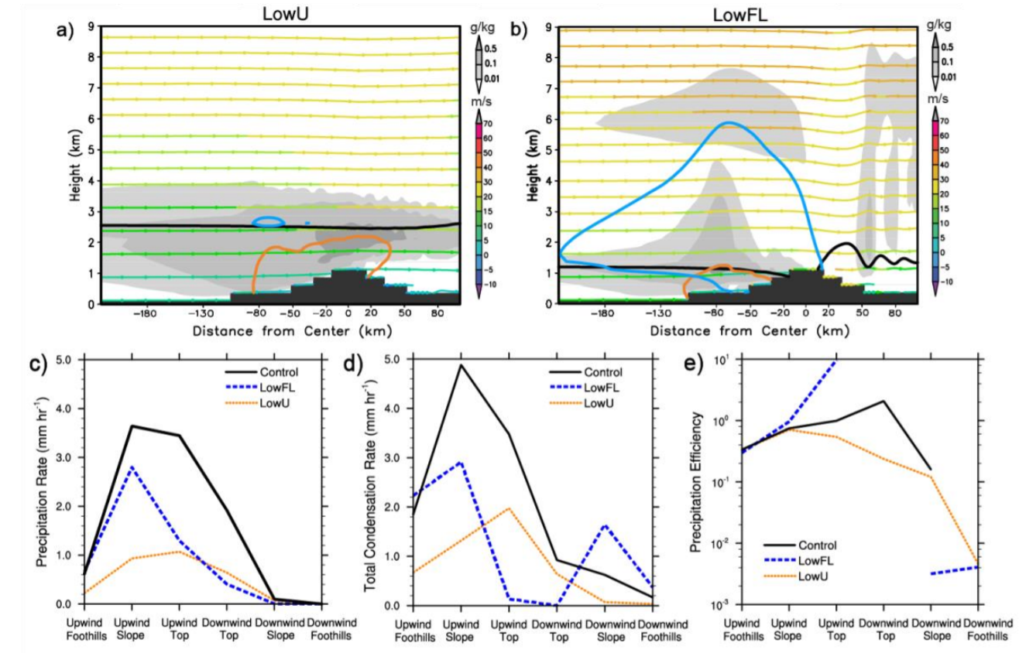
Environmental experiments
For LowU: 雖然melting layer和control相比變化不大，能夠有足夠的warm-rain process,但是由於雲太淺，溶解層以上的冰雲不夠多，造成PREC的減少。
For LowFL:雲的結構和control類似，且因為溶解層較低，溶解層以上有足夠的冰雪形成。PREC遠較LowU接近CTL，因為降水效率極高。
背風面有lee waves產生，使COND有一極值，但因為PE太低，造成的PREC不顯著。
Shallower cloud due to weak w(m/s)
PREC
COND
PE
Lee waves
Notes:
LowFL:讓0度C低於山頂
LOWU: 風速減小，造成垂直速度減小，雲較shallower
LOWFL的PE極高，所以造成PREC接近CTL。

Slide 22
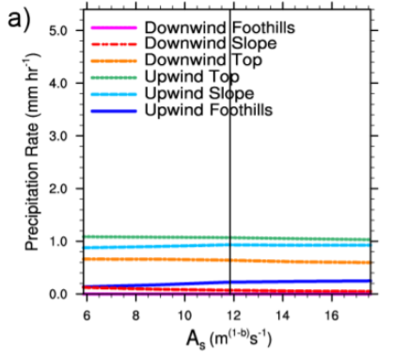
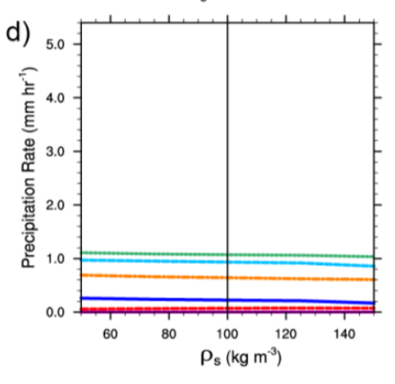
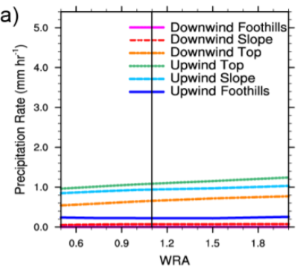
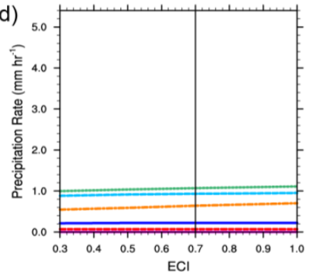
LowU
Overall, the LowU case results in a reduction in the magnitude of PREC responses to perturbations in As, ρs, ECI, and WRA than in the control environment, mainly due to less condensate being available.
These responses are expected, as LowU results in weaker ascent, causing a reduction in the amount of cloud water available above the freezing level, thus allowing for warm-rain processes to dominate precipitation.
Although the ice processes play a smaller role in this case, the mechanisms controlling PE and COND are similar to those in the control environment:
1. Changes in PE primarily explain the PREC responses to As and ρs perturbations,
2. WRA affects through changes in the cloud base, while ECI does not.
Notes:
PREC都少許多主要是和環境有關。
For ECI 沒什麼變動的原因在於，LOWU，造成上升速度小，根本沒有冷雲過程，自然而然riming那些都變少，因為ECI是跟冷雲有關，這邊完全沒冷雲所以幾乎沒啥變化。

Slide 23
LowFL
As在COND有很大的變動
There is a minimal response of PREC,
PE, and COND to change in ρs , and
PREC also changes a little in ECI ,
compared to the control simulation.
These results reflect the complexity of precipitation
sensitivities; although ice microphysical
processes are generally expected to play a larger
role in this case, this does not hold true for all of the
associated parameter perturbations.
Cloud water above the freezing level increased when As is smaller.
(upwind side)
Large As induced higher-amplitude lee waves, causing COND increased.
Notes:
As在LOWFL的變化較不同，其在COND有很大的變動，因為有更多的雲在0度線以上。
至於WRA，由於LOWFL幾乎都是冷雨過程，所以對於WRA這個warm-rain procrss來說，對於COND的影響就小許多。

Slide 24
Summary
1. Precipitation rate responses to As and ρs perturbations are mainly a result of changes to precipitation efficiency (PE) through direct and indirect impacts, respectively, on snow fall speed.
2. Increasing WRA leads to greater removal of cloud water below the freezing level from conversion of cloud to precipitation and reduced <COND> caused by drying and raising of the cloud base height. Increased PE compensates the decrease in <COND> and results in little change on PREC.
3. Increasing ECI also removes cloud water from the atmosphere yet does changes to PREC. Increasing ECI results in a decrease in cloud water above the freezing level, but little effect on updraft speeds or below the freezing level, where the largest condensation rates occur.

Slide 25
Summary
4. Compared to perturbations of the microphysical parameters, the total amount of precipitation was more sensitive to environmental parameter perturbations. Overall, reducing wind speed had a strong effect on the amount of precipitation, while the changes in microphysical parameters in this environment had similar mechanisms responsible for changes in precipitation as in the control environment.
5. Our results show these parameter perturbations have a strong influence on where precipitation falls, thus influencing which water basins may receive precipitation over a mountainous region.
6. Although the results presented here focused on orographic precipitation, parameters such as WRA, ECI and As also showed effects on the liquid and ice water paths(LWP&IWP). While cloud radiative effects are beyond the scope of this study, we suggest that future work should explore the impact of microphysical parameter perturbations on cloud optical properties and radiative transfer.

