Slide 1
Reducing TC Position Uncertainty in an Ensemble Data Assimilation and Prediction System: A Case Study of Typhoon Fanapi (2010)
Paper Review
KUAN-JEN LIN, SHU-CHIH YANG and SHUYI S. CHEN
2018.12.11
@CPLab

Slide 2
Outline
Introduction
Impact of TC position uncertainty in an idealized framework
TC-centered ensemble data assimilation framework
Typhoon Fanapi of 2010
Model, assimilation, and experimental setup
a. Model and experimental setup
b. Assimilated data
Results from the real case
a. Analysis
b. Forecast
Summary and discussion

Slide 3
Introduction (1/3)
Limited predictability of TC intensity
The lack of coupling to the ocean is a major shortcoming in many current prediction models (Chen et al. 2007, 2013).
Another limiting factor in the current TC prediction system may be due to the relatively poor representation of the TC structure and intensity in the initial conditions for TC forecasting (Kurihara et al. 1993).
TC vortex initialization methods
Vortex bogusing (Ueno 1989; Leslie and Holland 1995; Pu and Braun 2001)
Dynamical initialization (Kurihara et al. 1993, 1995, 1998; Nguyen and Chen 2011)
Vortex relocation (Liu et al. 2000; Hsiao et al. 2010)
Data assimilation (DA): the only method that uses observations (Zou and Xiao 2000; Chen and Snyder 2007; Torn and Hakim 2009; Zhang et al. 2011)

Slide 4
Introduction (2/3)
Combination of TC vortex initialization methods
Bogus data assimilation (BDA)
Background error covariance is static.
Ensemble Kalman Filter (EnKF)
Flow-dependent background error covariance.
…
Center position, minimum sea level pressure (MSLP) , velocity of TC motion, axisymmetric can be used to improve the initial status of TC vortex.
If the positon spread in not well constrained in EnKF, the unrealistic feature can occur.

Slide 5
Introduction (3/3)
Relocate TC ensemble to the observed TC position before performing the storm-scale assimilation (Navarro and Hakim 2014).
This study demonstrates
The importance of representing the TC position uncertainty in the TC ensemble-based DA (EDA) within idealized framework.
Examine the impact of constraining the position uncertainty in a regional EnKF system with in situ field observations of a real typhoon case.

Slide 6
Impact of TC position uncertainty
Idealized framework
The symmetric vortex is generated based on the sea level pressure and tangential wind profile in Holland (1980)
MSLP of 980 hPa, P_{env} of 1010 hPa, and RMW of 50 km
The experiments are as follows:
a position spread of 5 km but no differences in intensity (P5);
the same as in 1) but with a larger position spread of 30 km (P30);
differences in intensity, but no position spread (I2);
the same as in 1) but with intensity spread (P5I2); and
the same as in 2) but with intensity spread (P30I2)
Assimilating scenarios with MSLP = 976 hPa (observation error = 1 hPa)
located at the center of the mean TC
located 40 km away from the mean TC center

Slide 7
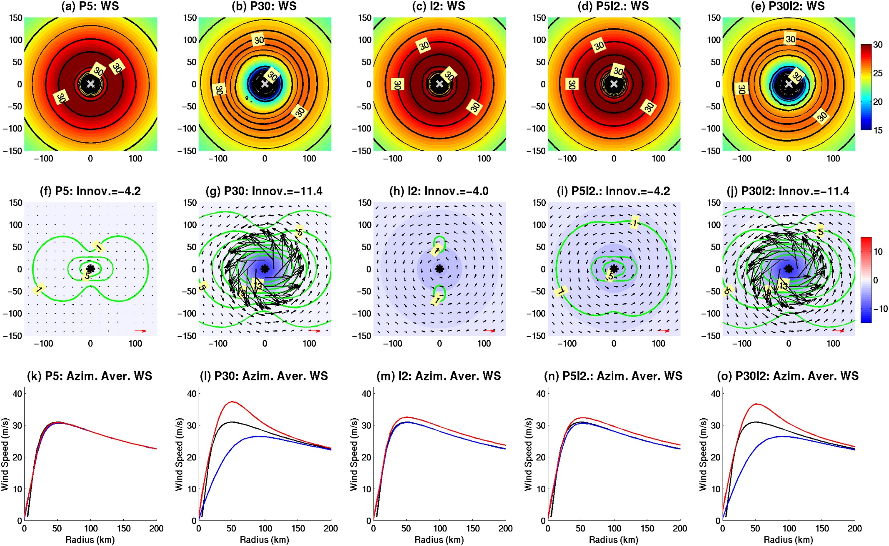
Scenario 1)
MSLP obs. located at the center of the mean TC

Slide 8
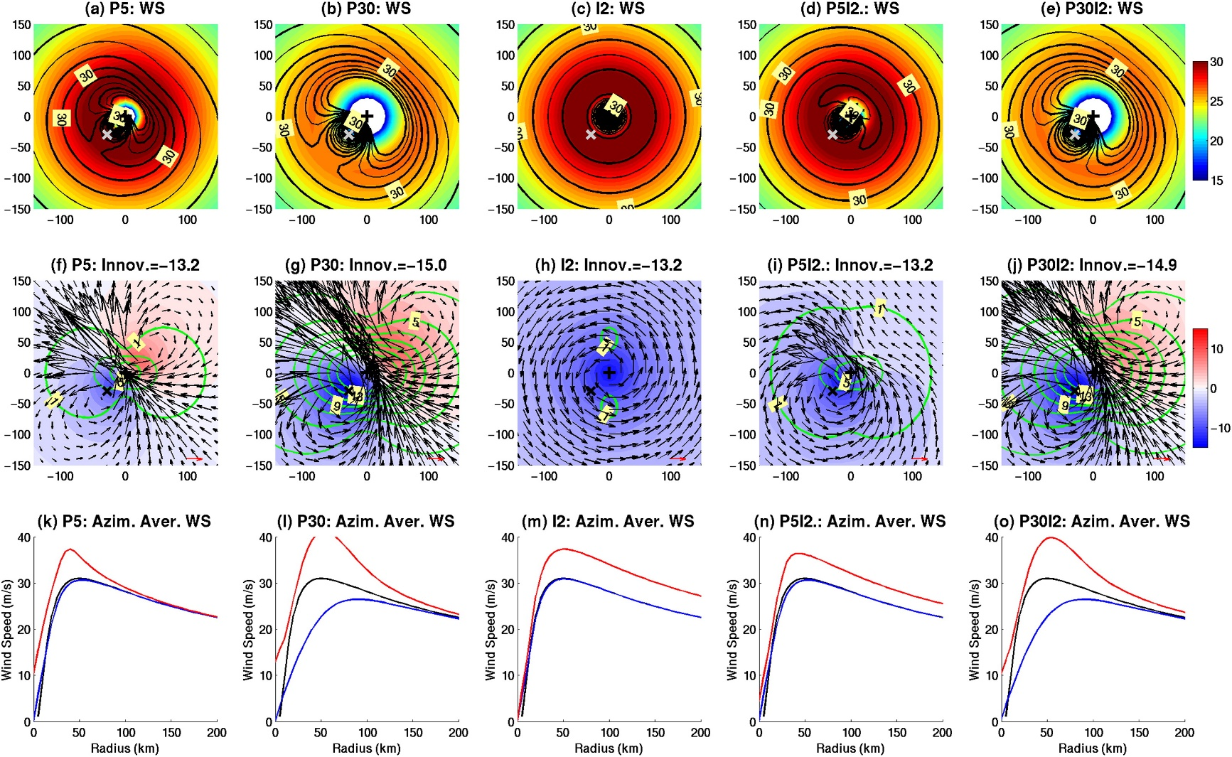
Scenario 2)
MSLP obs. located 40 km away
an asymmetry component

Slide 9
TC-centered ensemble data assimilation
1) A conventional data assimilation experiment is conducted to provide an analysis of the TC environment over the WRF’s outer domain.
2) Because the TC center of each ensemble member is located at the center of the vortex-following inner domain, we relocate the center of the inner domain of all ensemble members to the observed TC location. The TC-centered data assimilation process is then performed to generate an analysis in the TC area within the inner domain.
3) The results from steps 1) and 2) are merged together with the same method used in NH14. The merging process is performed by linearly combining two analyses over a finite area.
$$w=1−\left(\cos{\frac{π\hat{r}}{2}}\right)$$
$$\hat{r}=\frac{r−R_{in}}{R_{out}−R_{in}}$$
$$R_{in}=\frac{3}{4}R_{out}$$
$$R_{out}=280 km$$

Slide 10
Model and experimental setup
WRF-LETKF: with a vortex-following nested grid capability and LETKF data assimilation systems.
The horizontal grid spacings of the outer and inner domains are 12 and 4 km, with dimensions of 600 × 445 and 403 × 403 grid points, respectively. There are 36 vertical layers in both domains with a model top up to 50 hPa.
The physical parameterizations include the WSM 5-class microphysics scheme, the RRTM scheme for longwave and shortwave radiation, the MM5 surface-layer scheme, the YSU PBL scheme, and the Kain–Fritsch scheme for cumulus parameterization (outer domain only).
The configuration for the TCC experiment is mostly the same as that of CTL, except the inner domain is vortex following with 151 × 151 grid points in order to implement the TC-centered DA.

Slide 11
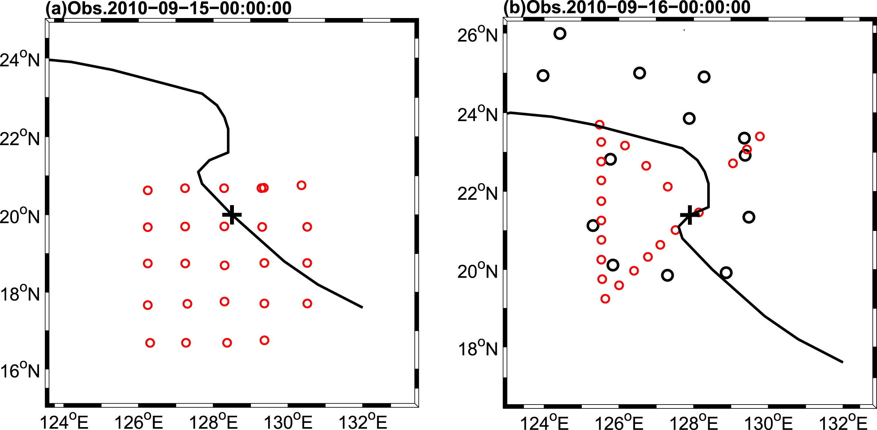
Assimilated data
Surface stations, rawinsondes, aircraft reports, mid-to-upper-level atmosphere motion vectors (AMVs), the MSLP of the TC from the Joint Typhoon Warning Center (JTWC), and dropsondes from the ITOP field campaign in 2010.
For quality control, observations are rejected when the innovations are greater than 5 times the observation errors.
DOTSTAR
C-130

Slide 12
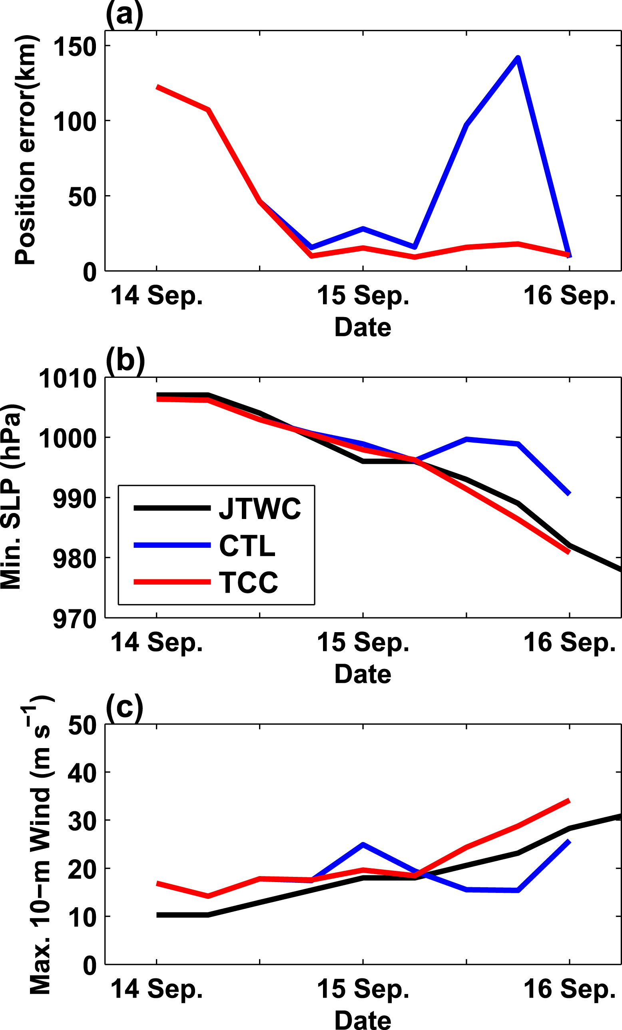
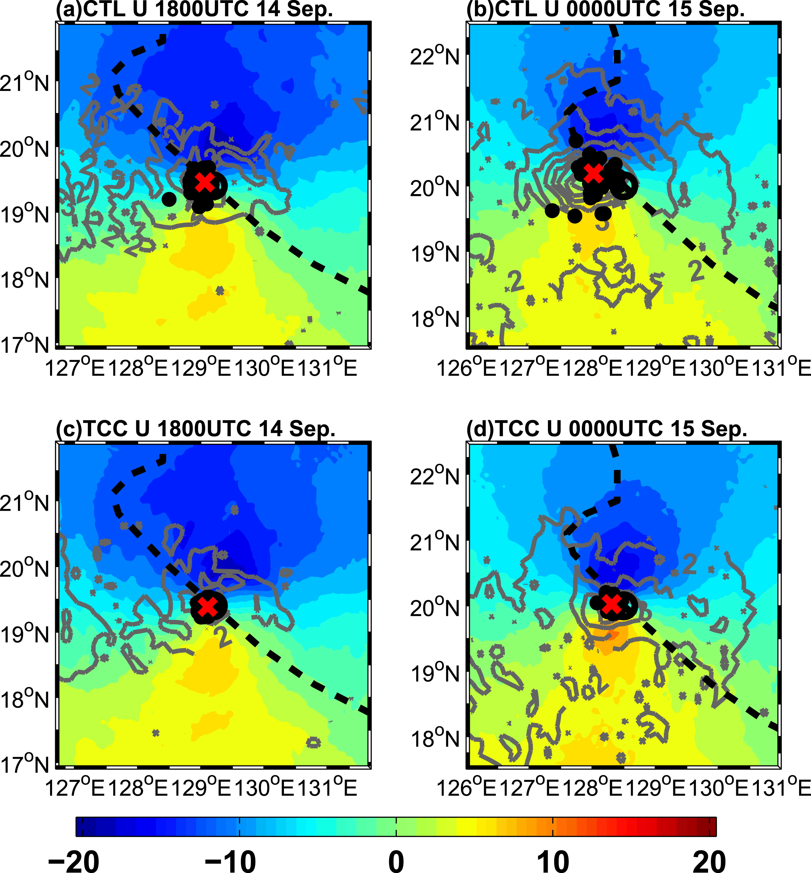
Analysis

Slide 13
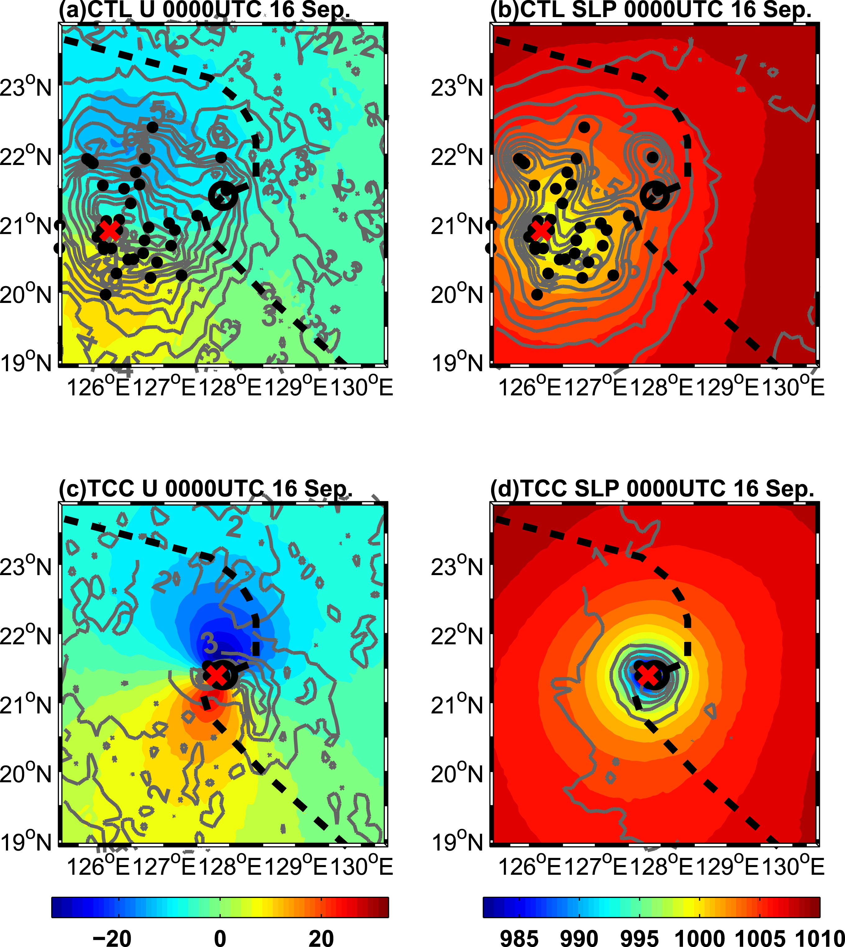
Initial condition
Large position spread westward bias
The MWS 16 m s⁻¹ MSLP is 998 hPa
Spread = 17 m s⁻¹
JTWC:
The MWS 28 m s⁻¹ MSLP is 982 hPa
The MWS 31 m s⁻¹ MSLP is 981 hPa
Spread = 8 m s⁻¹

Slide 14
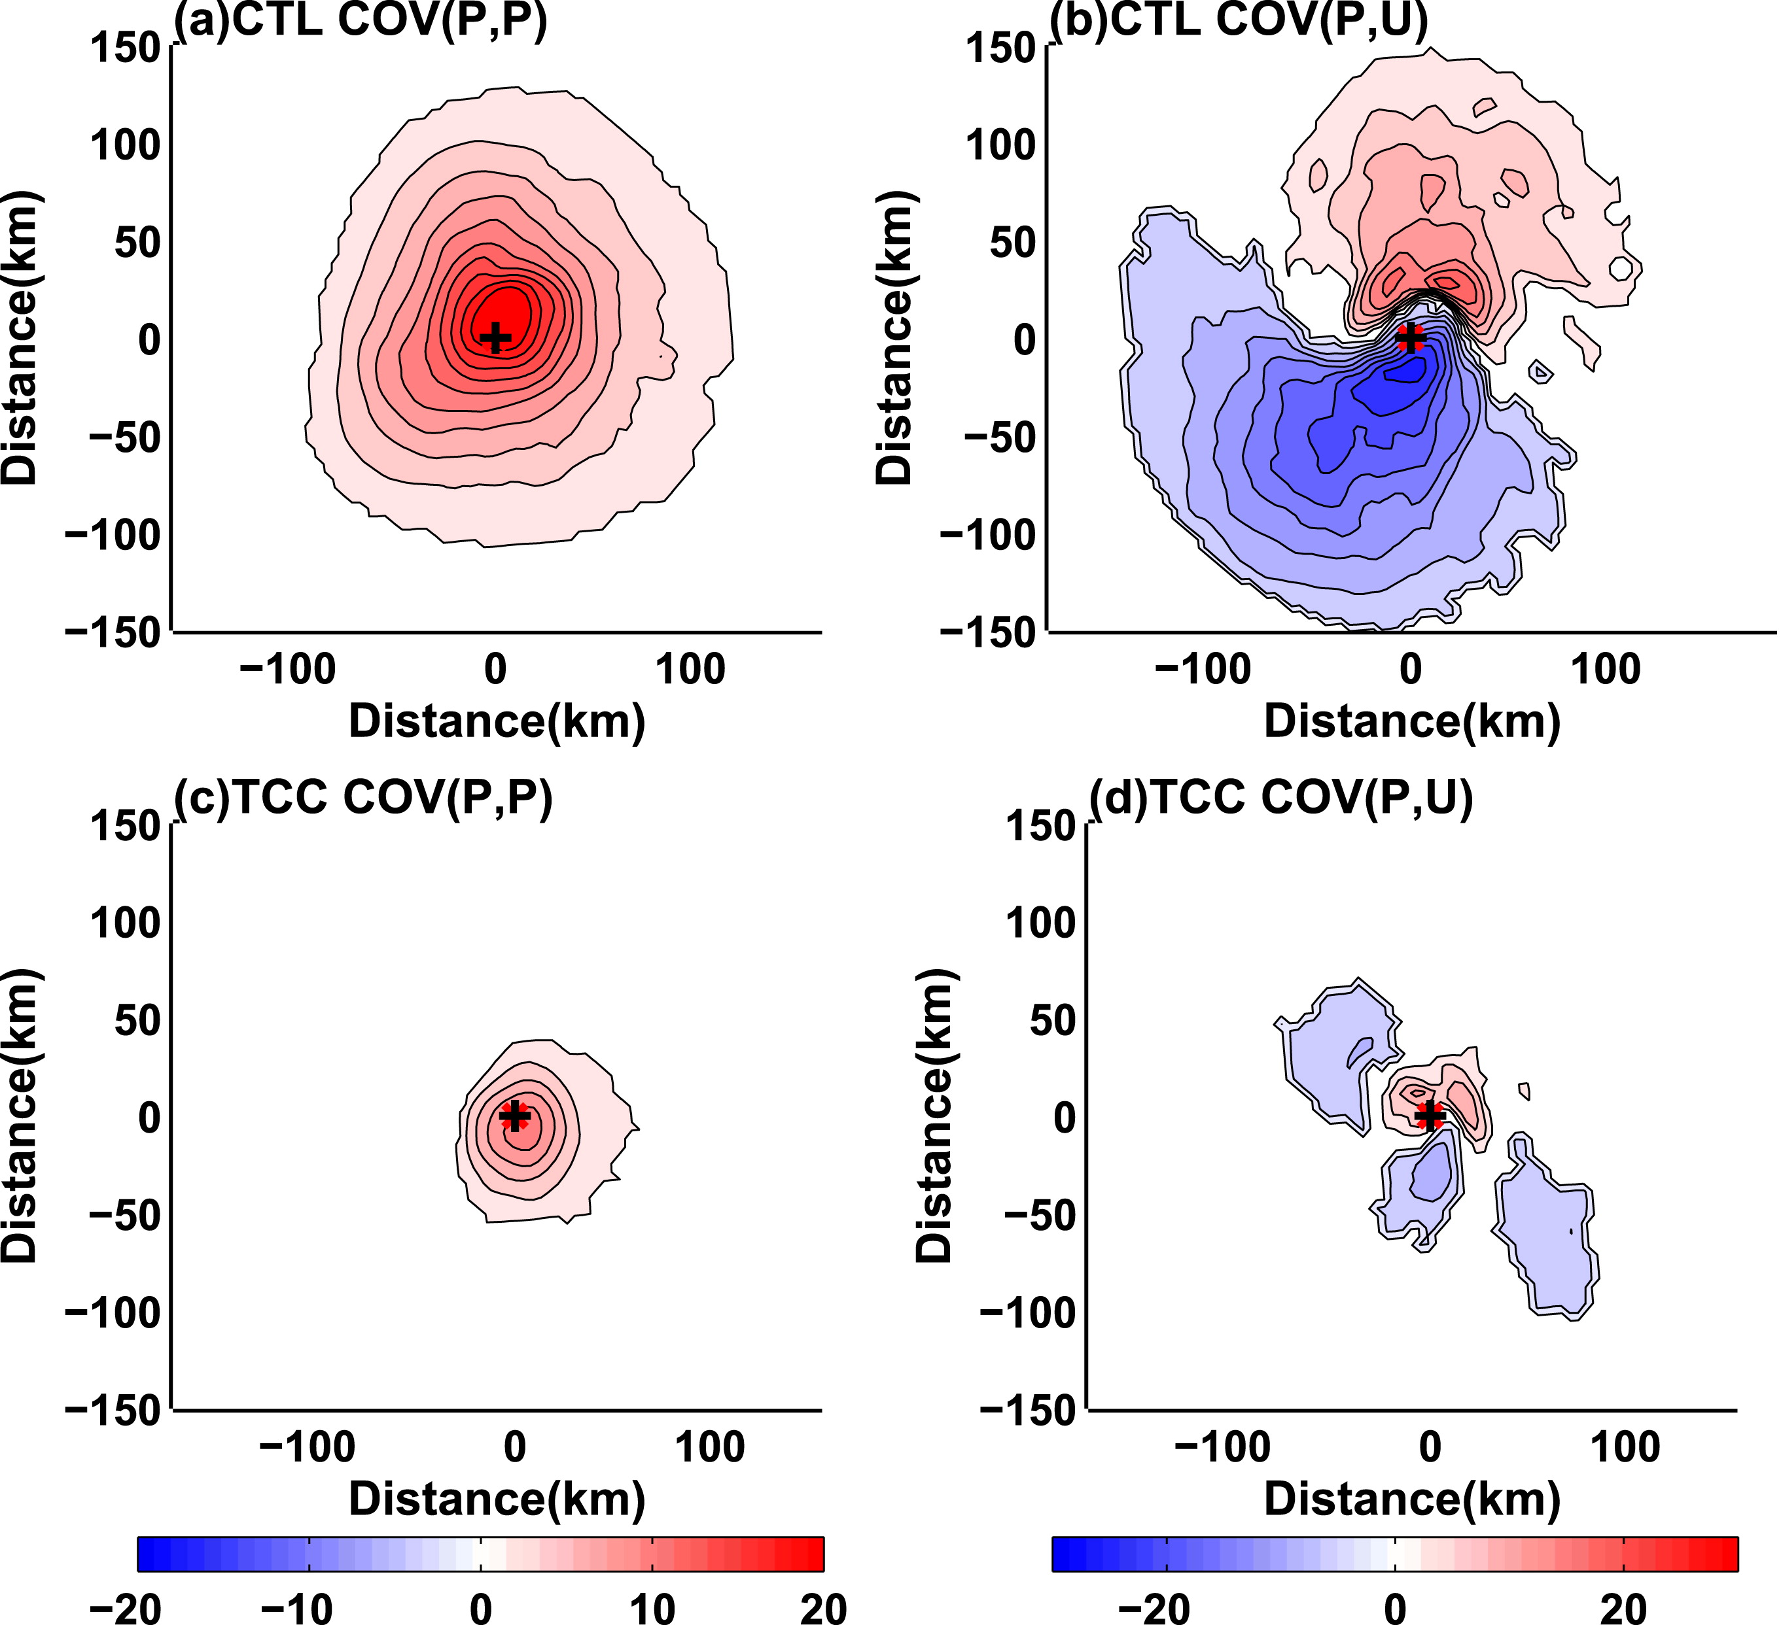
Background error covariance

Slide 15
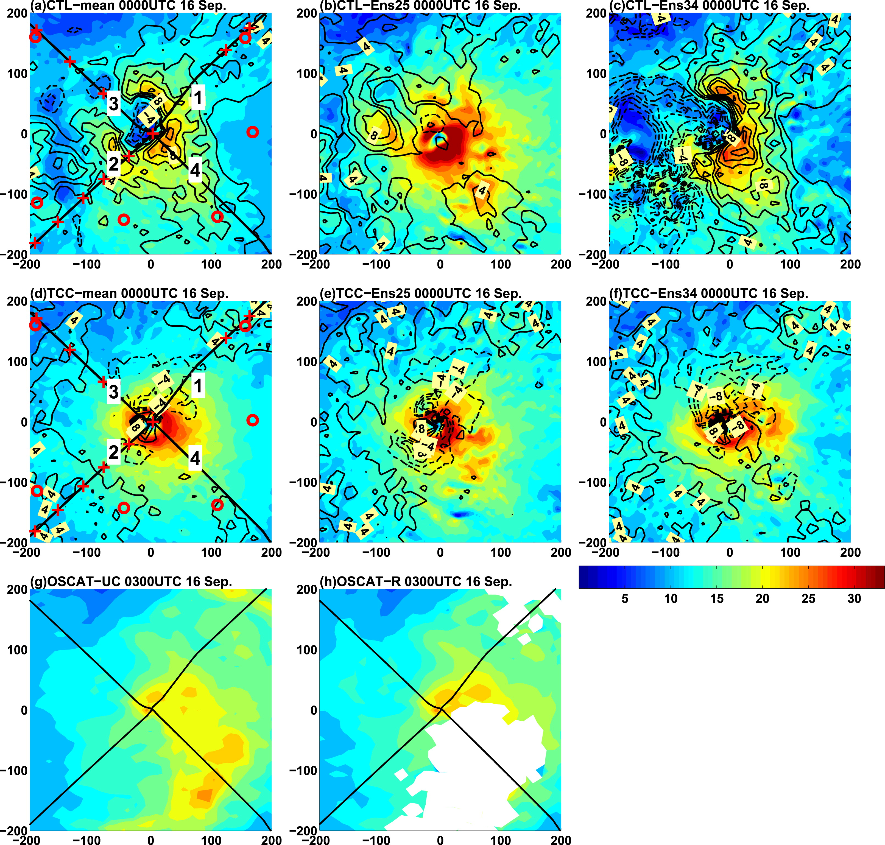
Analysis surface wind speed
EnKF successfully adjusts the position error and attempts to build a vortex structure with the help of the dropsonde information.
But TC is still not well constructed.
Further strengthening of the inner core and shrinking of the eye.
With the same observations, it is clear that the observational influences can be very different given the CTL and TCC background ensembles.

Slide 16
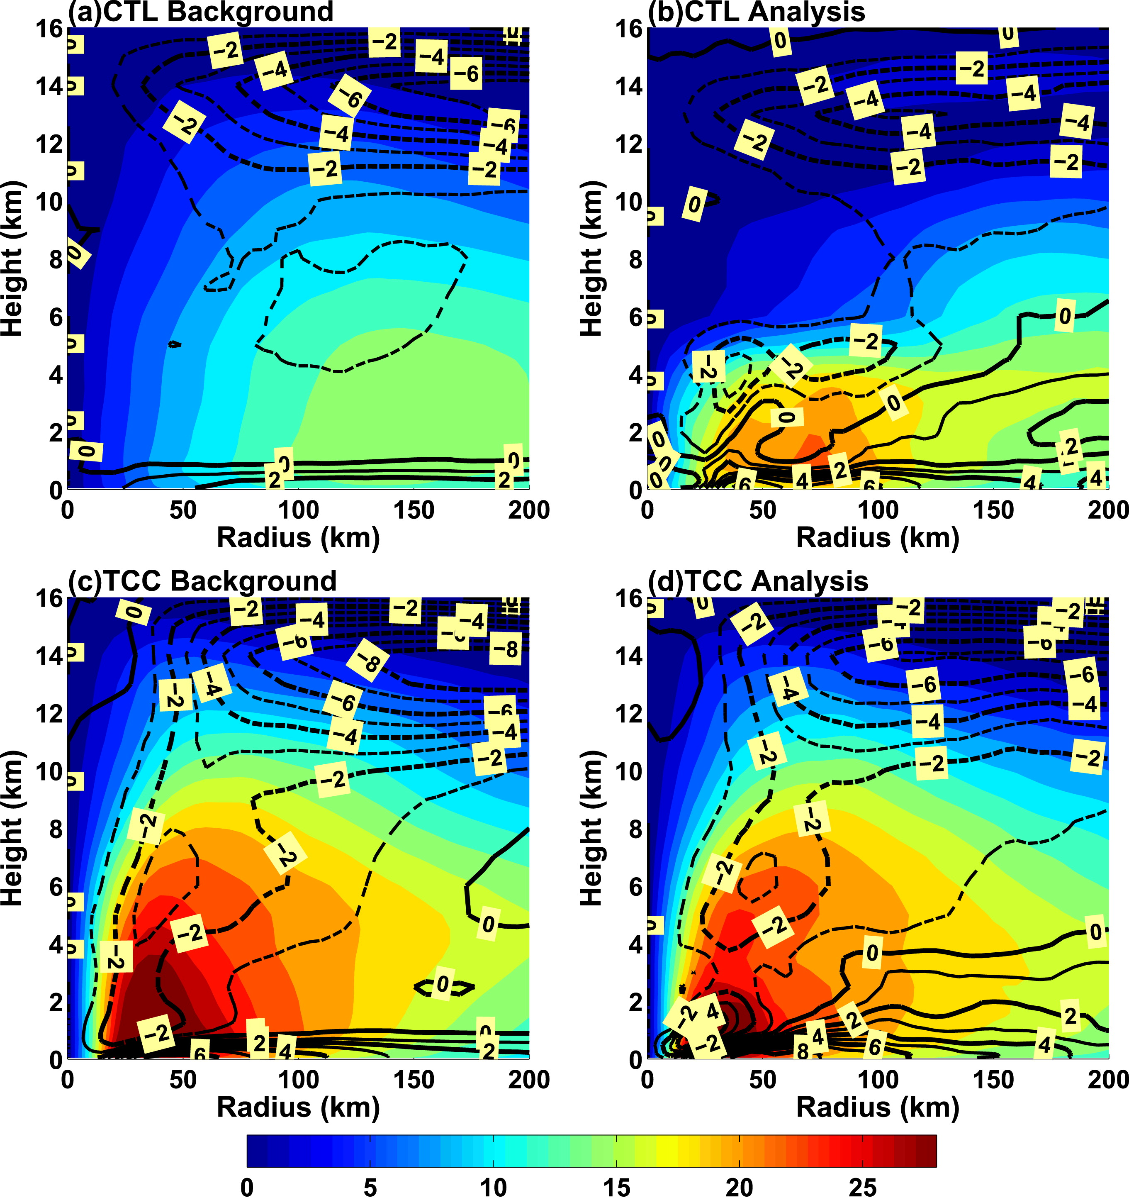
Vertical development
dropsondes were deployed near 700 hPa

Slide 17
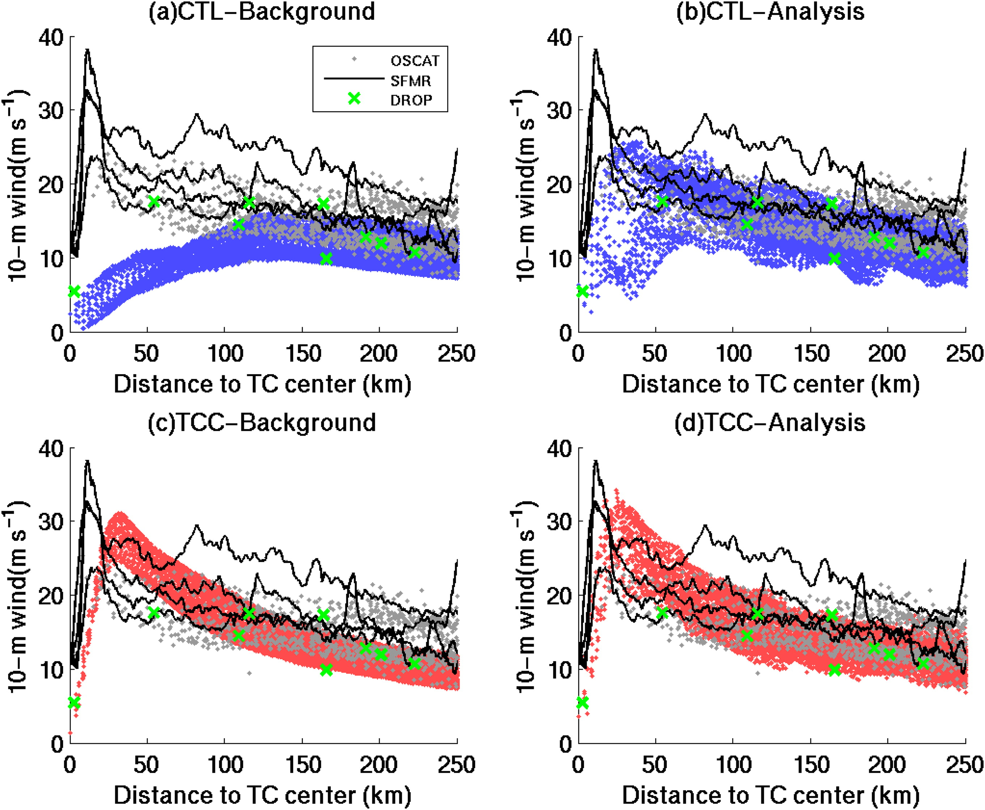
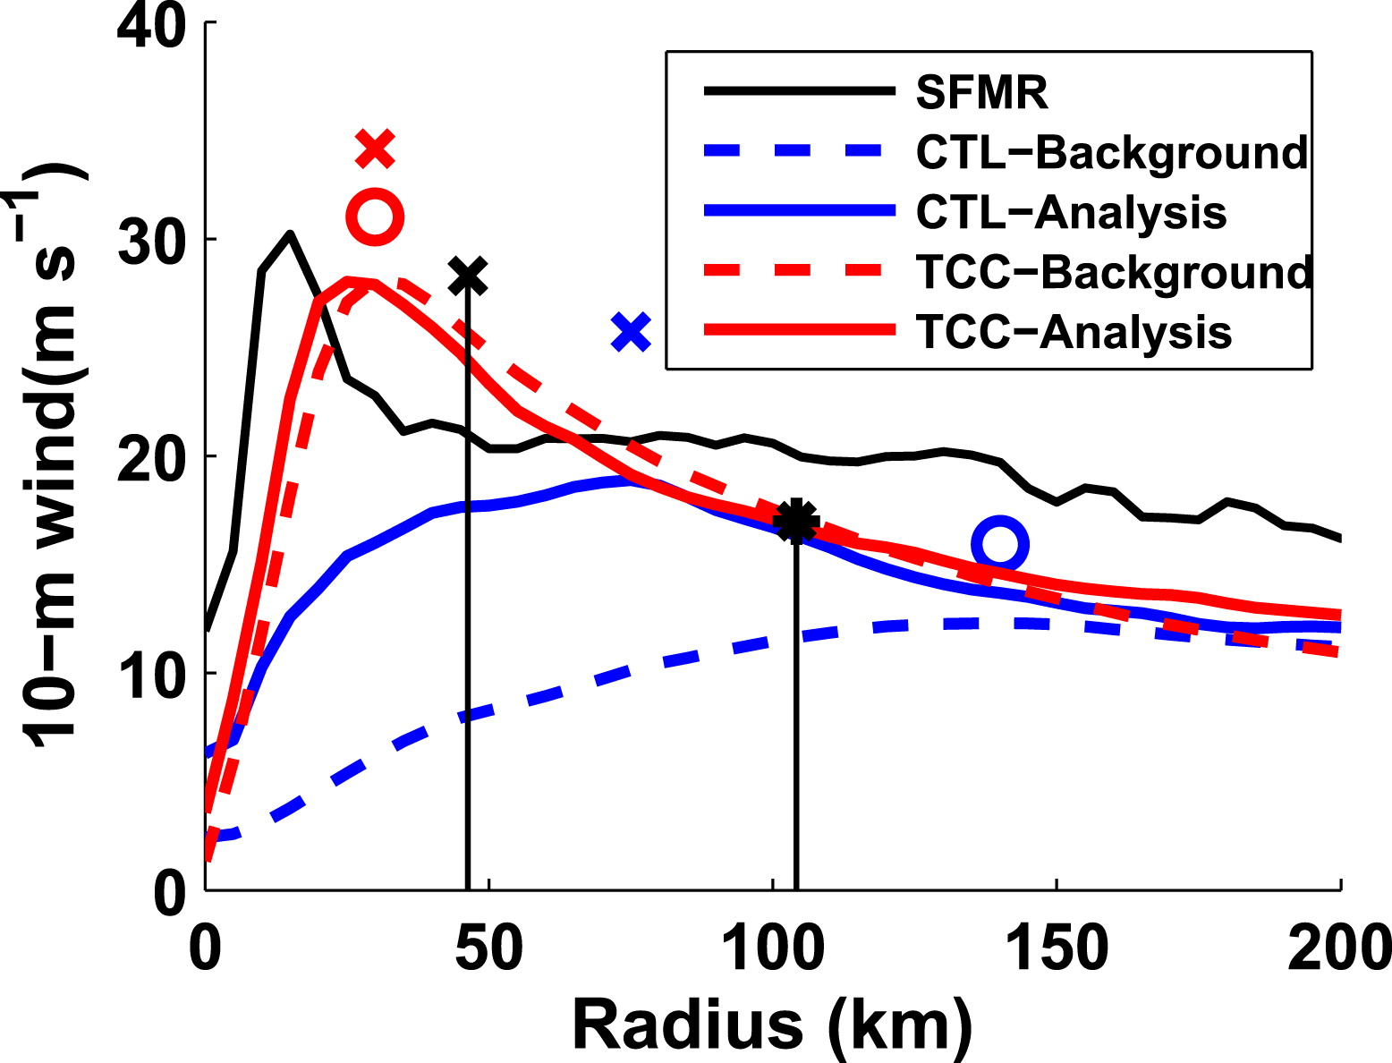
Quantitative verification

Slide 18
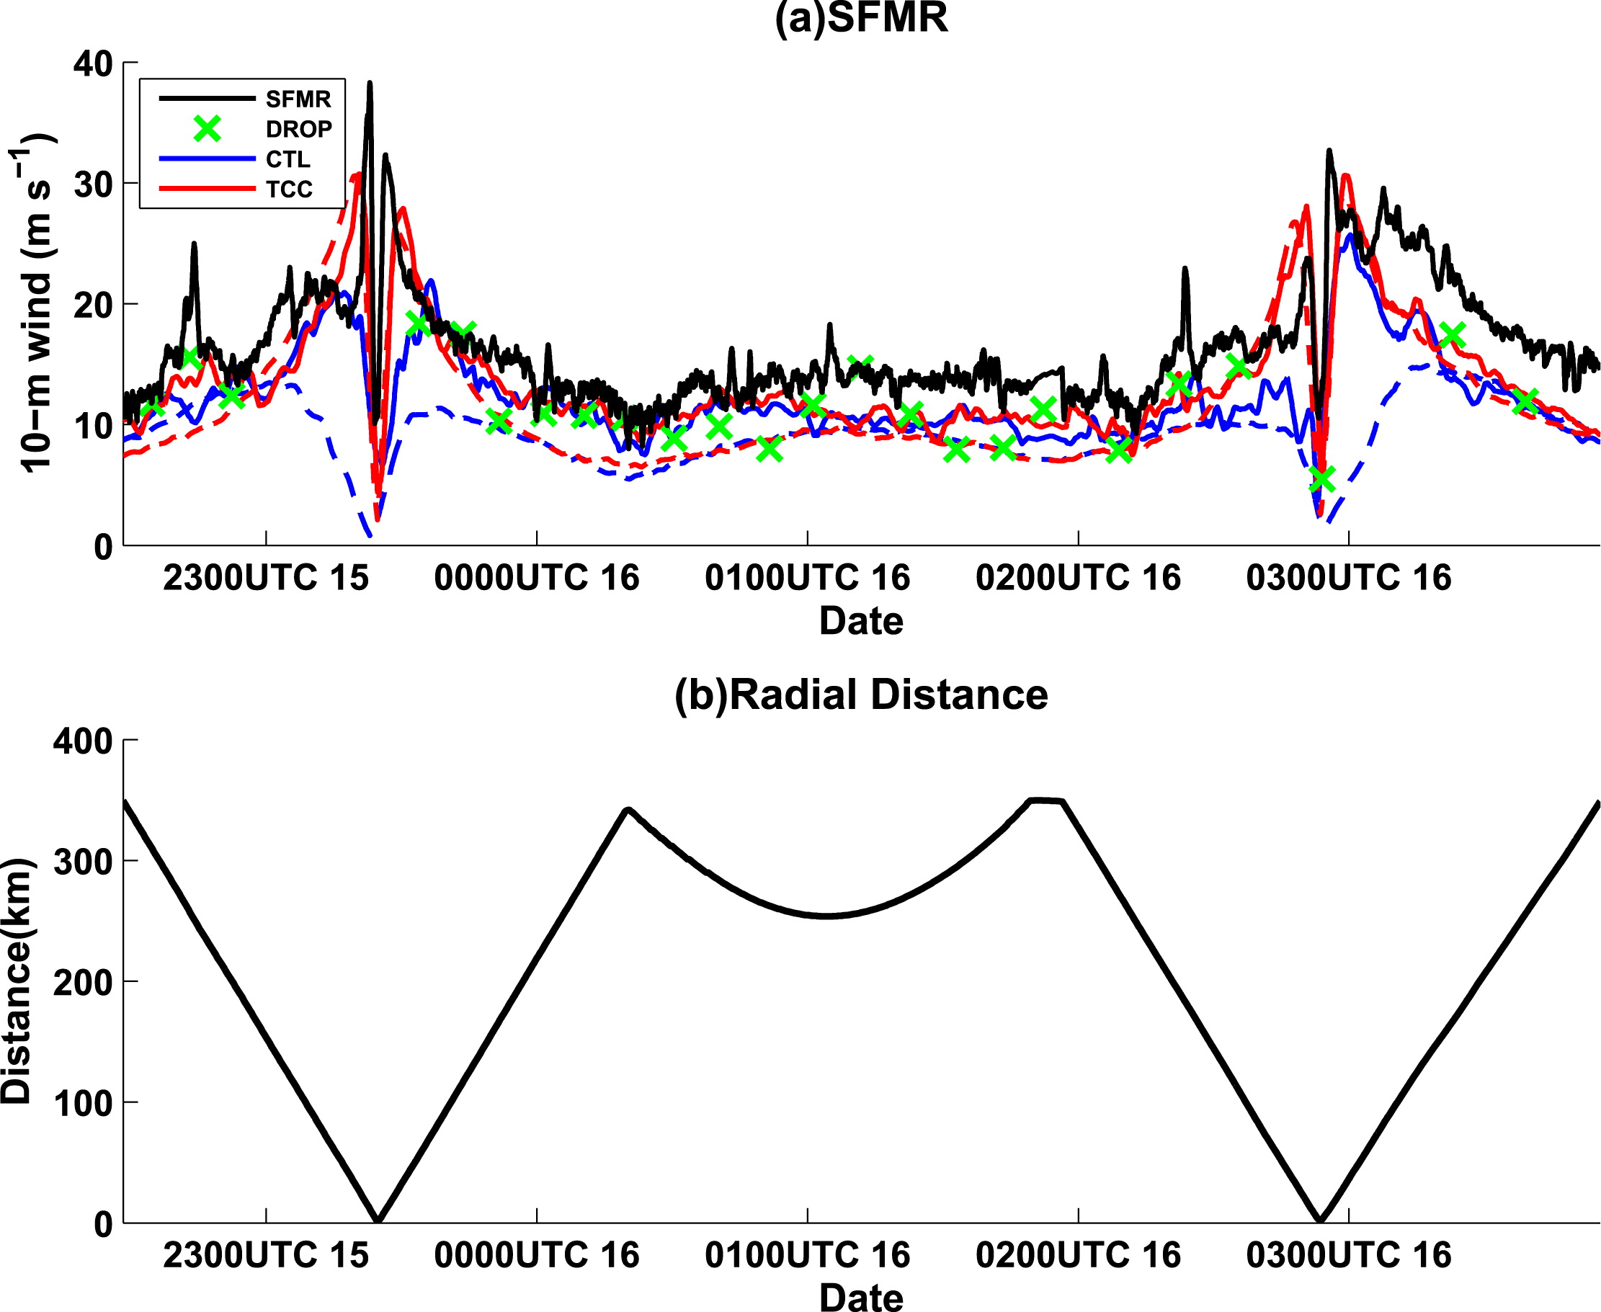
Along the path of the flight
RMSD
CTL: 8.7  5.3 m s⁻¹
TCC: 5.8  4.2 m s⁻¹
Surface wind speed from OSCAT and the dropsondes is generally weaker than the SFMR wind speeds.
Southwestward
Southeastward
northward

Slide 19
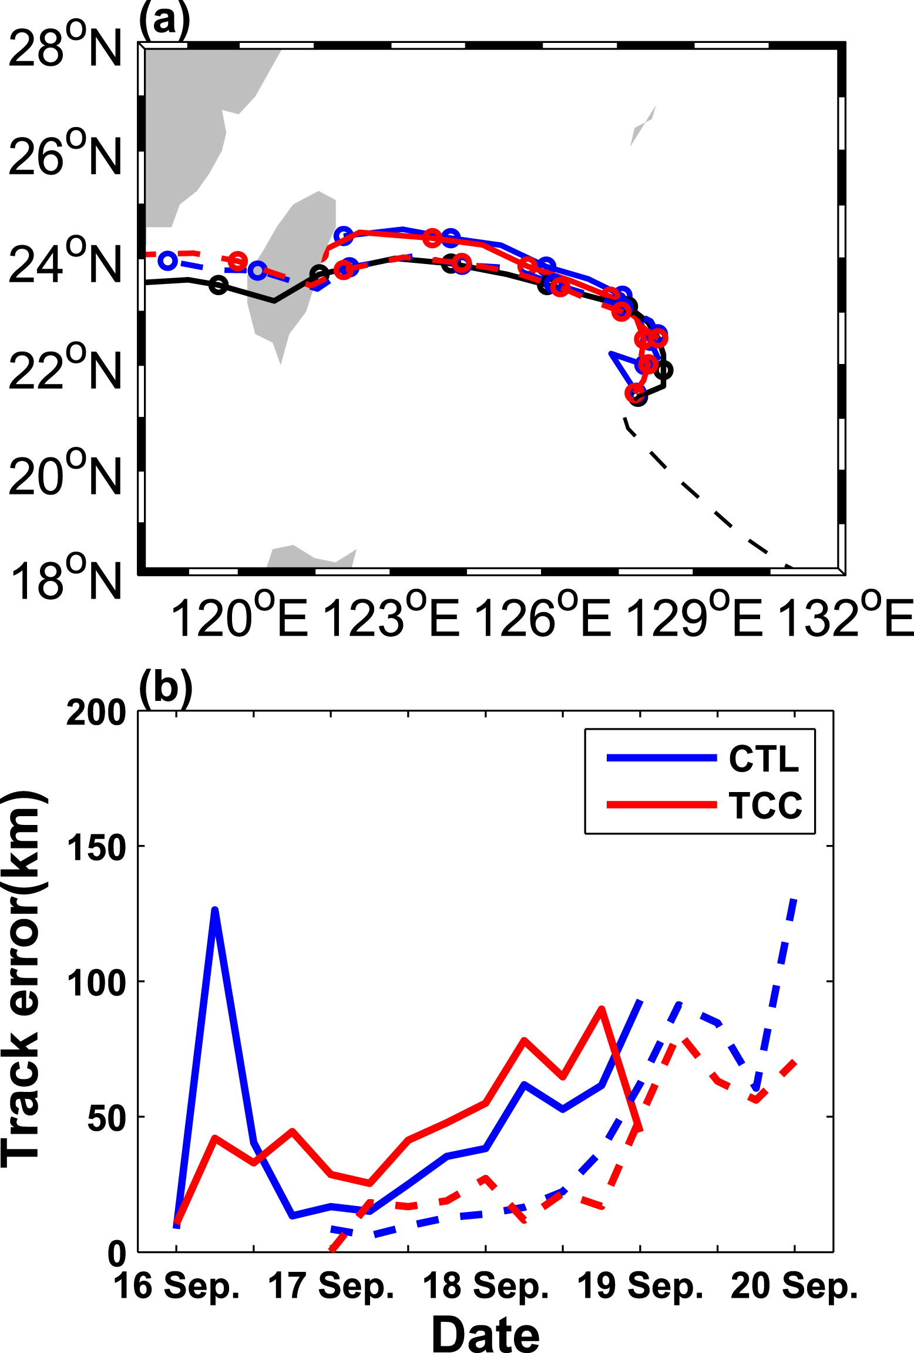
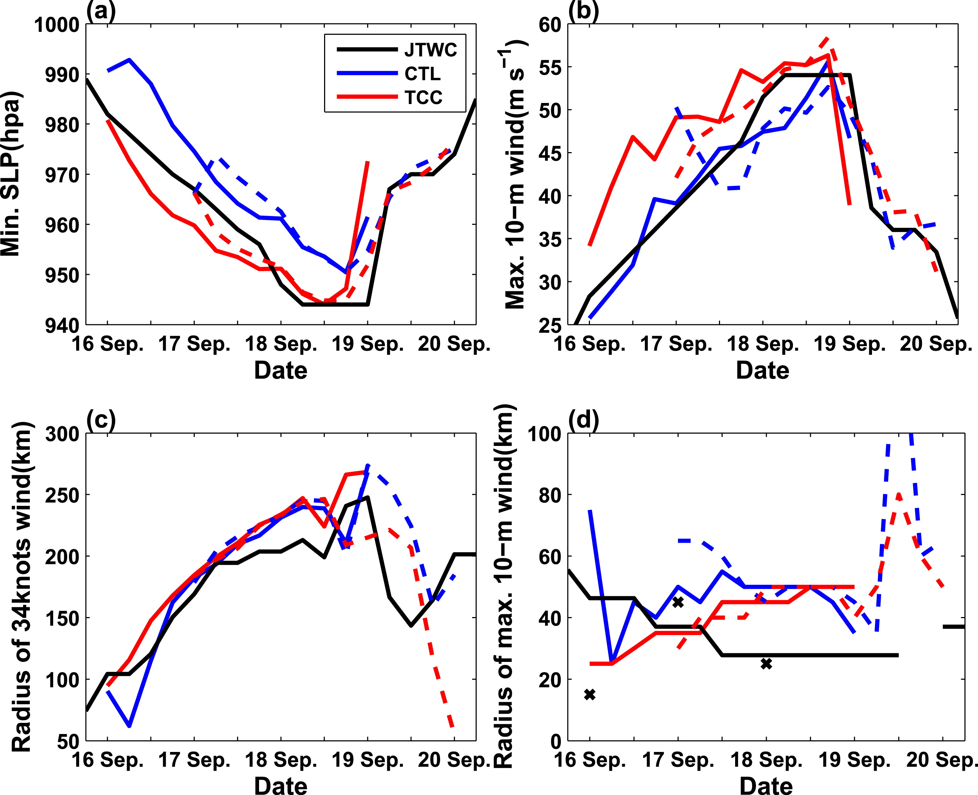
Forecast
Initialized @ 0000 UTC 16 Sep and 17 Sep
TC’s deep vertical development
93 km
44 km

Slide 20
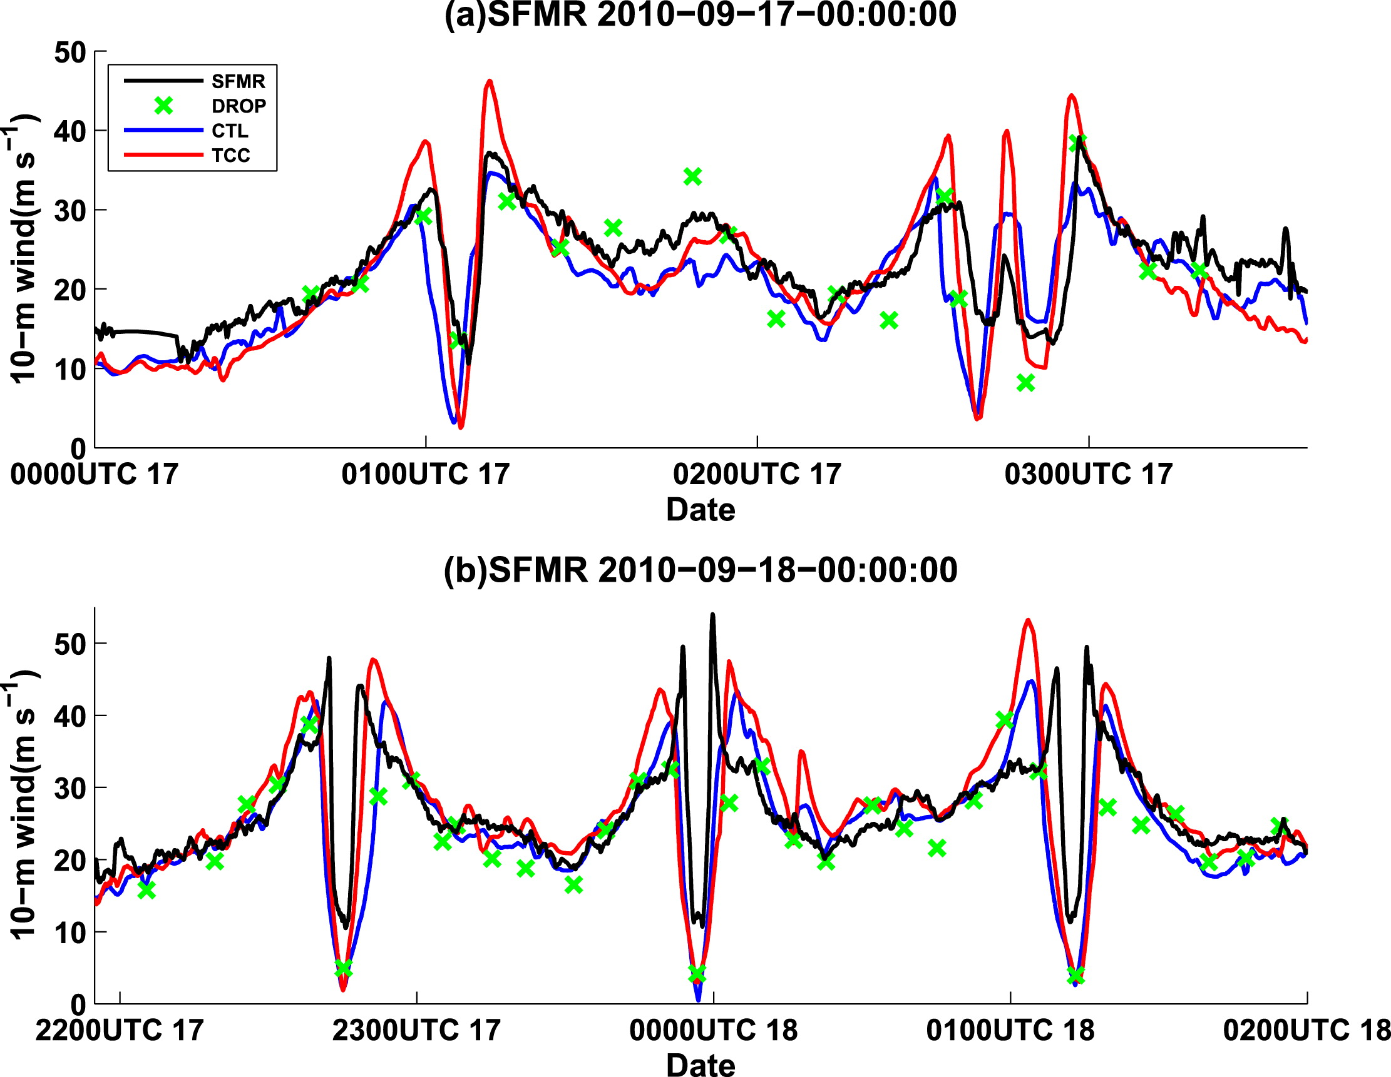
Forecast surface wind speed

Slide 21
Summary
Large TC position uncertainty has a major negative impact on the ensemble-based DA system, resulting in a less representative ensemble mean state through averaging and an ensemble-estimated background error covariance.
TC-centered (TCC) regional EnKF DA can help alleviate the negative impacts of position errors by limiting position uncertainty and improving the TC structure in the ensemble DA system. The performance of 6-hourly analysis–forecast cycles is also improved significantly
The improved DA analysis in TCC had a positive impact on Fanapi track forecasts during the first 12 h by mitigating the model spinup issues as well as improving the landfall position at 72 h.
The TCC DA impact on Fanapi intensity forecasts yielded mixed results. While the TC in the TCC forecast is overintensified during the first 2 days, it begins to resemble the JTWC best-track estimation afterward. The variations in TC structure from the TCC forecast generally agree better with the observations.

Slide 22
Thanks

Slide 23
Tab1

Slide 24
Fig1

Slide 25
Fig2

