Slide 1
Analysis of cloud-resolving model simulations for scale dependence of convective momentum transport
Liu, Y.-C., J. Fan, K.-M. Xu, and G. J. Zhang, 2018: Analysis of cloud-resolving model simulations for scale dependence of convective momentum transport. J. Atmos. Sci., 75, 2445–2472.

Slide 2
Introduction
Convective momentum transport (CMT), which refers to transport of horizontal momentum in the vertical direction by cumulus clouds.
it is a challenging task to fully understand CMT and parameterize:
1) CMT cannot be directly measured on a global scale and instead is estimated as a residual from the small imbalance between the PGF and the Coriolis force from intensive field experiments.
2) CMT is not a conserved variable and comprises two horizontal components that can behave differently for different mesoscale convective systems
3) CMT has multiscale features ranging from cloud clusters on mesoscale to convectively coupled equatorial waves (CCW) on equatorial synoptic scales

Slide 3
Using CMT parameterizations in GCMs has greatly improved the simulations and forecasting of largescale circulations:
an enhanced winter Hadley circulation and more realistic simulated meridional winds (Helfand 1979, Zhang and McFarlane 1995)
the seasonal migration of the ITCZ precipitation (Wu et al. 2003)
stationary anomalous precipitation can be reduced and more realistic large-scale circulation (Cheng and Xu 2014)
tropical wave variability and the global simulations of seasonal climate (Tulich 2015)
Hurricane intensity forecasting (Han and Pan 2006)
more coherent structure for the MJO deep convective center (Deng and Wu 2010)

Slide 4
CMT was parameterized in a simplified form by assuming that in-cloud horizontal momentum depends only on lateral detrainment and entrainment rates (Ooyama 1971; SL76).
in-cloud horizontal momentum can also be strongly influenced by the convection-induced pressure gradient (CIPG). (LeMone (1983) and LeMone et al. (1984))

Slide 5
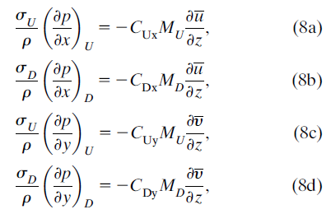
GKI97 scheme (Gregory et al. 1997)
The GKI97 scheme includes only the linear-shear forcing for parameterizing CIPG
C_{Ux}, C_{Dx}, C_{Uy}, and C_{dy} are set to the same value (C).

Slide 6
The uncertainties may be amplified at higher spatial resolutions because of the lack of understanding of the scale dependency of CMT and CIPG.
The main goal of this study is twofold:
1) to explore the scale dependencies of mass flux, CMT, and CIPG for the midlatitude convective cloud systems
2) to evaluate the formulation for parameterizing CIPG in the GKI97 scheme for different grid spacings.

Slide 7
CRM simulations
Model: WRF, v3.3.1
advanced microphysics scheme: explicit spectral-bin microphysics (SBM)
horizontal domain size : 560 x 560 km²
Horizontal grid spacing: 1 x 1 km²
vertical layers: 41 for MCC (MC3E-0523)
45 for squall line (MC3E-0520)
The Midlatitude Continental Convective Clouds Experiment (MC3E) took place from April 22 – June 6, 2011, near Lamont, Oklahoma in the region surrounding the Department of Energy (DOE) Atmospheric Radiation Measurement (ARM) Program Southern Great Plains Central Facility.
Notes:
The Midlatitude Continental Convective Clouds Experiment (MC3E) took place from April 22 – June 6, 2011, near Lamont, Oklahoma in the region surrounding the Department of Energy (DOE) Atmospheric Radiation Measurement (ARM) Program Southern Great Plains Central Facility.

Slide 8
Methodology
to divide the CRM domain into subdomains with different horizontal sizes to mimic the GCM grid spacings
$$560×560 {km}^{2}\left\{\begin{aligned}2×2 \\ 4×4 \\ 8×8 \\ 16×16 \\ 32×32 \\ 64×64 \\ 128×128 \\ 256×256 \\ 512×512\end{aligned}\right.{km}^{2}$$

Slide 9
Defining clouds in convective updraft and downdraft regions :
Updraft: $\left\{\begin{aligned}\text{w} >1 {(ms}^{−1})\text{, }\text{q}\text{tot} >1×{10}^{−5}{ (kgkg}^{−1}) \\ \text{w} >2 ({ms}^{−1})\end{aligned}\right.$
Downdrafts: w $<−1 ({ms}^{−1})$, q_{tot} $<1×{10}^{−5}{ (kgkg}^{−1})$
These subdomain types include 1) updraft only; 2) downdraft only; 3) environment only; 4) updraft and environment; 5) downdraft and environment; 6) updraft, downdraft, and environment; and 7) updraft and downdraft.
Our analysis considers only types 4, 5, and 6 because as far as CMT parameterization is concerned, types 1, 2, and 3 do not contribute to CMT.
Contribution of type 7 to the total momentum transport is very small.

Slide 10
The CRM-simulated CMT in the x and y directions from the CRM simulations are defined as
Subdomain 2 x 2
$$w_{i}$$
$$w_{i}$$
$ρ$: air density
$u_{i},v_{i},w_{i}$: velocity at each grid point i in a subdomain considered
overbar: mean over the subdomain
prime: deviation from the mean over the subdomain
N: total number of grid points in the subdomain
$$w_{i}$$
$$w_{i}$$
$$N=4$$
$$\overline{w}=\frac{1}{N}\sum_{i=1}^{N}{w_{i}}$$
Notes:
Rw’u’ and rw’y’ can be further partitioned into contributions from updrafts (Uxcrm, Uycrm) and downdrafts (Dxcrm, Dycrm) and environment (Excrm, Eycrm), with similar definitions to Eq. (1) except only those grid points satisfying their respective criteria are included, and the summation is overNU,ND, andNE, respectively.

Slide 11
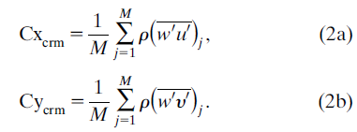
For a given grid spacing, the number of such subdomains j within the CRM domain that meet conditions of 4, 5, and 6 is denoted by M.
Then the ensemble-mean x (Cx_{crm}) and y (Cy_{crm}) components of CMT of are given by

Slide 12
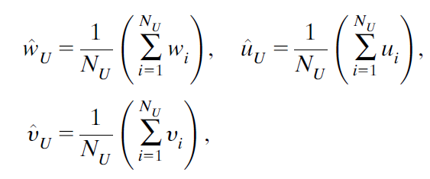
In terms of parameterizations of CMT, the traditional top-hat approach ignored inhomogeneity within updrafts and downdrafts.
The parameterized x component of CMT associated with updrafts, downdrafts, and environment in a subdomain
updraft
updraft
$$N_{u}=2$$
$$N=4$$
U, D, E: updraft, downdraft, environment
$σ_{U},σ_{D},σ_{E}$: fractions of updraft, downdraft and environmental areas
$$\overline{w}=\frac{1}{N}\sum_{i=1}^{N}{w_{i}}$$

Slide 13
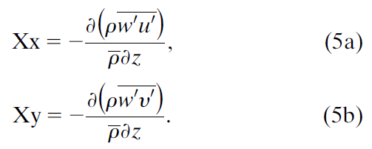
The vertical divergence of CMT is often called apparent momentum source $Χ$:
The apparent momentum source for updrafts can be approximated by
$δ$: air mass detrainment at the cloud boundaries
P: perturbation pressure induced by convection
Notes:
The first term on the right-hand side of Eqs. (6a) and (6b) is the product of the updraft mass flux and the vertical mean wind shear, which can be interpreted as the vertical advection of mean horizontal momentum by compensating subsidence.
the second term represents the effect of horizontal momentum that is detrained from updrafts into environment;
the last term is the effect of the CIPG force on environment.

Slide 14
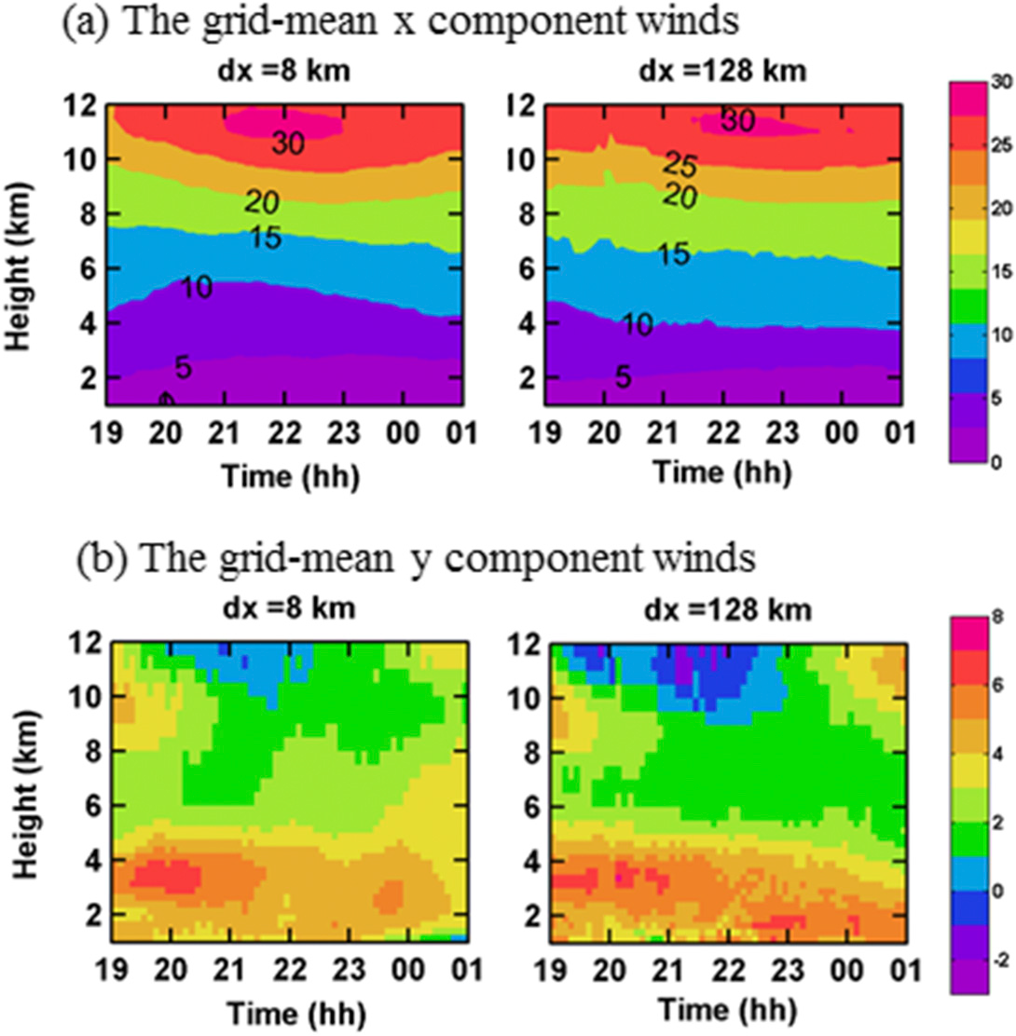
for MCC
a weak scale dependency for grid-mean wind components
Notes:
the grid-mean x component of winds (u) are westerly throughout the troposphere with the maximum wind speeds in the upper troposphere during the entire period.
The grid-mean y component of winds (y) are southerly in most of the troposphere except for 2100–2300 UTC above 10-km height, and the maximum y occurs in the lower troposphere.
The time–height cross-sections of u and y are very similar for different grid spacings except weaker westerly winds and stronger northerly winds above 10-km altitude for larger grid spacings.
This indicates a weak scale dependency for grid-mean wind components.

Slide 15
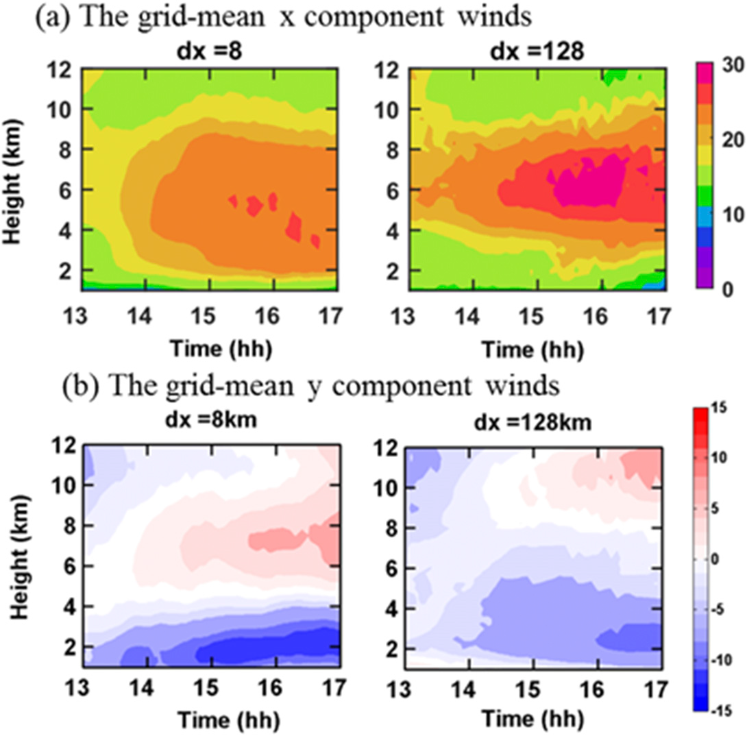
Squall line
m/s
Notes:
The grid-mean x component of winds (u) from MC3E-0520 shows results similar to MCE-0523.
the grid-mean y component of winds (y) from MC3E-0520 exhibits distinct differences between small and large grid spacings (Fig. 2b and Fig. S2), as indicated by the gradual decrease of vertical gradient as the grid spacing increases from dx = 4–16 to dx = 32–512 km.

Slide 16
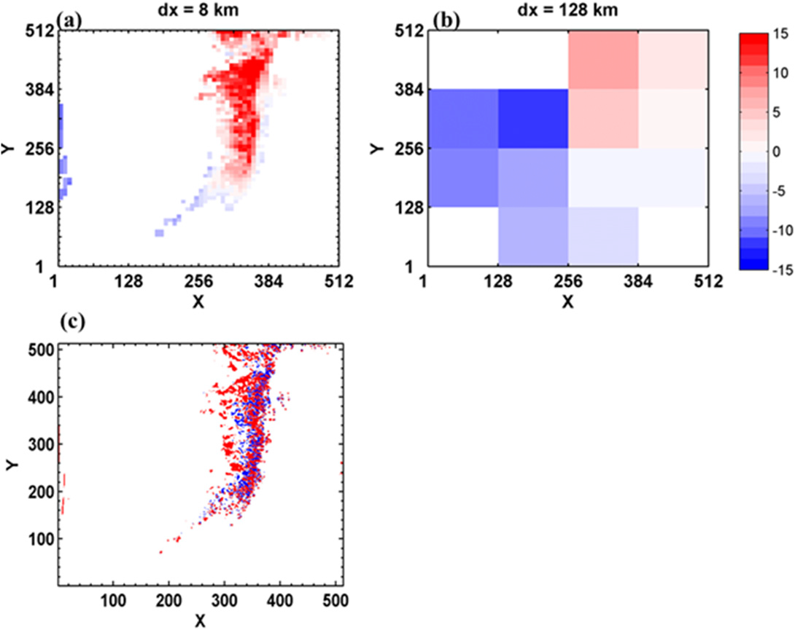
grid-mean y-component winds (m/s) at 6.0-km altitude at 1400 UTC 20 May
CRM simulation
(m/s)
Red points: updraft
Blue points: downdraft
Notes:
The selected subdomains for dx = 128km occupy much larger regions than those for dx = 8 km.
The latter are closer to where the squall line is located.
for dx = 128 km, the majority of the subdomains contain negative V, resulting in negative ensemble-mean y.
However, for dx = 8 km, the majority of the subdomains have positive V, producing positive ensemble-mean y.
This explains the different upper level winds between large and small grid spacings, and where the scale dependency of y comes from.

Slide 17
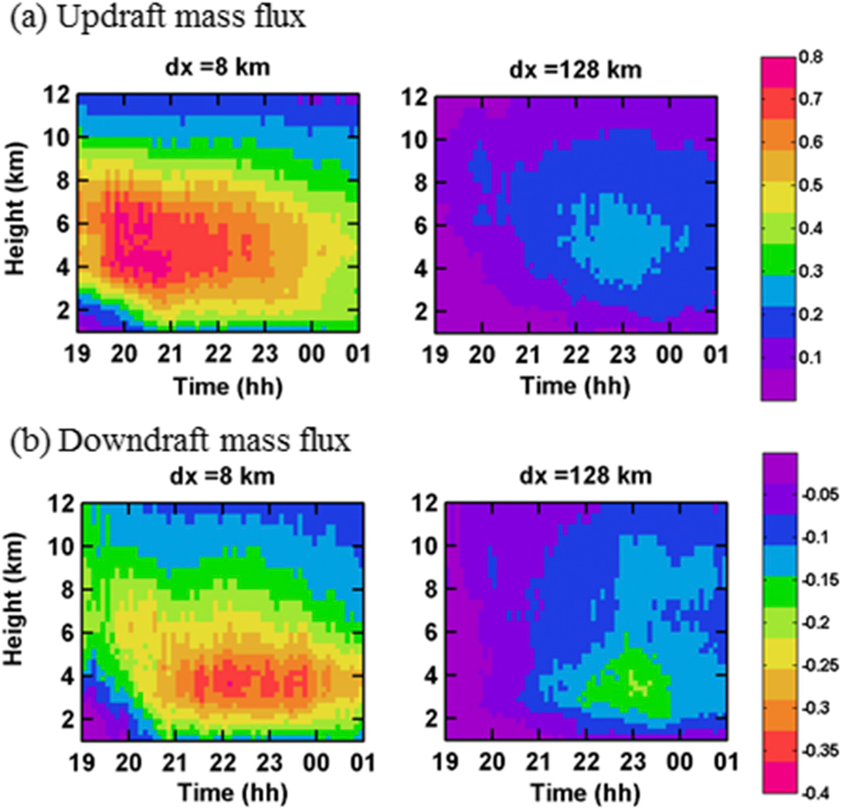
both updraft and downdraft mass fluxes have strong scale dependency
Notes:
The updraft mass fluxes decrease monotonically as subdomain size–grid spacing (dx) increases and peak from the initial developing
stage at small grid spacings to the mature stage at very large grid spacings, while downdraft mass fluxes peak at dx = 8 or 16 km and then decrease as dx increases
(Fig. S3).
downdraft mass fluxes peak near 4-km altitude where the freezing level is located and at the mature stage for all the grid spacings
downdraft CMTs peak in the lower troposphere while updraft CMTs are significant over a much larger extent of the troposphere.

Slide 18
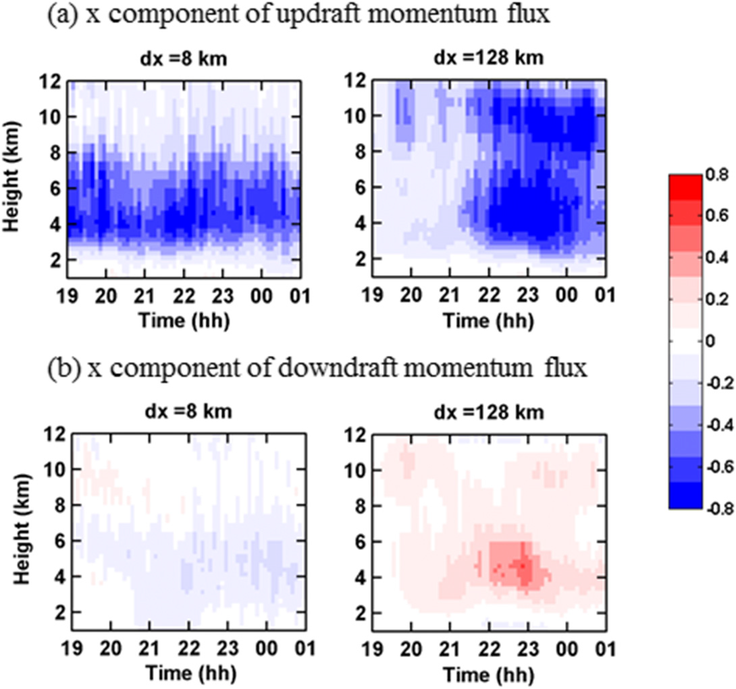
x component of ensemble-mean vertical momentum flux
Notes:
As expected, the time–height cross sections of CMT show even larger differences among different grid spacings relative to those of either updraft or downdraft
mass fluxes because CMT is the product of fluctuations of both horizontal and vertical wind components.
For small grid spacings, the updraft CMT peaks from the initial developing stage compared to the mature stage for the very coarse grid spacings,
For the x component of downdraft CMT, as the grid spacing increases, it evolves from mostly negative at dx <16km to mostly positive at and above dx > 64 km.

Slide 19
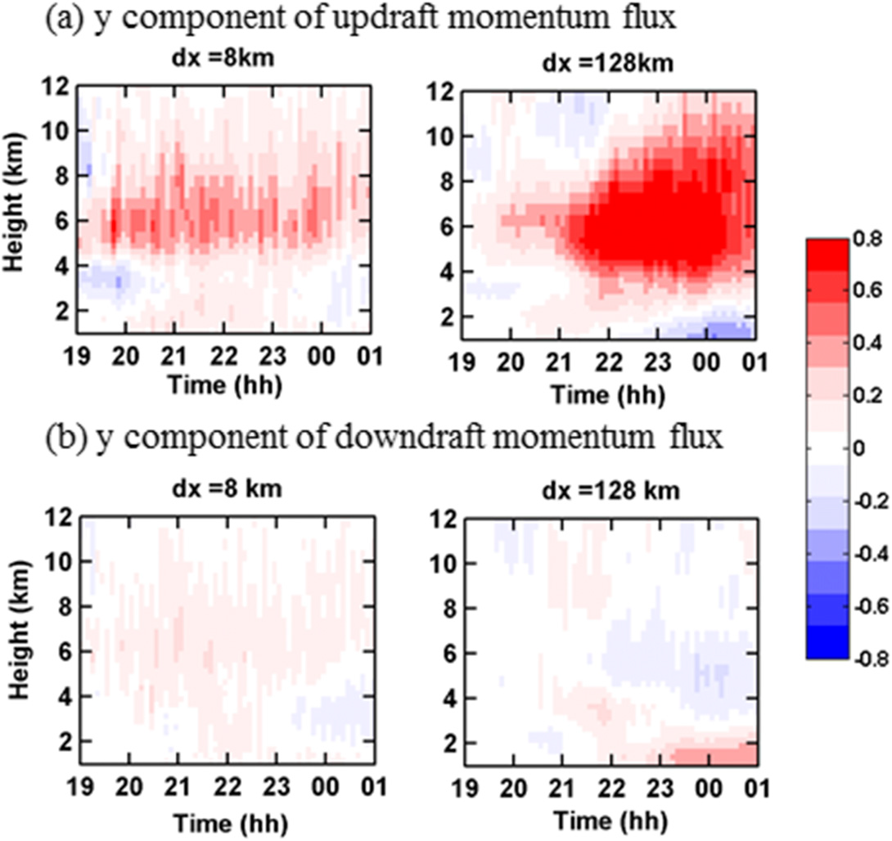
Notes:
the y component of updraft CMT is mostly positive except for dx<32km at the first hour and for dx>32km below the 2-km altitude, indicating mostly
upward momentum transport in southerlies.
the magnitude increases with the grid spacing more significantly than that of its x-component counterpart.
As for the y component of downdraft momentum flux, it evolves from mostly positive for dx = 4–32km to changing signs in the vertical for dx = 64–512km (i.e., negative CMT at the 4–8-km altitude but positive CMTs below 4- and above 8-km altitudes).

Slide 20
Relationships between CMT and wind shear
for linear MCS such as squall line, CMT may be upgradient in the line-normal (y) direction and downgradient in the line-parallel (x) direction.
CMT is generally downgradient for nonlinear MCS
The grid-mean vertical-x-component wind shear is calculated by
$Z_{k}$: the altitude of vertical level Z

Slide 21
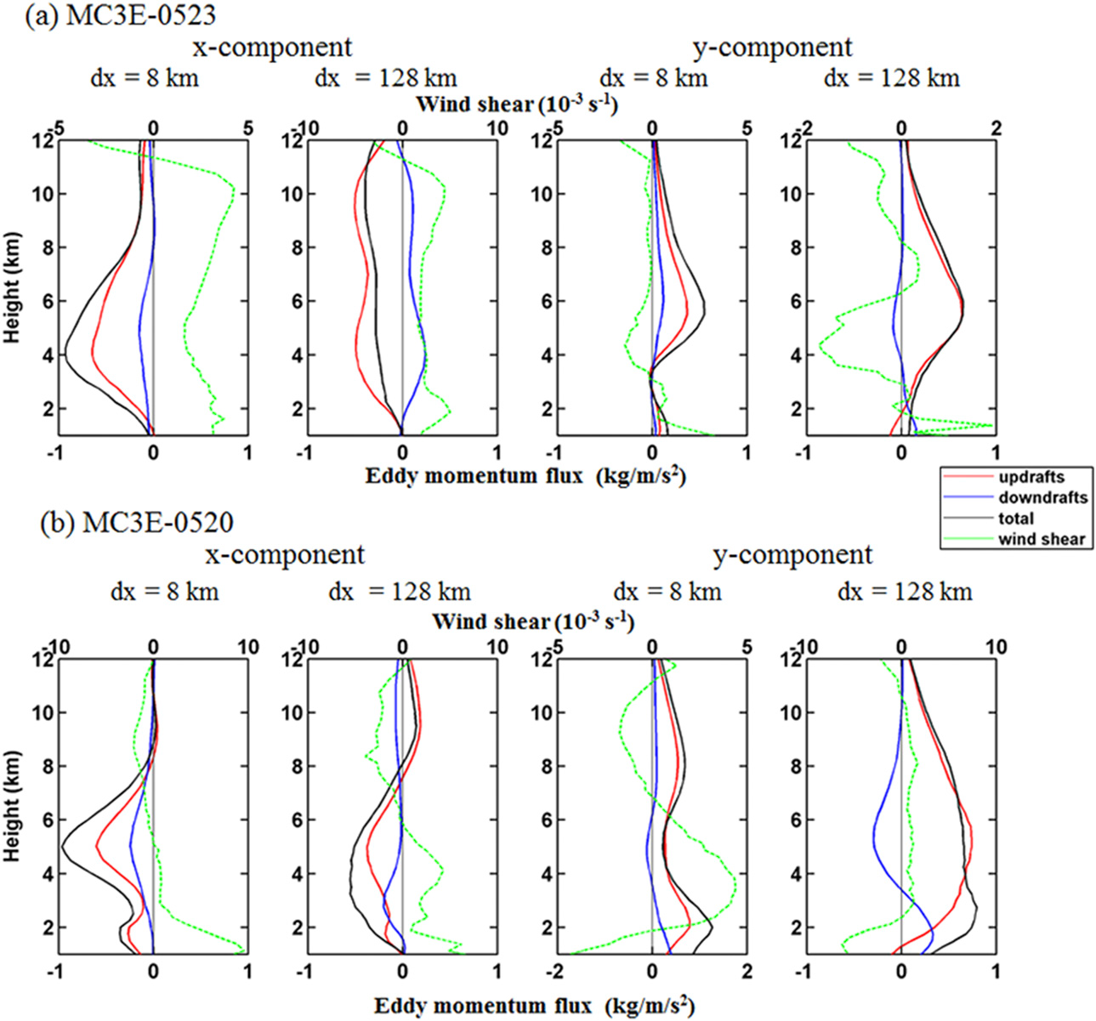
Nonlinear MCS
for the nonlinear MCS, the downgradient transports for updrafts and total CMTs generally do not change with grid spacings and are consistent with previous studies.
downdraft CMT has downgradient transport at small grid spacings but becomes upgradient at large grid spacings.
Squall line
for the linear MCS, the downgradient transport in the line-parallel direction and upgradient transport in the line-normal direction for updraft and total CMTs.
The downdraft CMT is always downgradient
Notes:
For MC3E-0523 (nonlinear MCS), updraft and total CMT and vertical wind shear are generally opposite in sign at both large and small grid spacings, indicating that both the x and y components of total and updraft CMTs are downgradient with respect to vertical wind shear (Fig. 7a).
An exception occurs around the 7-km altitude for the y component of dx = 128 km.
A similar downgradient transport can also be seen from the x and y components of downdraft CMT at dx = 8km, but it is upgradient at dx = 128 km.
This suggests that downdraft CMT is very sensitive to grid spacing and can have different transport directions for small and large grid spacings.
For MC3E-0520 (linear MCS), the x components of updraft, downdraft, and total CMTs for dx = 8 and 128km are generally opposite in sign to the grid-mean wind shear (except for downdraft CMT above the 8-km altitude at dx = 128km with small magnitudes), indicating downgradient transport (Fig. 7b).
for the y component, At dx=128 km, the grid-mean wind shear above 2-km heights as well as updraft and total CMTs at all levels are positive, indicating an upgradient momentum transport, while the downdraft momentum transport is downgradient at all levels (also for dx = 8km).
At dx = 8km, the updraft and total CMTs are mostly positive at all levels, while the grid-mean vertical wind shears are negative above 7- and below 2-km height, and are positive between 2- and 7-km height, which suggests an upgradient transport below 7-km height and downgradient transport above 7 km.

Slide 22
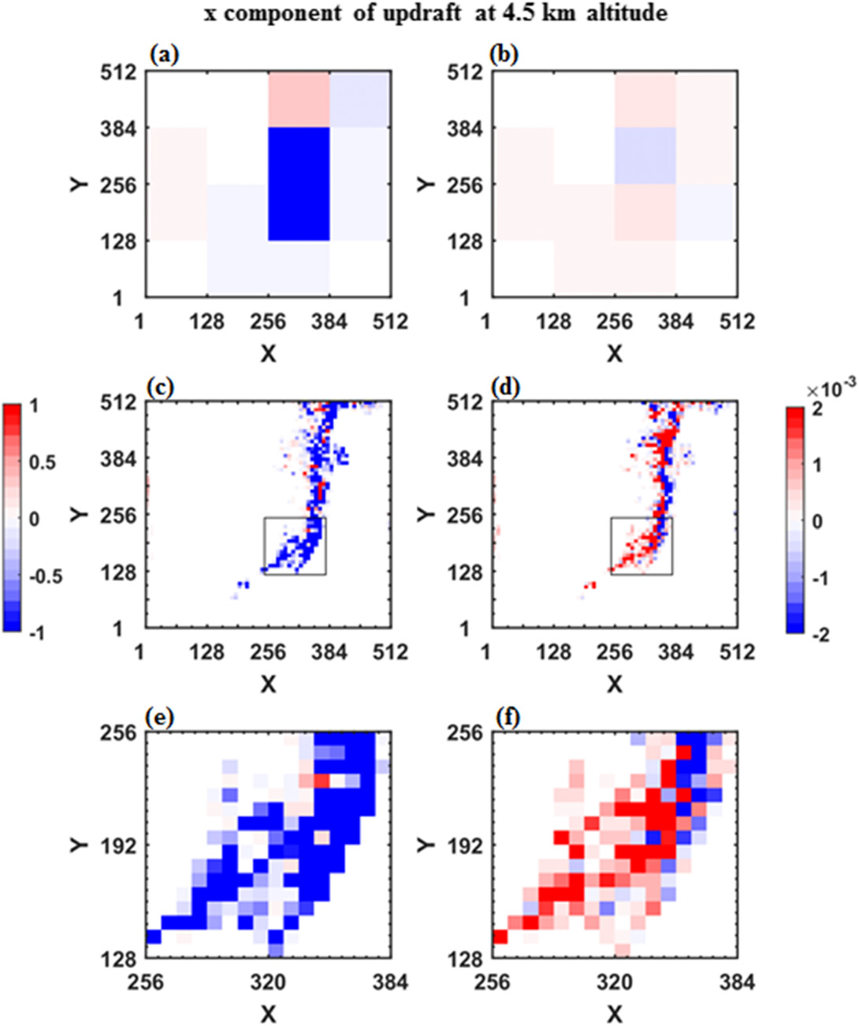
line-parallel direction
(a)、(b) dx = 128 km
(c)、(f) dx = 8 km
updraft pressure gradient force
updraft convective momentum flux
Notes:
Figures 8 and 9 show the x component of updraft CMT and PGF in convective updrafts at 4.5- and 9-kmaltitudes, respectively, at 1500 UTC 20 May when the squall line is at the intensifying stage.
The majority of the x component of updraft CMTs is negative with exception for one subdomain at dx = 128km and a few subdomains for dx = 8km.
The negative x component of updraft CMT indicates that the air feeding the updrafts carries negative perturbation wind (u’).
Because the x component of updraft PGFs is mostly positive, the updraft PGF is opposite to the direction of the perturbation wind (u’) in updrafts, decelerating
the perturbation wind when air moves upward inside updrafts.
As a result, the CMT at both large and small grid spacings is downgradient.

Slide 23
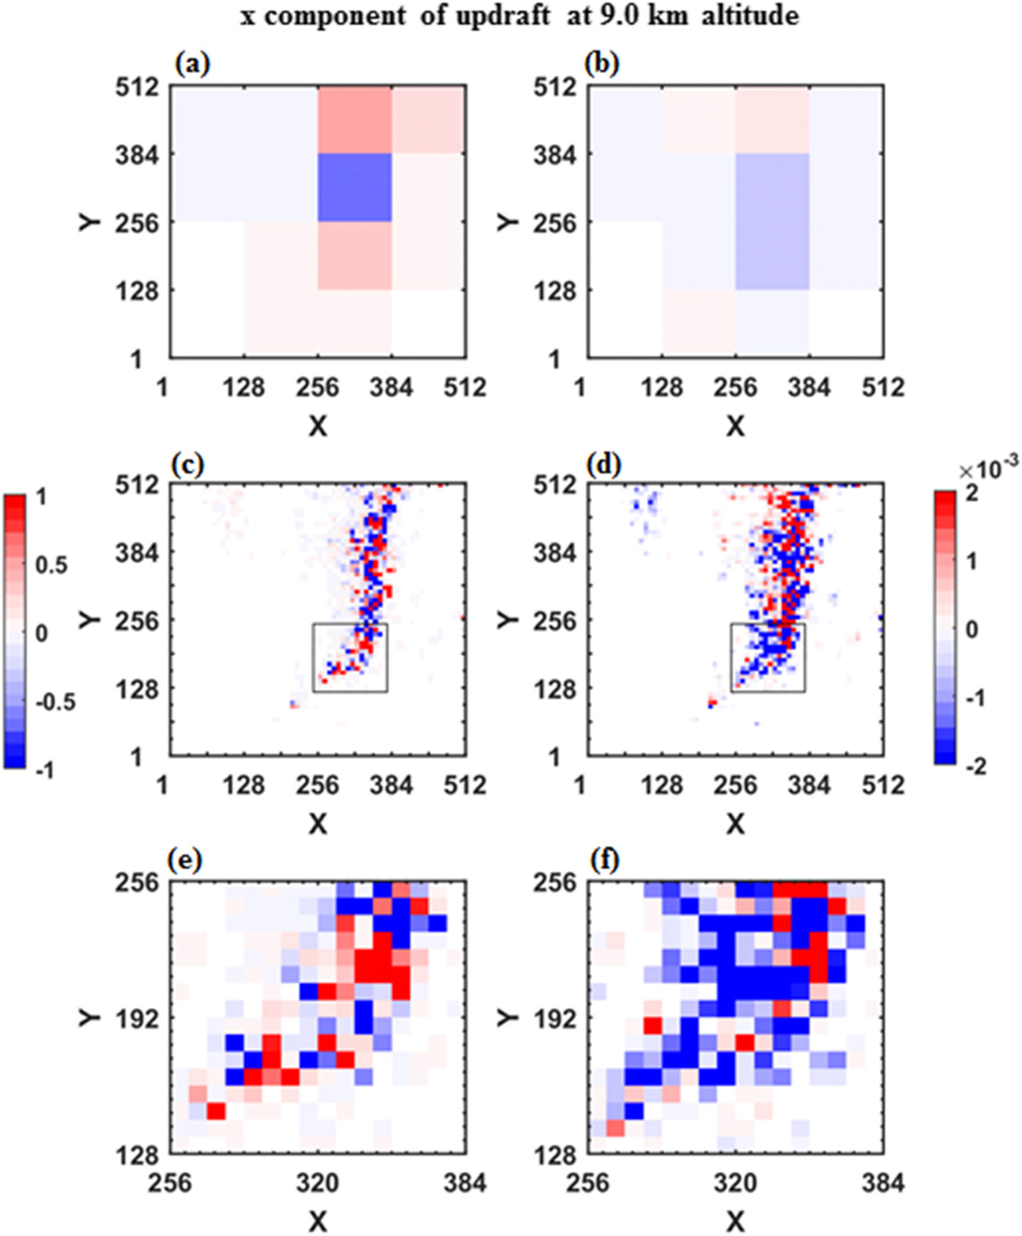
line-parallel direction
(a)、(b) dx = 128 km
(c)、(f) dx = 8 km
updraft pressure gradient force
updraft convective momentum flux
Notes:
the updraft CMT is mainly positive while the updraft PGF is negative

Slide 24
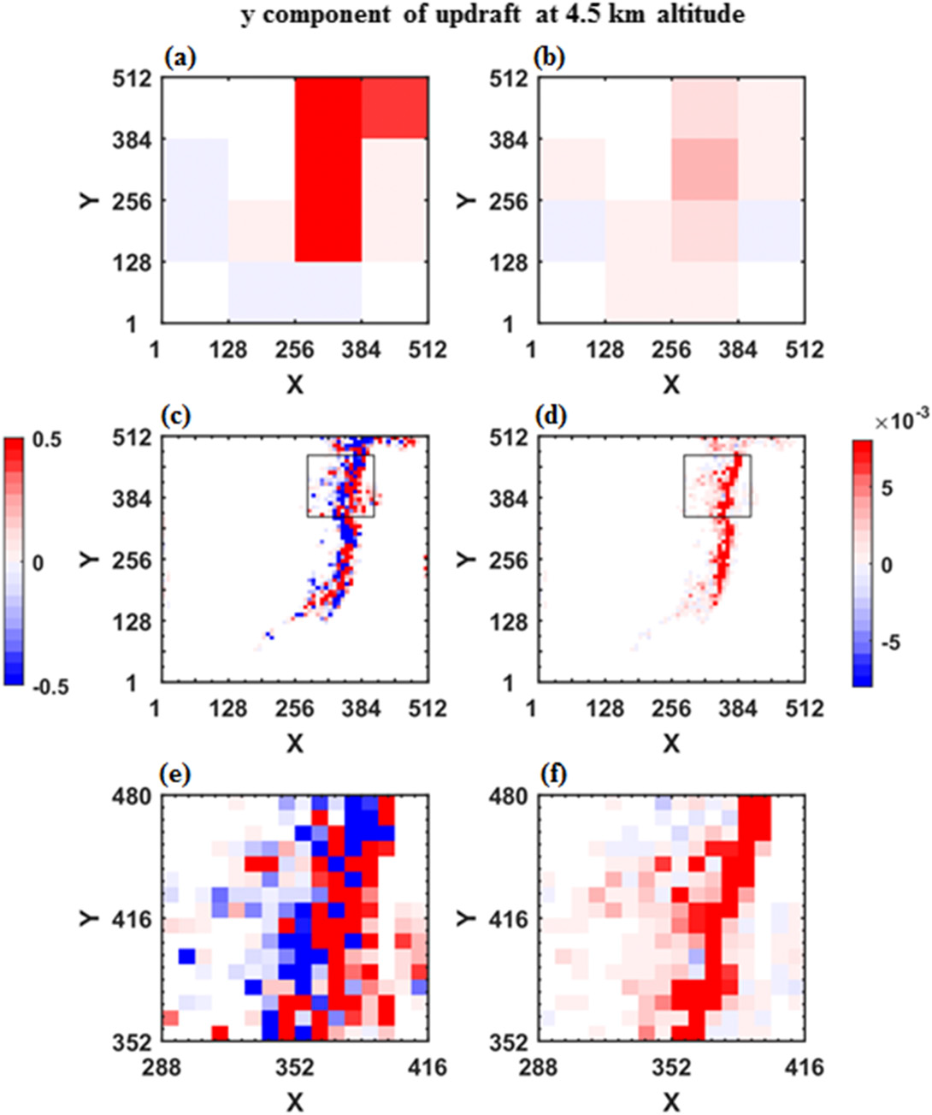
line-normal direction
(a)、(b) dx = 128 km
(c)、(f) dx = 8 km
updraft pressure gradient force
updraft convective momentum flux
Notes:
the majority of line-normal updraft CMT at both small and large grid spacings is positive, indicating that the air entering convective updrafts carries positive perturbation wind (y’).
The positive y component of updraft PGF is in the same direction as the perturbation wind (y’) in the updrafts, accelerating the perturbation wind, resulting in upgradient CMT for both small and large grid spacings.

Slide 25
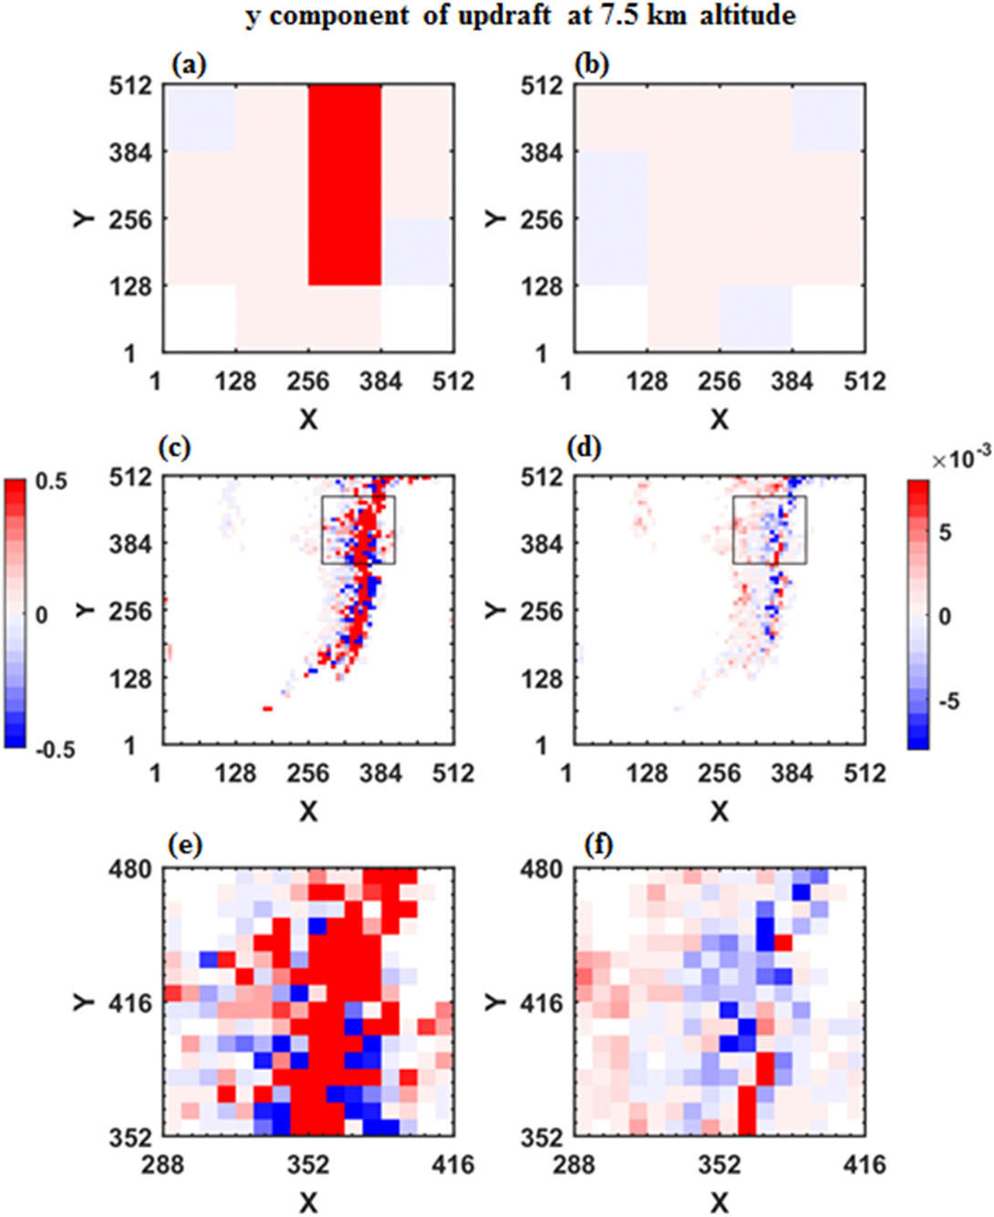
line-normal direction
(a)、(b) dx = 128 km
(c)、(f) dx = 8 km
updraft pressure gradient force
updraft convective momentum flux
Notes:
For large grid spacings at 7.5-km altitude, the y component of updraft CMT and updraft PGF are mostly positive, indicating that the updraft PGF accelerates
the perturbation wind in the updrafts, resulting in upgradient CMT.
However, for small grid spacing, the majority of updraft CMT remains positive, but a large area of updraft PGF where the positive updraft CMT is located becomes negative, leading to decelerating the perturbation wind and downgradient CMT.

Slide 26
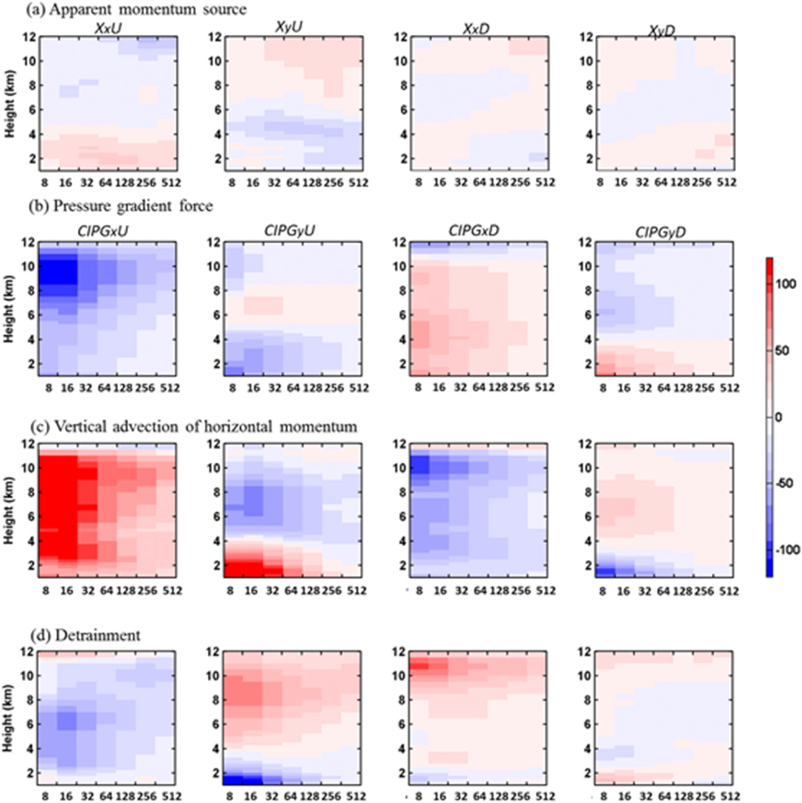
MC3E-0523
The magnitudes of CIPG and apparent momentum source are comparable at very large grid spacing such as 512 and 256 km.
As grid spacing decreases, the magnitude of CIGP increases more rapidly than that of apparent momentum source
CIPG can have significant impacts on apparent momentum source at GCM resolution
Notes:
Scale dependency of apparent momentum source and CIPG
To examine the importance of CIPG to apparent momentum source
apparent momentum source varies significantly with height and grid spacing for both updraft and downdrafts.
the x component of updraft apparent momentum source (XxU) is positive and negative below and above 4-km height, respectively, with the maximum positive value at 3-km altitude for dx = 32–128 km.
The y component of updraft apparent momentum source (XyU) is negative below 6-km height but positive above 6-km height, with the minimum XyU
occurring at ;5-km altitude for dx = 32–256 km.
Further, apparent momentum source in updrafts is larger than that in downdrafts (XxD and XyD).
The vertical advection of horizontal momentum has a slightly larger magnitude than that of CIPG, and they are opposite in sign except for the updraft y component above 8-km altitude.
The detrainment term is the smallest among the three terms.
The magnitudes of CIPG and apparent momentum source are comparable at very large grid spacing such as 512 and 256 km.
As grid spacing decreases, the magnitude of CIGP increases more rapidly than that of apparent momentum source;
thus, CIPG becomes significantly larger than apparent momentum source at small grid spacings.
These results suggest that CIPG can have significant impacts on apparent momentum source at GCM resolution, and the impact may become even larger at the gray-zone resolution.

Slide 27
nonlinear MCS
Notes:
To further understand the factors impacting the scale dependency of CIPG
For MC3E-0523 (nonlinear MCS), contributions from the buoyancy, divergence, and stratification forcings to the Laplacian of CIPG are very small for all grid spacings.
Therefore, the discussion for MC3E-0523 will focus on the linear-shear and nonlinear-shear forcings below.
For the x component of both updraft and downdraft Laplacian of CIPG, the absolute value of the linear shear forcing increases monotonically with decreasing
grid spacing and is the major contributor to the Laplacian of CIPG for all grid spacings (Figs. 13a,c).
Although the linear-shear forcing has the same sign and similar vertical structures as the Laplacian of CIPG for all grid spacings, their differences in vertical profiles
increase as the grid spacing increases.
Unlike the linear-shear forcing, the nonlinear-shear forcing has similar magnitudes across the grid spacings and in general has the opposite sign to the Laplacian of
CIPG and the linear-shear forcing.
Because the linear shear forcing’s absolute value monotonically decreases with increasing grid spacing, contribution from the nonlinear-shear forcing to the Laplacian of CIPG becomes noticeable at dx = 32km and becomes comparable to the linear-shear forcing in magnitude at grid spacings. 64 km.
Different from the x component for updraft and downdraft Laplacian of CIPG whose linear-shear forcing is always larger than the other four terms regardless
of grid spacings.
for the y component of updraft and downdraft Laplacian of CIPG (Figs. 13b,d), the nonlinear-shear forcing in its absolute value becomes larger than the linear-shear forcing at dx . 64 km.
In addition, the linear-shear forcing term does not always have the same sign as the Laplacian of CIPG when dx >16 km, in particular at dx = 256 and 512 km.

Slide 28
Squall line
Notes:
For MC3E-0520 (linear MCS), contributions from the divergence and stratification forcings to the Laplacian of CIPG remain negligibly small (Fig. 14).
For dx = 4–64 km, the x and y components of both updraft and downdraft linear-shear forcings in general have the same sign as the Laplacian of CIPG and are the major contributor to the Laplacian of CIPG.
However, for dx = 128–512 km, contributions of the linear-shear, nonlinear-shear, and buoyancy forcings to the Laplacian of CIPG become comparable, and the linear shear forcing sometimes has an opposite sign to the Laplacian of CIPG below the 6-km altitudes.

Slide 29
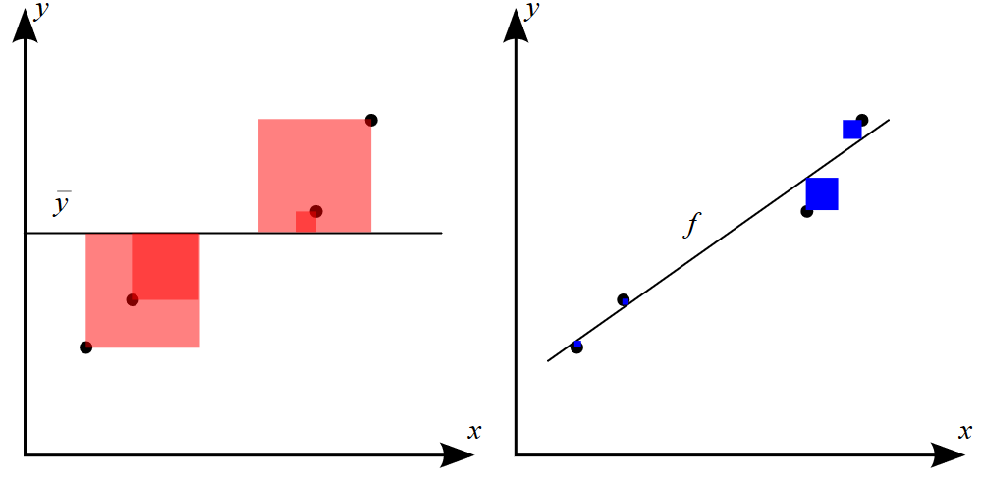
https://en.wikipedia.org/wiki/Coefficient_of_determination
$R_{adj}^{2}$: adjusted coefficient of determination
$R^{2}:$ coefficient of determination
${SS}_{resid}$: the sum of the squared residuals from the regression
${SS}_{total}$: the sum of the squared differences from the mean of the dependent variable, or the total sum of squares
d: total number of predictor variables in the regression equation
n: sample size
$${SS}_{total}=\sum_{i}{{\left(y_{i}−\overline{y}\right)}^{2}}$$
總平方和
$${SS}_{resied}=\sum_{i}{{\left(y_{i}−f_{i}\right)}^{2}}$$
殘差平方和
The larger $R_{adj}^{2}$ is the more variability in the response variable is explained by the predictor variables.
Notes:
To further quantity the performance of the GKI97 scheme for parameterizing CIPG at different grid spacings
we conduct a linear regression analysis for Eqs. (8a)–(8d) using the product of mass flux and vertical mean wind shear as the predictor variable and CRM derived
CIPG as the response variable.

Slide 30
MCC (MC3E-0523)
Correlation coefficient
CC
$${adjusted R}^{2}$$
slope
Notes:
(left to right) Pearson CC, adjusted coefficient of determination (R2 adj), and linear regression slope between CIPG and the product of mass flux and the vertical mean wind shear
Both MC3E-0520 and MC3E-0523 consistently show that at dx = 4–128 km, the x- and y-component CIPG and product of mass flux and vertical mean wind shear
for updrafts and downdrafts [Eq. (8)] are negatively correlated at all levels, while for dx = 256 and 512 km, they can be either positively or negatively correlated
In addition, R2 adj monotonically increases with increasing grid spacing at the 4–64-km range, in which the grid spacing of 64km has the maximum R2
adj.
This suggests that the GKI97 scheme may explain the most CIPG variation at dx = 64 km, and at the smaller grid spacing, the less variation of CIPG can be captured by the GKI97 scheme.
In contrast, for dx >64 km, there is no such clear relation between R2 adj and grid spacing, and R2 adj varies greatly with height.
As for the regression slopes, it is shown that at the grid spacing ranging from 4 to 128 km, the range of the slope variation in the vertical (1–12-km altitudes) tends to increase as grid spacing increases for both the x and y components of updrafts and downdrafts (Table 1 and Table S1 in SI).

Slide 31
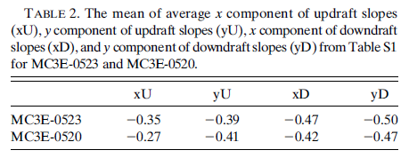
MCC
Squall line
Notes:
the range of the slope variation in the vertical (1–12-km altitudes) tends to increase as grid spacing increases for both the x and y components of updrafts and downdrafts
For example, for dx = 4 km from MC3E-0523, the x component of updraft slopes ranges from -0.44 to -0.24, and for dx = 128 km, they range from -0.47 to -0.07.
However, the mean slopes averaged over 1–12-km altitude do not vary much with grid spacings.
The mean slopes are ranging from -0.32 to -0.37 across the grid spacings for the x component of updraft slopes, from-0.32 to-0.41 for the y component of updrafts slopes, from -0.45 to -0.49 for the x component of downdraft slopes, and from-0.49 to-0.52 for the y component of downdraft slopes.

Slide 32
linear shear
+
Non-linear hear
linear shear
+
Non-linear hear
Non-linear shear
difference
Non-linear shear
difference
Notes:
when nonlinear-shear term is added into the regression equation, R2 adj value increases significantly at dx=128–512km (Fig. 16).
However, the increase of R2 adj value at dx < 100km is much smaller compared to that at dx > 100 km.

Slide 33
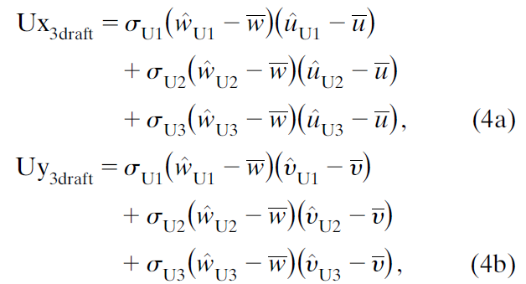
Modified GKI97 scheme
To account for the inhomogeneous structures of updrafts to better represent the convective transport of water vapor, Liu et al. (2015) adopted a three-updraft approach.
Week updrafts: $1<w<3{ms}^{−1}$, and $Q_{tot}>{10}^{−6}{kgkg}^{−1}$, or $2<w≤3{ms}^{−1}$
Medium-strength updrafts: $3<w≤6{ms}^{−1}$
Strong updrafts: $w>6{ms}^{−1}$
(Arakawa and Wu 2013; Liu et al. 2015).

Slide 34
Single updraft
three-updrafts
Notes:
This may be achieved by using the three-updrafts and one-downdraft approach (Liu et al. 2015), which shows much improved CMT compared to the traditional
single updraft and downdraft approach as shown in Fig. 17 because it well accounts for the increasing variation inside convection at the gray-zone scale.

Slide 35
Summary (I)
weak scale dependency: grid-mean wind components
Strong scale dependency: Updraft and downdraft mass fluxes, CMTs
nonlinear MCSs:
Total and updraft CMT→ downgradient transport
Downdraft CMT → upgradient (large grid spacings), downgradient (small grid spacings)
Linear MCSs:
Total and updraft CMT→ downgradient (line-parallel direction), upgradient (line-normal direction)
Downdraft CMT → downgradient transport
upgradient CMT:
y direction: updraft PGF strengthens perturbation wind in updrafts
x direction: updraft PGF weakens perturbation wind inside updrafts
downdraft CMT shows no clear relation to downdraft PGF

Slide 36
Summary (II)
CIPG has significant impacts on apparent momentum source at GCM resolution.
The major contributor to the Laplacian of CIPG:
for MCCs:
x component: linear shear forcing (all the grid spacings)
y component: linear shear forcing + nonlinear-shear forcing (dx>64 km)
For squall line:
x and y component: linear shear forcing (4 < dx < 64 km)
x and y component: linear shear forcing + nonlinear-shear forcing (dx>64km)
Notes:
although linear-shear forcing is the major contributor to the x component of updraft and downdraft Laplacian of CIPG for all the grid spacings from MC3E-0523,
the contribution of nonlinear-shear forcing to the y component of updraft and downdraft Laplacian of CIPG from MC3E-0523 as well as both the x and y
components of Laplacian of CIPG from MC3E-0520 can be comparable and even exceeds the linear-shear forcing at grid spacing larger than 64 km.

